Slide 1
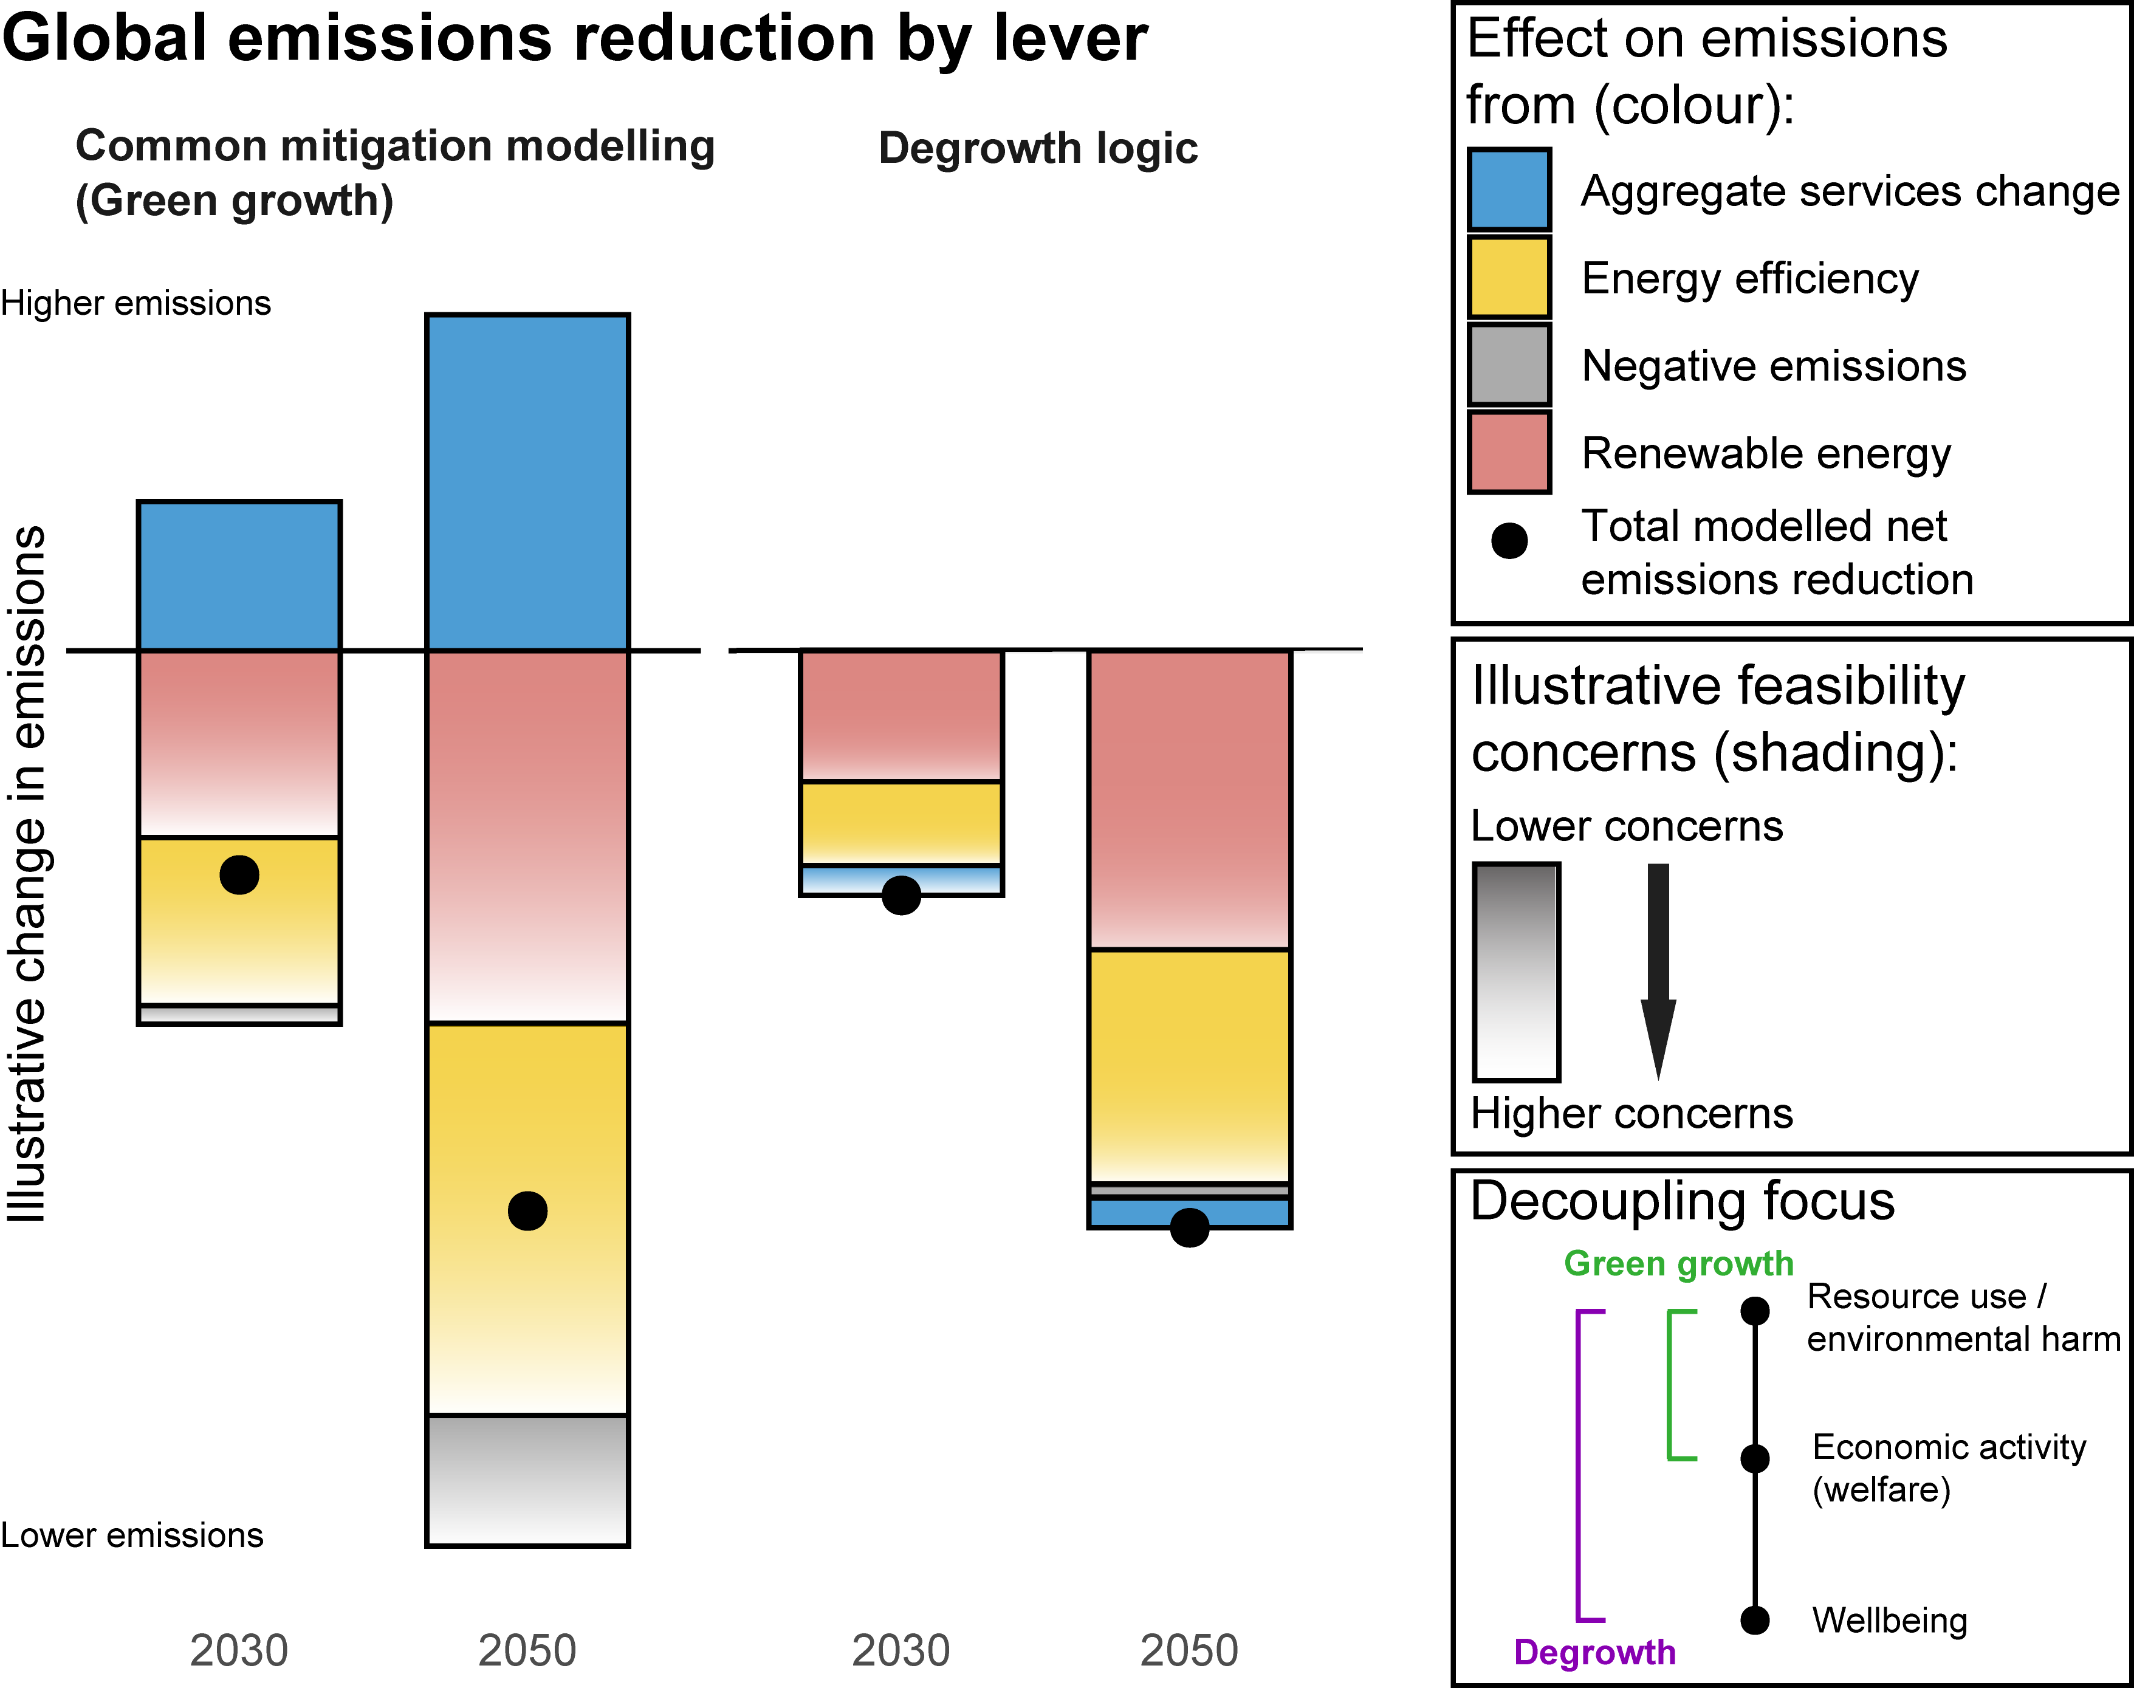
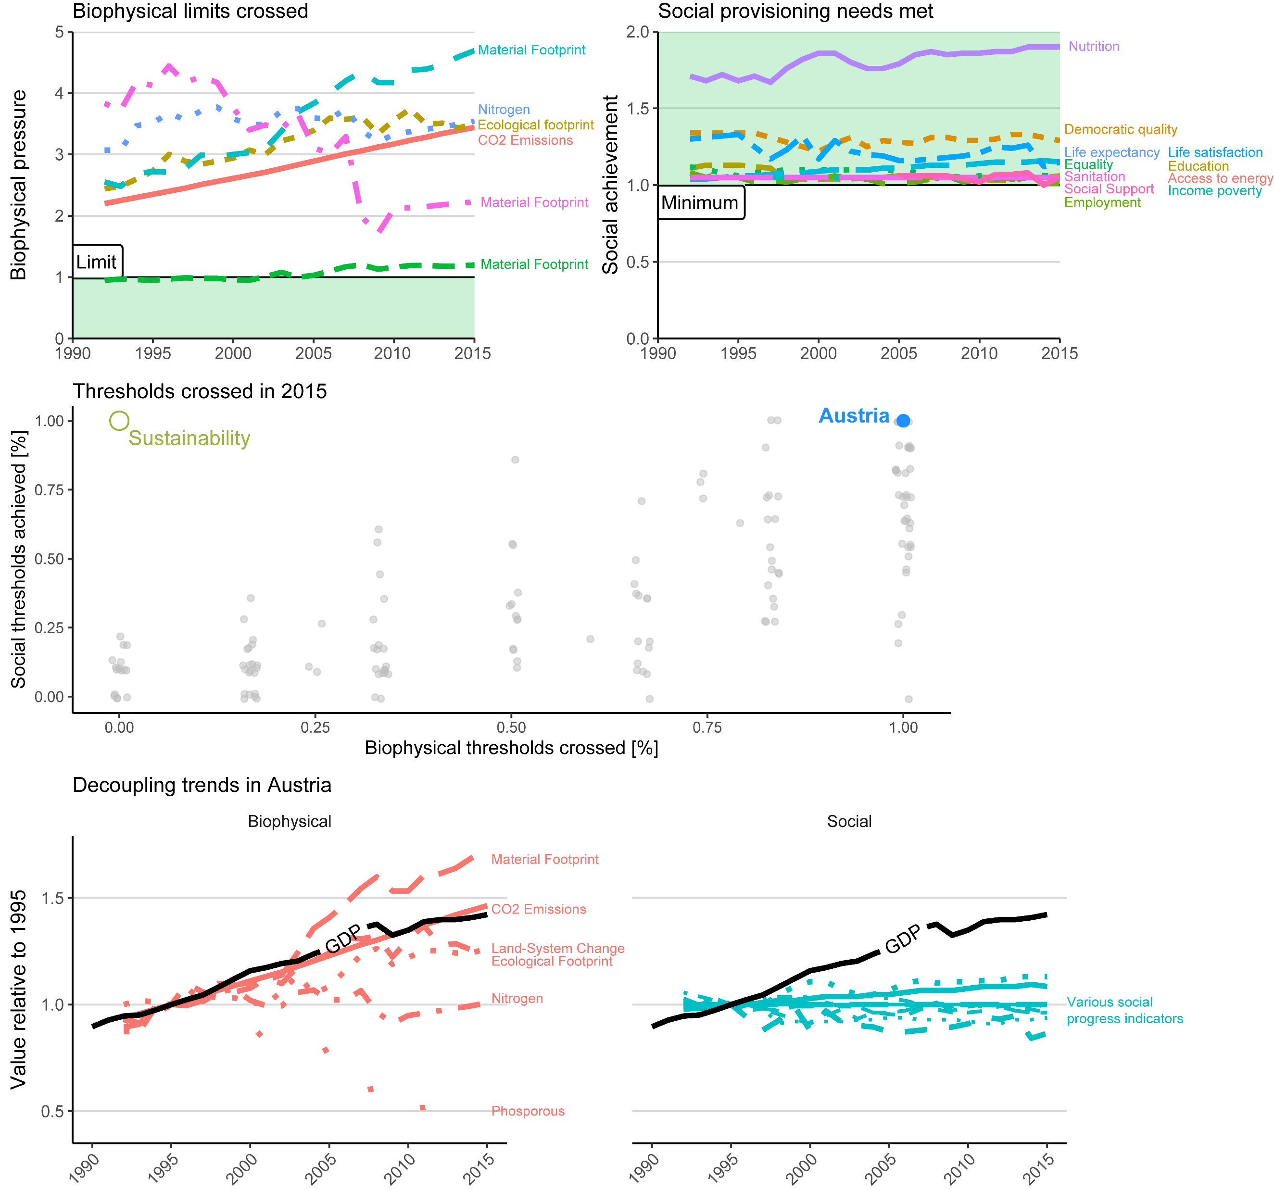
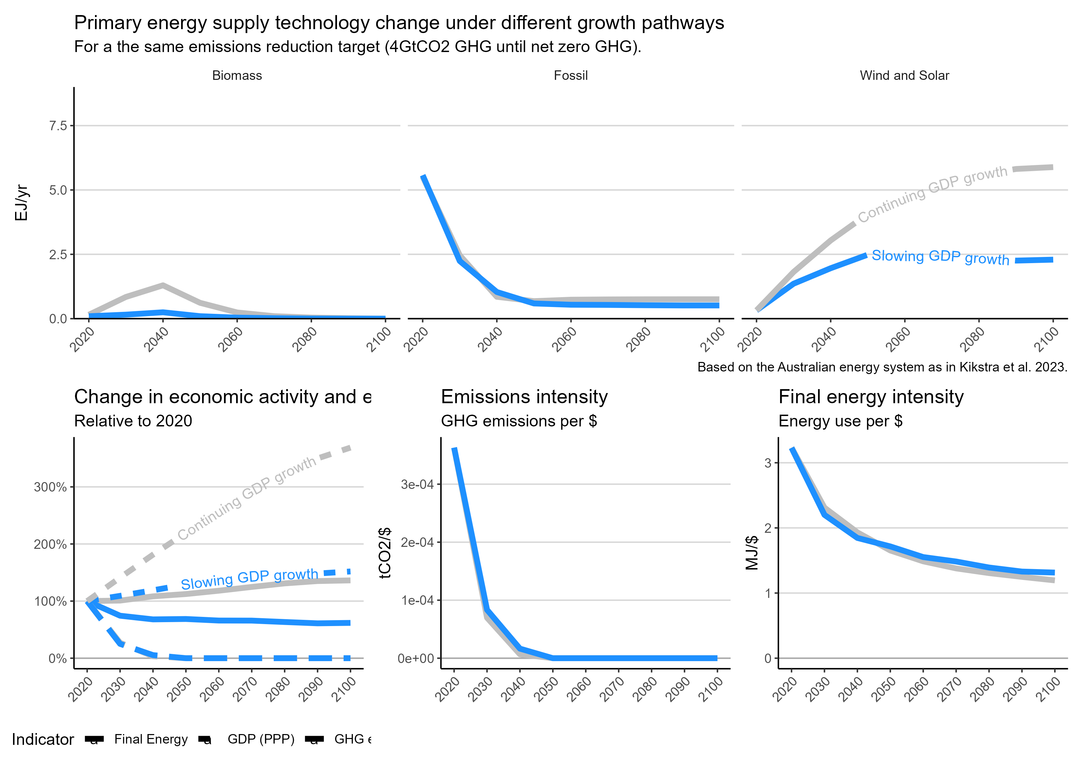
E
A
B
C
F
D

Slide 2
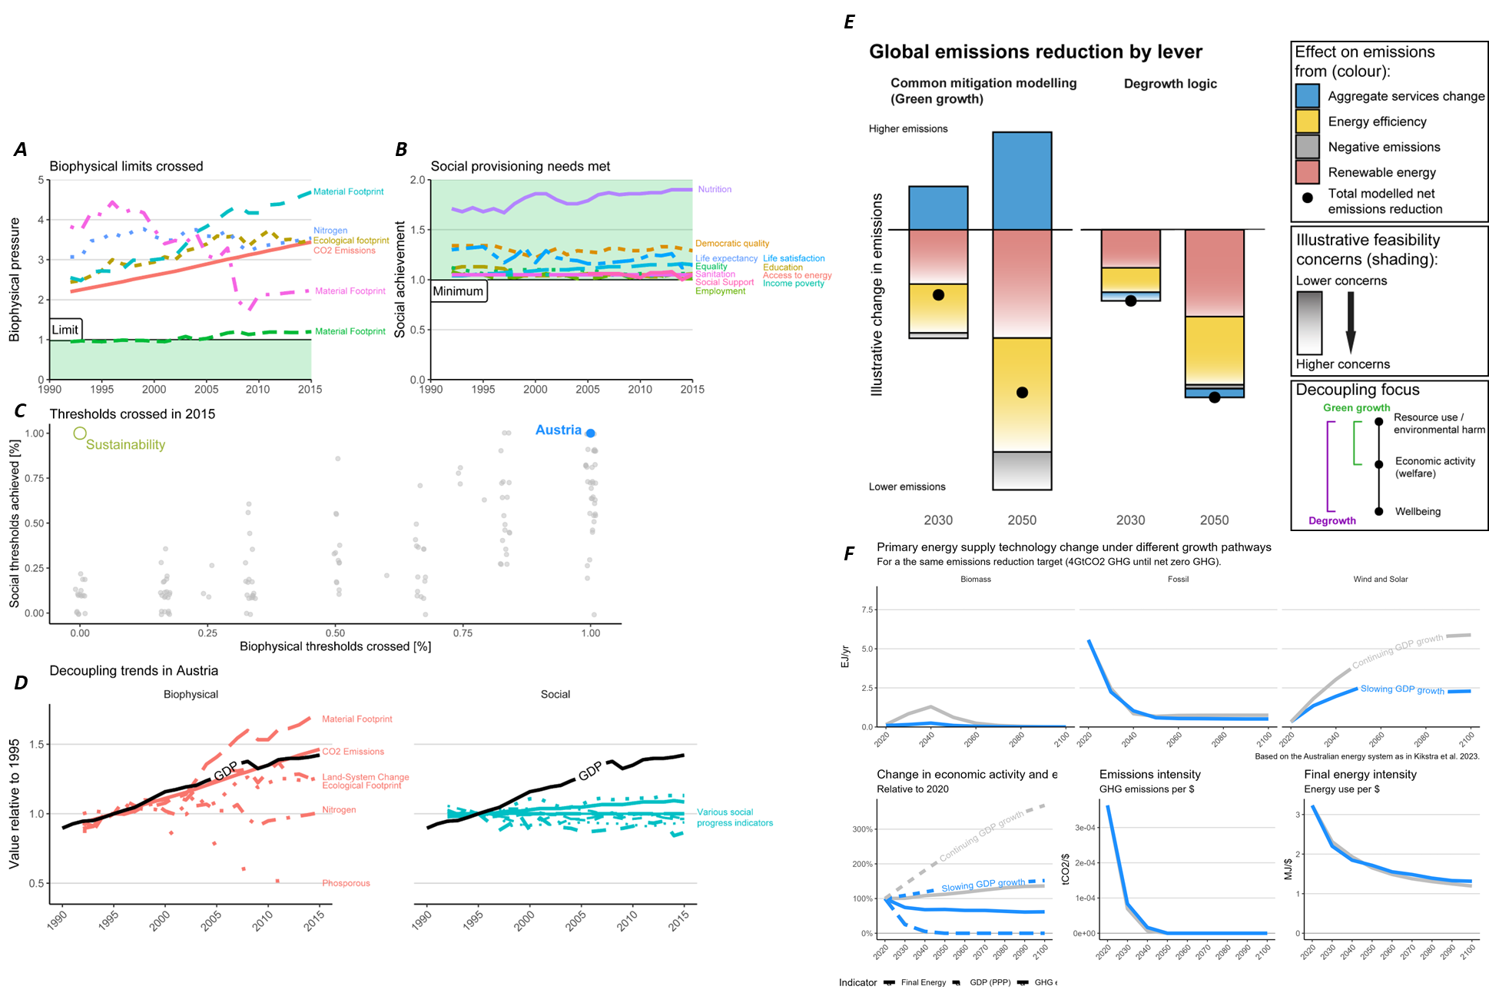

Slide 3
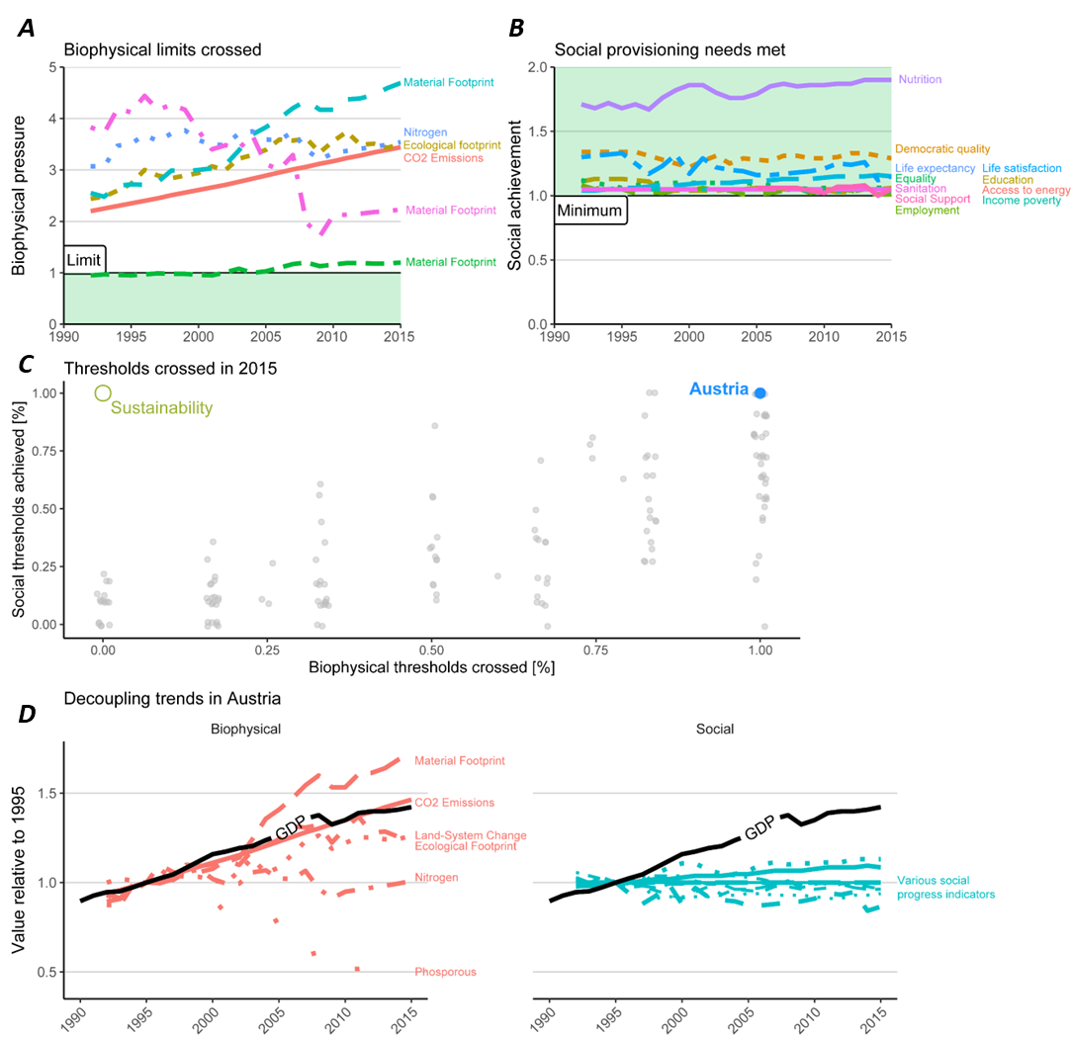
A
B
C
D

Slide 4
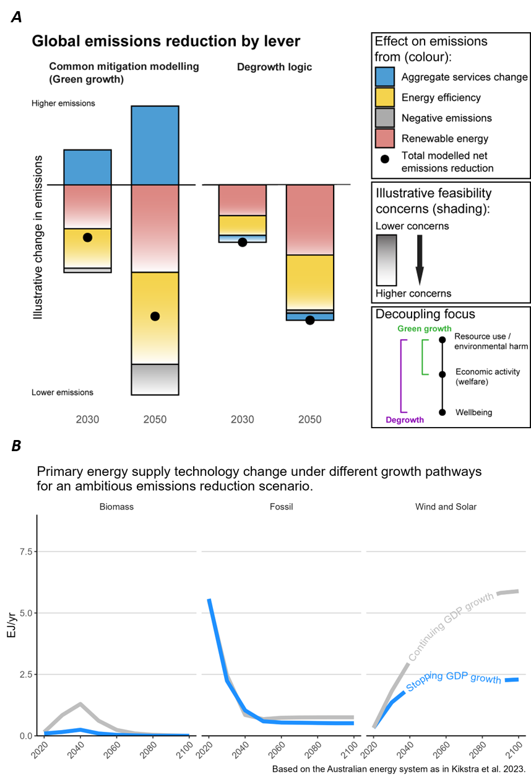
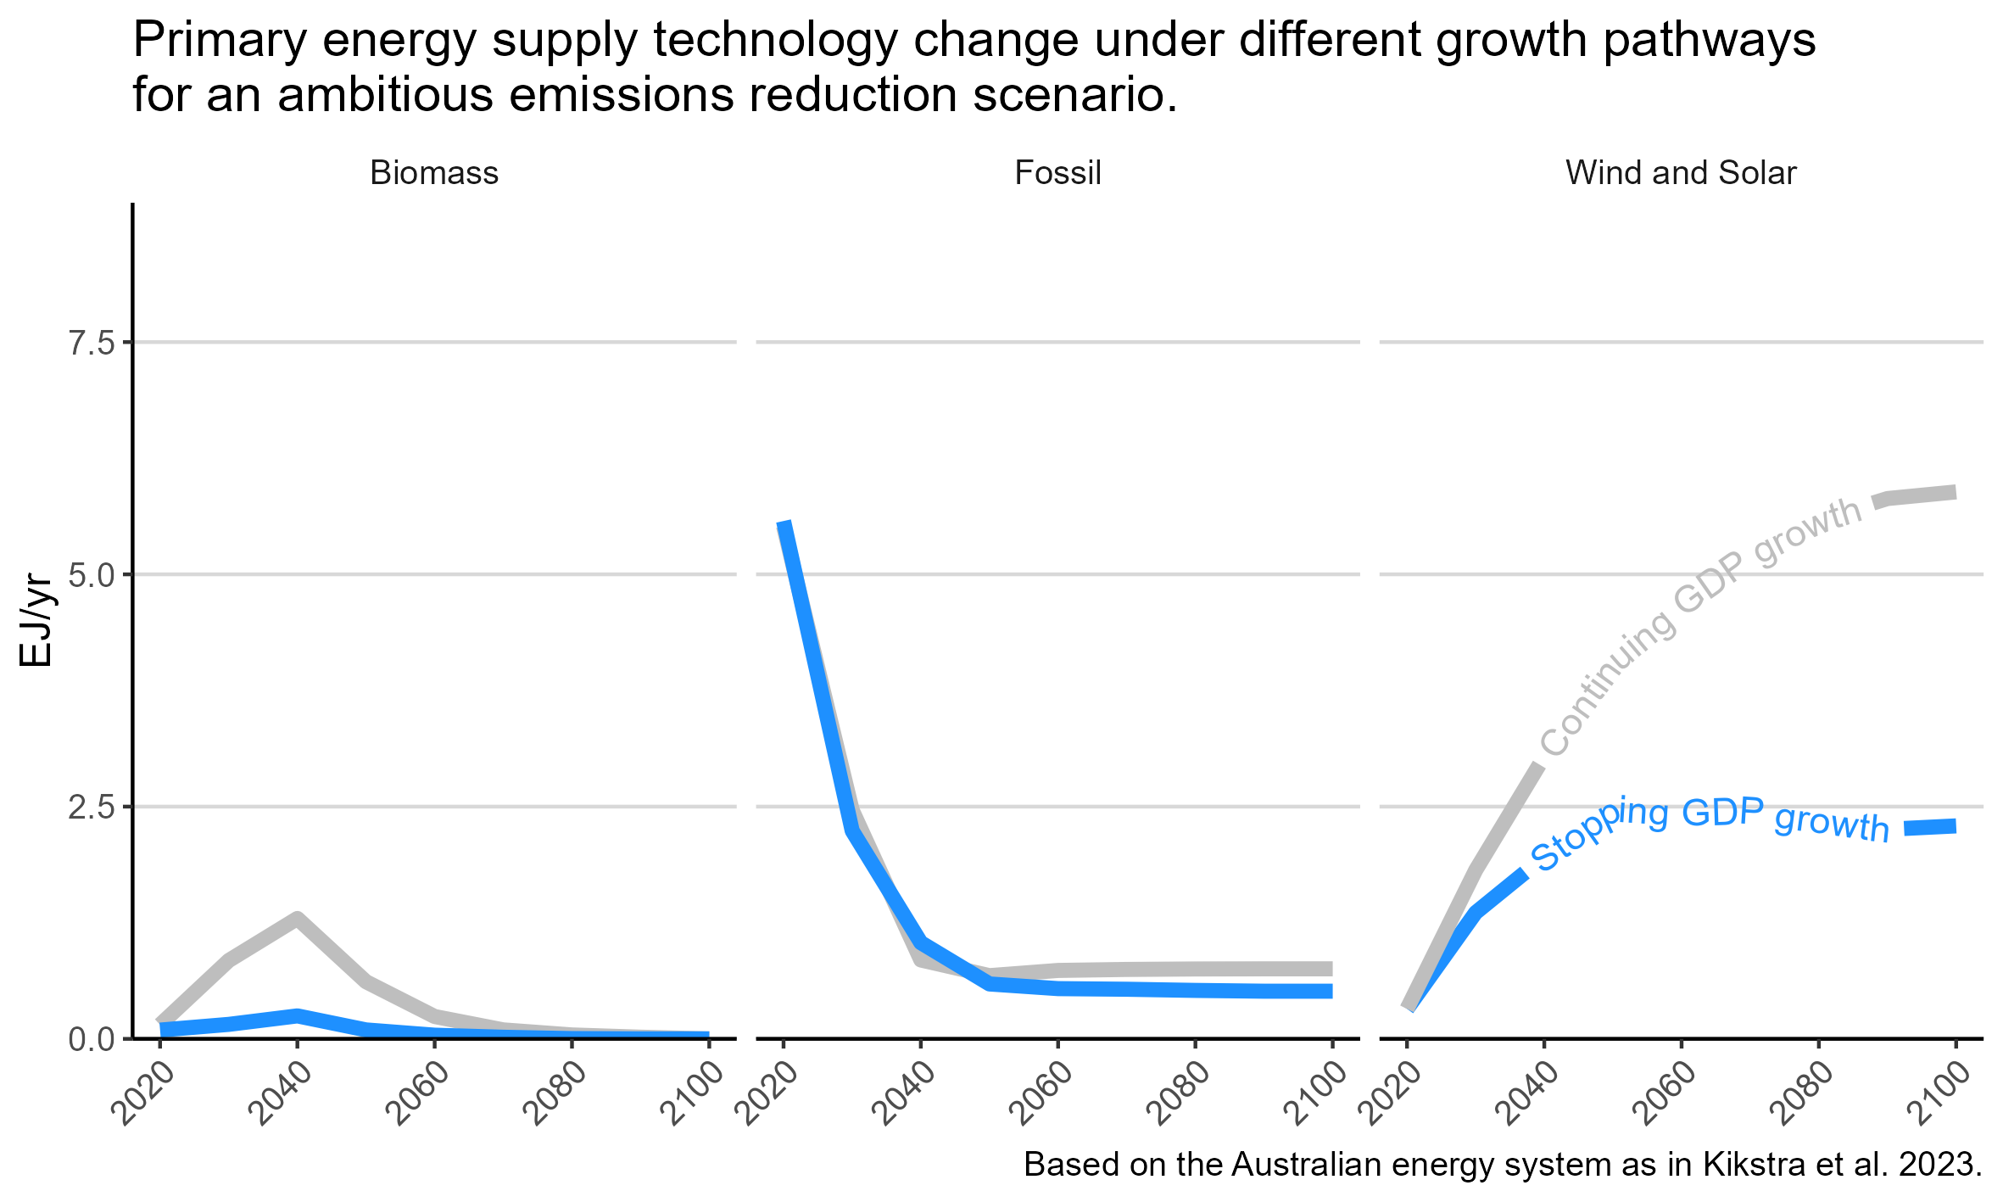
A
B

Slide 5
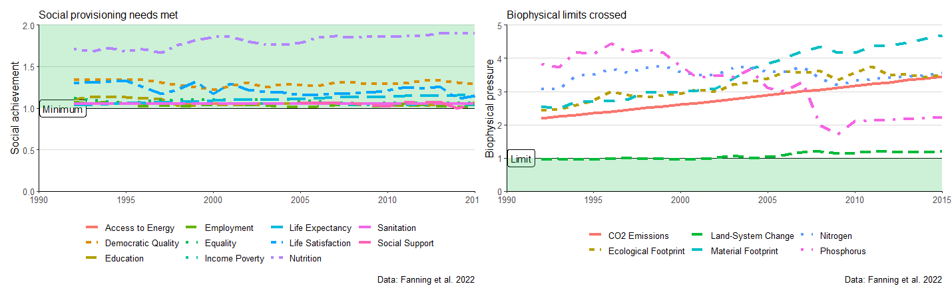
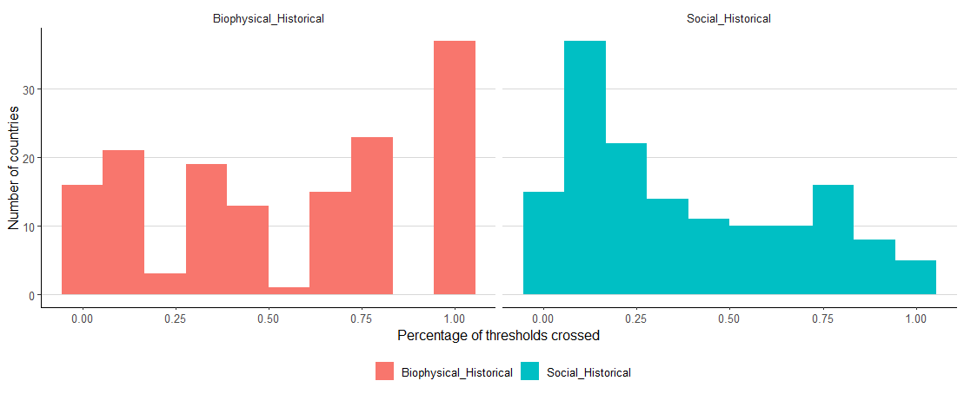
A: Austrian trends
B: All countries (2015)
Austria
Austria

Slide 6
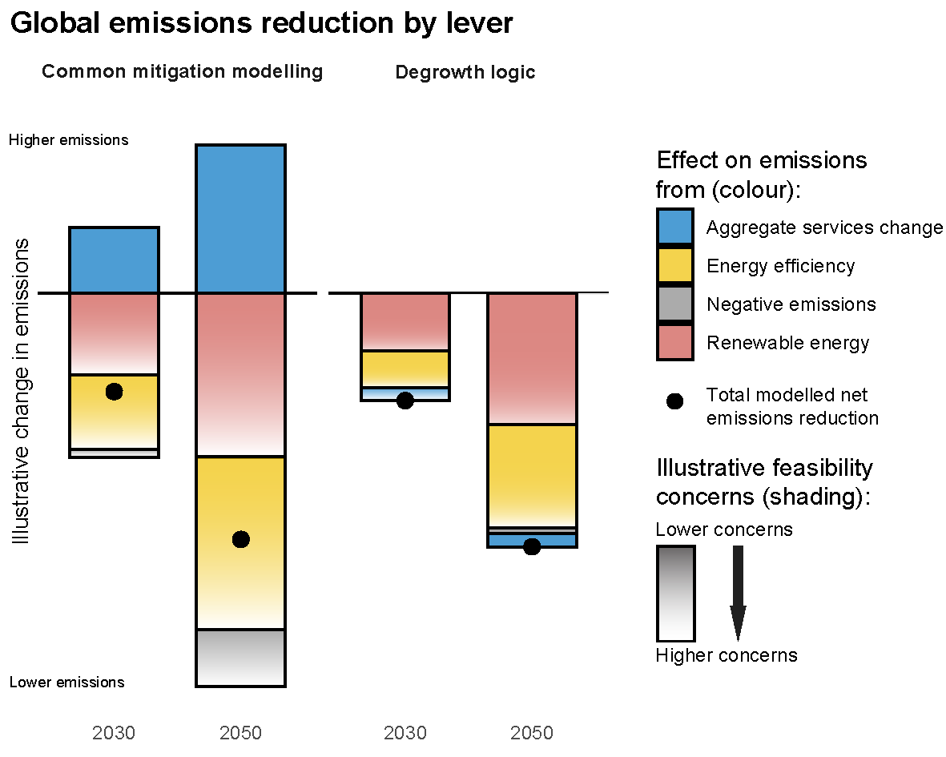
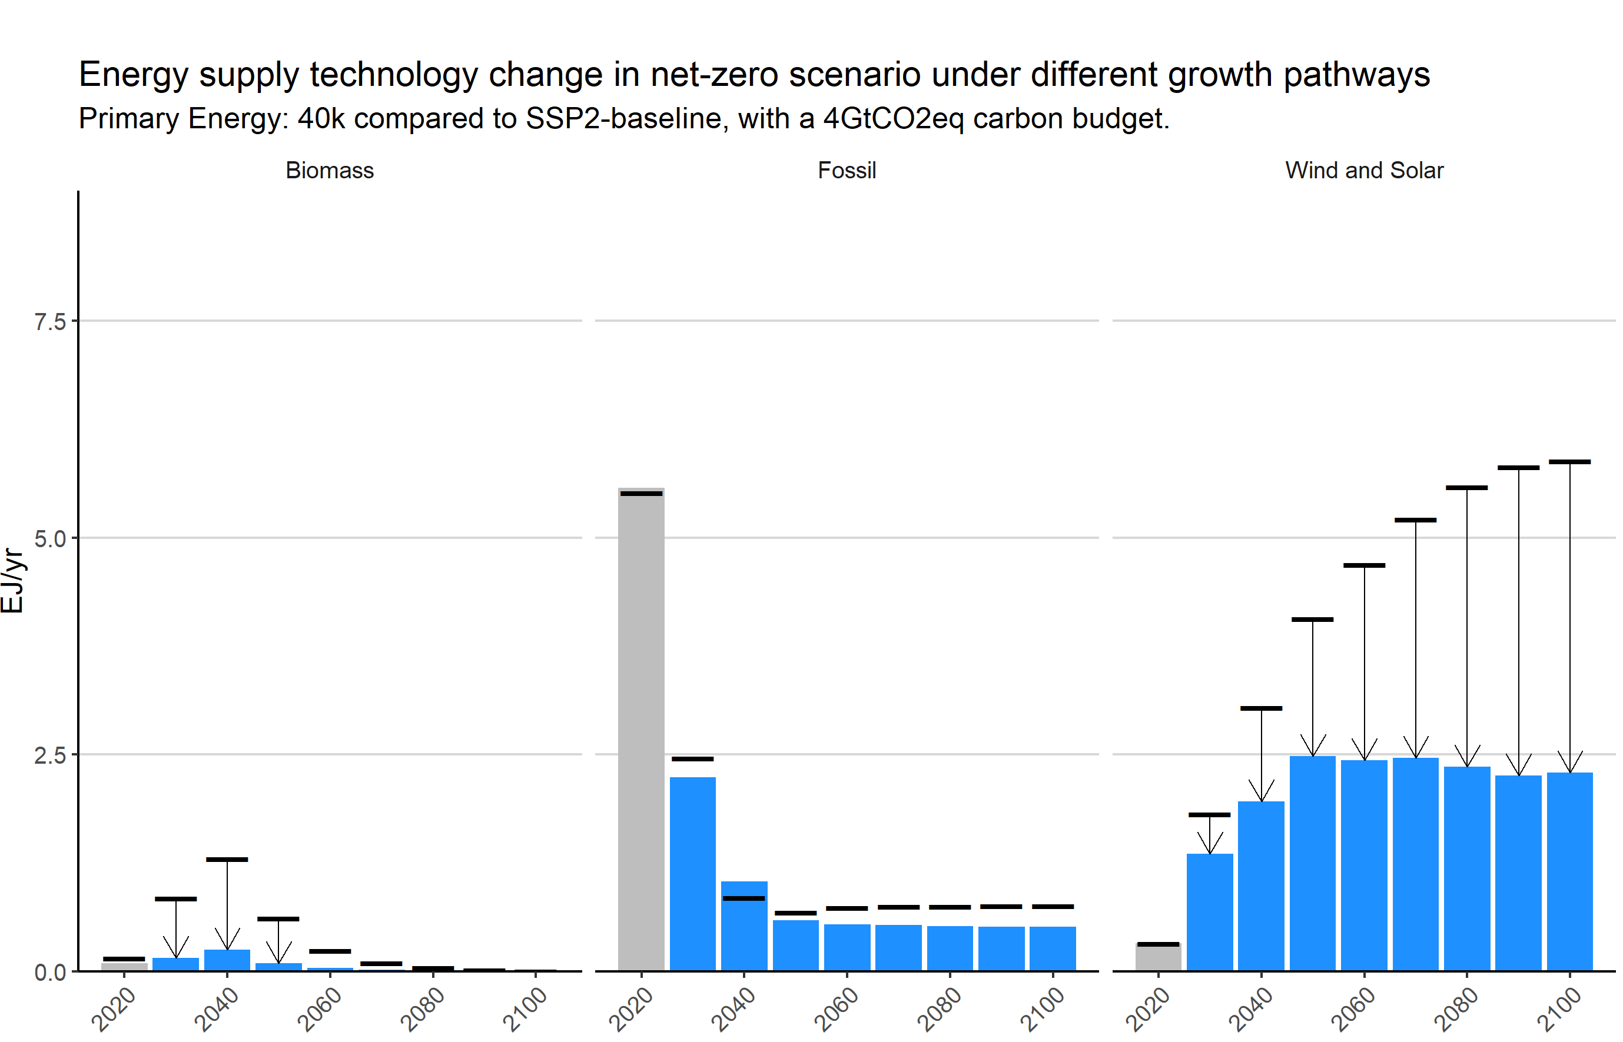
A: Theoretical
B: Modelling (Australia)
Continued GDP growth
No GDP growth

Slide 7
Agenda outline
Tour de table.
Update on sections
Discussion on sections and outline.
Discussion on figures.
Updated timeline

Slide 8
Overview of sections (current state)
Introduction [Jarmo + richard]
Basis is there.
Needs: (i) a discussion on figure 1, (ii) more references, (iii) refinement.
Write more clearly in that most GG policies are included in degrowth strategies – and that the policies section will focus only on the degrowth-specific ones.
Add inequality&inequity here as generally important to all policies
See if limits&boundaries can be stressed more seriously (e.g. add limitarianism).
Add note Degrowth on consumption & production.
Explicitly refer to (a) supply-side chapters, and (b) demand chapter. (Ernest notes framing on ‘push & pull’, Richard notes the importance of linking – e.g. through “production corridors”). Point out why this is important.
Policies [Ernest & Halliki] -> general NOTE to add: streamlining between chapters will be done.
Transport/Mobility [Danyal]
Slight shortening may be needed – but not for now. Key sector where (a) growth imperatives, and (b) built-up infrastructure can be highlighted.
What about existing policy frameworks (in Austria)?
What about shared mobility? Car-sharing? (shift to cars vs public transport, or better use of cars)
Note: focus on (a) growth imperatives, (b) corridors, not so much on demand-side potentials (which can be somewhere else).
Housing [Halliki + richard]
Broad focus of proposed housing policies.
Confidence statements on the effects of policies – (leave it out for FOD when not sure – more for later or chapters?)
Industry [Ernest]
Food/Agriculture [Halliki]
Just started working. Will finish. (maybe Christiana Plank)
Energy [Halliki & Michi?]
Tbd.
Leisure [Ernest]
Work & Care [Ernest]
Next week – together with the longer section in chapter.
Inequality & Justice [unassigned]
--> see in the end if still relevant
Maybe Nathan Barlow or Hannah at some point.
Note: policy expertise needs to go into the chapters, not into the overarching box which is more general theoretical framing.
Other [unassigned]
Finance [Ernest/Michi]
Michi can summarise from their chapter (later this month)
Modelling pathways/scenarios [Jarmo]: a few sentences ready, but needs more plurality to still be added (e.g. SFC modelling, Jackson et al.) – chapter 8.
Figures [Jarmo]
Ready for first version?
Note of Danyal: is this too complex?
Andreas: leave it in FOD – and see what the reviews and comments will say.
Ernest: complexity is not an issue. Noting that both text and figures will be complex. Modelling frame needs to be there.
2A: add “for a similar emissions reduction target”
2A: is degrowth more ‘politically feasible’?
Feasibility debate will be had in Chapter 8 – does panel A ‘hide’ the infeasibility of degrowth? Maybe add an arrow to aggregate services. Maybe change the bars – or making an arrow.

Slide 9
Notes discussion
Introduction [jarmo]
Policies [Ernest & Halliki)
Transport/Mobility [Danyal]
Housing [Halliki]
Industry [Ernest]
Food/Agriculture [Halliki]
Energy [Halliki & Michi?]
Leisure [Ernest]
Work & Care [Ernest]
Inequality & Justice [unassigned]
Other [unassigned]
Finance [Ernest/…Michi?]
Modelling [Jarmo]: a few sentences ready, but needs more plurality to still be added (e.g. SFC modelling, Jackson et al.)
Figures [Jarmo]
Other notes:
Richard: Ecosufficiency & sufficiency – will be discussed somewhere else (chapter 3 and 8).
E.g. Transport: in box only issue, policies referring to somewhere else?
Solutions: can be discussed in chapter 8.
Andreas: longer box is good for FOD.
Transport section: most probably in chapter 3 (and some to be in 8). So – from FOD and SOD, it will need to refocus. Even
Example transport: Creutzig demand-side policies (convincing on reducing consumption)

Slide 10
Geospatial focus:
Box focuses on degrowth – theoretical.
No need to push in degrowth data on Austria specifically – as that can go to the chapters.
Degrowth: adds additional policies beyond existing general insights (e.g., retrofitting).
So, policies: general + changes, or only the changes.
Richard: in Ch8 we summarise. The box can focus on the ‘plus’ part.
Jarmo: only focus on ‘degrowth-specific’ policies
Ernest: but note that key point is strongly limiting
Write more clearly in introduction that most GG policies are included in degrowth strategies – and that the policies section will focus only on the degrowth-specific ones.
Are we linking enough to the demand-side chapter?
CLA: Ilona Otto
Can we do more here?
Bullet points:
Degrowth on consumption & production.
Explicitly refer to (a) supply-side chapters, and (b) demand chapter.
Point out why this is important.

Slide 11
Timeline
First give time to new authors to help, and together finish.
…
What about sending it out to the group that Daniel Huppmann emailed?
Especially the demand-side chapter
Handing in: latest 28 August (Jarmo on leave from 25 August)
…Richard…
Decision:
Send an email (on Monday) to those that indicated interest, as “here’s the state” – with option for comments. 3 days for feedback – noting they will be kept even if not integrated in FOD.
Send to Daniel Huppmann ([25th /] 28th).

Slide 12
Task division
Jarmo:
Halliki
Ernest:
Richard: housing & introduction (lit & shortening)
Was part of APCC special report – strategies for soc eco transformation, will go to Leeds
Simon: … (interested listener) – helps a bit on food and housing.
Danyal: …
Ch sc of initiating chapter for the box
Michi: …
Focus:
Introduction & theoretical framing. “Increasing evidence that degrowth framing is important, with implications A B C” – then sectors: where does it have implications.

Slide 13
TdT
Highlight of the last week.
Work updates?

Slide 14
Introduction
focus of the literature.
starting points/assumptions of the literature.
paragraph contrasting degrowth with green growth – for mitigation (+co-benefits&tradeoffs)
paragraph linking to evidence and adjacent literatures (possibilities & necessity)

Slide 15
Policies – overview

Slide 16
Policies – outcomes

Slide 17
Figures feedback
Figure 1:
Panel A:
Panel B:
Figure 2:
Panel A:
Panel B: (possible to just do in the text)?
Figures that you want but aren’t there yet:
Figure of Steinberger Provisioning System

Slide 18
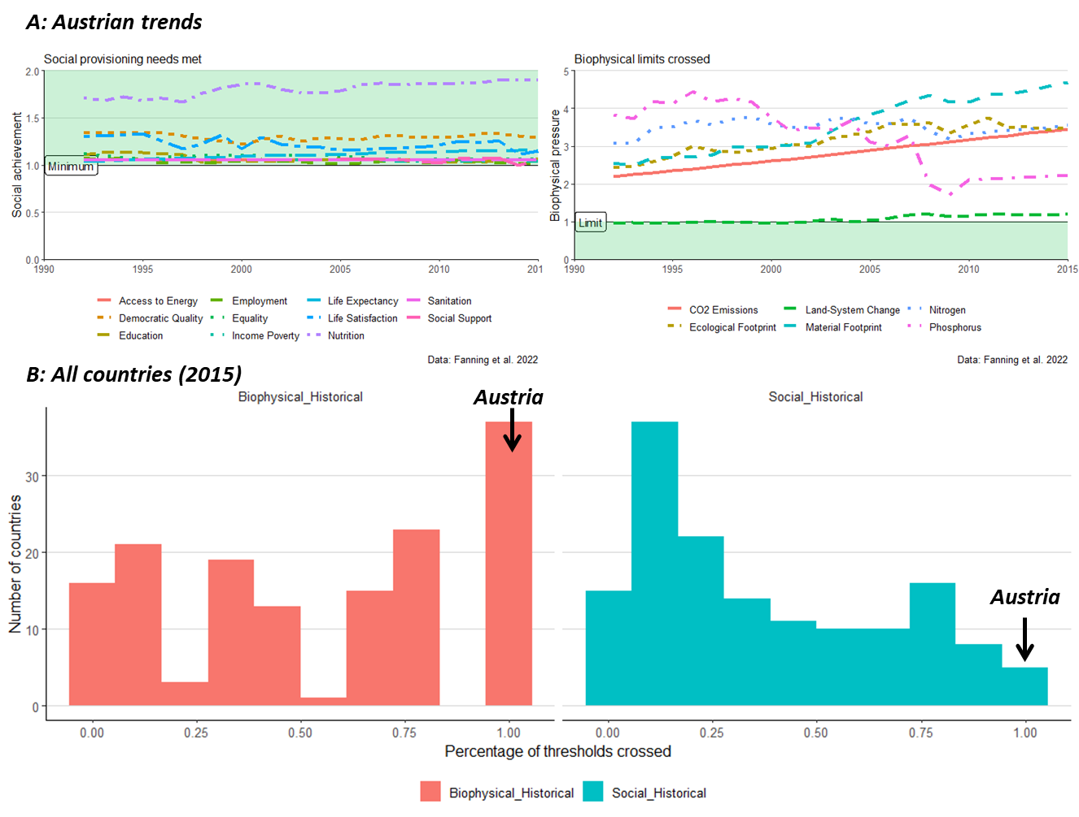

Slide 19
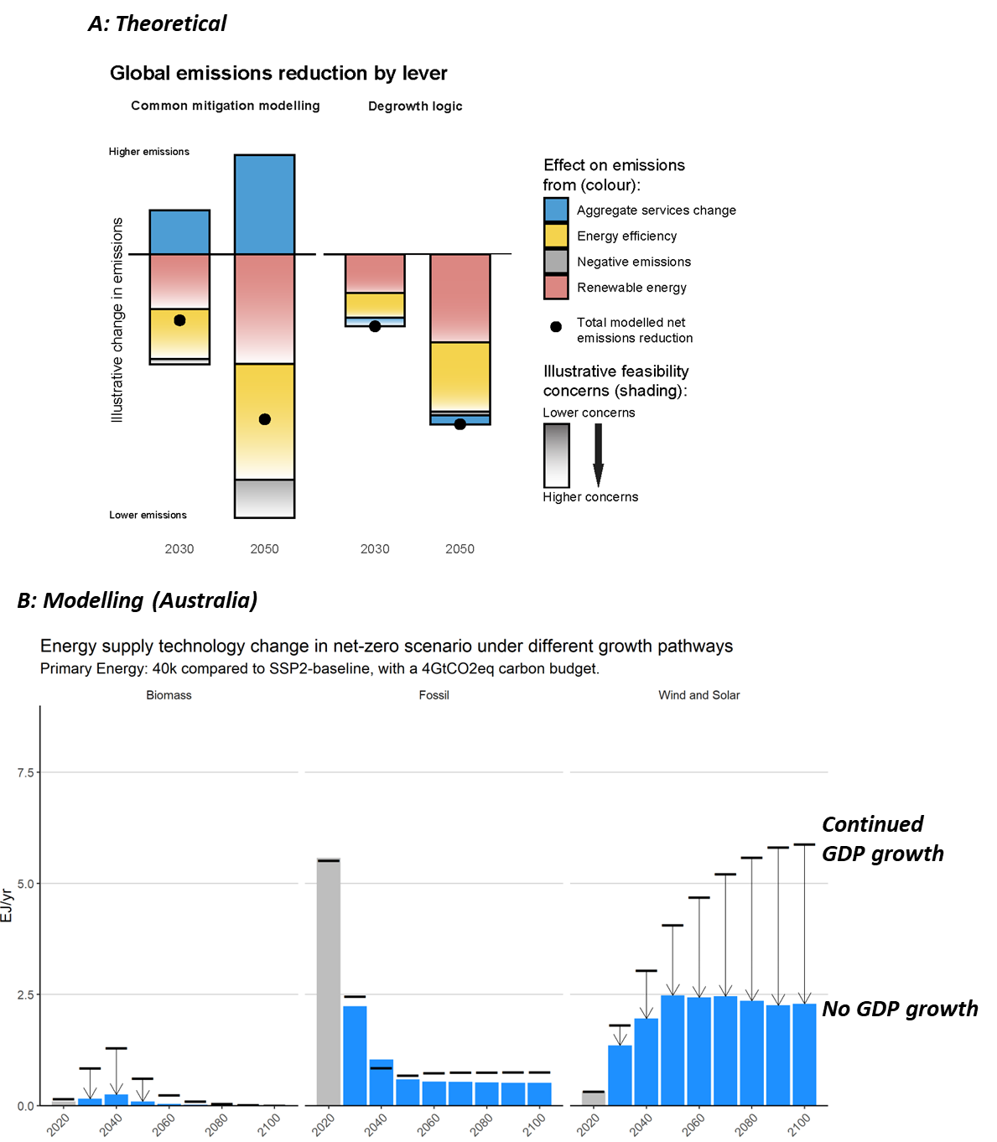

Slide 20
Timeline
ZOD for internal feedback: 13th of August
Internal (only us?)
Internal+ (all interested AAR2 authors)
Handing in: 21 August (Jarmo on leave from 25 August)

Slide 21
Task division
Jarmo: Introduction, modelled outcomes of degrowth transition, figure design
Halliki & Ernest: degrowth policies
1 paragraph per point
All: suggestions and comments (and generally help anywhere of course always welcome)
Danyal: facilitator, read text (understandability & cross-references)
Aim for circulating:
Wednesday 16th August
Official:
End-of-August
(unofficial) mid-September

Slide 22
Notes
Ernest:
Chapter 4 (with katharina)
Chapter 8 (transformative pathways)
E&D&J:
Agreement on making the DG box quite big, communicating where bits could go – and change to cross references.
Box:
Only bullet points? Or text?
AAR2 authors: actual text.

Slide 23
Notes
Introduction:
Ernest: more concise. Introduce degrowth, and then references.
Ernest: To decide: “stand for itself” or “in opposition to green growth”.
Need to identify DG as coherent approach. Important, because: (i) it is true in the literature, (ii) it allows different conversations [independent of growth].
-> can ask for feedback from other authors
“growth-critical box” vs
“degrowth on its own”
Danyal topics:
Work/mobility/industry (SET literature)
-> do mobility.

