Slide 1
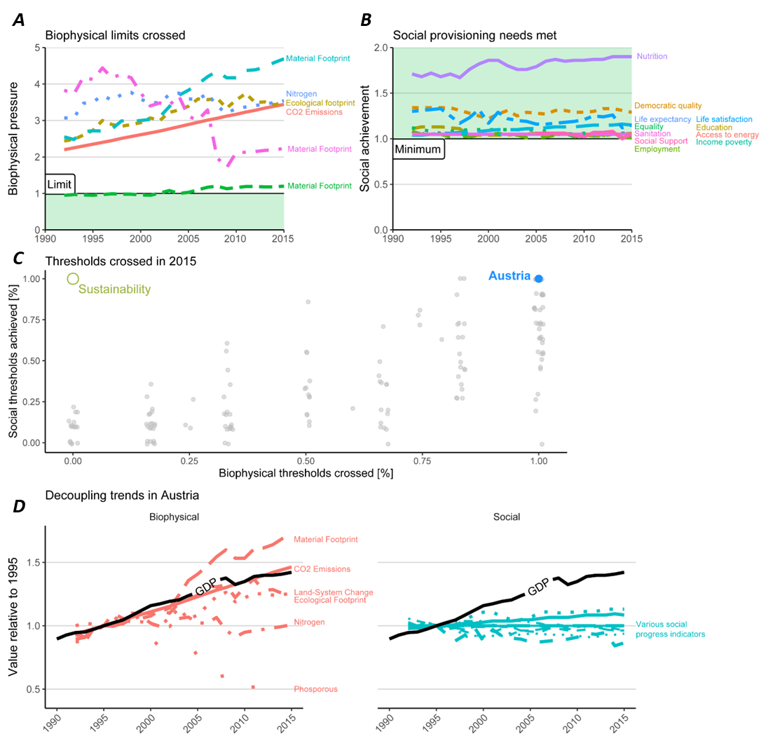
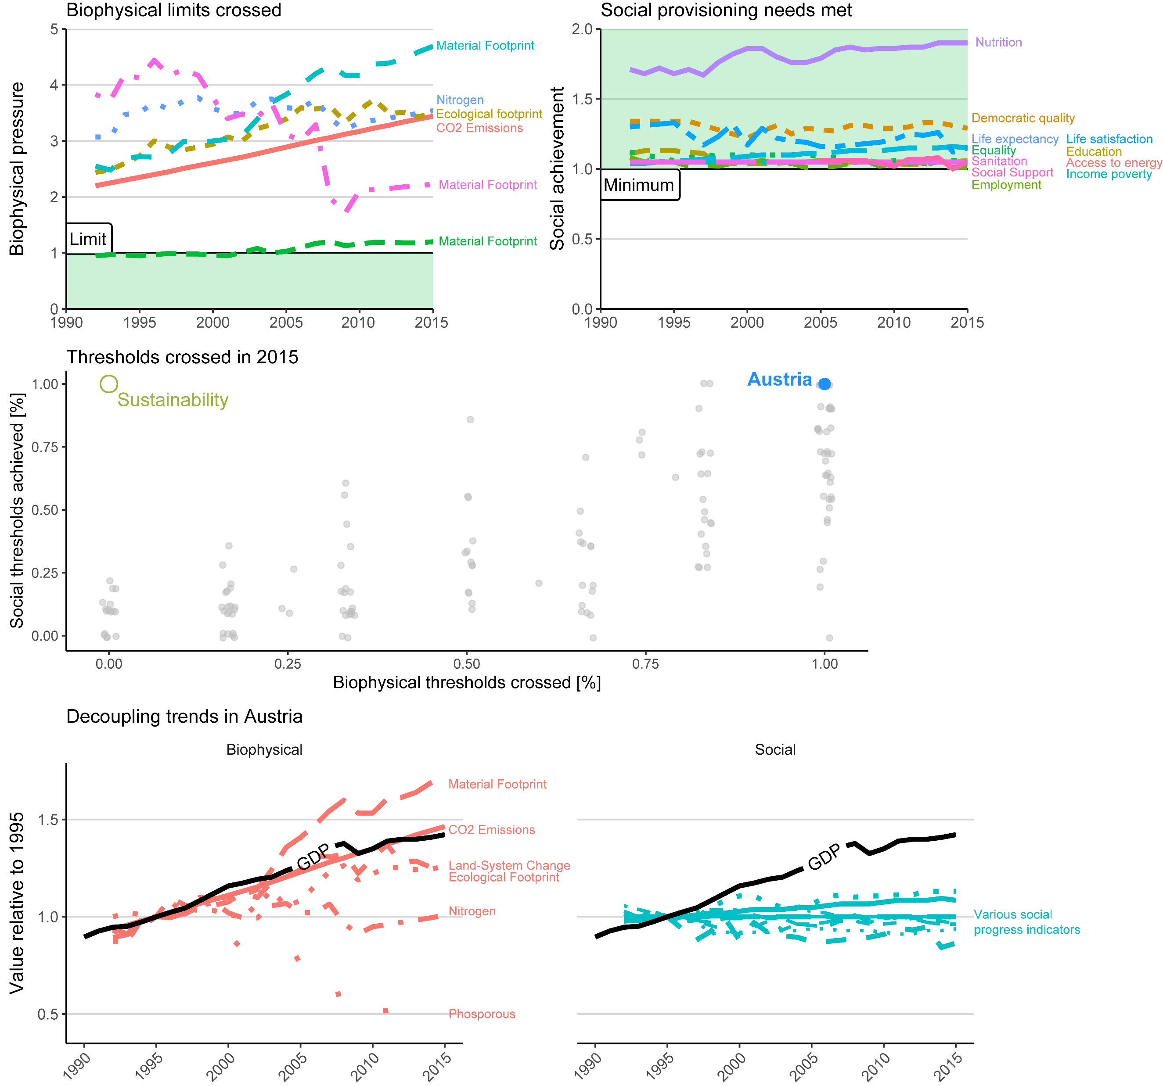
A
B
C
D

Slide 2
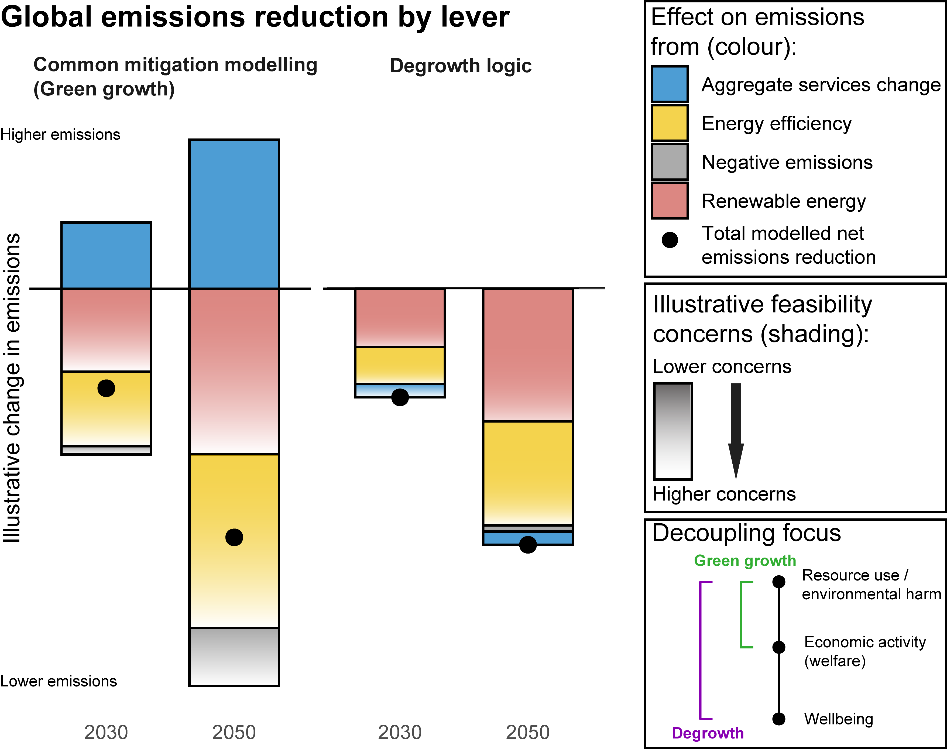
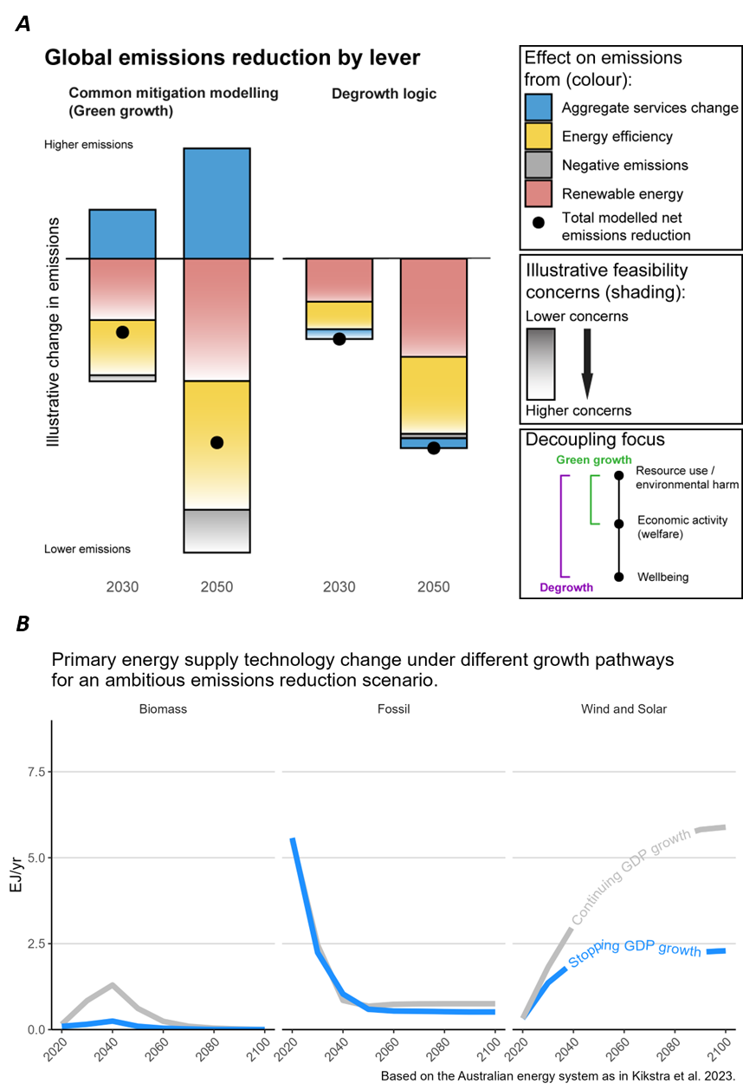
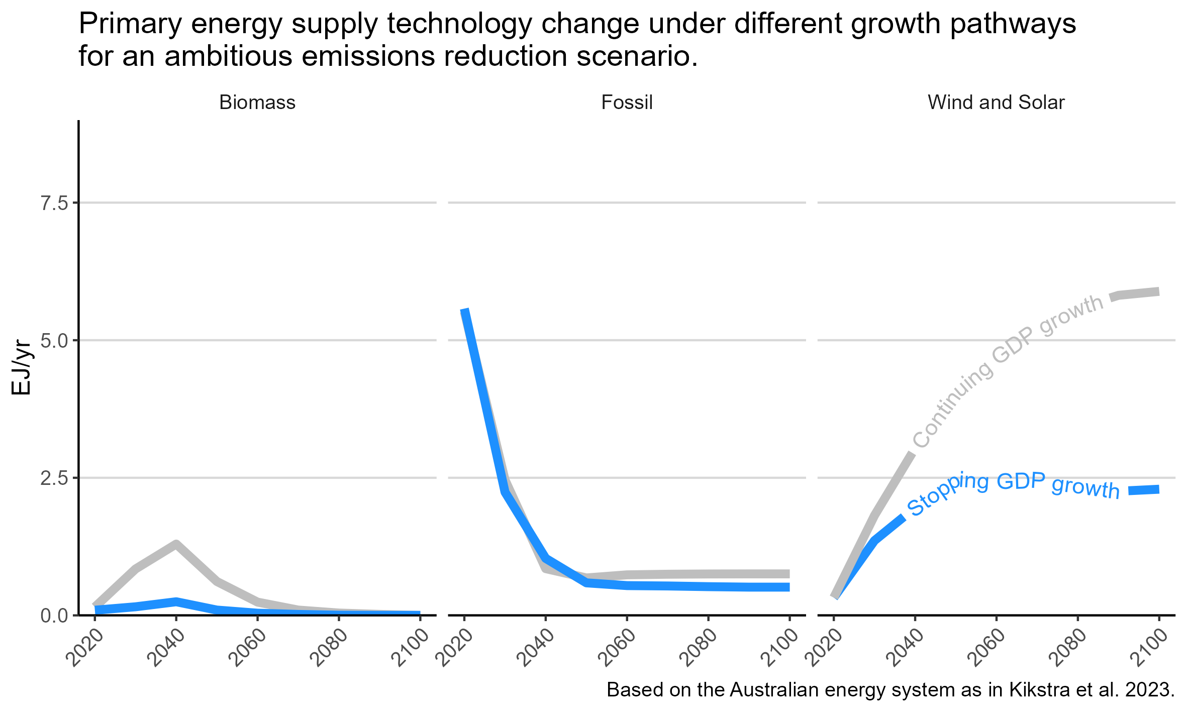
A
B

Slide 3
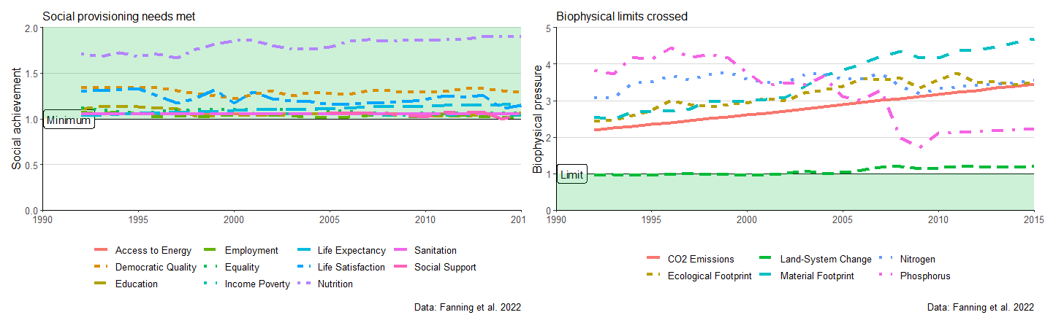
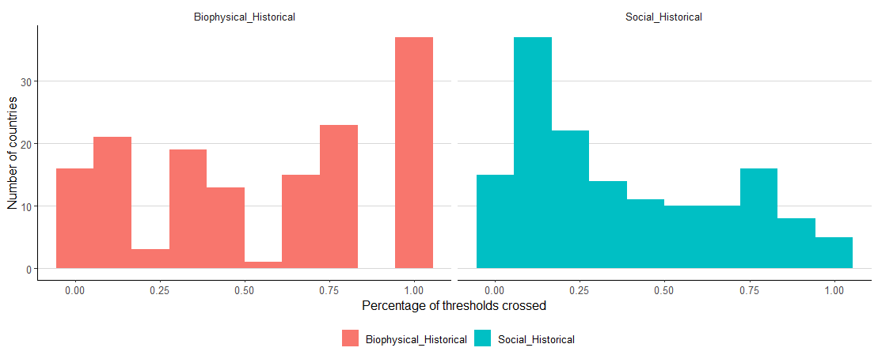
A: Austrian trends
B: All countries (2015)
Austria
Austria

Slide 4
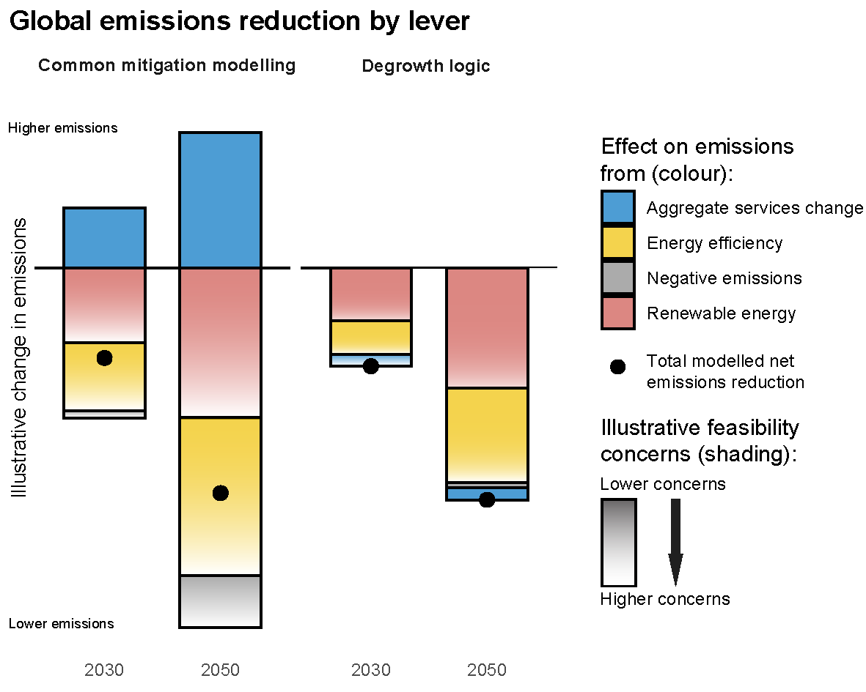
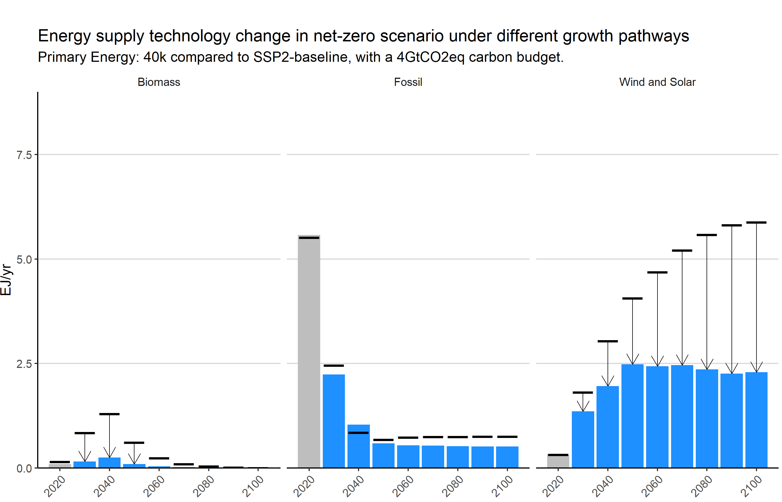
A: Theoretical
B: Modelling (Australia)
Continued GDP growth
No GDP growth

Slide 5
TdT
Highlight of the last week.
Work updates?

Slide 6
Introduction
focus of the literature.
starting points/assumptions of the literature.
paragraph contrasting degrowth with green growth – for mitigation (+co-benefits&tradeoffs)
paragraph linking to evidence and adjacent literatures (possibilities & necessity)

Slide 7
Policies – overview

Slide 8
Policies – outcomes

Slide 9
Figures feedback
Figure 1:
Panel A:
Panel B:
Figure 2:
Panel A:
Panel B: (possible to just do in the text)?
Figures that you want but aren’t there yet:
Figure of Steinberger Provisioning System

Slide 10
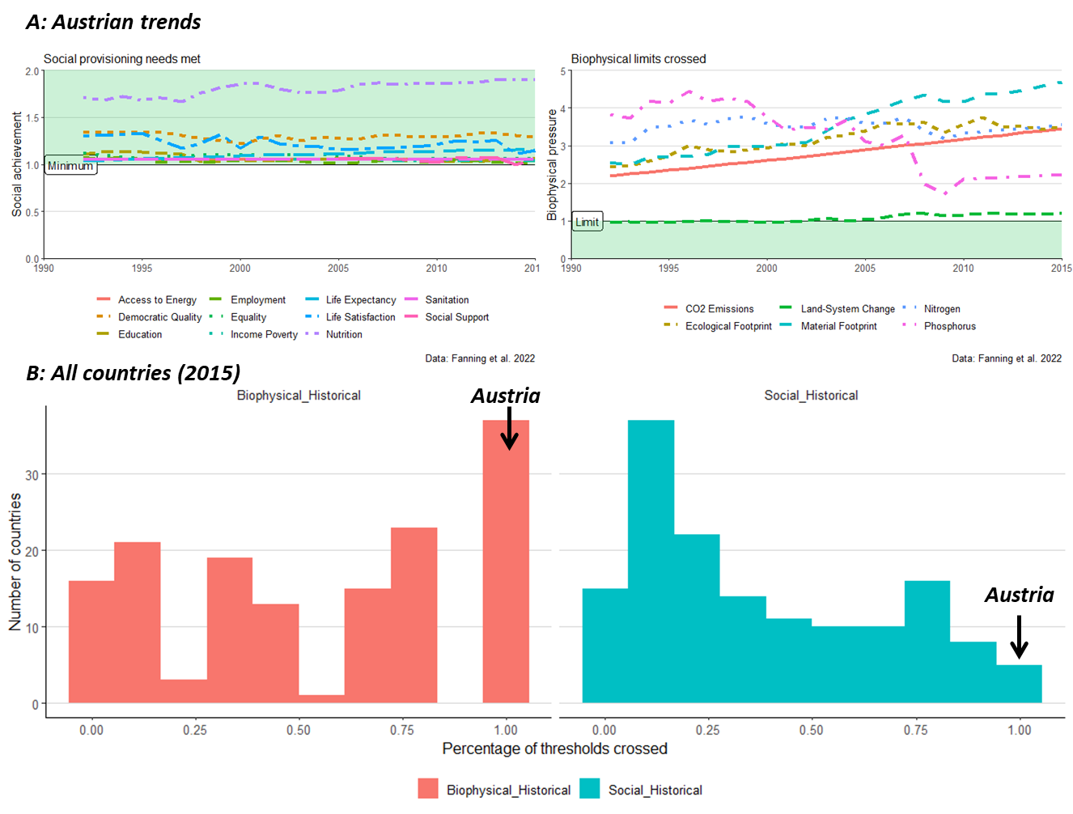

Slide 11
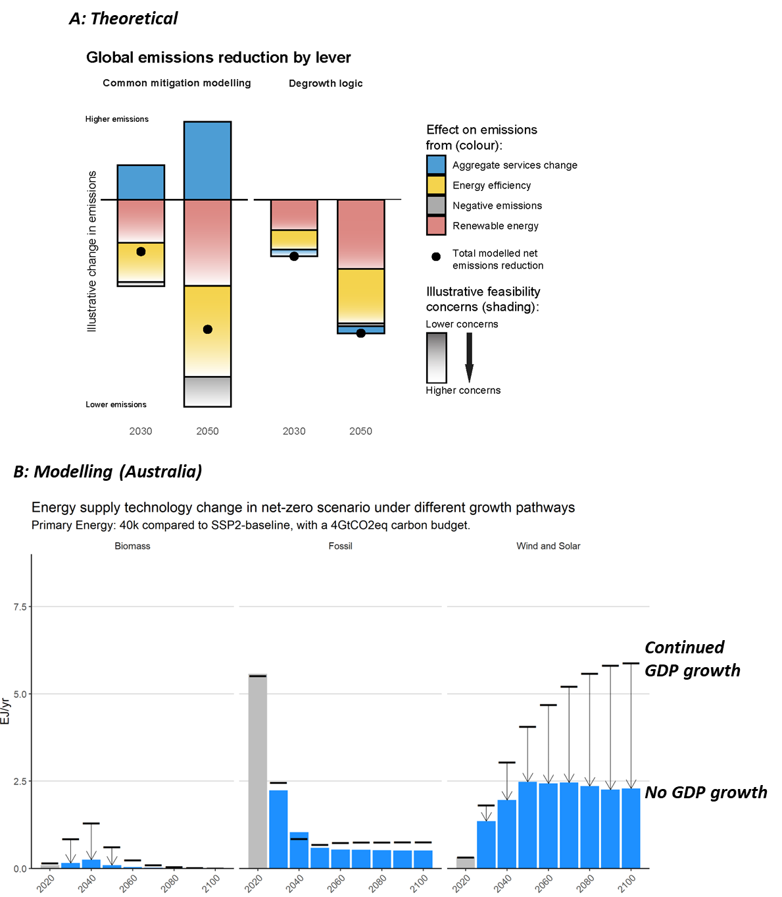

Slide 12
Timeline
ZOD for internal feedback: 13th of August
Internal (only us?)
Internal+ (all interested AAR2 authors)
Handing in: 21 August (Jarmo on leave from 25 August)

Slide 13
Task division
Jarmo: Introduction, modelled outcomes of degrowth transition, figure design
Halliki & Ernest: degrowth policies
1 paragraph per point
All: suggestions and comments (and generally help anywhere of course always welcome)
Danyal: facilitator, read text (understandability & cross-references)
Aim for circulating:
Wednesday 16th August
Official:
End-of-August
(unofficial) mid-September

Slide 14
Notes
Ernest:
Chapter 4 (with katharina)
Chapter 8 (transformative pathways)
E&D&J:
Agreement on making the DG box quite big, communicating where bits could go – and change to cross references.
Box:
Only bullet points? Or text?
AAR2 authors: actual text.

Slide 15
Notes
Introduction:
Ernest: more concise. Introduce degrowth, and then references.
Ernest: To decide: “stand for itself” or “in opposition to green growth”.
Need to identify DG as coherent approach. Important, because: (i) it is true in the literature, (ii) it allows different conversations [independent of growth].
-> can ask for feedback from other authors
“growth-critical box” vs
“degrowth on its own”
Danyal topics:
Work/mobility/industry (SET literature)
-> do mobility.

