Slide 1

Final Presentation
Team Name: StorageMate - Webapp
Team Members: Justin Cheon (PO) , Mai Linh Ngo, Ji Woo Kim, Michael Nguyen
(March 14th, 2018)

Slide 2
StorageMate - Webapp
Strive to provide an environment where people may list and rent out extra space for others to use as storage.
To facilitate the above, we will create a web application using Django as the framework and PostgreSQL for data storage and retrieval

Slide 3
Desired Goals
Creating a working web app forum
Learn to work as a team
Learn scrum and agile methods
Become familiar Django Framework, PostgreSQL, Python, HTML, CSS, and Javascript.

Slide 4
Achieved Goals
Learned web app development
Learned to work as a team
Learned scrum and agile methods
Finished 85% of expected product

Slide 5
Challenges
Learning new technologies
Installing environments/software needed
Working with strict PO
Software updates/version updates
Pushing from the proper branches in git

Slide 6
Management Techniques
Scrum
Consistent meetings MWF
Burn up chart
Scrum board (Trello)
Constant communication
Google Drive
Facebook Messenger

Slide 7
Enjoyed
Didn’t Enjoy
Working with a team
Learning Django and other languages
Making a cool web-app
The homeworks took away too much of our project time.
Having to coordinate weekly meeting schedules (always changing)

Slide 8
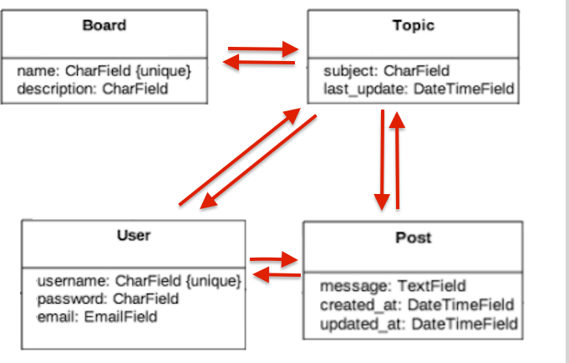
Architecture

Slide 9
Technologies
Django - Website Framework
PostgreSQL - Data Manipulation
HTML, CSS, Javascript
Github for Version Control

Slide 10
Lessons Learned
what worked/what you will keep doing
– what didn’t work/what you will stop doing
– things you wished you had done

Slide 11
Demo

Slide 12
Questions?

