Slide 1

Project Release Plan
Team Name: StorageMate
Team Members: Justin Cheon, Ji Woo Kim, Lawrence Ngo, Michael Nguyen
(PO: Justin Cheon)
(SM: Lawrence Ngo)
January 22, 2018

Slide 2
StorageMate
Strive to provide an environment where people may list and rent out extra space for others to use as storage.
To facilitate the above, we will create a web application using Django as the framework and SQLite for data storage and retrieval

Slide 3
Sprint 1
As a developer, I want to learn how to use Django and set up the web application
As a developer, I want to learn Python, Javascript, and SQLite (Queries, Insert)
As a developer, I want to learn how to host a Web App
As a developer, I want to design a prototype framework

Slide 4
Sprint 2
As a developer, I want to create a loading page.
As a user, I would like Login Page (with user authentication)
As a user, I would like a menu (for navigation between pages)
As a user, I want a header to display the current directory.

Slide 5
Sprint 3:
As a user, I want to upload a picture of my storage space
As a user, I want an easy and simple to use UI that is also aesthetically pleasing.

Slide 6
Sprint 4
As a developer, I want to make sure the web application is free of errors and has no bugs
As a user, I want to receive notifications from people interested in my storage space

Slide 7
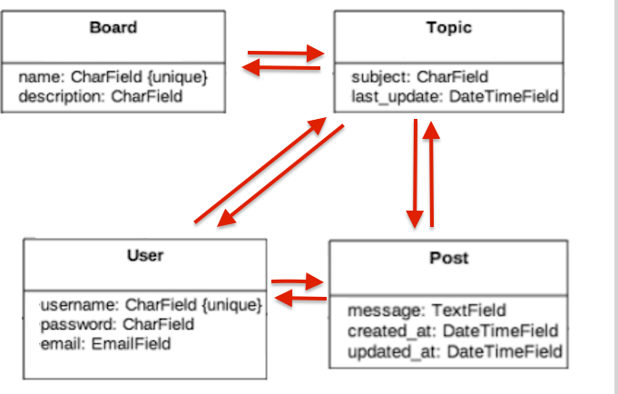
Architecture

Slide 8
Challenges/Risks
1. Learning Django Framework, SQL, Python, HTML, CSS, and Javascript.
2. Being able to meet 3 times a week.
3. Git logging and branching organization

Slide 9
Technologies
Django - Website Framework
SQL - Data Manipulation
D3 - UI and Website Graphics
Github for Version Control

