Slide 1
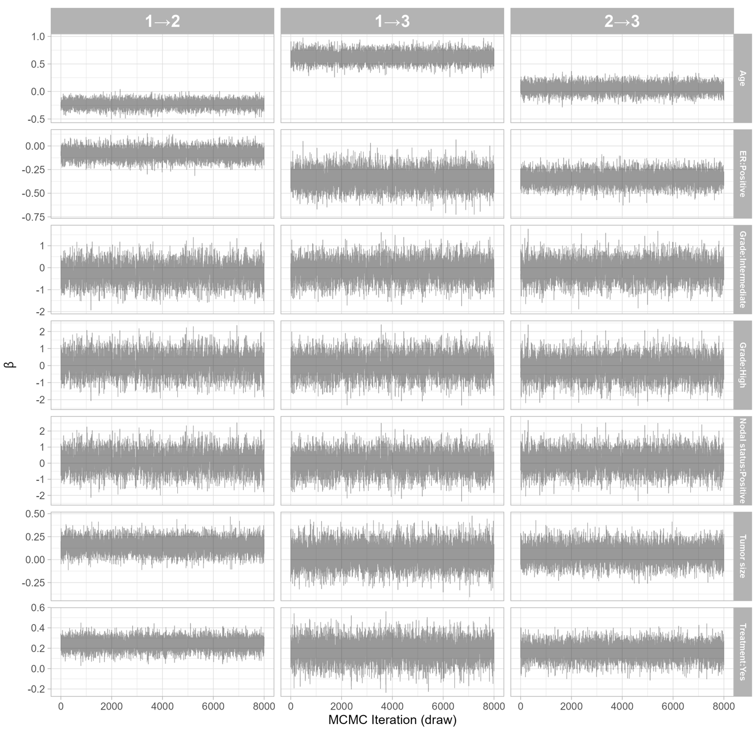
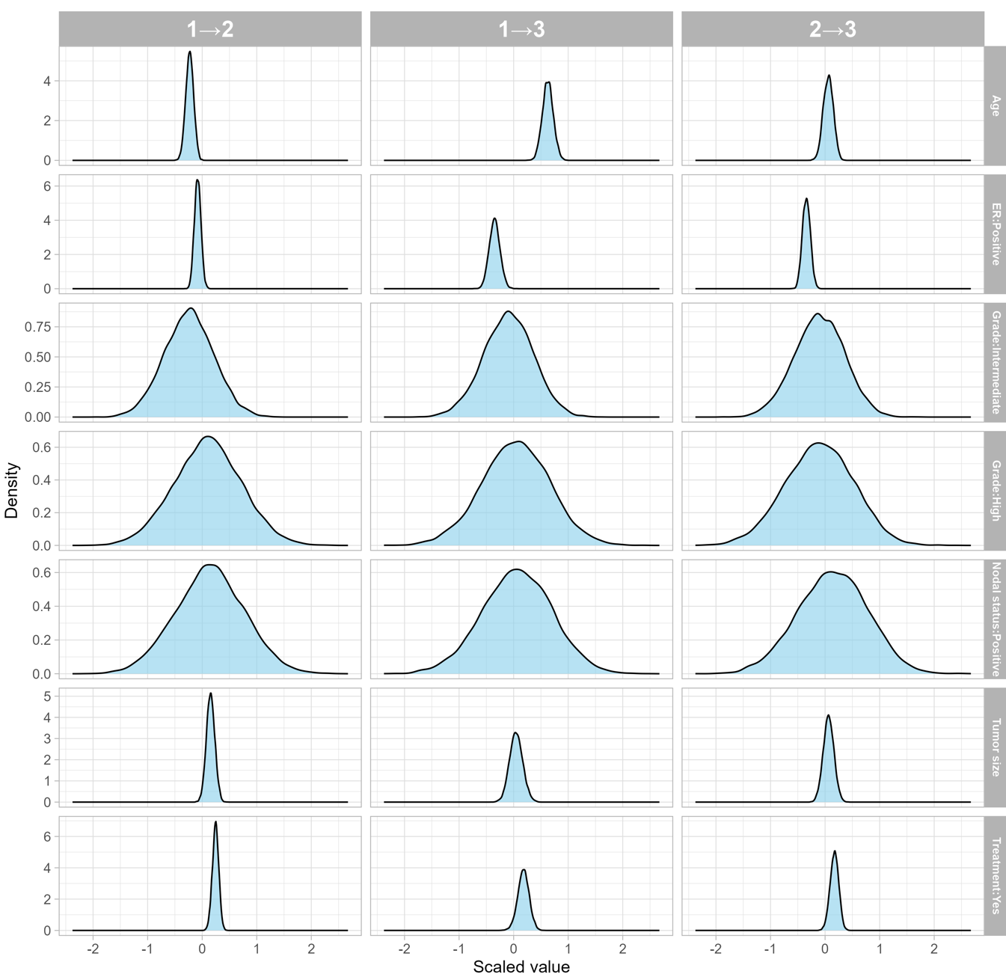
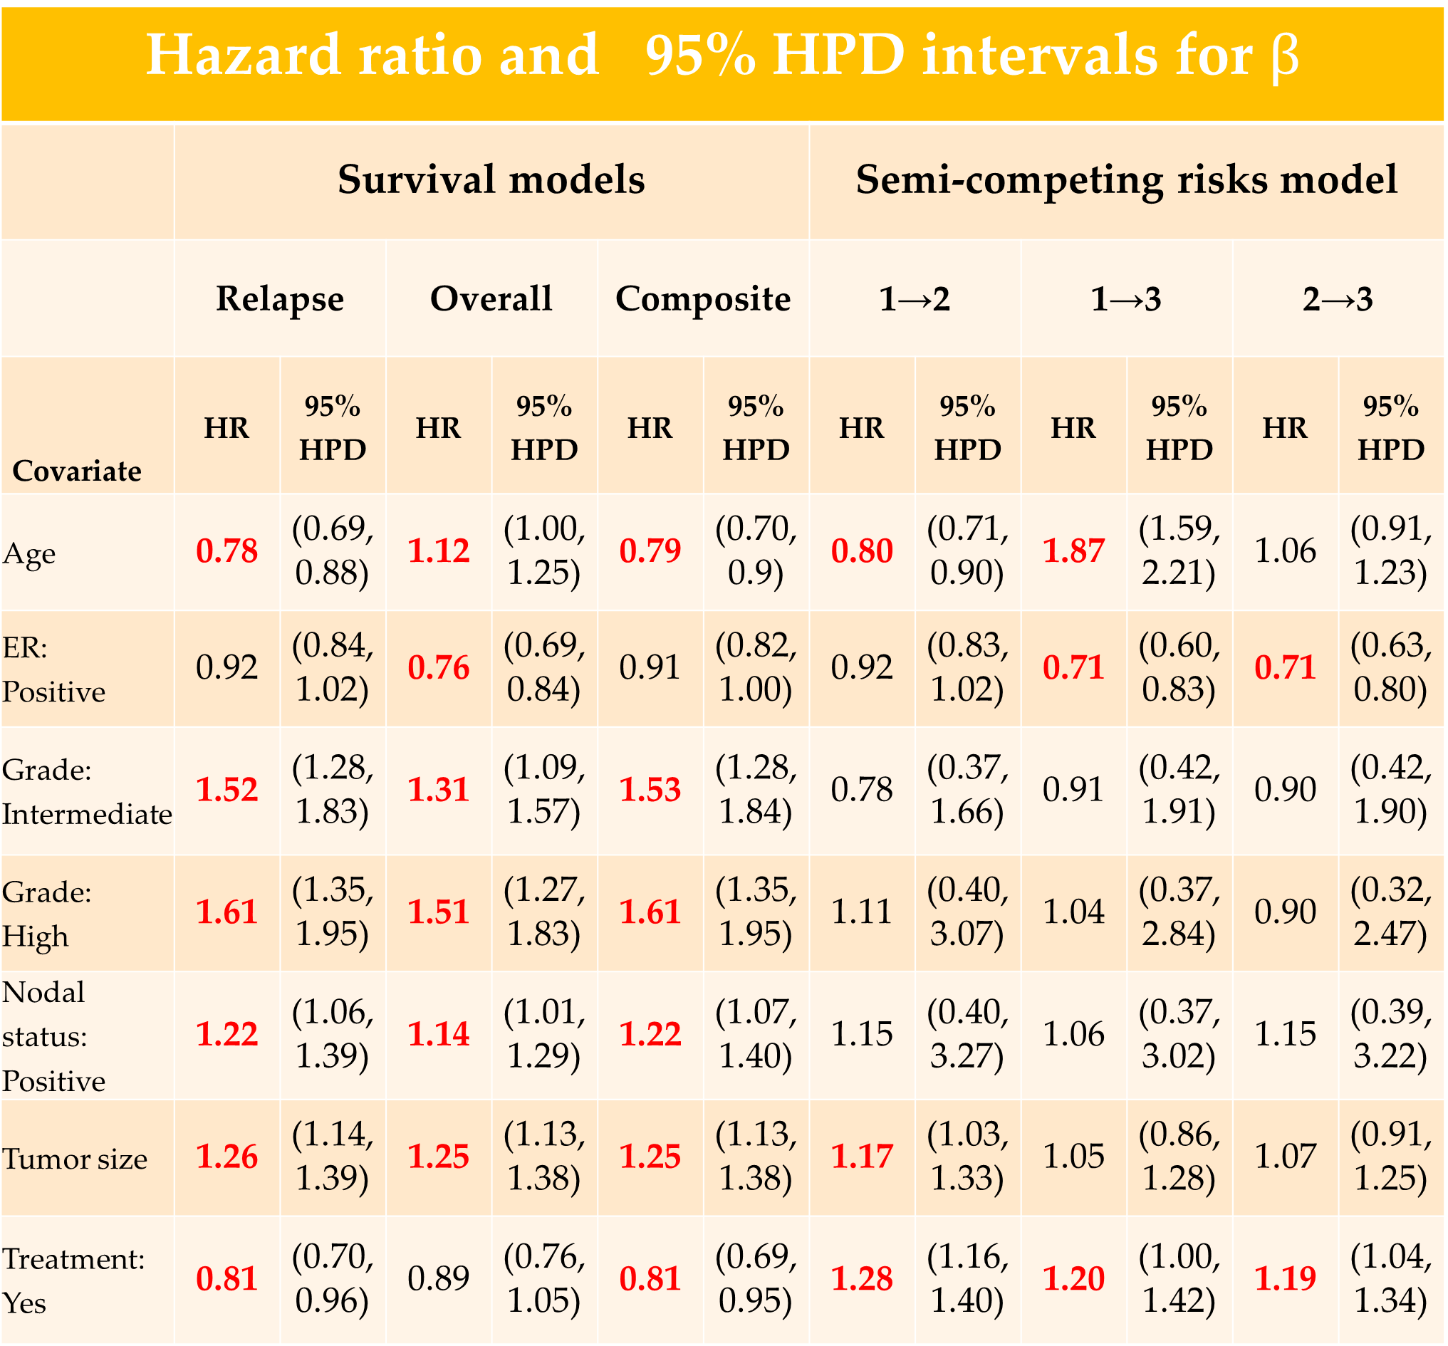



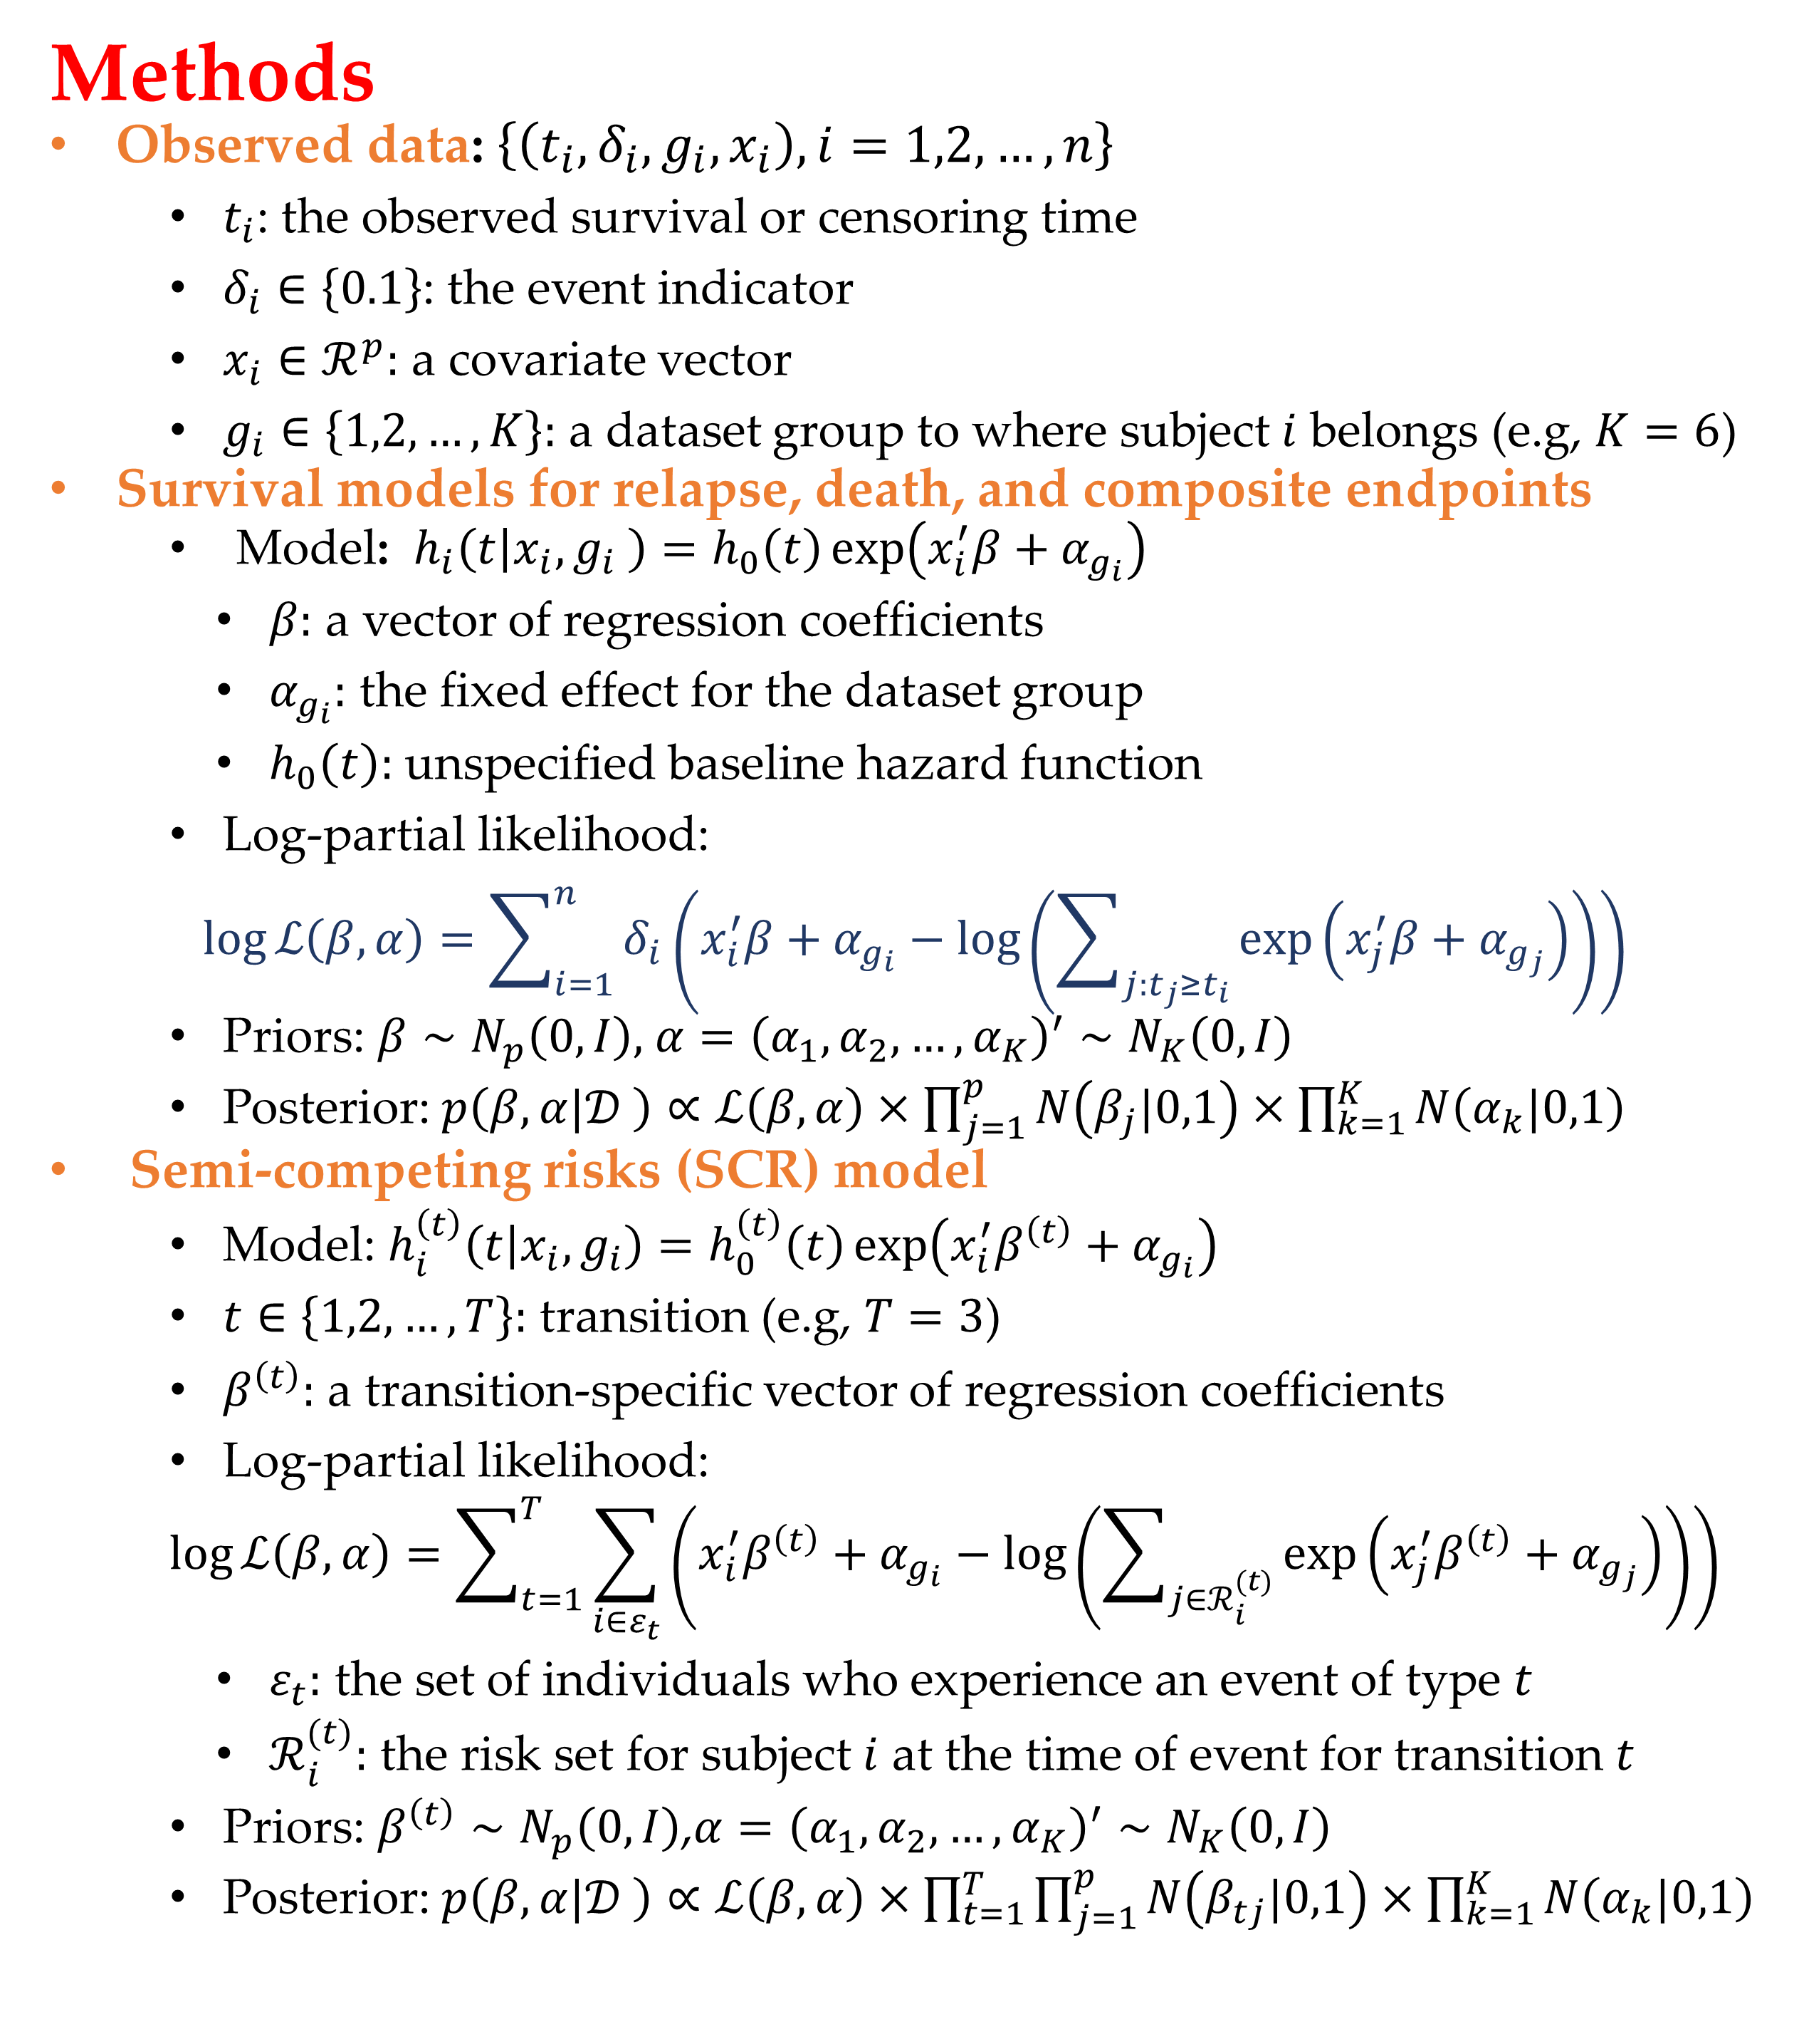
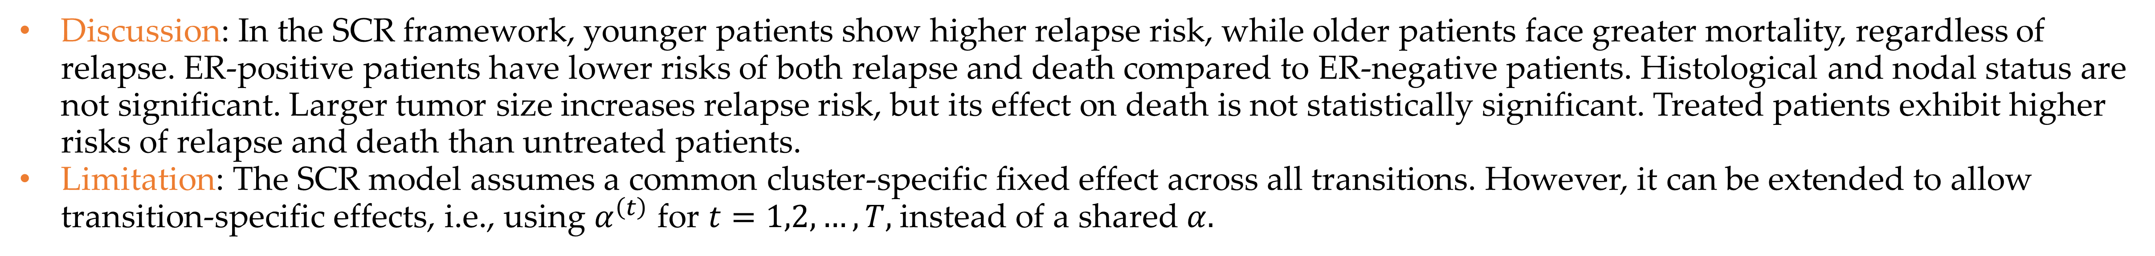
Presented at BayesComp 2025, Singapore, June 15–20
Bayesian analysis of clustered data within a semi-competing risks framework$⋆$
Jinheum Kim¹, Eunjeong Cha²
¹University of Suwon, Department of Applied Statistics, South Korea; ²University of Suwon, Department of Nursing Science, South Korea
Background
Traditional survival models typically focus on a single terminal event. However, clinical settings often involve more complex outcome structures. In competing risks, individuals face mutually exclusive events, while semi-competing risks arise when a non-terminal event (e.g., relapse) may be censored by a terminal event (e.g., death), which cannot be preceded by the non-terminal event—common in cancer studies.
Survival data are often clustered (e.g., by clinical center), requiring methods that account for intra-cluster correlation. Bayesian models provide a flexible framework to model both semi-competing risks and clustering. This study applies such an approach to multi-center breast cancer trial data.
Methods
Observed data:$\left\{\left(t_{i}, δ_{i},g_{i},x_{i}\right), i=1,2,…,n\right\}$
$t_{i}$: the observed survival or censoring time
$δ_{i}∈\left\{0.1\right\}$: the event indicator
$x_{i}∈ℛ^{p}:$ a covariate vector
$g_{i}∈\left\{1,2,…,K\right\}:$ a dataset group to where subject $i$ belongs (e.g, $K=6$)
Survival models for relapse, death, and composite endpoints
Model: $h_{i}\left(t | x_{i},g_{i} \right)=h_{0}\left(t\right)\exp\left(x_{i}^{′}β+α_{g_{i}}\right)$
$β:$ a vector of regression coefficients
$α_{g_{i}}:$ the fixed effect for the dataset group
$h_{0}\left(t\right):$ unspecified baseline hazard function
Log-partial likelihood:
$$\log{ℒ\left(β,α\right)}=\sum_{i=1}^{n}{δ_{i}\left(x_{i}^{′}β+α_{g_{i}}−\log\left(\sum_{j:t_{j}≥t_{i}}{\exp\left(x_{j}^{′}β+α_{g_{j}}\right)}\right)\right)}$$
Priors: $β∼N_{p}\left(0,I\right),$ $α={\left(α_{1},α_{2},…,α_{K}\right)}^{′}∼N_{K}\left(0,I\right)$
Posterior:$p\left(β,α|𝒟 \right)∝ℒ\left(β,α\right)×\prod_{j=1}^{p}{N\left(β_{j}|0,1\right)}×\prod_{k=1}^{K}{N\left(α_{k}|0,1\right)}$
Semi-competing risks (SCR) model
Model: $h_{i}^{\left(t\right)}\left(t | x_{i},g_{i}\right)=h_{0}^{\left(t\right)}\left(t\right)\exp\left(x_{i}^{′}β^{\left(t\right)}+α_{g_{i}}\right)$
$t∈\left\{1,2,…,T\right\}:$ transition (e.g, $T=3$)
$β^{\left(t\right)}:$ a transition-specific vector of regression coefficients
Log-partial likelihood:
$$\log{ℒ\left(β,α\right)}=\sum_{t=1}^{T}{\sum_{i∈ε_{t}}{\left(x_{i}^{′}β^{\left(t\right)}+α_{g_{i}}−\log\left(\sum_{j∈ℛ_{i}^{(t)}}{\exp\left(x_{j}^{′}β^{\left(t\right)}+α_{g_{j}}\right)}\right)\right)}}$$
$ε_{t}:$ the set of individuals who experience an event of type $t$
$ℛ_{i}^{(t)}:$ the risk set for subject $i$ at the time of event for transition $t$
Priors: $β^{\left(t\right)}∼N_{p}\left(0,I\right)$,$α={\left(α_{1},α_{2},…,α_{K}\right)}^{′}∼N_{K}\left(0,I\right)$
Posterior: $p\left(β,α|𝒟 \right)∝ℒ\left(β,α\right)×\prod_{t=1}^{T}{\prod_{j=1}^{p}{N\left(β_{tj}|0,1\right)}×\prod_{k=1}^{K}{N\left(α_{k}|0,1\right)}}$
Materials
Data source: We used data from clinical trials involving 5,715 breast cancer patients across 36 centers in the US and Europe. The dataset, originally published by Haibe-Kains et al. (2012) and later reanalyzed by Peng et al. (2018), includes event times for relapse and death across six cohorts. It is publicly available as supplementary material from the original publication (link).
Outcome: Relapse-free survival (RFS) and overall survival (OS) were analyzed under a semi-competing risks framework. RFS is defined as time from surgery to relapse (non-terminal), and OS as time from surgery to death (terminal). After excluding cases with missing data, 973 patients were included. Time was measured in years. The goal was to assess how clinical predictors influence both outcomes and their interdependence.
Predictors: The model included two continuous predictors—age at diagnosis and tumor size—and five categorical predictors: estrogen receptor status, histological grade, nodal status, treatment, and clinical center.
Results
Implementation: Models were implemented in R using cmdstanr (Stan Development Team, 2022) with 4 chains, 1,000 warm-up iterations, and 2,000 sampling iterations per chain.
Pathway | Age | Estrogen receptor |  | Histological grade |  |  | Nodal status |  | Tumor size | Treatment |  | Dataset
 |  | Negative | Positive | Low | Intermediate | High | Negative | Positive |  | No | Yes | CALª | NKI^{b} | STNO2^{c} | TRANSBIG^{d} | UCSF^{e} | UNC4^{f}
Total | 50.7 (±13.0) | 287 (29.5%) | 686 (70.5%) | 153 (15.7%) | 373 (38.3%) | 447 (45.9%) | 563 (57.9%) | 410 (42.1%) | 2.5 (±1.2) | 401 (41.2%) | 572 (58.8%) | 106 (10.9%) | 295 (30.3%) | 86 (8.8%) | 191 (19.6%) | 113 (11.6%) | 182 (18.7%)
Alive | 51.0 (±12.4) | 143 (25.5%) | 418 (74.5%) | 117 (20.9%) | 207 (36.9%) | 237 (42.2%) | 342 (61.0%) | 219 (39.0%) | 2.4 (±1.2) | 229 (40.8%) | 332 (59.2%) | 6 (1.1%) | 189 (33.7%) | 46 (8.2%) | 107 (19.1%) | 72 (12.8%) | 141 (25.1%)
Realpsed | 48.7 (±12.2) | 24 (19.7%) | 98 (80.3%) | 12 (9.8%) | 63 (51.6%) | 47 (38.5%) | 69 (56.6%) | 53 (43.4%) | 2.6 (±1.3) | 59 (48.4%) | 63 (51.6%) | 27 (22.1%) | 27 (22.1%) | 11 (9.0%) | 33 (27.0%) | 9 (7.4%) | 15 (12.3%)
Dead with relapse | 58.8 (±15.8) | 39 (38.2%) | 63 (61.8%) | 12 (11.8%) | 43 (42.2%) | 47 (46.1%) | 43 (42.2%) | 59 (57.8%) | 2.7 (±1.2) | 16 (15.7%) | 86 (84.3%) | 67 (65.7%) | 5 (4.9%) | 5 (4.9%) | 0 (0.0%) | 22 (21.6%) | 3 (2.9%)
Dead w/o relapse | 46.9 (±11.4) | 81 (43.1%) | 107 (56.9%) | 12 (6.4%) | 60 (31.9%) | 116 (61.7%) | 109 (58.0%) | 79 (42.0%) | 2.8 (±1.2) | 97 (51.6%) | 91 (48.4%) | 6 (3.2%) | 74 (39.4%) | 24 (12.8%) | 51 (27.1%) | 10 (5.3%) | 23 (12.2%)
ªCAL: UCSF & Cal Pacific; ^{b}NKI: Netherlands Cancer Inst.; ^{C}STNO: Stanford/Norway; ^{d}TRANSBIG: TransBIG (EU); ^{e}UCSF: Univ. of California, SF; ^{f}UNC: Univ. of North Carolina.
Hazard ratio and 95% HPD intervals for $β$
 | Survival models |  |  |  |  |  | Semi-competing risks model
 | Relapse |  | Overall |  | Composite |  | 1→2 |  | 1→3 |  | 2→3
Covariate | HR | 95% HPD | HR | 95% HPD | HR | 95% HPD | HR | 95% HPD | HR | 95% HPD | HR | 95% HPD
Age | 0.78 | (0.69, 0.88) | 1.12 | (1.00, 1.25) | 0.79 | (0.70, 0.9) | 0.80 | (0.71, 0.90) | 1.87 | (1.59, 2.21) | 1.06 | (0.91, 1.23)
ER: Positive | 0.92 | (0.84, 1.02) | 0.76 | (0.69, 0.84) | 0.91 | (0.82, 1.00) | 0.92 | (0.83, 1.02) | 0.71 | (0.60, 0.83) | 0.71 | (0.63, 0.80)
Grade: Intermediate | 1.52 | (1.28, 1.83) | 1.31 | (1.09, 1.57) | 1.53 | (1.28, 1.84) | 0.78 | (0.37, 1.66) | 0.91 | (0.42, 1.91) | 0.90 | (0.42, 1.90)
Grade: High | 1.61 | (1.35, 1.95) | 1.51 | (1.27, 1.83) | 1.61 | (1.35, 1.95) | 1.11 | (0.40, 3.07) | 1.04 | (0.37, 2.84) | 0.90 | (0.32, 2.47)
Nodal status: Positive | 1.22 | (1.06, 1.39) | 1.14 | (1.01, 1.29) | 1.22 | (1.07, 1.40) | 1.15 | (0.40, 3.27) | 1.06 | (0.37, 3.02) | 1.15 | (0.39, 3.22)
Tumor size | 1.26 | (1.14, 1.39) | 1.25 | (1.13, 1.38) | 1.25 | (1.13, 1.38) | 1.17 | (1.03, 1.33) | 1.05 | (0.86, 1.28) | 1.07 | (0.91, 1.25)
Treatment: Yes | 0.81 | (0.70, 0.96) | 0.89 | (0.76, 1.05) | 0.81 | (0.69, 0.95) | 1.28 | (1.16, 1.40) | 1.20 | (1.00, 1.42) | 1.19 | (1.04, 1.34)
Trace plots for $β$ by transition and covariate
Posterior density plots of $β$ by transition and covariate
Discussion: In the SCR framework, younger patients show higher relapse risk, while older patients face greater mortality, regardless of relapse. ER-positive patients have lower risks of both relapse and death compared to ER-negative patients. Histological and nodal status are not significant. Larger tumor size increases relapse risk, but its effect on death is not statistically significant. Treated patients exhibit higher risks of relapse and death than untreated patients.
Limitation: The SCR model assumes a common cluster-specific fixed effect across all transitions. However, it can be extended to allow transition-specific effects, i.e., using $α^{\left(t\right)}$ for $t=1,2,…, T,$instead of a shared $α.$
*This research was partially supported by the National Research Foundation of Korea (NRF) grant funded by the Korean government (MSIT) (No. RS-2023-00239958) (Jinheum Kim) and by the University of Suwon in 2024 (Jinheum Kim & Eunjeong Cha).

