Slide 1
Capstone Project
Reddit Comment Analytics:
January 2019 to April 2019
Julie Kim
June 20, 2019

Slide 2





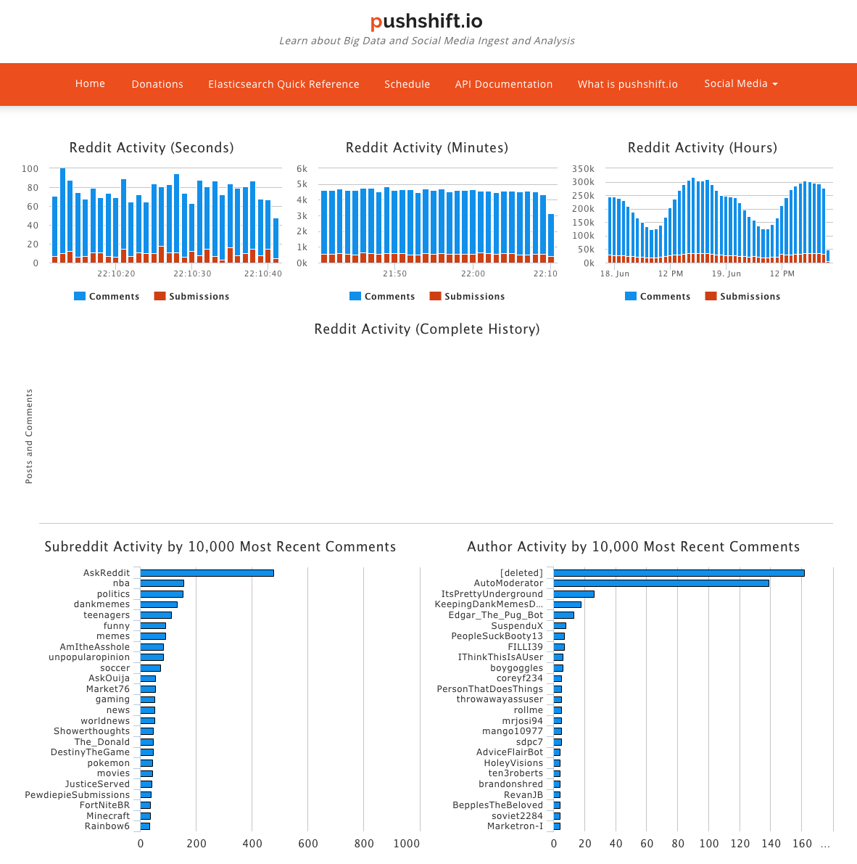
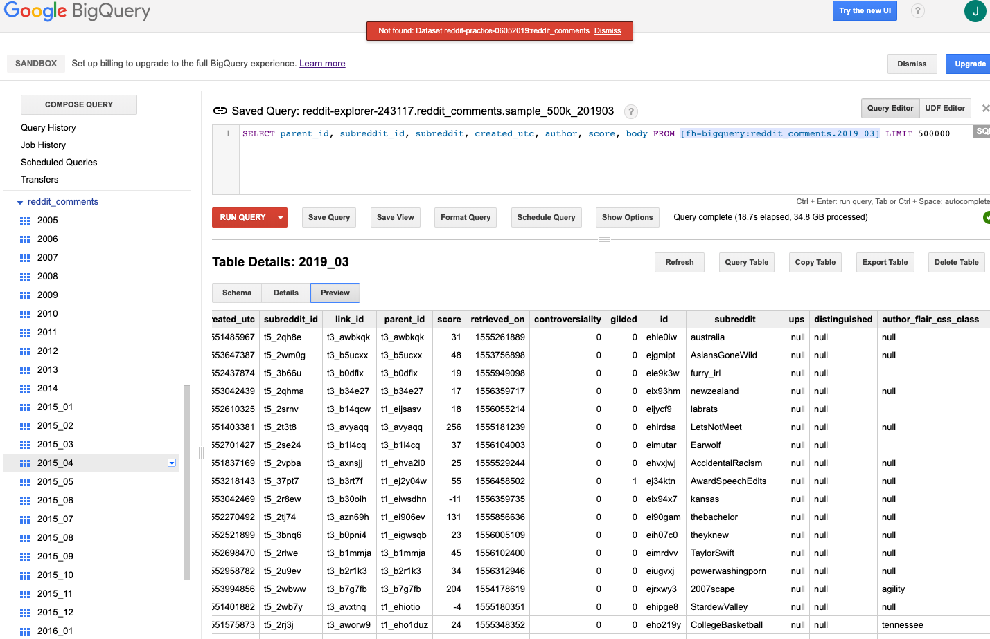
Project Timeline
STAGE 01
Reddit API
Local machine
STAGE 03
Data Cleaning
STAGE 02
STAGE 04
STAGE 05
Data Analysis
Further Development
BigQuery (SQL)
JSON File
500k comments per month from Jan. 2019 to
Apr. 2019
500k comments on
Feb. 2019
Data Exploration

Slide 3
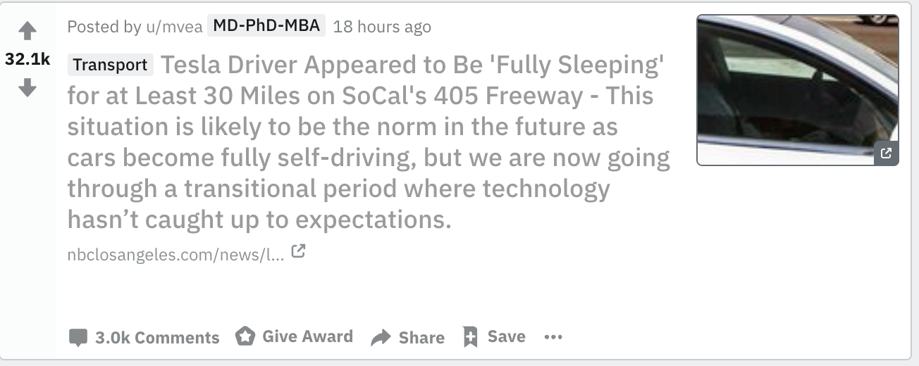
Reddit post

Slide 4
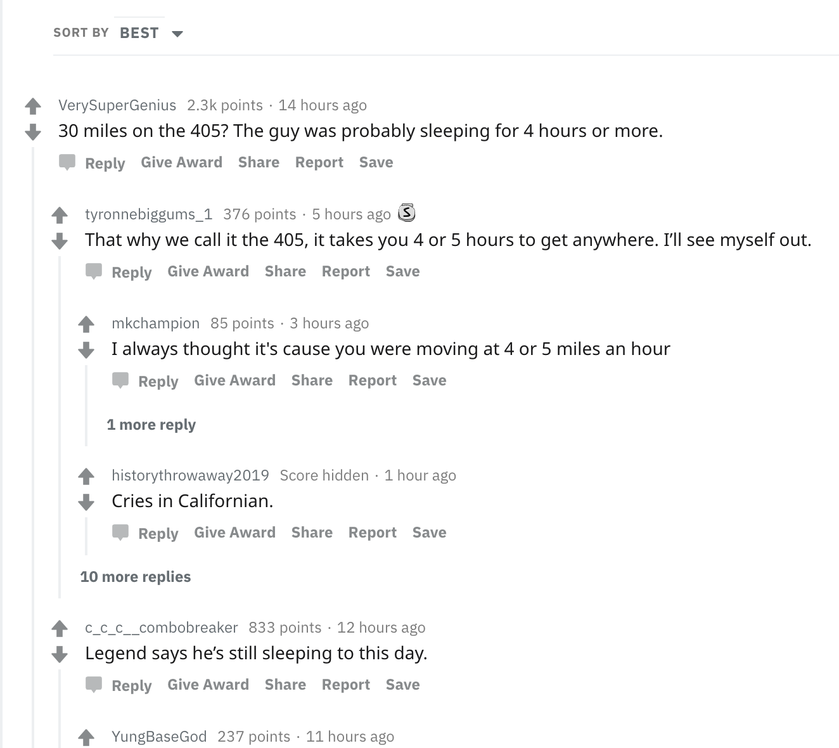
Reddit comments

Slide 5
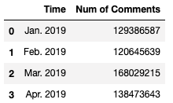
Reddit Comments by Month
2005 – 2014: annual data
2015 – current: monthly data

Slide 6
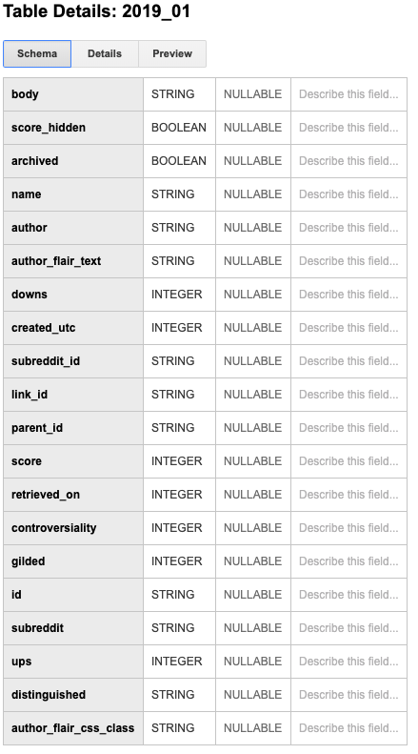
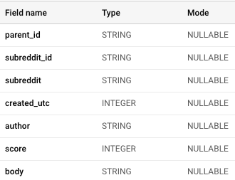
Sample 500k comments

Slide 7
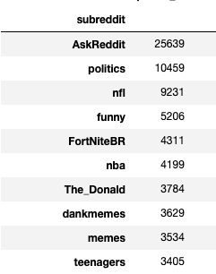
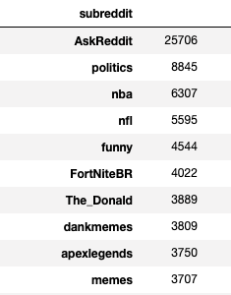
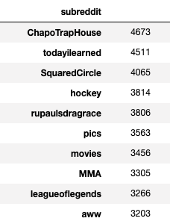
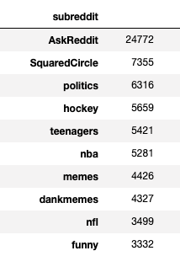
Data Exploration
Group by subreddits
Jan. 2019 | Feb. 2019 | Mar. 2019 | Apr. 2019
Number of subreddits
19563 | 20103 | 10684 | 20164

Slide 8
Data Cleaning
Clean the comments (Remove special characters)
Remove stop words with NLTK

Slide 9
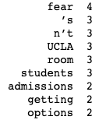
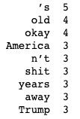
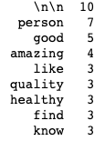
Data Analysis - spaCy
Word count by subreddit
-Top words for each subreddit
ucla
Impeach_Trump
beauty

Slide 10
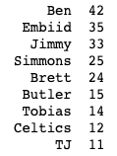
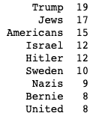
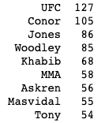
Data Analysis
Entity count by subreddit
-Top entities for each subreddit
sixers
WorldPolitics
MMA

Slide 11
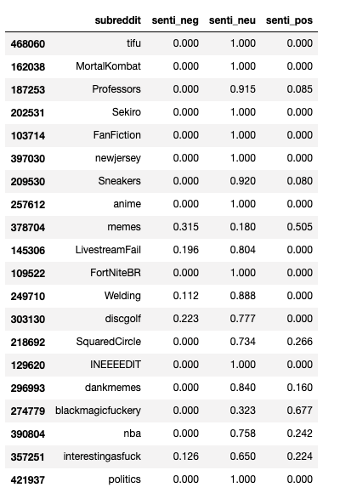
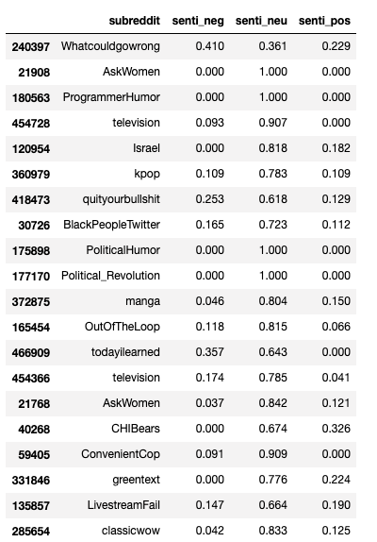
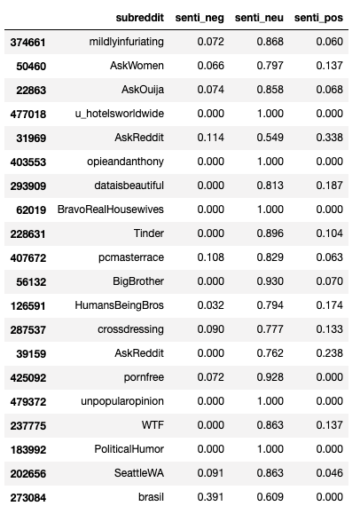
VADER (Valence Aware Dictionary and sEntiment Reasoner) analysis
censored

Slide 12
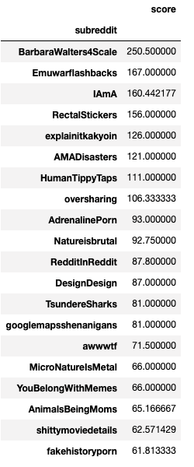
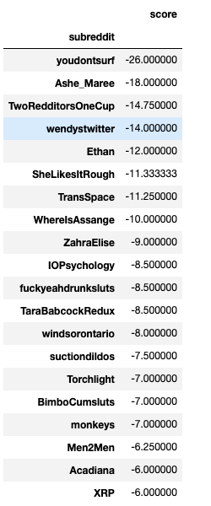
Score analysis
censored
censored
censored
censored
censored
censored
censored
censored
censored

Slide 13
Further Development
Remove NSFW items!!!
Further analysis on columns
- Gilded (platinum, silver, or gold)
- Time series (changes to number and sentiment of comments by subreddit, by month, by year)
Examine relationship between comments and posts
Explore images and gifs
Analyze full data set (in millions)

Slide 14
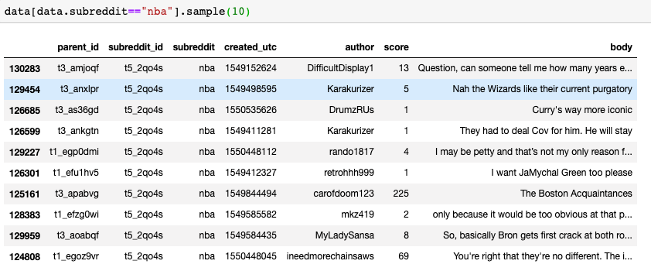
Further Development

