Slide 1
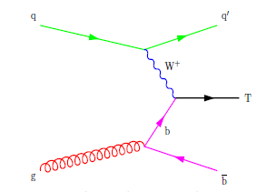
Study of T→tH* your name, 6/27/16
Channel: T→tH
t→all hadronic, H→bb

Slide 2
Your Root file check as needed
# events
# T
# t, from production/decay
# b, from H/t/other
# q, from W/Z/other
# b from W/Z/other
# H,
# H→bb
# W, W→qq

Slide 3
T plots
p_{T}: should have a bin size of 20 GeV
η: should be from -5 to 5 with bin size of 0.2
Get template from Jack to make sure that all labels and axes are appropriate size

Slide 4
t plots (label source of t)
Make sure you are plotting the t from the T on this slide. Make another slide for other t’s in the event, put p_{T}, η plots on each slide with same bin size

Slide 5
ΔR vs. p_{T} for t from T decay
Get template from Grant

Slide 6
ΔR vs. p_{T} for H from T decay

Slide 7
Distributions from other produced particles
p_{T} and η from t, b, or q in addition to the T decay products

