Slide 1

Chapter 3
Traditional Symmetric-Key Ciphers
3.‹#›
Copyright © The McGraw-Hill Companies, Inc. Permission required for reproduction or display.
Notes:
‹#›

Slide 2
Chapter 3
Objectives
❏ To define the terms and the concepts of symmetric key ciphers
❏ To emphasize the two categories of traditional ciphers: substitution and transposition ciphers
❏ To describe the categories of cryptanalysis used to break the symmetric ciphers
❏ To introduce the concepts of the stream ciphers and block ciphers
❏ To discuss some very dominant ciphers used in the past, such as the Enigma machine
3.‹#›
Notes:
‹#›

Slide 3
3-1 INTRODUCTION
Figure 3.1 shows the general idea behind a symmetric-key cipher. The original message from Alice to Bob is called plaintext; the message that is sent through the channel is called the ciphertext. To create the ciphertext from the plaintext, Alice uses an encryption algorithm and a shared secret key. To create the plaintext from ciphertext, Bob uses a decryption algorithm and the same secret key.
Topics discussed in this section:
3.1.1 Kerckhoff’s Principle 3.1.2 Cryptanalysis 3.1.3 Categories of Traditional Ciphers
3.‹#›
Notes:
‹#›

Slide 4
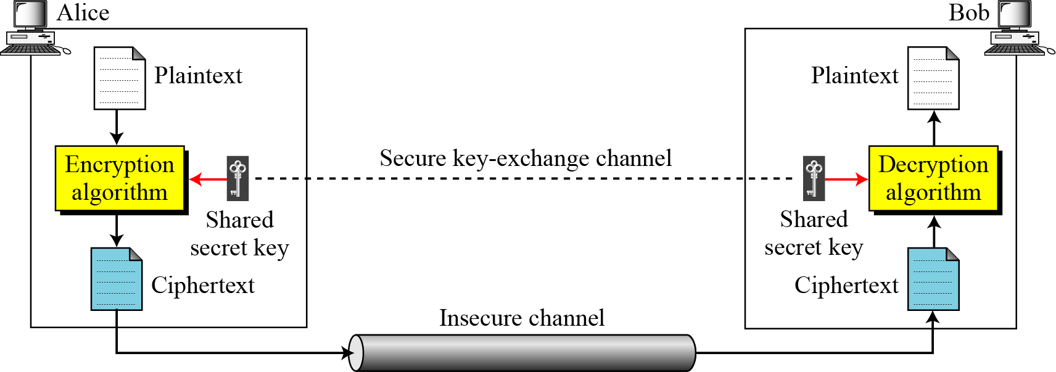
3.1 Continued
Figure 3.1 General idea of symmetric-key cipher
3.‹#›
Notes:
‹#›

Slide 5
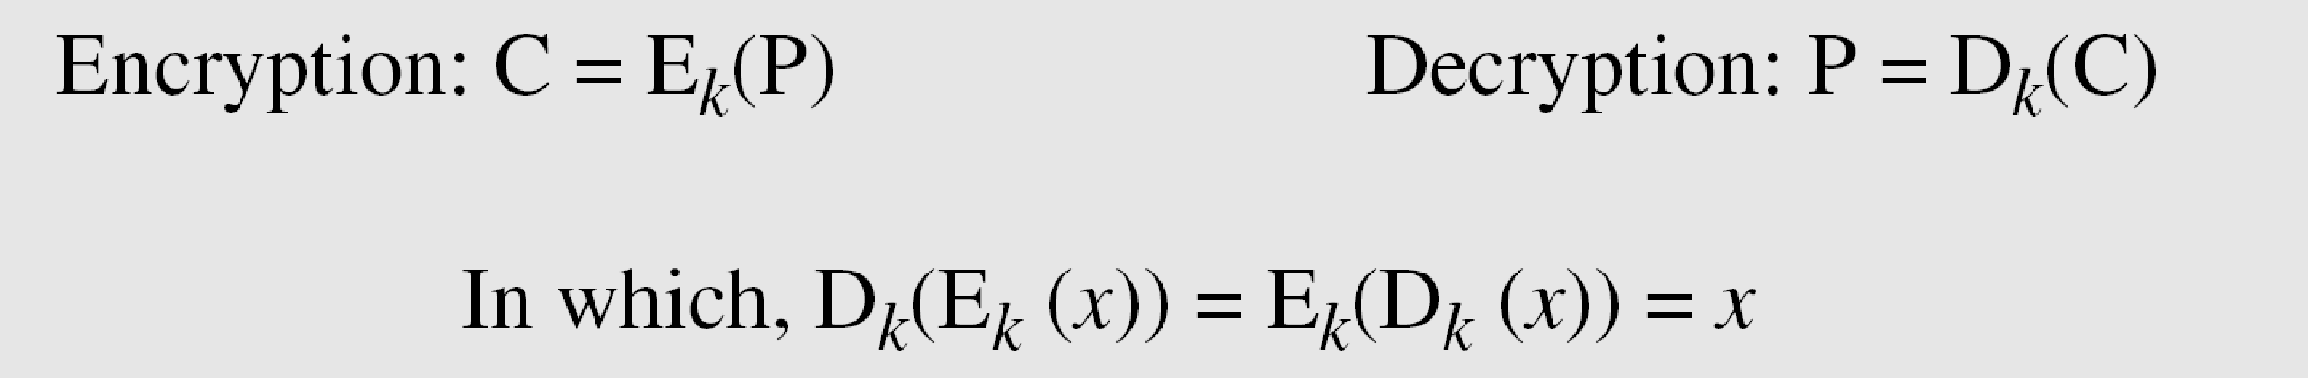
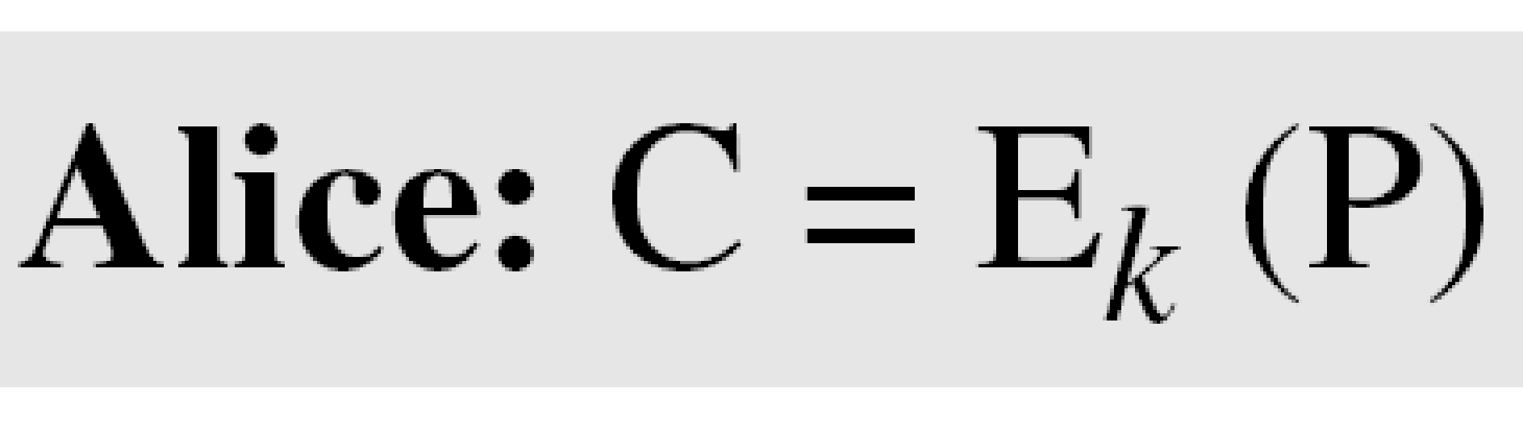
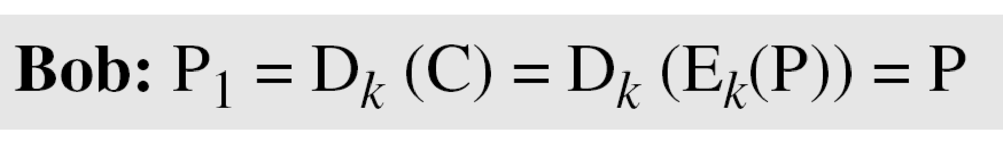
3.1 Continued
If P is the plaintext, C is the ciphertext, and K is the key,
We assume that Bob creates P₁; we prove that P₁ = P:
3.‹#›
Notes:
‹#›

Slide 6
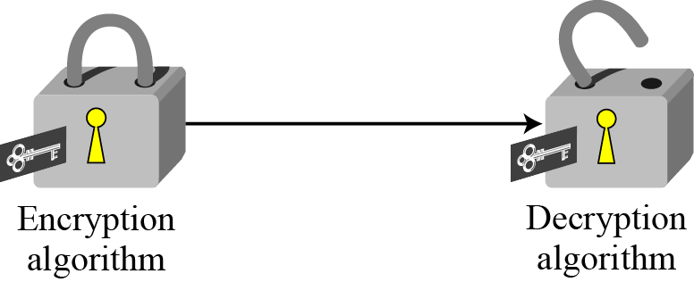
3.1 Continued
Figure 3.2 Locking and unlocking with the same key
3.‹#›
Notes:
‹#›

Slide 7
3.1.1 Kerckhoff’s Principle
Based on Kerckhoff’s principle, one should always assume that the adversary, Eve, knows the encryption/decryption algorithm. The resistance of the cipher to attack must be based only on the secrecy of the key.
3.‹#›
Notes:
‹#›

Slide 8
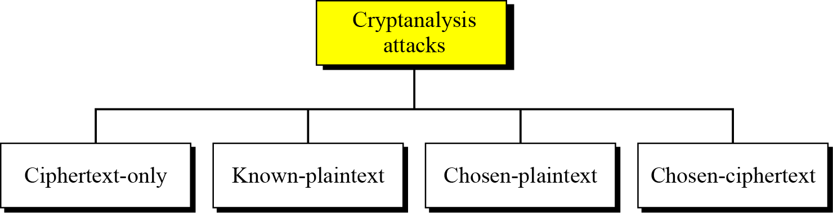
3.1.2 Cryptanalysis
As cryptography is the science and art of creating secret codes, cryptanalysis is the science and art of breaking those codes.
Figure 3.3 Cryptanalysis attacks
3.‹#›
Notes:
‹#›

Slide 9
Cryptanalysis
‹#›
Objective: to recover the plaintext of a ciphertext or, more typically, to recover the secret key.
Kerkhoff’s principle: the adversary knows all details about a cryptosystem except the secret key.
Two general approaches:
brute-force attack
non-brute-force attack (cryptanalytic attack)
Notes:
‹#›

Slide 10
Cryptanalytic Attacks
‹#›
May be classified by how much information needed by the attacker:
Ciphertext-only attack
Known-plaintext attack
Chosen-plaintext attack
Chosen-ciphertext attack

Slide 11
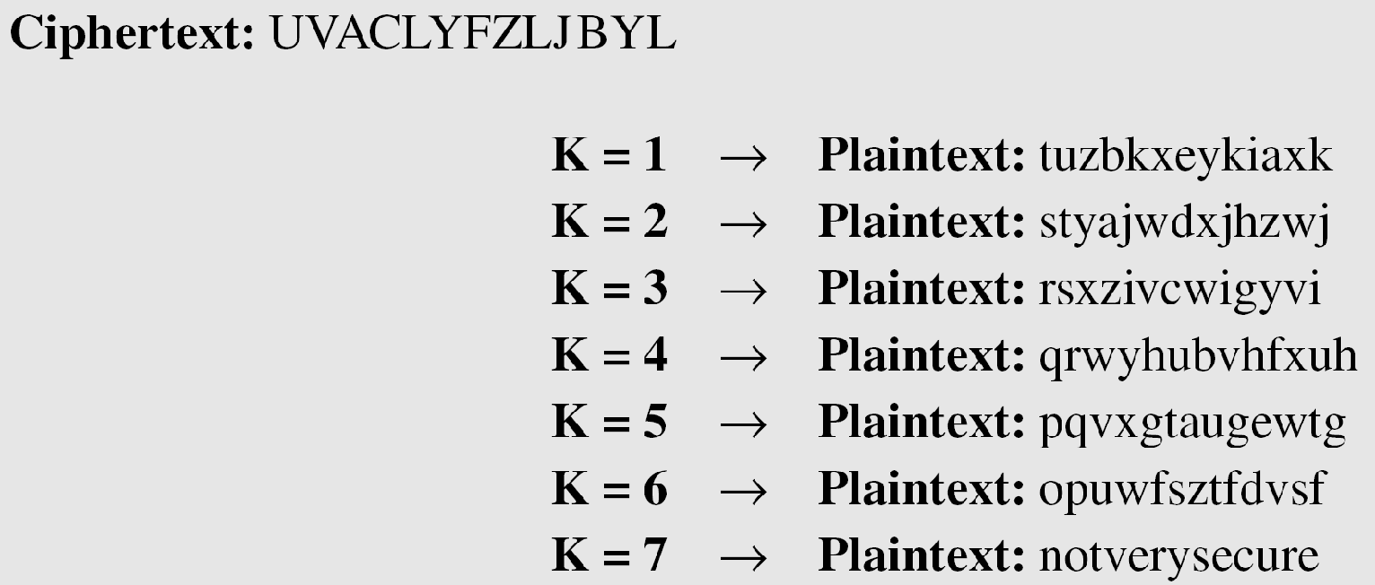
3.2.1 Continued
Example 3.5
Eve has intercepted the ciphertext “UVACLYFZLJBYL”. Can she find out the key?? How??
Solution 1
Eve tries keys from 1 to 7. With a key of 7, the plaintext is “not very secure”, which makes sense.
_{BRUTE FORCE!!}
3.‹#›
Notes:
‹#›

Slide 12
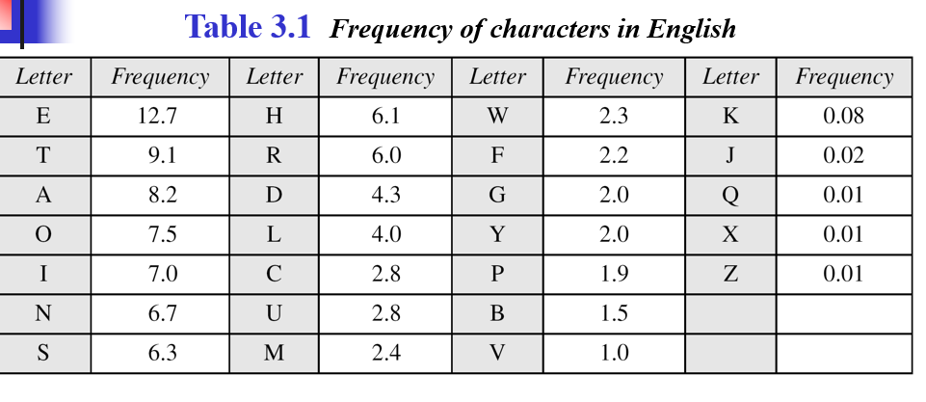
_{Solution 2 -}
_{Statistical Attack}
3.‹#›

Slide 13
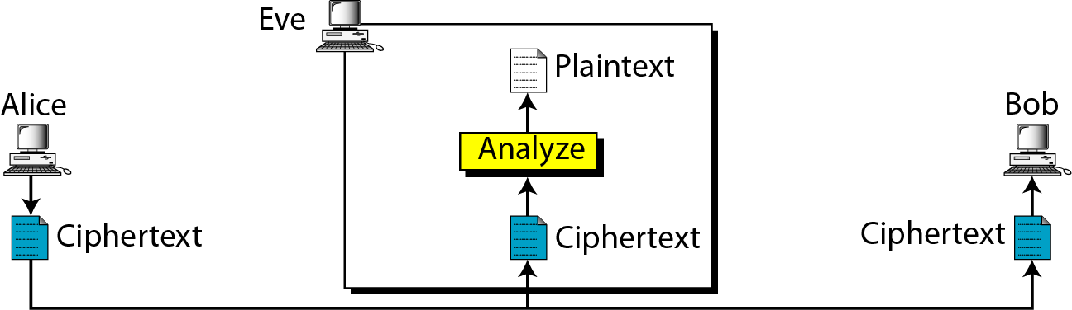
3.1.2 Continued
Ciphertext-Only Attack
Figure 3.4 Ciphertext-only attack
3.‹#›
Notes:
‹#›

Slide 14
Cryptanalyst knows the following :
Wklv lv d vhfuhw phvvdjh → This is a secret message
Can he find the key ? ? HOW ?? Assuming shift cipher is used
On analyzing the known information the following is deduced
_{W → T}
_{K → h}
_{L → I and so on…}
_{There fore key = 3 !!!}
3.‹#›

Slide 15
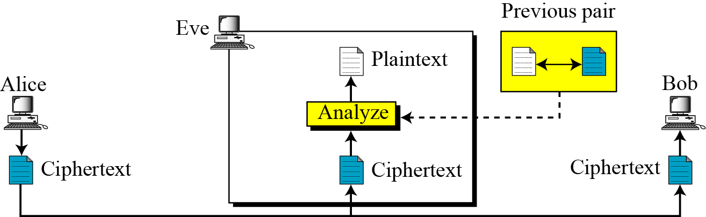
3.1.2 Continued
Known-Plaintext Attack
Figure 3.5 Known-plaintext attack
3.‹#›
Notes:
‹#›

Slide 16
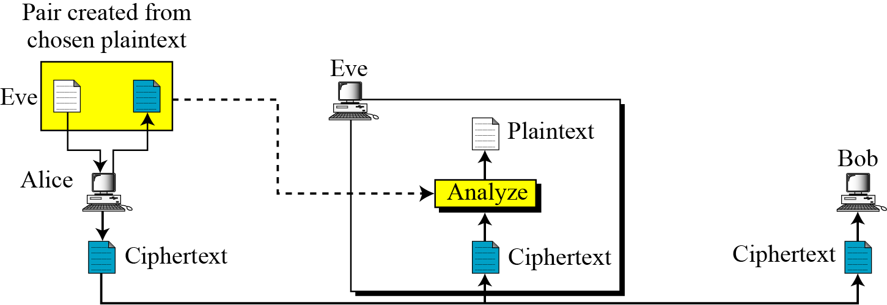
3.1.2 Continued
Chosen-Plaintext Attack
Figure 3.6 Chosen-plaintext attack
3.‹#›
Notes:
‹#›

Slide 17
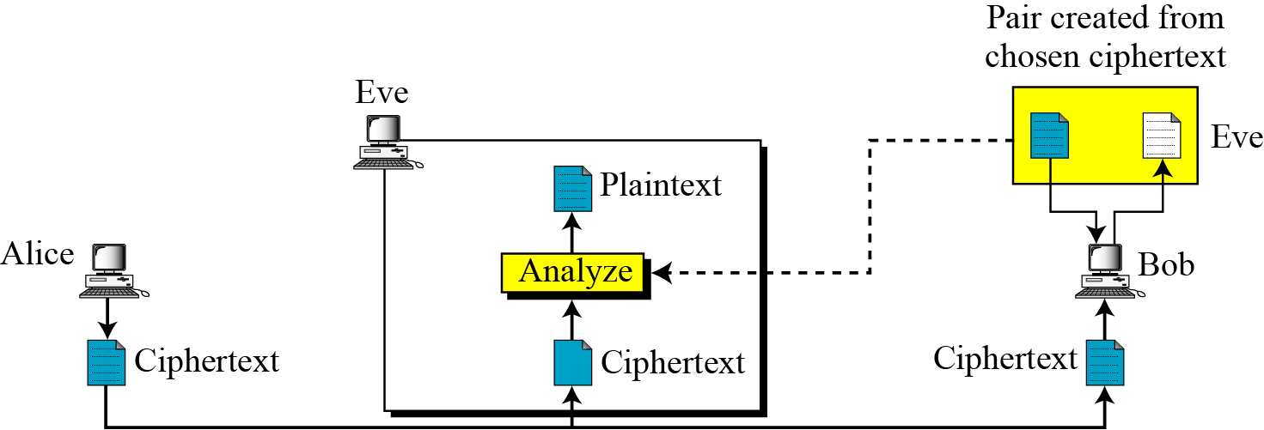
3.1.2 Continued
_{Chosen-Ciphertext Attack}
Figure 3.7 Chosen-ciphertext attack
3.‹#›
Notes:
‹#›

Slide 18
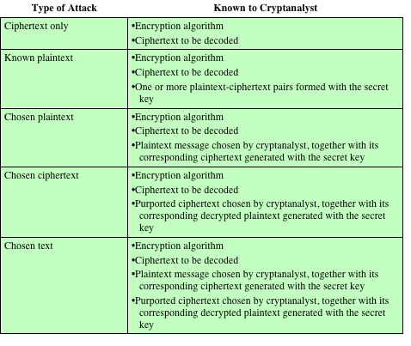
_{Table 2.1}
Types of Attacks on Encrypted Messages
Notes:
‹#›
The process of attempting to discover the plaintext or key is known as cryptanalysis .
The strategy used by the cryptanalyst depends on the nature of the encryption scheme
and the information available to the cryptanalyst.
Table 2.1 summarizes the various types of cryptanalytic attacks based on the
amount of information known to the cryptanalyst. The most difficult problem is
presented when all that is available is the ciphertext only . In some cases, not even
the encryption algorithm is known, but in general, we can assume that the opponent
does know the algorithm used for encryption. One possible attack under these circumstances
is the brute-force approach of trying all possible keys. If the key space
is very large, this becomes impractical. Thus, the opponent must rely on an analysis
of the ciphertext itself, generally applying various statistical tests to it. To use this
approach, the opponent must have some general idea of the type of plaintext that
is concealed, such as English or French text, an EXE file, a Java source listing, an
accounting file, and so on.
The ciphertext-only attack is the easiest to defend against because the
opponent has the least amount of information to work with. In many cases, however,
the analyst has more information. The analyst may be able to capture one
or more plaintext messages as well as their encryptions. Or the analyst may know
that certain plaintext patterns will appear in a message. For example, a file that is
encoded in the Postscript format always begins with the same pattern, or there may
be a standardized header or banner to an electronic funds transfer message, and so
on. All of these are examples of known plaintext . With this knowledge, the analyst
may be able to deduce the key on the basis of the way in which the known plaintext
is transformed.
Closely related to the known-plaintext attack is what might be referred to as a
probable-word attack. If the opponent is working with the encryption of some general
prose message, he or she may have little knowledge of what is in the message.
However, if the opponent is after some very specific information, then parts of the
message may be known. For example, if an entire accounting file is being transmitted,
the opponent may know the placement of certain key words in the header of
the file. As another example, the source code for a program developed by a corporation
might include a copyright statement in some standardized position.
If the analyst is able somehow to get the source system to insert into the system
a message chosen by the analyst, then a chosen-plaintext attack is possible. In
general, if the analyst is able to choose the messages to encrypt, the analyst may
deliberately pick patterns that can be expected to reveal the structure of the key.
Table 2.1 lists two other types of attack: chosen ciphertext and chosen text.
These are less commonly employed as cryptanalytic techniques but are nevertheless
possible avenues of attack.

Slide 19
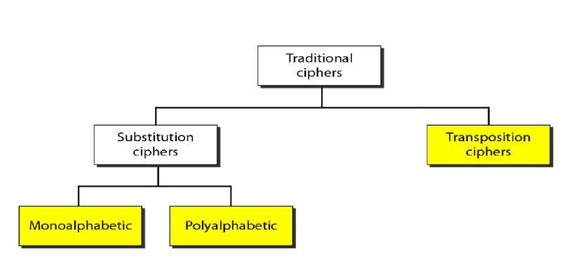
Traditional Symmetric Key Ciphers
‹#›

Slide 20
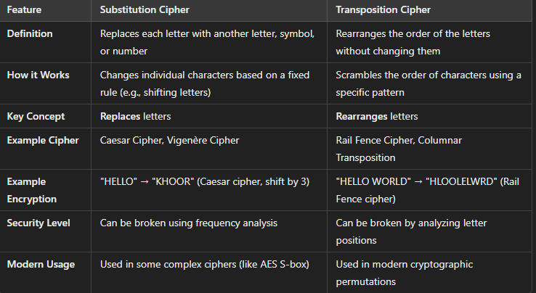
_{Differences}
‹#›

Slide 21

3-2 SUBSTITUTION CIPHERS
A substitution cipher replaces one symbol with another. Substitution ciphers can be categorized as either monoalphabetic ciphers or polyalphabetic ciphers.
Note
A substitution cipher replaces one symbol with another.
Topics discussed in this section:
3.2.1 Monoalphabetic Ciphers 3.2.2 Polyalphabetic Ciphers
3.‹#›
Notes:
‹#›

Slide 22
3.2.1 Monoalphabetic Ciphers
Note
In monoalphabetic substitution, the relationship between a symbol in the plaintext to a symbol in the ciphertext is always one-to-one.
3.‹#›
Notes:
‹#›

Slide 23
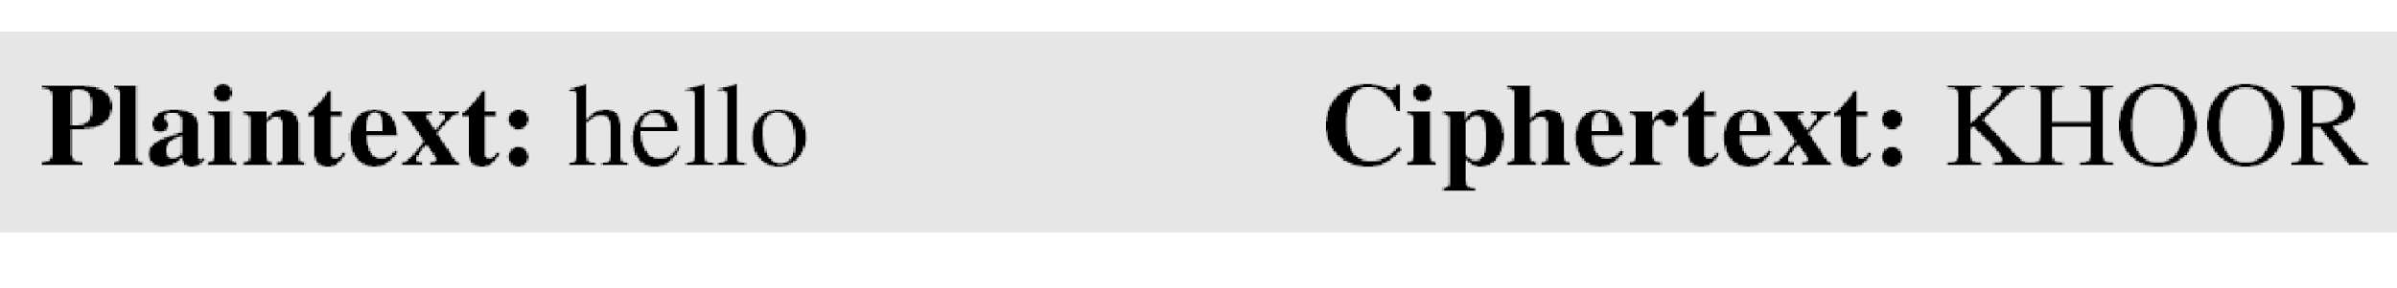
3.2.1 Continued
Example 3.1
The following shows a plaintext and its corresponding ciphertext. The cipher is probably monoalphabetic because both l’s (els) are encrypted as O’s.
Example 3.2
The following shows a plaintext and its corresponding ciphertext. The cipher is not monoalphabetic because each l (el) is encrypted by a different character.
Plaintext : hello Ciphertext : ABNZF
3.‹#›
Notes:
‹#›

Slide 24
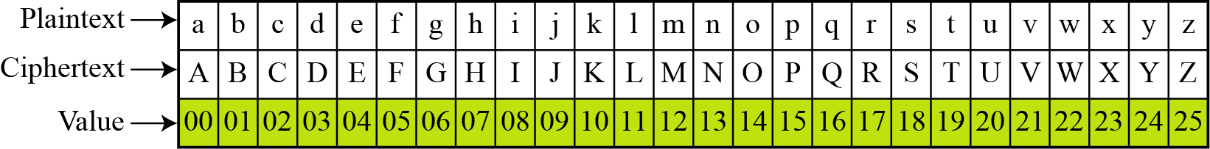
3.2.1 Continued
Additive Cipher
The simplest monoalphabetic cipher is the additive cipher. This cipher is sometimes called a shift cipher and sometimes a Caesar cipher, but the term additive cipher better reveals its mathematical nature.
Figure 3.8 Plaintext and ciphertext in Z₂₆
3.‹#›
Notes:
‹#›

Slide 25
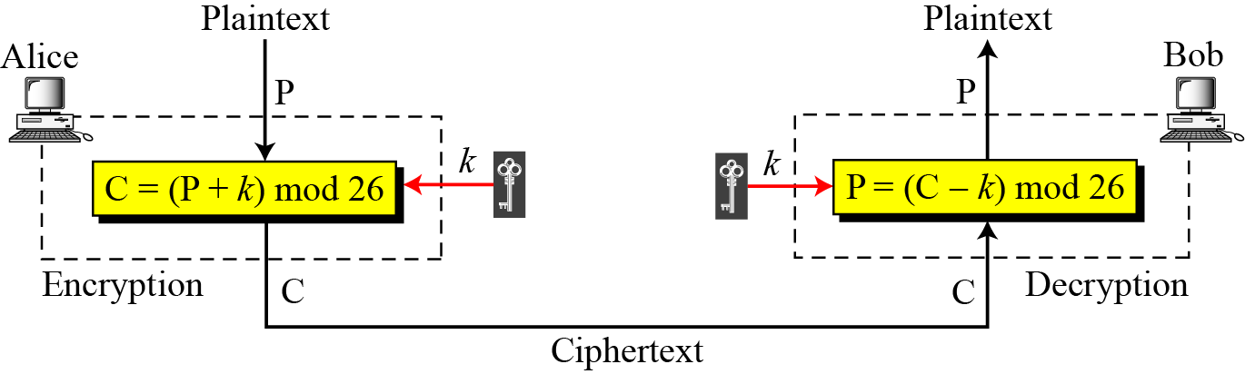
3.2.1 Continued
Figure 3.9 Additive cipher
Note
When the cipher is additive, the plaintext, ciphertext, and key are integers in Z₂₆.
3.‹#›
Notes:
‹#›

Slide 26

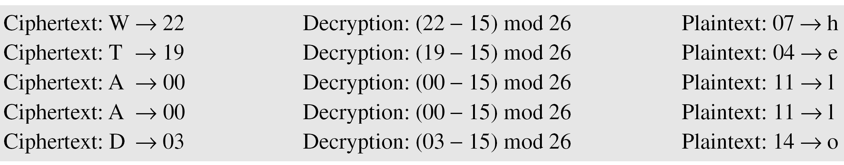
3.2.1 Continued
Example 3.4
Use the additive cipher with key = 15 to decrypt the message “WTAAD”.
Solution
We apply the decryption algorithm to the plaintext character by character:
3.‹#›
Notes:
‹#›

Slide 27
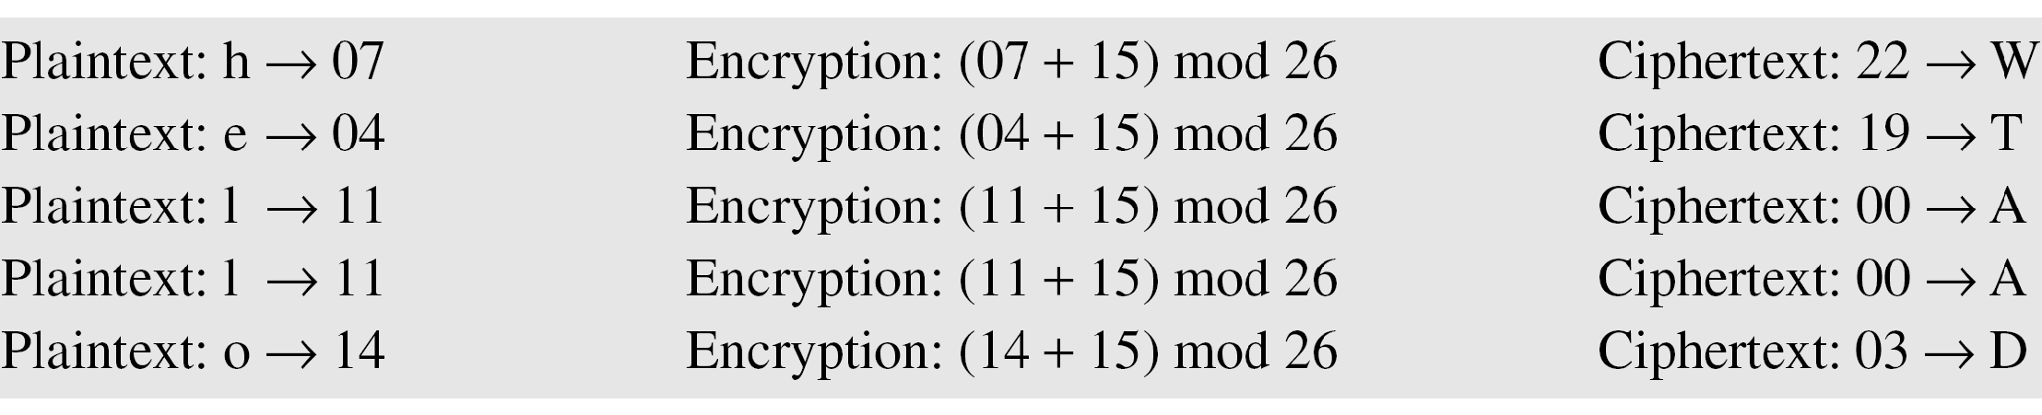
3.2.1 Continued
Example 3.3
Use the additive cipher with key = 15 to encrypt the message “hello”.
Solution
We apply the encryption algorithm to the plaintext, character by character:
3.‹#›
Notes:
‹#›

Slide 28
3.2.1 Continued
Shift Cipher and Caesar Cipher
Historically, additive ciphers are called shift ciphers. Julius Caesar used an additive cipher to communicate with his officers. For this reason, additive ciphers are sometimes referred to as the Caesar cipher. Caesar used a key of 3 for his communications.
Note
Additive ciphers are sometimes referred to as shift ciphers or Caesar cipher.
3.‹#›
Notes:
‹#›

Slide 29
3.2.1 Continued
Example 3.5
Eve has intercepted the ciphertext “UVACLYFZLJBYL”. Show how she can use a brute-force attack to break the cipher.
Solution
Eve tries keys from 1 to 7. With a key of 7, the plaintext is “not very secure”, which makes sense.
3.‹#›
Notes:
‹#›

Slide 30
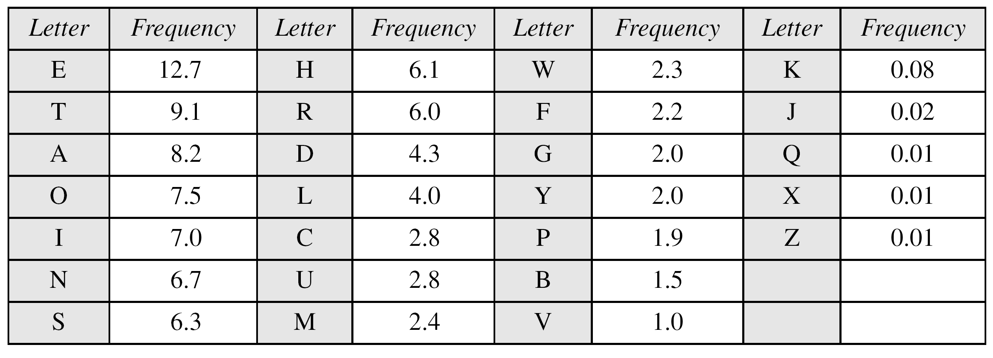
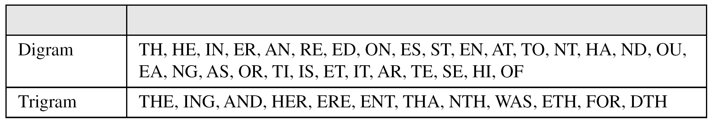
3.2.1 Continued
Table 3.1 Frequency of characters in English
Table 3.2 Frequency of diagrams and trigrams
3.‹#›
Notes:
‹#›

Slide 31
3.2.1 Continued
Example 3.6
Eve has intercepted the following ciphertext. Using a statistical attack, find the plaintext.
Solution
When Eve tabulates the frequency of letters in this ciphertext, she gets: I =14, V =13, S =12, and so on. The most common character is I with 14 occurrences. This means key = 4.
3.‹#›
Notes:
‹#›

Slide 32
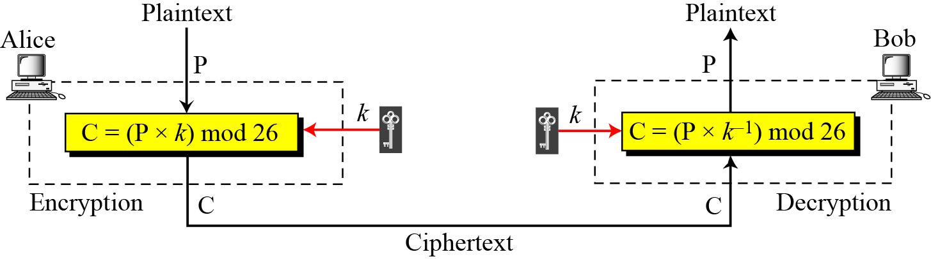
3.2.1 Continued
Multiplicative Ciphers
Figure 3.10 Multiplicative cipher
Note
In a multiplicative cipher, the plaintext and ciphertext are integers in Z₂₆; the key is an integer in Z₂₆*.
3.‹#›
Notes:
‹#›

Slide 33
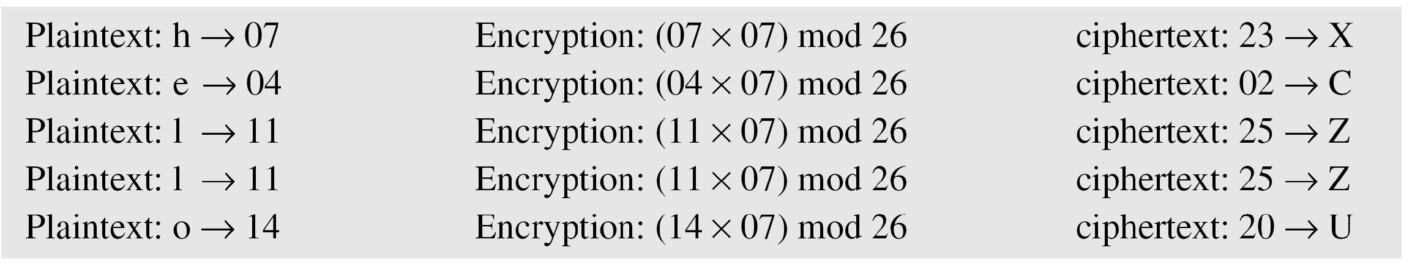
3.2.1 Continued
Example 3.7
What is the key domain for any multiplicative cipher?
Solution
The key needs to be in Z₂₆*. This set has only 12 members: 1, 3, 5, 7, 9, 11, 15, 17, 19, 21, 23, 25.
Example 3.8
We use a multiplicative cipher to encrypt the message “hello” with a key of 7. The ciphertext is “XCZZU”.
3.‹#›
Notes:
‹#›

Slide 34
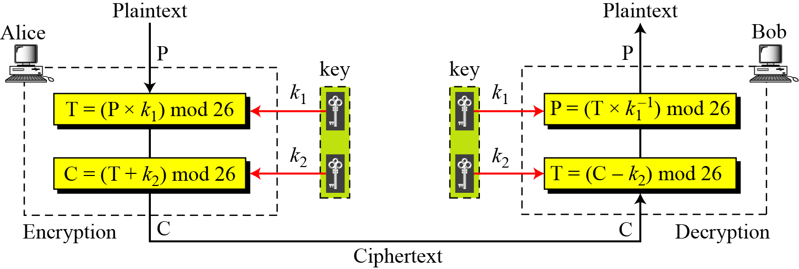
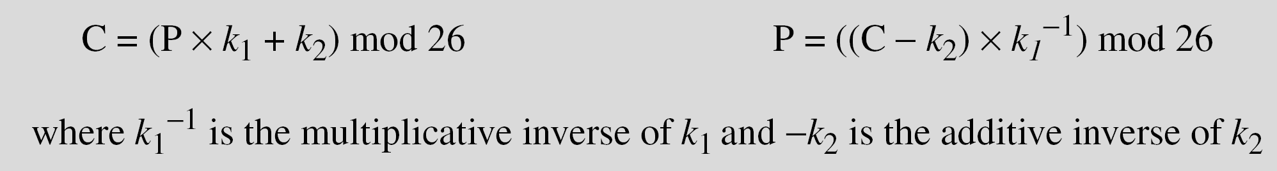
3.2.1 Continued
Affine Ciphers
Figure 3.11 Affine cipher
3.‹#›
Notes:
‹#›

Slide 35
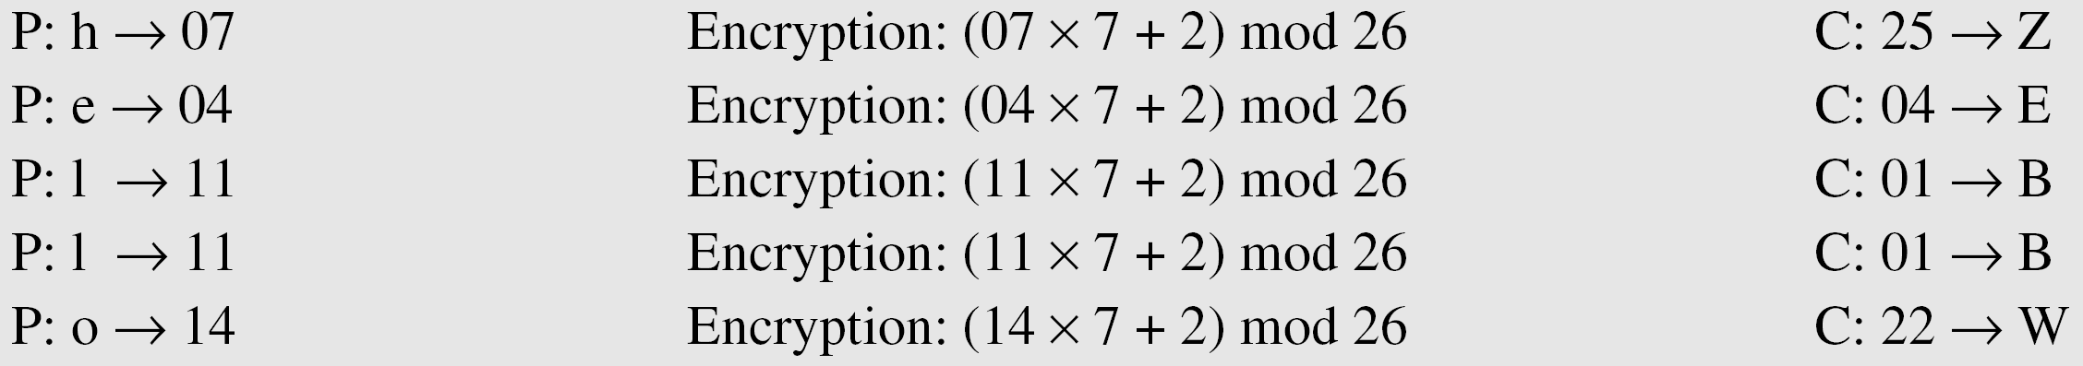
3.2.1 Continued
Example 3.09
The affine cipher uses a pair of keys in which the first key is from Z₂₆* and the second is from Z₂₆. The size of the key domain is 26 × 12 = 312.
Example 3.10
Use an affine cipher to encrypt the message “hello” with the key pair (7, 2).
3.‹#›
Notes:
‹#›

Slide 36
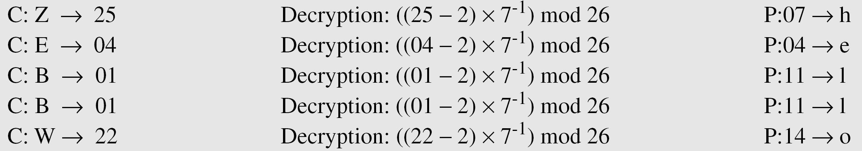
3.2.1 Continued
Example 3.11
Use the affine cipher to decrypt the message “ZEBBW” with the key pair (7, 2) in modulus 26.
Solution
Example 3.12
The additive cipher is a special case of an affine cipher in which k₁ = 1. The multiplicative cipher is a special case of affine cipher in which k₂ = 0.
3.‹#›
Notes:
‹#›

Slide 37
3.2.1 Continued
Cryptanalysis of Affine Cipher – chosen plain text attack
Assume eve intercepts the following cipher text :
PWUFFOGWCHFDWIWEJOUUNJORSMDWRHVCMWJUPVCCG”
She also briefly obtains access to alice’s computer and has enough time to type
two – letters “et” . She receives two cipher text “WC” and “WF” .
_{Can she find what the key was?}
3.‹#›
Notes:
‹#›

Slide 38
Continued
Decipher the following message using suitable Cryptanalysis. Assume Affine cipher is used and Plain text “ab” is enciphered to Cipher text “GL”
“XPALASXYFGFUKPXUSOGEUTKCDGFXANMGNVS”
3.‹#›
Notes:
‹#›

Slide 39
3.2.1 Continued
Monoalphabetic Substitution Cipher
Because additive, multiplicative, and affine ciphers have small key domains, they are very vulnerable to brute-force attack.
A better solution is to create a mapping between each plaintext character and the corresponding ciphertext character. Alice and Bob can agree on a table showing the mapping for each character.
Figure 3.12 An example key for monoalphabetic substitution cipher
3.‹#›
Notes:
‹#›

Slide 40
3.2.1 Continued
Example 3.13
We can use the key in Figure 3.12 to encrypt the message
The ciphertext is
_{Key space is 26!}
3.‹#›
Notes:
‹#›

Slide 41
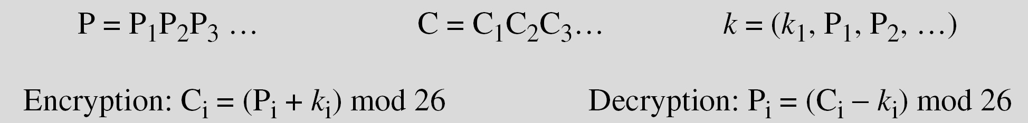
3.2.2 Polyalphabetic Ciphers
In polyalphabetic substitution, each occurrence of a character may have a different substitute. The relationship between a character in the plaintext to a character in the ciphertext is one-to-many.
Autokey Cipher
3.‹#›
Notes:
‹#›

Slide 42
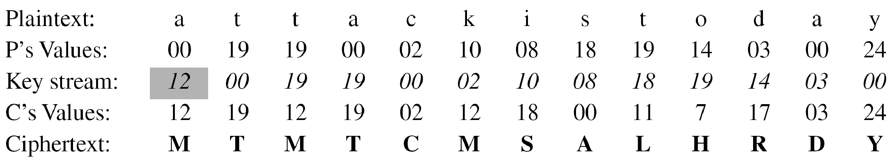
3.2.2 Continued
Example 3.14
Assume that Alice and Bob agreed to use an autokey cipher with initial key value k₁ = 12. Now Alice wants to send Bob the message “Attack is today”. Enciphering is done character by character.
3.‹#›
Notes:
‹#›

Slide 43
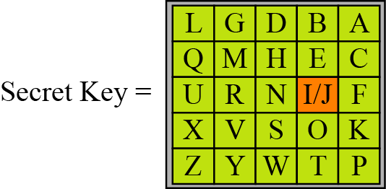
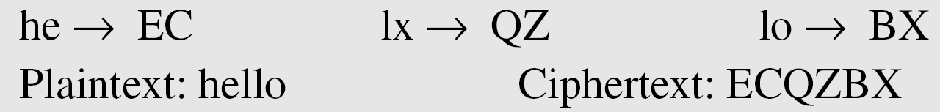
3.2.2 Continued
Playfair Cipher
Figure 3.13 An example of a secret key in the Playfair cipher
Example 3.15
Let us encrypt the plaintext “hello” using the key in Figure 3.13.
3.‹#›
Notes:
‹#›

Slide 44
3.2.2 Continued
Playfair Cipher
Encryption Rules
Rule 1: Same Row
If both letters are in the same row:
Replace each letter with the letter to its right.
If at the end, wrap around to the first column.
Rule 2: Same Column
If both letters are in the same column:
Replace each letter with the letter below it.
If at the bottom, wrap to the top.
Rule 3: Rectangle Rule
If letters form a rectangle:
Replace each letter with the letter in the same row but in the column of the other letter.
Decryption Rules
Decryption uses the reverse operations:
Same Row - Move left
Same Column – Move up
Rectangle - Same rectangle swap
3.‹#›
Notes:
‹#›

Slide 45
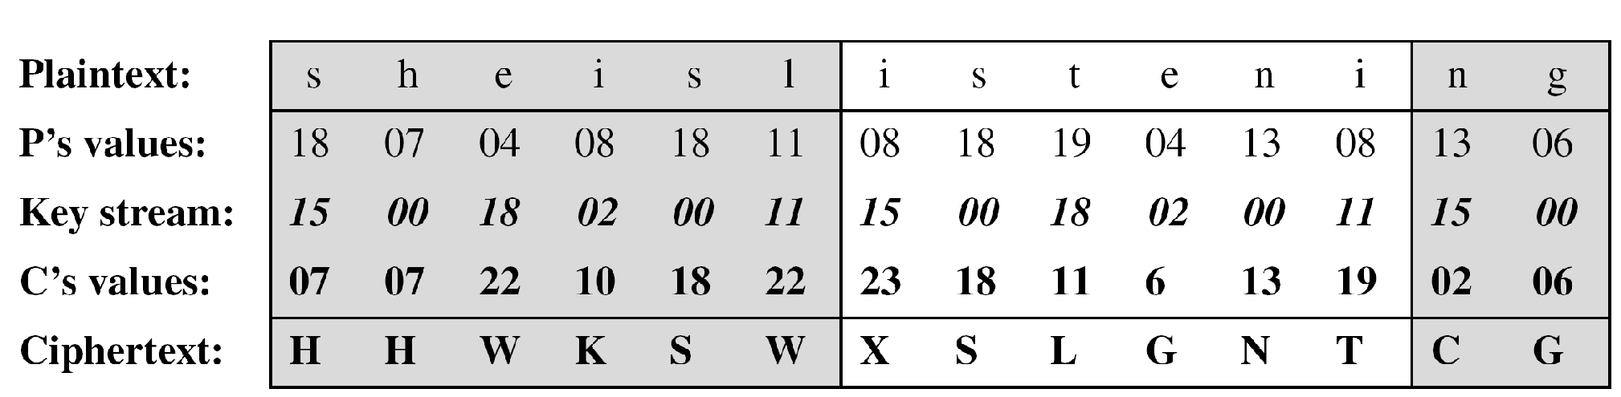
3.2.2 Continued
Vigenere Cipher
Example 3.16
We can encrypt the message “She is listening” using the 6-character keyword “PASCAL”.
3.‹#›
Notes:
‹#›

Slide 46
3.2.2 Continued
Example 3.16
Let us see how we can encrypt the message “She is listening” using the 6-character keyword “PASCAL”. The initial key stream is (15, 0, 18, 2, 0, 11). The key stream is the repetition of this initial key stream (as many times as needed).
3.‹#›
Notes:
‹#›

Slide 47
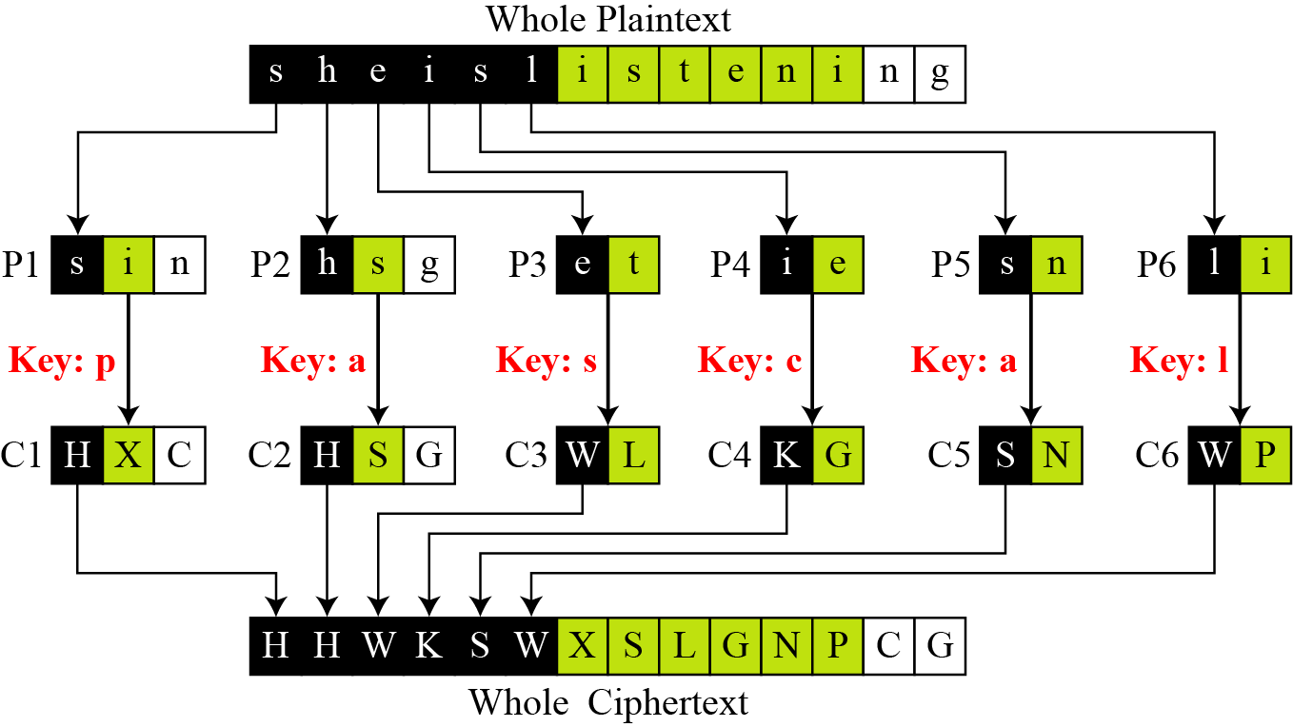
3.2.2 Continued
Example 3.17
Vigenere cipher can be seen as combinations of m additive ciphers.
Figure 3.14 A Vigenere cipher as a combination of m additive ciphers
3.‹#›
Notes:
‹#›

Slide 48
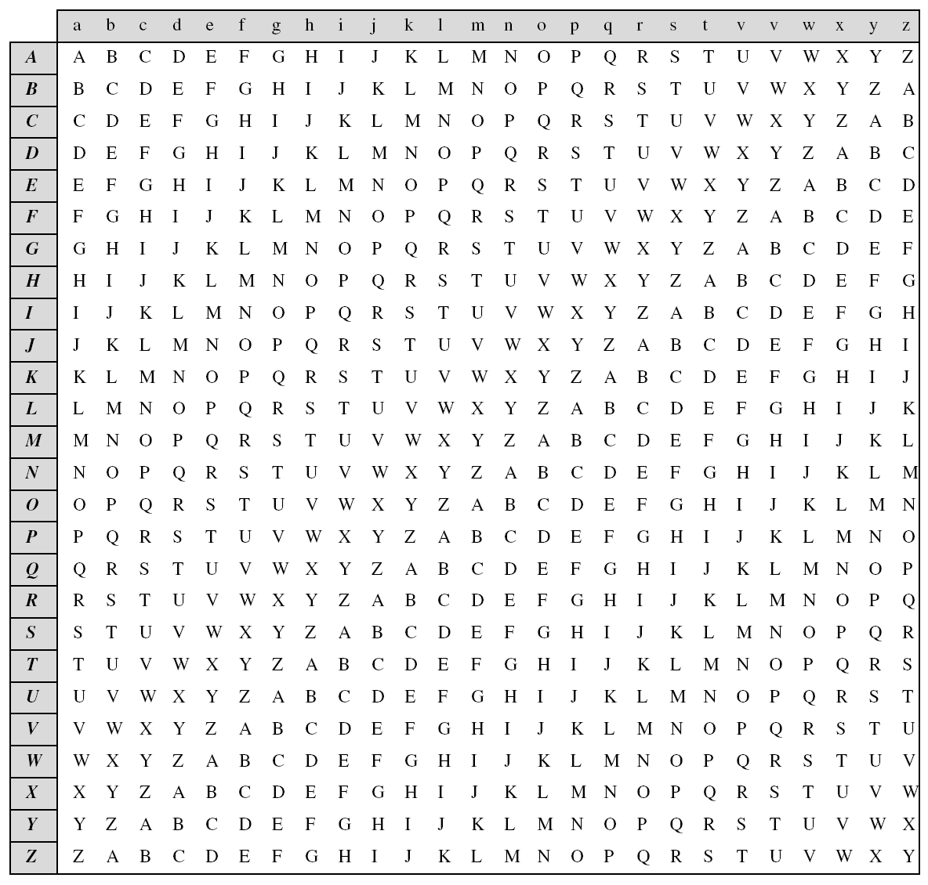
3.2.2 Continued
Example 3.18
Using Example 3.18, we can say that the additive cipher is a special case of Vigenere cipher in which m = 1.
Table 3.3
A Vigenere Tableau
3.‹#›
Notes:
‹#›

Slide 49
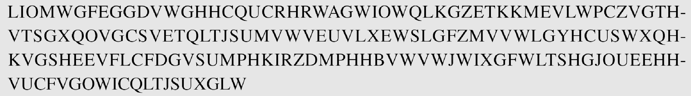
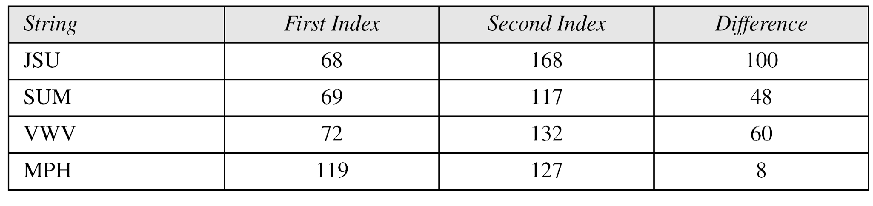
3.2.2 Continued
Vigenere Cipher (Crypanalysis)
Example 3.19
Let us assume we have intercepted the following ciphertext:
The Kasiski test for repetition of three-character segments yields the results shown in Table 3.4.
3.‹#›
Notes:
‹#›

Slide 50
3.2.2 Continued
Example 3.19
Let us assume we have intercepted the following ciphertext:
The Kasiski test for repetition of three-character segments yields the results shown in Table 3.4.
3.‹#›
Notes:
‹#›

Slide 51
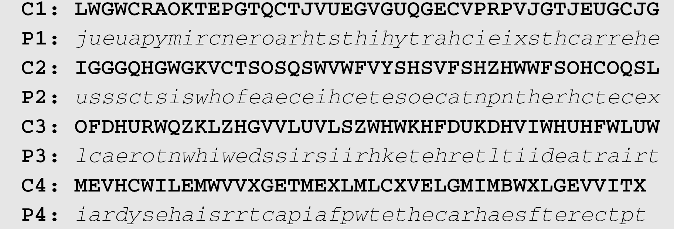
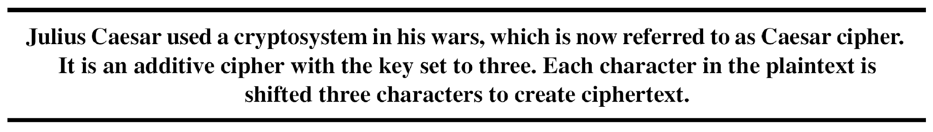
3.2.2 Continued
Example 3.19
(Continued)
The greatest common divisor of differences is 4, which means that the key length is multiple of 4. First try m = 4.
In this case, the plaintext makes sense.
3.‹#›
Notes:
‹#›

Slide 52
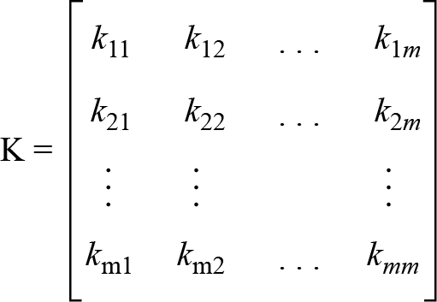
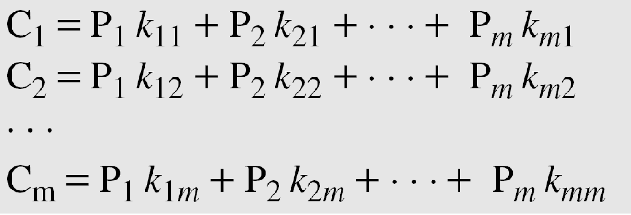
3.2.2 Continued
Hill Cipher
Figure 3.15 Key in the Hill cipher
Note
The key matrix in the Hill cipher needs to have a multiplicative inverse.
3.‹#›
Notes:
‹#›

Slide 53
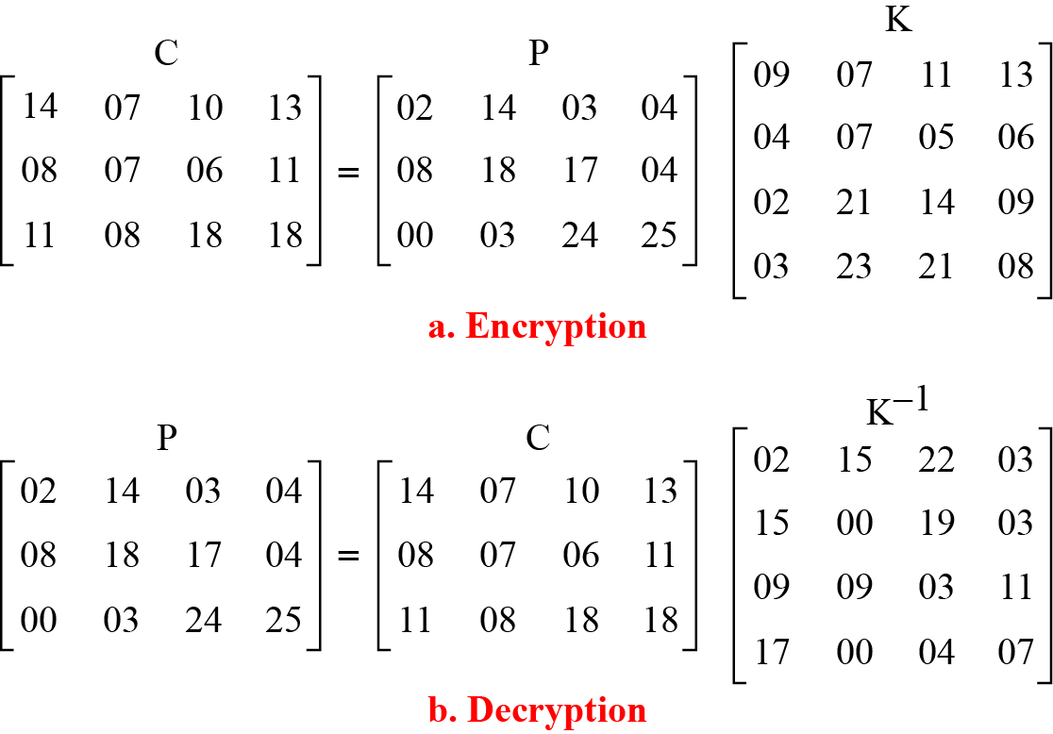
3.2.2 Continued
Example 3.20
For example, the plaintext “code is ready” can make a 3 × 4 matrix when adding extra bogus character “z” to the last block and removing the spaces. The ciphertext is “OHKNIHGKLISS”.
Figure 3.16 Example 3.20
3.‹#›
Notes:
‹#›

Slide 54
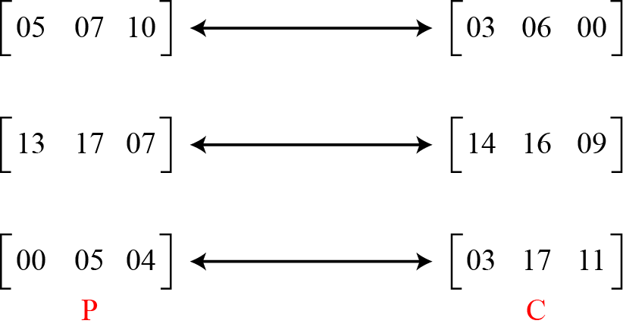
3.2.2 Continued
Example 3.21
Assume that Eve knows that m = 3. She has intercepted three plaintext/ciphertext pair blocks (not necessarily from the same message) as shown in Figure 3.17.
Figure 3.17 Example 3.21
3.‹#›
Notes:
‹#›

Slide 55
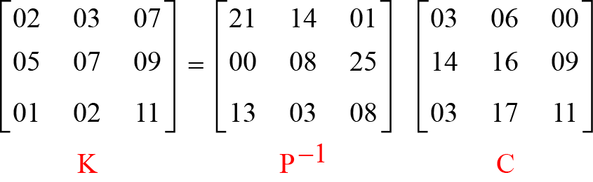
3.2.2 Continued
Example 3.21
(Continued)
She makes matrices P and C from these pairs. Because P is invertible, she inverts the P matrix and multiplies it by C to get the K matrix as shown in Figure 3.18.
Figure 3.18 Example 3.21
Now she has the key and can break any ciphertext encrypted with that key.
3.‹#›
Notes:
‹#›

Slide 56
3.2.2 Continued
One-Time Pad
One of the goals of cryptography is perfect secrecy. A study by Shannon has shown that perfect secrecy can be achieved if each plaintext symbol is encrypted with a key
randomly chosen from a key domain. This idea is used in a cipher called one-time pad, invented by Vernam.
3.‹#›
Notes:
‹#›

Slide 57
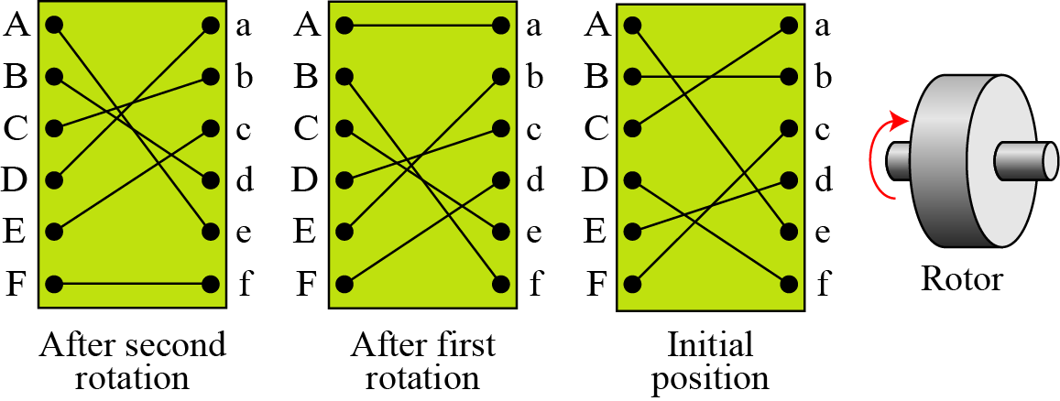
3.2.2 Continued
Rotor Cipher
Figure 3.19 A rotor cipher
3.‹#›
Notes:
‹#›

Slide 58
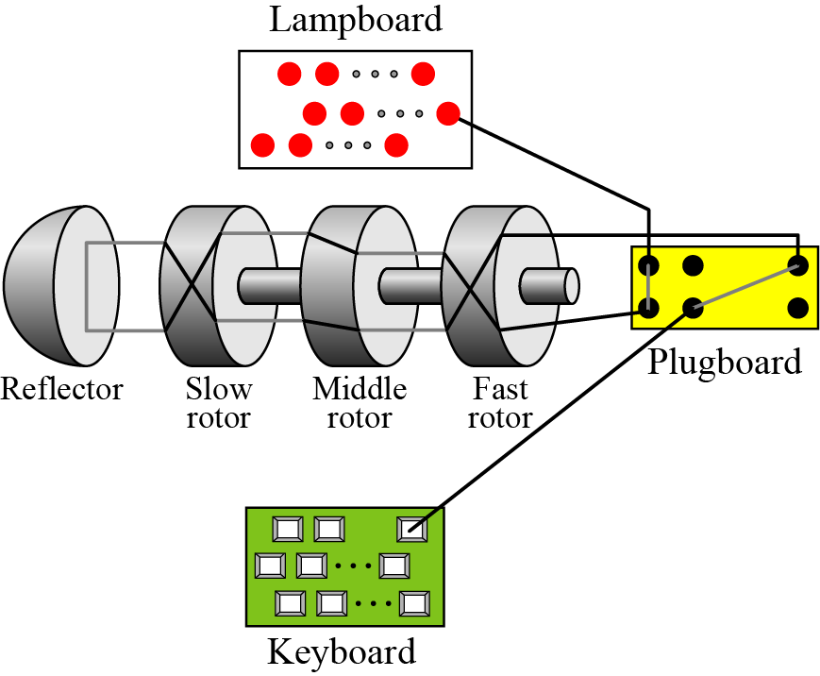
3.2.2 Continued
Enigma Machine
Figure 3.20 A schematic of the Enigma machine
3.‹#›
Notes:
‹#›

Slide 59
3-3 TRANSPOSITION CIPHERS
A transposition cipher does not substitute one symbol for another, instead it changes the location of the symbols.
Note
A transposition cipher reorders symbols.
Topics discussed in this section:
3.3.1 Keyless Transposition Ciphers 3.3.2 Keyed Transposition Ciphers 3.3.3 Combining Two Approaches
3.‹#›
Notes:
‹#›

Slide 60
3.3.1 Keyless Transposition Ciphers
Simple transposition ciphers, which were used in the past, are keyless.
Example 3.22
A good example of a keyless cipher using the first method is the rail fence cipher. The ciphertext is created reading the pattern row by row. For example, to send the message “Meet me at the park” to Bob, Alice writes
She then creates the ciphertext “MEMATEAKETETHPR”.
3.‹#›
Notes:
‹#›

Slide 61
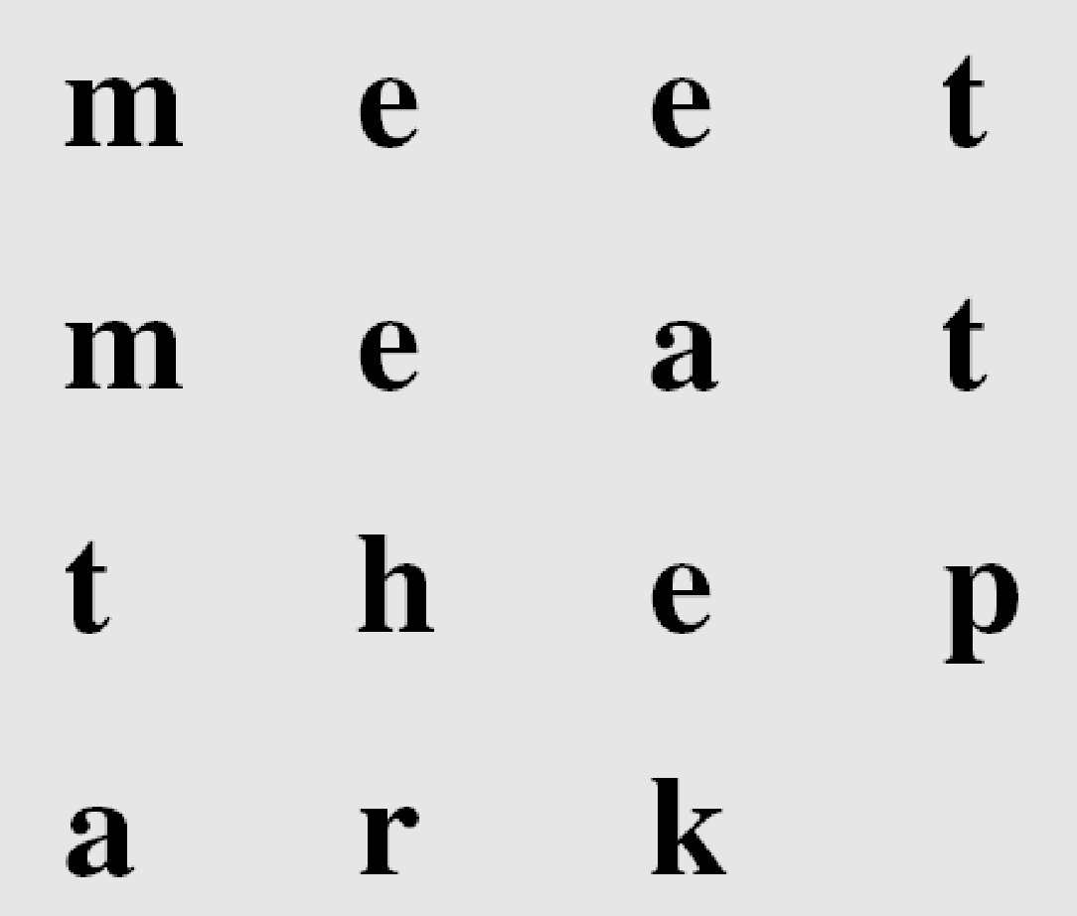
3.3.1 Continued
Example 3.23
Alice and Bob can agree on the number of columns and use the second method. Alice writes the same plaintext, row by row, in a table of four columns.
She then creates the ciphertext “MMTAEEHREAEKTTP”.
3.‹#›
Notes:
‹#›

Slide 62
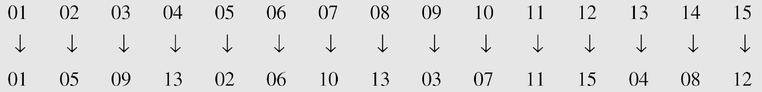
3.3.1 Continued
Example 3.24
The cipher in Example 3.23 is actually a transposition cipher. The following shows the permutation of each character in the plaintext into the ciphertext based on the positions.
The second character in the plaintext has moved to the fifth position in the ciphertext; the third character has moved to the ninth position; and so on. Although the characters are permuted,
there is a pattern in the permutation: (01, 05, 09, 13), (02, 06, 10, 13), (03, 07, 11, 15), and (08, 12). In each section, the difference between the two adjacent numbers is 4.
3.‹#›
Notes:
‹#›

Slide 63
3.3.2 Keyed Transposition Ciphers
The keyless ciphers permute the characters by using writing plaintext in one way and reading it in another way The permutation is done on the whole plaintext to create the whole ciphertext. Another method is to divide the plaintext into groups of predetermined size, called blocks, and then use a key to permute the characters in each block separately.
3.‹#›
Notes:
‹#›

Slide 64
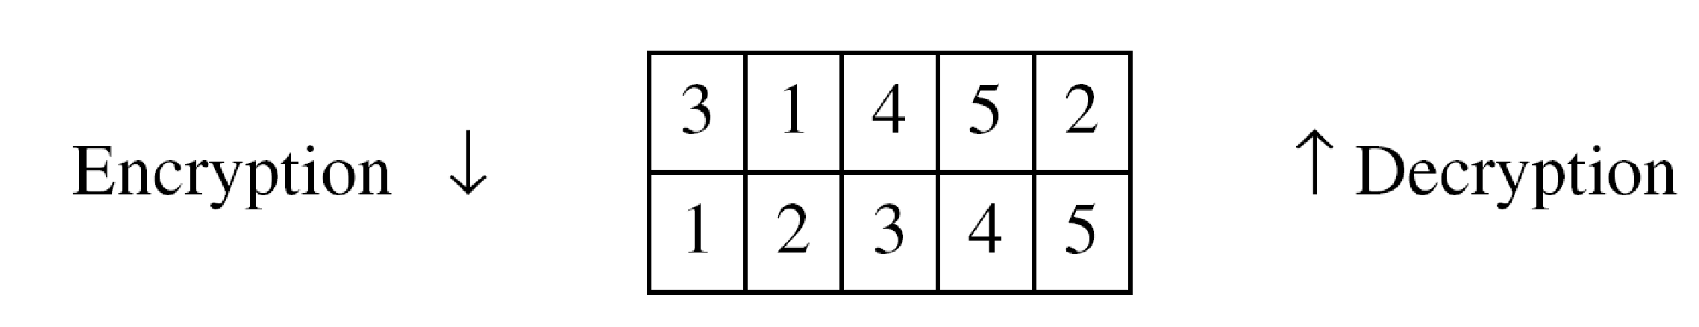
3.3.2 Continued
Example 3.25
Alice needs to send the message “Enemy attacks tonight” to Bob..
The key used for encryption and decryption is a permutation key, which shows how the character are permuted.
The permutation yields
3.‹#›
Notes:
‹#›

Slide 65
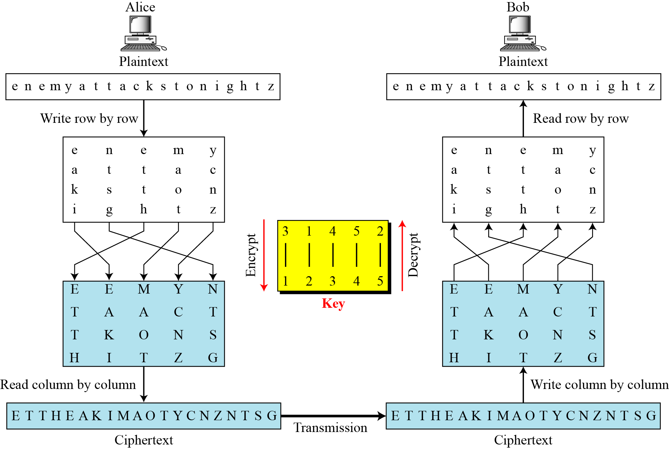
3.3.3 Combining Two Approaches
Example 3.26
Figure 3.21
3.‹#›
Notes:
‹#›

Slide 66

3.3.3 Continued
Keys
In Example 3.27, a single key was used in two directions for the column exchange: downward for encryption, upward for decryption. It is customary to create two keys.
Figure 3.22 Encryption/decryption keys in transpositional ciphers
3.‹#›
Notes:
‹#›

Slide 67

3.3.3 Continued
Figure 3.23 Key inversion in a transposition cipher
3.‹#›
Notes:
‹#›

Slide 68

3.3.3 Continued
Using Matrices
We can use matrices to show the encryption/decryption process for a transposition cipher.
Example 3.27
Figure 3.24 Representation of the key as a matrix in the transposition cipher
3.‹#›
Notes:
‹#›

Slide 69
3.3.3 Continued
Example 3.27
Figure 3.24 shows the encryption process. Multiplying the 4 × 5 plaintext matrix by the 5 × 5 encryption key gives the 4 × 5 ciphertext matrix.
Figure 3.24 Representation of the key as a matrix in the transposition cipher
3.‹#›
Notes:
‹#›

Slide 70

3.3.3 Continued
Double Transposition Ciphers
Figure 3.25 Double transposition cipher
3.‹#›
Notes:
‹#›

Slide 71
3-4 STREAM AND BLOCK CIPHERS
The literature divides the symmetric ciphers into two broad categories: stream ciphers and block ciphers. Although the definitions are normally applied to modern ciphers, this categorization also applies to traditional ciphers.
Topics discussed in this section:
3.4.1 Stream Ciphers 3.4.2 Block Ciphers
3.4.3 Combination
3.‹#›
Notes:
‹#›

Slide 72


3.4.1 Stream Ciphers
Call the plaintext stream P, the ciphertext stream C, and the key stream K.
Figure 3.26 Stream cipher
3.‹#›
Notes:
‹#›

Slide 73
3.4.1 Continued
Example 3.30
Additive ciphers can be categorized as stream ciphers in which the key stream is the repeated value of the key. In other words, the key stream is considered as a predetermined stream of keys or K = (k, k, …, k). In this cipher, however, each character in the ciphertext depends only on the corresponding character in the plaintext, because the key stream is generated independently.
Example 3.31
The monoalphabetic substitution ciphers discussed in this chapter are also stream ciphers. However, each value of the key stream in this case is the mapping of the current plaintext character to the corresponding ciphertext character in the mapping table.
3.‹#›
Notes:
‹#›

Slide 74

3.4.1 Continued
Example 3.32
Vigenere ciphers are also stream ciphers according to the definition. In this case, the key stream is a repetition of m values, where m is the size of the keyword. In other words,
Example 3.33
We can establish a criterion to divide stream ciphers based on their key streams. We can say that a stream cipher is a monoalphabetic cipher if the value of k_{i} does not depend on the position of the plaintext character in the plaintext stream; otherwise, the cipher is polyalphabetic.
3.‹#›
Notes:
‹#›

Slide 75
3.4.1 Continued
Example 3.33
(Continued)
Additive ciphers are definitely monoalphabetic because k_{i} in the key stream is fixed; it does not depend on the position of the character in the plaintext.
Monoalphabetic substitution ciphers are monoalphabetic because k_{i} does not depend on the position of the corresponding character in the plaintext stream; it depends only on the value of the plaintext character.
Vigenere ciphers are polyalphabetic ciphers because k_{i} definitely depends on the position of the plaintext character. However, the dependency is cyclic. The key is the same for two characters m positions apart.
3.‹#›
Notes:
‹#›

Slide 76

3.4.2 Stream Ciphers
In a block cipher, a group of plaintext symbols of size m (m > 1) are encrypted together creating a group of ciphertext of the same size. A single key is used to encrypt the whole block even if the key is made of multiple values. Figure 3.27 shows the concept of a block cipher.
Figure 3.27 Block cipher
3.‹#›
Notes:
‹#›

Slide 77
3.4.2 Continued
Example 3.34
Playfair ciphers are block ciphers. The size of the block is m = 2. Two characters are encrypted together.
Example 3.35
Hill ciphers are block ciphers. A block of plaintext, of size 2 or more is encrypted together using a single key (a matrix). In these ciphers, the value of each character in the ciphertext depends on
all the values of the characters in the plaintext. Although the key is made of m × m values, it is considered as a single key.
Example 3.36
From the definition of the block cipher, it is clear that every block cipher is a polyalphabetic cipher because each character in a ciphertext block depends on all characters in the plaintext block.
3.‹#›
Notes:
‹#›

Slide 78
3.4.3 Combination
In practice, blocks of plaintext are encrypted individually, but they use a stream of keys to encrypt the whole message block by block. In other words, the cipher is a block cipher when looking at the individual blocks, but it is a stream cipher when looking at the whole message considering each block as a single unit.
3.‹#›
Notes:
‹#›

