Slide 1


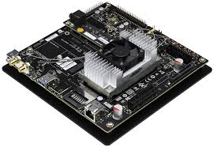
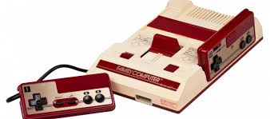
“Agent” on Jetson TX1
(AVerMedia EX711-AA)
HDMI images as “State” & “Reward”
GPIO control signals as “Action”
“Environment”

