Slide 1
Training 3: Agile and planning
Part of cooperative research platform (CRP) project between SZE and Bosch.

Slide 2
Agenda
Training 3: Agile and planning
Motivation
Definitions – common language
Team evolution
Iterative planning: how shall we do it?
Proposed work model: meetings
Roles: per book, practically
Tools

Slide 3
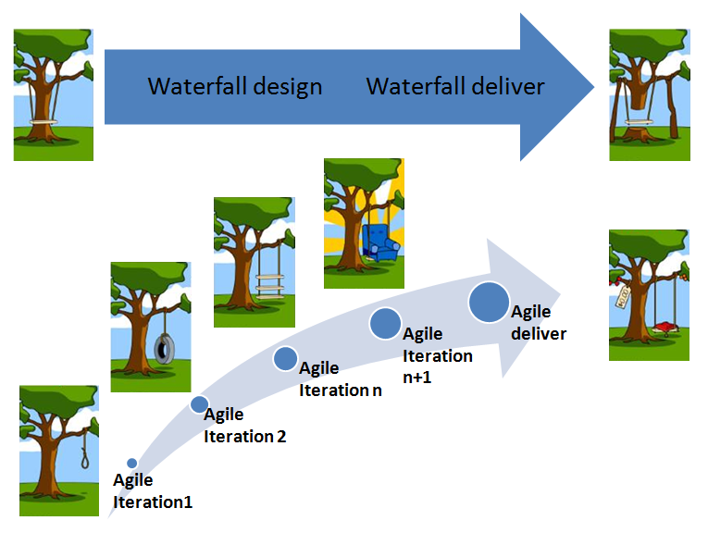
Motivation
Training 3: Agile and planning

Slide 4
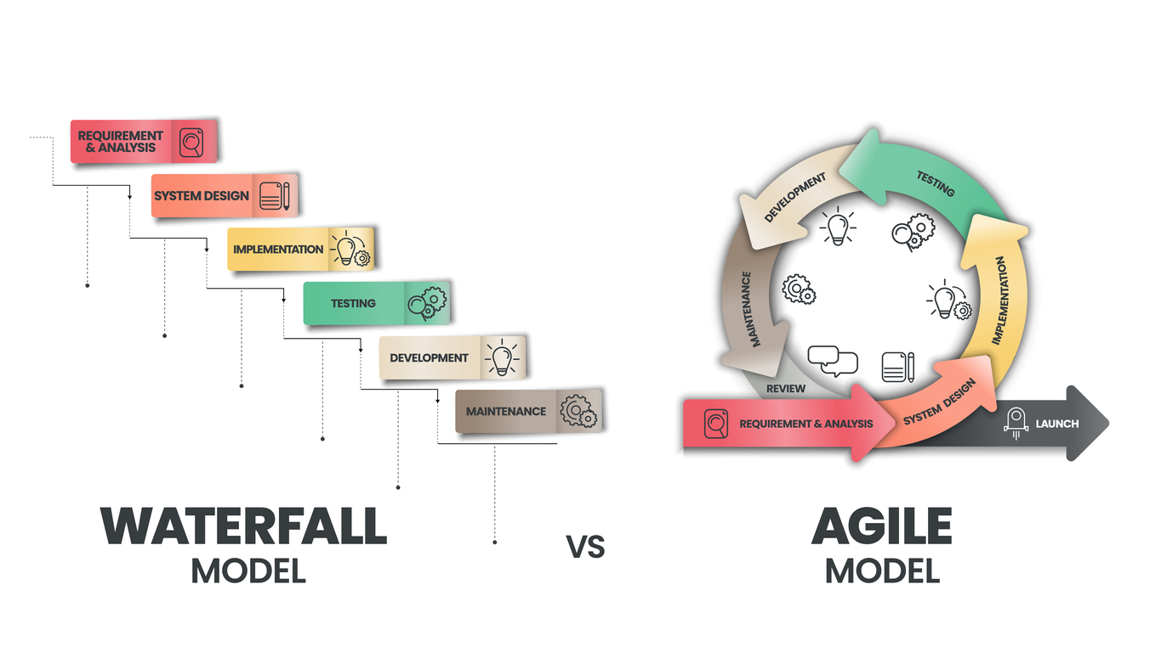
Motivation
Training 3: Agile and planning

Slide 5
Definitions – common language
Training 3: Agile and planning
Road-map
Product Increment (PI)
Sprint
Backlog
Grooming
Planning
Retrospective
Review
Standup
Capacity planning

Slide 6
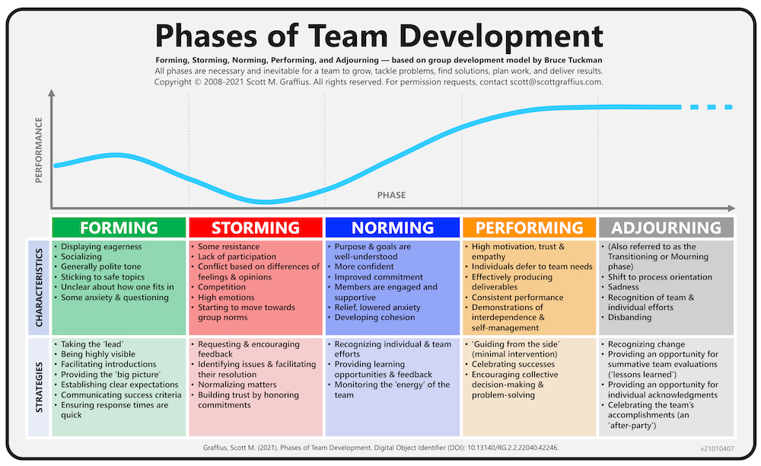
Team evolution
Training 3: Agile and planning

Slide 7
Iterative planning
Training 3: Agile and planning
Prepare a road-map:
Milestones
Priorization of mile-stones
We need to know what we want to achieve, what external desires are, what we are capable of
Usually this follows a brainstorming, creative dreaming, visioning… → responsibility of leaders
Takes place e.g., every 6-12 months.
Prepare a backlog on main feature level
Project features are created, priorization is taken over
Main goals, inputs/expected outputs are clear.
Then, backlog is derived to epic/story level, which reflect not more than 3-6 months ahead.
Backlog refinement
Look at the short-term tasks, epics, stories
This is also called grooming
All developers are involved
Stories are detailed, prioritized and effort is estimated

Slide 8
Iterative planning
Training 3: Agile and planning
Planning - PI
Refined backlog stories are taken over
Effort is matched with capacity
Story level priorization, blockers
Continuous adjustment with other parties (e.g., lexus is used by other projects, too)
Assignment → competence check
Done for 2 months ahead
Planning – Sprint
2 months PI can be divided to smaller packs
Continuous tracking
Review
Sprint and PI level, both
Expected outcome?
Input for next PI

Slide 9
Proposed work model - meetings
Training 3: Agile and planning
Planning (PI: 2 months, Sprint: 2 weeks?)
Proper preparation: high level goals → low level goals
How many persons? E.g., integration team, function research team, architects? One
Review (PI review only)
Measures
Responsibility
Retro
Honesty
Low/highlights, actions!
Standup
Short, only indicating blockers, advancements
No technical details, but indication of neccesity of technical discussions!

Slide 10
Roles – per book, in practice
Training 3: Agile and planning
Stakeholders
Project owner
Product owner
Scrum muster
Developers

Slide 11
Tools
Training 3: Agile and planning
Github

