Slide 1
క్ష ద్ర ಕ್ಕ स्ते ক্ষ
Measuring the Indic Tokenizer Tax
A comparative study of Sarvam AI's tokenizers and akshara-aware subword segmentation for Indian languages
Nikhileshwar Jakka | Reg. No. 23FE10CII00213
B.Tech CSE (IoT & Intelligent Systems), Manipal University Jaipur
Natural Language Processing (NLP) | Guide: Heena Kalim | November 2026
Notes:
Good morning. My project measures how much more it costs, in tokens, to use large language models in Indian languages, and whether tokenizers respect the syllables our scripts are built on. The characters at the top are aksharas, conjunct syllables from Telugu, Kannada, Hindi and Bengali.

Slide 2
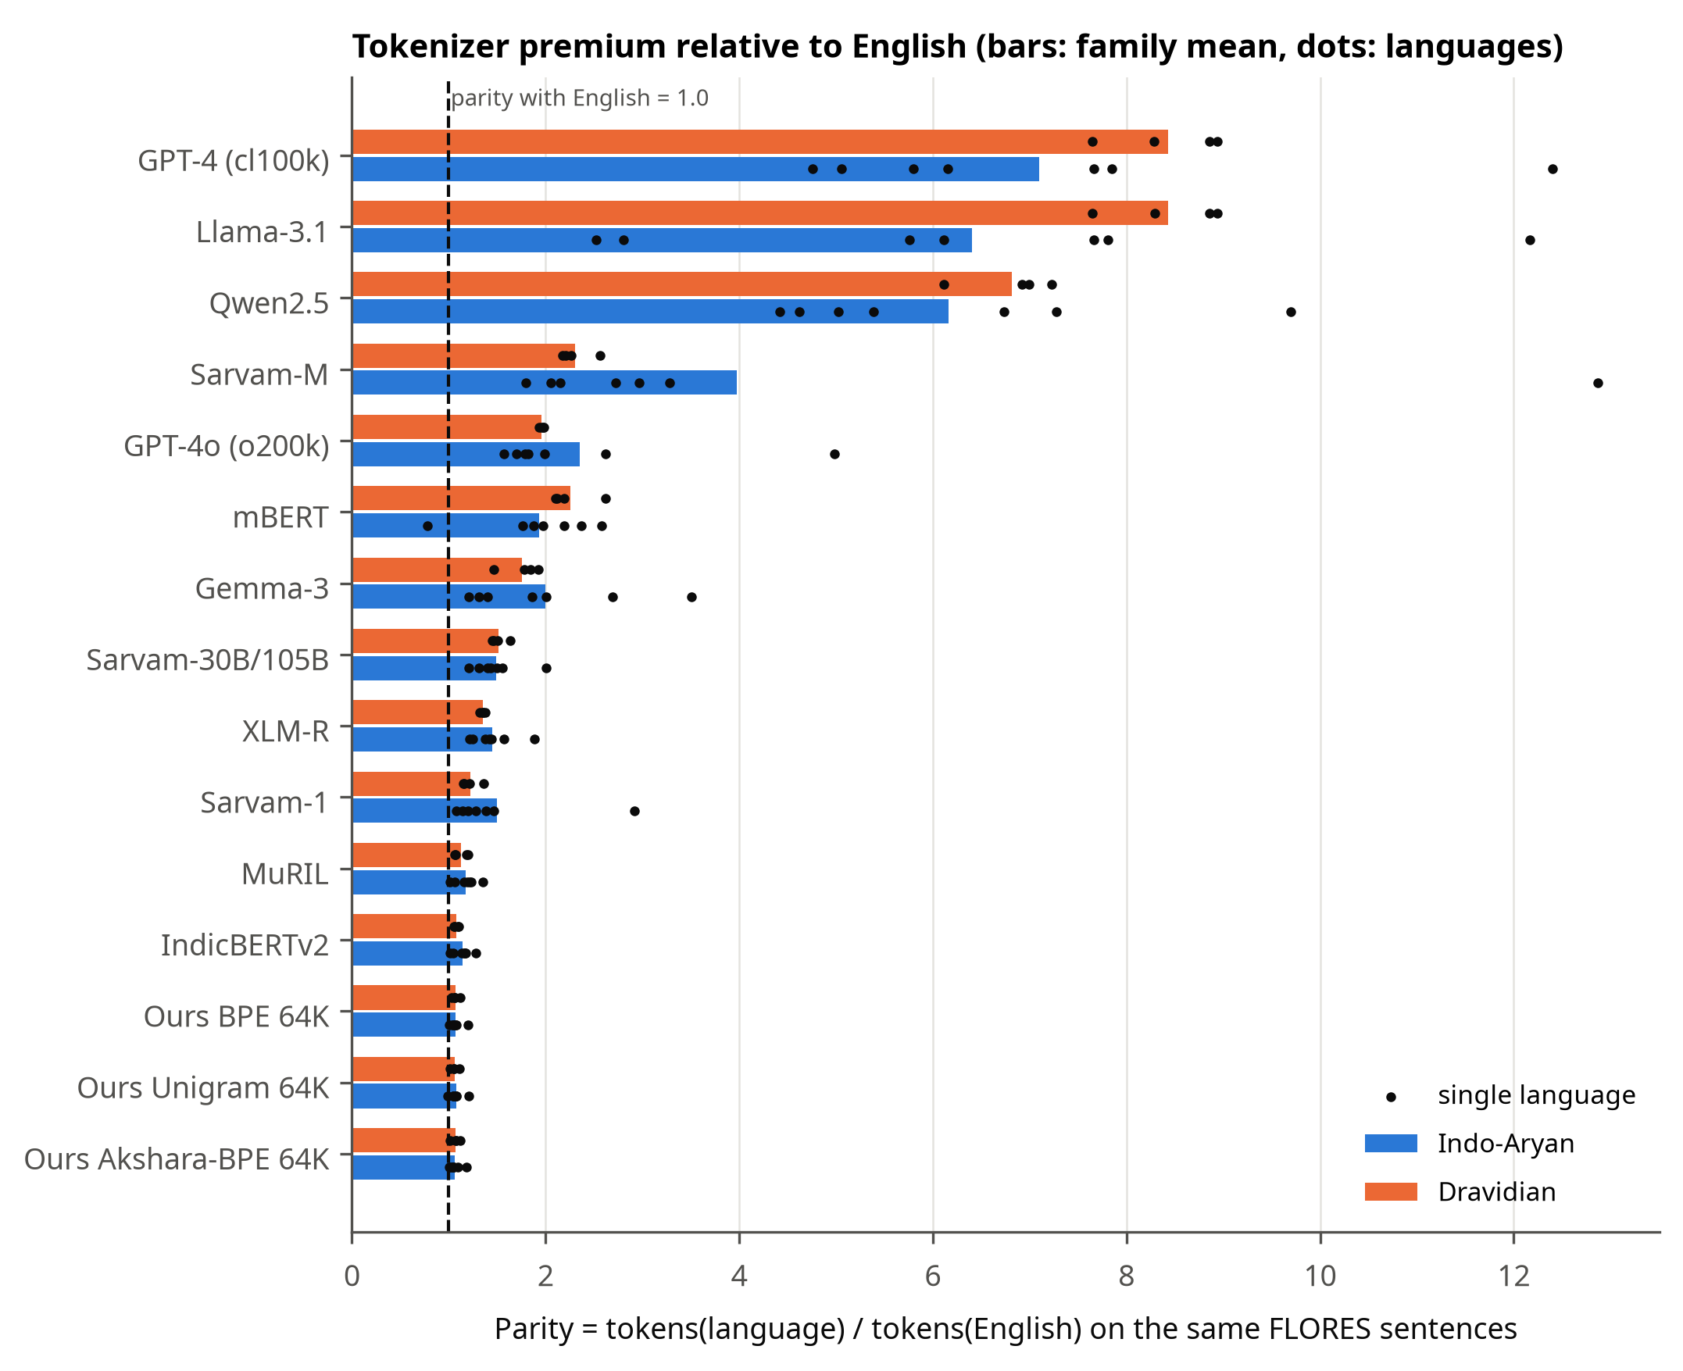
The tokenizer tax
Same FLORES sentence, translated: how many tokens compared with English?
8.29×
Telugu with Llama-3.1
1.93×
Telugu with GPT-4o
1.15×
Telugu with Sarvam-1
2
Notes:
FLORES gives us the same 1,012 sentences in every language. With Llama-3.1, a Telugu sentence costs 8.29 times the tokens of its English translation; GPT-4o brings that to 1.93, Sarvam-1 to 1.15. Because APIs bill per token and context is measured in tokens, this is a direct cost and capacity penalty.

Slide 3
What a tokenizer does, and why aksharas matter
An akshara is the written syllable of Brahmic scripts: consonants + virama + vowel sign
Word: क्षत्रिय (kshatriya)
Akshara Split Rate (ASR)
% of aksharas that contain a token boundary
Akshara-respecting split (XLM-R, ours)
क्ष
त्रि
य
Fertility
tokens per word
Parity
tokens vs English
mBERT's actual split: virama and vowel sign orphaned
क
्ष
त्र
िय
Exact byte spans
for every token, 4 tokenizer families
3
Notes:
A tokenizer cuts text into vocabulary pieces. In Brahmic scripts the natural unit is the akshara. If a boundary falls inside one, a virama or vowel sign ends up as a token on its own. I measure this with the Akshara Split Rate, alongside fertility and parity, using exact byte spans for every token.

Slide 4
Sarvam's tokenizer journey
Three model generations, three tokenizers
Oct 2024
May 2025
Mar 2026
Sarvam-1
Sarvam-M
Sarvam-30B / 105B
68,096 vocab
custom Indic vocabulary
73.0% Indic entries
131,072 vocab
Mistral-Small-3.1 (Tekken)
131,072 entries identical
262,144 vocab
91.3% identical to Gemma-3
22,828 slots re-assigned
Sources: Sarvam AI blog posts; vocabulary comparisons computed in this project.
4
Notes:
Sarvam-1 had a custom 68K vocabulary. Sarvam-M was built on Mistral Small, and I verified that its vocabulary is identical to Mistral-Small-3.1. For Sarvam-30B and 105B I found that 91.3 percent of the vocabulary is identical, same strings and same ids, to Google's Gemma-3; 22,828 slots were re-assigned, mostly from CJK, Latin and Thai to Indic scripts.

Slide 5
Research questions
RQ1
How did Sarvam's tokenizers change, and how do they compare with global tokenizers?
RQ2
Is there a cost gap between Indo-Aryan and Dravidian languages, or between scripts?
RQ3
How often do tokenizers break aksharas?
RQ4
Does akshara-atomic BPE remove broken aksharas without hurting fertility?
RQ4 is my own contribution.
5
Notes:
Four questions: the Sarvam lineage, the language-family gap, broken aksharas, and whether my akshara-atomic BPE fixes them and at what cost.

Slide 6
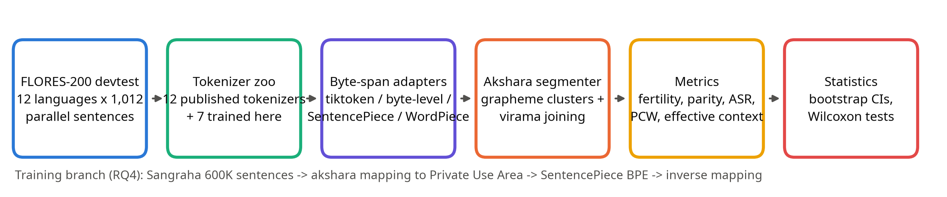
Method
12 published + 7 trained tokenizers, 12 languages, 1,012 parallel sentences each
600,000
30
1,000
training sentences (Sangraha)
hand-checked akshara tests, 9 scripts
bootstrap resamples + Wilcoxon tests
6
Notes:
Evaluation uses the parallel FLORES-200 devtest set. Each tokenizer goes through a byte-span adapter so that I know the exact bytes of every token; then the akshara segmenter and the metrics run, and finally bootstrap confidence intervals and paired Wilcoxon tests. Only tokenizer files are downloaded.

Slide 7
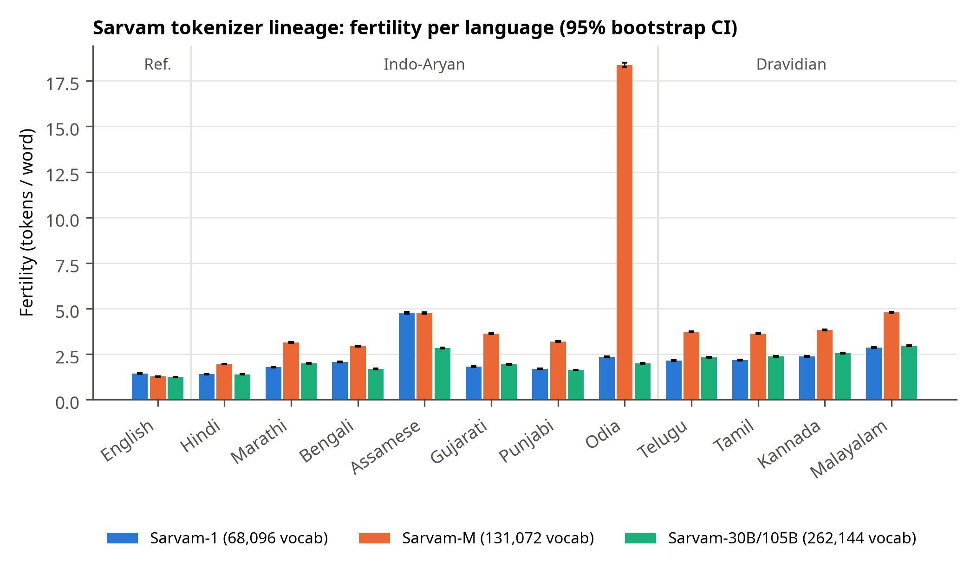
RQ1: Sarvam-30B gained on Indo-Aryan, lost on Dravidian
Fertility per language with 95% bootstrap CIs
5
languages better with Sarvam-30B than Sarvam-1
6
languages worse, incl. all 4 Dravidian
18.36
Sarvam-M tokens per Odia word
7
Notes:
Against Sarvam-1, Sarvam-30B is better on 5 languages such as Bengali and Odia, but worse on 6, including Telugu, Tamil, Kannada and Malayalam; all differences are significant after Holm correction. Sarvam-M, which kept Mistral's vocabulary, needs 18.36 tokens per Odia word.

Slide 8
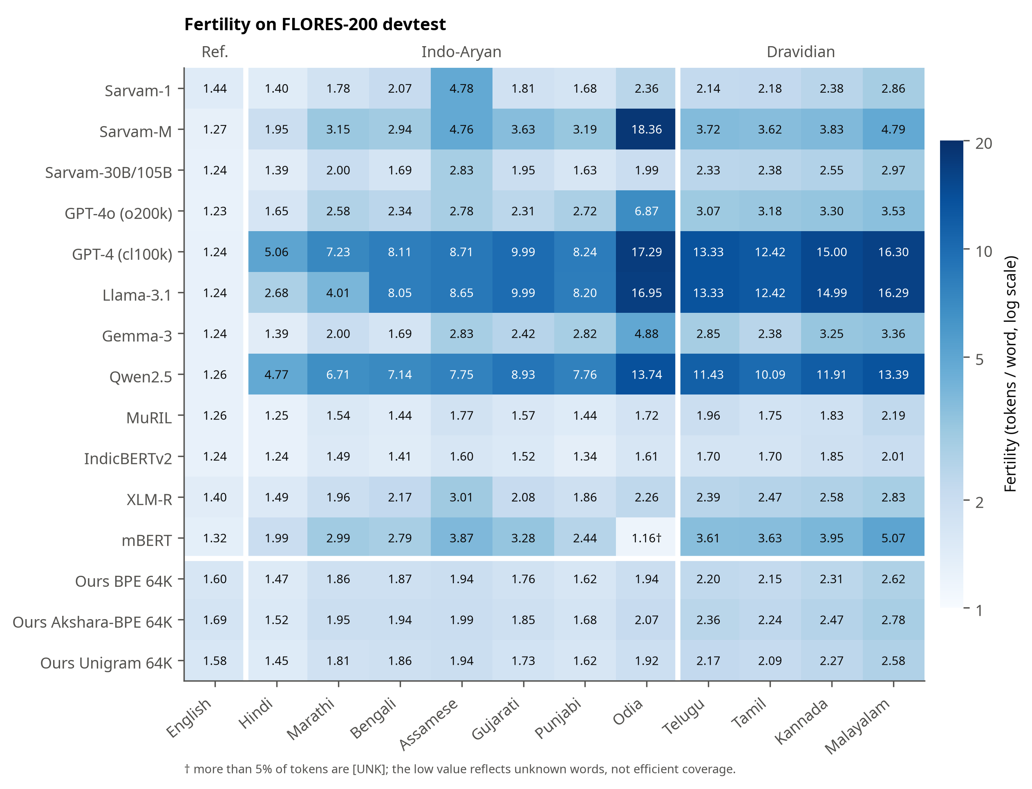
RQ2: Script coverage matters more than language family
Fertility across all tokenizers
1.05 → 1.32
Dravidian / Indo-Aryan fertility, Sarvam-1 → Sarvam-30B
10 / 19
tokenizers where Dravidian parity is higher
4.98×
GPT-4o parity for Odia (worst language)
8
Notes:
Dravidian fertility is higher for almost every tokenizer, partly because agglutinative words are longer. Parity controls for content: Dravidian text costs more in only 10 tokenizers, mostly byte-level ones. The bigger driver is script coverage: Odia is the most expensive language for GPT-4o and Sarvam-M.

Slide 9
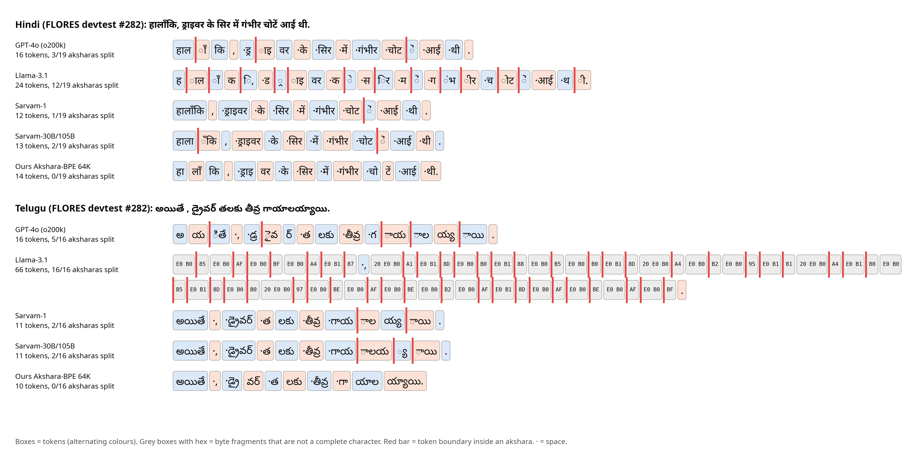
What the tokenizers actually see
Red bars = token boundary inside an akshara; grey hex = byte fragments
9
Notes:
The same Hindi and Telugu sentence under five tokenizers. Llama-3.1 falls back to raw UTF-8 bytes for Telugu, shown as hex boxes. Sarvam and GPT-4o leave vowel signs as separate tokens. My akshara-atomic tokenizer never splits an akshara here.

Slide 10
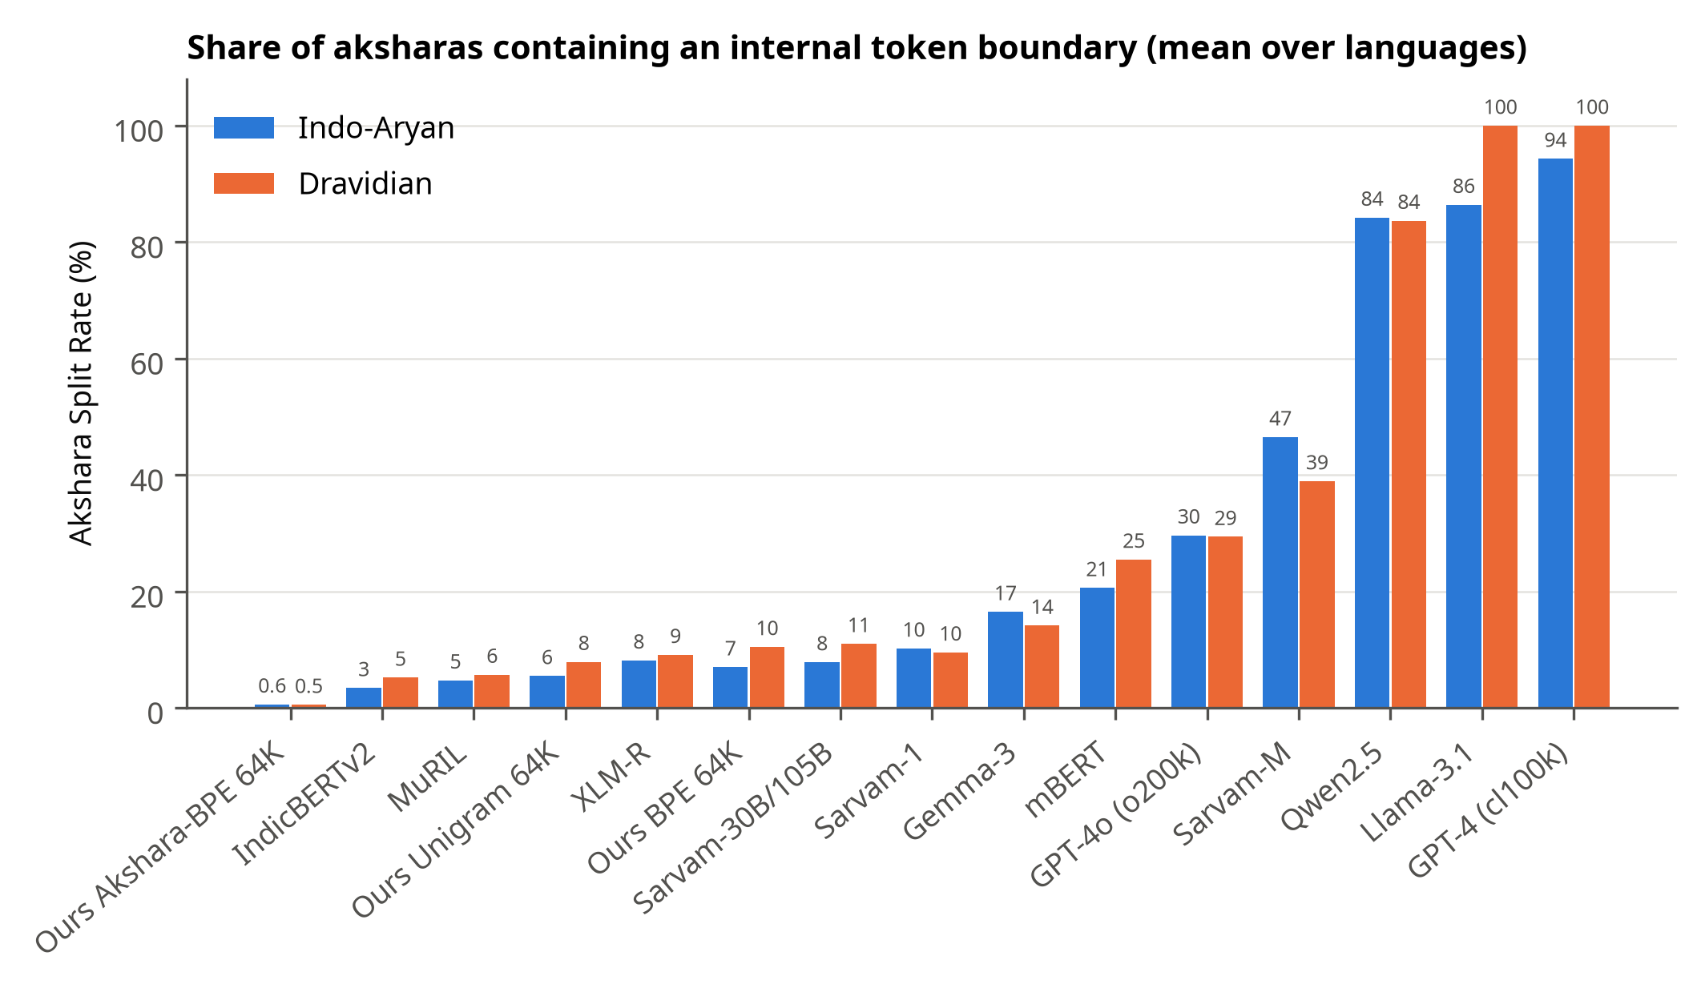
RQ3: Byte-level tokenizers break almost every akshara
Akshara Split Rate by tokenizer
91.4%
aksharas split by Llama-3.1
9.0%
aksharas split by Sarvam-30B
1.40×
Sarvam-30B: Dravidian vs Indo-Aryan split rate
10
Notes:
GPT-4's cl100k splits 96.4 percent of aksharas and Llama-3.1 91.4 percent. Indic-aware tokenizers do much better, but Sarvam-30B splits Dravidian aksharas 1.40 times as often as Indo-Aryan ones.

Slide 11
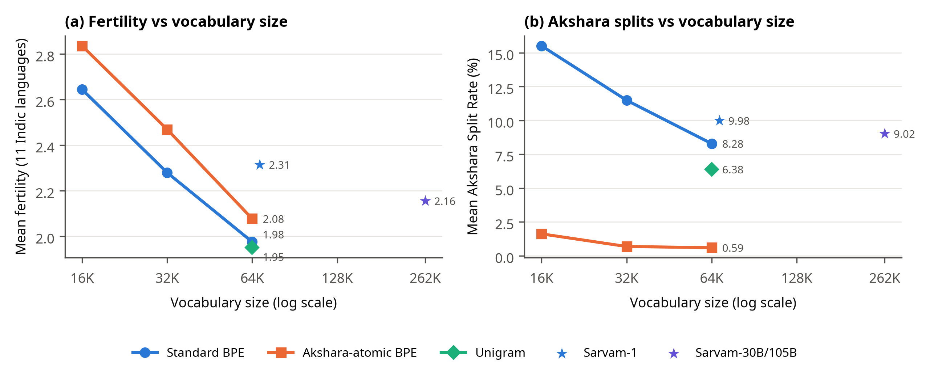
RQ4: Akshara-atomic BPE
Each frequent akshara gets one private-use symbol before BPE training
8.3% → 0.6%
Akshara Split Rate at 64K
+5.1%
fertility cost at 64K
0
Every remaining split is on one of the 0.59% of aksharas outside the mapped inventory. vs Sarvam-1: fertility 2.08 vs 2.31, ASR 17× lower.
mapped aksharas ever split
11
Notes:
At 64K, akshara-atomic BPE cuts the split rate from 8.3 to 0.6 percent, while fertility rises by 5.1 percent. The cost shrinks as the vocabulary grows. The remaining splits all come from rare aksharas outside the mapped inventory. About 20 percent of the extra tokens are standalone word-boundary tokens, which suggests an easy improvement.

Slide 12
Key takeaways
91.3%
6 / 11
of Sarvam-30B's vocabulary is identical to Gemma-3
languages got more expensive from Sarvam-1 to Sarvam-30B
8.29×
−92.9%
Telugu token premium on Llama-3.1
akshara splits with akshara-atomic BPE (64K)
12
Notes:
Four things to remember: the Sarvam-30B tokenizer is mostly Gemma-3; it made Dravidian languages more expensive than Sarvam-1; byte-level global tokenizers charge Indian users many times more; and akshara-atomic BPE removes almost all akshara splits for a small fertility cost.

Slide 13
Limitations and future work
Limitations
Future work
Whitespace words penalise agglutinative languages
Train small LMs per tokenizer to test downstream effects
FLORES is a single (Wikipedia-style) domain
Add IN22 and conversational text
Intrinsic metrics only: no models trained
Combine akshara units with morphology-aware segmentation
Akshara rules approximate syllables
Cover all 22 scheduled languages
13
Notes:
The main limitations: fertility depends on a whitespace word definition, FLORES is one domain, and everything is intrinsic. Next I want to train small models on each tokenizer to see whether fewer broken aksharas actually improve downstream quality.

Slide 14

Thank you
Questions?
Code, data pointers, results, paper and slides:
https://github.com/jkknikhil-git/indic-tokenizer-study
Scan for the repository
Nikhileshwar Jakka | jkk.nikhil@gmail.com
Notes:
Thank you. Everything is reproducible with one command from the repository linked here. I'm happy to take questions.

