Slide 1
Machine Learning III
Linear regression and introduction to clustering
DAVE3625 · Umair Mehmood Imam
Notes:
90 minutes in total. The worked regression example is intentionally simple. The later clustering lecture covers evaluation and hierarchical methods.

Slide 2
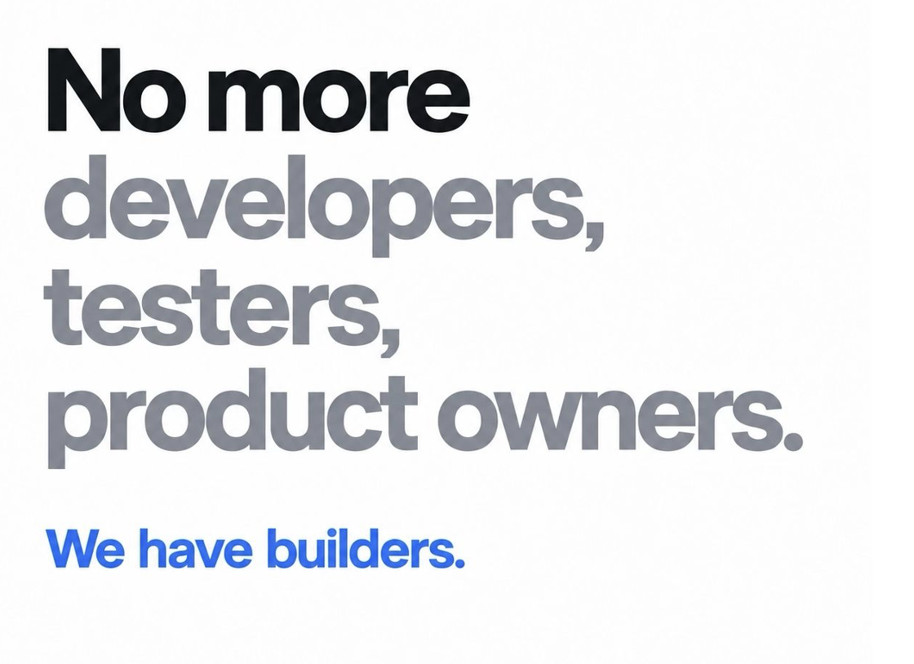

Slide 3
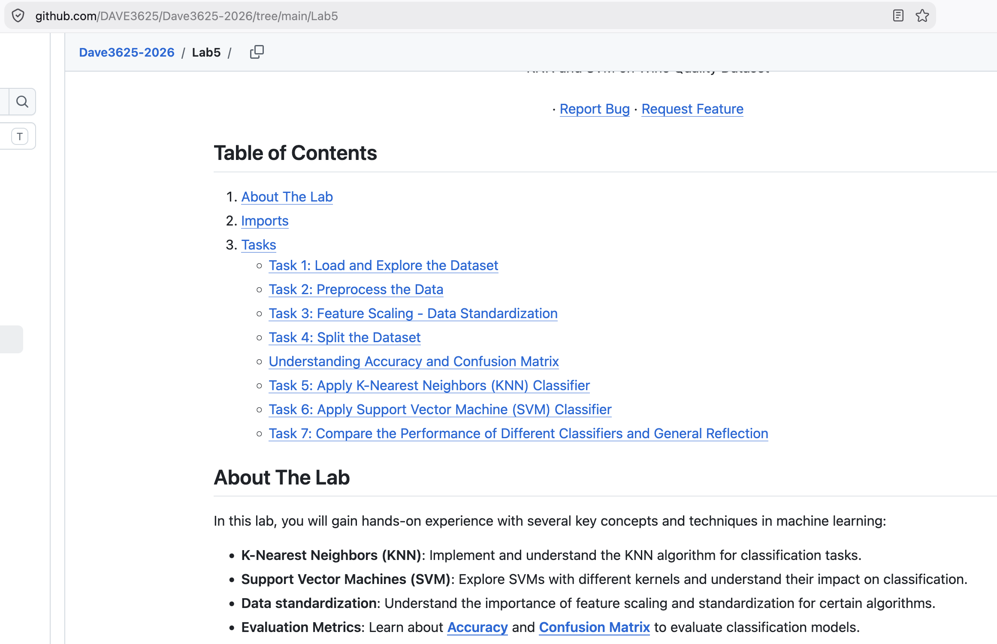
Labs

Slide 4
Three main learning settings
SUPERVISED
UNSUPERVISED
REINFORCEMENT
Known labels
No target labels
Rewards from actions
Spam or not spam
Customer groups
Game-playing agent
Recommender systems are applications. They may use any of these learning settings.
OSLO METROPOLITAN UNIVERSITY
DAVE3625 · UMAIR MEHMOOD IMAM

Slide 5
Two kinds of supervised learning : Regression and classification
REGRESSION
CLASSIFICATION
Predict a number
Predict a category
Examples
House price
Travel time
Energy use
Examples
Spam or normal
Pass or fail
Bus, tram or metro
OSLO METROPOLITAN UNIVERSITY
DAVE3625 · UMAIR MEHMOOD IMAM
05 MACHINE LEARNING II

Slide 6
Various types of algortihms
Regression
Support vector machines
Decision Trees
K-Nearest Neighbour
Random Forest
Linear Regression
Polynomial Regression
…
…
Classification
Logistic regression
Naïve Bayes classifier
Notes:
Supervised learning splits in two, according to what kind of answer you want.
Classification predicts a category — spam or not spam, survived or died. Regression predicts a number — a price, a salary, a delay in minutes.
Regression was Week 37's lecture. Everything in this one is classification.

Slide 7
What is regression?
Regression predicts a numerical value.
TRAINING
Examples include input features and a known number.
PREDICTION
For a new input, the model estimates that number.
EXAMPLES
Trip duration, apartment price, or passenger count.
DAVE3625 | Umair Mehmood Imam
MACHINE LEARNING III | 03
Notes:
Start with an explicit definition. Regression is a supervised task with known numeric target values. Logistic regression, which students met in ML II, is usually a classifier; the name does not determine the task.

Slide 8
Churn: Classification
Stock market price prediction: Classification
Spam email: classification
Prediction of price of an oil: Regression
Salary prediction: Regression
Age prediction: Regression
Gender prediction: Classification

Slide 9
Regression
Regression models are used to predict a continuous value
Examples
  Predicting prices of a house given a set of features (size, price, location etc)
  Predicting sales revenue of a company based on previous sales figures
Question: Are the following use cases regression or classification ?
  Customer Churn: when a customer leaves the company
  Stock market price prediction
  Spam email
  Prediction of price of an oil
  Salary prediction
  Age prediction
  Gender prediction
Notes:
The main difference between Regression and Classification algorithms that Regression algorithms are used to predict the continuous values such as price, salary, age, etc. and Classification algorithms are used to predict/Classify the discrete values such as Male or Female, True or False, Spam or Not Spam, etc.

Slide 10
How does regression work?
1. Measure
Record features, such as trip distance.
2. Label
Record the numeric target, such as travel time.
3. Fit
Find a relationship that reduces prediction errors.
4. Predict
Apply the learned relationship to a new trip.
DAVE3625 | Umair Mehmood Imam
MACHINE LEARNING III | 04
Notes:
Use the upcoming travel-time data to explain these steps. Features are input measurements, target is the known value. Fitting reduces a training loss; use separate data to assess generalisation in the next evaluation lecture.

Slide 11
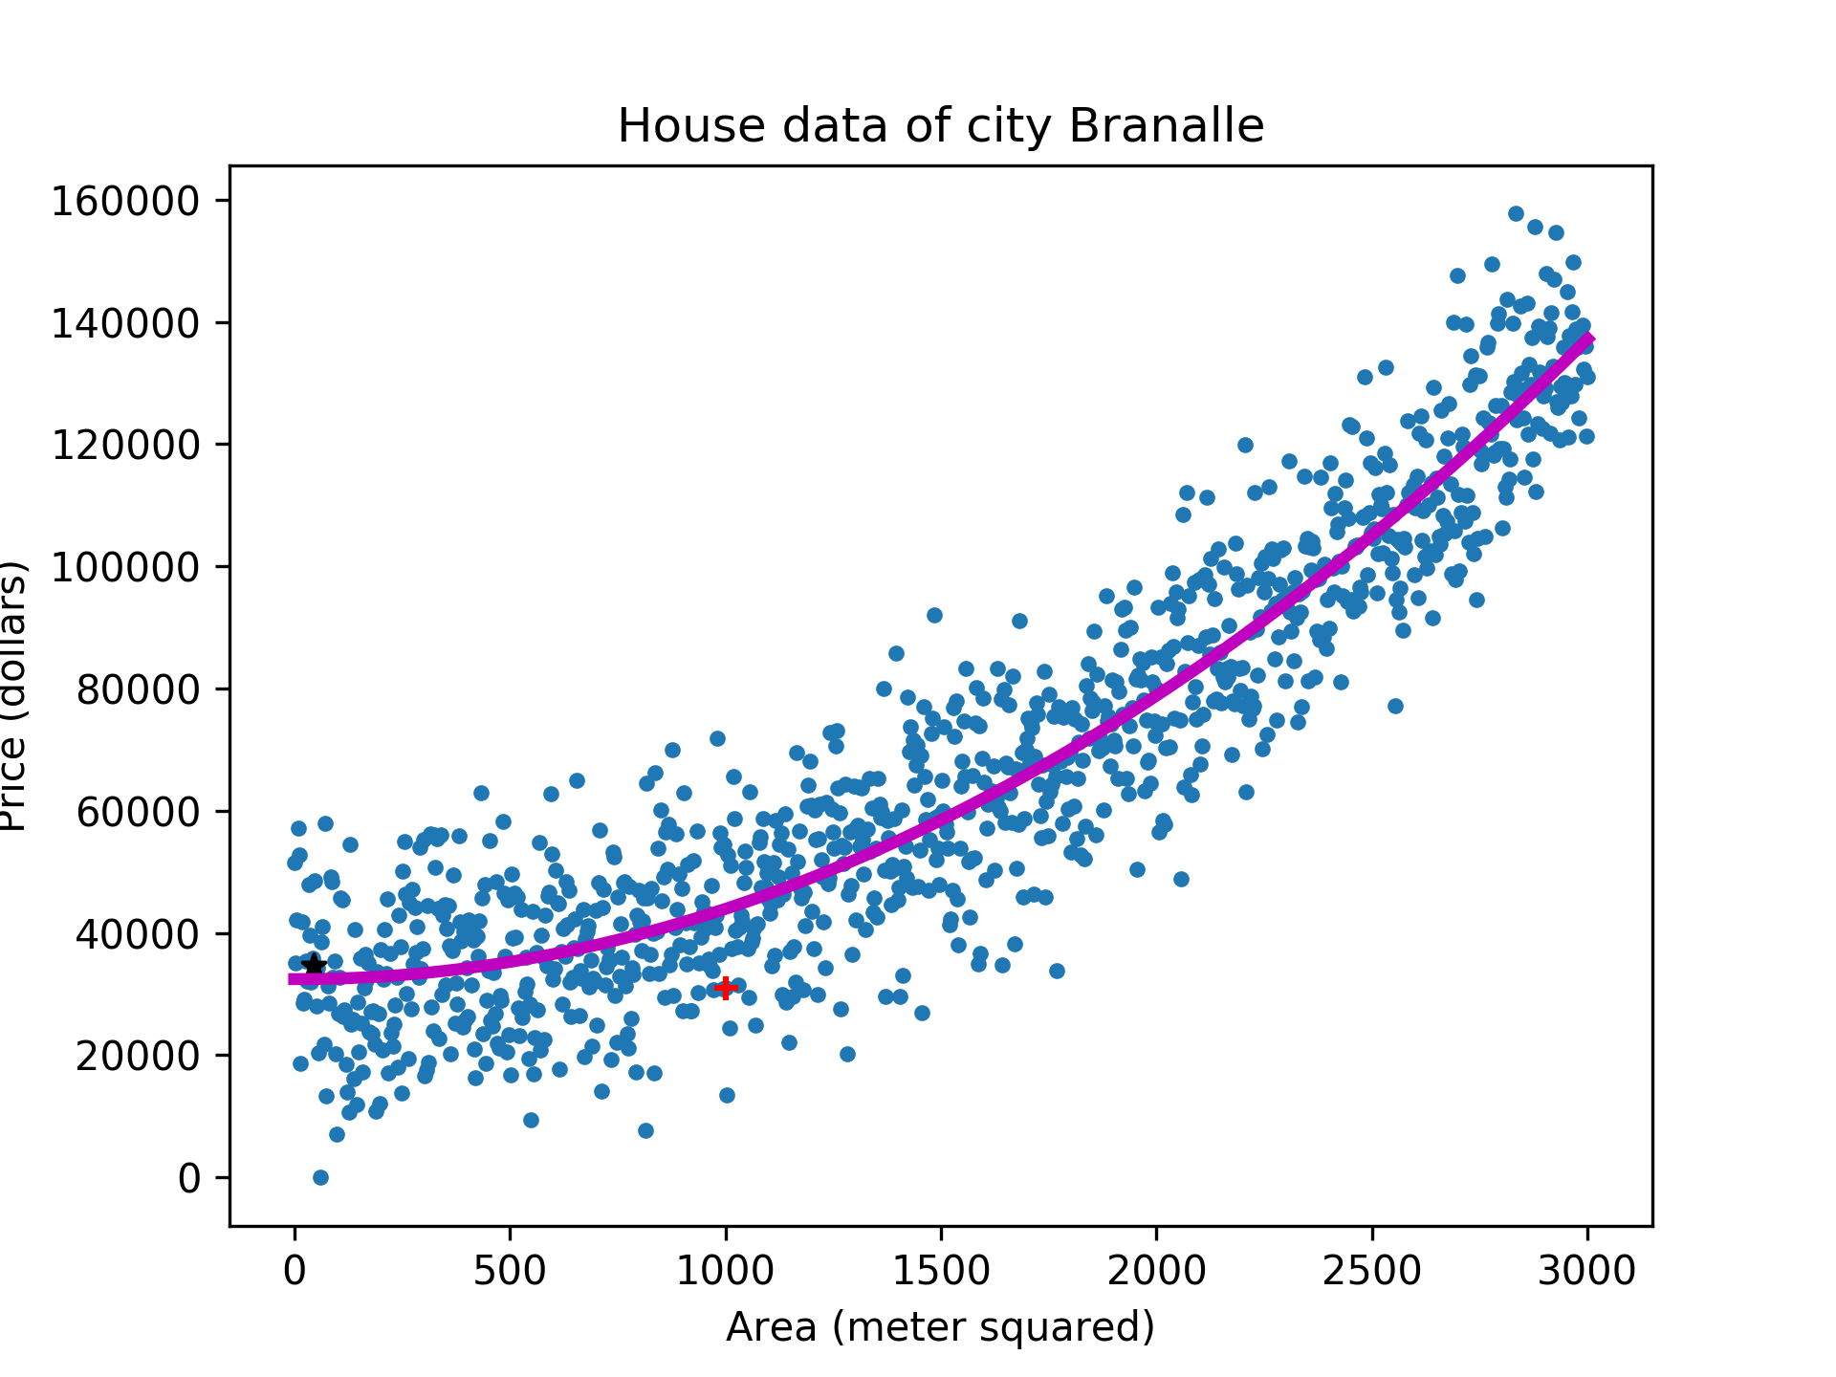
https://www.quora.com/What-is-regression-in-machine-learning

Slide 12
Regression is used for prediction, forecasting, time series modeling, and determining the causal effect between variables

Slide 13
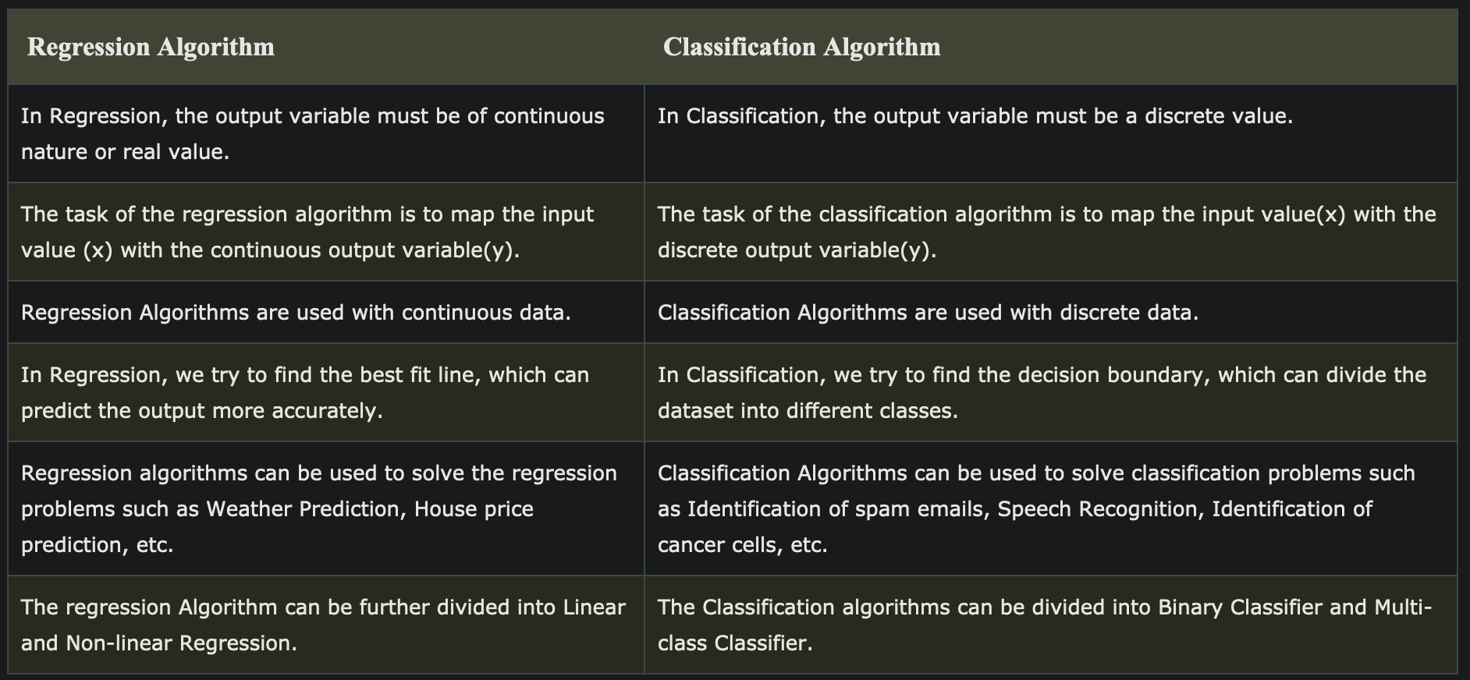

Slide 14
Regression algorithms
Linear regression
Polynomial regression
Support vector regression
Decision tree regression
Random forest regression
Ridge regression
Lasso regression

Slide 15
1. Linear Regression
It’s a linear model
  an equation that describes a relationship between two quantities that show a constant rate of change.
  e.g the older I get, the wiser I will be (hopefully)
  Attending all lectures in Intro to A.I course will result in passing the exam
There is always an input variable (x) and an output variable (y)
  Y can be calculated from a linear combination of input variables (x)

Slide 16
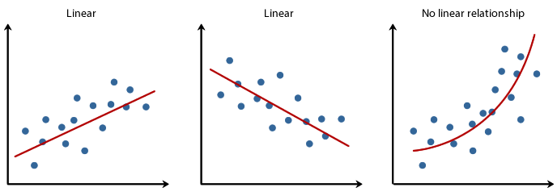
Notes:
Linear regression is a predictive statistical approach for modelling relationship between a dependent variable with a given set of independent variables.

Slide 17
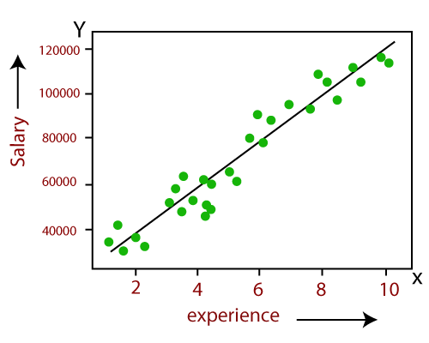
Y = a+bX
Y = Salary
X = Employees age
A,B: Coefficients of the equation
Coefficients are estimates of the unknown. These are calculated for a regression model and help us predict value of Y for each value of X
Notes:
So in order to predict Y (salary) given X (age), we need to know the values of a and b (the model’s coefficients).
While training and building a regression model, it is these coefficients which are learned and fitted to training data. The aim of the training is to find the best fit line such that cost function is minimized. The cost function helps in measuring the error. During the training process, we try to minimize the error between actual and predicted values and thus minimizing the cost function.

Slide 18
The coefficients are the numbers that tell you:
How much does the line go up or down when you change one of the input values.
Positive coefficient → output goes up when input increases.
Negative coefficient → output goes down when input increases.
Bigger number → stronger effect.

Slide 19
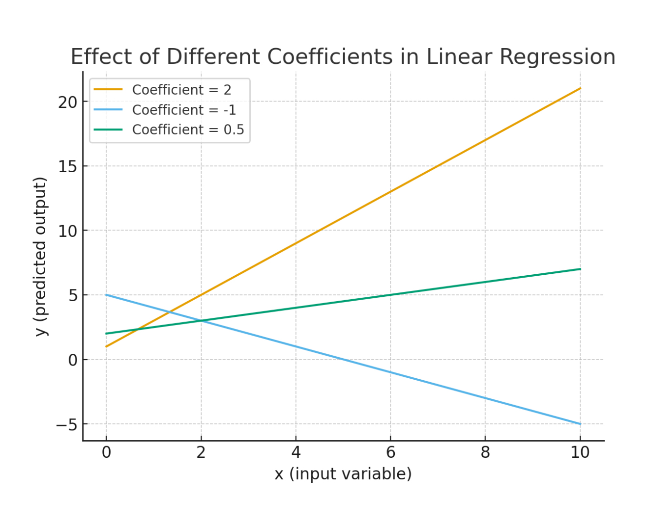

Slide 20
Example of Coefficient
Suppose we model house prices:
Price = 50,000 + 200 x Size + 1,000 x Bedrooms
Intercept (50,000) → base price of a house even if size = 0 and bedrooms = 0.
Coefficient of Size (200) → for every extra square meter, price increases by $200.
Coefficient of Bedrooms (1,000) → for each additional bedroom, price increases by $1,000.

Slide 21
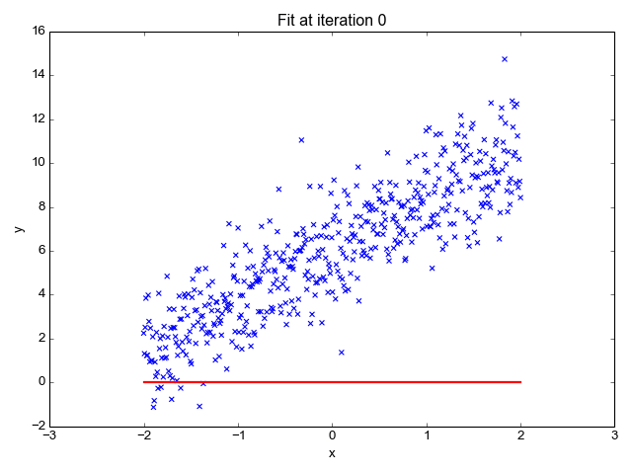

Slide 22
Example: predicting travel time
Distance
Travel time
1 km
5 min
2 km
8 min
3 km
11 min
4 km
14 min
Each extra kilometer adds 3 minutes.
DAVE3625 | Umair Mehmood Imam
MACHINE LEARNING III | 06
Notes:
This is a deliberately simple, illustrative dataset. Ask students to spot the +3 minute step. Distance is the input feature and time is the target. All four rows follow the same rule; a real dataset would have variation.

Slide 23
Y = a+bX
Predicted time = 2 + 3 × distance
Start with 2 minutes.
Add 3 minutes for each kilometre.
A straight-line rule like this is called linear regression.
DAVE3625 | Umair Mehmood Imam
MACHINE LEARNING III | 08
Notes:
Do not introduce b0, b1 or y-hat until students can explain the plain-language rule. The 2-minute intercept is simply the fitted starting value for this toy example, not a realistic zero-distance trip.

Slide 24
The pattern as a line
The points follow a simple straight-line pattern.
DAVE3625 | Umair Mehmood Imam
MACHINE LEARNING III | 07
Notes:
The four dots form a straight line. First point at distance 1 and time 5. Each kilometre adds three minutes. Only after the visual introduce the rule time = 2 + 3×distance. Real observations often sit above or below a fitted line.

Slide 25
Example: predict a trip
Distance: 5 km
Start at 2 minutes. Add 3 minutes five times.
2 + 3 × 5 = 17 minutes
Actual journeys can take longer or shorter.
DAVE3625 | Umair Mehmood Imam
MACHINE LEARNING III | 09
Notes:
If 4 km takes 14 minutes, how many for 5 km according to the rule? Answer 2+3×5=17 minutes. This is just beyond the example distances, so it is an estimate.

Slide 26
When the prediction is off
The rule predicts 14 minutes for a 4 km trip.
Another 4 km trip actually takes 15 minutes.
Prediction error: 15 − 14 = 1 minute
Regression learns a pattern, but predictions need not be exact.
DAVE3625 | Umair Mehmood Imam
MACHINE LEARNING III | 10
Notes:
Use another trip at 4 km which takes 15 minutes even though the simple rule predicts 14. The difference is +1 minute.

Slide 27
Another example: gym spending
Monthly cost = 200 NOK + 50 NOK × classes
2 classes
300 NOK
4 classes
400 NOK
Question: What about 3 classes?
DAVE3625 | Umair Mehmood Imam
MACHINE LEARNING III | 11
Notes:
The rule is illustrative and can be learned from example invoices. A fixed membership costs 200 NOK and each class adds 50 NOK. Ask: with 3 classes, 200 + 3×50 = 350 NOK. This shows regression predicts a number in a different setting.

Slide 28
How is the line learned?
Try a rule
For example, start at 2 and add 3 for each km.
Check
Compare its predictions with the known trip times.
Improve
Adjust the numbers to make the overall mistakes smaller.
DAVE3625 | Umair Mehmood Imam
MACHINE LEARNING III | 12
Notes:
ordinary least squares squares errors to penalise larger mistakes; avoid derivations. Emphasise the fitted line is chosen from data, not hand-coded in typical machine learning.

Slide 29
Linear regression in Python
from sklearn.linear_model import LinearRegression
X = [[1], [2], [3], [4]] # distance in km
y = [5, 8, 11, 14] # time in min
model = LinearRegression().fit(X, y)
print(model.predict([[5]])) # about 17 minutes
The algorithm learns the line from these four examples.
DAVE3625 | Umair Mehmood Imam
MACHINE LEARNING III | 13
Notes:
Optional slide for practical work. X contains feature values as 2D rows; y contains target times. The model learns a slope and intercept; model.predict([[5]]) returns approximately 17.0.

Slide 30
Quick check: linear regression
Predicted time = 2 + 3 × distance.
1
What does the rule predict for a 2 km trip?
2
At 3 km it predicts 11, but a trip takes 12. By how much is it off?
3
Why be careful when predicting a 20 km trip?
DAVE3625 | Umair Mehmood Imam
MACHINE LEARNING III | 14
Notes:
Give pairs about 2 minutes. 1: 2+3×2=8. 2: predicted 11 at 3 km, observed 12, difference +1. 3: 20 km is far beyond observed 1–4 km and the relation may change.

Slide 31
Simple Linear regression
  When there is a single input variable (x)
Multiple linear regression
  Multiple input variables
Ref: https://sphweb.bumc.bu.edu/otlt/MPH-Modules/BS/BS704-EP713_MultivariableMethods/
Notes:
https://sphweb.bumc.bu.edu/otlt/MPH-Modules/BS/BS704-EP713_MultivariableMethods/

Slide 32
Polynomial regression: a curved pattern
Toy data: demand rises, peaks and then falls. A straight line misses the pattern.
DAVE3625 | Umair Mehmood Imam
MACHINE LEARNING III | 15
Notes:
Illustrative numbers: time periods 1–5 with demand 4,10,12,10,4. The quadratic relation y = 12 - 2(x - 3)^2 fits those toy values. Explain that a polynomial model uses x and x² as features and learns coefficients from examples. A higher degree increases flexibility and may overfit.

Slide 33
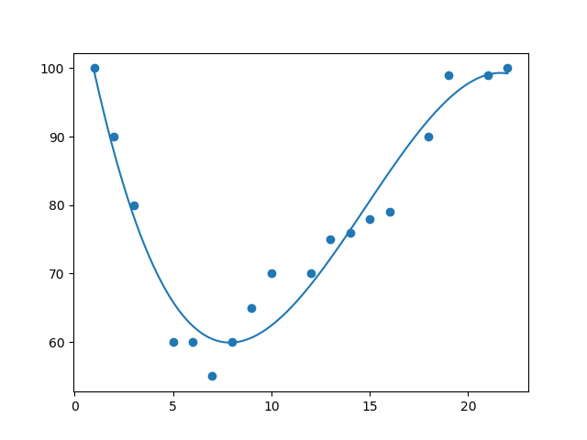
Polynomial Regression
It is also a linear model
But it is never a striaght line
https://www.w3schools.com/python/python_ml_polynomial_regression.asp

Slide 34
Polynomial regression: the idea
Linear regression: a straight line
Polynomial regression: a curve
It uses an extra feature such as time² to let the line bend.
In the example, demand rises and later falls.
DAVE3625 | Umair Mehmood Imam
MACHINE LEARNING III | 16
Notes:
The earlier chart illustrates a curve. A polynomial model can include time² as an additional feature. This allows the predicted value to bend. For the toy chart, the exact equation 12 - 2(time - 3)^2 gives 10 at time 2 and 12 at time 3; keep the equation in notes unless students request it. This lesson is conceptual, not an exercise in powers.

Slide 35
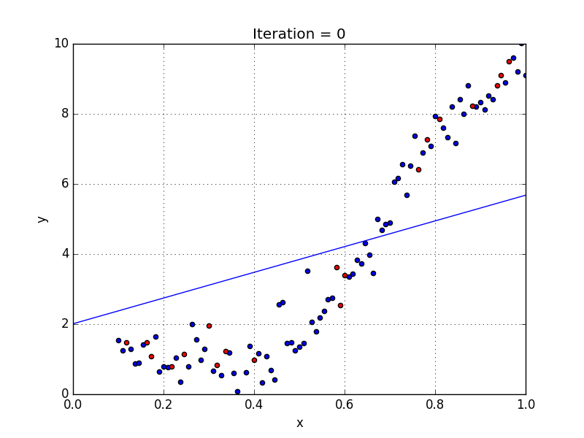
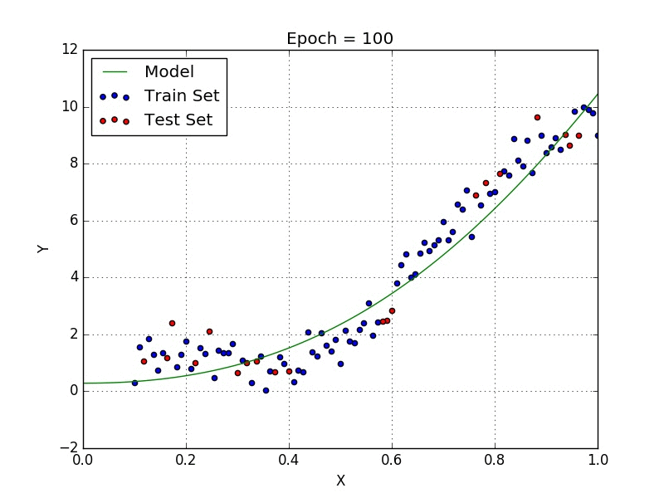
Linear regression
Polynomial regression
https://towardsdatascience.com/introduction-to-linear-regression-and-polynomial-regression-f8adc96f31cb
Notes:
https://towardsdatascience.com/introduction-to-linear-regression-and-polynomial-regression-f8adc96f31cb

Slide 36
Unsupervised machine learning
Looks for undetected patterns in a data set (with no labels and minimum human supervision)

Slide 37
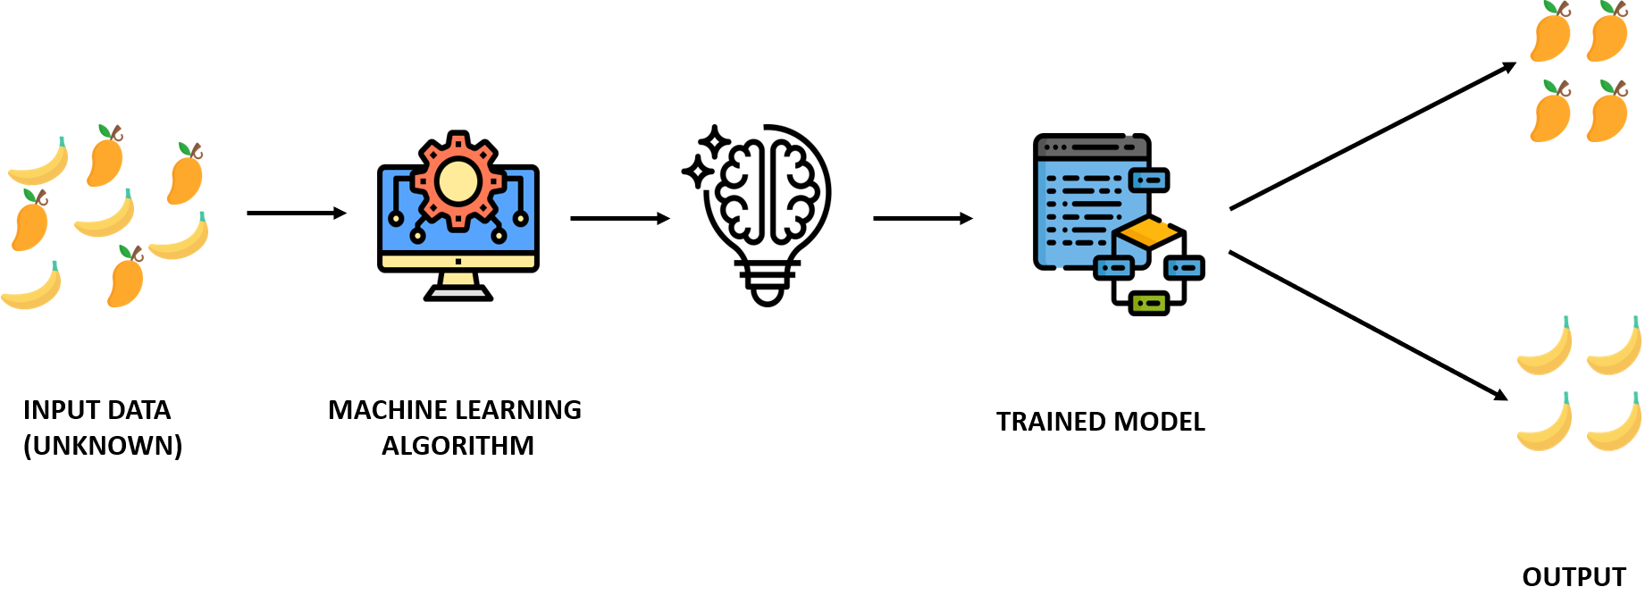
Unsupervised learning
Notes:
Image ref: https://www.verzeo.in/blog-what-is-machine-learning
An unsupervised model, provides unlabeled data that the algorithm tries to make sense of by extracting features and patterns on its own
The training data is unknown or unlabelled.
The model tries to find patterns and relationships in the dataset by creating clusters in it
Model cannot add labels to the data

Slide 38
Classification versus clustering
CLASSIFICATION
CLUSTERING
We specify the categories before training.
The model learns from examples with those labels.
The algorithm groups similar observations.
We inspect the groups before deciding whether they are useful.
DAVE3625 | Umair Mehmood Imam
MACHINE LEARNING III | 16
Notes:
Ask: do groups discovered in unlabelled data necessarily match our intended business categories? No. Clusters need interpretation.

Slide 39
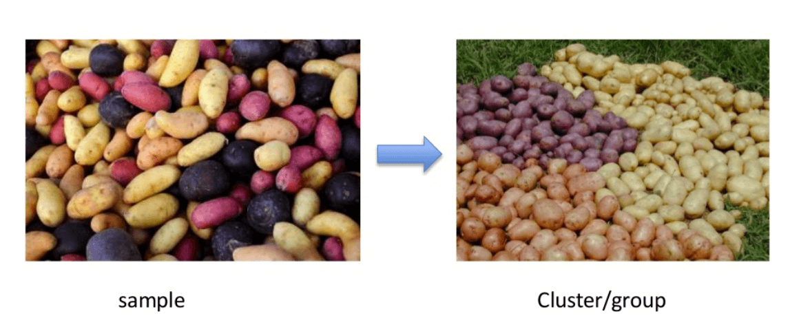
Clustering
Notes:
Rather than defining groups before looking at the data, clustering allows you to find and analyze the groups that have formed organically.

Slide 40
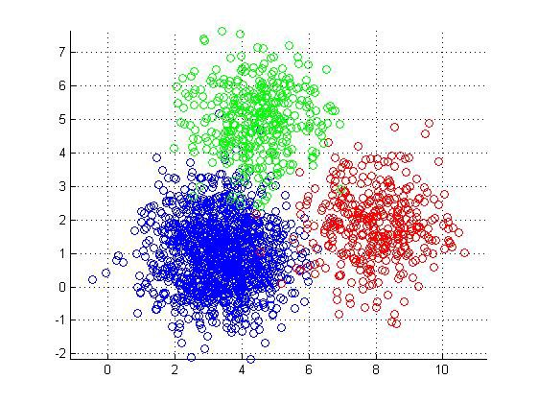
https://miro.medium.com/max/561/0*ff7kw5DRQbs_uixR.jpg

Slide 41
A dataset without labels
We have measurements for each point, but no group labels.
DAVE3625 | Umair Mehmood Imam
MACHINE LEARNING III | 18
Notes:
Show that a person can notice two compact areas before naming either group.

Slide 42
Examples: what can clustering reveal?
Transport
Trips with similar distance and departure time
Energy
Buildings with similar usage patterns
Documents
Texts with similar measured features
Limit
A group may reflect data collection or feature scaling
DAVE3625 | Umair Mehmood Imam
MACHINE LEARNING III | 17

Slide 43
K-Means Clustering
K-means is a distance based algorithm where we calculate distances between data points to assign a point to the cluster

Slide 44
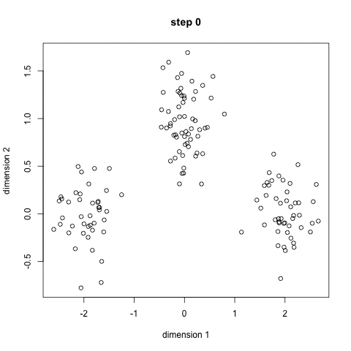
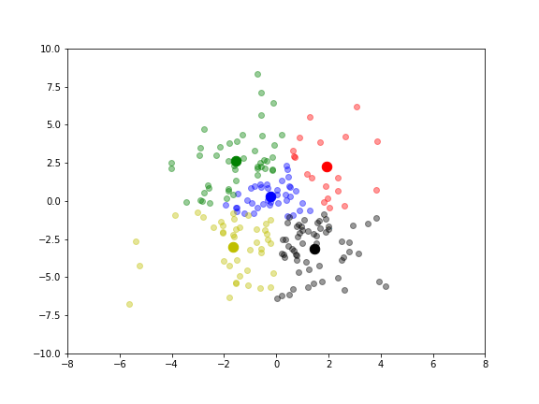
Notes:
You’ll define a target number k, which refers to the number of centroids you need in the dataset. A centroid is the imaginary or real location representing the center of the cluster.
In other words, the K-means algorithm identifies k number of centroids, and then allocates every data point to the nearest cluster, while keeping the centroids as small as possible.
The ‘means’ in the K-means refers to averaging of the data; that is, finding the centroid.

Slide 45
K-means with K = 2
Centre A ≈ (1.8, 2.4) Centre B ≈ (7.8, 7.6)
DAVE3625 | Umair Mehmood Imam
MACHINE LEARNING III | 20
Notes:
These assignments are illustrative and correspond to natural compact groups. Left centroid mean x=(1+2+2.4)/3=1.8, mean y=(2+2.2+3)/3=2.4. Right centroid mean x=(7+8+8.5)/3≈7.83, mean y=(7+7.5+8.2)/3≈7.57.

Slide 46
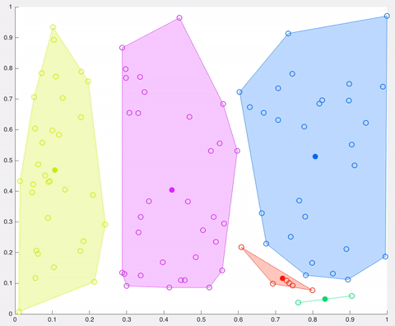

Slide 47
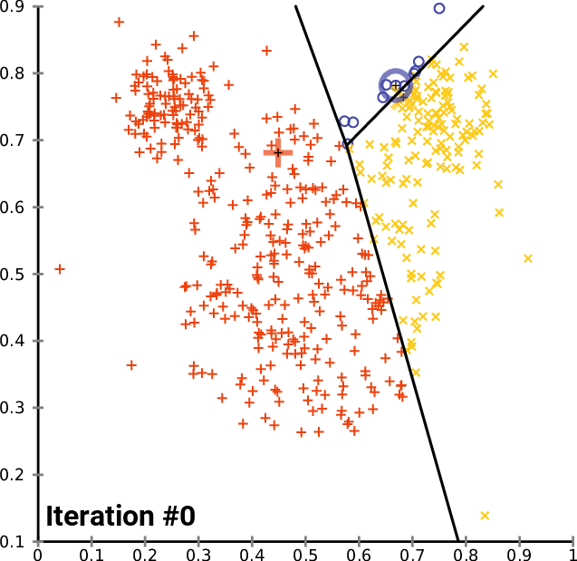

Slide 48
It will stop when
The centroids have been stabilized – there is no change in their values since clustering has been successful
  A centroid is the imaginary or real location representing the center of the cluster.
The defined number of iterations have been reached.

Slide 49
Advantages of K-means
Very simple to run. (choose k and run it a number of times)
Most projects donot need quality sensitive clusters

Slide 50
K-means: the core idea
1. Choose K
Decide how many groups to look for.
2. Assign
Place each point with its closest centre.
3. Update
Move each centre to the mean of its assigned points.
4. Repeat
Keep assigning and updating until the result stabilises.
DAVE3625 | Umair Mehmood Imam
MACHINE LEARNING III | 19
Notes:
Explain the steps verbally, then return to the same six observations. K must be chosen in advance. A centroid is a mean location, not necessarily an actual data point.

Slide 51
Clustering example: travel patterns
Inputs
Trip distance and departure time; no group labels.
Possible group A
Short trips made early in the morning.
Possible group B
Longer trips made later in the day.
Discuss
Would the same groups appear if we used fare instead of time?
DAVE3625 | Umair Mehmood Imam
MACHINE LEARNING III | 21
Notes:
Illustrative group descriptions based on distance and departure time, not learned group identities. You should notice that choosing features decides what similarity means. A practical notebook can demonstrate the actual fit.

Slide 52
Uses of K-means
Document classification
Customer segmentation
Fraud detection (insurance n bank)
Ride share data analysis (uber etc)
Detection of anomalies
Sorting sensor measurements

Slide 53
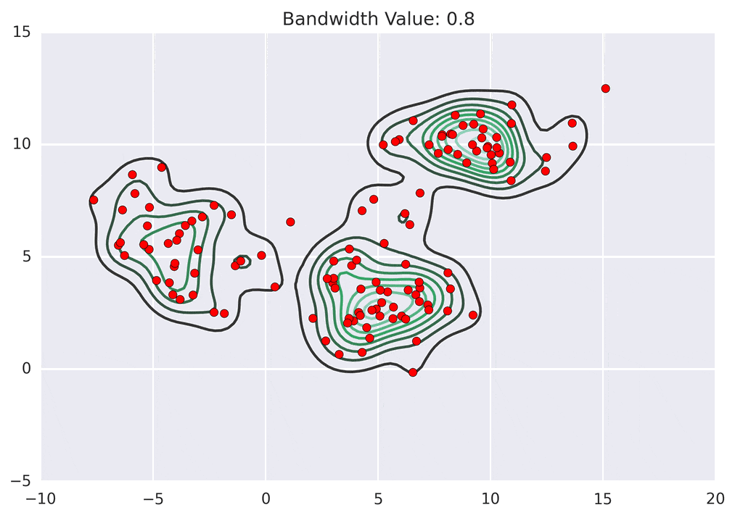
Mean shift clustering algorithm
It locates the heavy density clusters in a data
Imagine placing a circle around a point, finding the average position of the points inside it, and moving the circle there. Repeat until it stops moving. Points that end up at the same dense peak form a cluster.
The circle’s size is called the bandwidth
You do not choose the number of clusters, but bandwidth strongly affects how many it finds.
Notes:
Mean shift clustering is a sliding-window-based algorithm that attempts to find dense areas of data points.
It is a centroid-based algorithm meaning that the goal is to locate the center points of each group/class, which works by updating candidates for center points to be the mean of the points within the sliding-window.

Slide 54
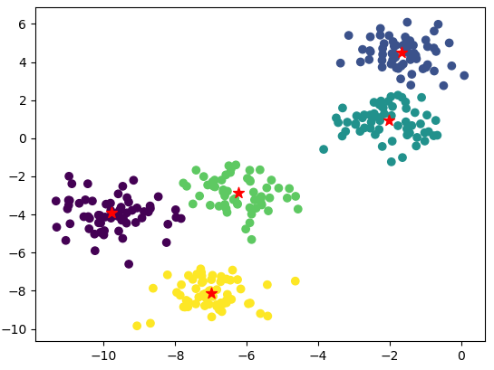
Mean shift clustering algorithm
Uses:
Computer vision
Image processing
Notes:
Mean shift clustering is a sliding-window-based algorithm that attempts to find dense areas of data points.
It is a centroid-based algorithm meaning that the goal is to locate the center points of each group/class, which works by updating candidates for center points to be the mean of the points within the sliding-window.

Slide 55
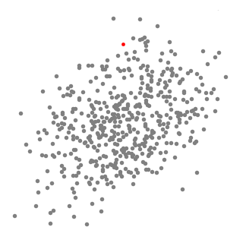
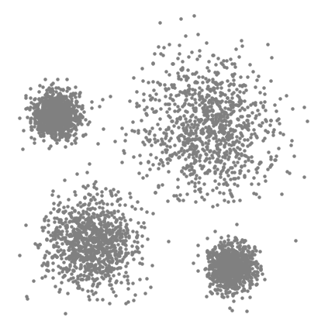
Example 2
Example 1

Slide 56
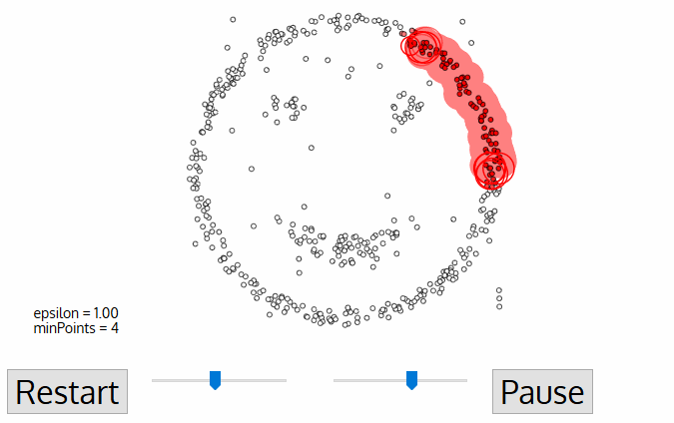
DBSCAN Algorithm
Finds dense groups of nearby points
Notes:
eps: specifies how close points should be to each other to be considered a part of a cluster. It means that if the distance between two points is lower or equal to this value (eps), these points are considered neighbors.
minPoints: the minimum number of points to form a dense region. For example, if we set the minPoints parameter as 5, then we need at least 5 points to form a dense region.

Slide 57
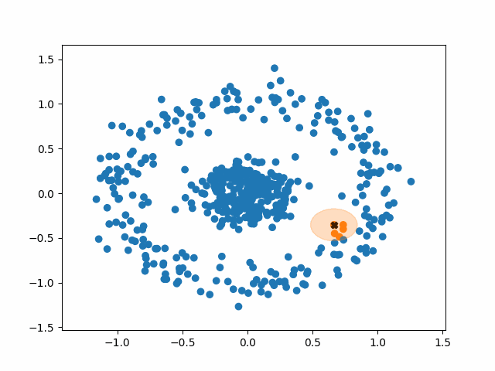

Slide 58
DBSCAN Algorithm
Stands for Density-Based Spatial Clustering of Applications with Noise
This is also a density based algorithm
It separates regions by areas of low-density so that it can detect outliers between the high-density clusters.
Uses two parameters:
  ε (epsilon): how close points must be to count as neighbours.
  min_samples: how many nearby points are needed to start a dense area.
Compared with K-means, DBSCAN does not require you to choose the number of clusters in advance, and it can find irregularly shaped groups. Its results depend strongly on the distance scale and those two settings
Isolated dots are marked as noise rather than forced into a cluster.
Notes:
eps: specifies how close points should be to each other to be considered a part of a cluster. It means that if the distance between two points is lower or equal to this value (eps), these points are considered neighbors.
minPoints/min Samples: the minimum number of points to form a dense region. For example, if we set the minPoints parameter as 5, then we need at least 5 points to form a dense region.

Slide 59
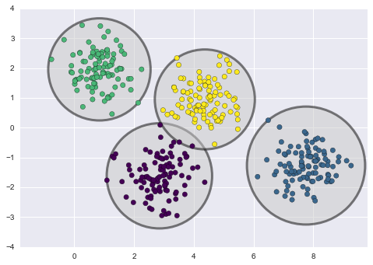
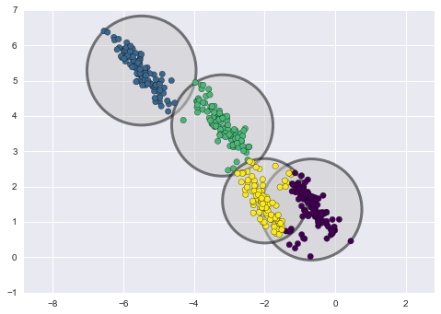
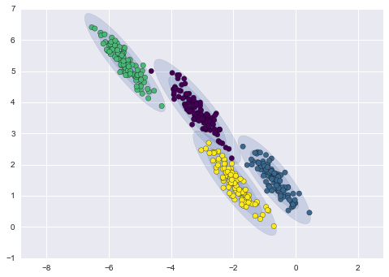
Gaussian mixture model
Very similar to K-Means HOWEVER
  K-menas follows a circular format
  Gaussian can take on any format
K-means
K-means
Gaussian
https://towardsdatascience.com/gaussian-mixture-models-d13a5e915c8e

Slide 60
Few more clusstering algorithms
BIRCH algorithm
Affinity Propagation clustering algorithm
OPTICS algorithm
Agglomerative Hierarchy clustering algorithm
etc etc

Slide 61
Types of unsupervised learning
Clustering
Association

Slide 62
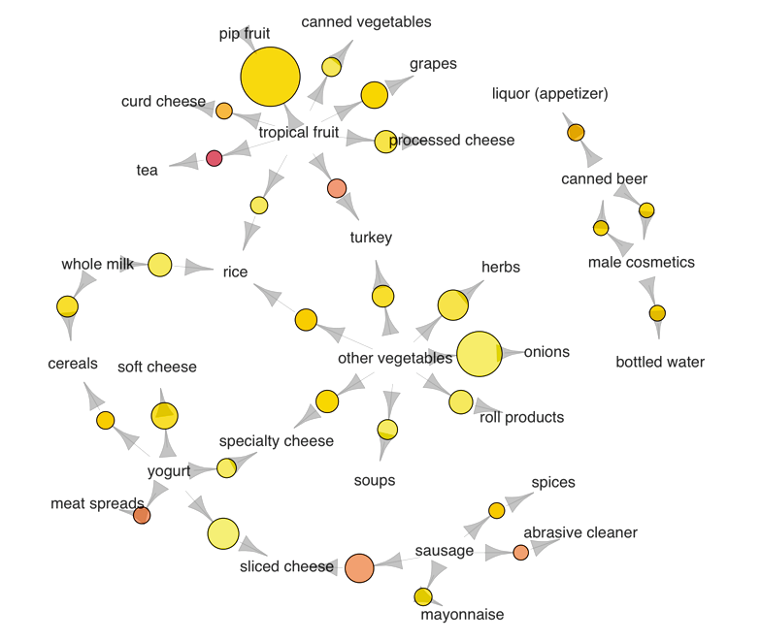
Association algorithms
https://www.kdnuggets.com/2016/04/association-rules-apriori-algorithm-tutorial.html
Notes:
We use a dataset on grocery transactions from the arules R library. It contains actual transactions at a grocery outlet over 30 days. The network graph below shows associations between selected items. Larger circles imply higher support, while red circles imply higher lift:
The most popular transaction was of pip and tropical fruits
Another popular transaction was of onions and other vegetables
If someone buys meat spreads, he is likely to have bought yogurt as well
Relatively many people buy sausage along with sliced cheese
If someone buys tea, he is likely to have bought fruit as well, possibly inspiring the production of fruit-flavored tea

Slide 63
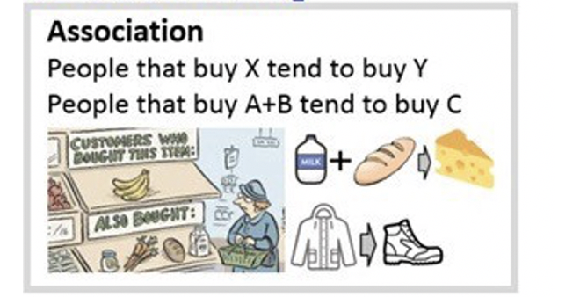
2. Association
  When we want to discover rules that describe our data.
https://miro.medium.com/max/1324/0*LHiIYYxuVUd4qYFW.jpeg
Notes:
Store example in USA where they increased sales of beer by putting beer and diapers together.
Since they found that men bought beers and diapers on Thursdays

Slide 64
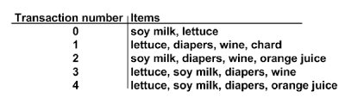
Notes:
Frequent items which commonly appear together are: {wine, diapers, soy milk}.
association rule such as diapers -> wine. This means that if someone buys diapers, there is a good chance they will buy wine.

Slide 65
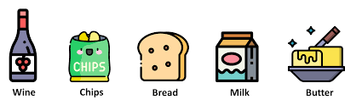
Apriori algorithm
is used for mining frequent itemsets and devising association rules.
It is created to operate on a database containing a lot of transactions, for instance, items brought by customers in a store.
This is the algorithm behind: “You may also like”

Slide 66
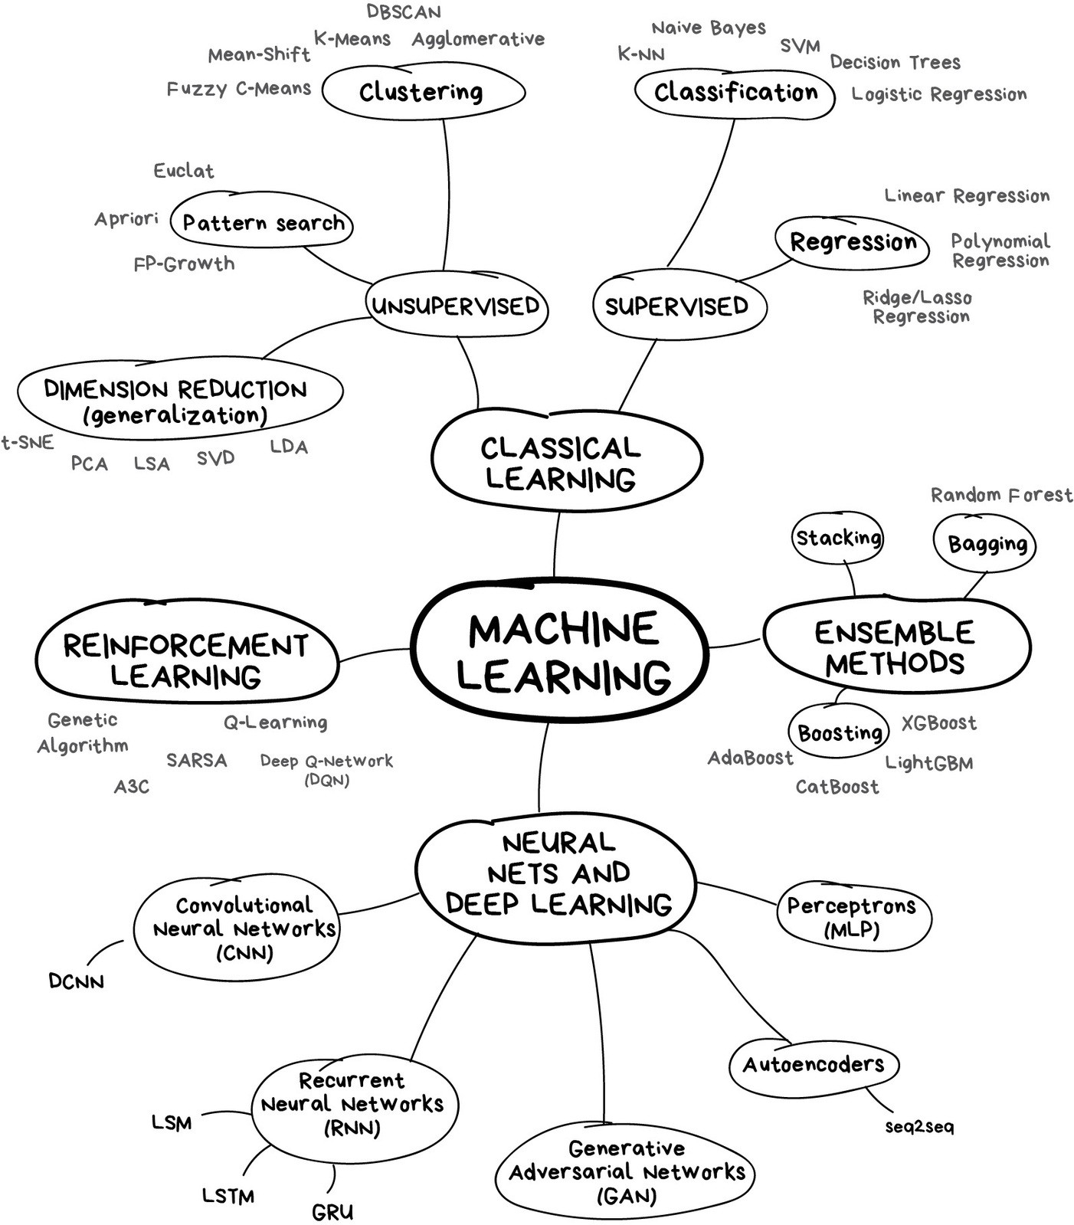
https://towardsdatascience.com/what-is-machine-learning-885aa35db58b

