Slide 1
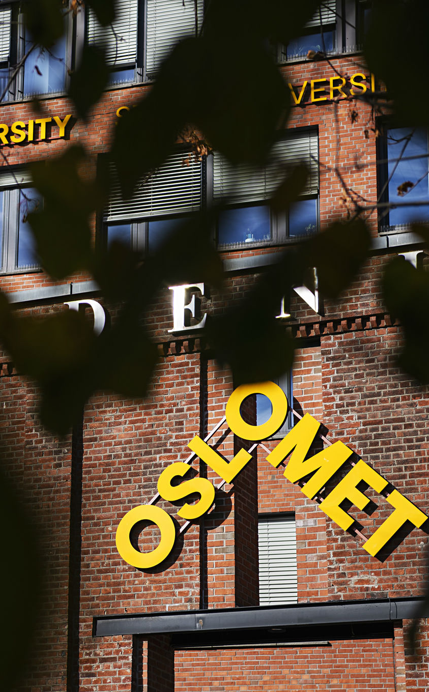
Introduction to AI
Umair Mehmood Imam

Slide 2
Class of 218 students
Lectures
  Tuesday : 14:30 – 16:15
Lab
  Wednesday: 14:30 – 16:15

Slide 3
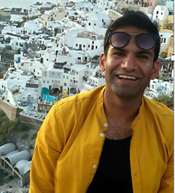


Umair Mehmood Imam
Assistant Professor @ OsloMet
    Course: Intro to A.I
    Member of the A.I lab
Founder of Bineric AI
  Norwegian / European llms (NorskGPT) , Bineric Ai Assistant, Inference platform
Director for AI and Quantum @ TET Digitial (part of Ruter)
  Laucnhed RuterGPT, TeTGPT, Tet Whisper and around 50 different AI projects
Founder of Offentlig AI
  Community of all state (offentlig) employees working with A.I
  150+ members and 25+ state companies
Masters in Distributed computing from KTH, Stockholm, Sweden
Umair_
umairmi

Slide 4
Teacher assistants
We have 4 TAs for the course
Please send emails to TAs first.
Or ask questions on Canvas

Slide 5
Class representative
The course evaluation cannot happen without a class representative
You must choose a class representative
The class representative should:
  Communicate with the students and learn their opinions, concerns and preferences regarding the course.
  Speak on behalf of the class to voice their concerns and opinions.
  Contribute to a good social and learning environment
  Collaborate with the teacher on conducting the course evaluation and preparing a summary of the results
  The class representative will sign the course evaluation before it is sent to the Head of Department

Slide 6
Grading
Assignments
3 compulsory assignments done in groups of 2-4 students must be approved in order to be admitted to the final exam.
Assessment
Grade based on individual written examination (4 hours).

Slide 7
Scope of Intro to AI course
The course is a mix of theory and practical work
We will do some programming
  aim is to show you how different A.I algorithms work
We will work with data
  Cleansing
  Anonymization
  Labeling etc..
We will investigate if A.I is the answer to everything or if A.I is really stupid ?

Slide 8
Course Outline
Basics of AI – history, definitions, and scope
Data and Data Science – the fuel for AI systems
Key AI Concepts – search, reasoning, and knowledge representation
Machine Learning – supervised, unsupervised, and reinforcement learning
Deep Learning – neural networks and backpropagation (if we get time)
Gen AI – Introduction and explanation to Gen AI
Responsible AI & Ethics – fairness, accountability, and societal impact

Slide 9
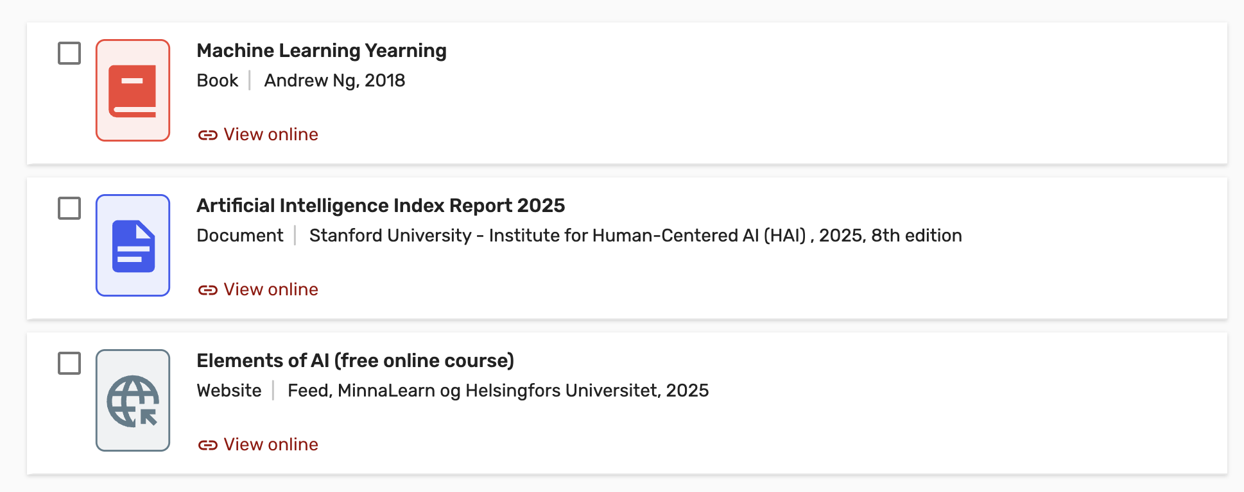
Reading material

