Slide 1

Machine Learning
DAVE3625
Umair Mehmood Imam
Notes:
Machine learning is the part of artificial intelligence where a program works out its own rules from examples, instead of being given rules by a programmer.
This lecture covers what machine learning is, the main types of it, and then one algorithm in full: linear regression, including how to measure how wrong it is.
Reading: Elements of AI, Chapter 4 — the sections on types of machine learning and on linear regression.

Slide 2
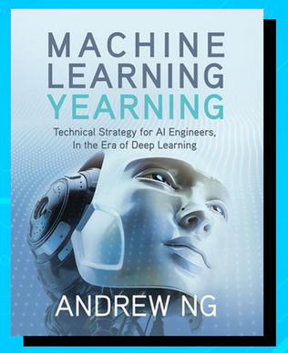
Resources for Machine learning
Course slide from
DIKU 004 - Supervised Machine Learning.pdf
Notes:
These slides borrow from a course on supervised machine learning (DIKU 004). The file is on Canvas together with the lecture.
The other two resources for this part of the course are Elements of AI Chapter 4, which covers the same ground more slowly, and Machine Learning Yearning by Andrew Ng, which is about how to run a machine learning project rather than about the algorithms.

Slide 3
Some core and important concepts
Notes:
Two ideas come before any machine learning: probability, because a model gives you an estimate with uncertainty attached rather than a certainty, and statistics, because you have to understand a dataset before you can model it.
Neither is treated in depth here. What follows is the minimum needed to read the rest of the course.

Slide 4
Probability
How likely something is to happen
Notes:
Whenever we’re unsure about the outcome of an event, we can talk about the probabilities of certain outcomes—how likely they are. The analysis of events governed by probability is called statistics.

Slide 5
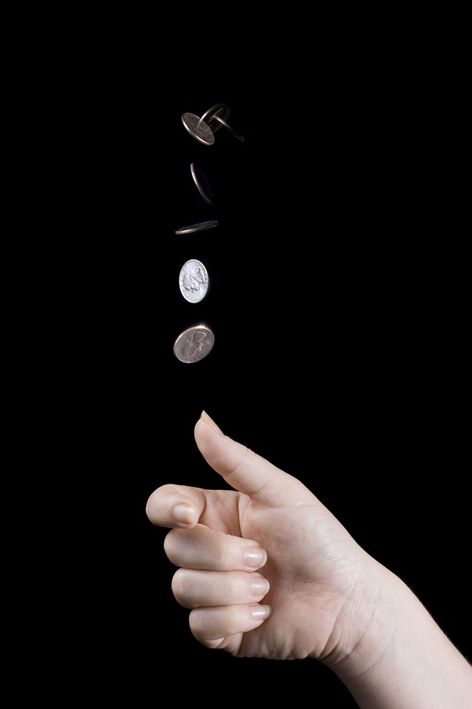
Example 1: Coin Flipping
P(H) = (number of ways it can happen) / (Total number of outcomes)
P(H) = ½ = 0.5 or 50%
Ref image : https://www.bellevuerarecoins.com/history-coin-flip/
Notes:
A fair coin has two possible outcomes and one of them is heads, so the probability is one out of two: 0.5, or 50%.
The formula assumes every outcome is equally likely, which is true for a fair coin and usually false in real data. Working out the probability of something in a real dataset normally means counting how often it happened, not counting possibilities.

Slide 6
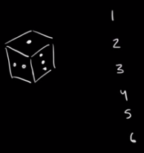

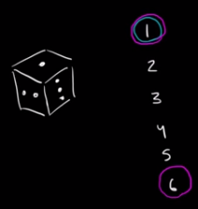

Another example
What’s the probability of rolling a one?
What’s the probability of rolling a one or a six?
Ref: Khan Academy
Notes:
Two questions on one die. The probability of rolling a one is 1/6, about 17%. The probability of rolling a one or a six is 2/6, which is 1/3, about 33%.
The probabilities add together because the two outcomes are mutually exclusive — a single die cannot show a one and a six at the same time. When events can happen together, adding them counts the overlap twice.
https://www.khanacademy.org/math/statistics-probability/probability-library/basic-theoretical-probability/a/probability-the-basics

Slide 7
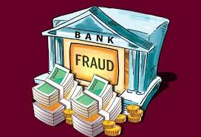
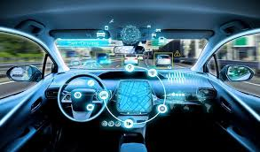
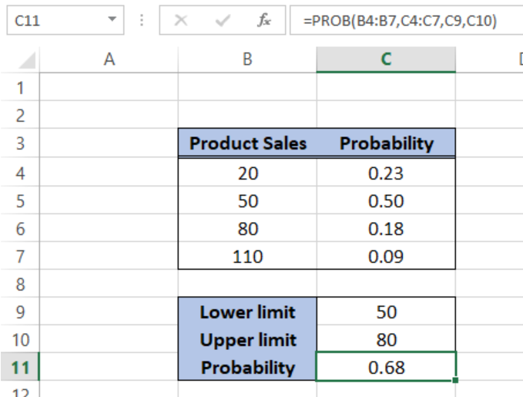
Uses of Probability
Notes:
Two very different uses of the same mathematics.
A self-driving car has to act while uncertain: its software assigns probabilities to what an object beside the road is and to what it will do next, and then chooses an action that is safe across those possibilities.
The spreadsheet does something far more ordinary — Excel's PROB function gives the probability that product sales land between 50 and 80, which comes to 0.68. Forecasting in a business works on exactly the same principles as the car.

Slide 8
Statistics
Statistics is a traditional field, broadly defined as a branch of mathematics dealing with data collection, organization, analysis, interpretation and presentation
(Ref: Wikipedia)
Notes:
Statistics comes in two halves. Descriptive statistics summarise the data you have: the mean, the median, the quartiles, the counts. That is what describe() produced last week.
Inferential statistics use a sample to draw conclusions about a larger population, with a statement about how confident you can be.
In this lecture statistics is used for a third purpose: looking for relationships in the data that are worth building a model around.

Slide 9
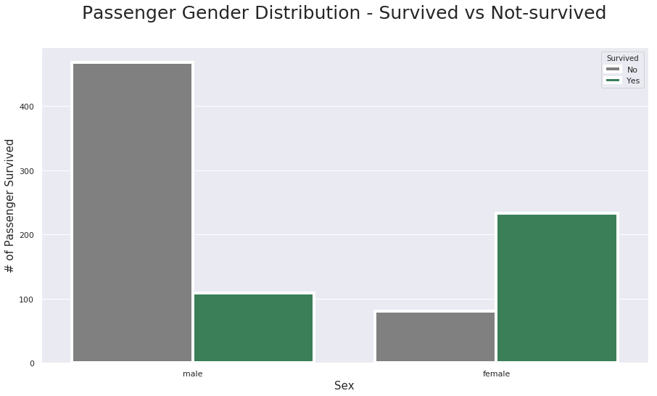
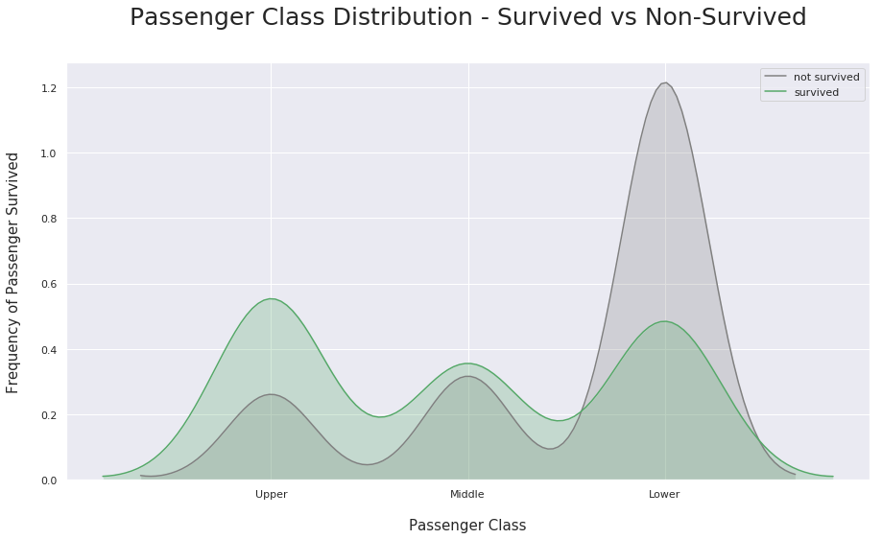
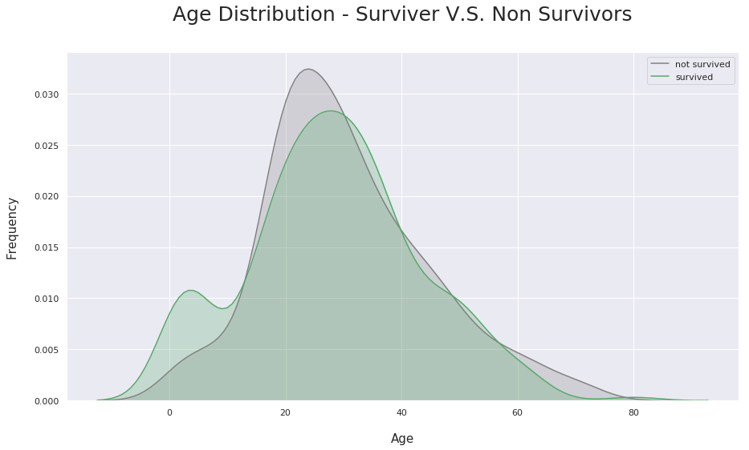
Titanic data set
Port | Passengers | Survived | Survival rate
S — Southampton | 644 | 217 | 34%
C — Cherbourg | 168 | 93 | 55%
Q — Queenstown | 77 | 30 | 39%
Notes:
The Titanic passenger list is the standard first dataset in machine learning: 891 passengers, twelve columns, and one column recording whether each person survived.
It is used throughout this course because it is small enough to read by eye and rich enough to be interesting — it contains numbers, categories, missing values and a clear question to answer.
Ref: https://www.kaggle.com/masumrumi/a-statistical-analysis-ml-workflow-of-titanic

Slide 10
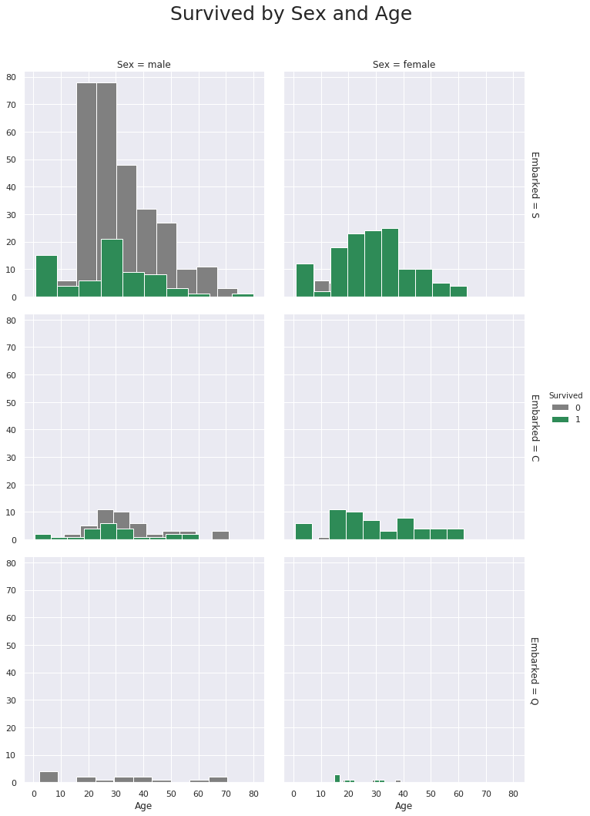
Most passengers seem to be boarded on Southampton(S).
About 66% of the passengers who boarded at Southampton (S) did not survive.
About 55% of the passengers who boarded at Cherbourg (C) survived.
Pretty much every male that boarded on Queenstown(Q) did not survive.
There were very few females boarded on Queenstown, however, most of them survived.
Notes:
This is a compelling facet grid illustrating four features relationship at once.
They are Embarked, Age, Survived & Sex.
The color illustrates passengers survival status(green represents survived, gray represents not survived)
The column represents Sex(left being male, right stands for female)
The row represents Embarked(from top to bottom: S, C, Q)

Slide 11
Why did more Cherbourg passengers survive ?
▪ Boarding at Cherbourg did not make anybody safer.
▪ Cherbourg boarded a much larger share of first-class passengers,
▪ and first class was closer to the lifeboats, with women and children given priority.
▪ So Embarked looks like it predicts survival. What it actually carries is
▪ passenger class and sex.
▪ A third variable that explains an apparent relationship is called a confounder.
▪ Correlation is not causation.
DAVE3625- Intro to A.I. by Umair M.I
11
Notes:
This matters in three ways that come back throughout the course.
First, a feature can predict well while explaining nothing. For predicting who survived, Embarked is a perfectly useful feature. For understanding why people died, it is misleading. Prediction and explanation are different goals.
Second, it is why exploring data before modelling is worth the time — the pattern you notice first is often a shadow of something else.
Third, this is how a model can pick up a bias you thought you had removed. A model built without the Sex column would still reconstruct most of that information from Embarked, Fare and the passenger's title.

Slide 12
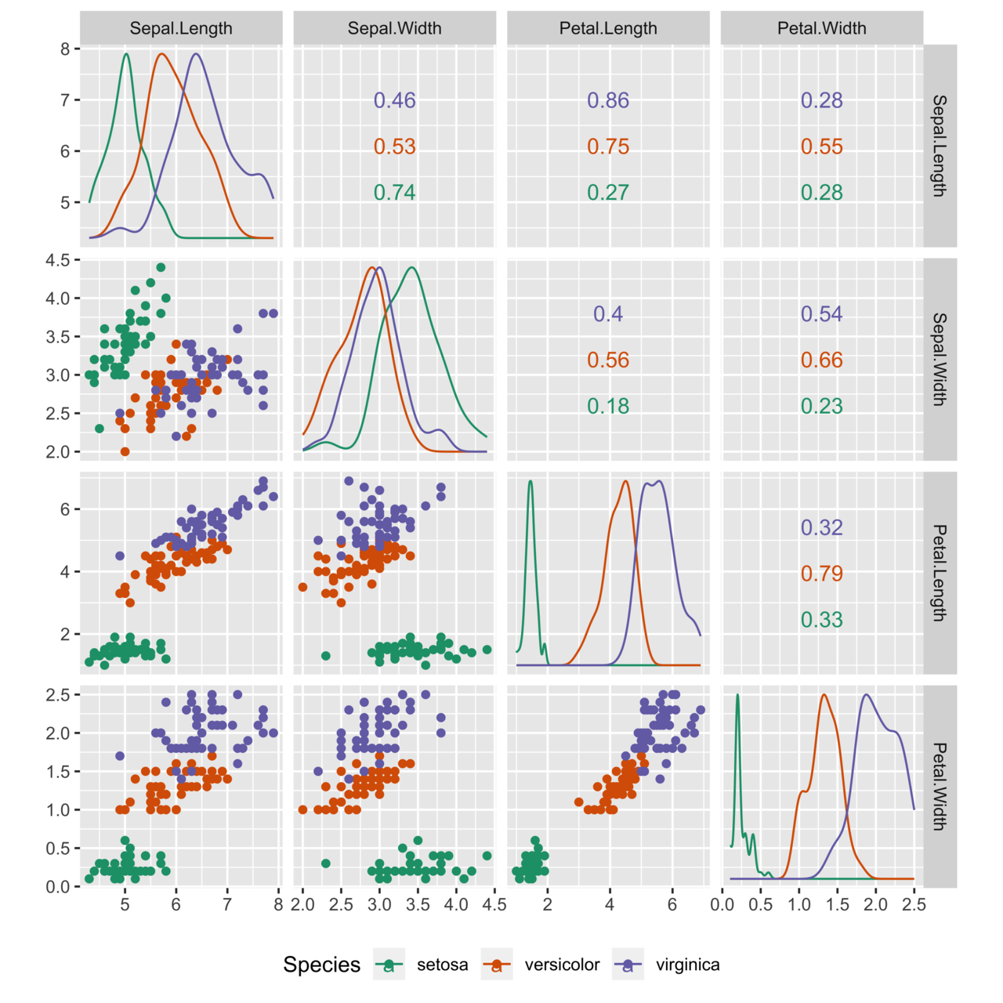
Scatter plots
Notes:
Scatter plots are used in descriptive statistics to show the observed relationships between different variables, here using the Iris flower data set.

Slide 13
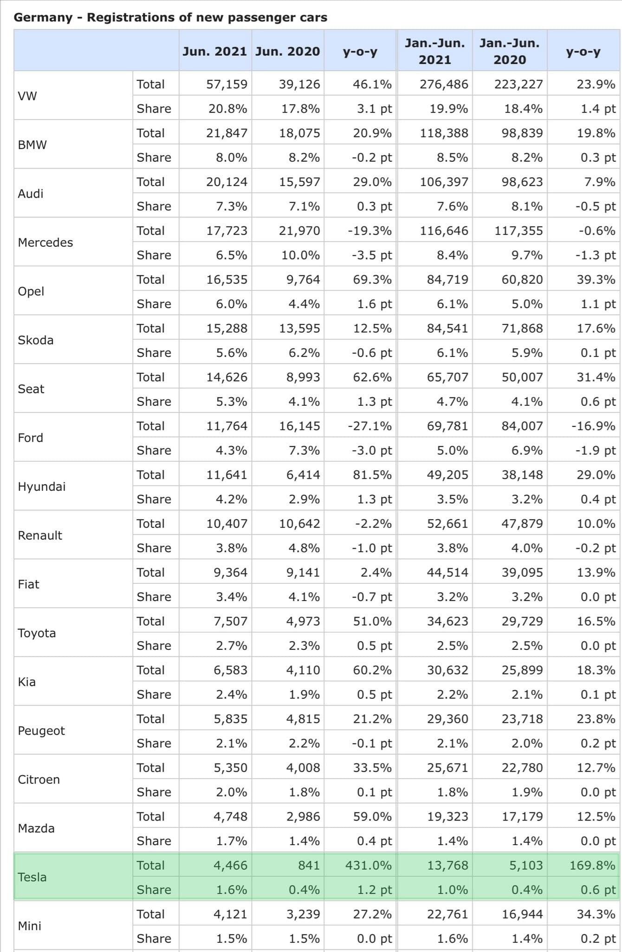
Notes:
New passenger car registrations in Germany, June 2021 against June 2020, with Tesla highlighted.
Tesla's growth is 431% year on year, which looks spectacular until you look at the numbers behind it: 841 cars to 4 466. Its share of the market is still 1.6%. VW sold 57 159 in the same month.
This is the most common way statistics mislead: a percentage change without the size it started from. A small number growing fast produces a large percentage. Always ask what the base was.

Slide 14
What is Machine Learning
Machine learning is an application of artificial intelligence (AI) that provides systems the ability to automatically learn and improve from experience without being explicitly programmed.
Notes:
ML algorithms can learn on its own from past experiences, just like humans do. When exposed to new data, these algorithms learn, change and grow by themselves without you needing to change the code every single time.
Ref: https://www.verzeo.in/blog-what-is-machine-learning

Slide 15
The flip that defines machine learning
Conventional programming
Machine learning
▪ You write the rules
▪ Input + rules → output
▪ You can read the logic line by line
▪ Fails on cases you did not foresee
▪ The algorithm is the important part
▪ The algorithm derives the rules from examples
▪ Input + output → rules
▪ You inspect a model; it may not be interpretable
▪ Handles unforeseen cases — sometimes badly, silently
▪ Data and algorithm together are the important part
Machine learning: systems that learn and improve from experience without being explicitly programmed.
DAVE3625 · Intro to A.I. by Umair M.I
12
Notes:
You supply examples of the answer and the algorithm works backwards to a rule that reproduces them. The fourth row is the one with professional consequences: conventional software fails loudly on inputs it was not written for, while a model returns a confident answer for anything you hand it, including nonsense. That is why monitoring exists.

Slide 16
The words we will use
Term | What it means
Model | The thing that has learned. Empty before training; holds numbers after
Parameters | The numbers the model works out from the data — a slope, a weight
Hyperparameters | The numbers you choose before training starts
Training (fitting) | Adjusting the parameters until the predictions match the known answers
Inference (predicting) | Using the trained model on new data
Loss (cost) function | A measure of how wrong the model is — what training tries to make small
Generalisation | Working well on data never seen during training. The only goal that counts
DAVE3625- Intro to A.I. by Umair M.I
16
Notes:
The distinction between parameters and hyperparameters matters and is easy to mix up. Parameters are learned by the algorithm; hyperparameters are settings you decide in advance, such as how many neighbours to look at or how deep a tree may grow.
Generalisation is the point of the whole exercise. A model that answers perfectly on the data it was trained on and badly on anything new has not learned the pattern — it has memorised the examples.

Slide 17
Uses of M.L
Notes:
Machine learning is behind a great deal of ordinary software: recommendations on Netflix, Spotify and Amazon; fraud and money-laundering detection in banks; finding tumours and disease in medical scans; transcribing speech; translation and sentiment analysis; credit and insurance scoring; predicting equipment failure from sensor readings; and predicting delays and demand in transport.
What all of them have in common is that nobody could write the rule by hand, but plenty of past examples exist to learn from.

Slide 18
Uses of machine learning
Area | What it does
Recommendations | Netflix, Spotify, Amazon — what you are likely to want next
Fraud and money laundering | Flagging transactions that do not fit a pattern
Medical imaging | Finding tumours, eye disease, fractures in a scan
Speech and audio | Transcribing calls, understanding dialects
Language | Translation, sentiment analysis, chat assistants
Credit and insurance | Scoring risk from an applicant's history
Predictive maintenance | Predicting a failure from sensor readings before it happens
Transport | Predicting delays, demand and travel times
What these have in common: a rule too complicated to write by hand, and enough past examples to learn from.
DAVE3625- Intro to A.I. by Umair M.I
18
Notes:
Every one of these is a problem where nobody could write down the rule, but where large numbers of past examples exist. That combination is the signal that machine learning is the right tool.
Several of them are also regulated. Credit scoring, insurance and medical decisions affect people directly, so in those areas being able to explain a prediction matters as much as being accurate — a theme we return to at the end of the course.

Slide 19
Example: Search for cats on google. How does this search work ?
Google first gets a large quantity of examples of photos labeled “cat”
Then the Machine learning algorithm looks for patterns of pixels and patterns of colors that will help it predict if the image is of “cat”.
At first, Google’s computers make a random guess of what patterns are good in order to identify an image of a cat.
If it makes a mistake, the algorithm adjusts its own internal values so that next time it is closer to being right. No human edits the model by hand.
In the end the algorithm will learn such patterns and improve its output
Notes:
The important step is the fourth one. The model starts with random guesses about which patterns of pixels indicate a cat, and every mistake nudges its internal numbers towards what would have been correct. That adjustment is automatic and happens thousands or millions of times.
The end result is a rule that recognises cats, stored as numbers inside the model. Nobody ever wrote down what a cat looks like, which is also why it is hard to explain how such a model reaches a particular answer.
Ref: https://www.verzeo.in/blog-what-is-machine-learning

Slide 20
Q. How would you build such a M.L algorithm ?
Notes:
Before looking at the answer, think about what a program would actually need.
It needs examples — a lot of photographs. It needs to be told which of them contain a cat, because otherwise there is nothing to learn from. It needs a way to change itself when it gets one wrong. And it needs photographs it has never seen, to check whether it learned anything or simply memorised the ones it was shown.
Those four requirements are the next two slides.

Slide 21

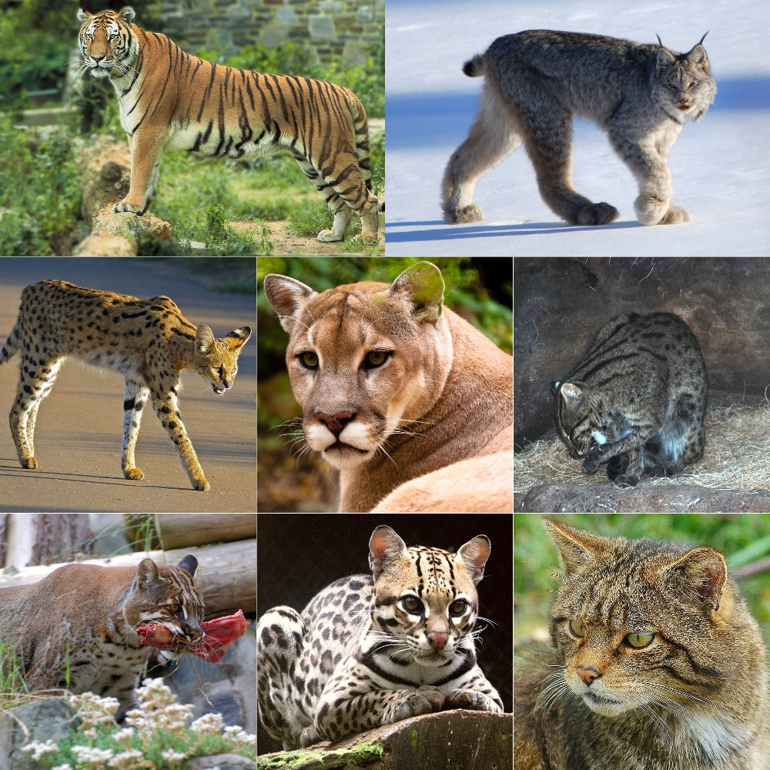
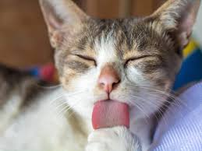
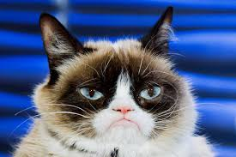
Collect data
Label the data
Notes:
The first two steps, and the expensive ones.
Collecting the images is straightforward. Labelling them — recording for each photograph whether it shows a cat or a lion — is manual work, and on a real project it is often the largest single cost.
It also sets a ceiling on the result. If the people labelling disagree with each other, the model cannot be more consistent than they were, and no change to the algorithm will fix that.

Slide 22
3. Train the machine learning model with data
The model will look for patterns in the images in order to identify cats and lions
4. Once the model is trained, we give it different input images to test and see if the model gives us the right answer.
Notes:
Step 4 is the important one. The model is tested on images it has never seen.
A model that answers correctly on its training images but badly on new ones has not learned what a cat looks like — it has memorised the specific photographs. That is called overfitting, and it is why data is always split into a part used for learning and a part kept back for judging. Detecting and fixing it is a large part of the later lectures.

Slide 23
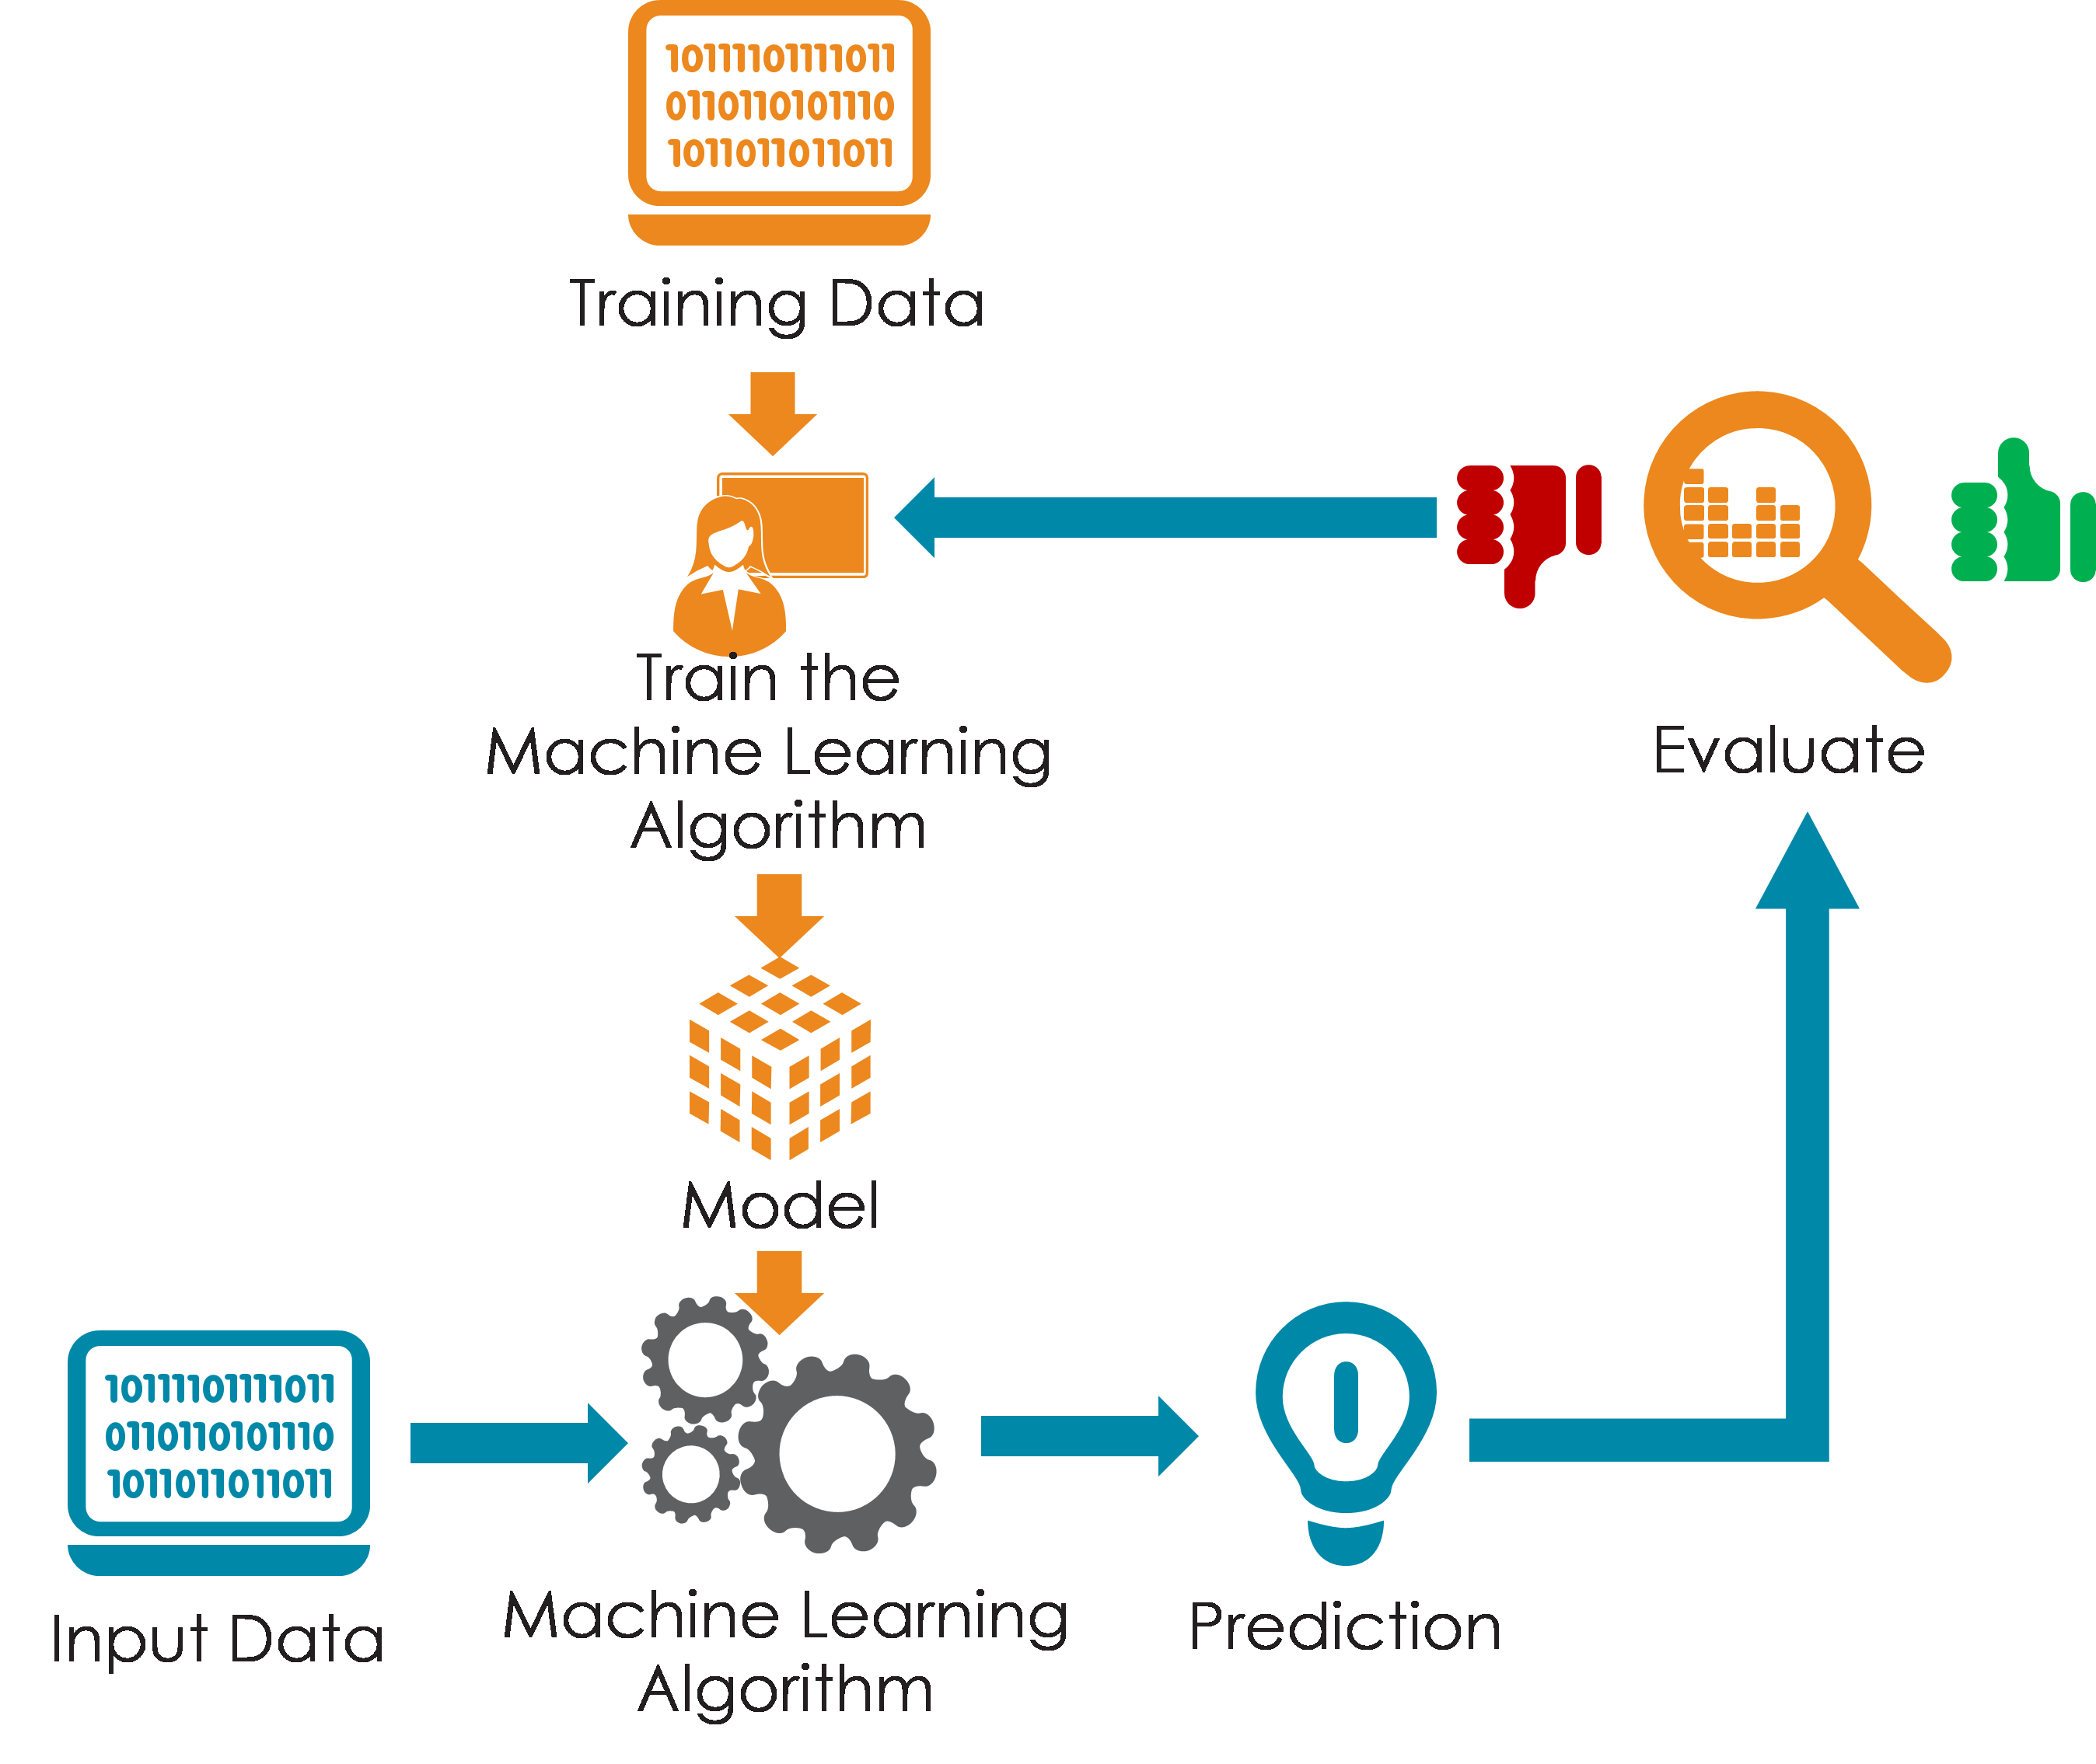
Typical M.L Flow
Notes:
Read the loop rather than the line. Preparing data comes before choosing an algorithm, and evaluating the result usually sends you backwards — most often back to the data, not to the algorithm.
The last stage matters in practice and is easy to forget: a model that is deployed has to be monitored, because the world changes while the model stays exactly as it was.
Ref: https://no.pinterest.com/pin/704883779153047931/

Slide 24
4 Types of Machine Learning algorithms
Supervised learning
Unsupervised learning
Reinforcement learning
Recommender systems
Notes:
The four types are told apart by what you can give the algorithm, not by the subject area or the algorithm itself.
Supervised learning needs examples with the answers attached. Unsupervised learning works without answers, finding structure on its own. Reinforcement learning has no dataset at all — an agent acts in an environment and is rewarded or penalised. Recommender systems work from records of what people interacted with.
Supervised and unsupervised learning are covered in depth next week.

Slide 25
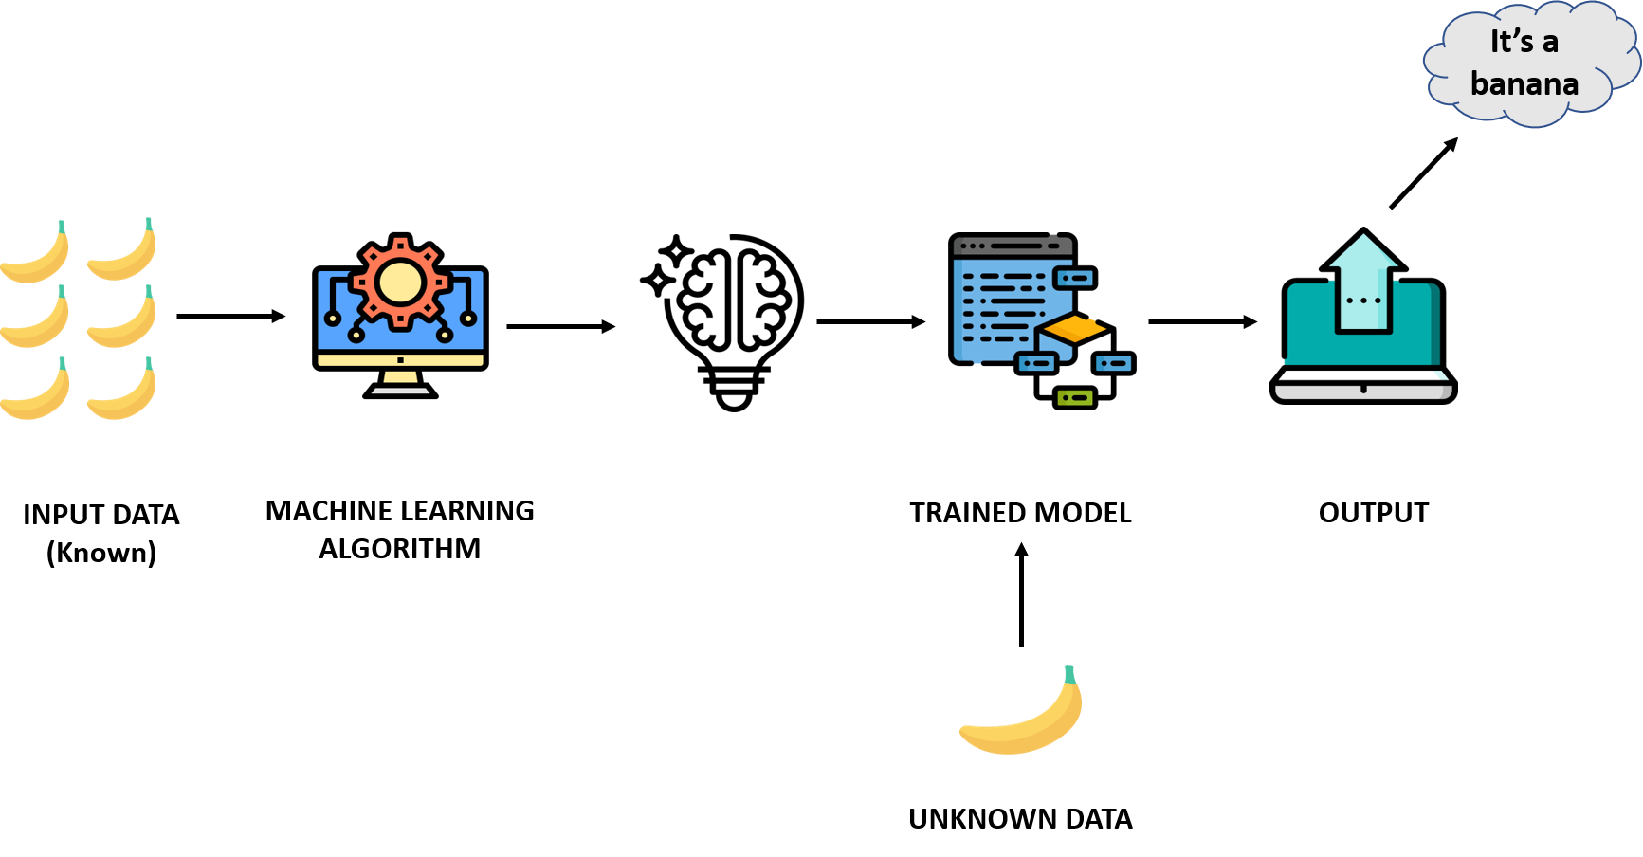
Supervised learning
Notes:
In a supervised learning model, the algorithm learns on a labeled dataset, providing an answer key that the algorithm can use to evaluate its accuracy on training data.
Ref: https://blogs.nvidia.com/blog/2018/08/02/supervised-unsupervised-learning/
Image ref: https://www.verzeo.in/blog-what-is-machine-learning

Slide 26
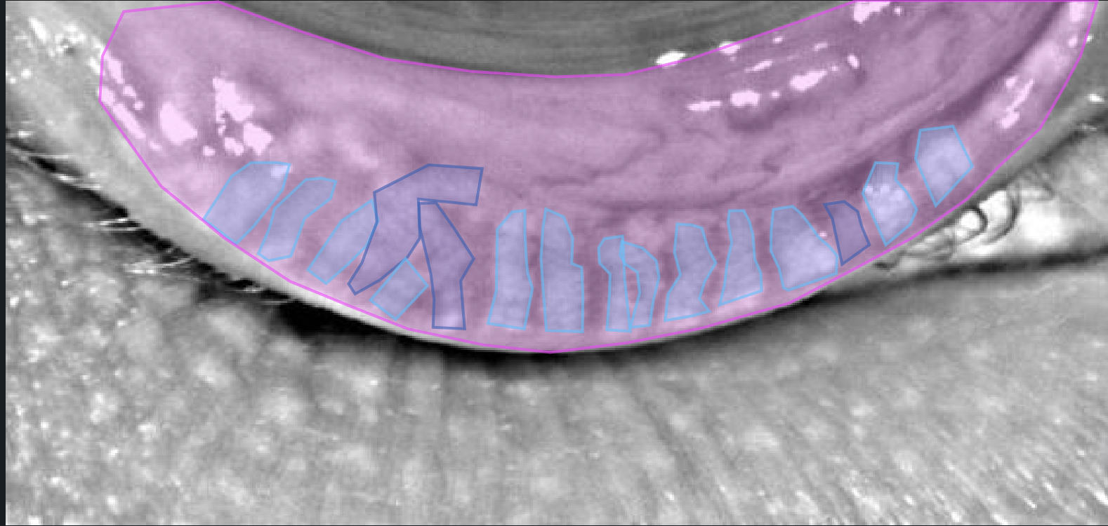
Notes:
What do you see?

Slide 27
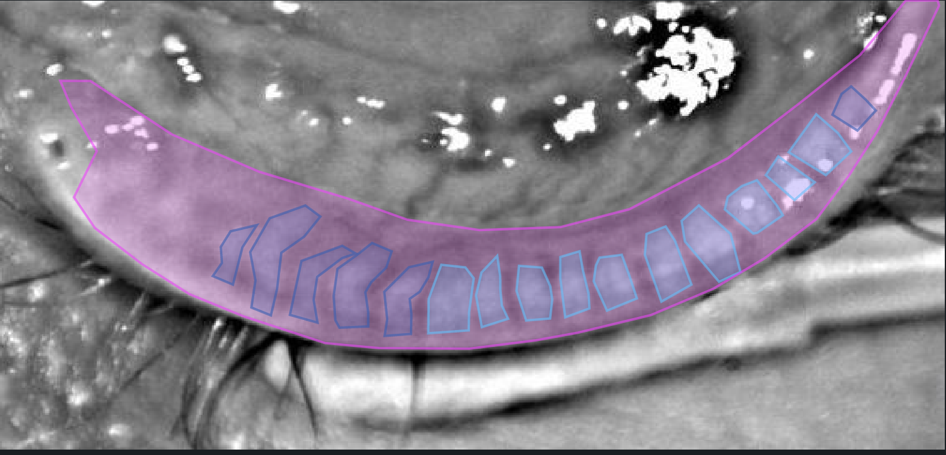
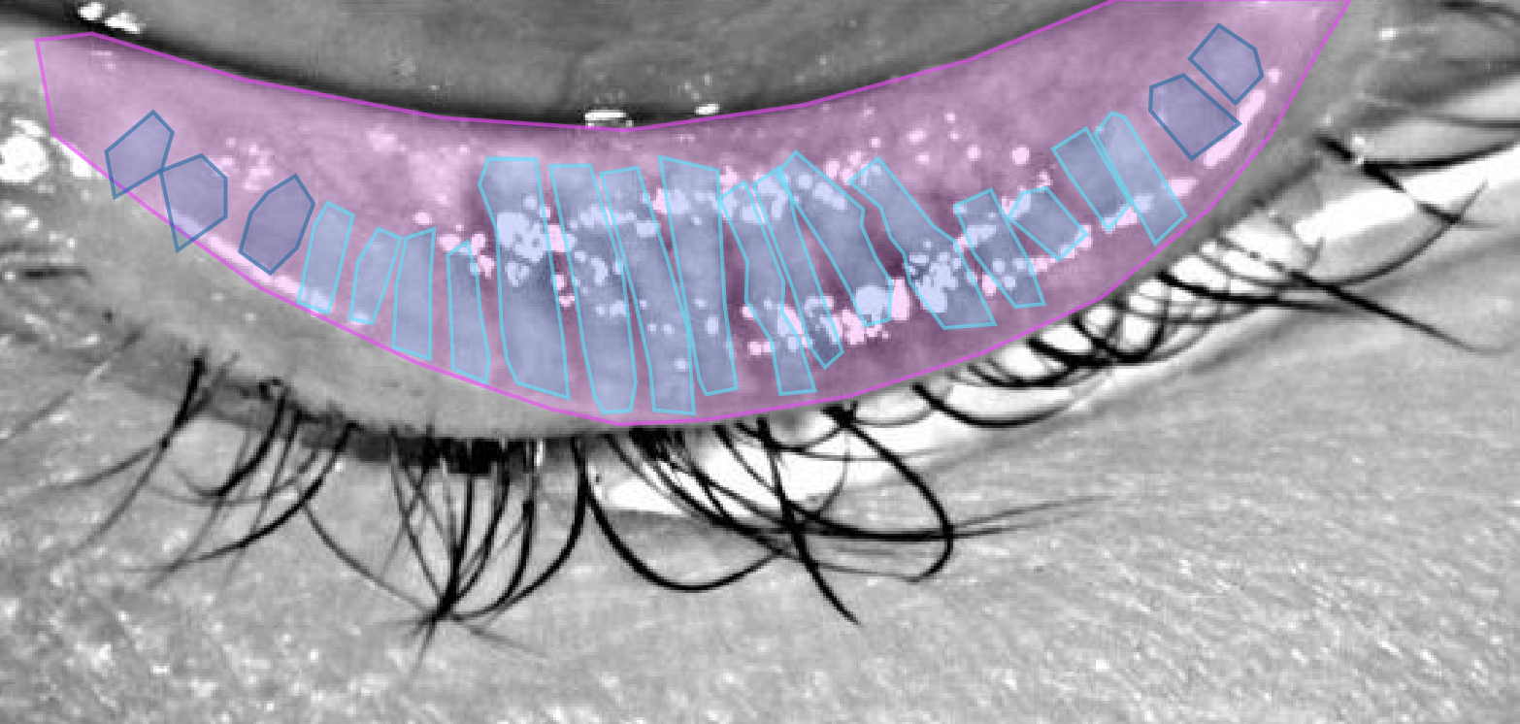


Health AI (labeling sections to identify dry eye disease)
bineric data
Notes:
A project with simula to identify dry eye disease.

Slide 28
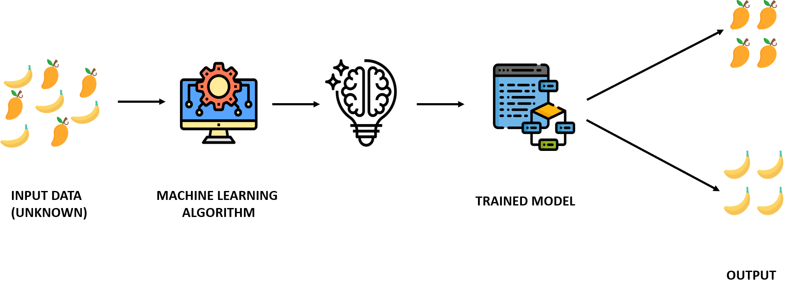
Unsupervised learning
Notes:
Image ref: https://www.verzeo.in/blog-what-is-machine-learning
An unsupervised model, provides unlabeled data that the algorithm tries to make sense of by extracting features and patterns on its own
The training data is unknown or unlabelled.
The model tries to find patterns and relationships in the dataset by creating clusters in it
Model cannot add labels to the data

Slide 29
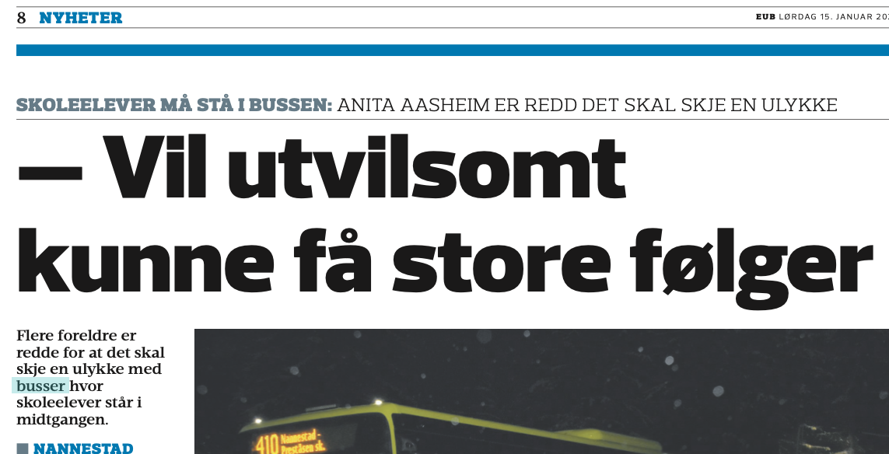
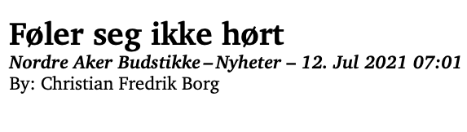
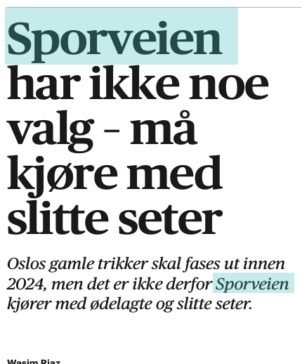
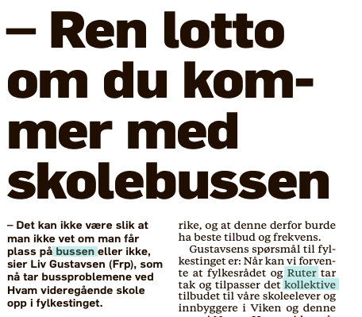
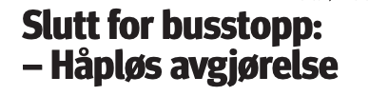

Notes:
The raw material for the project on the following slides: newspaper coverage and customer complaints about bus services — pupils standing in the aisle, a bus that did not stop, someone late for school.
Notice what kind of data this is. It is free text, written by the public, with no labels, no structure and no fixed vocabulary. Nobody has marked which complaints are serious. That is exactly the situation unsupervised methods exist for.

Slide 30
Step 1: Analyzing how angry the users are (sentiment analysis)
Project: Customer Insights using A.I
Notes:
The first question was not "what are people complaining about" but "how angry are they". Sentiment analysis assigns each piece of text a score for how positive or negative it is, which turns thousands of unstructured complaints into something that can be sorted, counted and mapped.
Only once that exists is it possible to ask the more useful question: what are the angriest people angry about?

Slide 31
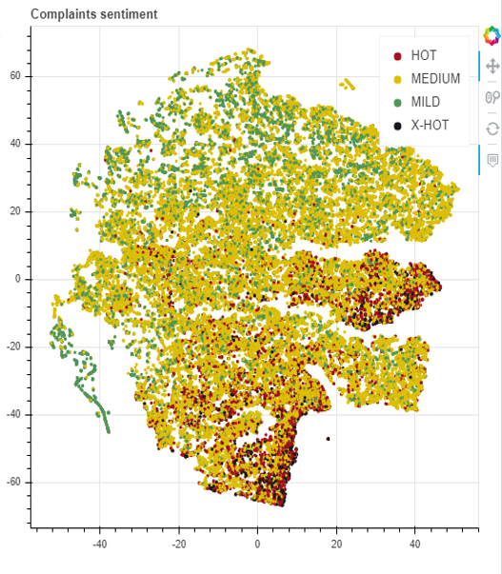
Notes:
Every dot is one complaint. Roughly ten thousand of them.
The position of each dot comes from the words in the complaint itself — complaints about similar things end up near each other. No human decided the layout or the groups; the structure was found in the text. The colour shows how negative the complaint is, from mild through medium to hot and extra hot.
The useful part is the dense red areas at the bottom and on the right. Those are subjects that reliably produce furious customers, and they were found without anyone deciding in advance what the subjects were.

Slide 32
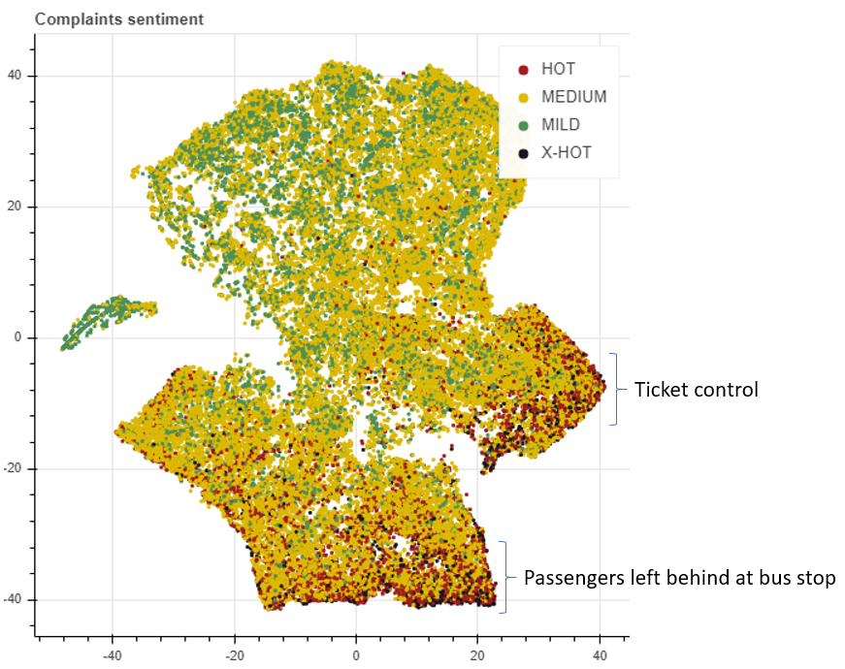
Sentiment Analysis
(Nor-BERT)
Notes:
NorBERT is a language model for Norwegian, built by the Language Technology Group at the University of Oslo.
Using a Norwegian model matters here. Models trained mostly on English handle Norwegian poorly, and they miss the things that carry sentiment in practice: dialect, sarcasm, compound words, and place and route names. Working in a smaller language usually means either finding a model built for it or adapting one yourself.
How models like this work is covered later in the course, in the lecture on large language models.

Slide 33
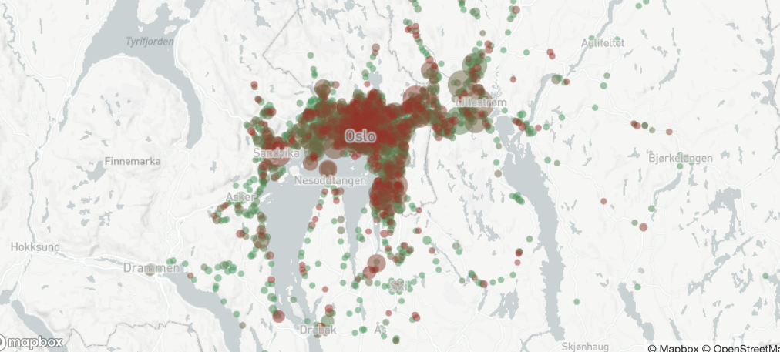
Notes:
The same complaints, placed on a map of Oslo and the surrounding region. Red is negative, and the larger circles are places with more complaints.
This is the step that turns analysis into something a transport operator can act on. A sentiment score for the whole company is interesting; a cluster of angry complaints on one corridor is a work order.
It is also a good illustration of why joining data to other data — here, location — often adds more value than improving the model.

Slide 34
Reinforcement learning
Reinforcement Learning is a type of machine learning technique that enables an agent to learn in an interactive environment by trial and error using feedback from its own actions and experiences.
Whenever the model predicts or produces a result, it is penalized if the prediction is wrong or rewarded if the prediction is correct.
Notes:
The vocabulary of reinforcement learning: an agent takes actions in an environment, and receives a reward or a penalty in return. Over many attempts it learns a policy — what to do in each situation.
The difference from the other types is that there is no dataset. The agent generates its own experience by acting, and the reward is the only teacher it has.

Slide 35
Challenges with Reinforcement learning
The main challenge in reinforcement learning lays in preparing the simulation environment, which is highly dependant on the task to be performed.
Scaling and tweaking the neural network controlling the agent is another challenge. There is no way to communicate with the network other than through the system of rewards and penalties.
Notes:
When the model has to go superhuman in Chess, Go or Atari games, preparing the simulation environment is relatively simple. When it comes to building a model capable of driving an autonomous car, building a realistic simulator is crucial before letting the car ride on the street. The model has to figure out how to brake or avoid a collision in a safe environment, where sacrificing even a thousand cars comes at a minimal cost. Transferring the model out of the training environment and into to the real world is where things get tricky.

Slide 36

There are agents that will optimize the prize without performing the task it was designed for. An interesting example can be found in the OpenAI video (below), where the agent learned to gain rewards, but not to complete the race.
Notes:
The example is a boat racing game. The agent found that it could score more points by driving in circles in a lagoon, repeatedly hitting bonus targets that reappeared, than by finishing the race. It scored higher than human players while crashing constantly and never completing a lap.
The agent was not broken. It optimised exactly what it was rewarded for — points — which was not what its designers meant. This is called reward hacking, and the general version is worth remembering: any system optimising a measure will optimise that measure, not your intention.
Ref: OpenAI, Faulty Reward Functions in the Wild (2016).

Slide 37



Breakout game - Atari
Initial performance
After 15 min of training
After 30 min of training
Notes:
The three frames show the same agent after no training, after fifteen minutes and after thirty minutes.
At the end it has discovered that digging a tunnel through the side of the wall and letting the ball bounce around behind it scores far faster than chipping away at the front. Nobody programmed that strategy or even suggested it. It was found by trial and error against a score.
https://deepsense.ai/what-is-reinforcement-learning-the-complete-guide/

Slide 38
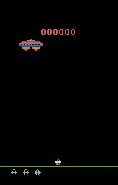
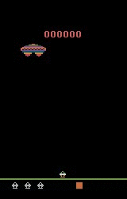
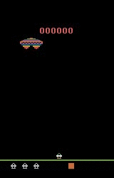
Assault game - Atari
Initial performance
After 15 min of training
After 30 min of training
Notes:
The same progression in a different game, which is the point: the agent was not written for Breakout or for Assault. It was given a screen, a set of controls and a score, and it learned each game from scratch.
https://deepsense.ai/what-is-reinforcement-learning-the-complete-guide/

Slide 39
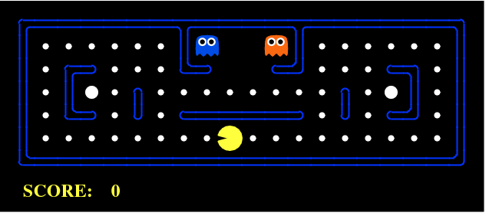
Notes:
Reinforcement learning is impressive in games and rare in industry, and the reason is the environment. An agent needs somewhere it can fail thousands of times at no cost. A game provides that; a hospital, a road or a payment system does not.
That is why the successes you hear about are mostly games, simulations and robotics, where a simulator can be built.
https://www.kdnuggets.com/2018/03/5-things-reinforcement-learning.html

Slide 40
Wanna try some A.I reinforcement learning in games ?
https://gymnasium.farama.org/
Notes:
Gymnasium is the standard toolkit for experimenting with reinforcement learning, and is the maintained successor to OpenAI Gym, which is no longer developed.
pip install gymnasium
It provides ready-made environments — balancing a pole, landing a spacecraft, Atari games — all with the same interface, so you can write an agent once and try it on many problems. It is worth an evening if you are curious; it is not needed for the assignments.

Slide 41
Reccomender systems
Recommender systems are an important class of machine learning algorithms that offer "relevant" suggestions to users.
These systems predict the most likely product that the users are most likely to purchase and are of interest to them
Notes:
There are two main strategies, and they are quite different.
Content-based filtering recommends items similar to ones you already liked, which requires knowing something about the items themselves — genre, author, ingredients.
Collaborative filtering recommends what people similar to you liked. It needs to know nothing at all about the items, only who interacted with what. That is the idea behind "customers who bought this also bought…", and it is why it scales to catalogues nobody could ever describe by hand.

Slide 42
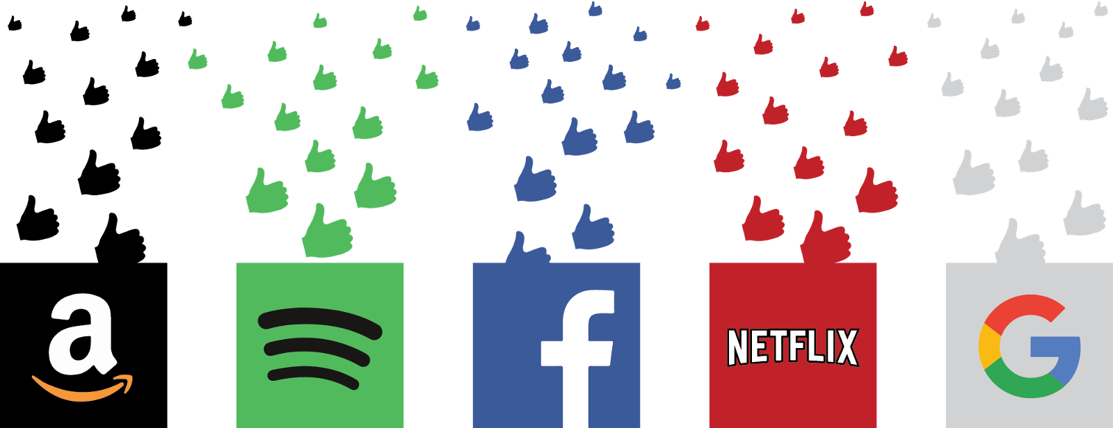
Notes:
Every one of these services runs on the same fuel: a record of what each user clicked, watched, bought, skipped or liked. Each interaction is another training example.
It is worth noticing the loop that creates. Recommendations shape what you see, what you see shapes what you interact with, and what you interact with becomes tomorrow's training data. Over time a recommender can narrow what it shows you without any line of the algorithm intending it.

Slide 43
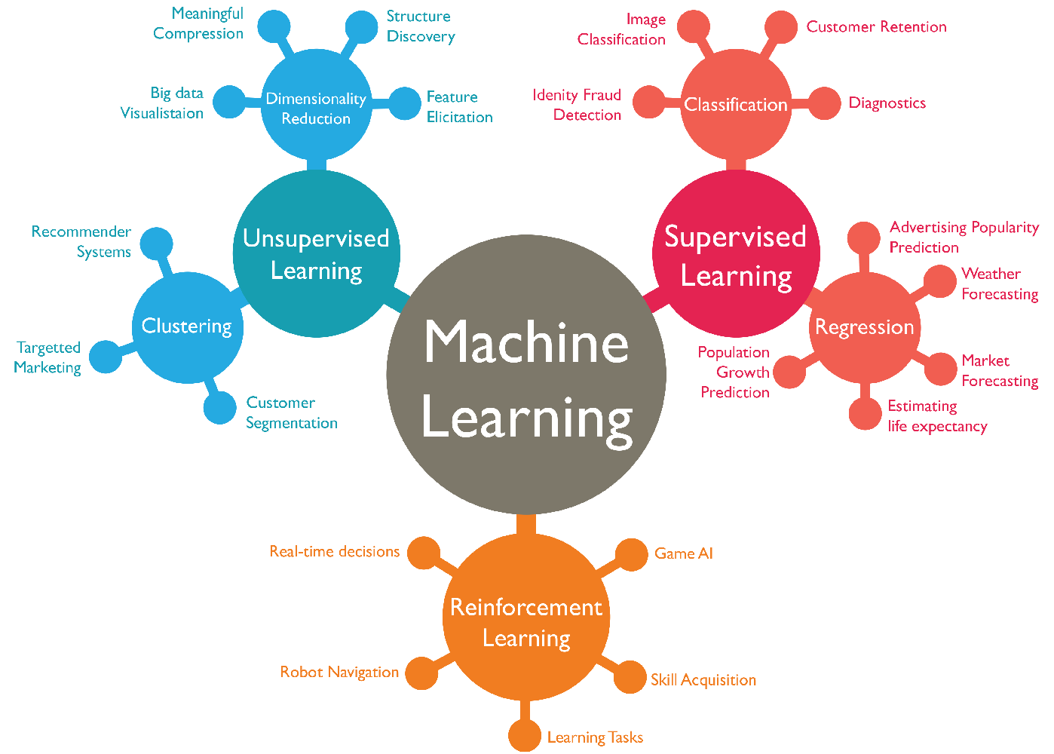
Notes:
Recommendation is the machine learning that most people meet most often, usually without noticing it. Search rankings, social feeds, shop front pages, autoplay and "people also bought" are all the same class of system.
Ref: https://www.wordstream.com/blog/ws/2017/07/28/machine-learning-applications

Slide 44
Which type is your problem ?
The problem | The type
Predict tomorrow's electricity price from past prices | Supervised
Decide if a transaction is fraud, using 10 000 labelled examples | Supervised
Group 50 000 customers into segments nobody has defined yet | Unsupervised
Find which products are often bought together | Unsupervised
Teach a robot arm to pick up a cup | Reinforcement
Suggest the next film to a viewer | Recommender
Find unusual sensor readings, with no examples of "unusual" | Unsupervised
The question to ask: what do I already have, and what do I want out?
DAVE3625- Intro to A.I. by Umair M.I
44
Notes:
The type of machine learning is decided by what you can give the algorithm, not by the subject area. If you have labelled examples of the answer, it is supervised. If you have no labels, it is unsupervised. If there is no dataset at all, only an environment that responds to actions, it is reinforcement learning.
The last row catches most people. "Find unusual readings" sounds like classification, but with no examples of what unusual looks like there are no labels, so it is unsupervised (anomaly detection). If someone hands you 500 labelled failures, the same problem becomes supervised.

Slide 45
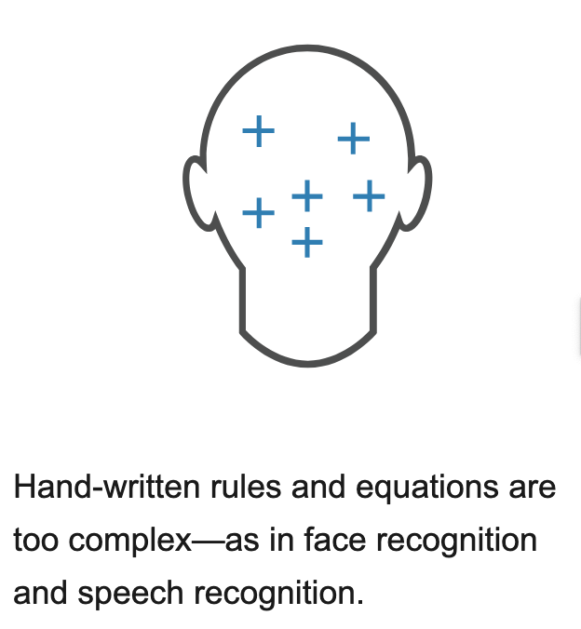
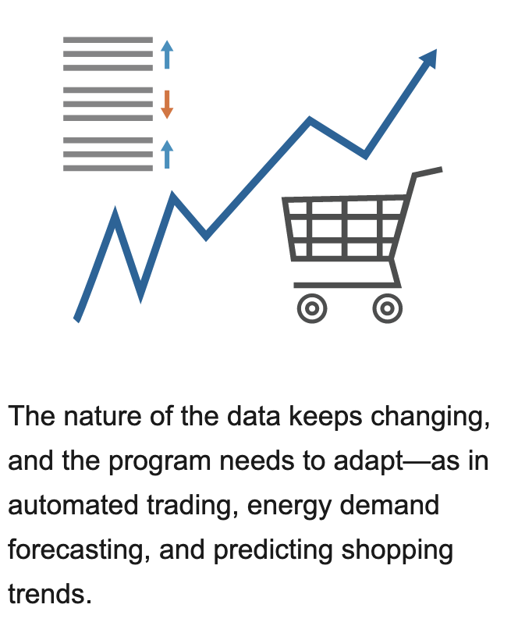
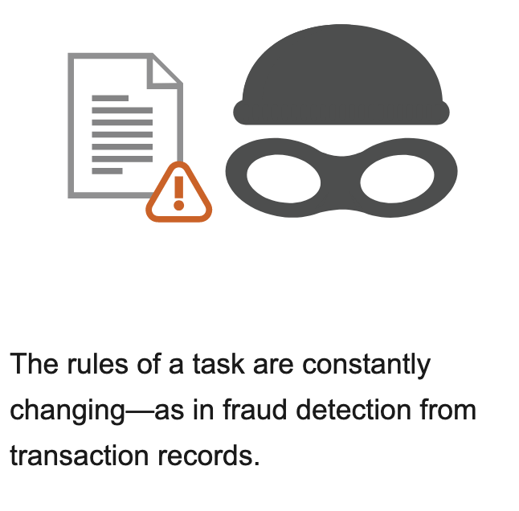
When should we use machine learning ?
Notes:
There is no single answer, but there is a checklist. Machine learning is worth using when the rule is too complicated to write by hand, when a pattern genuinely exists in the data, when enough relevant examples are available, and when the occasional mistake is tolerable or a human checks the output.
It is the wrong tool when ordinary rules already work — nobody should train a model to calculate VAT — when there is no data, when every individual decision has to be explained and defended, or when a single error is catastrophic and nothing checks it.
https://se.mathworks.com/discovery/machine-learning.html

Slide 46
Supervised learning asks two kinds of question
▪ What kind of thing you are predicting decides everything that follows
▪ Regression — the answer is a number on a continuous scale
– House price · salary · temperature · minutes of delay · price of oil
▪ Classification — the answer is a category
– Survived or died · spam or not spam · which of four fruits · yes or no
▪ Different algorithms, and completely different ways of measuring success.
DAVE3625- Intro to A.I. by Umair M.I
46
Notes:
This split runs through the rest of the course. It decides which algorithms you can use, which numbers you use to judge the result, and even what model.score() returns in scikit-learn.
The rest of this lecture is about regression. Classification comes next week.

Slide 47
Regression or classification ?
▪ Customer churn — will this customer leave the company ?
▪ Spam email
▪ Gender prediction
▪ Prediction of the price of oil
▪ Salary prediction
▪ Age prediction
▪ Stock market prediction
For each one, ask: is the answer a number, or a category?
DAVE3625- Intro to A.I. by Umair M.I
47
Notes:
Work through the list before looking at the next slide. The test is simply whether the answer is a number on a scale or one of a set of categories.

Slide 48
Answers — and the one that depends on you
Classification
Regression
▪ Customer churn — leaves or stays
▪ Spam email — spam or not spam
▪ Gender prediction — a category
▪ Price of oil — a number
▪ Salary prediction — a number
▪ Age prediction — a number
Stock market prediction is EITHER: "what will the price be?" is regression · "will it go up or down?" is classification
DAVE3625- Intro to A.I. by Umair M.I
48
Notes:
Stock market prediction is the interesting case. Asking what the price will be tomorrow gives you a number, so it is regression. Asking whether the price will go up or down gives you two categories, so it is classification. Both are legitimate; they are different problems with different models and different measures of success.
The general lesson: the type of task is decided by how you frame the target, not by the subject matter. That is why framing the question is the first step of any machine learning project.

Slide 49
Linear Regression
▪ It is a linear model — an equation describing a relationship between two
▪ quantities that show a constant rate of change
▪ Y = a + bX
▪ Y — what we predict (for example, salary)
▪ X — the input we predict from (for example, age)
▪ a — the intercept: the value of Y when X is 0
▪ b — the coefficient, or slope: how much Y changes when X goes up by 1
"Constant rate of change" means every extra year of age adds the same amount to the predicted salary.
DAVE3625- Intro to A.I. by Umair M.I
49
Notes:
Of all the straight lines that could be drawn through a cloud of data points, linear regression picks the one that makes the total squared vertical distance from the points to the line as small as possible. That method is called least squares, and it is why the error measures later in this lecture are built on squared differences.
Simple as it is, this is the model to understand properly — most of what follows in the course is a variation on it.

Slide 50
What the coefficients tell you
▪ Price = 50 000 + 200 × Size + 1 000 × Bedrooms
▪ Intercept 50 000 — the base value where the line crosses. Often not meaningful on its own
▪ Coefficient 200 — each extra square metre adds 200, *if bedrooms stay the same*
▪ Coefficient 1 000 — each extra bedroom adds 1 000, *if size stays the same*
▪ Positive coefficient → the output goes up when the input increases
▪ Negative coefficient → the output goes down
▪ Bigger number → a stronger effect per unit
DAVE3625- Intro to A.I. by Umair M.I
50
Notes:
Two cautions. First, the size of a coefficient depends on the unit of the feature: measure size in square centimetres instead of square metres and the coefficient changes by a factor of 10 000 while the model is exactly the same. So you cannot read raw coefficients as a ranking of which feature matters most unless the features are on the same scale.
Second, a coefficient describes the fitted line, not cause and effect. Dividing one room into two to add a bedroom does not add 1 000 to the value of the house.

Slide 51
Three kinds of linear regression
Name | Inputs | Shape it draws
Simple linear regression | One input variable (X) | A straight line
Multiple linear regression | Several input variables | A flat plane or hyperplane
Polynomial regression | Inputs and their powers (X, X², X³) | A curve — never a straight line
Polynomial regression is still called a linear model, because it is linear in its coefficients — only the shape in X curves.
DAVE3625- Intro to A.I. by Umair M.I
51
Notes:
Polynomial regression fits Y = a + b₁X + b₂X² + … Each term is still a coefficient multiplied by a known value, which is what "linear" refers to, so exactly the same fitting machinery works — you simply hand the model X² as an extra column.
The risk is that a high enough degree lets the curve pass through every single training point and then predict nonsense between them. That is overfitting, and it is covered later in the course.

Slide 52
What the model is given, and what is held back
▪ One row is one observation. One column is one feature.
▪ X — the features the model predicts *from*
▪ y — the target the model predicts
▪ The data was split in two last week:
– X_train, y_train — the model learns from these
– X_test, y_test — kept back, and used only to judge the result
▪ A model scored on the same rows it learned from measures memory, not skill.
A common split is 80% for training and 20% for testing.
DAVE3625- Intro to A.I. by Umair M.I
52
Notes:
This is the reason last week's lecture spent its time on preparing data. The model is fitted using the training rows only, and every number reported in the next few slides is calculated on the test rows — data the model has never seen.
If you fit anything (a model, a scaler, an imputer) using the full dataset before splitting, information about the test rows leaks into training and the reported score is better than the truth. That is called data leakage.

Slide 53
Building a linear regression model
Choose a model, fit it, predict. Every algorithm in scikit-learn uses these same three steps.
from sklearn.linear_model import LinearRegression
model = LinearRegression()
model.fit(X_train, y_train) # learns a and b from the training data
print(model.intercept_) # a
print(dict(zip(X_train.columns, model.coef_))) # b, one per feature
y_pred = model.predict(X_test) # predict for data it has not seen
DAVE3625- Intro to A.I. by Umair M.I
53
Notes:
model.coef_ is a plain array of numbers in the same order as the columns of X_train, with no names attached. Pairing it with the column names using zip() is worth doing every time — reading the array by position is how people end up reporting the wrong feature.
Notice that the model is fitted on the training data and used to predict on the test data. Scoring a model on the same rows it learned from measures its memory, not whether it is useful.

Slide 54
Seeing how well the line fits
The second plot works no matter how many features the model uses.
# with one input: the data and the fitted line
plt.scatter(X_test["Size"], y_test, alpha=0.5)
plt.plot(X_test["Size"], y_pred, color="red")
# with any number of inputs: predicted against actual
plt.scatter(y_test, y_pred, alpha=0.5)
plt.plot([y_test.min(), y_test.max()],
[y_test.min(), y_test.max()], "k--") # the perfect line
DAVE3625- Intro to A.I. by Umair M.I
54
Notes:
In the predicted-against-actual plot, a perfect model would put every point on the dashed diagonal. Three patterns are worth recognising:
Points sitting consistently above or below the line at one end mean the model is biased in that range. A fan shape that widens to the right means the errors grow as the values grow, which is common with prices. A curved band rather than a straight one means a straight line is the wrong shape for this data, and a polynomial or a different model would fit better.

Slide 55
How wrong is the model ? Start with one row
▪ residual = actual value − predicted value
▪ A positive residual means the model predicted too low
▪ A negative residual means the model predicted too high
▪ To judge the whole model, these have to be combined into one number.
▪ But you cannot simply average them — the positives and negatives cancel out,
▪ and the average comes to zero for every model.
DAVE3625- Intro to A.I. by Umair M.I
55
Notes:
For a least squares fit the residuals always add up to zero, so their mean tells you nothing at all. There are two standard ways around this: take the absolute value of each residual, or square each residual. Those two choices produce the error measures on the next slides.

Slide 56
Five houses — prices in thousands of kroner
The residuals add up to zero, as they always do. The last two columns are the useful ones.
actual predicted residual |residual| residual²
------ --------- -------- ---------- ---------
200 210 -10 10 100
250 240 +10 10 100
300 310 -10 10 100
350 330 +20 20 400
400 420 -20 20 400
------ --------- -------- ---------- ---------
sum 0 sum 70 sum 1100
DAVE3625- Intro to A.I. by Umair M.I
56
Notes:
This small table is used to work out all four error measures on the next two slides. Working through it by hand once is the difference between memorising formulas and understanding them.
Notice the two errors of 20 among three errors of 10 — they are what makes RMSE differ from MAE.

Slide 57
Three ways to summarise the error
▪ MAE — Mean Absolute Error 70 / 5 = 14
– The average size of the error, in the original unit: about 14 000 kr out
– The easiest measure to explain to somebody who is not a specialist
▪ MSE — Mean Squared Error 1100 / 5 = 220
– The average of the squared errors. Its unit is thousands of kroner *squared*
– Hard to interpret, but it is what most models minimise while training
▪ RMSE — Root Mean Squared Error √220 ≈ 14.83
– Back in kroner, and it punishes large errors more heavily than small ones
DAVE3625- Intro to A.I. by Umair M.I
57
Notes:
Why is RMSE (14.83) larger than MAE (14) on the same data? Because squaring gives the two errors of 20 more weight than the three errors of 10. RMSE is always greater than or equal to MAE, and the gap grows when a few errors are much larger than the rest.
That makes the gap useful in itself: if RMSE is much bigger than MAE, the error is concentrated in a small number of bad predictions rather than spread evenly, so it is worth looking at those particular rows.

Slide 58
R² — how much better than just guessing the average ?
▪ R² = 1 − (sum of squared residuals ÷ sum of squared distances from the mean)
▪ The average price is 300, so SS_tot = 25 000 and SS_res = 1 100:
– R² = 1 − 1100 / 25000 = 0.956 — the model explains about 96% of the variation
▪ 1.0 — perfect predictions
▪ 0.0 — no better than always predicting the average
▪ Below 0 — worse than always predicting the average. This is possible.
▪ Always predicting 300 gives MAE 60, RMSE ≈ 70.7 and R² of exactly 0.
DAVE3625- Intro to A.I. by Umair M.I
58
Notes:
SS_tot here is (200−300)² + (250−300)² + (300−300)² + (350−300)² + (400−300)², which is 10 000 + 2 500 + 0 + 2 500 + 10 000 = 25 000.
The last line is the reason R² is readable at all: it compares your model against the simplest possible model, which is to ignore the inputs and always predict the average. Working that out shows why R² = 0 means what it means. Always compute this baseline for your own models — scikit-learn's DummyRegressor does it in two lines — because a number like R² = 0.4 means nothing until you know what guessing the average would have scored.
A negative R² usually means the model was fitted on different data than it is being scored on, that features and target are misaligned, or that the relationship is nothing like a straight line.

Slide 59
The four measures in code
Report MAE together with R², and say what the baseline scored.
from sklearn.metrics import (mean_absolute_error, mean_squared_error,
root_mean_squared_error, r2_score)
mean_absolute_error(y_test, y_pred) # 14.0
mean_squared_error(y_test, y_pred) # 220.0
root_mean_squared_error(y_test, y_pred) # 14.83
r2_score(y_test, y_pred) # 0.956
model.score(X_test, y_test) # R² again — .score() is R² for regression
DAVE3625- Intro to A.I. by Umair M.I
59
Notes:
Two things to watch for. root_mean_squared_error needs scikit-learn 1.4 or newer; older code writes mean_squared_error(..., squared=False), which no longer works in current versions.
And .score() returns R² for a regression model but accuracy for a classification model, so the same line of code means something different once you change task.
Which measure to report: MAE when explaining to a non-specialist, RMSE when large errors are especially costly, R² when comparing across different datasets because it has no unit. Decide which one matters before you look at the results, not after.

