Slide 1
Machine Learning II
Supervised (classification, regression) and
unsupervised learning
DAVE3625
Umair Mehmood Imam

Slide 2
Three main learning settings
SUPERVISED
UNSUPERVISED
REINFORCEMENT
Known labels
No target labels
Rewards from actions
Spam or not spam
Customer groups
Game-playing agent
Recommender systems are applications. They may use any of these learning settings.
OSLO METROPOLITAN UNIVERSITY
DAVE3625 · UMAIR MEHMOOD IMAM
04 MACHINE LEARNING II

Slide 3
Supervised Machine Learning
Notes:
Supervised learning means the algorithm is given the answers along with the questions: each example in the training data carries the correct label.
That is what makes it possible to measure how wrong the model is, which is what training uses to improve.

Slide 4
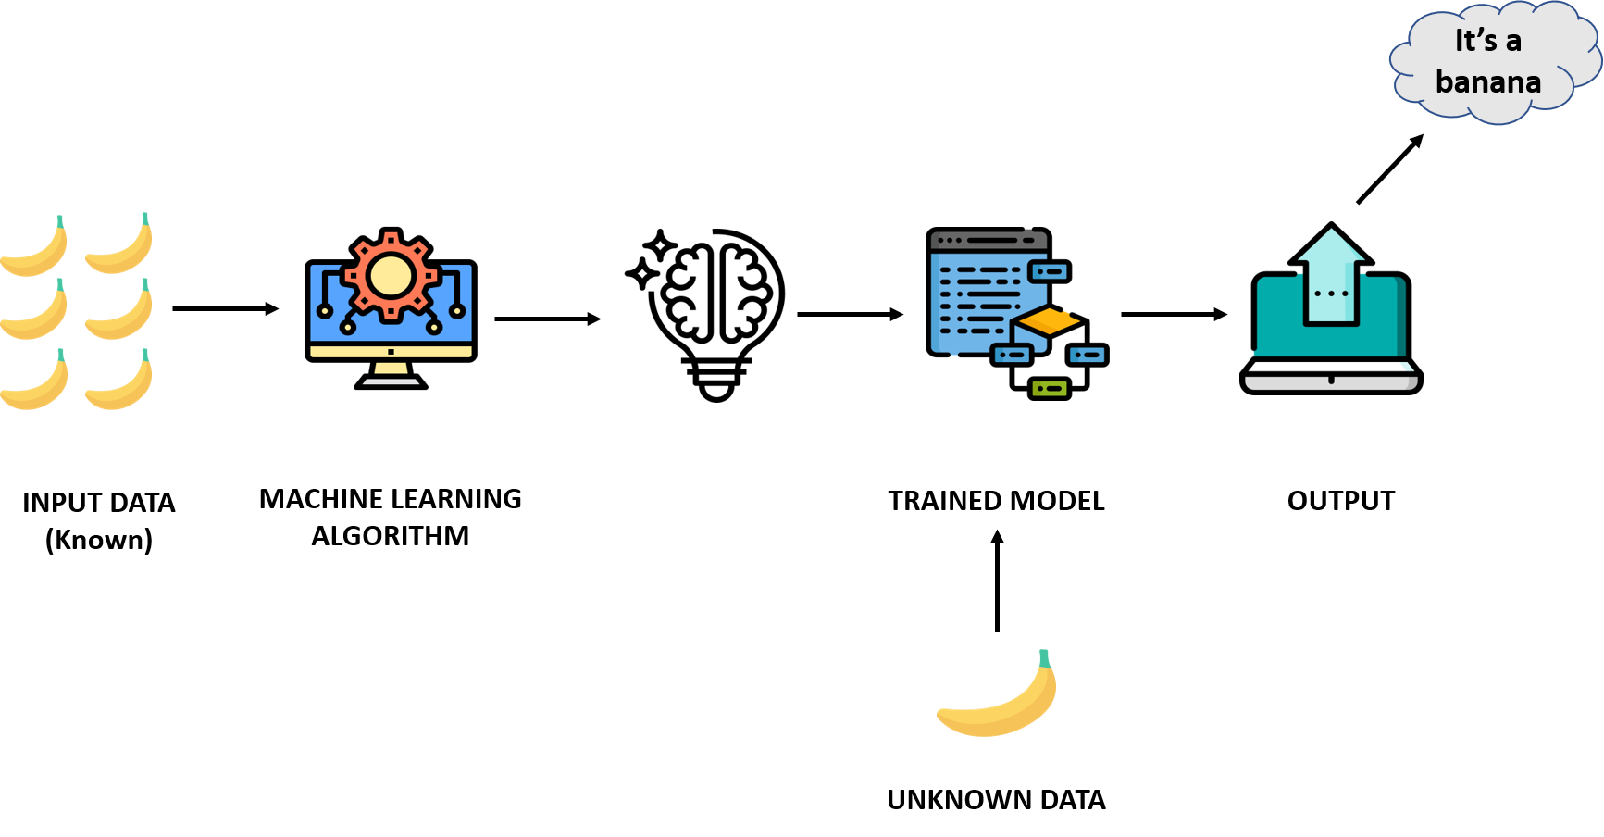
Supervised learning
Notes:
In a supervised learning model, the algorithm learns on a labeled dataset, providing an answer key that the algorithm can use to evaluate its accuracy on training data.
Ref: https://blogs.nvidia.com/blog/2018/08/02/supervised-unsupervised-learning/
Image ref: https://www.verzeo.in/blog-what-is-machine-learning

Slide 5
Supervised learning workflow
1
2
3
4
Define
Split
Train
Evaluate
→
→
→
Choose features and target
Separate training and test data
Fit the algorithm
Test on unseen examples
OSLO METROPOLITAN UNIVERSITY
DAVE3625 · UMAIR MEHMOOD IMAM
04 MACHINE LEARNING II
Notes:
Remind students that preprocessing should be fitted using training data only.

Slide 6
How to work with Supervised machine learning
Data collection
Data processing
  Data cleaning
  Data labeling
  Feature Engineering
  Feature scaling
  Data splitting (training, validation and test sets)
Model Selection
Training
Validation
Evaluation (with test data)
Deploy the model
Monitoring and mantainance
Notes:
Supervised machine learning involves training a model on a set of data where the "answers" (labels) are known, so the model can make predictions on new, unseen data. Here's a step-by-step breakdown of the process:
Problem Definition:
Clearly define the problem you want to solve.
Decide if it's a regression (predicting a continuous value) or classification (predicting discrete categories) problem.
Data Collection:
Gather data relevant to your problem. This could involve using existing datasets or collecting your own data.
Data processing:
Data Cleaning: Handle missing values, outliers, and any noise in the data.
Feature Engineering: Extract, transform, or combine features to better represent the underlying patterns in the data.
Feature Scaling: Normalize or standardize features so they have similar scales. Common methods include Min-Max scaling and Z-score normalization.
Data Splitting: Divide your data into training, validation (optional), and test sets. The training set is used to train the model, the validation set to tune hyperparameters, and the test set to evaluate the model's performance.
Model Selection:
Choose one or more machine learning algorithms suitable for your problem. For instance, you might choose decision trees, linear regression, or neural networks.
Training:
Feed your training data (both the features and labels) into the chosen algorithm. The model will "learn" from this data.
Adjust the model's internal parameters to minimize the difference between its predictions and the actual labels in the training data. This difference is often called "error" or "loss".
Validation and Hyperparameter Tuning (if you have a validation set):
Test the trained model on the validation set to see how it performs.
Adjust hyperparameters (settings of the algorithm that aren't learned from the data) based on validation set performance to find the best model.
Iterate between training and validation until you get the best performance.
Evaluation:
Once the model is trained and tuned, test it on the separate test set to evaluate its performance.
Use relevant metrics like accuracy, precision, recall, F1-score (for classification), or mean squared error, R^2 score (for regression).
Deployment:
If the model's performance is satisfactory, deploy the model to a production environment where it can start taking in new data and making predictions in real-time.
Monitoring and Maintenance:
Continuously monitor the model's performance in the real world. Models might need retraining or fine-tuning if the data they encounter in the wild is different from the training data or if the underlying patterns in the data change over time.
Feedback Loop:
Incorporate feedback from the model's predictions in the real world to improve and retrain the model.

Slide 7
Two kinds of supervised learning : Regression and classification
REGRESSION
CLASSIFICATION
Predict a number
Predict a category
Examples
House price
Travel time
Energy use
Examples
Spam or normal
Pass or fail
Bus, tram or metro
OSLO METROPOLITAN UNIVERSITY
DAVE3625 · UMAIR MEHMOOD IMAM
05 MACHINE LEARNING II

Slide 8
Regression or classification ?
▪ Customer churn — will this customer leave the company ?
▪ Spam email
▪ Gender prediction
▪ Prediction of the price of oil
▪ Salary prediction
▪ Age prediction
▪ Stock market prediction
For each one, ask: is the answer a number, or a category?
DAVE3625- Intro to A.I. by Umair M.I
8
Notes:
Work through the list before looking at the next slide. The test is simply whether the answer is a number on a scale or one of a set of categories.

Slide 9
Answers — and the one that depends on you
Classification
Regression
▪ Customer churn — leaves or stays
▪ Spam email — spam or not spam
▪ Gender prediction — a category
▪ Price of oil — a number
▪ Salary prediction — a number
▪ Age prediction — a number
Stock market prediction is EITHER: "what will the price be?" is regression · "will it go up or down?" is classification
DAVE3625- Intro to A.I. by Umair M.I
9
Notes:
Stock market prediction is the interesting case. Asking what the price will be tomorrow gives you a number, so it is regression. Asking whether the price will go up or down gives you two categories, so it is classification. Both are legitimate; they are different problems with different models and different measures of success.
The general lesson: the type of task is decided by how you frame the target, not by the subject matter. That is why framing the question is the first step of any machine learning project.

Slide 10
Various types of algortihms
Regression
Support vector machines
Decision Trees
K-Nearest Neighbour
Random Forest
Linear Regression
Polynomial Regression
…
…
Classification
Logistic regression
Naïve Bayes classifier
Notes:
Supervised learning splits in two, according to what kind of answer you want.
Classification predicts a category — spam or not spam, survived or died. Regression predicts a number — a price, a salary, a delay in minutes.
Regression was Week 37's lecture. Everything in this one is classification.

Slide 11
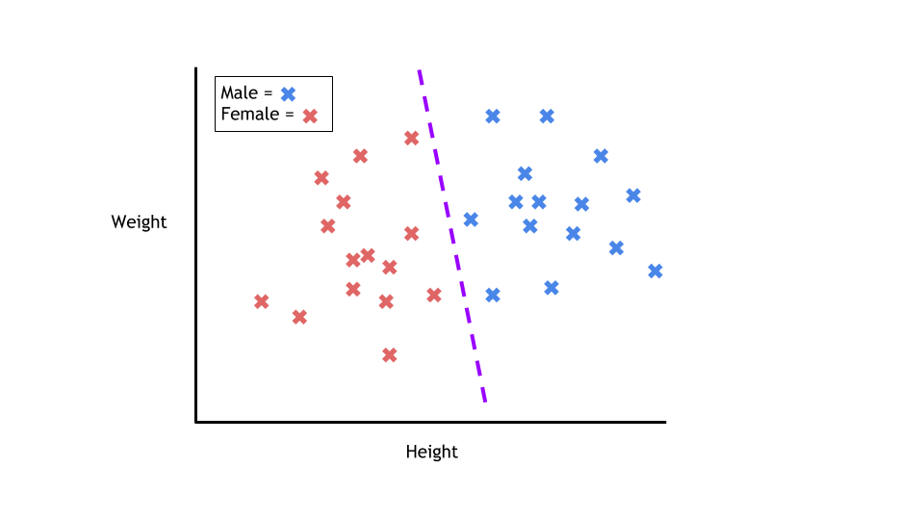
Classification
Notes:
Ref: https://towardsdatascience.com/a-brief-introduction-to-supervised-learning-54a3e3932590
The job of a classification algorithm is to then take an input value and assign it a class, or category, that it fits into based on the training data provided.
The most common example of classification is determining if an email is spam or not. With two classes to choose from (spam, or not spam), this problem is called a binary classification problem. The algorithm will be given training data with emails that are both spam and not spam. The model will find the features within the data that correlate to either class and create the mapping function mentioned earlier: Y=f(x). Then, when provided with an unseen email, the model will use this function to determine whether or not the email is spam.

Slide 12
Classification
The model predicts one of a set of known classes
BINARY
two classes, such as pass or fail
MULTICLASS
more than two classes, such as transport mode
OUTPUT
a class label, often based on a probability
decision boundary
OSLO METROPOLITAN UNIVERSITY
DAVE3625 · UMAIR MEHMOOD IMAM
08 MACHINE LEARNING II

Slide 13
Divides the data in classes / categories
Use cases:
  Spam detection (classification: spam or normal)
  Analysis of the customer data to predict whether they will buy computer accessories (classification: Yes or No)
  Classifying fruits from features like colour, taste, size, weight (classification: Apple, Orange, Cherry, Banana)
  Gender classification from hair length (classification: Male or Female)
  Stock market direction prediction (classification: up or down — predicting the price itself would be regression)
Notes:
All of these are questions with a fixed set of possible answers, which is what makes them classification problems.
The hair-length example is worth pausing on, because it shows how a model picks up a stereotype rather than a fact. Hair length and gender are correlated in some populations, so a model can score well on that data — while having learned nothing about gender and being wrong for anybody who does not fit the pattern. A model reproduces whatever regularity exists in its training data, including regularities we would not want to act on. That theme returns in the Responsible AI lecture.

Slide 14
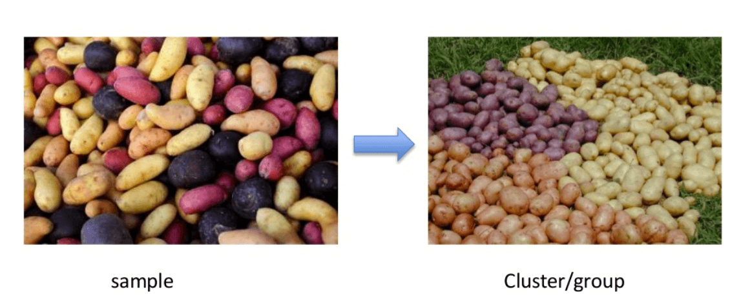
Classification versus Clustering algorithms
Clustering
  Where we want to discover the groupings in data
Notes:
Rather than defining groups before looking at the data, clustering allows you to find and analyze the groups that have formed organically.

Slide 15
Classification versus Clustering algorithms
Classification is assigning labels
Clustering is grouping data together
Classification is supervised, clustering is unsupervised.
Notes:
The distinction in one line: classification puts a label on each row, clustering puts rows into groups.
The deeper difference is what you have to start with. Classification needs somebody to have labelled examples in advance — it is supervised. Clustering invents the groups from the data itself — it is unsupervised, and there is no correct answer to compare against.

Slide 16
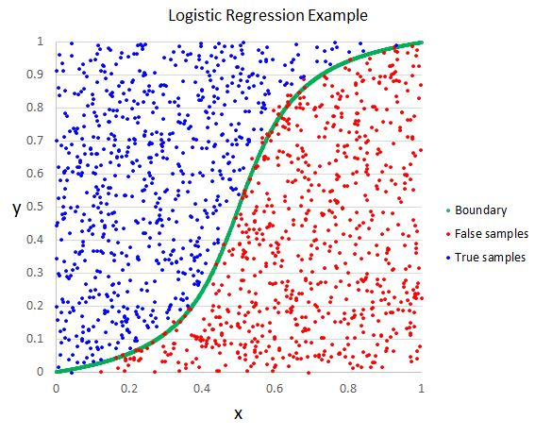
Classification -> Logistic regression
is used when you have a classification problem - yes/no, pass/fail, win/lose, alive/dead, healthy/sick etc..
It is the go-to method for binary classification problems
The logistic function looks like a big S and will transform any value into the range 0 to 1.
Notes:
Ref: http://primo.ai/index.php?title=Logistic_Regression_(LR)
Logistic regression has “regression” in its name because it estimates a continuous probability by modelling the log-odds. When we apply a threshold to that probability, it becomes a classification algorithm.

Slide 17
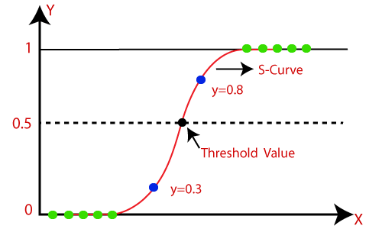
Sigmoid function:
The function maps any real value into another value between 0 and 1.
In machine learning, we use sigmoid to map predictions to probabilities.
Allows to put a threshold value. e.g 0.5 (use case spam detection)
Notes:
The S-shaped curve is what turns a classifier into a probability.
Whatever number the underlying straight-line model produces — large and positive, large and negative, anything — the sigmoid squashes it into the range 0 to 1, so it can be read as a probability. A prediction far from the boundary lands near 0 or near 1; a prediction close to the boundary lands near 0.5.
The threshold is then a separate decision, and 0.5 is a convention, not a law. For a cancer screening test you would set it far lower and accept more false alarms, because missing a case is much worse than checking an extra patient.

Slide 18
Uses
Logistic regression is used to predict the occurance of some event. e.g
  Predict whether rain will occur or not
  spam detection, Diabetes prediction, cancer detection etc.
Notes:
Every use on this list is a yes-or-no question: will it rain, is this spam, does this patient have diabetes.
Logistic regression is the standard first choice for that kind of problem because it is fast, it gives a probability rather than a bare answer, and its coefficients can be read to see which features pushed the decision.

Slide 19
Types of Logistic regression
Binary logistic regression (e.g pass / fail)
Multiclass logistic regression (e.g cats, dogs, sheep)
Ordinal (low, medium, high)
Notes:
Three variants, depending on how many categories there are and whether they have an order.
Binary is two categories with no order — pass or fail. Multiclass is several categories with no order — cat, dog, sheep; the model effectively answers "which one" by comparing all of them. Ordinal is several categories that do have an order — low, medium, high — where getting it wrong by one step is less bad than getting it wrong by two.

Slide 20
Logistic regression — the short version
▪ It draws a straight boundary through the data.
▪ It then pushes the distance from that boundary through the S-curve, so the output always lands between 0 and 1 and can be read as a probability.
▪ You choose a threshold, usually 0.5. Above it, class 1. Below it, class 0.
▪ Training means adjusting the boundary until those probabilities match the
▪ known answers as closely as possible.
▪ That is the whole idea. The slides that follow work through the mathematics.
DAVE3625- Intro to A.I. by Umair M.I
20
Notes:
What to take away, in four points. Despite its name, logistic regression is a classifier, not a regression model. Its output is a probability rather than a bare yes or no. The threshold is your decision, not the model's. And the boundary it can draw is a straight one, which is its main limitation — for data that needs a curved boundary you need a different model, or extra engineered features.
The slides that follow show how the adjustment in the third point actually happens: an error measure (the cost function) and a method for reducing it (gradient descent). Understanding the shape of that process matters more than reproducing the formulas.

Slide 21
2. Evaluate the algorithm
Example run of an A.I algorithm
1. Develop the algorithm
Notes:
Two stages, and both matter. First build something that makes predictions; then find out how good it actually is.
The slides that follow work through the first stage in detail. Judging a classifier properly — accuracy, precision, recall, and why accuracy alone can be misleading — is the subject of the Model Evaluation lecture in Week 41.

Slide 22
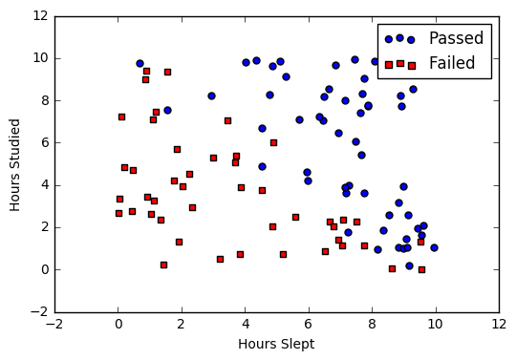
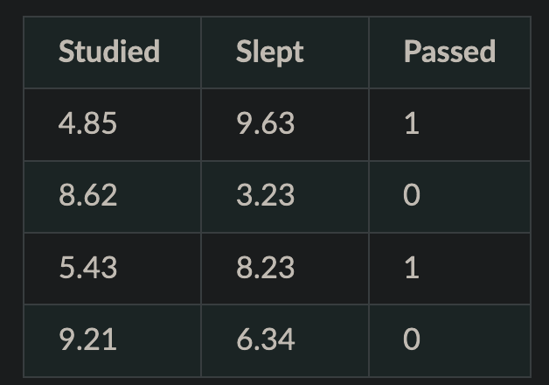
Develop (using binary logistic regression)
Step1 : Visualization
Notes:
1. Say we’re given data on student exam results and our goal is to predict whether a student will pass or fail based on number of hours slept and hours spent studying. We have two features (hours slept, hours studied) and two classes: passed (1) and failed (0).

Slide 23
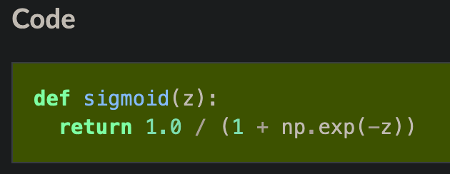
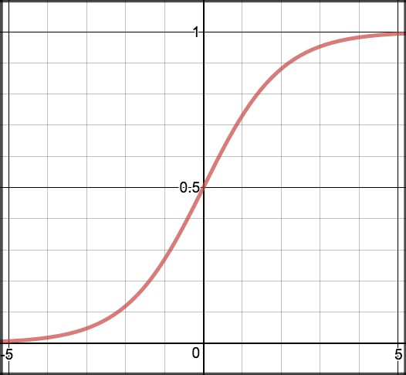
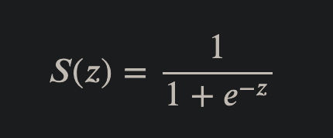
Step 2: Sigmoid activation (a bit of maths)
𝑠(𝑧) = output between 0 and 1 (probability estimate)
𝑧 = input to the function (your algorithm’s prediction e.g. mx + b)
𝑒 = base of natural log
Notes:
In order to map predicted values to probabilities, we use the sigmoid function. The function maps any real value into another value between 0 and 1. In machine learning, we use sigmoid to map predictions to probabilities.

Slide 24
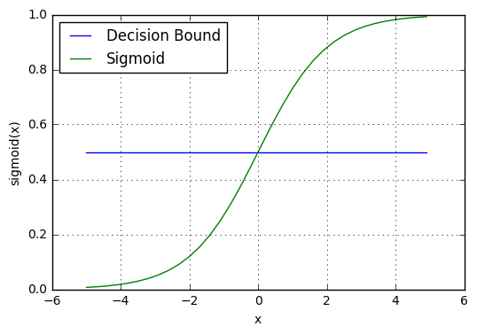
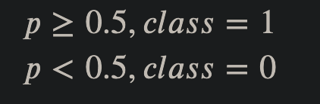
Step 3: Decision boundary
We need a threshold value
Notes:
Our current prediction function returns a probability score between 0 and 1. In order to map this to a discrete class (true/false, cat/dog), we select a threshold value or tipping point above which we will classify values into class 1 and below which we classify values into class 2.
For example, if our threshold was .5 and our prediction function returned .7, we would classify this observation as positive. If our prediction was .2 we would classify the observation as negative. For logistic regression with multiple classes we could select the class with the highest predicted probability.

Slide 25
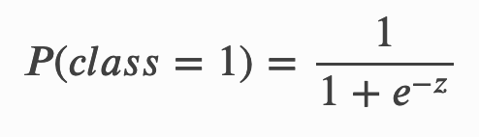
Step 4: Making predictions
Using our knowledge of sigmoid functions and decision boundaries, we can now write a prediction function.
A prediction function in logistic regression returns the probability of our observation being positive, True, or “Yes”.
We call this class 1 and its notation is 𝑃(𝑐𝑙𝑎𝑠𝑠=1).
If the model returns .4 it believes there is only a 40% chance of passing. If our decision boundary was .5, we would categorize this observation as “Fail.”“
Code it
Notes:
The prediction function returns the probability that this observation belongs to class 1 — the "yes" class.
The example on the slide is worth reading carefully: an output of 0.4 with a threshold of 0.5 is recorded as a fail, even though the model considers a 40% chance of passing. The single label thrown back to the user hides how uncertain the model was, which is why the probability is often more useful than the label.

Slide 26
Second stage: evaluate the algorithm
Notes:
Having built something that predicts, the second question is how wrong it is — because a model that is confidently wrong looks exactly like a model that is right until you measure it.

Slide 27
Evaluate using cost function
What is a cost function ?
  The cost function helps the learner to correct / change behaviour to minimize mistakes.
In ML, cost functions are used to estimate how badly models are performing.
Put simply, a cost function is a measure of how wrong the model is in terms of its ability to estimate the relationship between X and y.
Notes:
Ref: https://towardsdatascience.com/machine-learning-fundamentals-via-linear-regression-41a5d11f5220

Slide 28
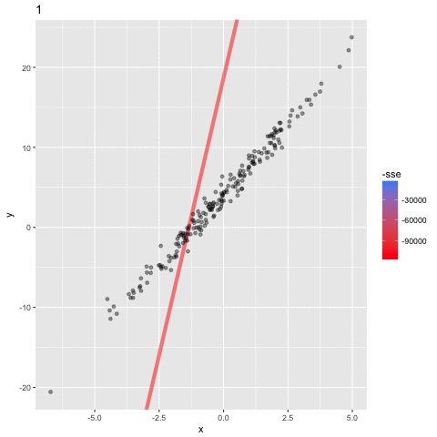
Notes:
The same process, seen from outside: the line is being fitted to the data one step at a time.
It begins at a bad angle with a large error, and each frame moves it in the direction that reduces the total squared error. The colour scale on the right is that error shrinking. When the line stops moving, the model has finished training.
This is what "the model learns" actually means in practice — a number being nudged repeatedly in whichever direction makes the mistakes smaller.
https://towardsdatascience.com/machine-learning-fundamentals-via-linear-regression-41a5d11f5220

Slide 29
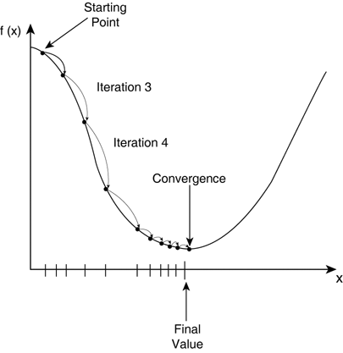
Cost function: Gradient descent
Gradient Descent is an optimization algorithm used to tweak parameters iteratively to minimize the cost function.
Gradient descent enables a model to learn the gradient or direction that the model should take in order to reduce errors (differences between actual y and predicted y).
Notes:
The curve is the error, drawn against the value of one of the model's parameters. High on the curve means a badly wrong model; the bottom of the curve is the best the model can do.
Gradient descent starts somewhere on the curve and repeatedly steps downhill. Notice that the steps get smaller as it approaches the bottom, because the slope is shallower there — and that it stops when further steps stop improving anything. That point is called convergence.
How big each step is is a setting called the learning rate. Too small and training takes forever; too large and it jumps over the bottom and never settles.
ref: https://towardsdatascience.com/machine-learning-fundamentals-via-linear-regression-41a5d11f5220

Slide 30
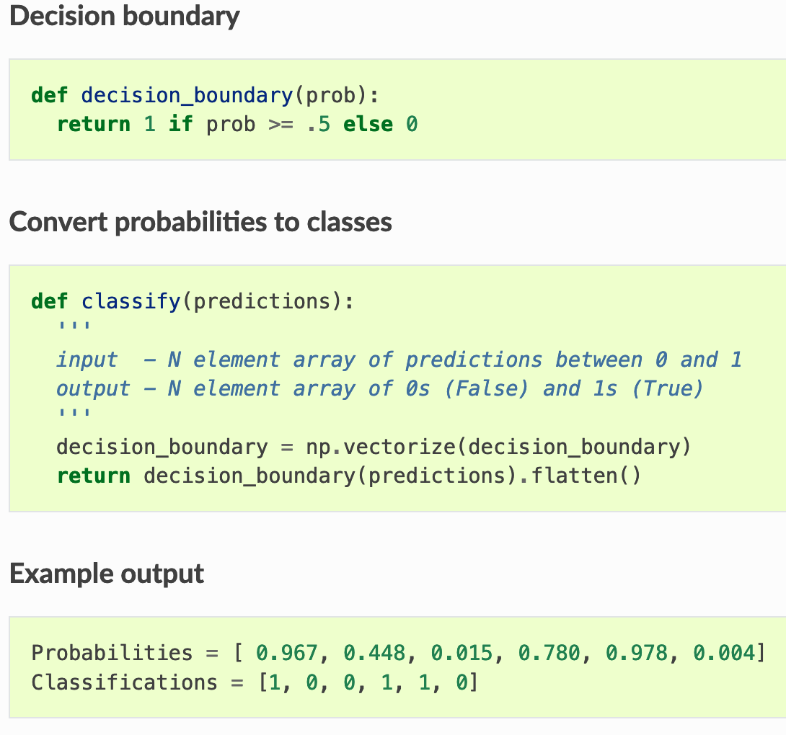
Develop: Map probabbilities to classes
The final step is assign class labels (0 or 1) to our predicted probabilities.
Notes:
Ref: https://ml-cheatsheet.readthedocs.io/en/latest/logistic_regression.html#id8

Slide 31
Final stage: Finish it up
Train the model
Evaluate the model
  Minimzie the cost with repeated iterations
Measure the accuracy of your outputs
Meausre the probabbility score
Notes:
The loop in four steps: train, evaluate, reduce the error, and measure the result — then repeat.
Note the last two lines. Accuracy and probability scores are how you decide whether the model is good enough, and they turn out to be a bigger subject than they look: accuracy alone can be badly misleading when one class is much more common than the other. That is Week 41.

Slide 32
2. Naive Bayes classification algorithm (classification)
A Naive Bayes classifier assumes that the presence of a particular feature in a class is unrelated to the presence of any other feature.
Naive bayes does not take into account the relationship between features
For example:
A dog will be considered a dog because it has 4 legs and a tail
  But a Naive Bayes will consider everything a dog which has 4 legs or tail (e.g squirrel) not because its an animal. Being an animal is the relationship not legs / tail.
A fruit may be considered to be an apple if it is red, round, and about 3 inches in diameter.

Slide 33
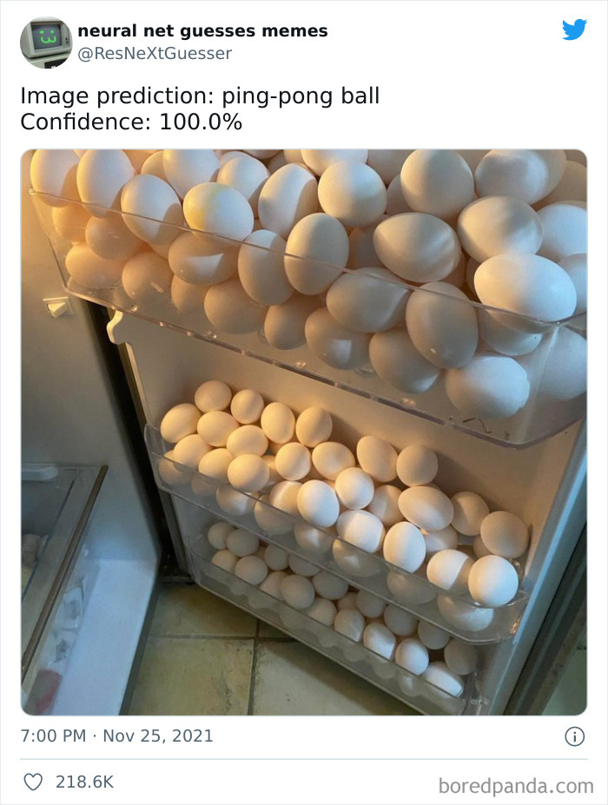
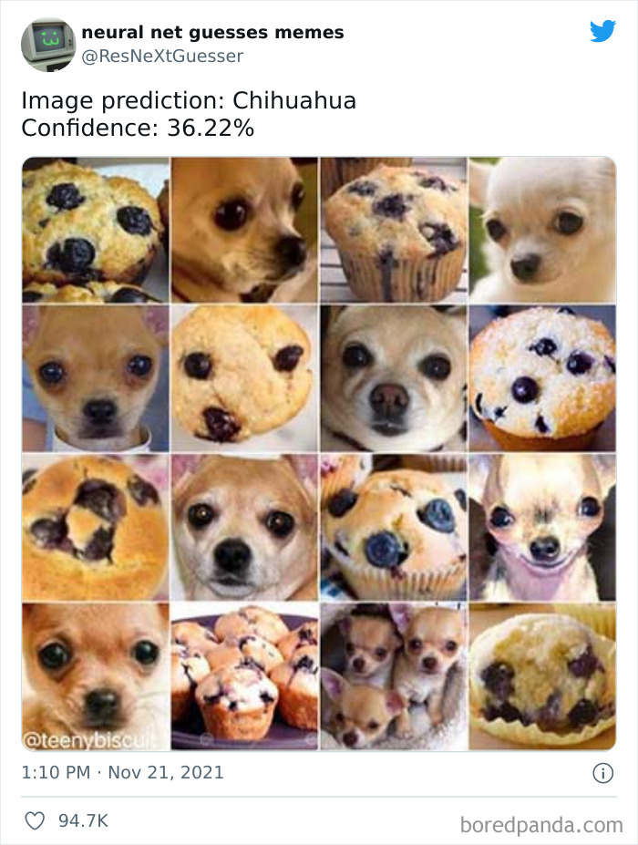

Slide 34
Spam emails:
“Win lottery now”
“Prize lottery claim”
Not spam emails:
“Team meeting now”
“Project team work”
Words we care about:
[win, lottery, prize, claim, team, meeting, project, work]

Slide 35
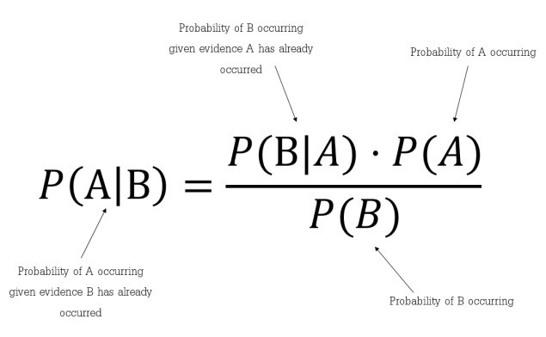
BAYES THEOREM
Bayes's theorem describes the probability of an event, based on prior knowledge of conditions that might be related to the event
Notes:
Using Bayes theorem, we can find the probability of A happening, given that B has occurred. Here, B is the evidence and A is the hypothesis. The assumption made here is that the predictors/features are independent. That is presence of one particular feature does not affect the other. Hence it is called naive.

Slide 36
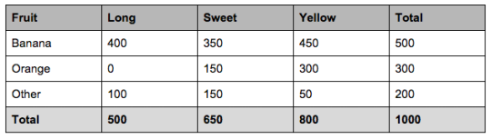
We can see that
  50% of the fruits are bananas
  30% are oranges
  20% are other fruits
We can also say
From 500 bananas 400 (0.8) are Long, 350 (0.7) are Sweet and 450 (0.9) are Yellow
Out of 300 oranges 0 are Long, 150 (0.5) are Sweet and 300 (1) are Yellow
From the remaining 200 fruits, 100 (0.5) are Long, 150 (0.75) are Sweet and 50 (0.25) are Yellow
https://www.datasciencecentral.com/profiles/blogs/naive-bayes-for-dummies-a-simple-explanation
Notes:
https://www.datasciencecentral.com/profiles/blogs/naive-bayes-for-dummies-a-simple-explanation

Slide 37
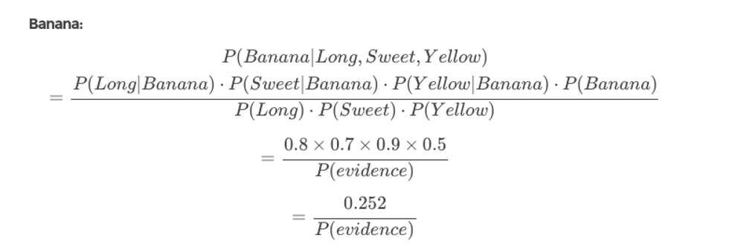

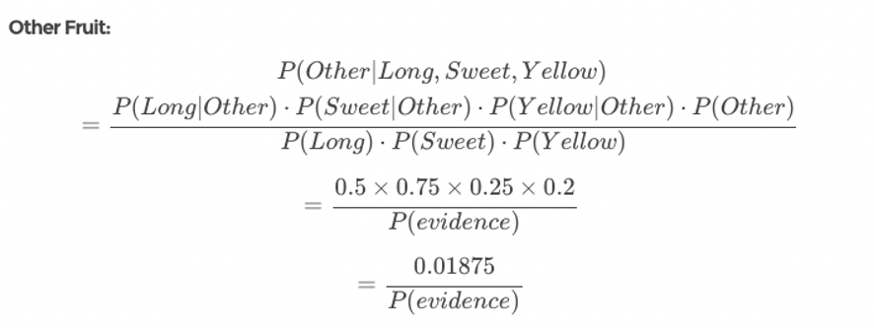
Notes:
So let’s say we’re given the features of a piece of fruit and we need to predict the class. If we’re told that the additional fruit is Long, Sweet and Yellow, we can classify it using the following formula and subbing in the values for each outcome, whether it’s a Banana, an Orange or Other Fruit. The one with the highest probability (score) being the winner.
In this case, based on the higher score 0.01875 < 0.252 we can assume this Long, Sweet and Yellow fruit is, in fact, a Banana.

Slide 38
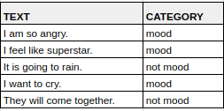

Naive Bayes use in Natural Language Processing
Task:
Determine if the text “I feel terrible” is either mood category or not mood.
Naive bayes will count 2 occurances for mood category and 0 for not mood category.
Hence classifying the text as mood
https://medium.com/@montjoile/easy-and-quick-explanation-naive-bayes-algorithm-99cb5f3f4e9c
Notes:
Ref: https://medium.com/@montjoile/easy-and-quick-explanation-naive-bayes-algorithm-99cb5f3f4e9c

Slide 39
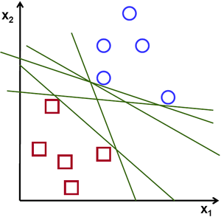
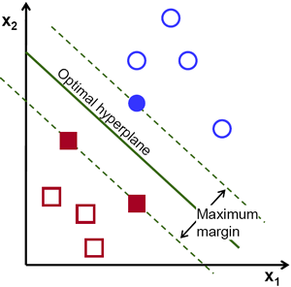
3. Support vector machines (classification)
Supprt vector machines classifies the data by finding a clear seperation between the data points
  It looks for a hyperplane
Can be used both in classification and regression
https://towardsdatascience.com/support-vector-machine-introduction-to-machine-learning-algorithms-934a444fca47
Notes:
https://towardsdatascience.com/support-vector-machine-introduction-to-machine-learning-algorithms-934a444fca47
To separate the two classes of data points, there are many possible hyperplanes that could be chosen. Our objective is to find a plane that has the maximum margin, i.e the maximum distance between data points of both classes. Maximizing the margin distance provides some reinforcement so that future data points can be classified with more confidence.

Slide 40
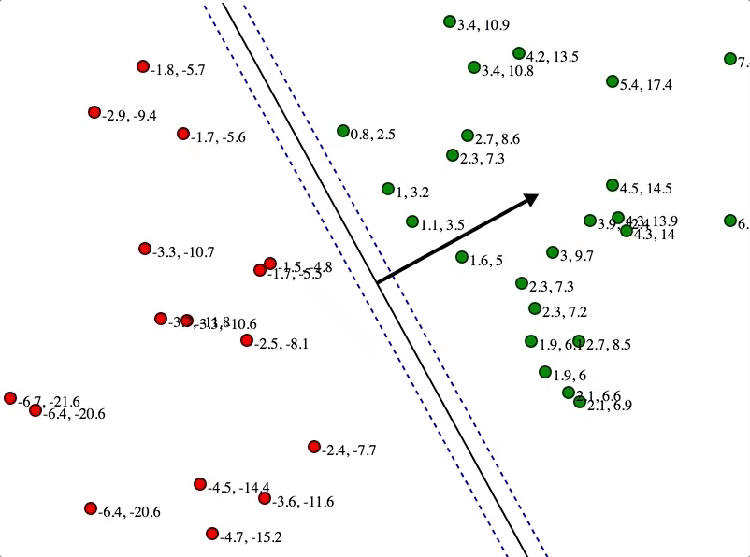
https://www.jeremykun.com/2017/06/05/formulating-the-support-vector-machine-optimization-problem/

Slide 41
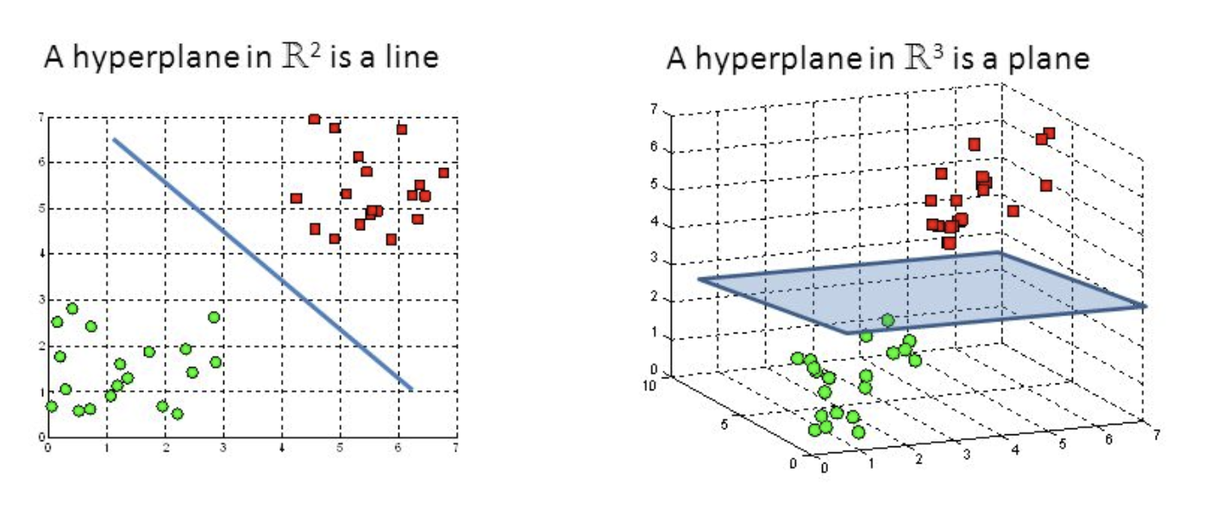
Hyperplanes
Hyperplanes are boundries that help classify the data points
We can use a 2 dimensional hyperplane (if number of features is 2)
or a 3 dimensional hyperplane (if number of features is 3)
We can also have n dimensional hyperplane (for more features)
https://towardsdatascience.com/support-vector-machine-introduction-to-machine-learning-algorithms-934a444fca47
Notes:
Another reason we use SVMs is because they can find complex relationships between your data without you needing to do a lot of transformations on your own.
t's a great option when you are working with smaller datasets that have tens to hundreds of thousands of features.

Slide 42
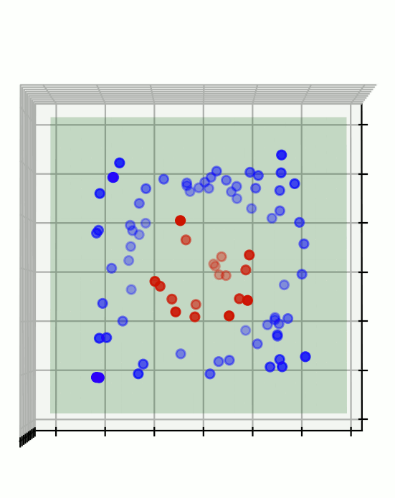
https://lamarr-institute.org/blog/support-vector-machines/

Slide 43
Uses of support vector machines
Used to detect cancerous cells
Used to predict driving routes
Face detection
Image classification
Handwriting detection

Slide 44
Pros and cons
Pros
  Effective on data sets with multiple features
  Effective in cases where number of features is greater than the data points
  Memory efficient
Cons
  They donot provide probability estimates. Those are calculated using an expensive five fold cross vsalidation
  Works best on small sample sets because of its high training time
Notes:
https://www.freecodecamp.org/news/svm-machine-learning-tutorial-what-is-the-support-vector-machine-algorithm-explained-with-code-examples/

Slide 45
Other classification algorithms
Decision trees
K nearest neigbour
Random Forest
..

Slide 46
K-nearest neighbours
KNN classifies a new observation using nearby labelled examples
new observation
The K closest neighbours vote on the class
OSLO METROPOLITAN UNIVERSITY
DAVE3625 · UMAIR MEHMOOD IMAM
16 MACHINE LEARNING II

Slide 47
K-nearest neighbours
▪ The simplest classifier there is. No equation and, in effect, no training.
▪ To classify something new:
– find the k examples in your data that are closest to it
– let them vote, and take the majority answer
▪ With k = 3 you look at the three most similar examples you have seen before.
▪ "Training" is simply storing the data. All the work happens at prediction time.
▪ The whole assumption: things that are close together tend to be the same kind of thing.
DAVE3625- Intro to A.I. by Umair M.I
47
Notes:
This is the classifier Elements of AI introduces first, and it is the reading for this week — Chapter 4, the nearest neighbour classifier.
It is sometimes called a lazy learner, because it postpones all the work: nothing is computed until you ask it a question, and then it measures the distance to every stored example. That makes it fast to set up and slow to use, which is the opposite trade-off from most other models.
Closeness is normally straight-line (Euclidean) distance across all the features at once.

Slide 48
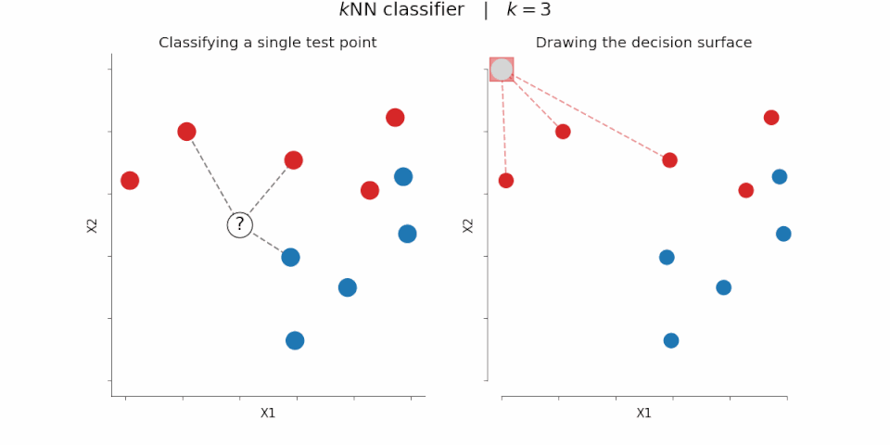
https://commons.wikimedia.org/wiki/File:KNN_decision_surface_animation.gif

Slide 49
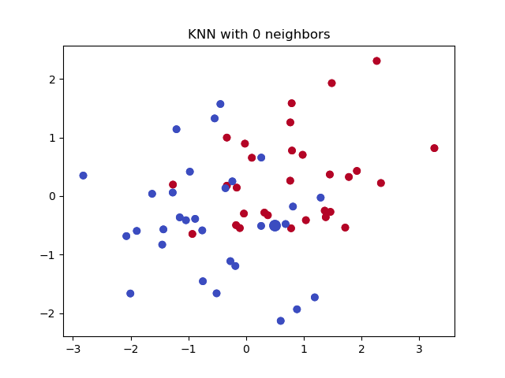
https://importq.wordpress.com/2017/11/24/mnist-analysis-using-knn/

Slide 50
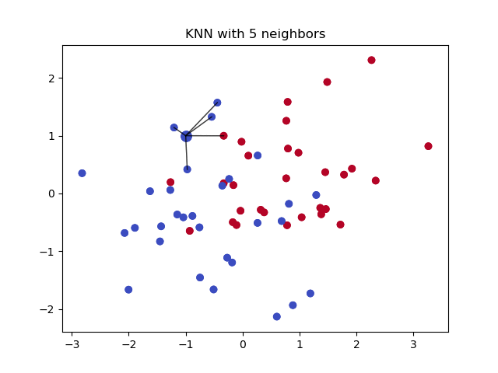
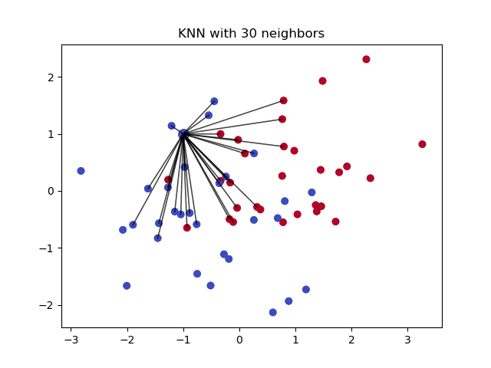
https://importq.wordpress.com/2017/11/24/mnist-analysis-using-knn/

Slide 51
How KNN works
1
2
3
4
Measure
Select
Vote
Predict
→
→
→
Calculate distances
Find the K nearest examples
Count their labels
Return the majority class
OSLO METROPOLITAN UNIVERSITY
DAVE3625 · UMAIR MEHMOOD IMAM
17 MACHINE LEARNING II

Slide 52
Euclidean distance
For two features, distance follows the Pythagorean theorem
d = √((x₂ − x₁)² + (y₂ − y₁)²)
Example: A = (2, 3), B = (5, 7)
d = √(3² + 4²) = 5
OSLO METROPOLITAN UNIVERSITY
DAVE3625 · UMAIR MEHMOOD IMAM
18 MACHINE LEARNING II

Slide 53
Choosing K
SMALL K
Follows local detail but becomes sensitive to noise
MEDIUM K
Balances local information and stability
LARGE K
Creates smoother decisions but may hide smaller patterns
VALIDATION
Choose K using validation data, not the final test set
OSLO METROPOLITAN UNIVERSITY
DAVE3625 · UMAIR MEHMOOD IMAM
19 MACHINE LEARNING II

Slide 54
Why scaling matters
BEFORE SCALING
AFTER SCALING
Age: 18 to 80
Income: 200,000 to 2,000,000
Income dominates the distance calculation.
Both features use comparable numerical ranges.
Each feature can contribute more fairly.
OSLO METROPOLITAN UNIVERSITY
DAVE3625 · UMAIR MEHMOOD IMAM
20 MACHINE LEARNING II

Slide 55
KNN in scikit-learn
from sklearn.pipeline import make_pipeline
from sklearn.preprocessing import StandardScaler
from sklearn.neighbors import KNeighborsClassifier
model = make_pipeline(
StandardScaler(),
KNeighborsClassifier(n_neighbors=5)
)
model.fit(X_train, y_train)
predictions = model.predict(X_test)
A pipeline applies the same scaling during training and prediction
OSLO METROPOLITAN UNIVERSITY
DAVE3625 · UMAIR MEHMOOD IMAM
21 MACHINE LEARNING II

Slide 56
KNN strengths and limitations
STRENGTHS
LIMITATIONS
Simple idea
Flexible decision boundary
Works with several classes
Useful baseline
Prediction can be slow
Sensitive to scaling
Affected by irrelevant features
Struggles in many dimensions
OSLO METROPOLITAN UNIVERSITY
DAVE3625 · UMAIR MEHMOOD IMAM
22 MACHINE LEARNING II

Slide 57
Decision trees
A series of yes/no questions, arranged as a tree. You can read the rule out loud.
Is the fare above 30 ?
/ \
no yes
/ \
Is the passenger male ? survived: YES
/ \
yes no
| |
died: NO survived: YES
"A woman travelling on a cheap ticket probably survived.
A man on a cheap ticket probably did not."
DAVE3625- Intro to A.I. by Umair M.I
57
Notes:
A schematic tree of the kind that can be learned from the Titanic passenger list. Each internal node asks one question about one feature, and each leaf gives an answer.
The reason trees matter out of proportion to their accuracy is the last two lines: the model can be read aloud in ordinary language and argued with. That is why they are used where a decision affecting a person has to be explained and defended — credit, insurance, public administration — even when a less interpretable model would score slightly better.
Note also that no scaling is needed. "Is the fare above 30" gives the same answer whatever units the fare is recorded in.

Slide 58
How the tree chooses its questions
▪ At each step it tries every feature and every threshold, and keeps the split
▪ that separates the classes best.
▪ "Best" means the split that leaves each side as pure as possible — as close as
▪ it can get to all-one-class. Measured by Gini impurity or entropy.
▪ Then it repeats on each side, and keeps going.
▪ Left alone, a tree keeps splitting until every training row has its own leaf.
– perfect on the training data, useless on anything new — this is overfitting
– so you limit it: maximum depth, or a minimum number of rows per leaf
▪ Many trees trained on different samples and allowed to vote is a random forest.
DAVE3625- Intro to A.I. by Umair M.I
58
Notes:
Purity is the whole idea. A split that leaves 50/50 on both sides has taught you nothing; a split that leaves all the survivors on one side and all the non-survivors on the other has taught you everything. Gini impurity and entropy are two ways of putting a number on that, and in practice they give very similar trees.
The overfitting behaviour is worth remembering because it is so easy to demonstrate: an unrestricted tree will reach 100% accuracy on its training data every time, which tells you nothing whatsoever about how it will perform. In scikit-learn the settings that stop it are max_depth and min_samples_leaf.
Random forests trade the readability of a single tree for accuracy — you can no longer read the rule, because there are hundreds of them.

