Slide 1
Model evaluation and improvement
Umair Mehmood Imam · DAVE3625 · Week 41
Notes:
So far in this course you have learned to prepare data and to train a model with five or six different algorithms. This lecture is about the part that comes after: finding out whether the model is any good, working out why it is not, and deciding what to change.
Reading for this week: Machine Learning Yearning by Andrew Ng, chapters 6 to 12 (development and test sets) and chapters 13 to 19 (error analysis). The chapters are one or two pages each.

Slide 2

Hackathon: Hands on with claude code
Umair M.Imam

Slide 3
Purpose
Requirements
Fun activity
Testing the limits
Claude Code

Slide 4
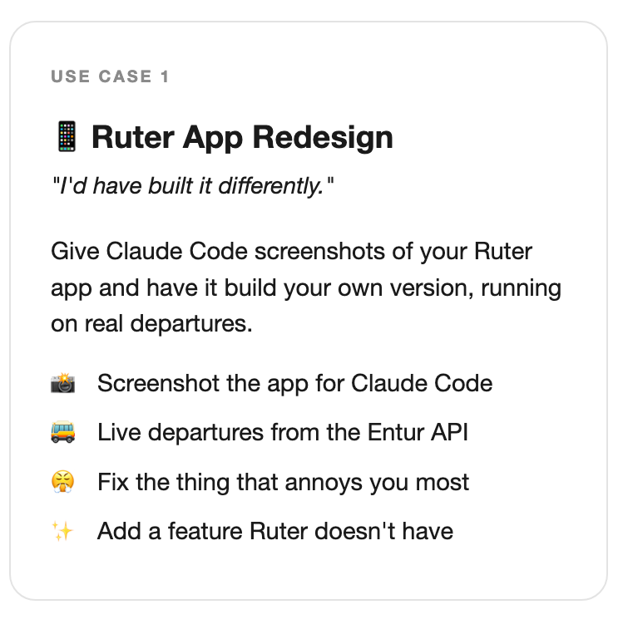
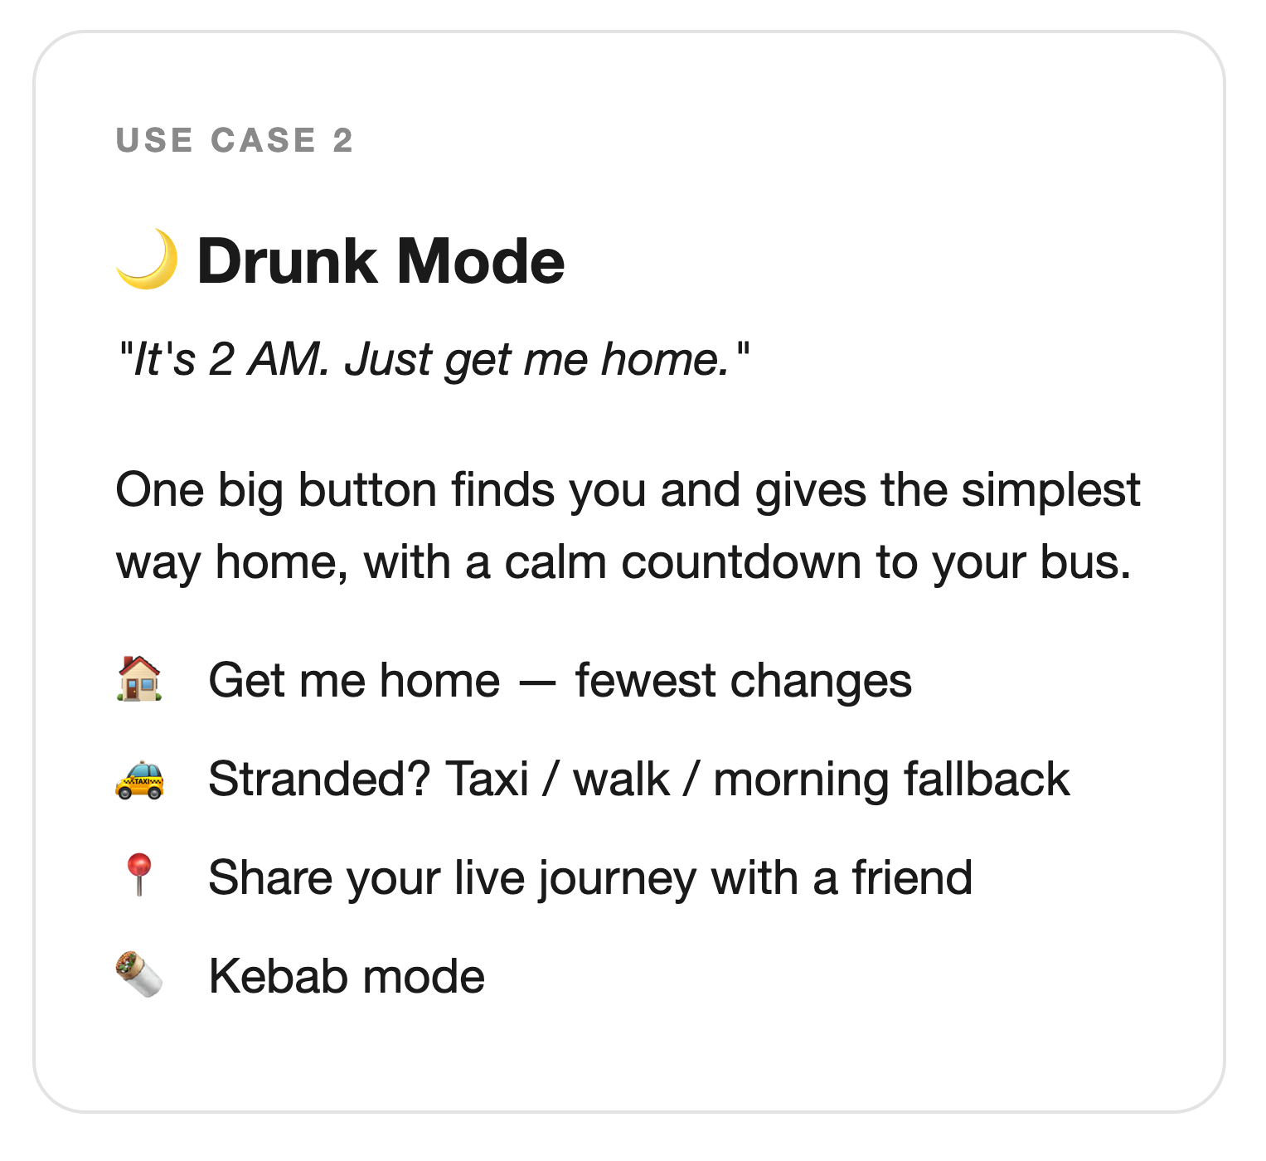
Pick one use case (or do both ☺)

Slide 5
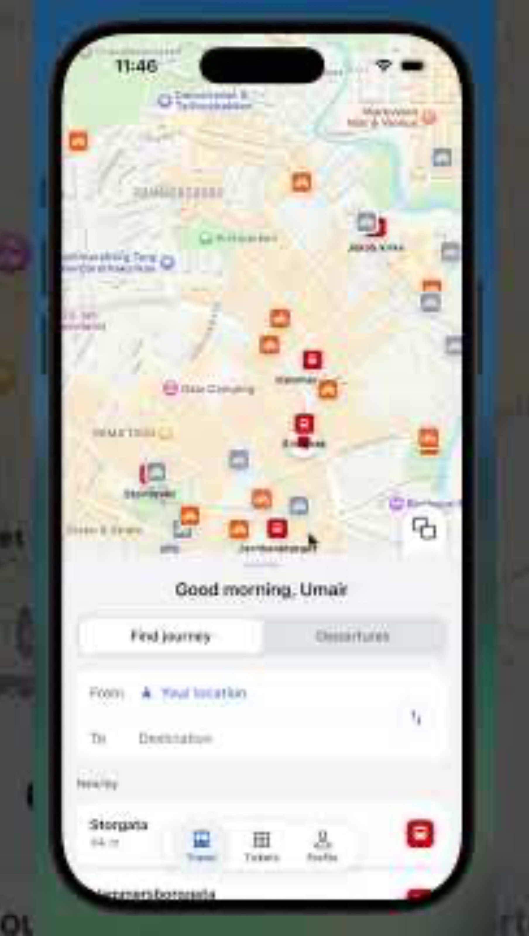

Slide 6
95% accuracy
A team has built a model to flag possible disease.
They want to put it into use next week.
Would you approve it? What would you ask first?
DAVE3625 · Introduction to AI · Umair Mehmood Imam
2

Slide 7
95% accuracy
The model answers “healthy” for every patient.
950 of 1 000 patients are healthy, so it is right 95% of the time — and it never finds a single sick person.
That’s a problem
DAVE3625- Intro to A.I. by Umair M.I
7
Notes:
Nothing was computed wrongly. 95% is the correct accuracy for this model.
The number is true and useless at the same time, because the question it answers — how often is the model right? — is not the question anybody cares about, which is: does it find the sick patients?
When one class is much more common than the other, the data is called imbalanced, and accuracy rewards a model for simply always guessing the common class. Fraud, disease, defects and spam are all like this.

Slide 8
Four questions to ask of any model
1. Measured on what ?
– Which data produced the number and has the model seen it before
– Can we trust the evaluation data?
2. Measured how ?
– Does the score reward useful predictions?
– Accuracy, precision, recall: which number fits the problem
3. Why is it wrong ?
– What explains the model’s mistakes?
– Too simple, or memorising ? Underfitting and overfitting
4. What do I fix next ?
– Error analysis: look at the mistakes before choosing what to work on
8
Notes:
These four questions are the structure of the lecture, and they are also a checklist you can apply to any result you are shown — your own, a classmate's, or a claim in a news article about an AI system.
Questions 1 and 4 follow Machine Learning Yearning closely. Questions 2 and 3 are the standard vocabulary of evaluation, and are examined.

Slide 9
Measured on what ?
PART 1
Can we trust the score?
DAVE3625- Intro to A.I. by Umair M.I
9
Notes:
A score means nothing until you know which data it was measured on. Machine Learning Yearning, chapters 5 to 7.

Slide 10
Data -> Three sets of data, three different jobs
Training set
Validation set
Test set
Set | Its job | How often you look at it
Training set | The model learns from it | Constantly — the algorithm sees every row
Development set (dev set, validation set) | You make decisions with it: which algorithm, which settings, which features | Again and again, after every change
Test set | It tells you how good the final model really is | Once, at the end
“Development set” (Ng) and “validation set” (scikit-learn, most textbooks) are the same thing.
DAVE3625- Intro to A.I. by Umair M.I
10
Notes:
In the Data for AI lecture the data was split in two: training and test. That is enough as long as you train one model and report its score.
The moment you start comparing — a tree against KNN, k = 3 against k = 9 — you need a third set to make those comparisons on. That is the development set. Ng calls it the dev set; scikit-learn and most textbooks call it the validation set. In this course the words mean the same.

Slide 11
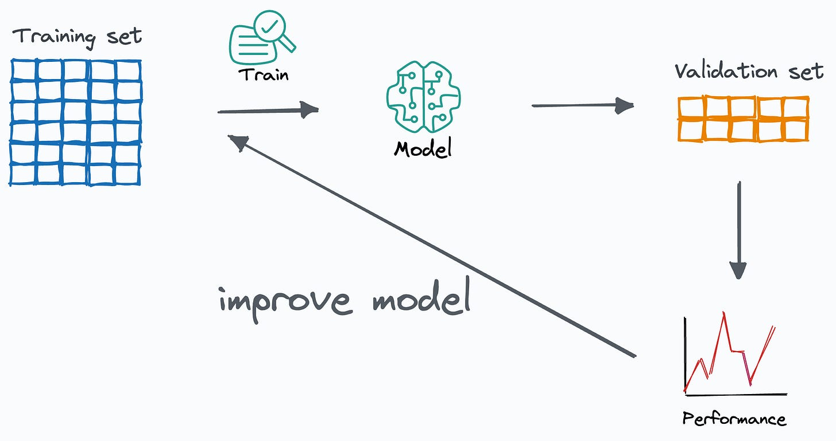
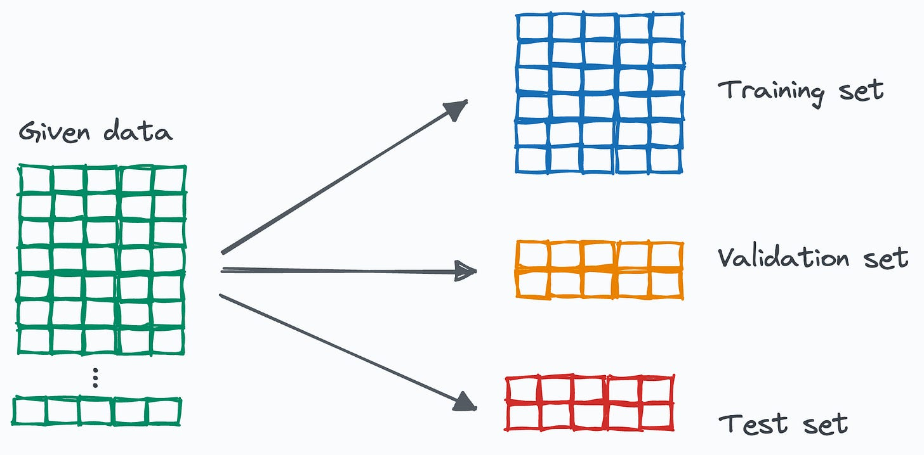
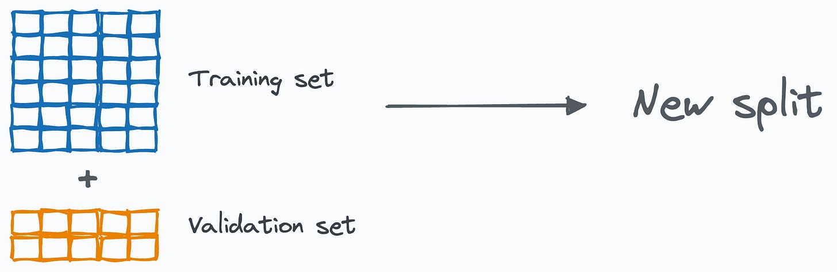
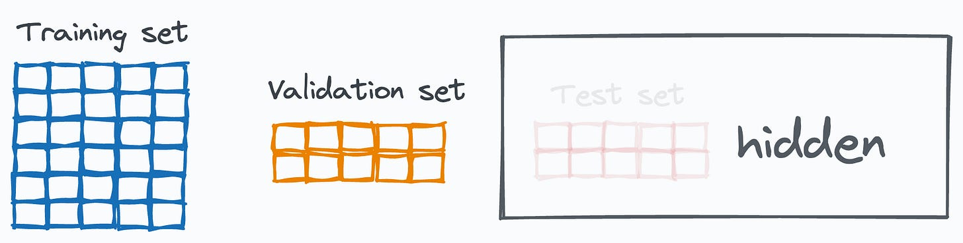
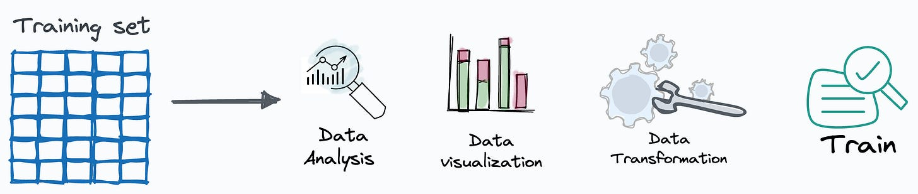
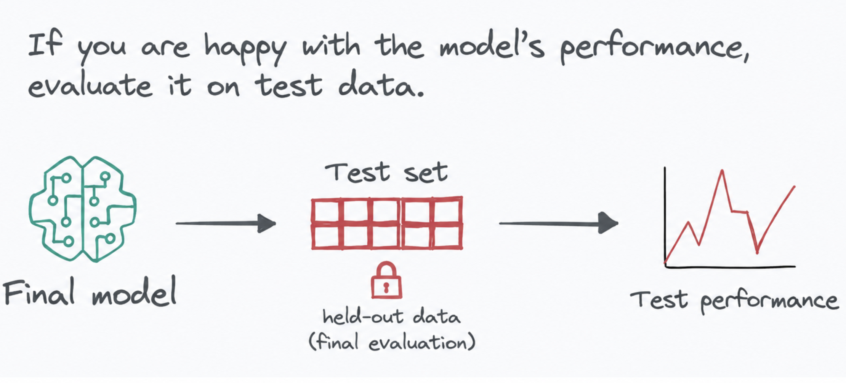
Ref: https://blog.dailydoseofds.com/p/how-to-actually-use-train-validation

Slide 12
Example: Why the test set is opened only once
▪ You sit the same practice exam twenty times, and change your revision after each attempt.
▪ Your score on that practice exam goes up. Does it still predict the real exam ?
▪ Trying twenty settings and keeping the best test score is the same thing:
– the model never trained on the test set — but you learned from it
▪ So: choose with the dev set. Report with the test set.
The same problem as data leakage from Week 36 — here the leak goes through the person, not the code.
DAVE3625- Intro to A.I. by Umair M.I
12
Notes:
With the practice exam, you have fitted yourself to its particular questions. With a model, you try twenty settings and one of them is bound to suit those particular test rows by luck. Keeping that one gives a score that is too optimistic, although no code ever trained on the test data.
Machine Learning Yearning calls this overfitting the dev set, and it is why a separate test set exists at all: it is the one measurement you have not spoiled by making decisions with it.

Slide 13
Best practice: Dev and test data must look like the future
▪ A team builds an app that finds cats in photos.
– Training data: thousands of sharp, well-lit pictures downloaded from websites
– Real use: blurry pictures taken by users on their phones
▪ It scored well in development and badly in use.
Choose dev and test sets that reflect the data you expect to get later and take both from the same source, so a good dev score predicts a good test score.
Machine Learning Yearning, chapters 5 and 6.
DAVE3625- Intro to A.I. by Umair M.I
13
Notes:
The example is Andrew Ng's, and the failure is one of the commonest in real projects. The model did exactly what it was trained to do; the data it was tested on simply was not the data it met.
The rule has two halves. First, dev and test data should resemble the future, even when that means they look different from your training data. Second, dev and test should come from the same distribution as each other. If they do not, and the test score is poor, you cannot tell whether you overfitted the dev set or whether the test set is simply a harder problem.
Closer to home: a model for predicting how full a bus will be, trained on summer data and evaluated in October, has the same problem.

Slide 14
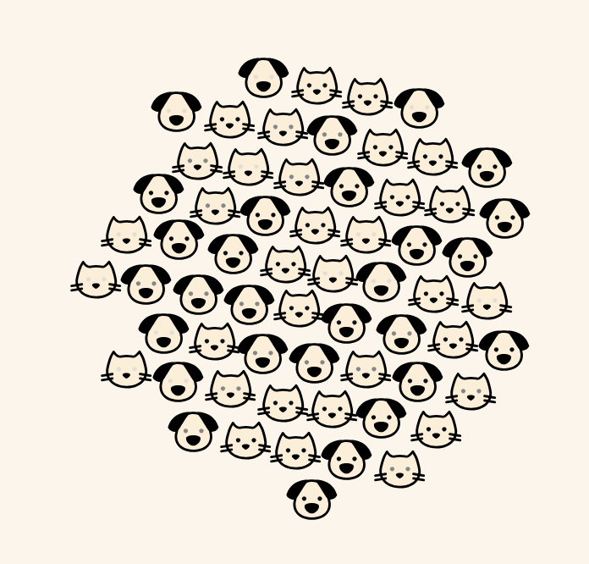
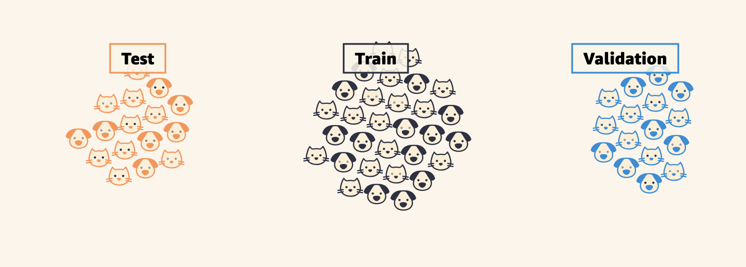
Each pet in our dataset has two features: weight and fluffiness.
https://mlu-explain.github.io/train-test-validation/

Slide 15
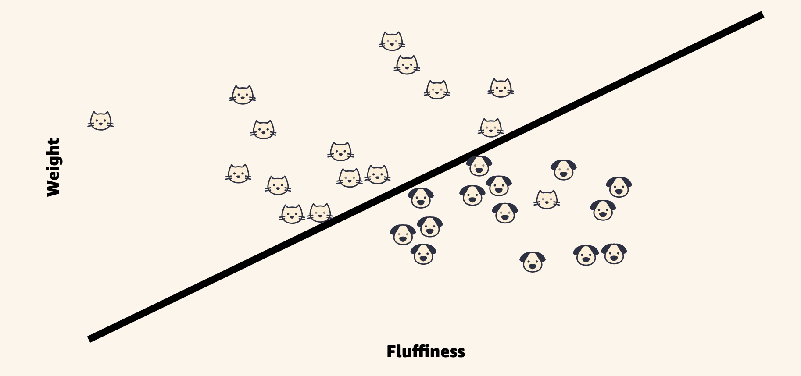
Logistic regression will learn a decision boundary to best separate the cats from dogs in our training data, using the selected feature (None, Weight, Fluffiness, or both Weight and Fluffiness).

Slide 16
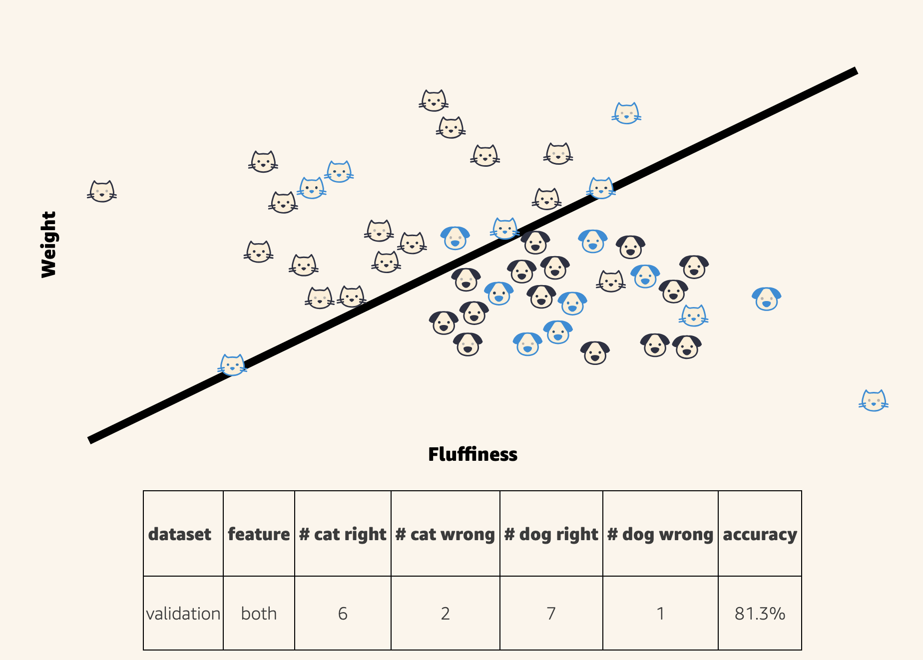
The Validation Set
it acts as an independent, unbiased dataset for comparing the performance of different algorithms trained on our training set

Slide 17
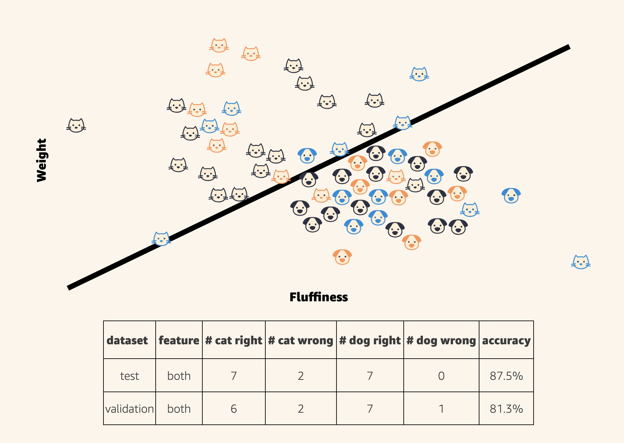
The Testing Set
It is the final step in evaluating our model's performance on unseen data.
We should never, under any circumstance, look at the test set's performance before selecting a model.

Slide 18
How big should the dev set be ?
Dev set size | One example is worth | Smallest difference you can trust
100 | 1 % | A few percent — 90% and 92% may be the same model
1 000 | 0.1 % | About one percent
10 000 | 0.01 % | About a tenth of a percent
Machine Learning Yearning, chapter 7. Dev sets of 1 000 to 10 000 examples are common.
DAVE3625- Intro to A.I. by Umair M.I
18
Notes:
The dev set has one purpose: to tell you which of two models is better. So it must be big enough to see the differences you care about.
With 100 examples, moving from 90% to 91% means one more example came out right, which could easily be chance. The third column is a rule of thumb rather than a formula, but the direction is exact: to see differences ten times smaller you need far more data.
The old habit of splitting 70/30 or 60/20/20 is fine for the small datasets in this course. With a million rows, 10 000 for dev and 10 000 for test is plenty and the remaining 98% can go to training.

Slide 19
Splitting in scikit-learn
The same dataset is used for every code slide today, so the numbers connect.
from sklearn.datasets import load_breast_cancer
from sklearn.model_selection import train_test_split
X, y = load_breast_cancer(return_X_y=True) # 569 tumours: malignant or benign
X_train, X_test, y_train, y_test = train_test_split(
X, y,
test_size=0.2, # 20% is locked away until the very end
stratify=y, # keep the same class balance in both parts
random_state=42) # same split every time you run it
# 455 rows to work with, 114 rows in the test set
DAVE3625- Intro to A.I. by Umair M.I
19
Notes:
Two arguments here are worth understanding rather than copying.
stratify=y keeps the proportion of each class the same in both parts. Without it, a rare class can end up almost entirely on one side by chance — and with imbalanced data that ruins the evaluation.
random_state fixes the shuffle so that you and the person checking your work get the same split. Any number will do; what matters is that it is set.
To make a separate dev set you would call train_test_split a second time on the 455 working rows. With a dataset this small there is a better way, which is the next slide.

Slide 20
Cross-validation: every row gets a turn as dev data
Round 1
check
train
train
train
train
93.4 %
Round 2
train
check
train
train
train
92.3 %
Round 3
train
train
check
train
train
90.1 %
Round 4
train
train
train
check
train
90.1 %
Round 5
train
train
train
train
check
96.7 %
Cut the working data into 5 parts. Train on four, check on the fifth, and rotate.
Five scores instead of one: average 92.5 %, spread ± 2.4
The spread is the news. A single split could have told you 90% or 97% for the same model.
DAVE3625- Intro to A.I. by Umair M.I
20
Notes:
A single dev set gives a single number, and that number depends on which rows happened to land in it. Cross-validation removes the luck by repeating the experiment.
With k = 5, the working data is cut into five equal parts called folds. The model is trained five separate times, each time leaving a different fold out and checking on it. Every row is used for checking exactly once and for training four times.
You report the average, and you look at the spread. The spread tells you how far to trust a difference between two models: if model A averages 92.5 and model B 93.0, and the scores vary by more than two points from fold to fold, you have not shown that B is better.
The cost is time — five trainings instead of one. The test set is still kept out of all of it. The scores on this slide are real, from the code on the next one.

Slide 21
Measured how ?
PART 2
DAVE3625- Intro to A.I. by Umair M.I
21
Notes:
Accuracy counts mistakes. It does not say which kind of mistake — and the kind is usually what matters.

Slide 22
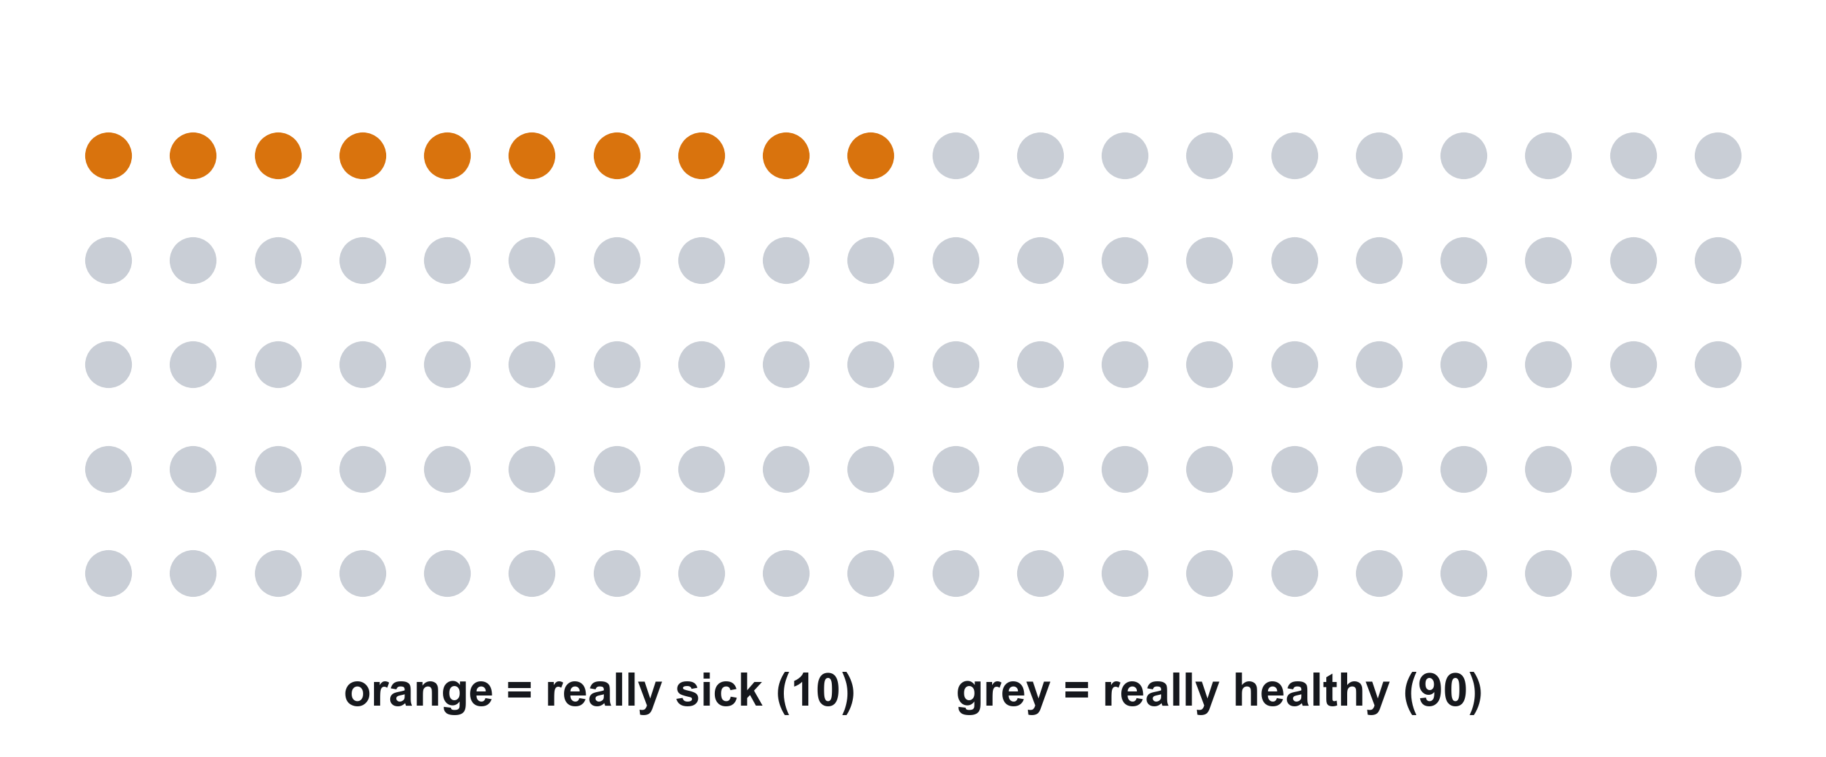
First, the truth: 100 patients, 10 are sick
This is what is really true. The model does not know it — it has to guess for each patient.
DAVE3625- Intro to A.I. by Umair M.I
22
Notes:
Each dot is one patient. Ten of them are sick, ninety are healthy. This is the truth, which the clinic finds out later.
Keep two things apart for the rest of this part. The colour of a dot is what is really true. What the model says about the patient is a separate thing, and it can be wrong.

Slide 23
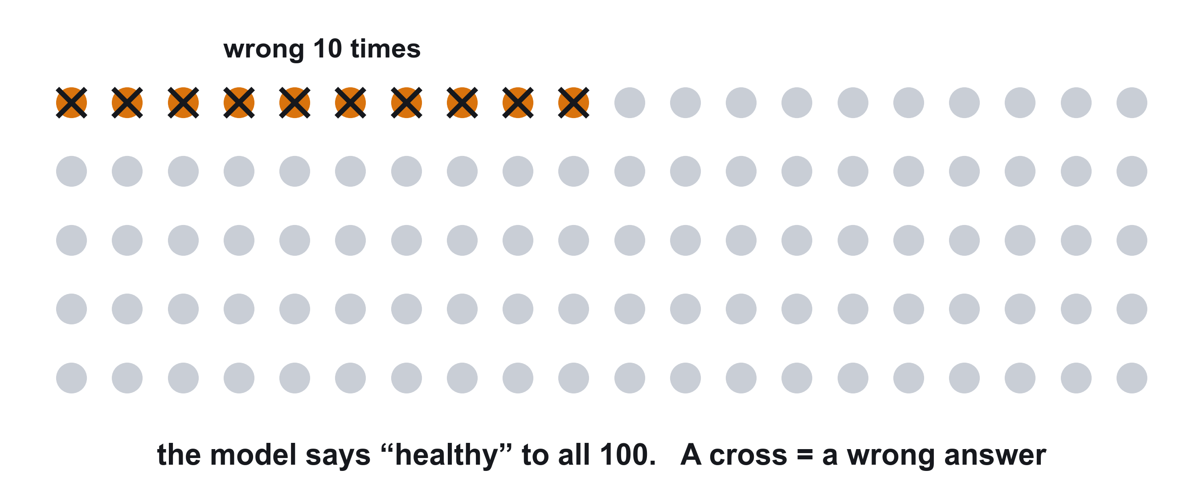
The first model says “healthy” to everyone
Right about the 90 grey dots. Wrong about the 10 orange dots. Right 90 times out of 100 — nobody found.
DAVE3625- Intro to A.I. by Umair M.I
23
Notes:
This is the model from the start of the lecture. It gives the same answer for every one of the 100 patients: healthy. It never says sick.
For the ninety patients who really are healthy, that answer is correct. For the ten who really are sick, it is wrong; each cross marks a wrong answer. So the model is right 90 times out of 100. Its accuracy really is 90% — and it is useless, because it never finds a sick patient.
Accuracy means: out of all the answers, how many were right. It works well when the two groups are about the same size. It misleads when one group is rare, because a model can score high by always guessing the common group. Disease, fraud and spam are all like this: the thing you are looking for is rare.

Slide 24
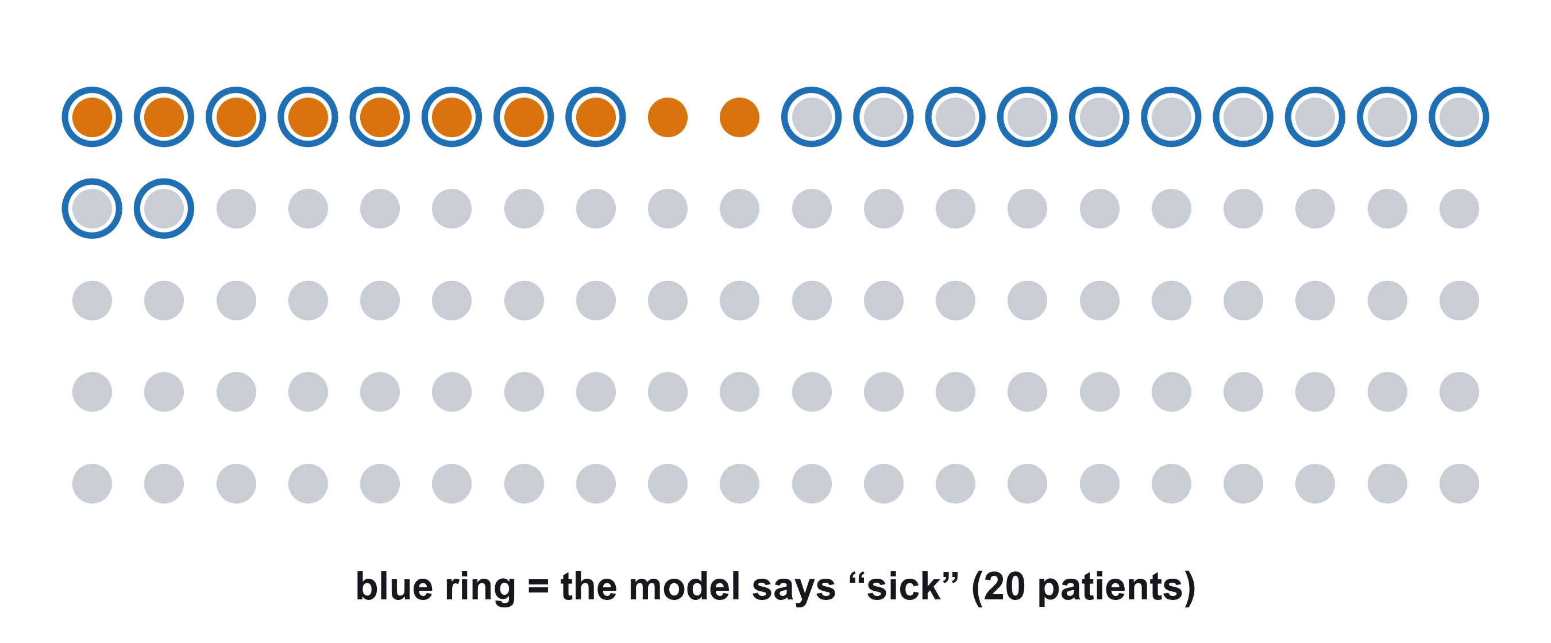
A better model says “sick” to 20 patients
It finds 8 of the sick patients. It misses 2. It raises 12 false alarms.
DAVE3625- Intro to A.I. by Umair M.I
24
Notes:
A second model looks at the same 100 patients. A blue ring means the model said sick.
Look at what the rings land on. Eight are around an orange dot: sick patients the model found. Two orange dots have no ring: sick patients it missed. Twelve rings are around grey dots: healthy people flagged by mistake, false alarms. The other 78 grey dots were correctly left alone.
So there are two ways to be right and two ways to be wrong, and the two mistakes are very different. A missed patient goes home ill. A false alarm means a healthy person has one more test.

Slide 25
The same picture as a table
Model says
sick
Model says
healthy
8
2
This table is called a confusion matrix.
Green — right
Red — wrong
The small grey words are the official names.
Really sick
10 patients
found
missed
true positive
false negative
12
78
Really healthy
90 patients
false alarm
left alone
false positive
true negative
DAVE3625- Intro to A.I. by Umair M.I
25
Notes:
A confusion matrix is the four counts from the previous slide, put in a table. Each row is what was really true. Each column is what the model said.
The official names are easier than they look. The second word is what the model said: positive means it raised the alarm. The first word says whether it was right. A false negative: the model said negative, and that was false — a sick patient missed.
Positive does not mean good. It means the thing you are looking for.
This model is right 8 + 78 = 86 times out of 100. Its accuracy is 86%, lower than the model that found nobody. Yet it is clearly the better model. That is why accuracy is not enough.

Slide 26
Two concepts: Recall and Precision

Slide 27
Recall: Did we find them ?
It looks only at the patients who really are sick.
▪ Of the sick patients, how many did the model find ?
▪ 10 are sick. The model found 8.
▪ Recall = 8 out of 10 = 80 %
▪ Low recall means many missed cases
- The model that says “healthy” to everyone: 0 out of 10 = 0 %
Low recall = many missed cases. Formula: TP / (TP + FN)
DAVE3625- Intro to A.I. by Umair M.I
27
Notes:
Recall looks only at the patients who really are sick: the top row of the table. Of those 10, how many did the model catch? 8.
The healthy patients do not come into it at all.
Recall is the number that exposes the first model. Its accuracy was 90% and its recall was zero.
----
Recall looks only at the patients who really are sick. Everybody else is faded out in the picture, because they play no part.
Ten patients are sick. So the model found 8 out of 10: its recall is 80%.
Low recall means many missed cases. The first model, which said healthy to everyone, has a recall of 0 out of 10. That one number exposes what its 90% accuracy was hiding.
As a formula: recall = TP / (TP + FN), the top row of the table.

Slide 28
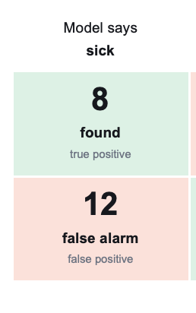
Precision: can we trust the alarm ?
▪ When the model says “sick”, how often is it right ?
▪ The model said “sick” 20 times. 8 really were sick.
▪ Precision = 8 out of 20 = 40 %
▪ More than half of its alarms are false alarms.
Low precision = many false alarms. Formula: TP / (TP + FP)
DAVE3625- Intro to A.I. by Umair M.I
28
Notes:
Precision looks only at the alarms: the left column of the table. The model said sick 8 + 12 = 20 times, and 8 of those were real.
A way to keep the two apart. Recall is the patient's question: if I am ill, will it find me? Precision is the doctor's question: when the alarm goes off, should I believe it?
Both are examined, as definitions and as small calculations like these.

Slide 29
Which mistake is worse ?
System | A false alarm means (precision) | A miss means (recall)
Cancer screening | A healthy person has another test | A tumour is not found
Spam filter | A real e-mail lands in the junk folder | One spam message gets through
Cancer screening: a miss is far worse. You want high recall, and you accept some false alarms as the price.
Spam filter: losing a real e-mail is worse than seeing one spam message. You want high precision.
A miss is worse → you want high recall. A false alarm is worse → you want high precision.
DAVE3625- Intro to A.I. by Umair M.I
29
Notes:
Cancer screening: a miss is far worse. You want high recall, and you accept some false alarms as the price.
Spam filter: losing a real e-mail is worse than seeing one spam message. You want high precision.
There is no general answer. Which measure matters depends on what each mistake costs, and people have to decide that — not the algorithm.
You can usually trade one for the other. A model that raises the alarm more easily finds more sick patients and produces more false alarms. The setting that controls this is called the threshold.

Slide 30
A perfect model would find every sick patient (recall 100%) and never raise a false alarm (precision 100%).
A model that raises the alarm more easily finds more sick patients and produces more false alarms. The setting that controls this is called the threshold.

Slide 31
F1: one number instead of two
▪ F1 makes one score out of recall and precision.
▪ It is high only when both are high.
– precision 80 % and recall 80 % → F1 = 80 %
– precision 100 % and recall 20 % → F1 = 33 %
▪ One good number cannot hide one bad number.
Machine Learning Yearning, chapter 8: pick one number to judge your model by.
DAVE3625- Intro to A.I. by Umair M.I
31
Notes:
With two numbers per model, comparing models gets awkward. The book's advice is to settle on one number.
F1 is the usual choice. When precision and recall are equal, F1 is that same number. When they are far apart, F1 ends up close to the lower one.
The formula is F1 = 2 × precision × recall / (precision + recall). You should know what F1 is for; if a calculation is asked, the formula will be given.

Slide 32
In scikit-learn
from sklearn.metrics import confusion_matrix
tree = DecisionTreeClassifier(max_depth=3, random_state=42) # a small tree
tree.fit(X_train, y_train)
y_pred = tree.predict(X_test)
print(confusion_matrix(y_test, y_pred))
# [[38 4] 42 malignant: 38 found, 4 missed
# [ 3 69]] 72 benign: 3 false alarms, 69 left alone
Recall: 38 of 42 found = 90 % Precision: 38 of 41 alarms real = 93 %
DAVE3625- Intro to A.I. by Umair M.I
32
Notes:
The same kind of table, produced by scikit-learn for a decision tree of depth 3 on the tumour test set. Here malignant is the thing being looked for.
Read it like the patient table: each row is the truth, each column is what the model said.
classification_report(y_test, y_pred) prints recall, precision and F1 for you; you will use it in the lab.

Slide 33
Learn, don't memorise
IDEA 3
DAVE3625- Intro to A.I. by Umair M.I
33
Notes:
Words in this part: overfitting, underfitting, bias, variance.

Slide 34
GUESS
Three students before an exam
▪ Anna learns last year's exam answers by heart.
▪ Ben hardly studies. His plan: “when in doubt, answer C”.
▪ Clara works through the exercises until she understands them.
▪ Who does well on the exercises ? Who does well on the new exam ?
DAVE3625- Intro to A.I. by Umair M.I
34
Notes:
Think about two scores for each student: how they would do on the old exercises, and how they would do on an exam with new questions.
The three students are the three things a model can do with its training data.

Slide 35
Two scores tell you which student you have
 | On the exercises (training set) | On the exam (test set) | This is called
Anna memorised | 100 % | 70 % | Overfitting
Ben hardly studied | 60 % | 60 % | Underfitting
Clara understood | 90 % | 88 % | A good model
Always look at both scores. One score alone cannot tell Anna from Clara.
DAVE3625- Intro to A.I. by Umair M.I
35
Notes:
Anna is perfect on what she memorised and lost when the questions are new. A big gap between the two scores is the sign.
Ben is poor on both. There is no gap, but both scores are low.
Clara is good on both, and her two scores are close together.
This is the most useful habit in the lecture: never judge a model by one score. Compare the score on the training set with the score on the validation or test set.

Slide 36
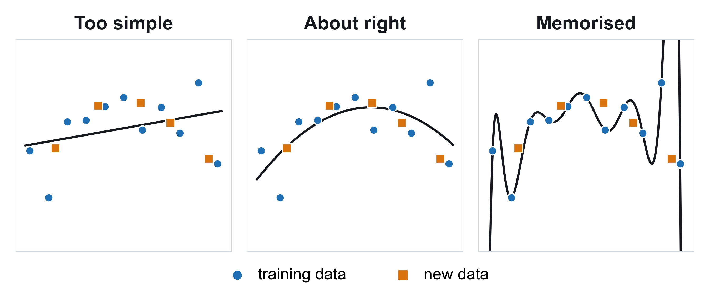
The same three, as models
Underfitting
Overfitting
The line is the model. Left is Ben, right is Anna, the middle is Clara.
36
Notes:
The blue dots are the training data. The black line is what the model learned from them. The orange squares are new data that the model has never seen.
On the left, the model is a straight line. The dots clearly follow a bend, and a straight line cannot bend. It is far from many of the blue dots and far from the orange ones too. This is underfitting.
On the right, the model twists so that it passes exactly through every blue dot. On the training data it is perfect. But look at the orange squares: the line misses several of them badly, because the twists were fitted to accidents in the blue dots. This is overfitting.
In the middle, the model is a smooth curve. It does not hit every blue dot, and it stays close to the orange squares. It learned the pattern, not the individual points.

Slide 37
Overfitting
▪ The model memorised the training data instead of learning the pattern.
▪ This is student, Anna.
– Very good on the training set
– Clearly worse on new data
▪ The tree from the code slide: 100 % on training, 91 % on test.
Also called high variance.
DAVE3625- Intro to A.I. by Umair M.I
37
Notes:
Real data always contains accidents: an unusual patient, a typing mistake, a coincidence. A model with enough freedom learns those accidents as if they were rules.
On the training data that looks excellent. On new data it hurts, because the accidents do not repeat.
A decision tree with no limit on its depth is the classic example. It keeps asking questions until it has every training example right — which is memorising.
The technical name is high variance, and it is examined.

Slide 38
Underfitting
▪ The model is too simple to learn the pattern.
▪ This is student, Ben.
– Poor on the training set
– Poor on new data too
▪ Example: a straight line through points that follow a curve.
Also called high bias.
DAVE3625- Intro to A.I. by Umair M.I
38
Notes:
Underfitting is the opposite problem. The model has not memorised anything; it has not learned enough.
You saw it in the regression lecture: a straight line cannot follow a curve, however much data you give it. A decision tree that is allowed to ask only one question is another example.
The technical name is high bias, and it is examined.

Slide 39
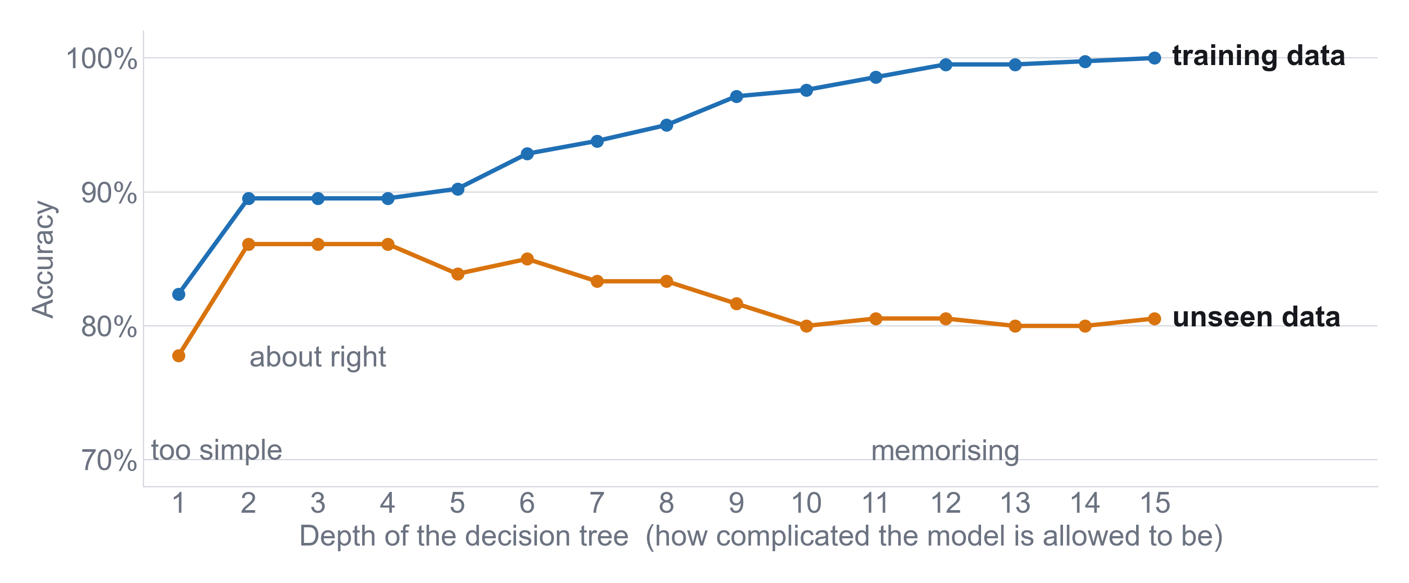
All three in one picture
A decision tree that is allowed to get more and more complicated.
DAVE3625- Intro to A.I. by Umair M.I
39
Notes:
From left to right, the tree is allowed to ask more and more questions.
The blue line is the score on the training data. It keeps rising to 100%: a more complicated model can always fit its own training data better.
The orange line is the score on new data. It rises, reaches a top, and then falls.
On the far left both lines are low: that is Ben, underfitting. On the right the lines move apart: that is Anna, overfitting. The best model is at the top of the orange line — Clara — and it is not the one with the best training score.

Slide 40
How to fix it
Underfitting (Ben)
Overfitting (Anna)
▪ Use a more flexible model
▪ Add better features
▪ More data does not help
▪ Get more training data
▪ Use a simpler model
▪ Use fewer features
The two lists are opposites. Find out which problem you have before you change anything.
DAVE3625- Intro to A.I. by Umair M.I
40
Notes:
Ben needs to study more: give the model more freedom. For a decision tree that means allowing more depth; for regression, a curve instead of a straight line.
Anna needs to be stopped from memorising: give the model less freedom, or so much data that memorising no longer works. For a decision tree that means limiting the depth; for KNN, using a larger k.
Settings like the depth of a tree or the k in KNN, which you choose before training, are called hyperparameters. You choose them by trying several values and comparing on the validation set.
The commonest mistake is collecting more data for a model that is underfitting. It cannot use the data it already has.

Slide 41
What should we fix first ?
IDEA 4
DAVE3625- Intro to A.I. by Umair M.I
41
Notes:
Word in this part: error analysis. Machine Learning Yearning, chapters 13 to 19.

Slide 42
DISCUSS · 2 MINUTES
The dog problem
▪ A team has an app that finds cats in photos.
▪ It is wrong on 10 out of 100 photos.
▪ Someone notices that it sometimes calls dogs cats,
▪ and wants to spend a month fixing that.
▪ Good idea ? What would you check first ?
Machine Learning Yearning, chapter 14.
DAVE3625- Intro to A.I. by Umair M.I
42
Notes:
The tempting answers are yes, because it is a real fault, and no, because a month is long. Neither is based on anything.
The thing to check is how many of the mistakes are actually dogs. That takes ten minutes.

Slide 43
Look at the mistakes and count
▪ Open 100 photos the model got wrong. Count the dogs.
▪ 5 are dogs
– Fixing dogs fixes 5 of every 100 mistakes. Not worth a month
▪ 50 are dogs
– Fixing dogs fixes half of all mistakes. Start today
▪ This is called error analysis.
Like going through a marked exam to see which topic your wrong answers came from.
DAVE3625- Intro to A.I. by Umair M.I
43
Notes:
Error analysis means opening the examples the model got wrong and sorting them by cause. It is only looking and counting.
The count tells you the most an idea can achieve, before anybody builds anything. If dogs are 5 of 100 mistakes, a perfect dog fix barely changes the result. If they are 50 of 100, it halves the mistakes.
In practice you count several causes at once — dogs, blurry photos, big cats — in a simple table, and work on the biggest group first. The book's advice is to build a simple first version quickly and let its mistakes tell you what to do next.

Slide 44
So — is a 90 % model good ?
▪ 1. Was it tested on new data ?
– training set · test set · validation set
▪ 2. What kind of mistakes does it make ?
– recall · precision
▪ 3. Did it learn, or did it memorise ?
– overfitting · underfitting
▪ 4. What should we fix first ?
– error analysis
DAVE3625- Intro to A.I. by Umair M.I
44
Notes:
The four questions from the start, each with the words it introduced. You can ask them about your own models and about any claim you read: 97% accurate on which data? Compared with always guessing the common answer? And what happens in the other 3%?

Slide 45
Today's words
Word | In plain language
Training set | The data the model learns from — the exercises
Validation set | Data for choosing between models — the mock exam. Also: dev set
Test set | Hidden data, used once at the end — the real exam
Overfitting | Memorised. Good on training data, worse on new data. High variance
Underfitting | Too simple. Poor on training data and on new data. High bias
Confusion matrix | Table of found, missed, false alarms and left alone
Recall | Of the real cases, how many did the model find ?
Precision | Of the model's alarms, how many were real ?
Error analysis | Looking at the mistakes and counting the causes
DAVE3625- Intro to A.I. by Umair M.I
45
Notes:
A slide for revision. Every word here can come up in the exam.

Slide 46
EXAM-STYLE QUESTIONS
Check yourself
▪ 1. A model scores 100 % on the training set and 70 % on the test set.
▪ What is this called ?
▪ 2. 20 e-mails are spam. A filter finds 10 of them.
▪ What is its recall ?
▪ 3. The filter flags 10 e-mails. 8 of them really are spam.
▪ What is its precision ?
DAVE3625- Intro to A.I. by Umair M.I
46
Notes:
Try all three before the next slide.

Slide 47
Answers
▪ 1. Overfitting. The model memorised the training data.
▪ 2. 10 out of 20 = 50 %
▪ 3. 8 out of 10 = 80 %
DAVE3625- Intro to A.I. by Umair M.I
47
Notes:
For question 1, possible fixes are more training data, a simpler model, or fewer features.
For questions 2 and 3, notice that recall starts from the real spam (20) and precision starts from what the filter flagged (10).

Slide 48
Reading and lab
▪ Machine Learning Yearning — Andrew Ng
– Chapters 6–12: development and test sets
– Chapters 13–19: error analysis
▪ In the lab
– Split, train, and compare the training score with the test score
– Make a tree overfit, then fix it with max_depth
– Print a confusion matrix and work out recall and precision
DAVE3625- Intro to A.I. by Umair M.I
48
Notes:
The book is free and each chapter is a page or two. The cat app and the dog problem in these slides come from it. It goes further than this lecture on several points: how big the validation set should be, what to do when one number is not enough, and what to do when the labels themselves are wrong.

