Slide 2
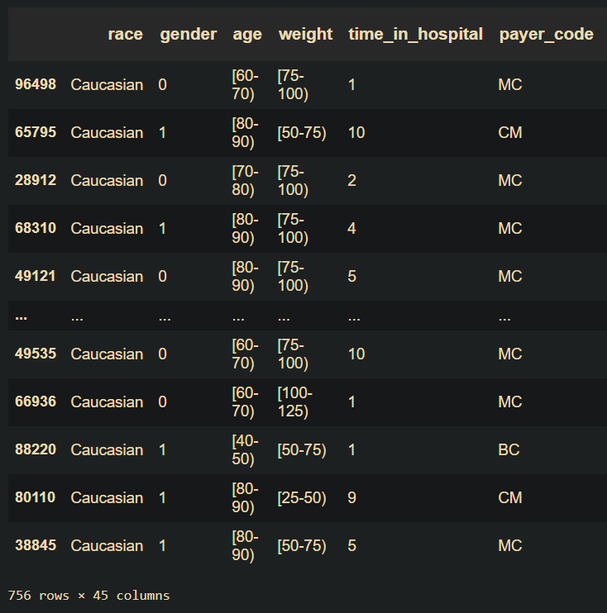
Imputation
If you don’t impute at all and cut out rows that have at least one missing entry, then you get back a tiny dataset with only 756 rows (less than 1% of the original training/cross-validation data) which is homogeneous: white, elderly people with health insurance

