Slide 1
Computer Vision and Artificial Intelligence
By: J. Klimack

Slide 2
Contents
What is Artificial Intelligence?
Types of AI
What is Computer Vision?
Applications of Computer Vision

Slide 3
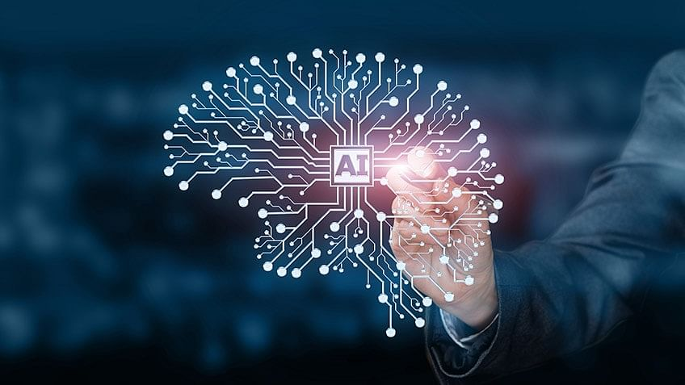
What is Artificial Intelligence?

Slide 4
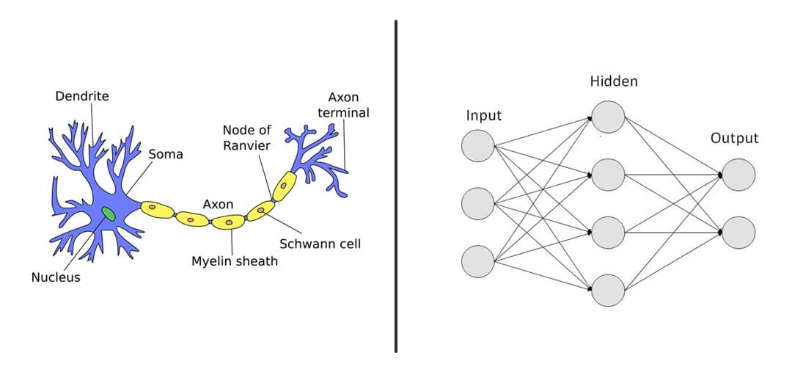
What is Artificial Intelligence?
Machines that can:
Learn
make decisions
Make Predictions
Recognize patterns

Slide 5
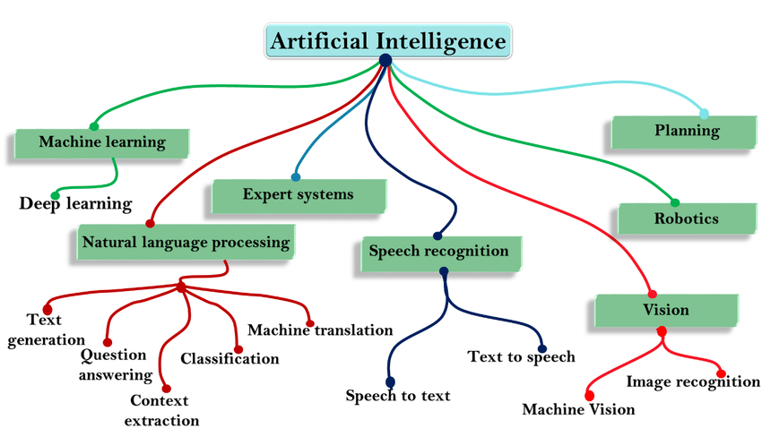

Slide 6
Train
Test
Data!

Slide 7
What is Computer Vision?
It is the branch of AI that deals with digital images, videos and other sources of visual media
It allows computers to understand visual data
Applications Include:
Image Manipulation
Edge Detection
Object detection / Classification
Face Recognition

Slide 8
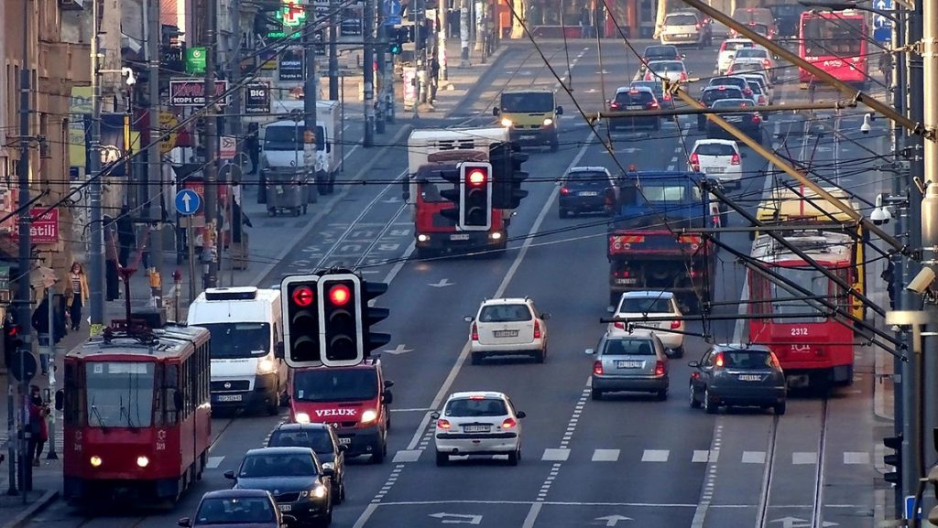
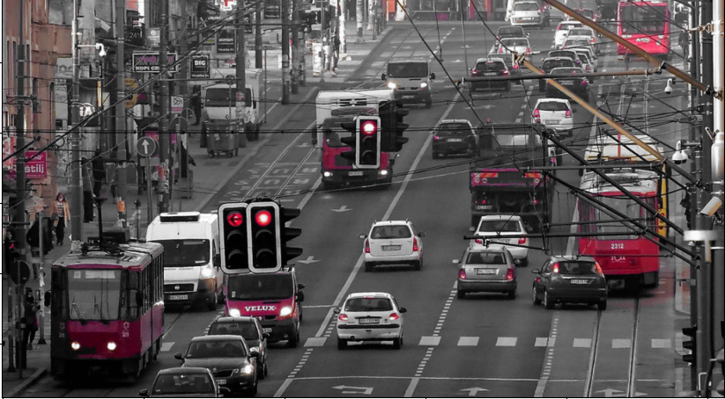
Color Accents
Black and White image except one color

Slide 9
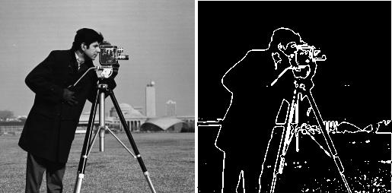
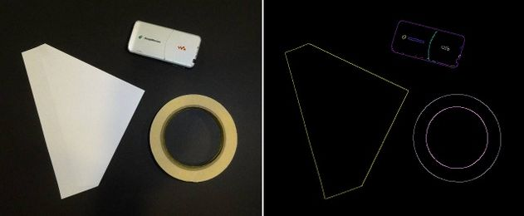
Edge Detection
Finding important edges between different colors or features in an image
Ex: Photoshop
Manufacturing:
Laser cutter
Cricut / die-cutter
Engraver

Slide 10
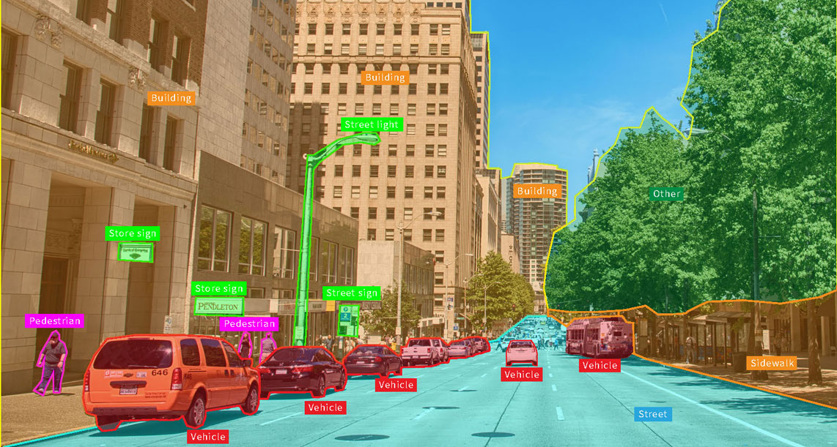
Object Detection / Classification

Slide 11
What is a Digital Image?
Computers can’t actually “see”
They only understand numbers
Digital Images are made up of thousands of pixels
More pixels = Higher resolution

Slide 12
Pixels
Each pixel has three numbers from 0-255:
R – Red
G – Green
B - Blue

