Slide 1

Data analytics to provide complete solution for groundwater management for the country
Team Name : Eff-Yuu

Slide 2
Solution Appearance
The solution will empower every citizen of the nation with the right of consistent supply of water.
It is an automated system capable of detecting, analysing and predicting the groundwater levels.
The solution allows CGWB officials to analyse the levels on a geospatial map, monitor performance of many locations and identify the most and least water stressed areas.
The system operates on web-cloud without any or with minimum human intervention.
Our system can analyse the provided ground water data, identify trends, compare current status with past year levels.

Slide 3
Impact
Groundwater contributes
62% in irrigation,
85% in rural water supply and
45% in urban water supply.
It is an annually replenishable resource, but its availability is nonuniform in space and time. Hence its sustainable utilization needs a realistic quantitative assessment based on scientific principles.

Slide 4
Impact
We propose
a framework for underground water management system that capable of taking an account of this invaluable resource which impacts nearly 60% of country’s population.
It will allow us to
identify which crops can be planted in a area.
Better urban water utilization and distribution.
This sophisticated system is designed to deal with one of the most critical problem of this country.

Slide 5
Impact
It will allow to draft policies to tackle possible drought and take measure to increase the groundwater level in worst affected locations.
It will allow central authorities to have a better insight in the groundwater scenario of the nation.
Develop interdisciplinary capability building for the efficiently managing the groundwater resources leading to following impacts:
No scarcity of water.
Better groundwater utilization.

Slide 6
Technology used & to be used
Cloud computing
Internet of things
Geospatial analysis
Artificial intelligence
Machine learning
Distributed system
System automation
Distributed computing
Bigdata

Slide 7
Execution
The System has been implemented as a web service, on React platform.
The system uses state of the art algorithms : ARIMA, Holt Winter’s Exponential Smoothing (HWES) among others to predict future values.
The data collected from CGWB's and India-WRIS site has been processed, analysed and visualised (e.g: waterfall plot, violin plot) for the application.
The system is capable of analysing past data, discovering trends, uncovering hidden patterns and predicting the future groundwater status and which will help us in tackling the inefficiencies and better managing the groundwater resources of the country.

Slide 8
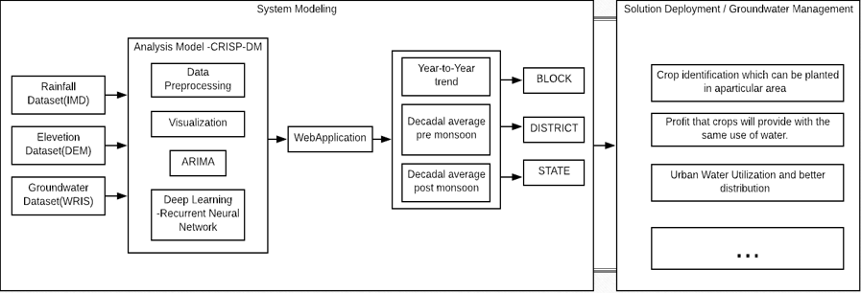
*
*
Execution details
* To be realize later

Slide 9
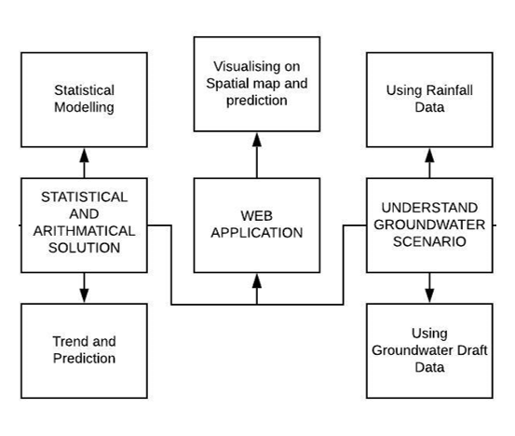
*
*
Overview of the system
* To be realize later

Slide 10
User experience
The system can be accessed through any web browser (mobile device, laptop or tablet) as it is hosted on cloud.
The statistics and observations are shown on map for geospatial analysis along with graphs for more granular analysis.
The web app is easy to use with multiple filters and search options.
We propose two data abstraction mechanism:
Centralized System : Control the systems around the country
Distributed System : Node that manages a particular location and works under centralized system.
Based on the proposed data abstraction mechanism the ability to manage the each and every geolocation by centralized system with the help of distributed system.

Slide 11
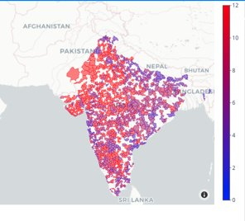
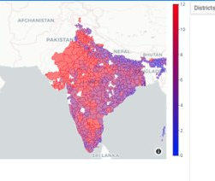
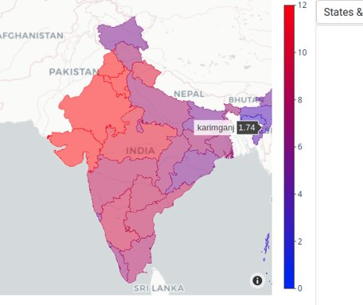
User Experience
Granularity: From left to right: block, district, state
Completely interactive and highly intuitive

Slide 12
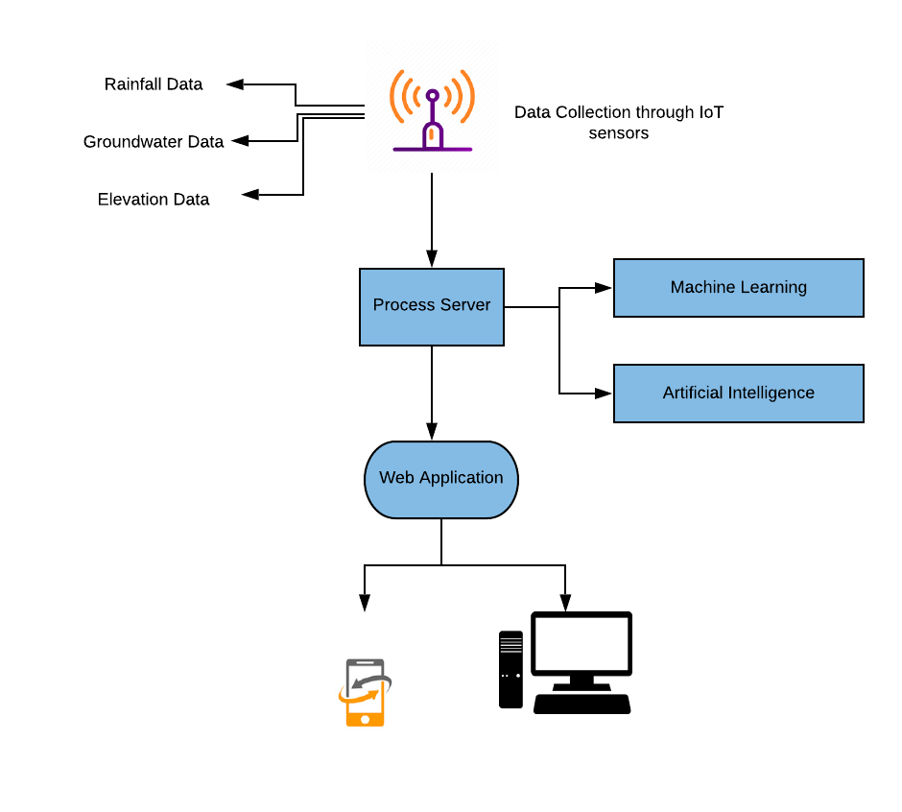

Slide 13
