Slide 1

Project Epidemics
Manu, Jason and Jag

Slide 2
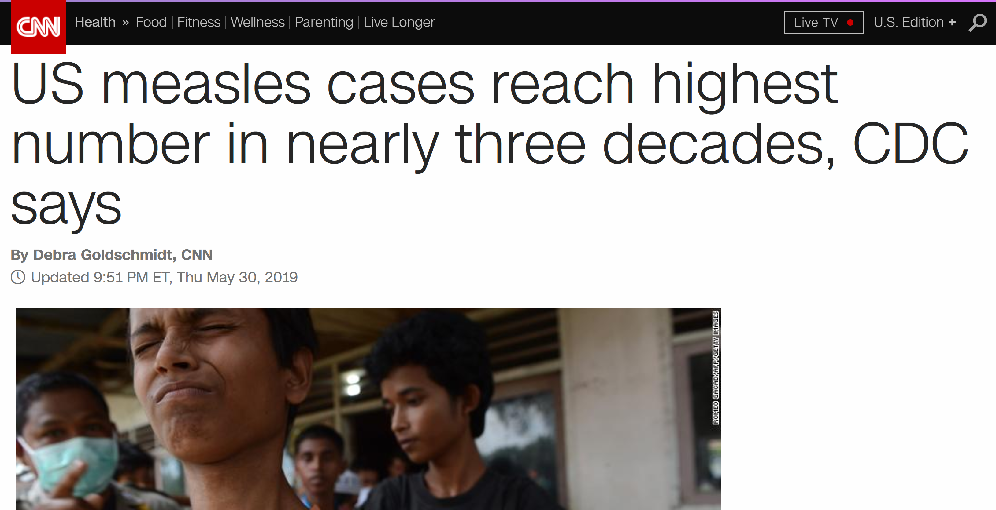
Measles was eliminated in the United States in 2000, meaning it was no longer continuously transmitted in the country.
The United States is current at risk of losing its measles elimination status.

Slide 3
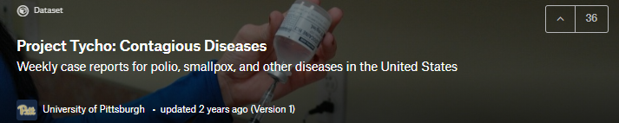
Objectives
Historical analysis of the rates of seven infectious diseases by U.S. state and year using datasets from Kaggle (Project Tycho : Contagious Diseases)
Smallpox, polio, measles, mumps, rubella, hepatitis A, and whooping cough (pertussis)
From the National Notifiable Disease Surveillance System (NNDSS) reports for the United States ranging from 1916-2011
Explore the relationship between population and disease
Produce a US heatmap of total measles cases by U.S. state

Slide 4
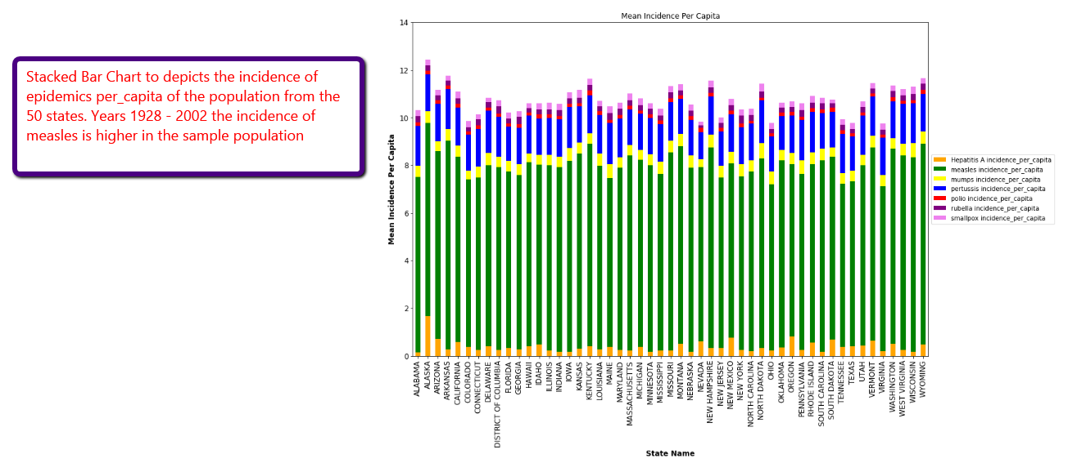
Stacked Bar Graph of All Epidemics Sorted by State

Slide 5
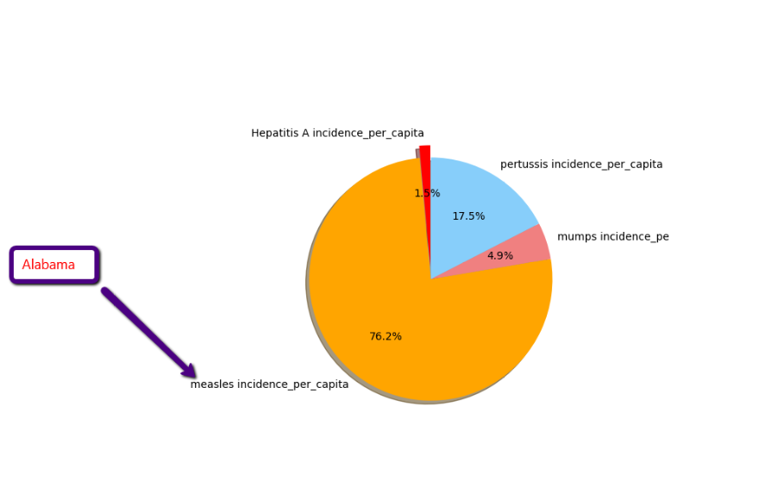
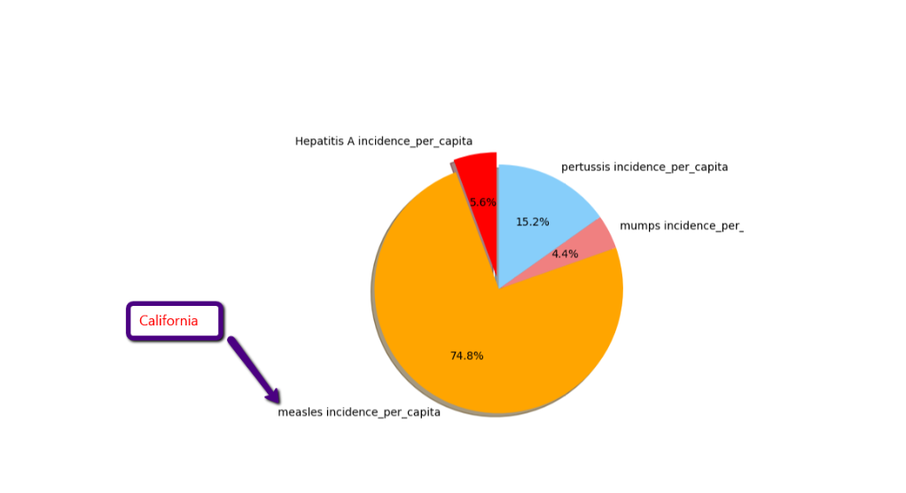
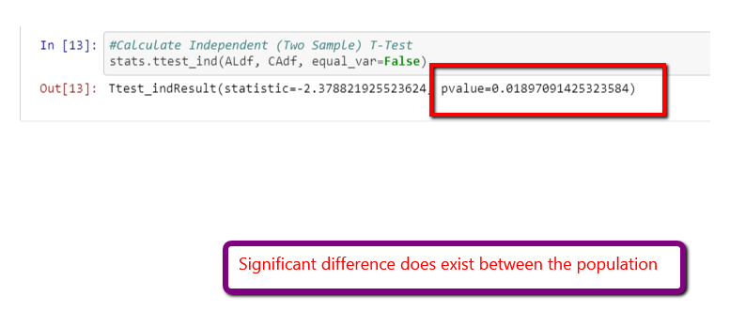
Relationship between Measles and Population

Slide 6
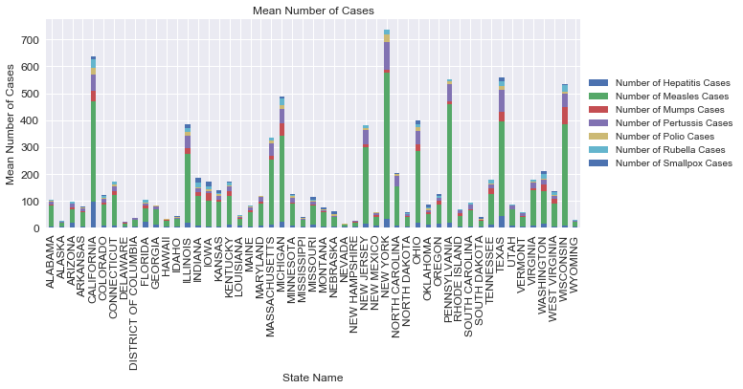
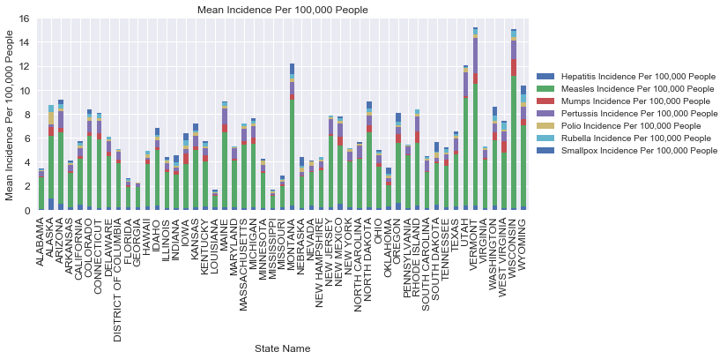
Average Number and Incidence Per 100,000 People by States

Slide 7
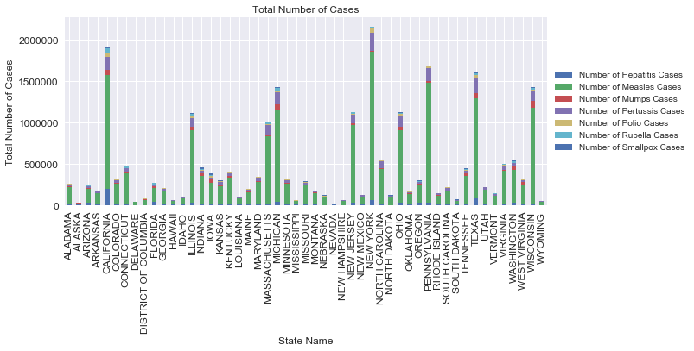
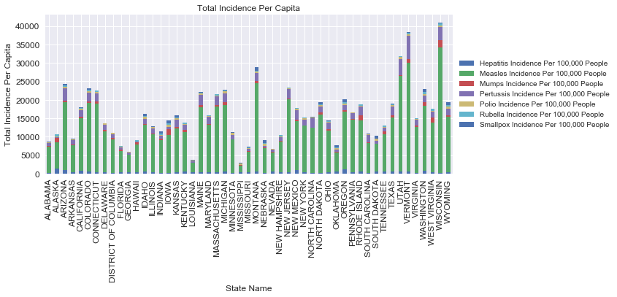
Total Cases and Incidence Per 100,000 People by States

Slide 8
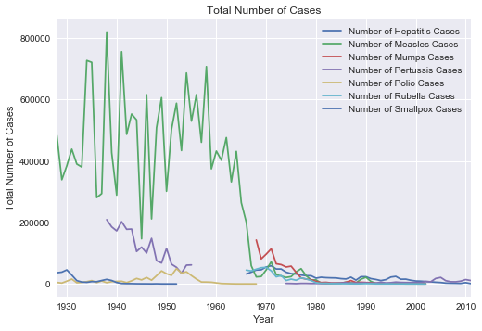
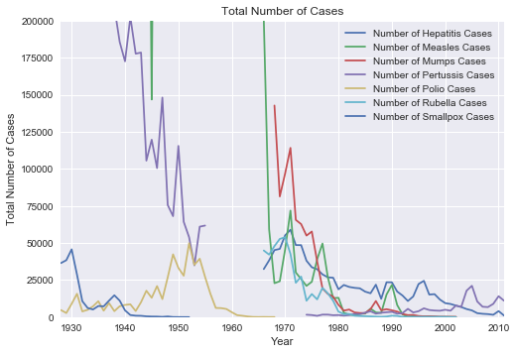
Following the development of a vaccine the number of cases precipitously falls

Slide 9
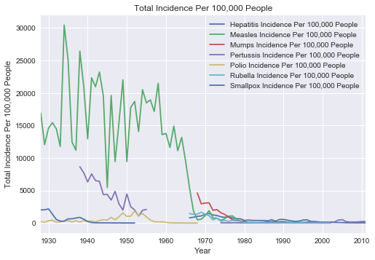
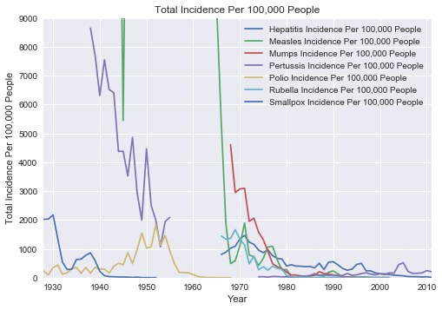
Following the development of a vaccine the number of cases precipitously falls

Slide 10
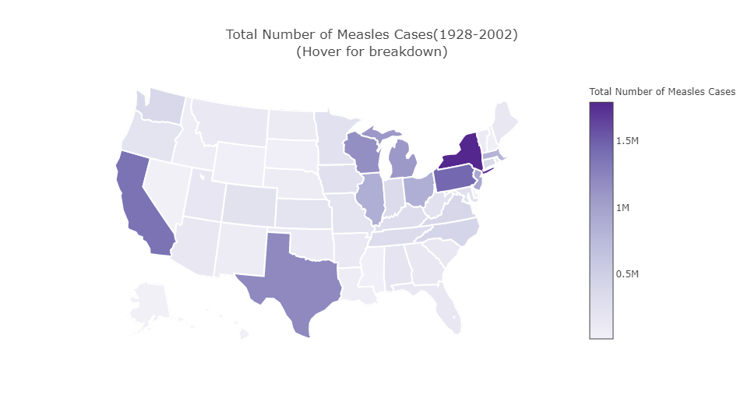
Heat Map of Total Measles Cases by State (1928-2002)
1.) NY
2.) PA
3.) CA
4.) TX
5.) WI

Slide 11
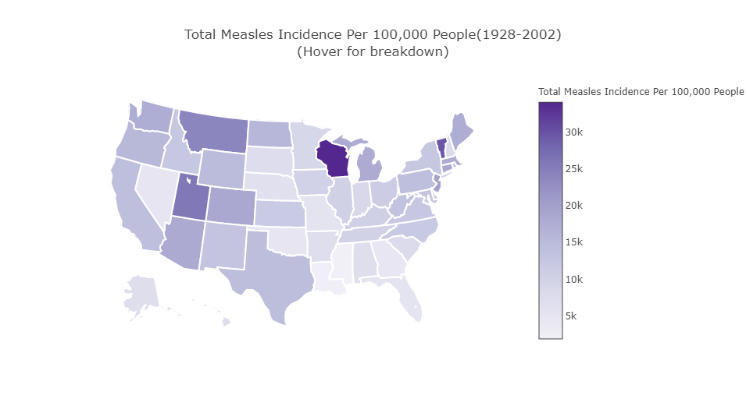
Heat Map of Total Incidence Per 100,000 People by State (1928-2002)
1.) WI
2.) VT
3.) UT
4.) MN
5.) NJ

Slide 12
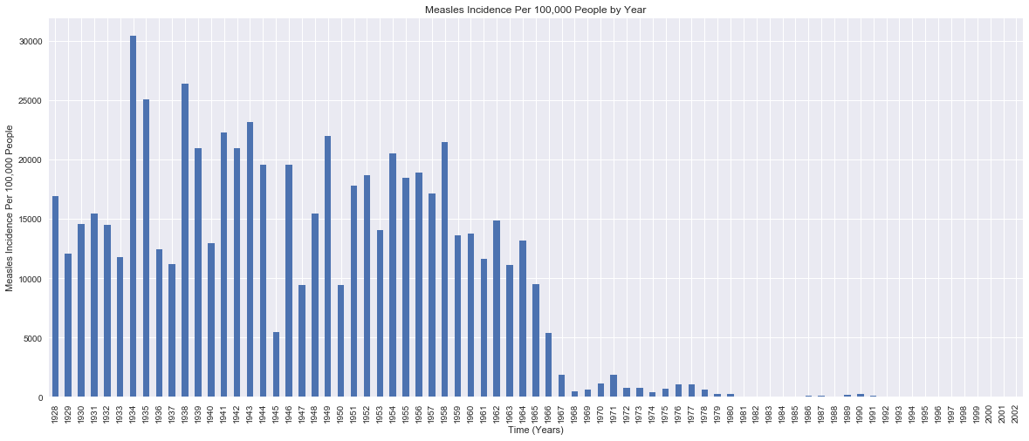
Following the public introduction of the Measles vaccine in 1963 cases fell steadly

Slide 13
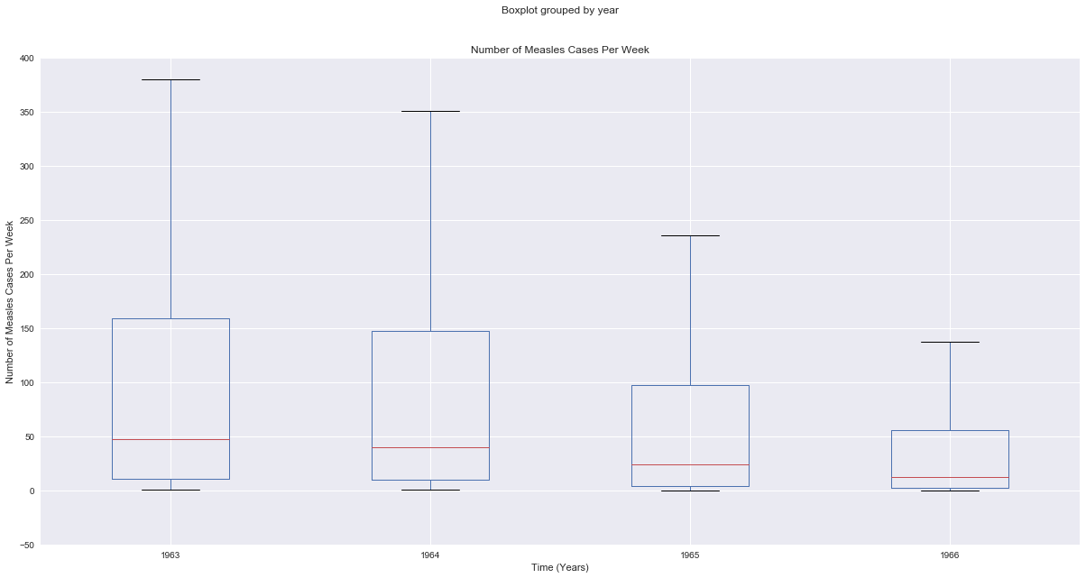
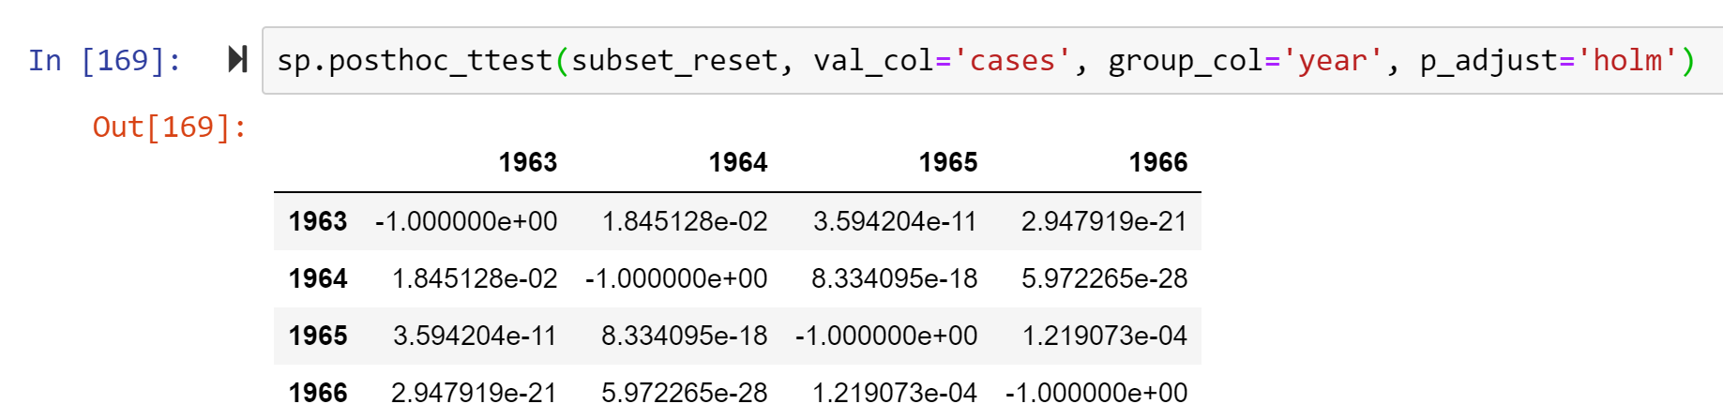
Measles cases significantly fell every year from 1963 - 1966
One-Way ANOVA
F value = 61.36225
P value = 2.768965e-39

Slide 14
Summary
Vaccines are effective at controlling epidemics
Measles had by far the greatest incidence in US population of the seven infectious diseases analyzed
The most populous states did not necessarily have the highest number of incidences of disease
While New York had the greatest number of cases, Wisconsin was the most impacted state during the measles epidemic when normalized by population

Slide 15

Welcome to Nevada
Move here if you want to avoid the next epidemic!
(lowest cumulative contagious disease incidence per capita)

Slide 17
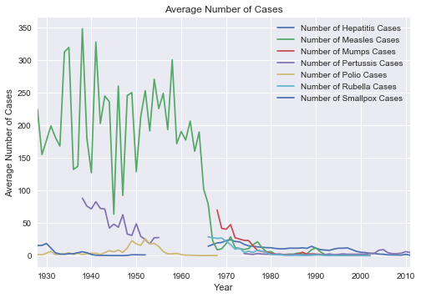
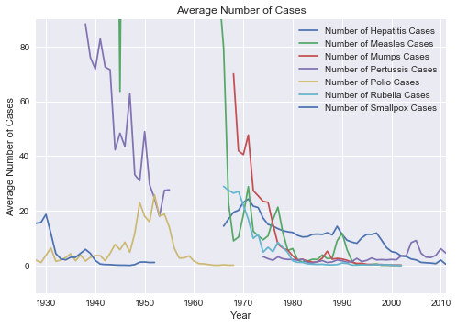
Average number of cases over years

Slide 18
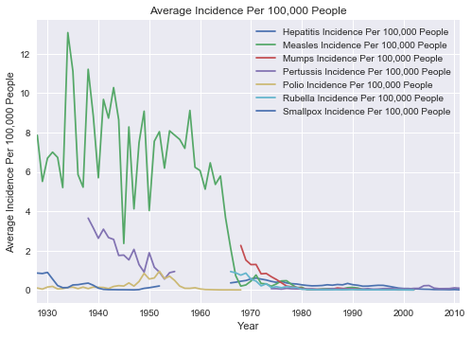
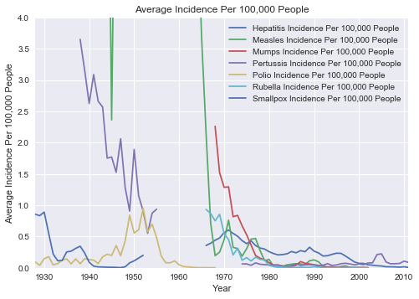
Average Incidence Per 100,000 People by Year

Slide 19
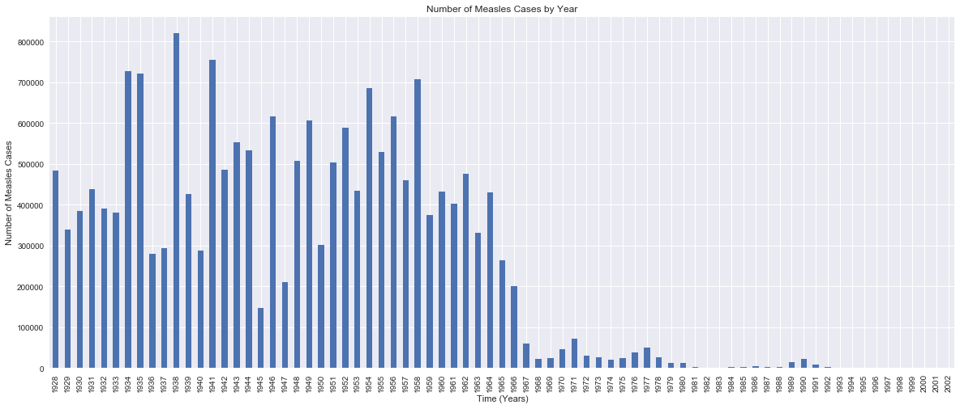
Total Number of Measles Cases by Year

