Slide 1

HR Digital Transformation
Building Capability to Accelerate Business

Slide 2
Course Overview
All industries and line of businesses have been experiencing digital disruption, with increasing competition from new entrants, startups, international players.
Introduction
The pandemic has forced companies to adopt transformational programs, especially towards employee experience.
Employee experience has been now seen as a priority by many organisations, and with it, digital experience.
HR Digital Transformation drives employee engagement and can deliver valuable insights as employees touch every aspect of an organisation.
With this human-centric view, enterprises are creating more digital services for their employees than ever before.
Understand how you can digitalise the workforce and workplace, improve employee digital experience, attracting and retaining employees, and boosting motivation.

Slide 3
Learning Objectives
Explain HR’s role in digital transformation
Understand influence of HR technology and ways of working
Highlight importance of an agile HR in the organisation’s strategic direction
Visualise a digital talent pool for a digital enterprise
Understand how to transform learning experience and HR programs
Explain the difference between continuous feedback and performance review
Find out how to transform experience and culture
Learn how HR can cultivate innovation, increase productivity, and improve engagement

Slide 4
Agenda
 | Day 1 | Day 2
09:00 – 10:30 | Introduction to Digital Transformation What is the role of HR | How to digitalise learning experience Example of HR Programs of Work
10:30 – 10:45 Break
10:45 – 12:30 | HR Technology: platforms, frameworks and integrations Example of HR architecture | How to shift to a continuous discussion around employee performance and growth
12:30 – 13:30 Lunch
13:30 – 15:15 | Introduction to agile methodology for HR What are the benefits of an agile HR | How to transform people experience, company culture and leadership
15:15 – 15:30 Break
15:30 – 17:00 | What is global workforce How to identify digital talent | How to keep the momentum, cultivate innovation, increase productivity, and improve engagement.

Slide 5



Details
Audience.
Prerequisites.
Duration.
None.
2 days.
HR Practitioners.
Managers.
Leaders.
Professionals working in a global environment.

Slide 6

Trainer Profile
Jacques Maeda runs the global performance and capability programs, frameworks and platforms for over 30 countries at IDP Education. Previously at SAP Brazil and SAP Australia, he has served as the Trusted Adviser for Australia Post, Companhia Siderúrgica Nacional, Petrobras, Mitsui & Co, and other companies in Latin America. Jacques has also been the go-to person responsible for business transformation, innovation and maximising returns on technology investment for top strategic enterprises. He has an MBA in IT Management and speaks Portuguese, Spanish, English and a bit of German, and currently is learning Chinese with his 3-year-old son. In his free time, he enjoys a workout and travelling - has been to all continents except Antarctica.

Slide 7
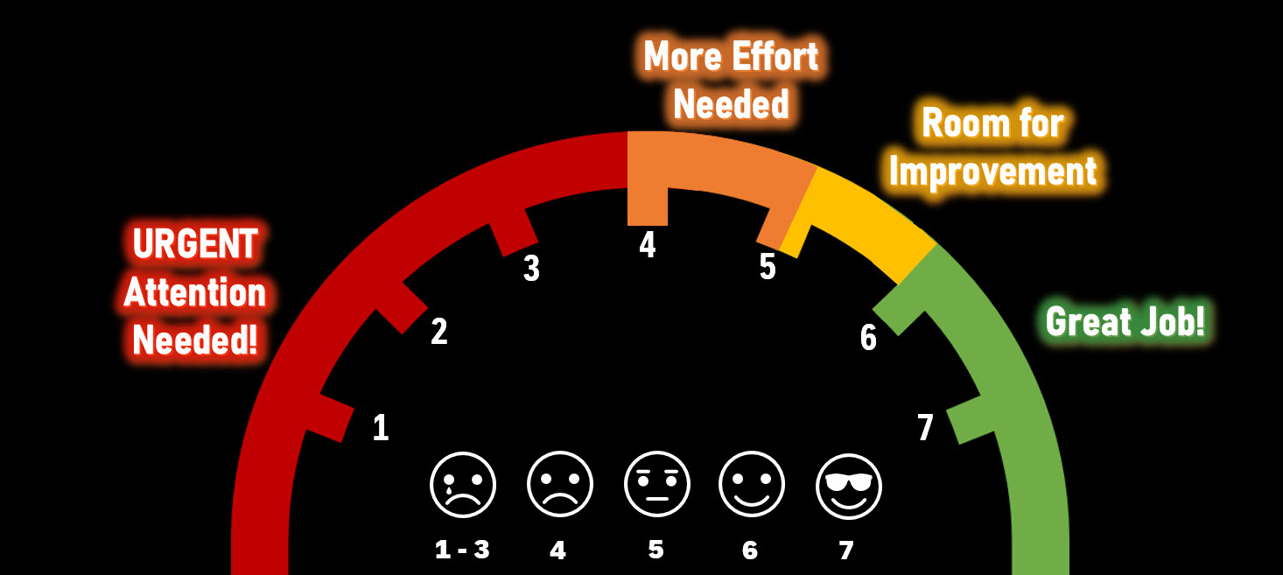
Feedback
Comments from learners at Services Australia:
“Really knowledgeable and supportive and friendly tutor”
“He was good when answering questions and discussing issues”
“He seems knowledgeable”
As SAP Trainer, the latest results of the course evaluation:
Trainer Score

