Slide 1
Spring Integration
Spring integration module provides lightweight messaging flows within Spring based applications.
Typically, without spring integration, the resposibility to manage message flow resides with the application code.
The logic for process flow within an application becomes configuration driven with spring0integration.

Slide 2
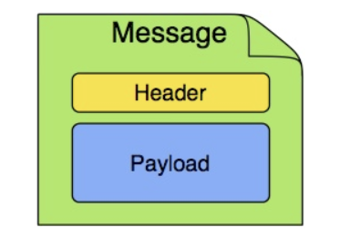
Basic components
Message: A message is a generic wrapper for any Java object combined with metadata. It has 2 main components:
Header : Add headers if needed
Payload : the actual object

Slide 3
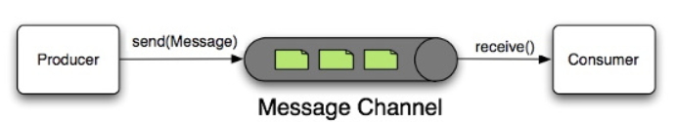
Basic components
Message Channel: A message channel represents the “pipe” of a pipes-and-filters architecture. Producers send messages to a channel, and consumers receive messages from a channel.

Slide 4
Basic components
Message Endpoint: Message Endpoint represents the “filter” of a pipes-and-filters architecture. The endpoint’s primary role is to connect application code to the messaging framework and to do so in a non-invasive manner.
Basic mesage endpoint types:
Transformer
Filter
Router
Splitter
Aggregator
Service Activator
Channel Adapter

Slide 5
Endpoint Types
Transformer:
A message transformer is responsible for converting a message’s content or structure and returning the modified message.
Filter:
A filter is used to determine if a message should be passed to a output channel or not.

Slide 6
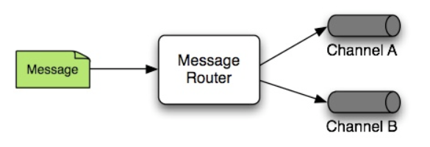
Endpoint Types
Router:
A message router is responsible for deciding what channel or channels (if any) should receive the message next.

Slide 7
Endpoint Types
Splitter:
Splitter’s responsibility is to accept a message from its input channel, split that message into multiple messages, and send each of those to its output channel.
Aggregator:
Basically a mirror-image of the splitter, the aggregator is a type of message endpoint that receives multiple messages and combines them into a single message.

Slide 8
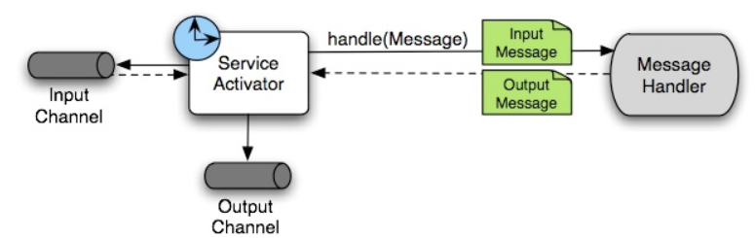
Endpoint Types
Service Activator:
Service Activator is a generic endpoint for connecting a service instance to the messaging system.

Slide 9
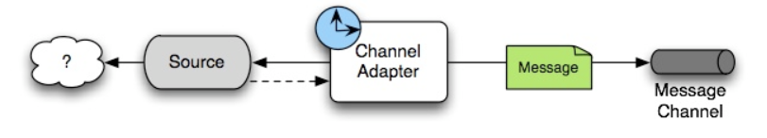
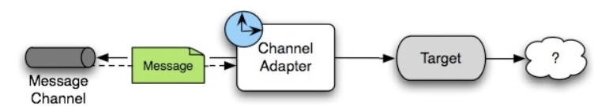
Endpoint Types
Channel Adapter:
A channel adapter is an endpoint that connects a message channel to some other system or transport. Channel adapters may be either inbound or outbound.

Slide 10
Java DSL
@Configuration
@EnableIntegration
public class MyConfiguration {
@Bean
public AtomicInteger integerSource() {
return new AtomicInteger();
}
@Bean
public IntegrationFlow myFlow(AtomicInteger integerSource) {
return IntegrationFlow.fromSupplier(integerSource::getAndIncrement,
c -> c.poller(Pollers.fixedRate(100)))
.channel("inputChannel")
.filter((Integer p) -> p > 0)
.transform(Object::toString)
.channel(MessageChannels.queue())
.get();
}
}

Slide 11
Java DSL
@Bean
public MessageSource<Object> jdbcMessageSource() {
return new JdbcPollingChannelAdapter(this.dataSource, "SELECT * FROM something");
}
@Bean
public IntegrationFlow pollingFlow() {
return IntegrationFlow.from(jdbcMessageSource(),
c -> c.poller(Pollers.fixedRate(100).maxMessagesPerPoll(1)))
.transform(Transformers.toJson())
.channel("furtherProcessChannel")
.get();
}

