Slide 1
4.2 Exercises: Scatterplots, Bubble Charts, & Density Plots/Maps
College: Bellevue University
Course: DSC640-T302 Data Presentation and Visualization
Instructor: Professor Williams
Report by: Jake Meyer
Date: 01/28/2022

Slide 2
Agenda
PowerBI
1 Scatterplot, 1 Bubble Chart and 1 Density Map
Python Charts
1 Scatterplot, 1 Bubble Chart and 1 Density Plot
R Charts
1 Scatterplot, 1 Bubble Chart and 1 Density Plot
Appendix
Assignment instructions.
Data reference link.
Supporting code for each section.

Slide 3
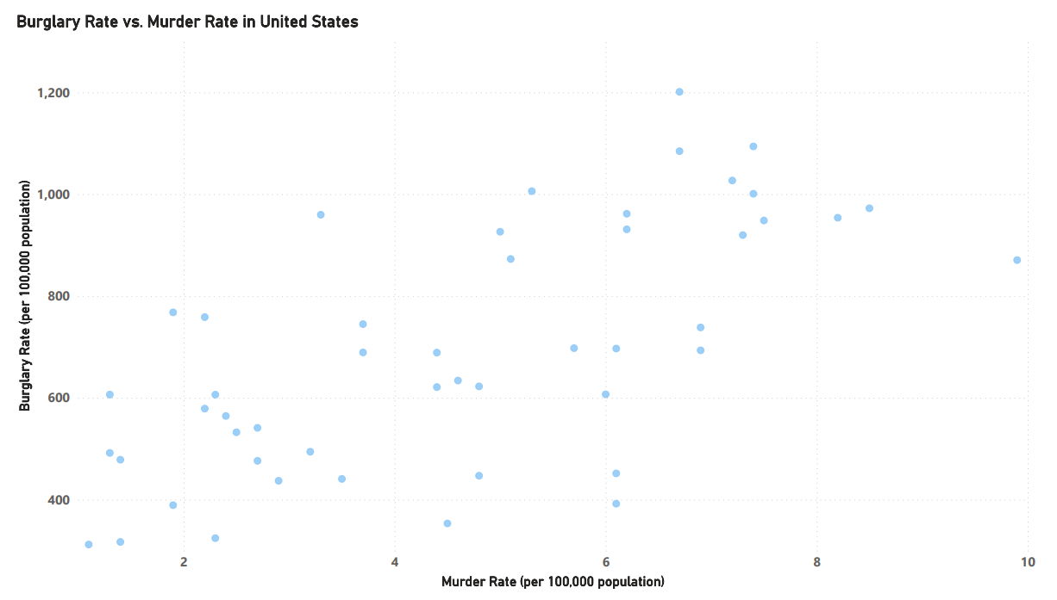
PowerBI – Scatterplot
Scatterplot created in PowerBI.
Map shows positive correlation between murder rate and robbery rate.

Slide 4
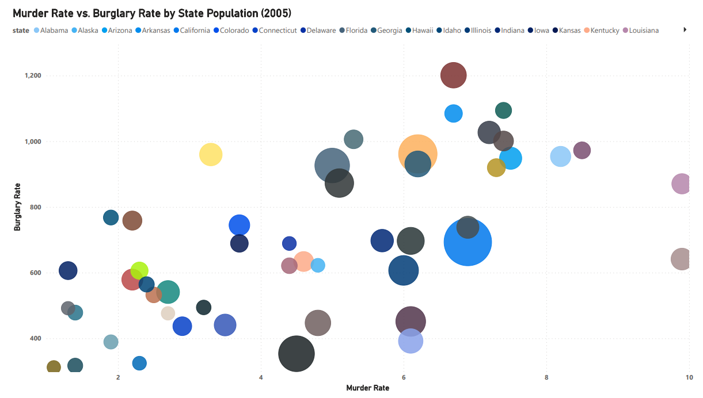
PowerBI – Bubble Chart
Bubble chart created in PowerBI.
Chart shows the murder rate vs. burglary rate with emphasis on state population.

Slide 5
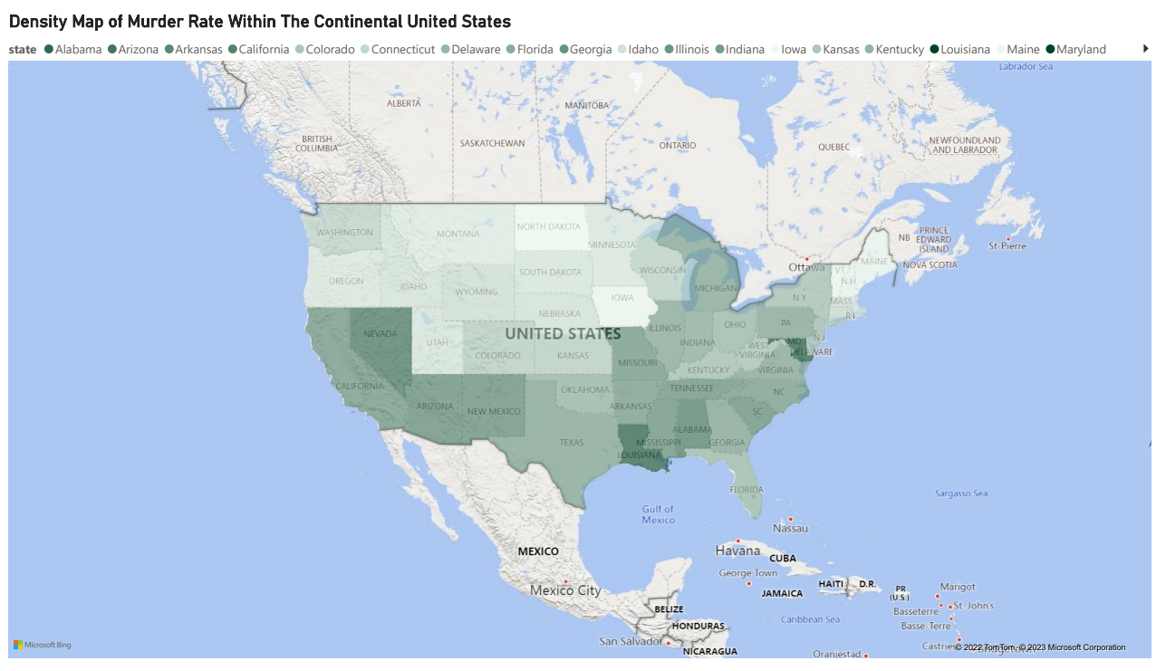
PowerBI – Density Map
Density map created in PowerBI.
Map shows the murder rate with intensity by state.

Slide 6
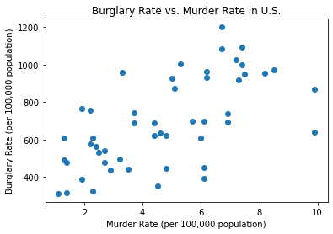
Python – Scatterplot
Scatterplot created in Python using Matplotlib (scatter()).
Chart shows burglary rate vs. murder Rate for U.S in 2005.

Slide 7
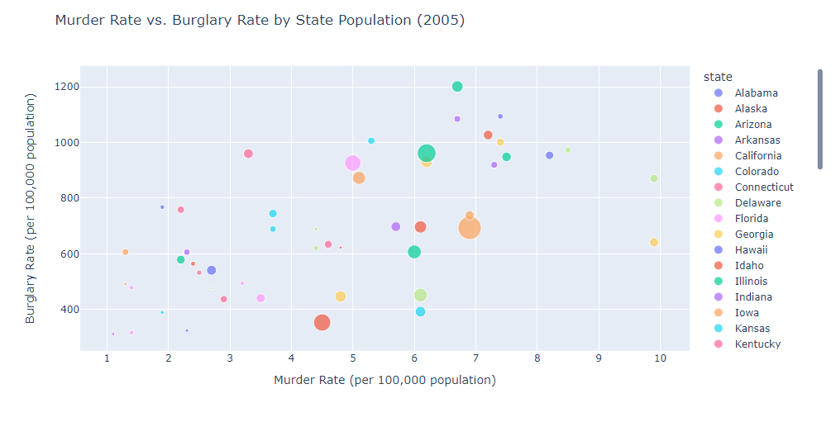
Python – Bubble Chart
Bubble chart created in Python using Plotly.
Chart shows burglary rate vs. murder rate in U.S by state population in 2005.

Slide 8
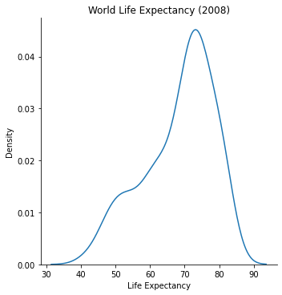
Python – Density Plot
Density plot created in Python using Seaborn.
Plot shows world life expectancy in 2008.

Slide 9
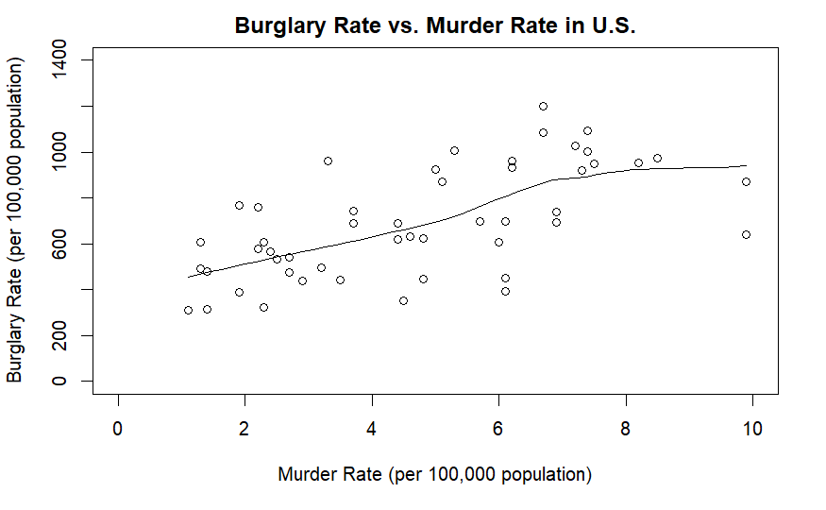
R – Scatterplot
Scatterplot created in R with scatter.smooth() function.
Scatterplot shows the burglary rate vs. murder rate in the U.S. in 2005.

Slide 10
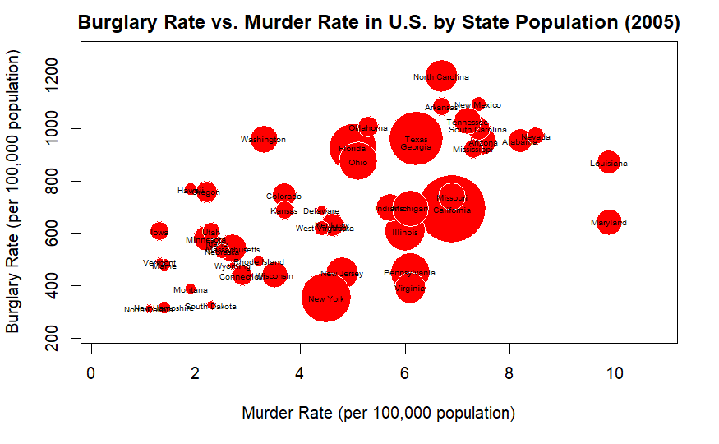
R – Bubble Chart
Bubble chart created in R using symbol().
Chart shows the burglary rate vs. murder rate in U.S. by state population indicated by bubble size.

Slide 11
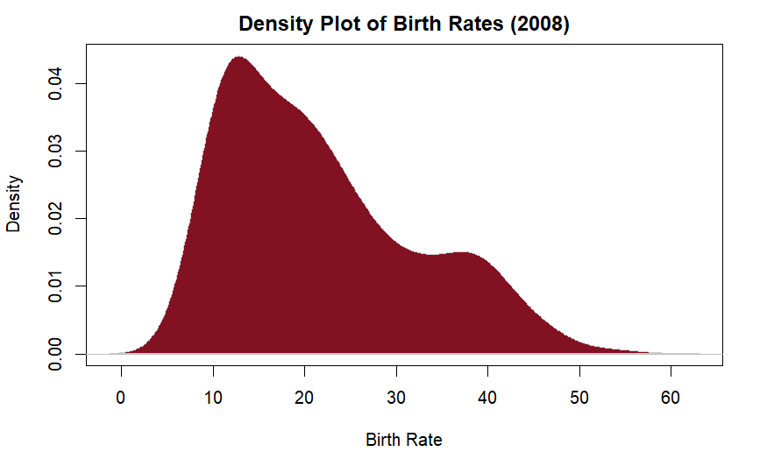
R – Density Plot
Density plot created in R using plot() function.
Chart shows distribution of world birth rates in 2008.

Slide 12
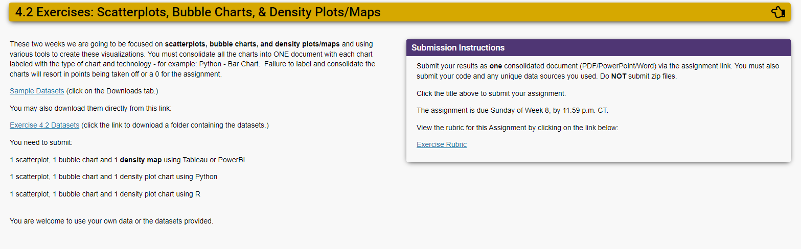
Assignment Instructions (DSC 640)

Slide 13
Dataset Reference(DSC 640)
https://content.bellevue.edu/cst/dsc/640/datasets/ex4-2.zip

Slide 14
Supporting Code Python
Python code summary in document below:

Slide 15
Supporting Code R
R Markdown code summary in document below:

