Slide 1
2.2 Exercises: Line Charts and Step Charts
College: Bellevue University
Course: DSC640-T302 Data Presentation and Visualization
Instructor: Professor Williams
Report by: Jake Meyer
Date: 12/12/2022

Slide 2
Agenda
Tableau Charts
1 Line Chart and 1 Step Chart
PowerBI
1 Line Chart and 1 Step Chart
Python Charts
1 Line Chart and 1 Step Chart
R Charts
1 Line Chart and 1 Step Chart
Appendix
Assignment instructions.
Data reference link.
Supporting code for each section.

Slide 3
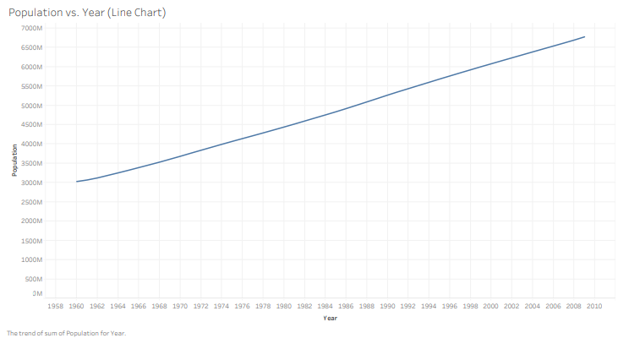
Tableau – Line Chart
Line chart created in Tableau.
Chart shows the population from 1960 to 2009.

Slide 4
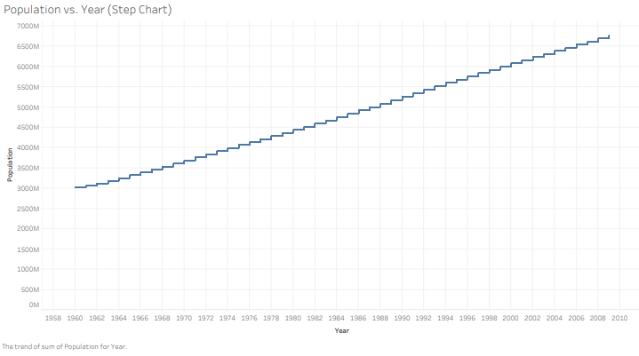
Tableau – Step Chart
Step chart created in Tableau.
Chart shows the population from 1960 to 2009.

Slide 5
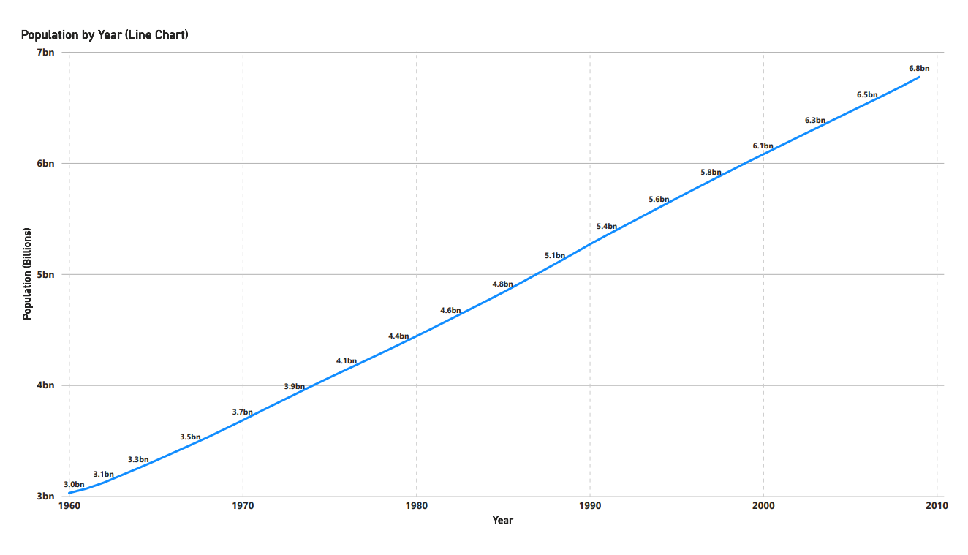
PowerBI – Line Chart
Line chart created in PowerBI.
Chart shows the population from 1960 to 2009.

Slide 6
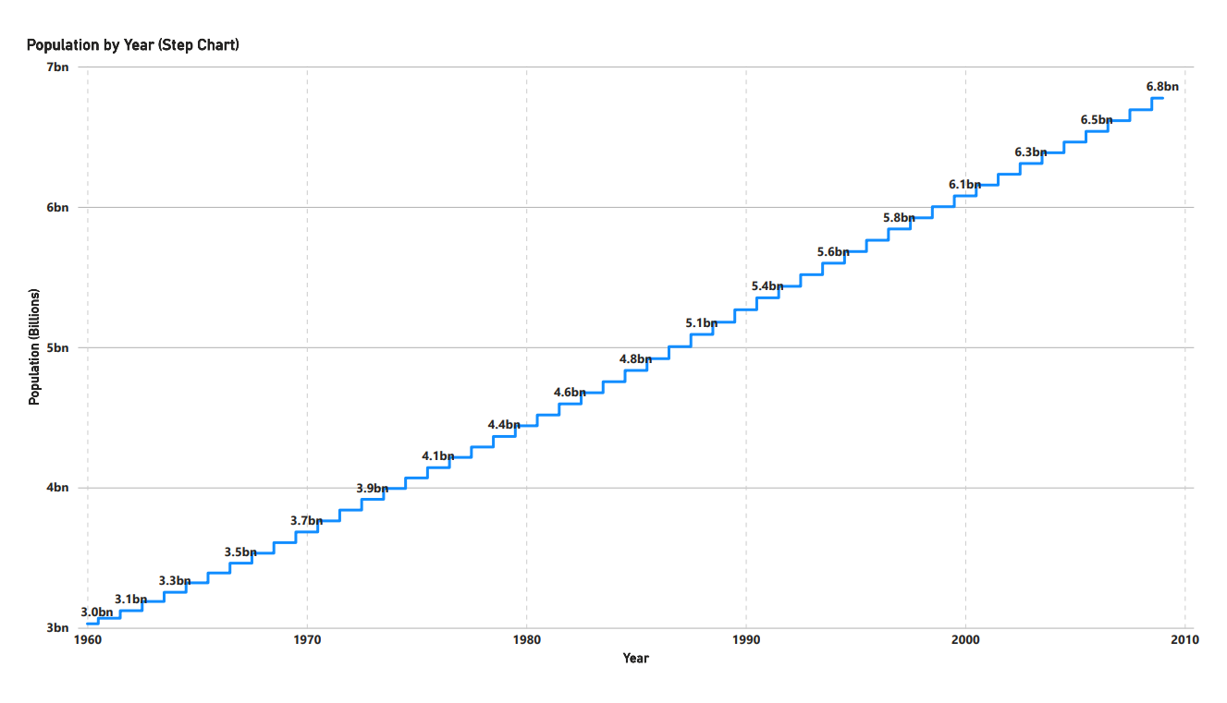
PowerBI – Step Chart
Step chart created in PowerBI.
Chart shows the population from 1960 to 2009.

Slide 7
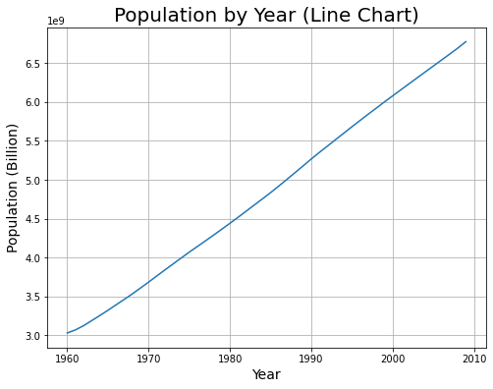
Python – Line Chart
Line chart created in Python using Seaborn and Matplotlib.
Chart shows the population from 1960 to 2009.

Slide 8
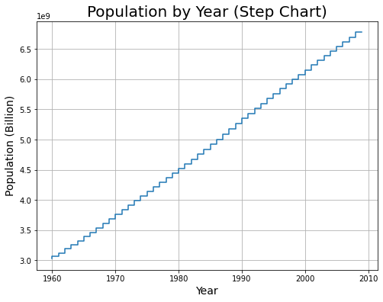
Python – Step Chart
Step chart created in Python using Seaborn and Matplotlib.
Chart shows the population from 1960 to 2009.

Slide 9
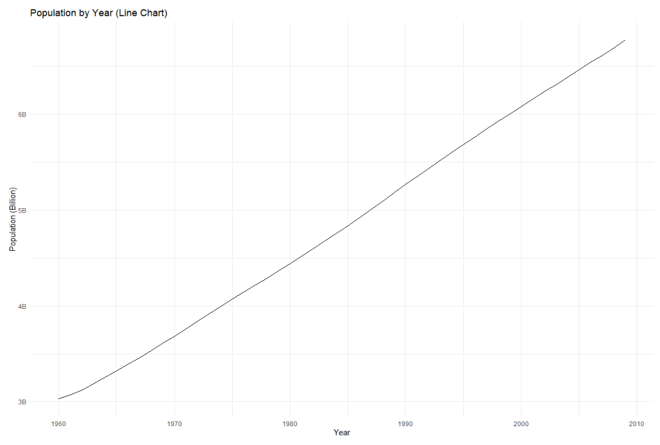
R – Line Chart
Line chart created in R with ggplot2 library.
Chart shows the population from 1960 to 2009.

Slide 10
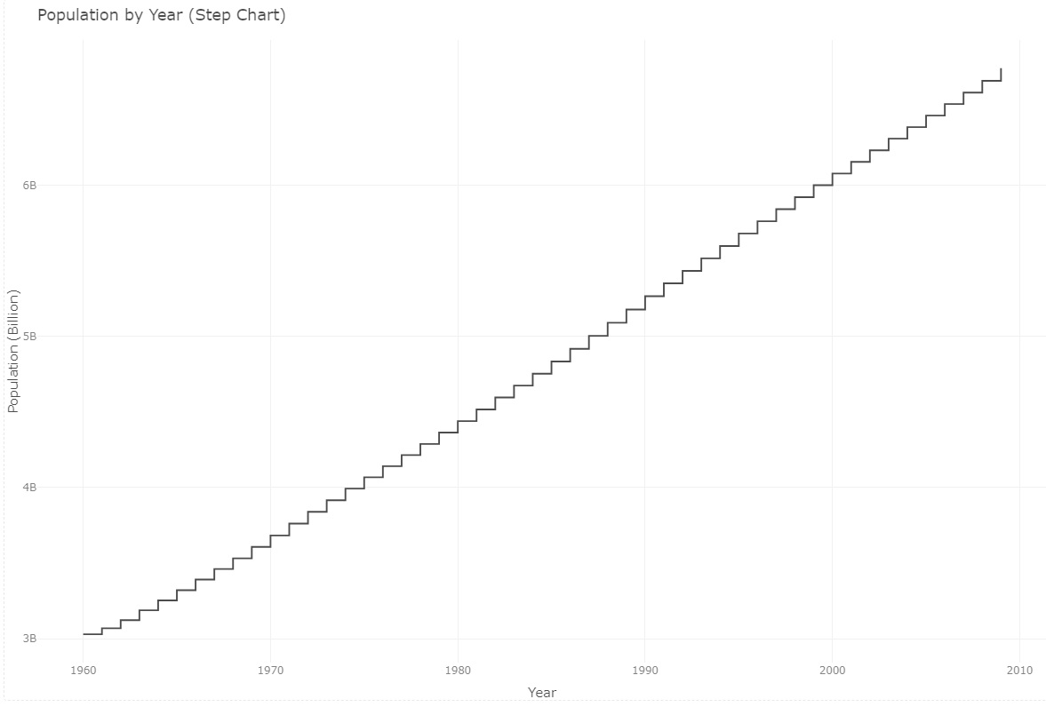
R – Step Chart
Step chart created in R using Plotly and ggplot2 library.
Chart shows the population from 1960 to 2009.

Slide 11
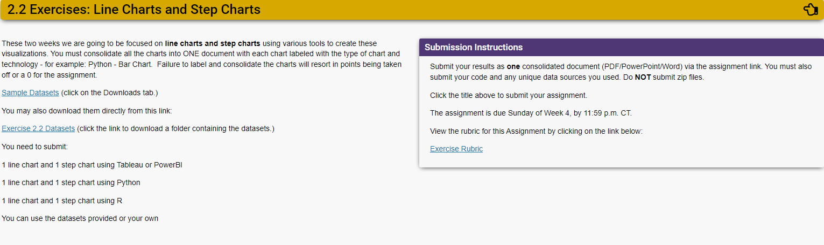
Assignment Instructions (DSC 640)

Slide 12
Dataset Reference(DSC 640)
https://content.bellevue.edu/cst/dsc/640/datasets/ex2-2.zip

Slide 13
Supporting Code Python
Python code summary in document below:

Slide 14
Supporting Code R
R Markdown code summary in document below:

