Slide 1
Southwest Airline Safety Summary
College: Bellevue University
Course: DSC640-T302 Data Presentation and Visualization
3.3 Project Task 2: Executive Summary
Instructor: Professor Williams
Report by: Jake Meyer
Date: 01/21/2022

Slide 2
Agenda
Background of Issue
Transportation Fatalities by Mode
Airline Accident Trend
Airline Accident and Fatality Breakdown
Airlines with Most Accidents and Fatalities
Monetary Considerations
Summary and Recommendations
Appendix
Data Sources

Slide 3
Background of Issue
Issue Overview:
Media has recently been reporting that air is no longer a safe way to travel.
Media is using recent airline crashes and trends of airline safety to create an unsafe image of air travel to the public.
Concern this type of media coverage will result in a decline of airline sales and severely impact our airline, Southwest.
Scope:
How does air travel compare to other modes of transportation for fatalities?
How have accidents via air trended over time?
Do number of accidents and number of fatalities for air travel have a relationship?
How does Southwest compare to other airlines in terms of accidents and fatalities?
Are there monetary implications tied to this negative publicity from the media?

Slide 4
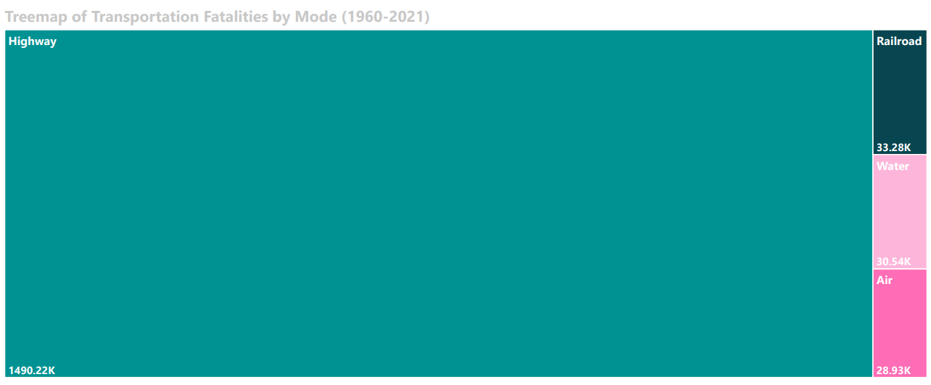
Transportation Fatalities by Mode
According to the Bureau of Transportation Statistics, AIR TRAVEL had the LEAST NUMBER OF FATALITIES (between 1960-2021) compared to Highway, Railroad, and Water Travel.

Slide 5
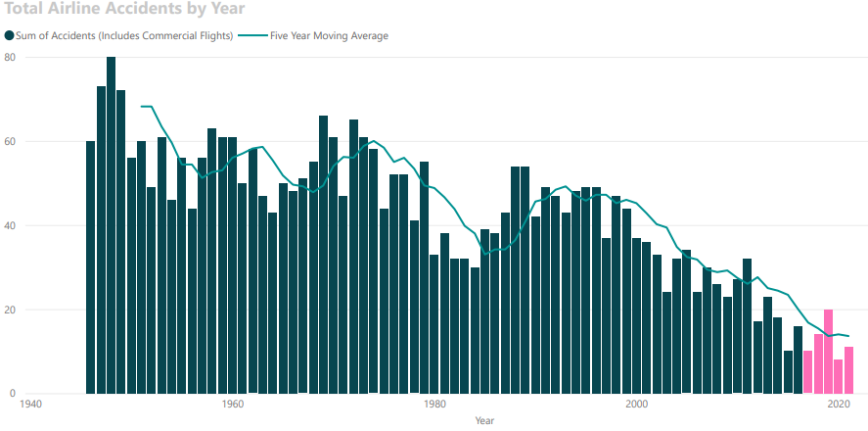
Airline Accident Trend
Air travel accidents have been trending downward over time. The Aviation Safety Network provides evidence the annual accidents due to air travel is at an all-time low since 1946.

Slide 6
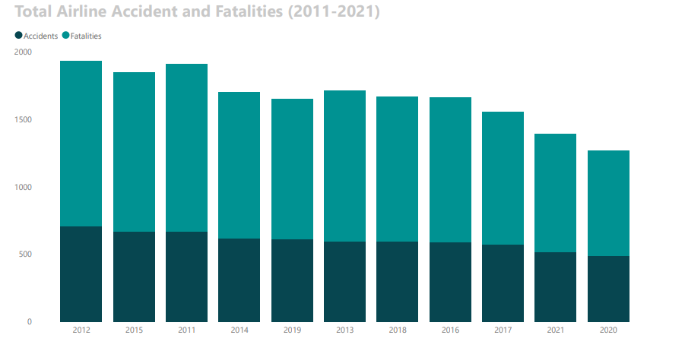
Airline Accident and Fatality Breakdown
From 2011-2021, the annual number of airline accidents and fatalities are shown in the above visualization. YEARS with MORE ACCIDENTS tended to RESULT IN MORE FATALITIES.

Slide 7
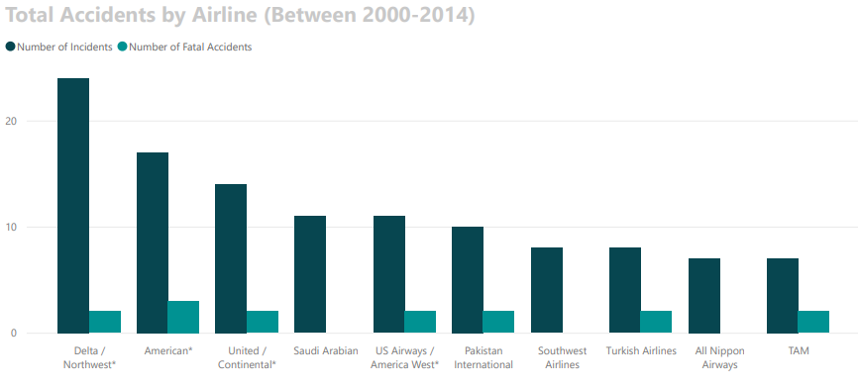
Airlines with Most Accidents
From 2000-2014, Southwest has one of the highest incident counts compared to other airlines.
No fatal incidents were reported during this timeframe.

Slide 8
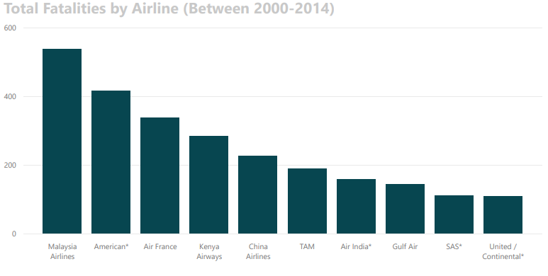
Airlines with Most Fatalities
Southwest did not have any fatal incidents from 2000-2014. Visualization shows the airlines with the highest fatality count within this timeframe.

Slide 9
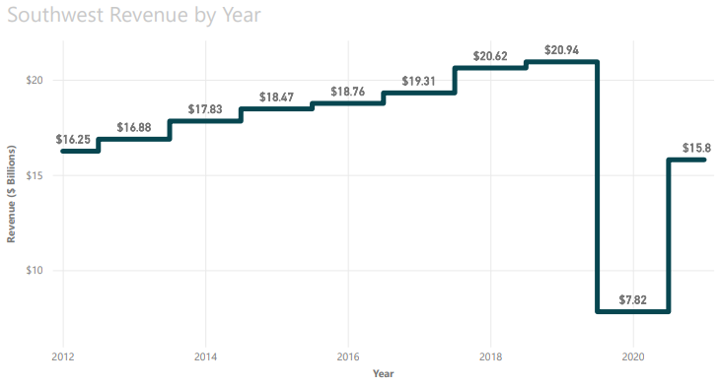
Monetary Considerations
Need to promote safety of airline to avoid potential impact to revenue.
Southwest Revenue was steadily increasing UNTIL 2020 by an average of 3.70%.
Large revenue decrease is likely a result of the COVID-19 Pandemic.
Revenue increased 19.70% from 2020-2021.
Negative publicity from media will likely impact rate of growth for revenue between 2021-2022.

Slide 10
Summary and Recommendations
Summary:
Air travel has the least number of fatalities since1960 when compared to Highway (car/bus/etc..), Railroad (train), and Water (boats) transportation.
Airline accidents have steadily declined over the years. The annual count of accidents is lower than it has ever been since 1946.
Higher number of accidents tend to result in a higher number of fatality counts for airline accidents.
Southwest has a high number of accidents reported; however, no accidents were fatal.
Potential negative impact to revenue due to the undesirable publicity from the media.
Recommendations:
Promote the facts presented today regarding airline safety compared to other modes of transportation.
Highlight the fact that airline accidents are at an all time low.
Launch an internal improvement project to decrease the number of accidents annually at Southwest.
Investigate advanced aircraft safety measures and technology to invest for the company.

Slide 11
Data Sources
Bureau of Aircraft Accidents Archives. (2023). Accidents Rate Per Year. Statistics. Accidents Rate per Year | Bureau of Aircraft Accidents Archives (baaa-acro.com)
Bureau of Transportation Statistics. (2023). Transportation Fatalities by Mode. United States Department of Transportation. Transportation Fatalities by Mode | Bureau of Transportation Statistics (bts.gov)
Escobar, Francisco. (2019). The Statistics of Airplane Accidents [Data]. Kaggle. The Statistics of Airplane Accidents | Kaggle
Fivethirtyeight. (2023). Airline Safety [Data]. Github. data/airline-safety at master · fivethirtyeight/data · GitHub
McMahon, Conor. (2022). 20 Southwest Airlines Statistics [2023]: Passengers, Revenue, and Facts. Zippia. 20 Southwest Airlines Statistics [2023]: Passengers, Revenue, And Facts – Zippia
Ranter, Harro. (2021). Aviation Safety Network [Data]. Aviation Safety Network Database. Accidents and fatalities per year - Google Sheets

