Slide 1
3.2 Exercises: Tree Maps, Area Charts, and Stacked Area Charts
College: Bellevue University
Course: DSC640-T302 Data Presentation and Visualization
Instructor: Professor Williams
Report by: Jake Meyer
Date: 01/14/2022

Slide 2
Agenda
PowerBI
1 Tree Map, 1 Area Chart, and 1 Stacked Area Chart
Python Charts
1 Tree Map, 1 Area Chart, and 1 Stacked Area Chart
R Charts
1 Tree Map, 1 Area Chart, and 1 Stacked Area Chart
Appendix
Assignment instructions.
Data reference link.
Supporting code for each section.

Slide 3
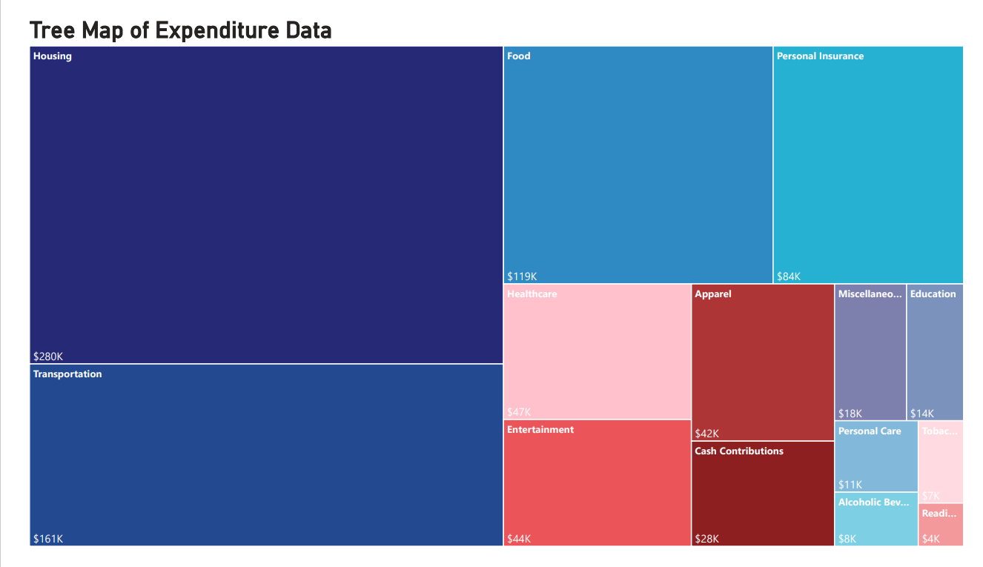
PowerBI – Tree Map
Tree Map created in PowerBI.
Map shows expenditure data by category.

Slide 4
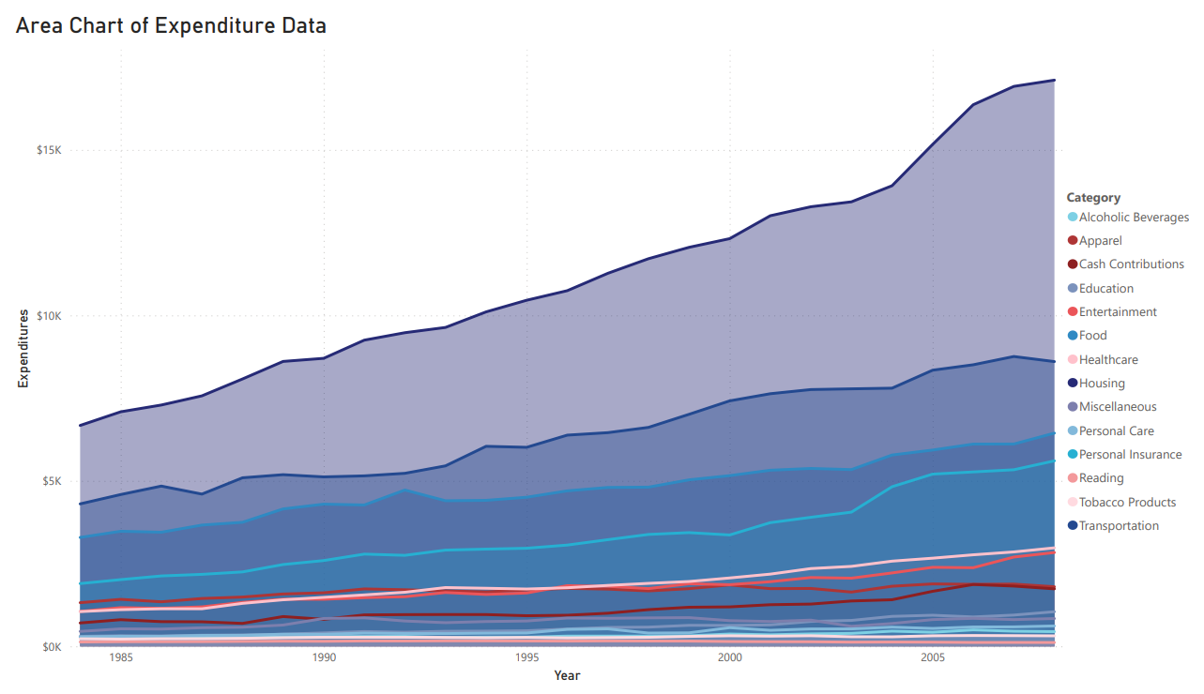
PowerBI – Area Chart
Area Chart created in PowerBI.
Chart shows the expenditure data over the years by category.

Slide 5
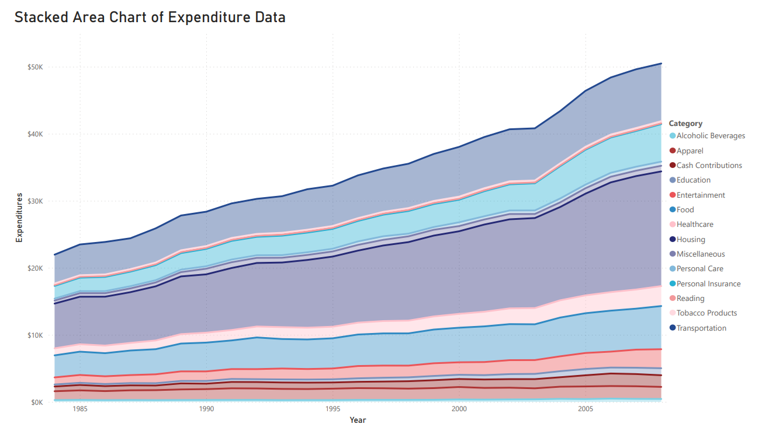
PowerBI – Stacked Area Chart
Stacked Area Chart created in PowerBI.
Chart shows the expenditure data over the years by category.

Slide 6
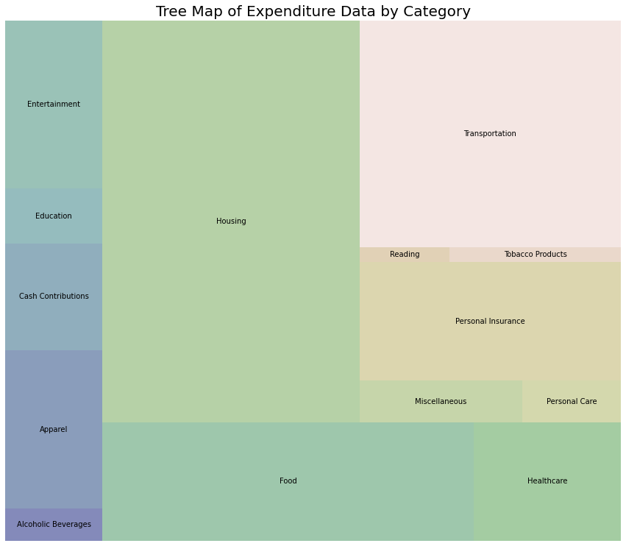
Python – Tree Map
Tree Map created in Python using Squarify.
Chart shows expenditure data by category.

Slide 7
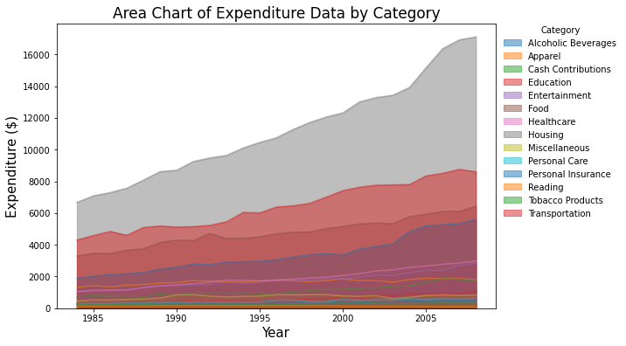
Python – Area Chart
Area Chart created in Python using Pandas and Matplotlib.
Chart shows the expenditure data over the years by category.

Slide 8
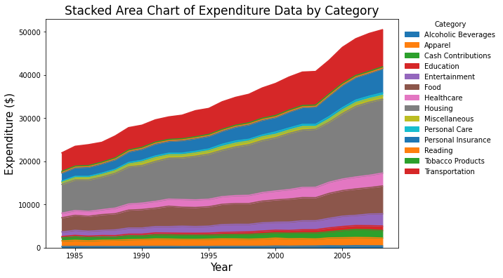
Python – Stacked Area Chart
Stacked Area chart created in Python using Matplotlib and Pandas.
Chart shows the expenditure data over the years by category.

Slide 9
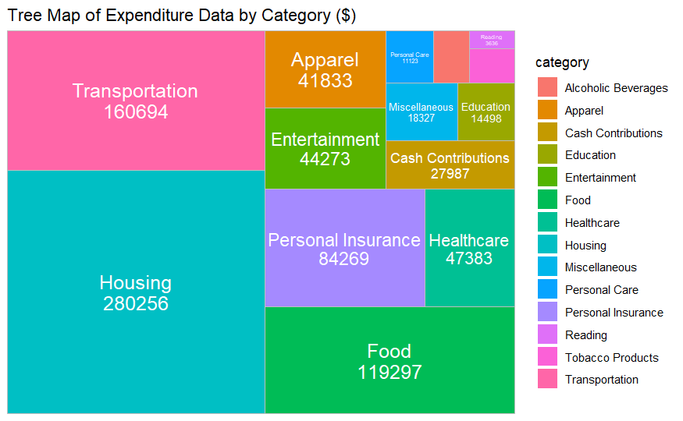
R – Tree Map
Tree Map created in R with ggplot2 and treemapify library.
Map shows the expenditure data by category.

Slide 10
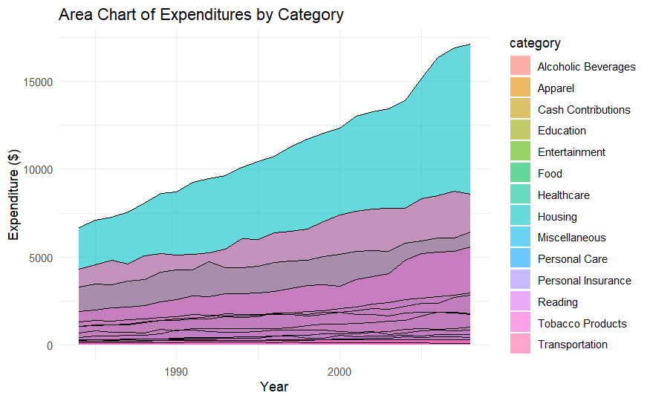
R – Area Chart
Area Chart created in R using ggplot2 library.
Chart shows the expenditure data over the years by category.

Slide 11
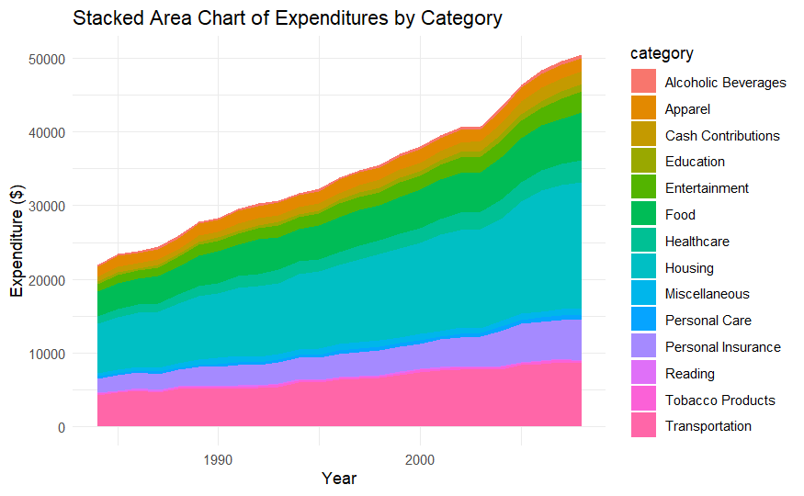
R – Stacked Area Chart
Stacked Area chart created in R using ggplot2 library.
Chart shows the expenditure data over the years by category.

Slide 12
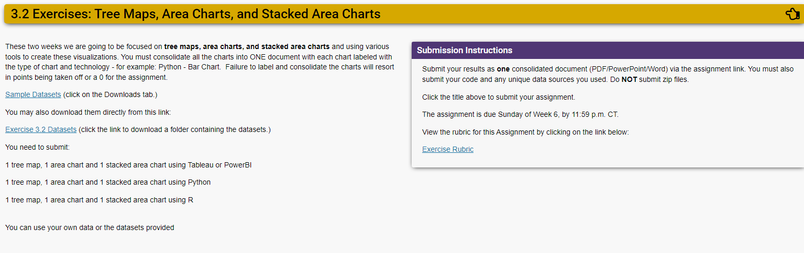
Assignment Instructions (DSC 640)

Slide 13
Dataset Reference(DSC 640)
https://content.bellevue.edu/cst/dsc/640/datasets/ex3-2.zip

Slide 14
Supporting Code Python
Python code summary in document below:

Slide 15
Supporting Code R
R Markdown code summary in document below:

