Slide 1
5.2 Exercises: Heat Maps, Spatial Charts, and Contour Charts
College: Bellevue University
Course: DSC640-T302 Data Presentation and Visualization
Instructor: Professor Williams
Report by: Jake Meyer
Date: 02/11/2023

Slide 2
Agenda
Power BI
1 heat map, 1 spatial chart, and 1 funnel or violin chart
Python Charts
1 heat map, 1 spatial chart, and 1 contour chart
R Charts
1 heat map, 1 spatial chart, and 1 contour chart
Appendix
Assignment instructions.
Data reference link.
Supporting code for each section.

Slide 3
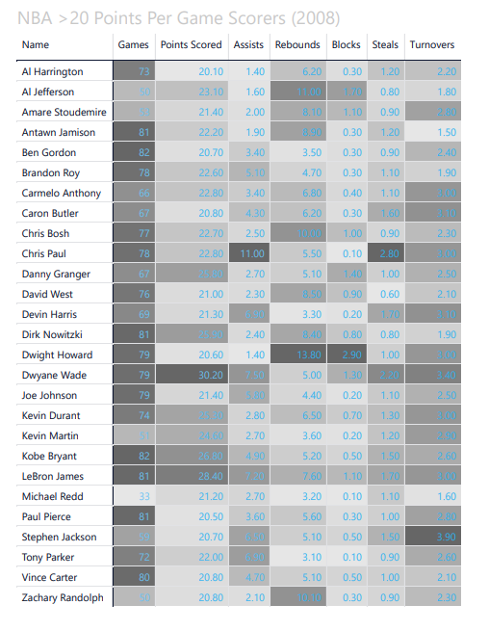
Power BI – Heat Map
Heat map created in Power BI.
Heat map shows players in the NBA averaging over 20 points per game from 2008.

Slide 4
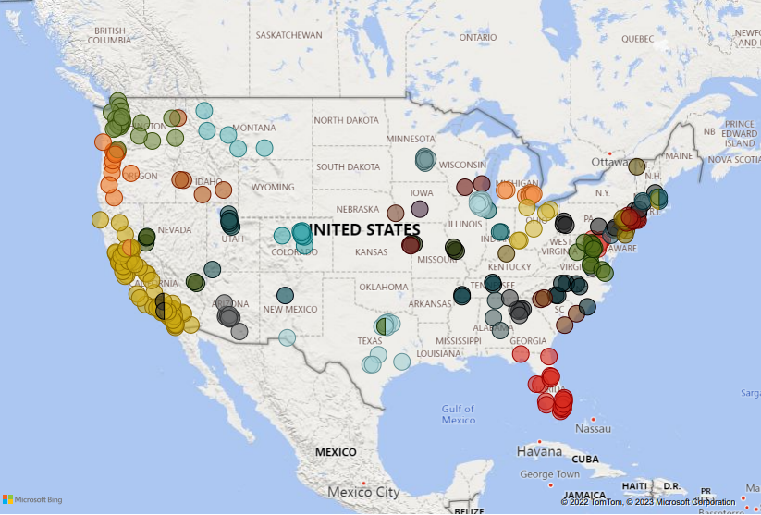
Power BI – Spatial Chart
Spatial chart created in Power BI.
Chart shows Costco store locations for the continental United States.

Slide 5
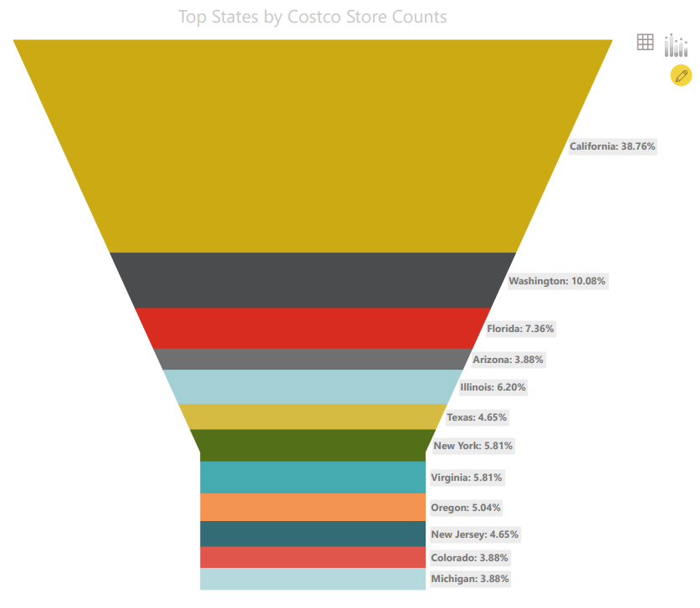
Power BI – Funnel Chart
Funnel chart created in Power BI.
Chart shows the states with the most Costco store locations.

Slide 6
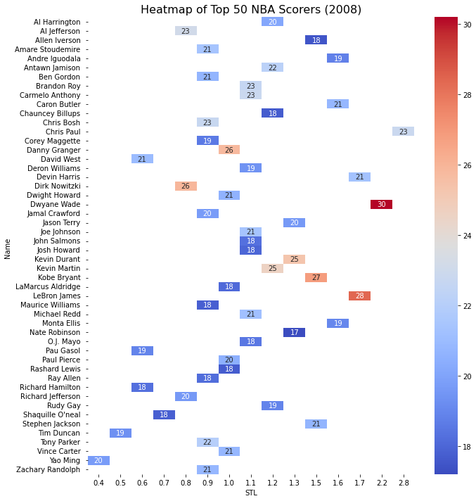
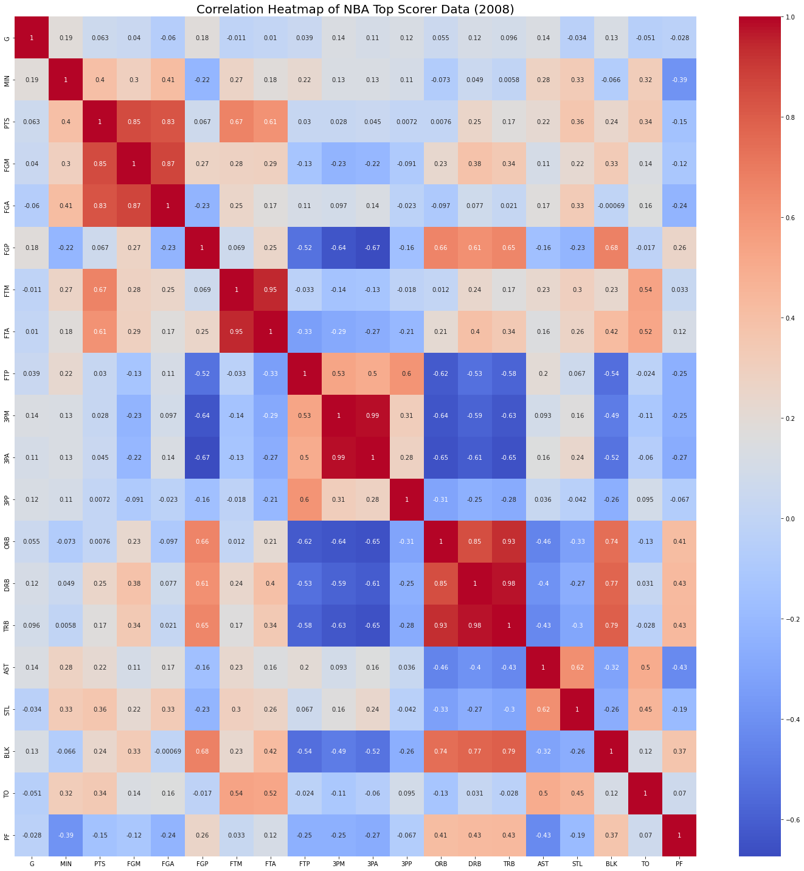
Python – Heat Map
Heat map and correlation heat map created in Python using Matplotlib heatmap().
Map (left) shows points based on color scale, steals, and player name.
Map (right) shows correlation of variables for the Top NBA scorers.

Slide 7
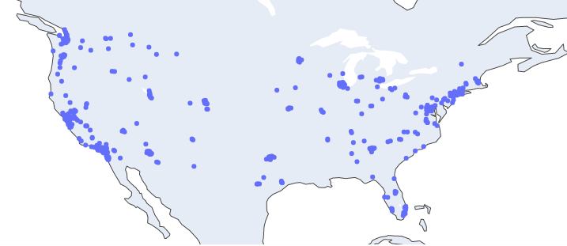
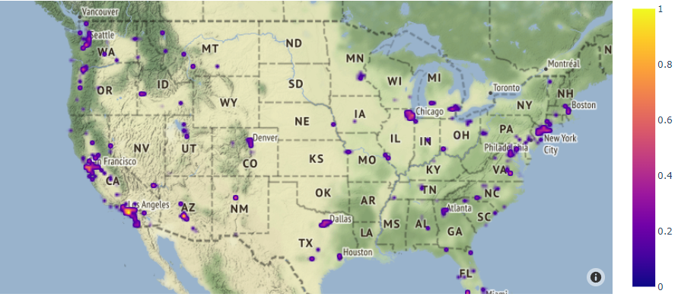
Python – Spatial Chart
Spatial charts created in Python using Plotly.
Top chart shows Costco locations with scatter_geo() with Plotly.
Bottom chart shows Costco locations with density_mapbox() with Plotly.

Slide 8
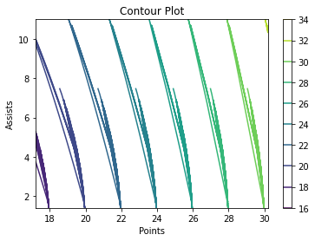
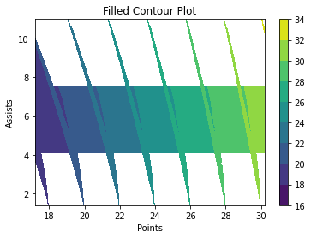
Python – Contour Chart
Contour plot created in Python using contour() and contour().
Left plot shows contour of points against assists for Top NBA scorers from 2008.
Right plot shows filled contour of points against assists for Top NBA scorers from 2008.

Slide 9
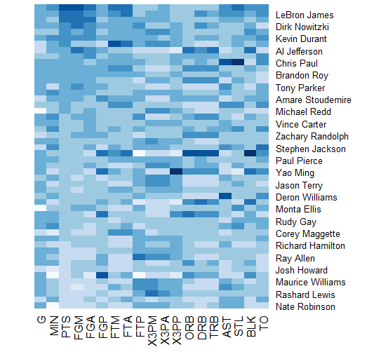
R – Heat Map
Heat map created in R with heatmap() function.
Heat map shows the attributes of Top 50 NBA Scorers from 2008.

Slide 10
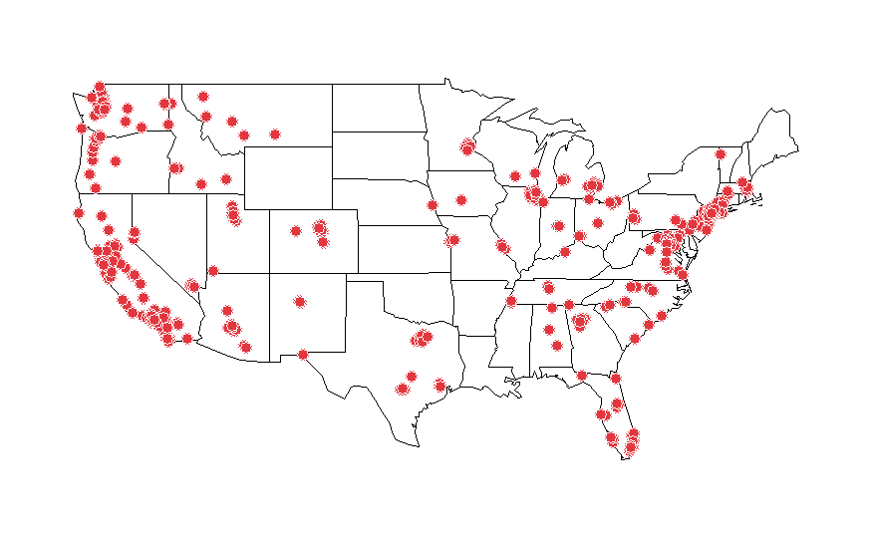
R – Spatial Chart
Spatial chart created in R using symbol().
Chart shows the Costco locations within the continental Unites States.

Slide 11
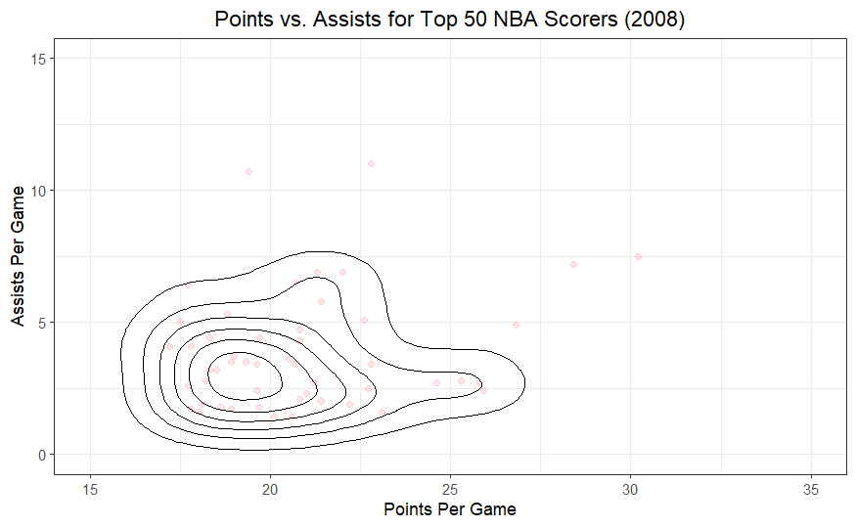
R – Contour Chart
Contour chart created in R with ggplot().
Chart shows points vs. assist data for Top 50 NBA scorers in 2008.

Slide 12
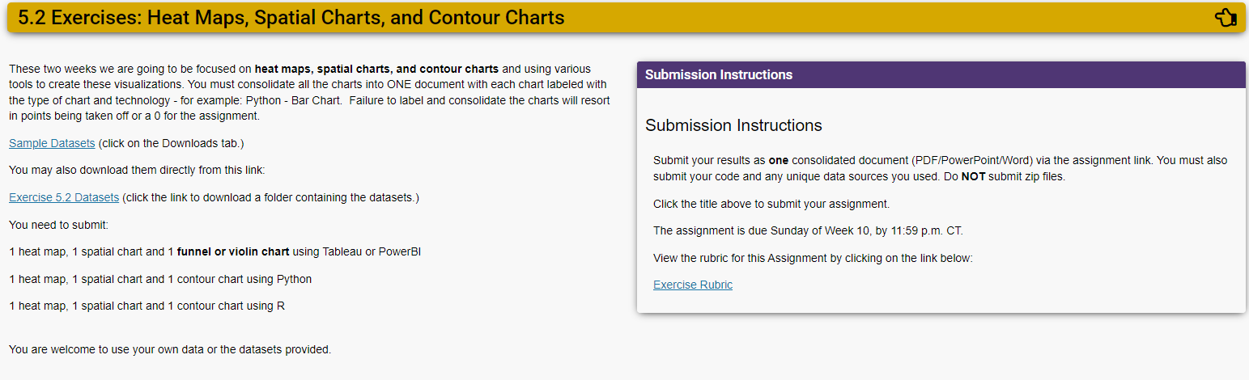
Assignment Instructions (DSC 640)

Slide 13
Dataset Reference(DSC 640)
https://content.bellevue.edu/cst/dsc/640/datasets/ex5-2.zip

Slide 14
Supporting Code Python
Python code summary in document below:

Slide 15
Supporting Code R
R Markdown code summary in document below:

