Slide 1
1.2 Exercises: Charts
College: Bellevue University
Course: DSC640-T302 Data Presentation and Visualization
Instructor: Professor Williams
Report by: Jake Meyer
Date: 12/08/2022

Slide 2
Agenda
Tableau Charts
1 Bar Chart, 1 Stacked Bar Chart, 1 Pie Chart, and 1 Donut Chart
PowerBI
1 Bar Chart, 1 Stacked Bar Chart, 1 Pie Chart, and 1 Donut Chart
Python Charts
1 Bar Chart, 1 Stacked Bar Chart, 1 Pie Chart, and 1 Donut Chart
R Charts
1 Bar Chart, 1 Stacked Bar Chart, 1 Pie Chart, and 1 Donut Chart
Appendix
Assignment instructions.
Data reference link.
Supporting code for each section.

Slide 3
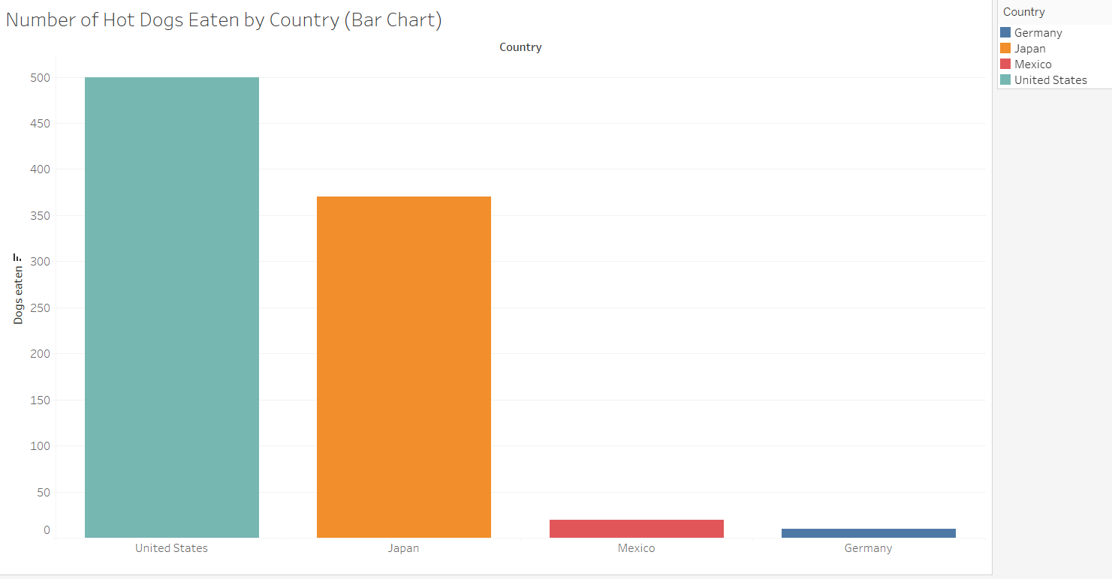
Tableau – Bar Chart
Bar chart created in Tableau.
Chart shows the number of hot dogs eaten by country.

Slide 4
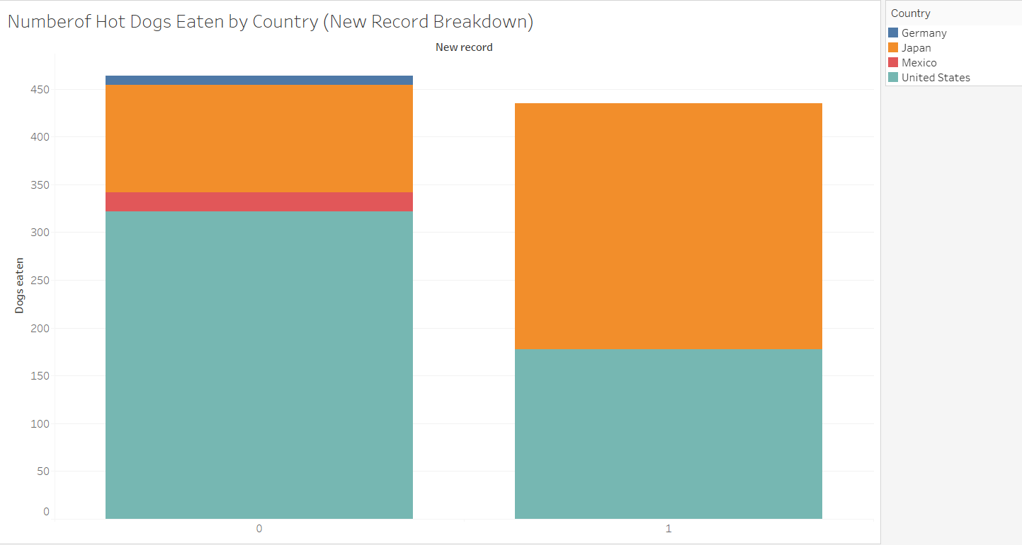
Tableau – Stacked Bar Chart
Stacked bar chart created in Tableau.
Chart shows number of hot dogs eaten per new record broken down by country.

Slide 5
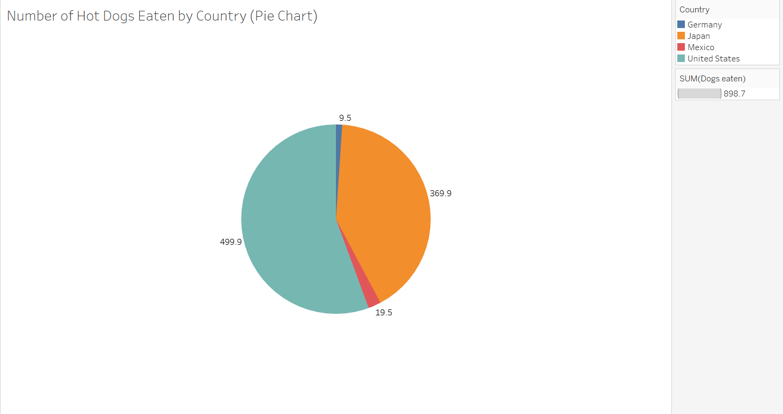
Tableau – Pie Chart
Pie chart created in Tableau.
Chart shows number of hot dogs eaten by country.

Slide 6
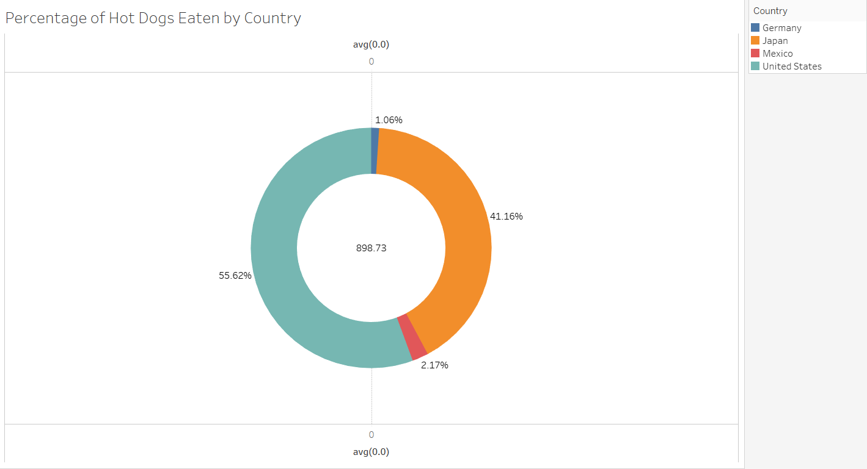
Tableau – Donut Chart
Donut chart created in Tableau.
Chart shows the percentage of hot dogs eaten by country.

Slide 7
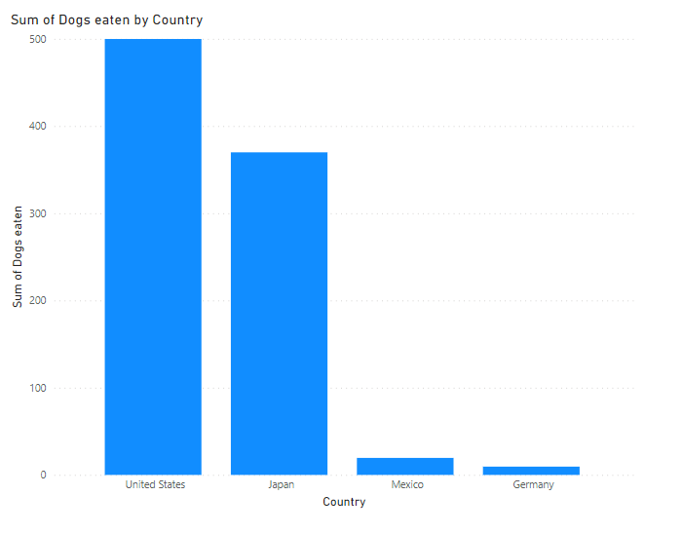
PowerBI – Bar Chart
Bar chart created in PowerBI.
Chart shows the sum of hot dogs eaten broken down by country.

Slide 8
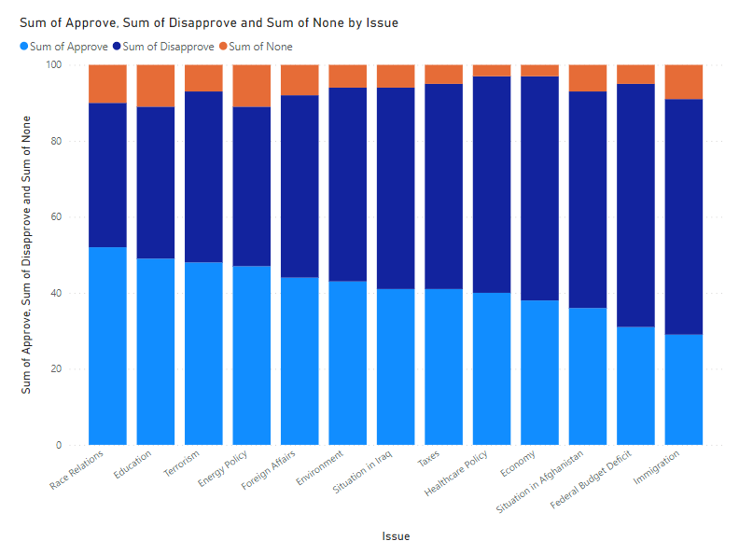
PowerBI – Stacked Bar Chart
Stacked bar chart created in PowerBI.
Chart shows the approval, disapproval, and none percent for certain issues.

Slide 9
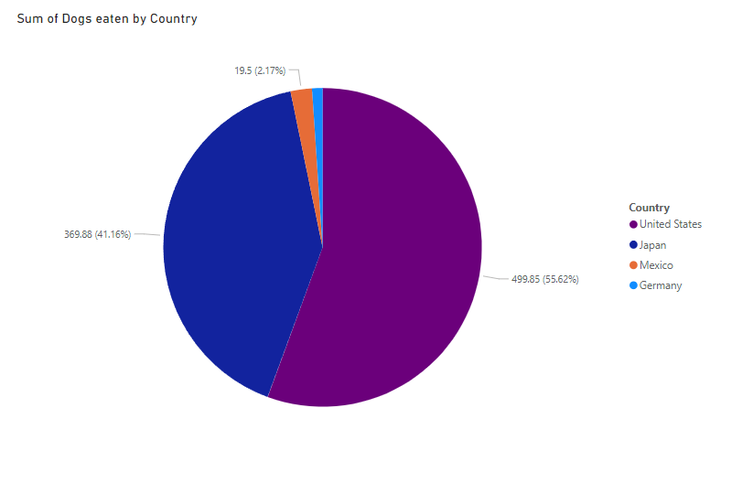
PowerBI – Pie Chart
Pie chart created in PowerBI.
Chart shows percentage of hot dogs eaten by country.

Slide 10
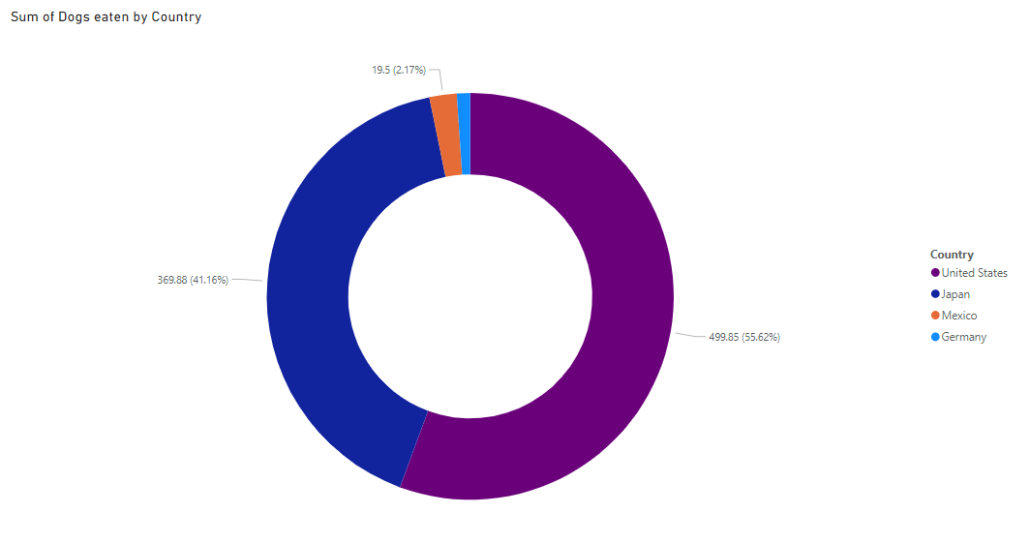
PowerBI – Donut Chart
Donut chart created in PowerBI.
Chart shows the percentage of hot dogs eaten by country.

Slide 11
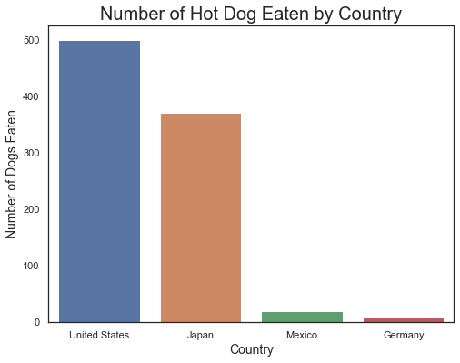
Python – Bar Chart
Chart created in Python using Seaborn and Matplotlib.
Bar chart shows the number of hot dogs eaten by country.

Slide 12
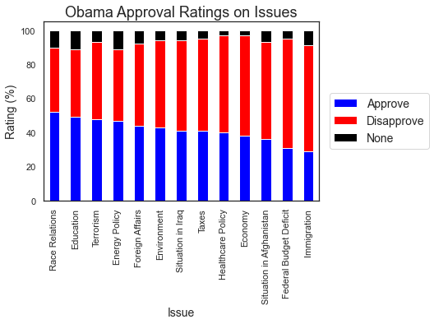
Python – Stacked Bar Chart
Chart created in Python using Seaborn and Matplotlib.
Stacked bar chart shows Obama approval ratings across certain issues.

Slide 13
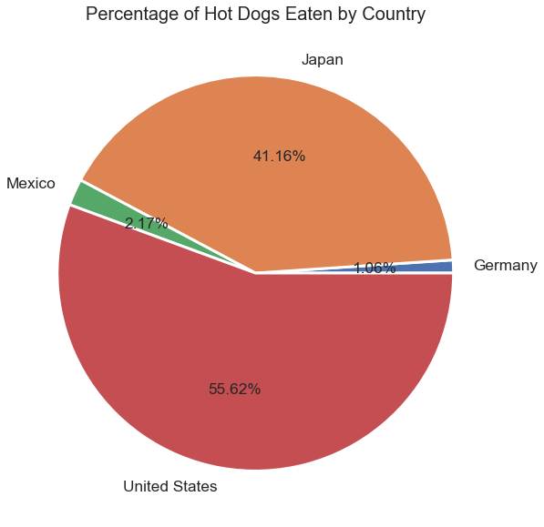
Python – Pie Chart
Chart created in Python using Matplotlib.
Pie chart shows the percentage of hot dogs eaten by country.

Slide 14
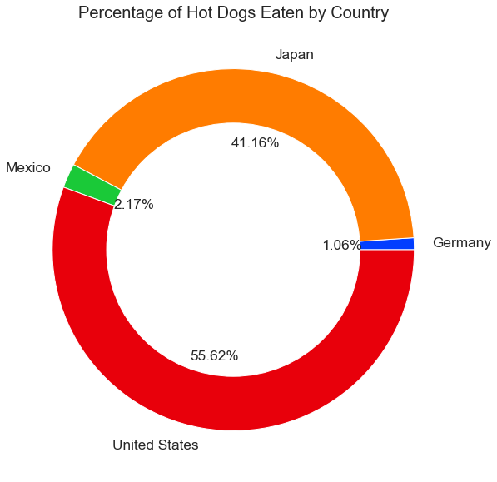
Python – Donut Chart
Donut chart created in Python using Seaborn and Matplotlib.
Chart shows the percentage of hot dogs eaten by country.

Slide 15
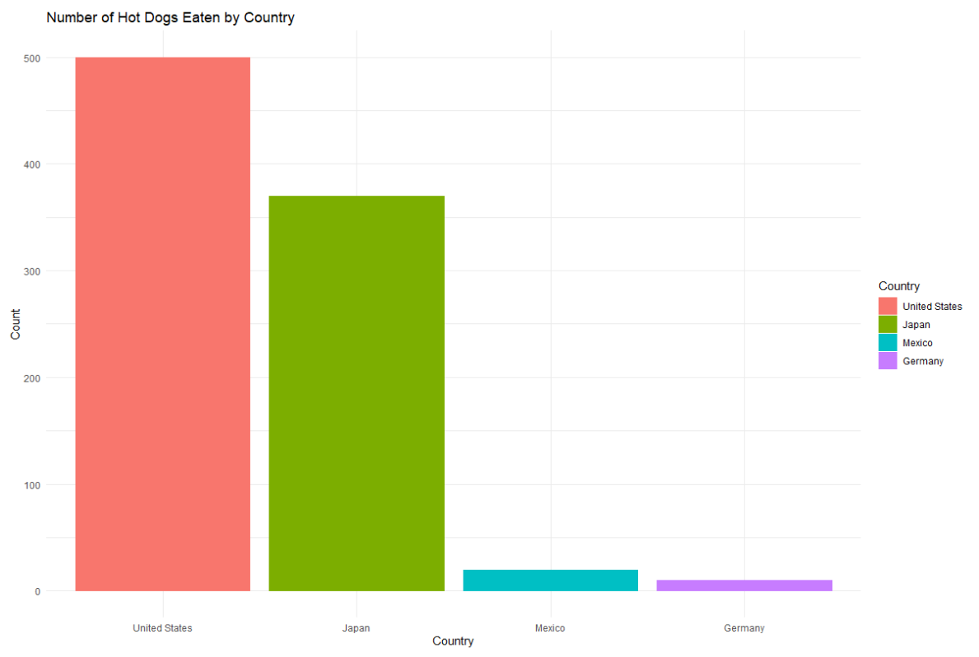
R – Bar Chart
Bar chart created in R with ggplot2 library.
Chart shows number of hot dog eating champions by country.

Slide 16
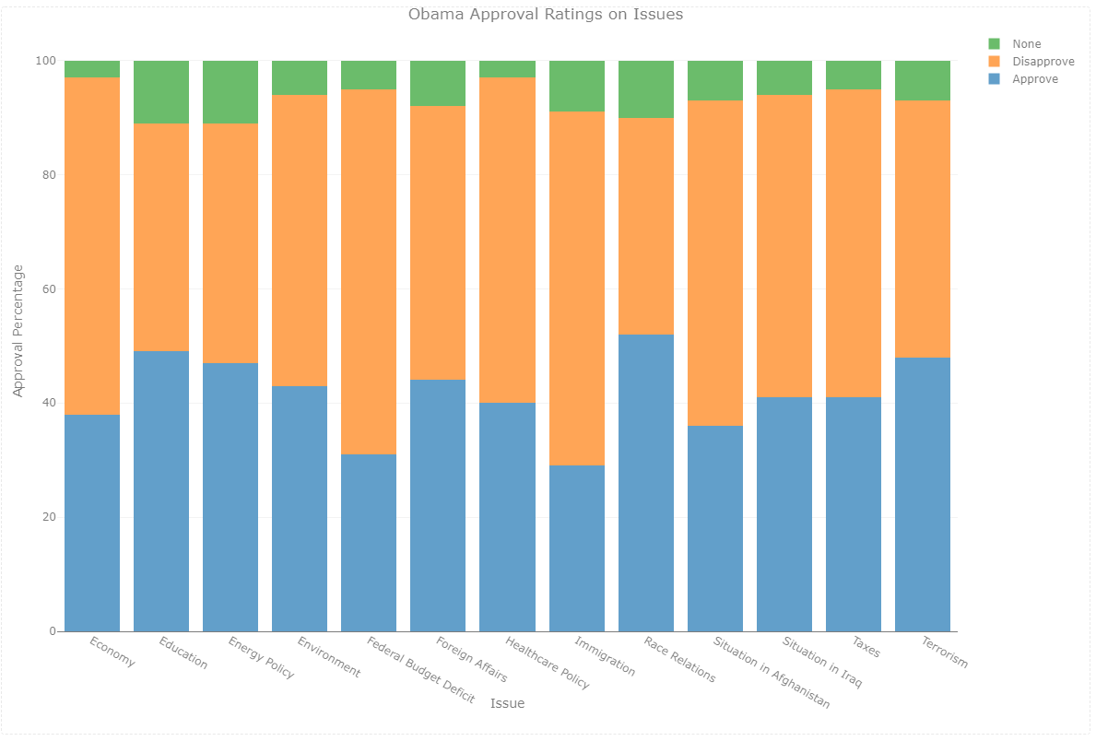
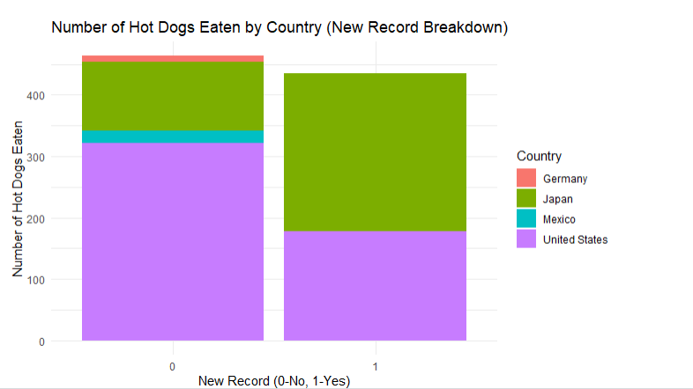
R – Stacked Bar Chart
Stacked bar charts created in R using Plotly and ggplot2 library.
Stacked bar chart (left) shows Obama approval ratings across certain issues.
Stacked bar chart (right) shows number of hot dogs eaten by country for a new record (or not).

Slide 17
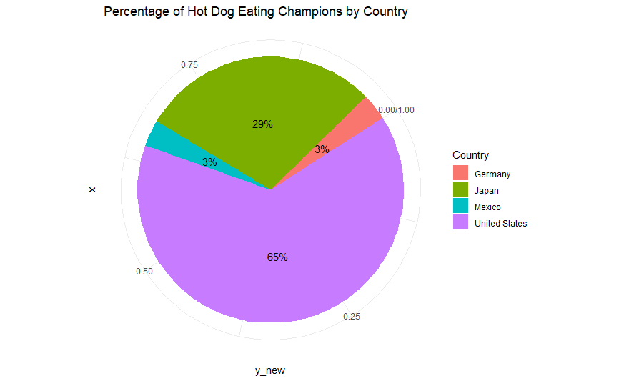
R – Pie Chart
Pie chart created in R with ggplot2 library.
Chart shows the percentage of hot dog eating champions by country.

Slide 18
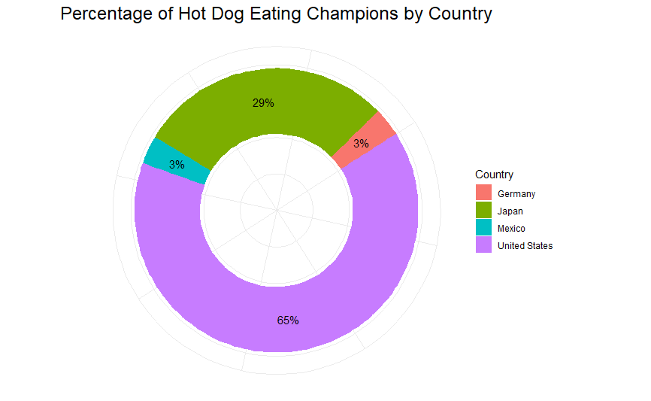
R – Donut Chart
Donut chart created in R using ggplot2 library.
Chart shows the percentage of hot dog eating champions by country.

Slide 19
Assignment Instructions (DSC 640)
Every two weeks you will be assigned a series of charts to create in Python, R, and PowerBI/Tableau (You will select either PowerBI or Tableau or both if you really want to have some fun!). The reason for this is to get you familiar with the different packages, tools and understand pros/cons and limitations of each. This way when you are out of the program, working on your first real data viz presentation you have an arsenal of tools at your disposal.
You will be provided datasets, but you are welcome to use any data you like. You must consolidate all the charts into ONE document with each chart labeled with the type of chart and technology - for example: Python - Bar Chart. Failure to label and consolidate the charts will resort in points being taken off or a 0 for the assignment.
These two weeks we are going to be focused on bar charts, stacked bar charts, pie charts, and donut charts and using various tools to create these visualizations. The book will cover one way to create a visualization, but we all know we have many tools at our disposal, so throughout these exercises you will be challenged to learn a variety of ways. Follow the recommendations and suggestions from your book on the design and use videos and other sources to find various ways to build the same visualizations.
To get started, you are going to need to install some things (if you don’t already have these!). You do not need to install all of these in Weeks 1 & 2 – you can decide to wait and install after you determine what you are going to use each week, but ultimately you will need at least one visualization tool like PowerBI or Tableau (can be something different if you have more experience) and then the ability to create visualizations using Python and R – you can pick which package you create them in. Not every visualization will be possible in one package, you will likely have to use multiple packages/libraries to get the job done.
Tableau. Your instructor should provide a key for you to use during the course, or you can download for a year as a student.
PowerBI. Desktop is free.
Sample Datasets can be found here for everything I am going to ask you to do – but you don’t have to use this data, you can use whatever data you want if you want to try learning on something else.
Sample Datasets (click on the Downloads tab.)
You may also download them directly from this link:
Exercise 1.2 Datasets (click the link to download a folder containing the datasets.)
You need to submit:
1 bar chart, 1 stacked bar chart, 1 pie chart, and 1 donut with Tableau or PowerBI (you can choose the tool)
1 bar chart, 1 stacked bar chart, 1 pie chart, and 1 donut with Python
1 bar chart, 1 stacked bar chart, 1 pie chart, and 1 donut with R
You can either use the data provided (the link will download a zipped folder containing three data files) or you may also use your own datasets. You can choose which library to use in Python or R, review the documentation in the Toolbox on the left hand menu of Blackboard to help you decide which library/package you want to use.

Slide 20
Dataset Reference(DSC 640)
https://content.bellevue.edu/cst/dsc/640/datasets/ex1-2.zip

Slide 21
Supporting Code Python
Python code summary in document below:

Slide 22
Supporting Code R
R Markdown code summary in document below:

