Slide 1
MLB Salaries and Player Performance
Bellevue University
DSC 530 Data Exploration and Analysis (T302)
Professor Matthew Metzger
Presentation by Jake Meyer

Slide 2
Analysis Scope
Main Question:
The question I intend to analyze is, “Do MLB players with high salaries tend to perform better than MLB players with lower salaries?”
Supporting Questions:
Does position play a role in salary? (i.e. do pitchers make more than field position players)
Do both offensive and defensive performance influence salary?
Are there players that are at the top of the MLB pay scale that play below average?
Are there players at the lower end of the MLB pay scale that play above average?

Slide 3
Data Set
Data set used for the analysis is from Sean Lahman’s Baseball Database.
Link to website: Download Lahman’s Baseball Database – SeanLahman.com
Link to Kaggle source: Lahman Baseball Database | Kaggle
Pertinent .csv files: People.csv, Batting.csv, Fielding.csv, Pitching.csv, Salaries.csv
Introduction to Baseball
Introduction link to baseball terminology and rules: baseball (uwaterloo.ca)

Slide 4
Clean Data
Raw data from .csv files contain various baseball statistics for Major League Baseball (MLB) players through the 2019 Season.
Steps to reach clean data set
Import data (.csv files) into Pandas Data Frame
Understand each variable based on description from database site
Identify which variables will be useful for the statistical questions
Merge relevant Pitcher data into a single data frame
Merge relevant field position (non pitcher) data into a single data frame
Limit data for MLB season 2000 or later
Drop rows in the data frames with missing salary data (none existed)

Slide 5
Pitcher Data Frame Overview
Pitcher Data Frame (pitch_df)
6812 rows and 27 columns
27 Variables Included in final data frame
Minimum 40 batters faced in a season
Top 5 variables for the analysis are:
Pitcher Salary – Salary of player (raw)
Strike Outs– Number of strike outs thrown in a season (raw)
Earned Run Average – Total number of earned runs divided by total innings pitched (raw)
Wins – Number of wins (raw)
Losses – Number of losses (raw)

Slide 6
Field Position Player Data Frame Overview
Field Position Player Data Frame (nonPitch_df)
13897 rows and 26 columns
26 Variables Included in final data frame
Minimum 40 at bats for a season
Top 5 variables for the analysis are:
Player Salary – Salary of player (raw)
Batting Average – Number of hits for a player in a season divided by the total number of at bats (recode)
Homeruns – Number of Homeruns for a player in a season (raw)
Runs Batted In (RBI’s) – Number of RBI’s in a season (raw)
Errors – Number of fielding errors in a season (raw)

Slide 7
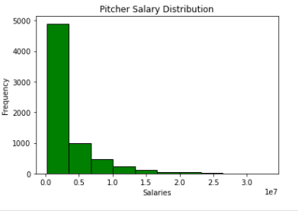
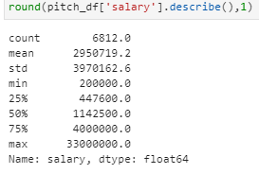

Pitcher Data Frame Histogram and Descriptive Statistics (Salary)

Slide 8
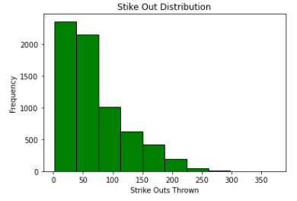
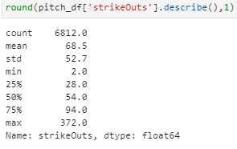

Pitcher Data Frame Histogram Descriptive Statistics (Strike Outs)

Slide 9
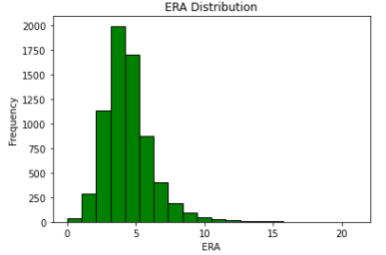
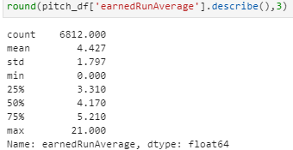

Pitcher Data Frame Histogram and Descriptive Statistics (Earned Run Average)

Slide 10
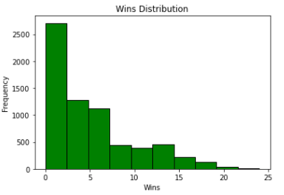
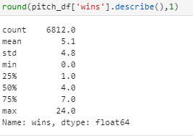

Pitcher Data Frame Histogram and Descriptive Statistics (Wins)

Slide 11
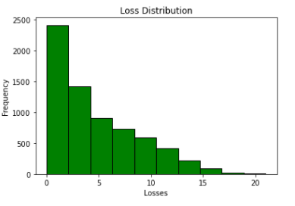
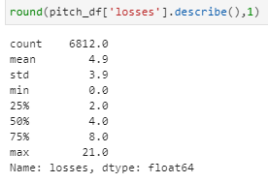

Pitcher Data Frame Histogram and Descriptive Statistics (Losses)

Slide 12
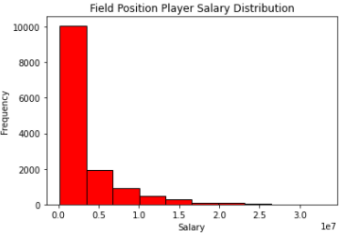
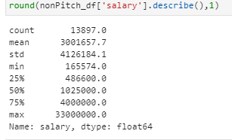

Field Position Player Histogram Descriptive Statistics (Salary)

Slide 13
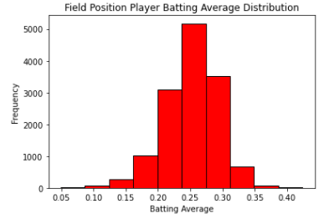
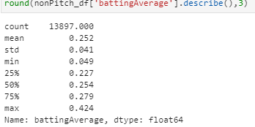

Field Position Player Histogram Descriptive Statistics (Batting Average)

Slide 14
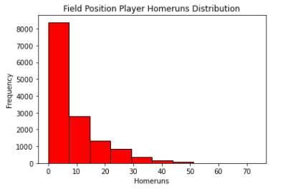
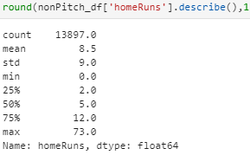

Field Position Player Histogram Descriptive Statistics (Homeruns)

Slide 15
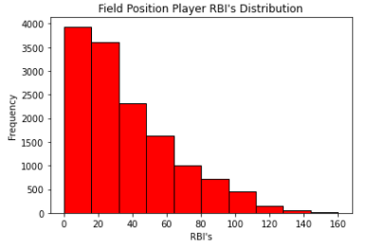
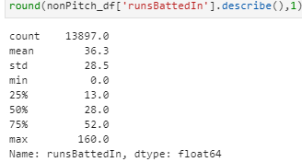

Field Position Player Histogram and Descriptive Statistics (RBI’s)

Slide 16
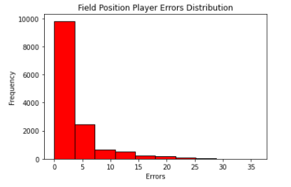
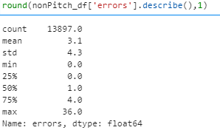

Field Position Player Histogram and Descriptive Statistics (Errors)

Slide 17
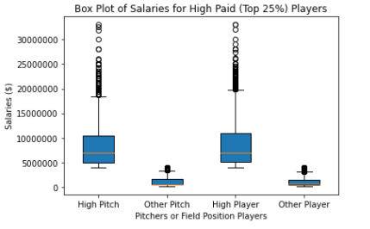
Box Plot of Pitcher and Position Player Salaries
Pitcher and Field Position Player salary data split from top 25% and shown on the box plot.
Other data for Pitchers and Position Players represent bottom 75%.

Slide 18
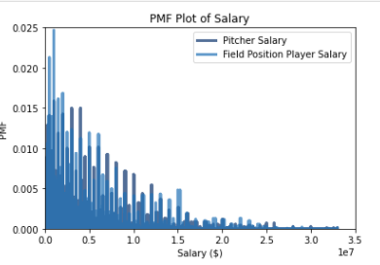
Probability Mass Function (PMF) for Salaries

Slide 19
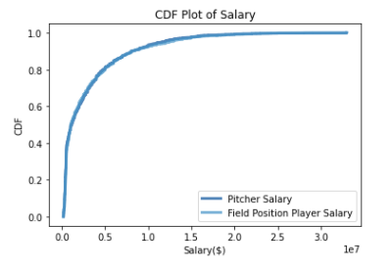
Cumulative Distribution Function (CDF) Plot for Salaries
CDF Plot shows similar distribution of Salary for Pitchers and Field Position Players
Most of the distribution for salary resides on the lower end of the scale

Slide 20
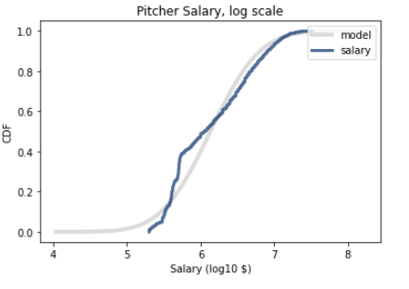
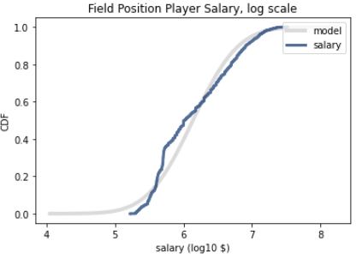
Analytical Distribution Plot (Lognormal)
Pitcher and Field Position Player Lognormal Plots provides a better fit after due to the skewness of the distributions.

Slide 21
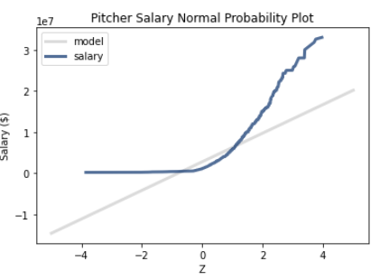
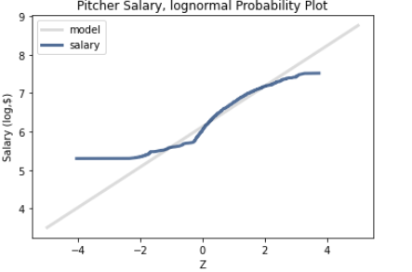
Analytical Distribution Plot (Lognormal) ctd.
Lognormal and Normal Probability Plots of Pitcher Salary to show fit against model line.

Slide 22
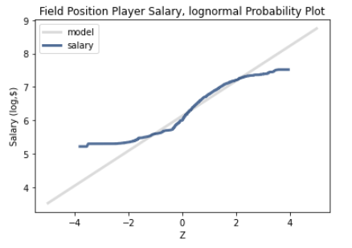
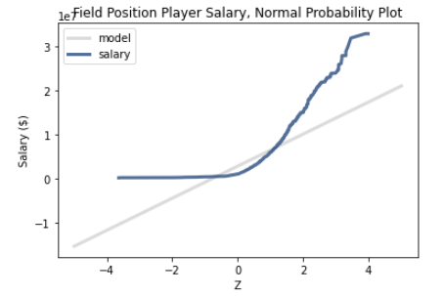
Analytical Distribution Plot (Lognormal) ctd.
Lognormal and Normal Probability Plots of Field Position Player Salary to show fit against model line.

Slide 23
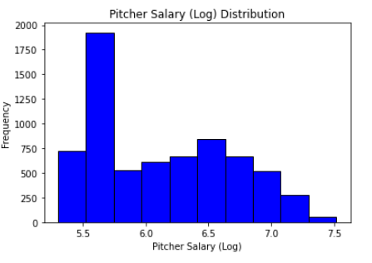
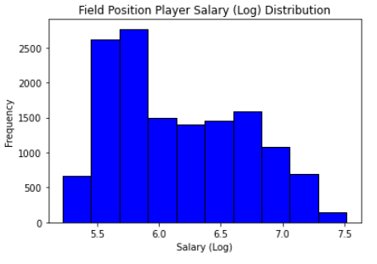
Lognormal Histograms for Pitcher and Field Position Player Salaries

Slide 24
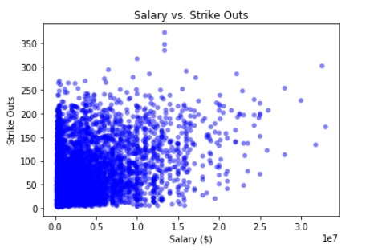
Scatter Plot of Salary vs. Strike Outs for Pitchers

Slide 25
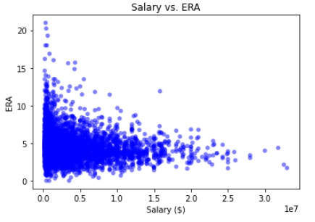
Scatter Plot of Salary vs. ERA for Pitchers

Slide 26
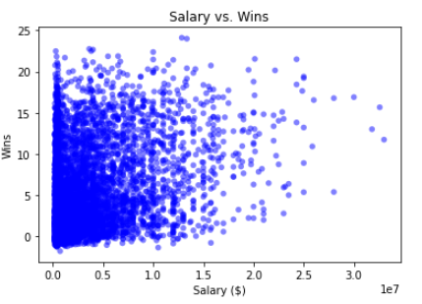
Scatter Plot of Salary vs. Wins for Pitchers

Slide 27
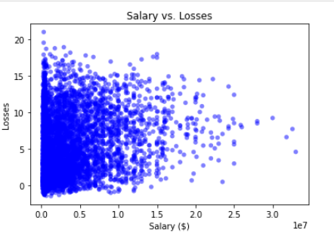
Scatter Plot of Salary vs. Losses for Pitchers

Slide 28
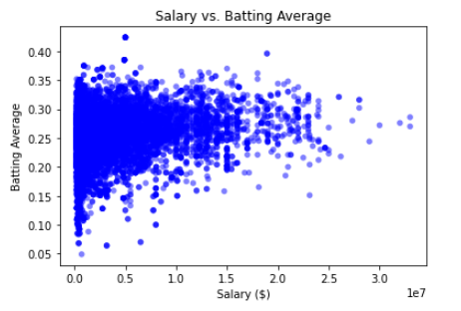
Scatter Plot of Salary vs. Batting Average for Fielding Position Players

Slide 29
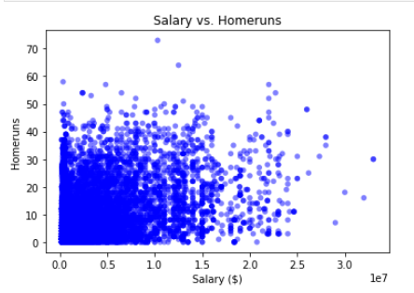
Scatter Plot of Salary vs. Homeruns for Field Position Players

Slide 30
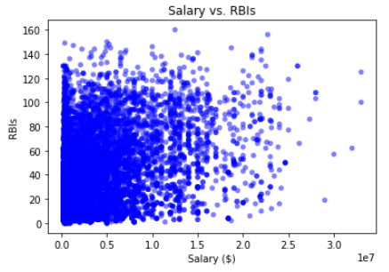
Scatter Plot of Salary vs. RBI’s for Field Position Players

Slide 31
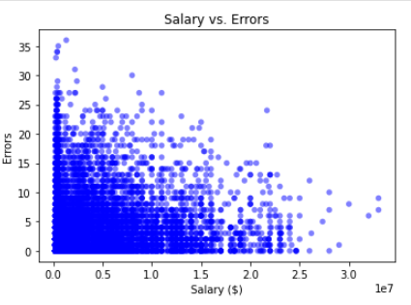
Scatter Plot of Salary vs. Errors for Field Position Players

Slide 32
Conduct and Test Hypothesis
Tested a difference of means between Pitcher Salary and Field Position Player Salary
Null Hypothesis: No difference in means
Pvalue = 0.402 (not statistically significant)
Fail to reject the Null Hypothesis
Pitchers make less on average than non pitchers.

Slide 33
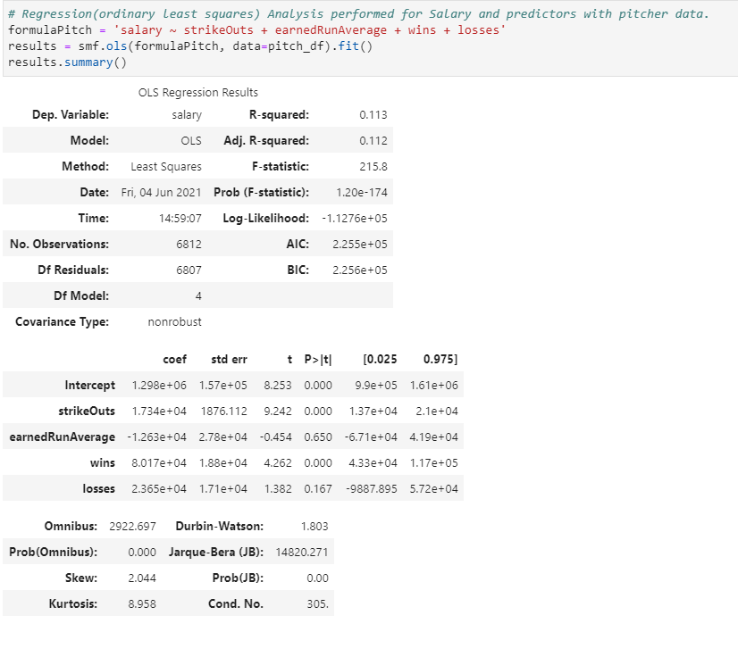
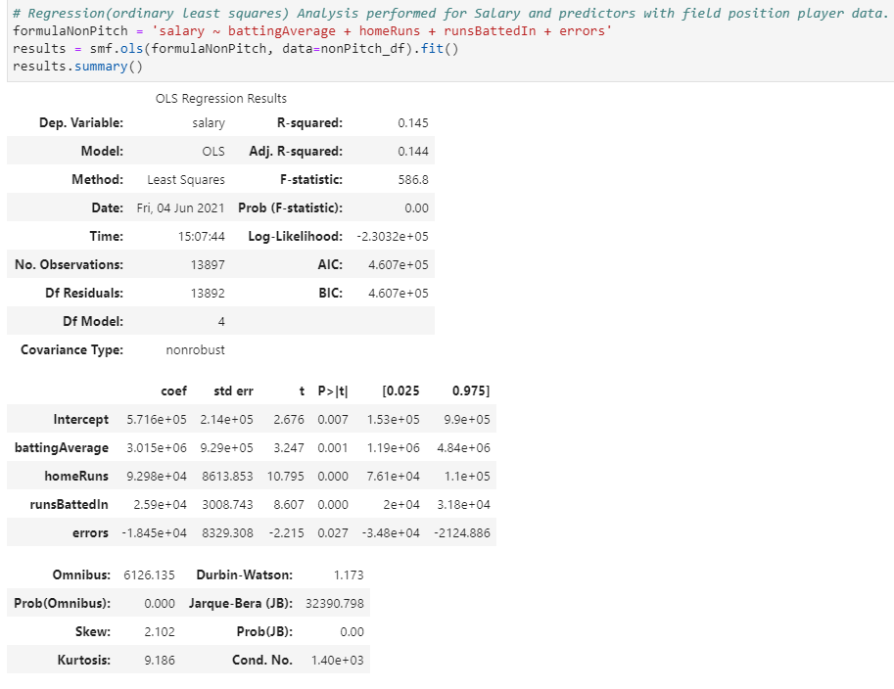
Regression Analysis

Slide 34
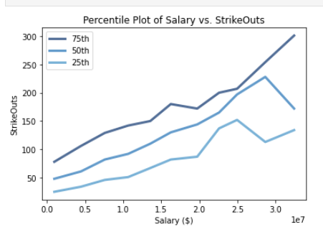
Characterizing Relationships for Pitchers Salary vs. StrikeOuts
Plot of Salary vs. StrikeOuts with Salary grouped by 75th, 50th, and 25th percentiles.

Slide 35
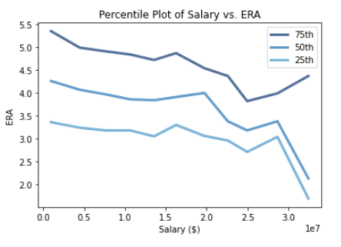
Characterizing Relationships for Pitchers Salary vs. ERA
Plot of Salary vs. ERA with Salary grouped by 75th, 50th, and 25th percentiles.

Slide 36
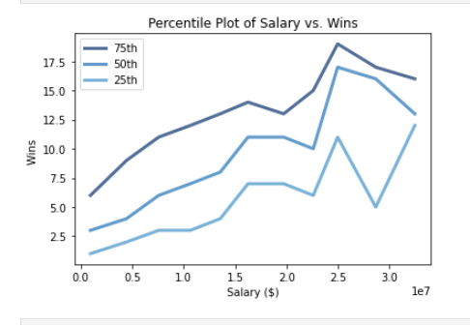
Characterizing Relationships for Pitchers Salary vs. Wins
Plot of Salary vs. Wins with Salary grouped by 75th, 50th, and 25th percentiles.

Slide 37
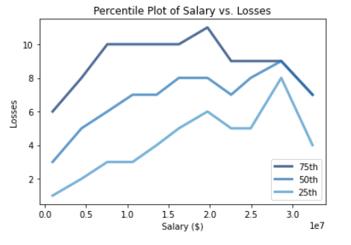
Characterizing Relationships for Pitchers Salary vs. Losses
Plot of Salary vs. Losses with Salary grouped by 75th, 50th, and 25th percentiles.

Slide 38
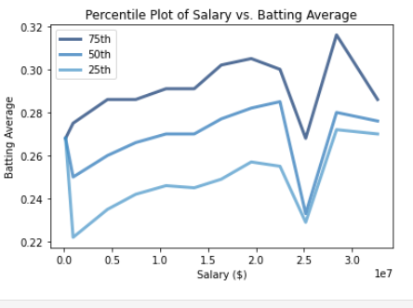
Characterizing Relationships for Field Position Player Salary vs. Batting Average
Plot of Salary vs. Batting Average with Salary grouped by 75th, 50th, and 25th percentiles.

Slide 39
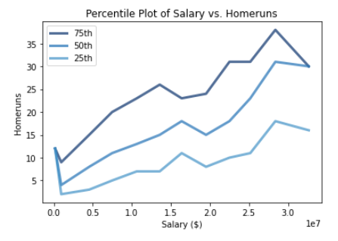
Characterizing Relationships for Field Position Player Salary vs. Homeruns
Plot of Salary vs. Homeruns with Salary grouped by 75th, 50th, and 25th percentiles.

Slide 40
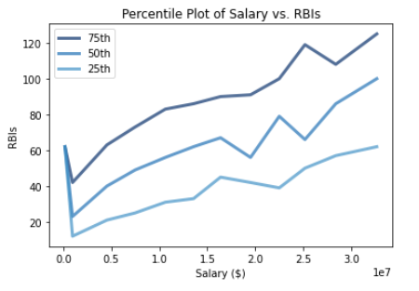
Characterizing Relationships for Field Position Player Salary vs. RBI’s
Plot of Salary vs. RBI’s with Salary grouped by 75th, 50th, and 25th percentiles.

Slide 41
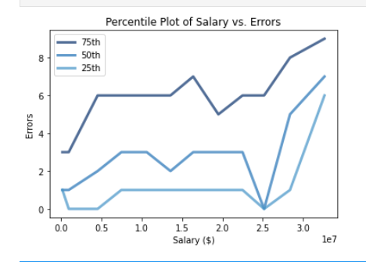
Characterizing Relationships for Field Position Player Salary vs. Errors
Plot of Salary vs. Errors with Salary grouped by 75th, 50th, and 25th percentiles.

