Slide 1

Prediction of Water Quality
DSC 630 Predictive Analytics
Bellevue University
Term Project Presentation – Final
Author: Jake Meyer
Date: 11/17/2022

Slide 2
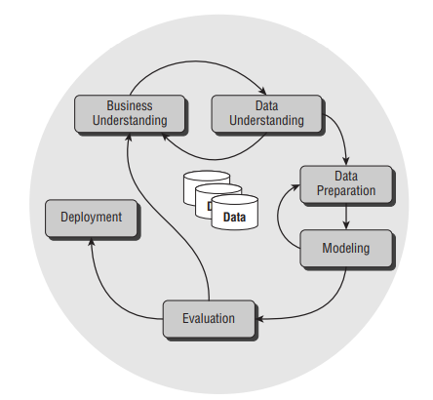
Agenda
CRISP-DM Process Model (Cross Industry Standard Process for Data Mining)
Business Understanding
Data Understanding
Data Preparation
Modeling
Evaluation
Deployment Recommendation

Slide 3
Problem Summary
Potential sources for clean, potable water are limited.
Water makes up ~75% of the Earth’s surface, but only 0.78% of this resource is accessible for human consumption (Misachi, 2018).
Roughly 1/3 of the non-saline, freshwater is frozen in glaciers, ice sheets, or ice caps (World Atlas, 2018).
Common sources for freshwater are groundwater (underground aquifers) and surface water (rivers and lakes).
Alternative sources for potable water are costly.
Wastewater requires extensive filtration to remove contaminants (fecal matter, chemicals, etc…)
Desalination of salt-water requires high-cost systems to monitor and maintenance.
About 30% of the world population do not have access to potable water (common in developing countries) leading to major health concerns (BOSAQ, 2020).
Primary objective is to construct a model to predict whether water is potable based on water quality measurements.
Sanitation Organization: Utilize model to eliminate non-value-added steps within their process.
Environmental Agency: Test new water sources with model to determine severity of sanitation required.
Human Health: Individuals would benefit from this model by reducing the consumption of non-potable water.

Slide 4
Dataset Introduction
Water potability dataset that will be used for this analysis.
Link to dataset from Aditya Kadiwal Kaggle - Water Quality | Kaggle
Water Quality data overview
10 Features include pH, Hardness, Total Dissolved Solids (TDS), Chloramines, Sulfate, Conductivity, Organic Carbon, Trihalomethanes, Turbidity, and Potability
There are 3276 records available from the raw dataset.
More details outlined later in the Data Understanding section.
CSV File used for the analysis provided below (double-click).

Slide 5
Project Objectives and Risks
Learning objectives for this project are:
How balanced is the dataset for Potable vs. Non-Potable water samples?
Are there any insights for the feature distributions included in this dataset?
What are the main features contributing to water Potability? Are there any features highly correlated with water Potability within this dataset?
Which model performs the best to predict water Potability?
Show how the best performing model compares to other models in the analysis.
Is the model recommended to be deployed?
Project may serve as a template for domain experts in water quality, water treatment, or environmentalists to build from for additional insights.
Risks identified for this project are:
No details provided for the method used to collect and consolidate water quality measurements for this dataset.
Assumption was made that all measurements from this dataset are valid.
Inability to construct a deployable model with the dataset available.

Slide 6
Dataset Overview – Table of Features
Feature | Description
pH | The pH test will indicate how acidic (0-6.9), neutral (7), or basic (7.1-14) the sample measures. It serves as a useful measure for water quality since corrosive water can lead to contamination from pipes and appliances.
Hardness (mg/L) | Hardness is a measure, typically in milligrams of calcium per liter, of the volume required to react with soap. There are usually calcium or magnesium cations that contribute to the Hardness in water.
Total Dissolved Solids (ppm) | Total Dissolved Solids (TDS) represent traces of organic matter and inorganic salts caused from environmental sources.
Chloramines (ppm) | Chloramine is generated from chlorine reacting with ammonia and results in odd smells or taste within the water.
Sulfate (mg/L) | Sulfate in drinking water may result in stomach issues and contribute to undesired taste.
Conductivity (µS/cm) | Conductivity will help indicate the amount of dissolved solids in water by measuring how well the water conducts electrical current.
Organic Carbon (ppm) | Total Organic Carbon (TOC) results from decomposing natural organic matter and is recommended to be below 2 milligrams per liter for drinking water.
Trihalomethanes (µg/L) | Trihalomethanes result from chlorine treated water and are recommended to be below 80 parts per million for drinking water.
Turbidity (NTU) | Turbidity utilizes light with water to measure waste discharge.
Potability (Target) | Potability feature indicates whether the water sample is drinkable or not.

Slide 7
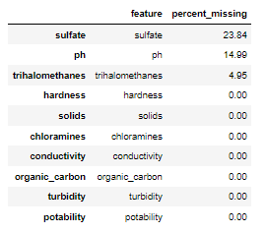
Dataset Overview Table of Missing Values
Sulfate (24%), pH (15%), and Trihalomethanes (5%) all had missing values.
Missing values were handles by imputing the median value for each respective feature.
Columns were also renamed (all lower-case, no spaces) for convenience.

Slide 8
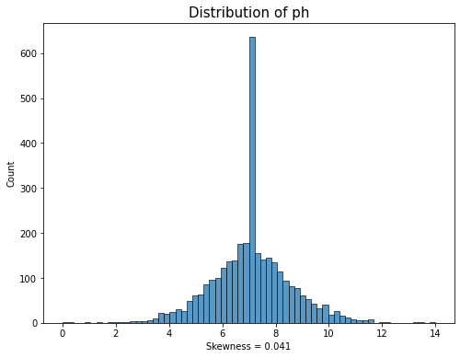
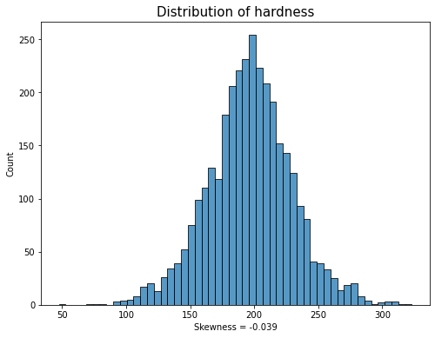
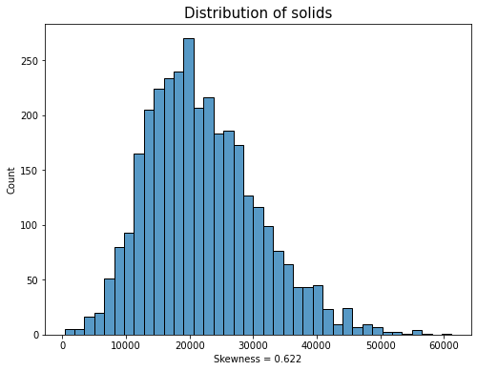
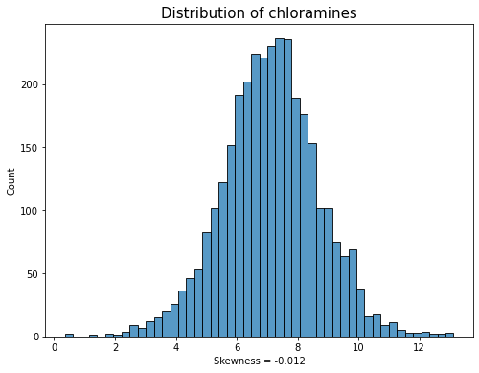
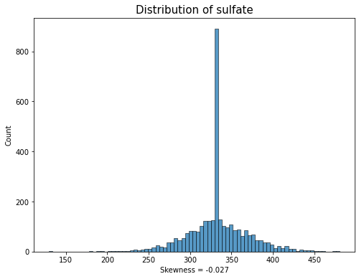
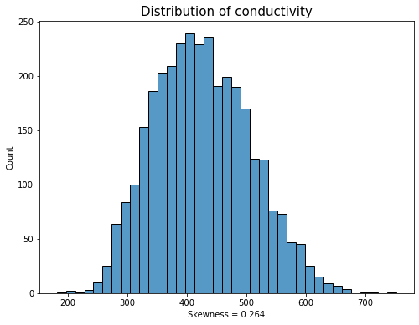
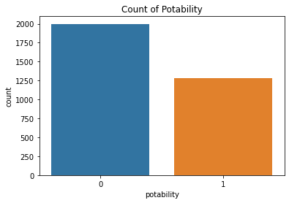
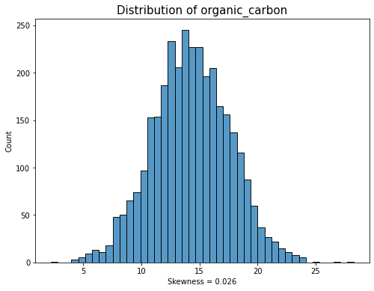
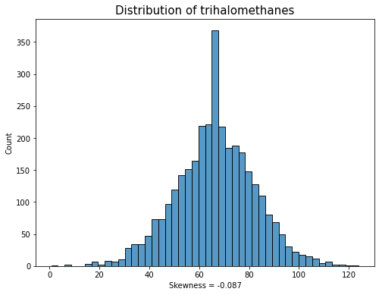
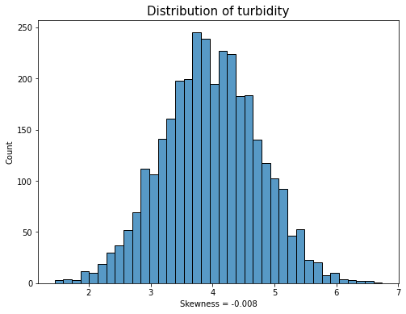
Univariate Analysis

Slide 9
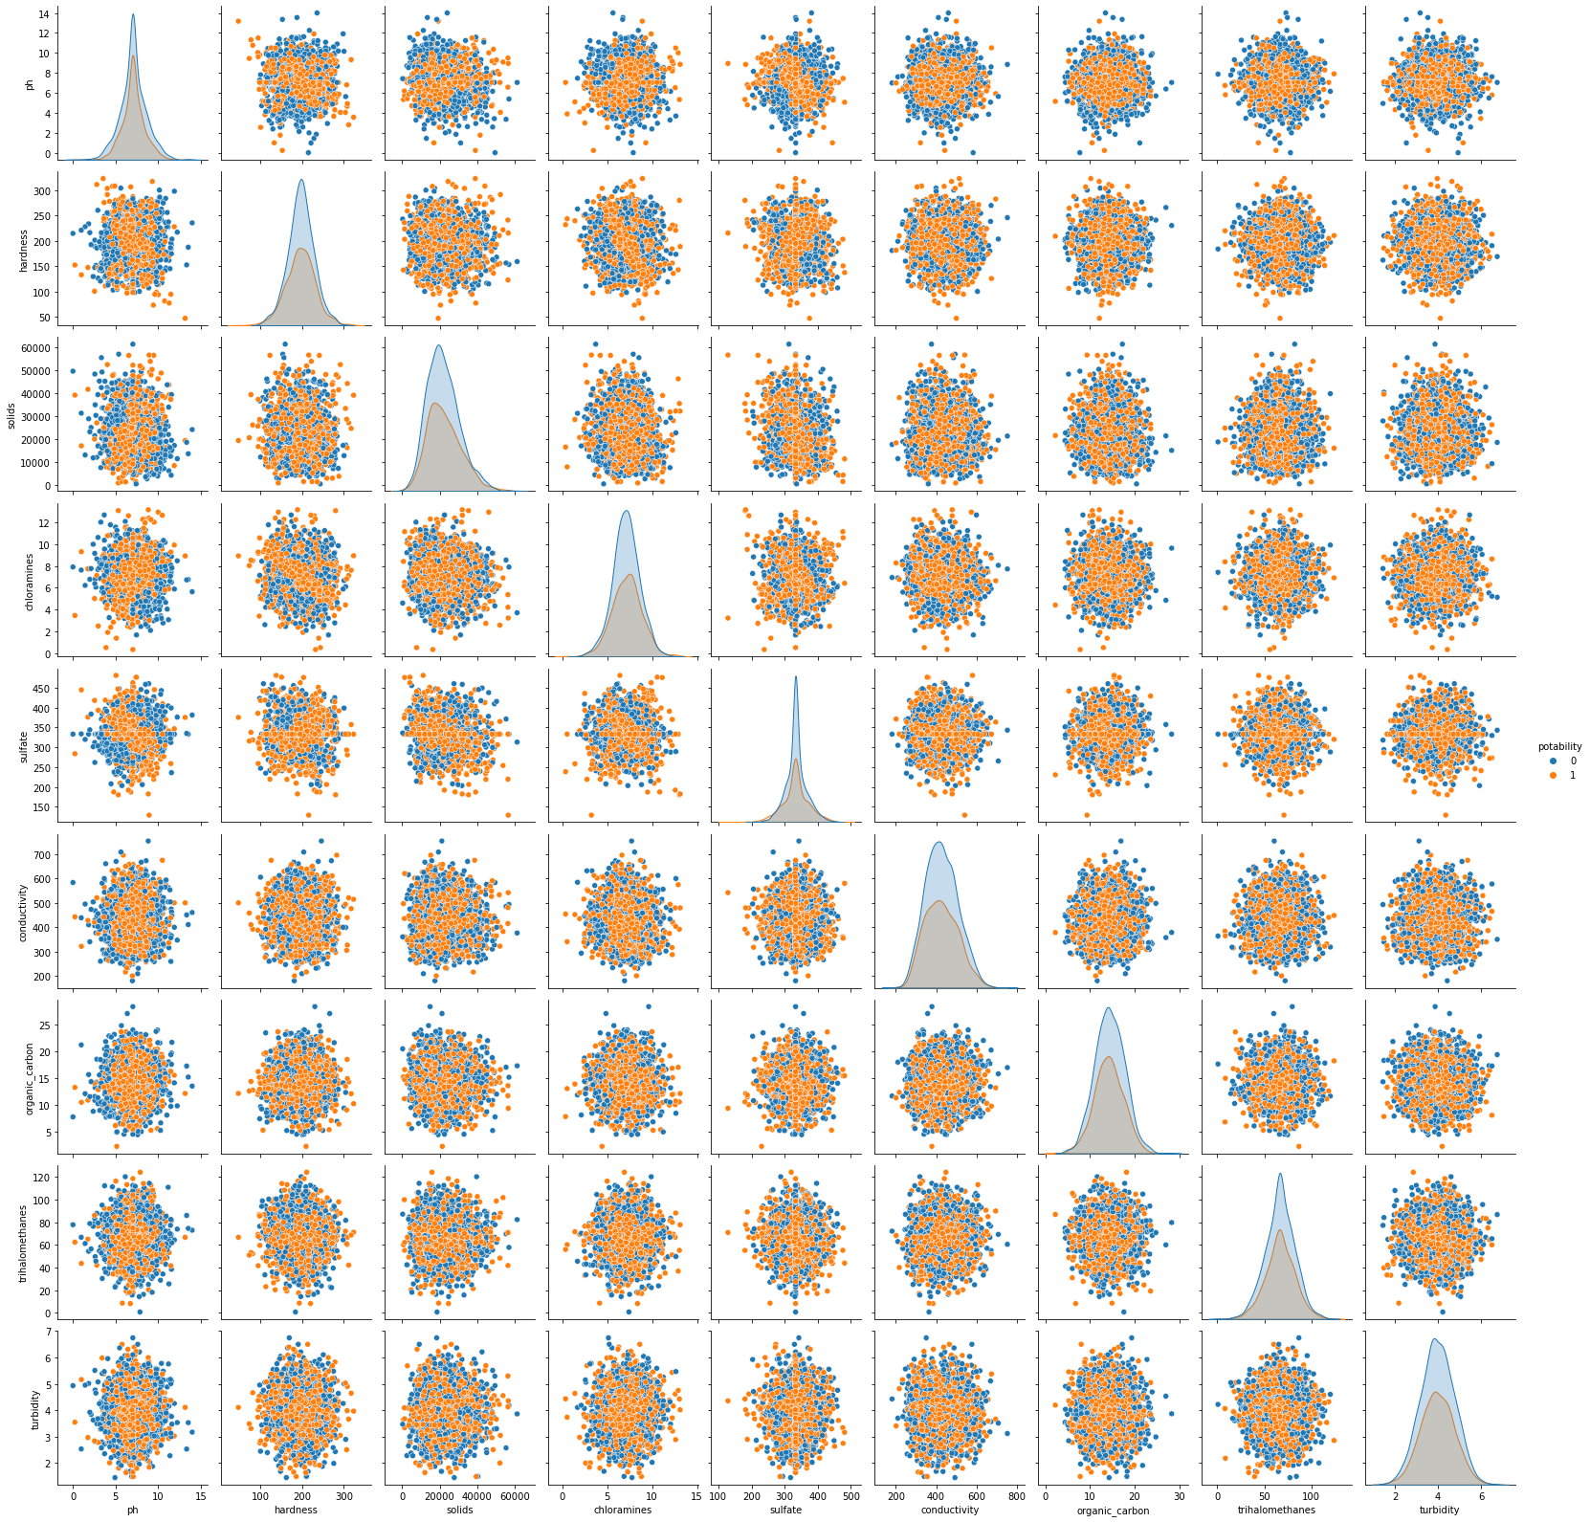
Bivariate Analysis - Pairplot
No obvious relationships observed from the pairplot.

Slide 10
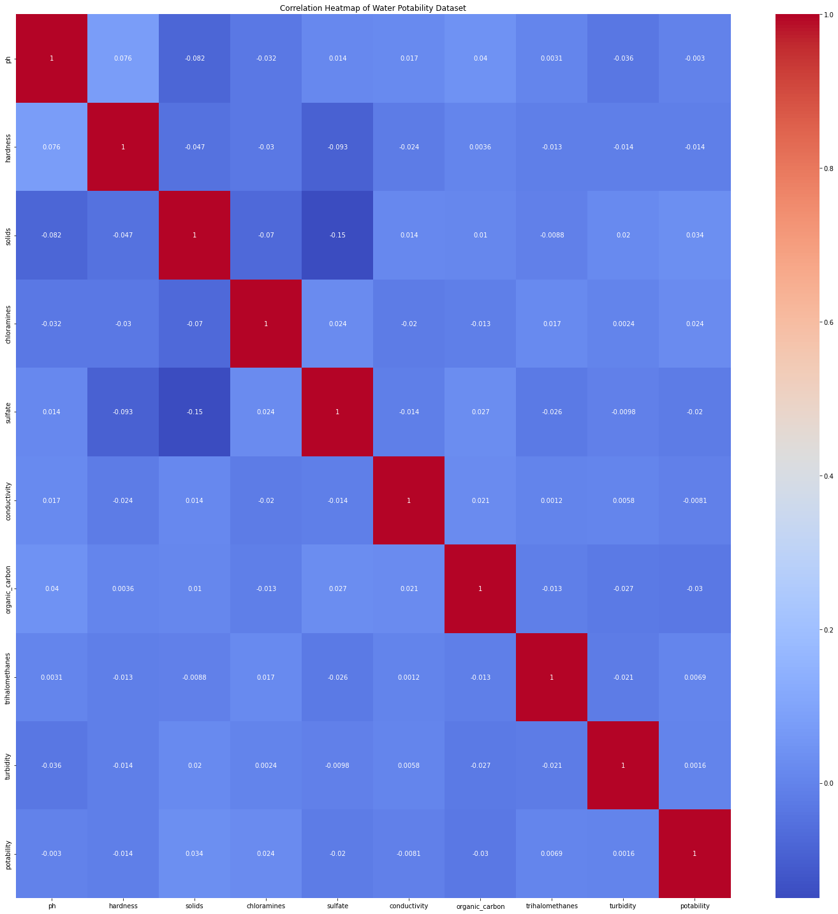
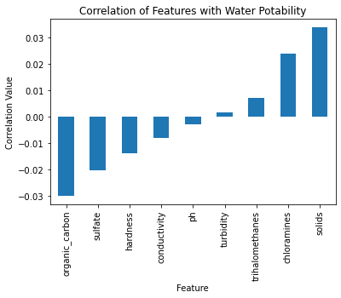
Bivariate Analysis – Correlation Heatmap

Slide 11
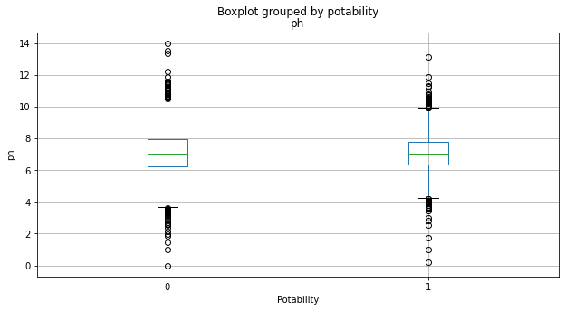
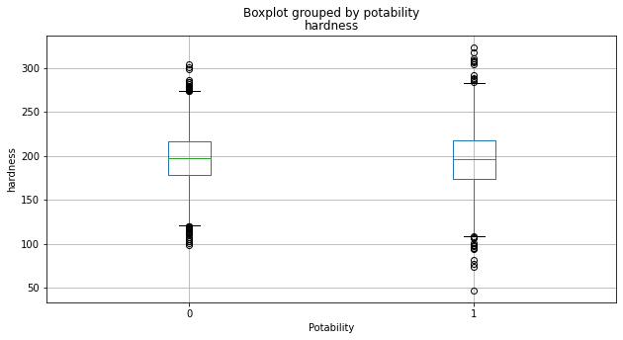
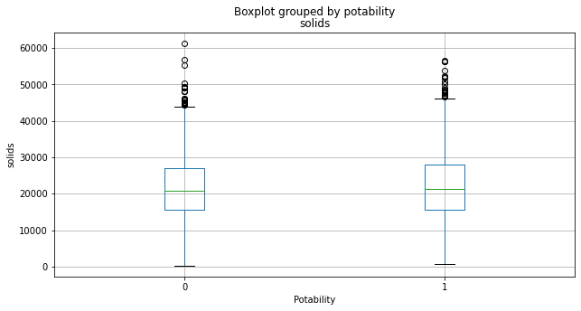
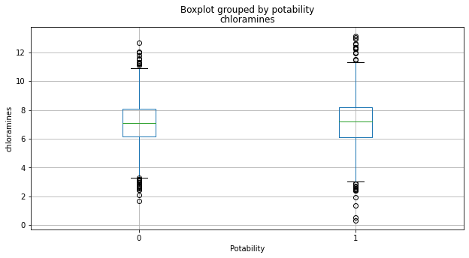
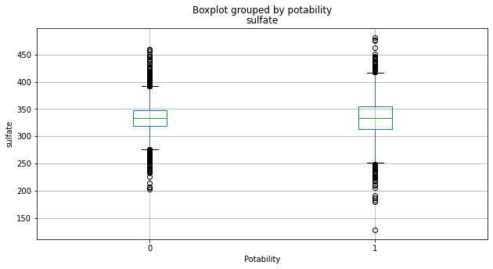
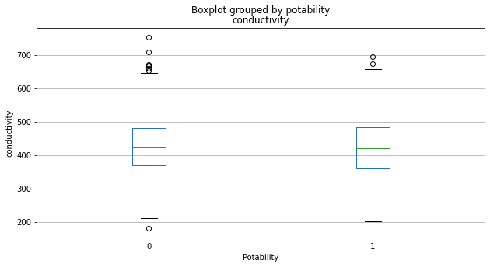
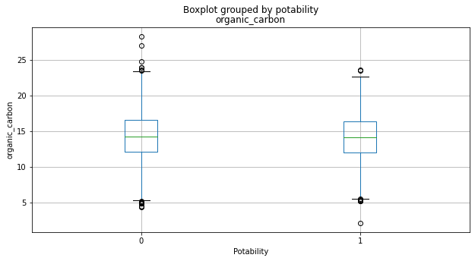
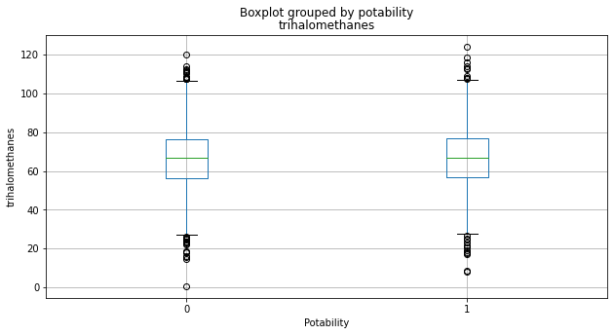
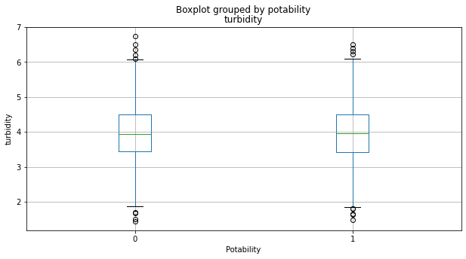
Bivariate Analysis - Boxplots

Slide 12
Data Preparation for Model Inputs
Preliminary data preparation steps consisted of the following:
Replace missing values with median value for each respective feature.
Rename the columns for convenience during the analysis.
Six models will be trained and tested using the data previously outlined.
Logistic Regression, KNN, Decision Tree, Random Forest, Support Vector Machine, and Adaboost.
Additional data preparation steps for model inputs are highlighted in the table below.
Model | Data Preparation Steps
Logistic Regression | Train(80%), Test(20%) split applied to dataset.
K-Nearest Neighbor (KNN) Decision Tree Random Forest Support Vector Machine (SVM) Adaboost | Train(80%), Test(20%) split applied to dataset. Standard scalar applied (fit and transform) to training subset. Standard scalar applied (transform) to test subset.

Slide 13
Model Training and Testing - Overview
Model | Training and Testing Steps | Model Arguments (sklearn) | Evaluation Metrics
Logistic Regression | Create the model classifier. Fit the classifier to the training subset. Create predictions for potability based on training data. Test the predictions and output in a confusion matrix (training). Create predictions for potability based on test data. Test the predictions and output in a confusion matrix (testing). Output classification report for test data. | solver = ‘liblinear’, multiclass = ‘ovr’ binary, class_weight = ‘balanced’) | Accuracy, Precision, Recall, and F1-Score
KNN |  | n_neighbors = 38
Decision Tree |  | defaults
Random Forest |  | n_estimators = 78
SVM |  | defaults
Adaboost |  | N_estimators = 20

Slide 14
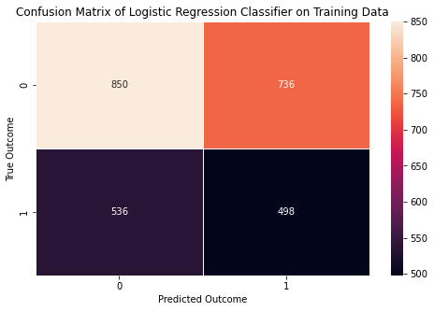
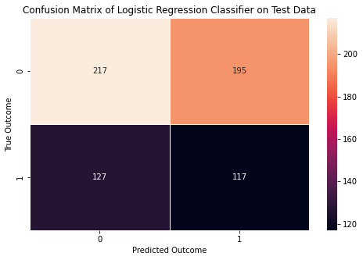
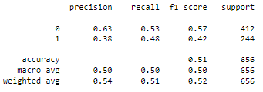
Model – Logistic Regression

Slide 15
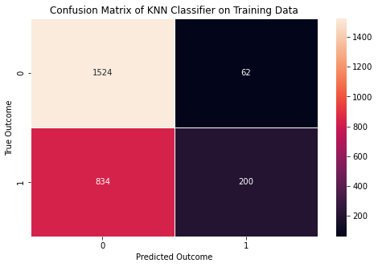
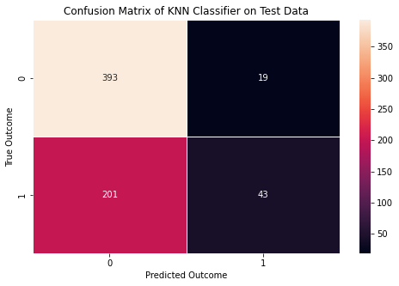
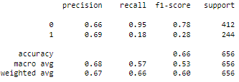
Model – KNN

Slide 16
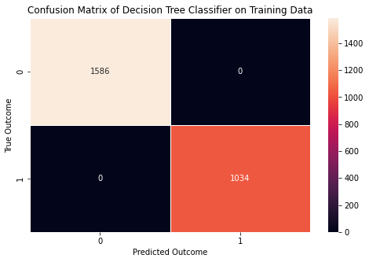
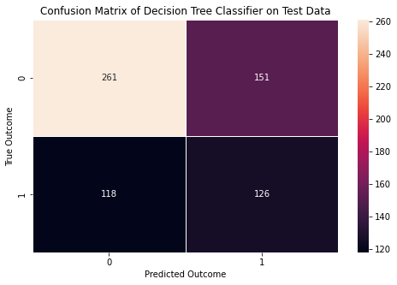
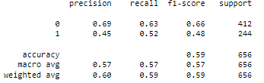
Model – Decision Tree

Slide 17

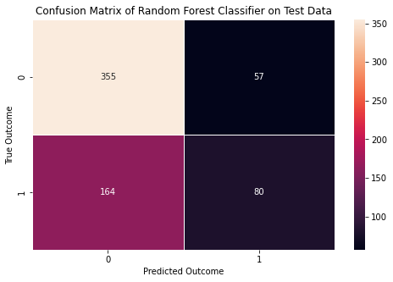
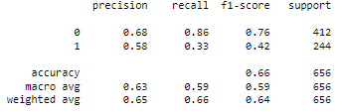
Model – Random Forest

Slide 18
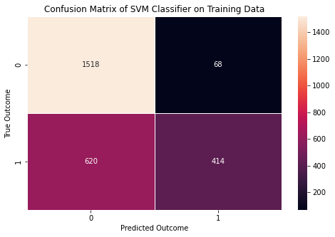
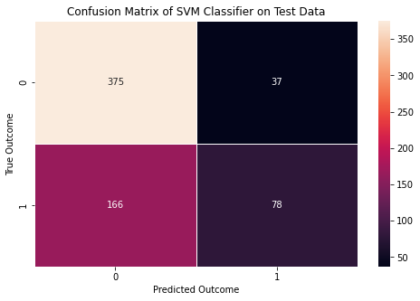
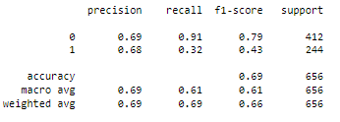
Model – SVM

Slide 19
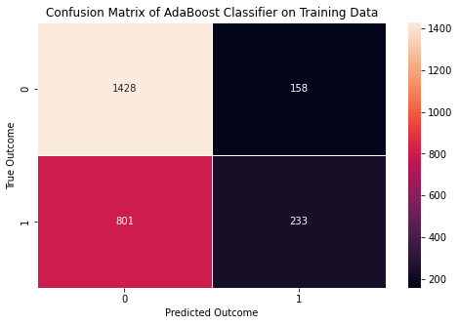

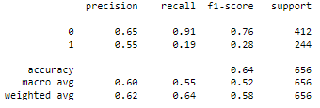
Model – Adaboost

Slide 20
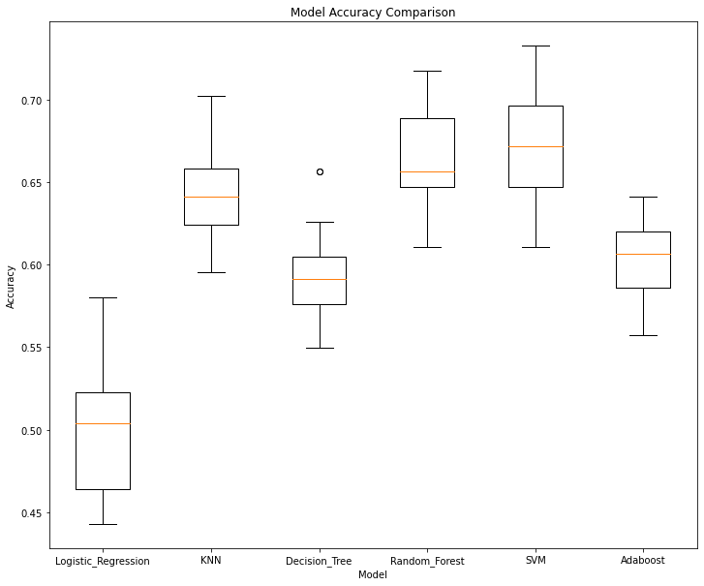
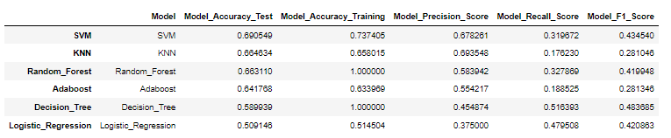
Model Evaluation
Top three models based on accuracy on test data are SVM, KNN, and Random Forest, respectively.

Slide 21
Summary of Learnings
Dataset is imbalanced in favor of non-Potable (61%) records compared to Potable (39%).
Univariate analysis helped understand each feature within the dataset. Only two features were normally distributed, and three features were treated for missing values.
There are no features highly correlated with water Potability in the dataset. The top two features with a positive correlation of water Potability were Total Dissolved Solids and Chloramines. The top two features with a negative correlation for water Potability were Organic Carbons and Sulfates.
The SVM Model generally performs better than the other models as seen after cross-validation with 20 iterations.
The model is not ready to be deployed now due to the low accuracy on test data.
This project may serve as a template for domain experts in water quality, water treatment, or environmentalists to build from for additional insights.

Slide 22
Deployment Recommendation
At this point in time, the SVM model is not recommended to be deployed.
Additional recommendations (current analysis):
Obtain insights from Subject Matter Experts (SME) for water quality to see what additional features need to be added (or calculated) for this dataset.
Perform hyperparmeter tuning on the models to see if accuracy can be improved.
Additional recommendations (future actions):
Focus data collection on a sanitation process with key input variables and output responses monitored for a set period.
Collect data from known potable sources and non-potable sources with key metrics (identified by SME’s) captured for analysis.

Slide 23
Prediction of Water Quality Project – Questions
Questions?

Slide 24
Prediction of Water Quality Project - Resources
Resources:
Abbott, D. (2014). Applied Predictive Analytics. (1st ed., pg. 23). John Wiley & Sons, Inc.
BOSAQ. (2020, March 18). Everything You Need To Know About Water Resources. BOSAQ Blog. Everything you need to know about water resources | Bosaq
Kadiwal, Aditya. (2021, April 25). Water Quality: Drinking water potability. Kaggle. Water Quality | Kaggle
Misachi, John. (2018, February). What Percentage of Earth’s Water Is Drinkable? WorldAtlas. What Percentage of the Earth's Water Is Drinkable? – WorldAtlas
World Health Organization. (2022, March 21). Drinking-water quality guidelines. Water Sanitation and Health. Water Sanitation and Health (who.int)
World Health Organization. (2022, March 21). Drinking-Water. World Health Organization Newsroom. Drinking-water (who.int)

