Slide 1
Solano County Dashboard Summary
2025 SCOE Assessment Research and Evaluation

Slide 2
Solano County Dashboard Overview 2025

Slide 3
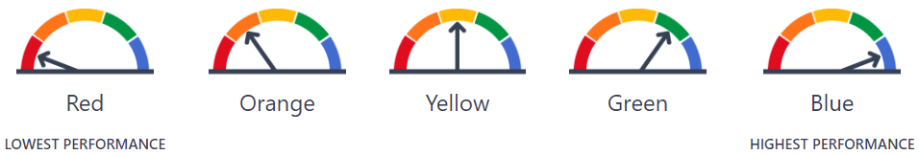
Dashboard Colors
CA Dashboard Performance Colors

Slide 4
2025 District Indicator Colors
 | Performance Colors | Performance Colors | Performance Colors | Performance Colors | Performance Colors | Performance Colors
District | No color | Red (lowest performance) | Orange | Yellow | Green | Blue (highest performance)
Benicia Unified | 50 | 1 | 11 | 21 | 27 | 9
Dixon Unified | 51 | 11 | 23 | 21 | 11 | 5
Fairfield-Suisun Unified | 24 | 11 | 38 | 22 | 24 | 3
Solano County Office of Education | 93 | 2 | 2 | 0 | 0 | 8
Travis Unified | 44 | 4 | 15 | 22 | 21 | 14
Vacaville Unified | 31 | 11 | 25 | 33 | 15 | 7
Vallejo City Unified | 32 | 22 | 32 | 30 | 6 | 0

Slide 5
2025 Charter Indicator Colors
 | Performance Colors | Performance Colors | Performance Colors | Performance Colors | Performance Colors | Performance Colors
Charter | No color | Red (lowest performance) | Orange | Yellow | Green | Blue (highest performance)
Buckingham Collegiate Charter Academy | 58 | 0 | 1 | 1 | 11 | 9
Caliber: ChangeMakers Academy | 44 | 5 | 11 | 16 | 9 | 1
Dixon Montessori Charter | 51 | 0 | 3 | 6 | 11 | 7
Elite Public | 75 | 2 | 11 | 15 | 3 | 0
Ernest Kimme Charter Academy | 75 | 15 | 4 | 1 | 1 | 0
Fairmont Charter Elementary | 49 | 6 | 18 | 8 | 2 | 0
Griffin Academy High | 78 | 3 | 5 | 2 | 1 | 1
Kairos Public | 56 | 0 | 2 | 10 | 11 | 3
MIT Academy | 67 | 2 | 5 | 7 | 8 | 3
MIT Griffin Academy Middle | 68 | 7 | 3 | 0 | 0 | 0
Mare Island Technology Academy | 54 | 5 | 8 | 4 | 1 | 4
Vallejo Charter | 51 | 4 | 12 | 15 | 1 | 0

Slide 6
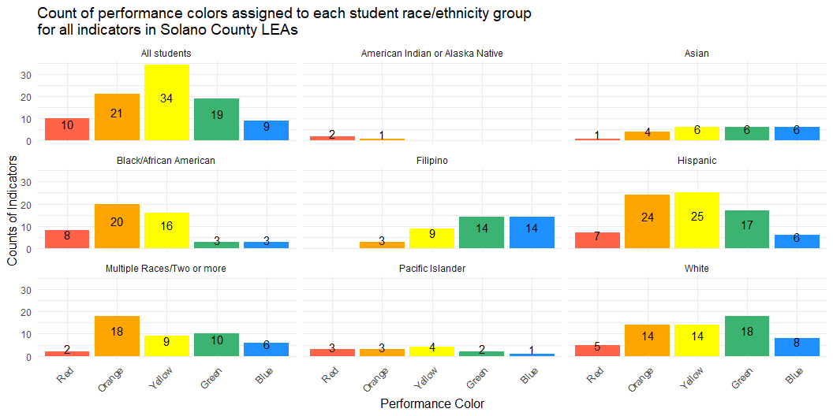
2025 Counts of Indicator Colors in Solano County Student Groups: Race/Ethnicity

Slide 7
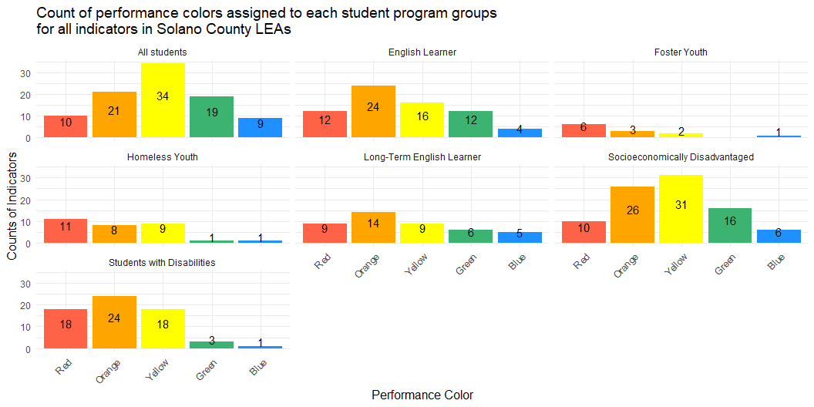
2025 Counts of Indicator Colors in Solano County Student Groups: Student Program

Slide 8
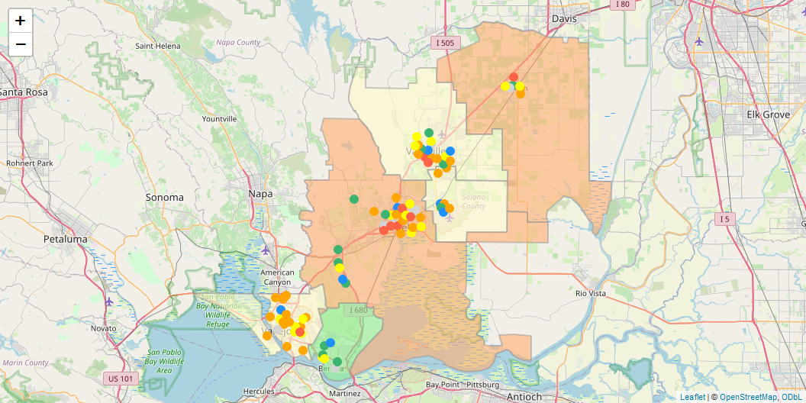
2025 County Wide ELA Performance (All students)

Slide 9
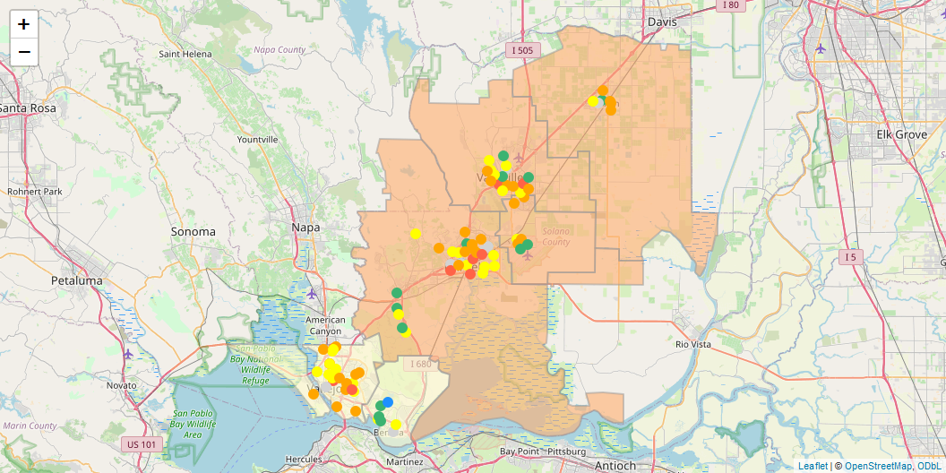
2025 County Wide Math Performance (All students)

Slide 10
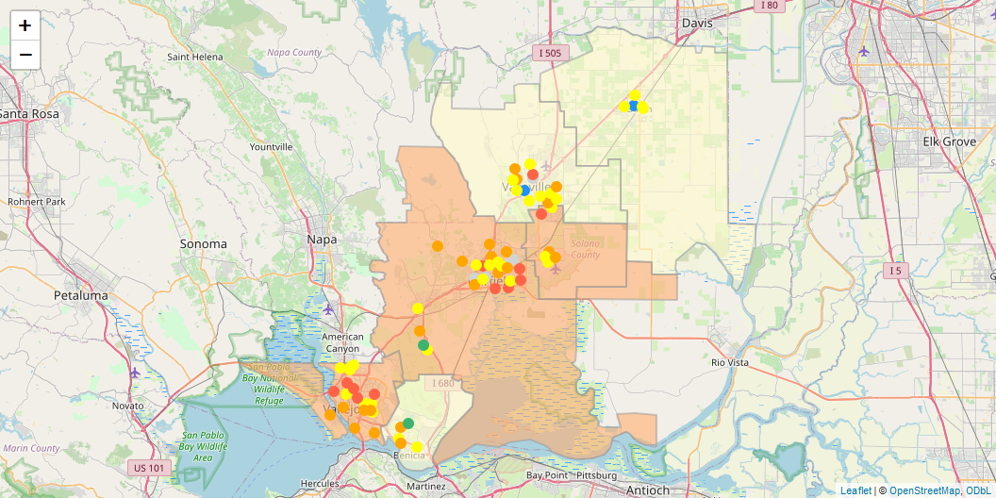
2025 County Wide Chronic Absenteeism (All students)

Slide 11
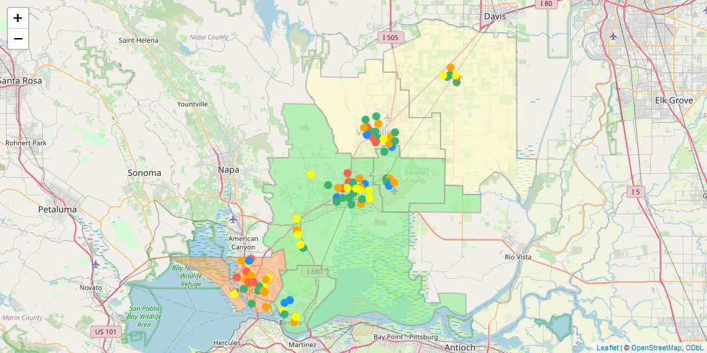
2025 County Wide Suspension (All students)

Slide 12
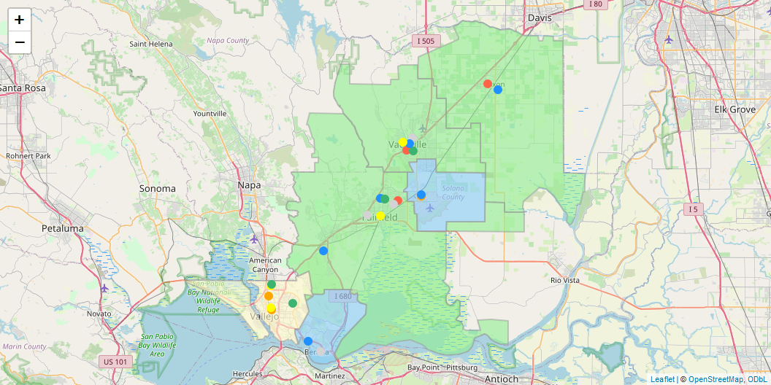
2025 County Wide Graduation (All students)

Slide 13
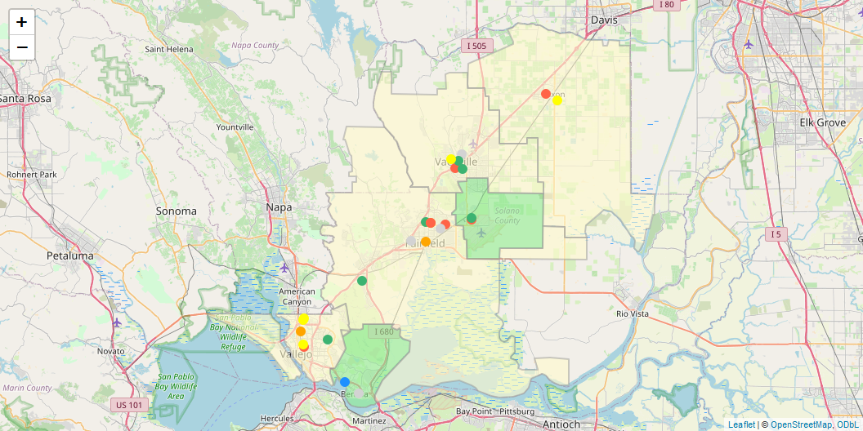
2025 County Wide College/Career (All students)

Slide 14
2025 Long-Term English Learners: Districts
LEA | All students | English Learners | Long-Term English Learners | Percent of students that are ELs | Percent of ELs that are LTELs
Solano County Office of Education | 256 | 26 | 23 | 10.16% | 88.46%
Benicia Unified | 4,458 | 150 | 32 | 3.36% | 21.33%
Dixon Unified | 3,169 | 696 | 194 | 21.96% | 27.87%
Fairfield-Suisun Unified | 21,419 | 3,458 | 630 | 16.14% | 18.22%
Travis Unified | 5,790 | 227 | 37 | 3.92% | 16.3%
Vacaville Unified | 12,053 | 1,053 | 191 | 8.74% | 18.14%
Vallejo City Unified | 10,037 | 2,804 | 646 | 27.94% | 23.04%
 | Values are taken from the denominator of the suspension indicator which is the most inclusive indicator. | Values are taken from the denominator of the suspension indicator which is the most inclusive indicator. | Values are taken from the denominator of the suspension indicator which is the most inclusive indicator. | Values are taken from the denominator of the suspension indicator which is the most inclusive indicator. | Values are taken from the denominator of the suspension indicator which is the most inclusive indicator.

Slide 15
2025 Long-Term English Learners: Charters
LEA | All students | English Learners | Long-Term English Learners | Percent of students that are ELs | Percent of ELs that are LTELs
Buckingham Collegiate Charter Academy | 485 | 3 | 3 | 0.62% | 100%
Caliber: ChangeMakers Academy | 1,000 | 255 | 36 | 25.5% | 14.12%
Elite Public | 709 | 159 | 26 | 22.43% | 16.35%
Ernest Kimme Charter Academy | 244 | 25 | 20 | 10.25% | 80%
Dixon Montessori Charter | 473 | 30 | 2 | 6.34% | 6.67%
Fairmont Charter Elementary | 613 | 80 | 2 | 13.05% | 2.5%
Griffin Academy High | 201 | 33 | 24 | 16.42% | 72.73%
Kairos Public | 807 | 11 | 4 | 1.36% | 36.36%
Mare Island Technology Academy | 277 | 57 | 33 | 20.58% | 57.89%
MIT Academy | 498 | 95 | 68 | 19.08% | 71.58%
MIT Griffin Academy Middle | 126 | 27 | 20 | 21.43% | 74.07%
Vallejo Charter | 421 | 89 | 17 | 21.14% | 19.1%
 | Values are taken from the denominator of the suspension indicator which is the most inclusive indicator. | Values are taken from the denominator of the suspension indicator which is the most inclusive indicator. | Values are taken from the denominator of the suspension indicator which is the most inclusive indicator. | Values are taken from the denominator of the suspension indicator which is the most inclusive indicator. | Values are taken from the denominator of the suspension indicator which is the most inclusive indicator.

Slide 16
2025 Student Group Details

Slide 17
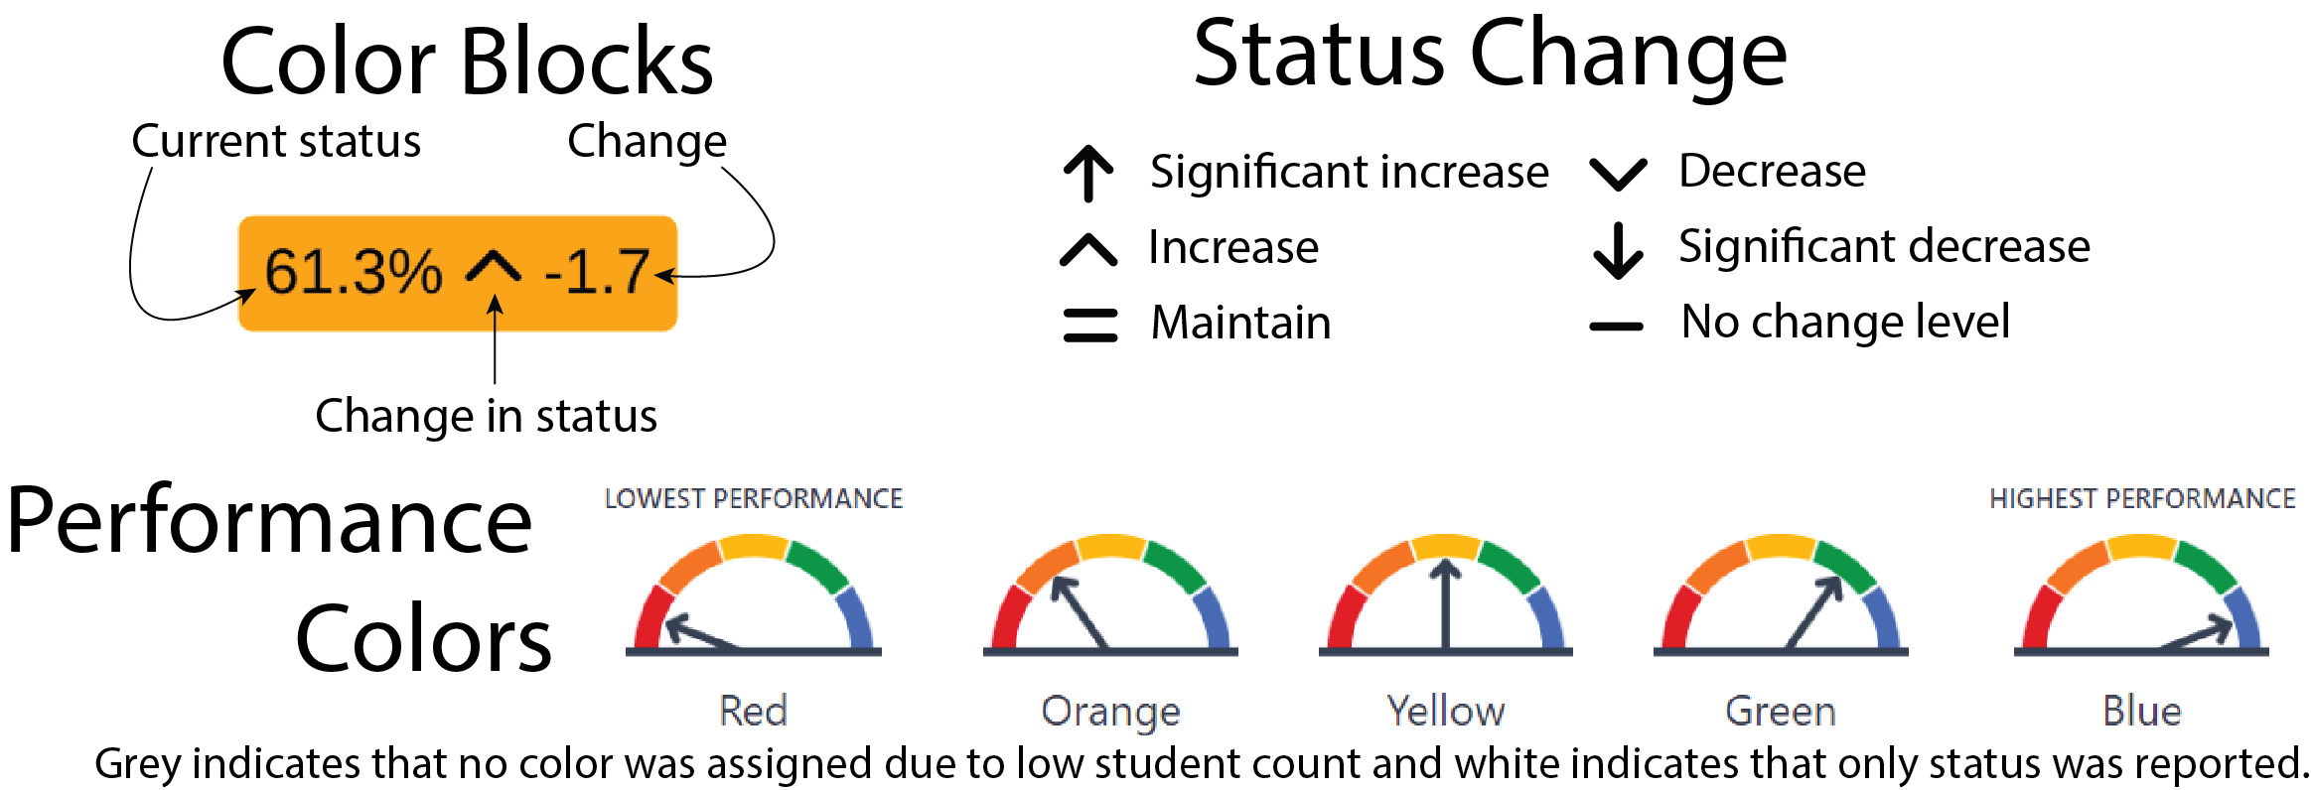
Detail Key

Slide 18
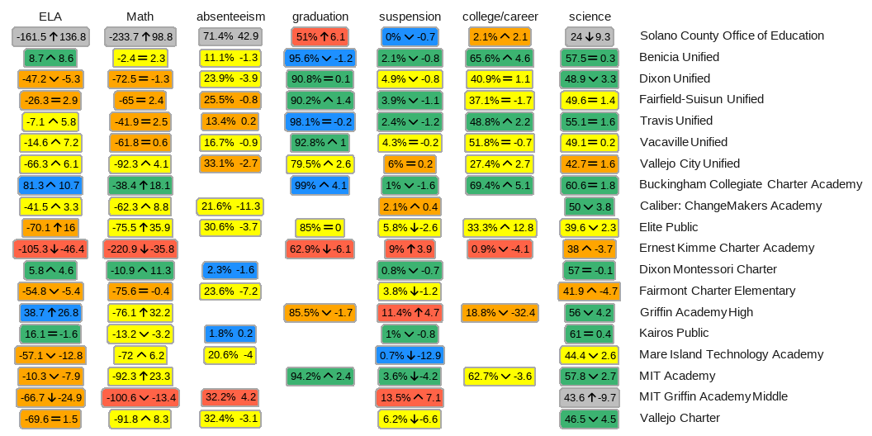
2025 All Students

Slide 19
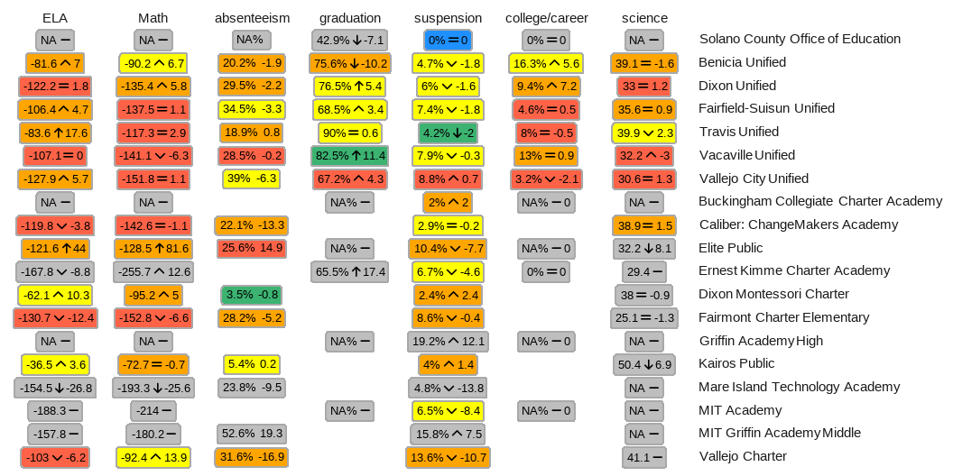
2025 Students with disabilities

Slide 20
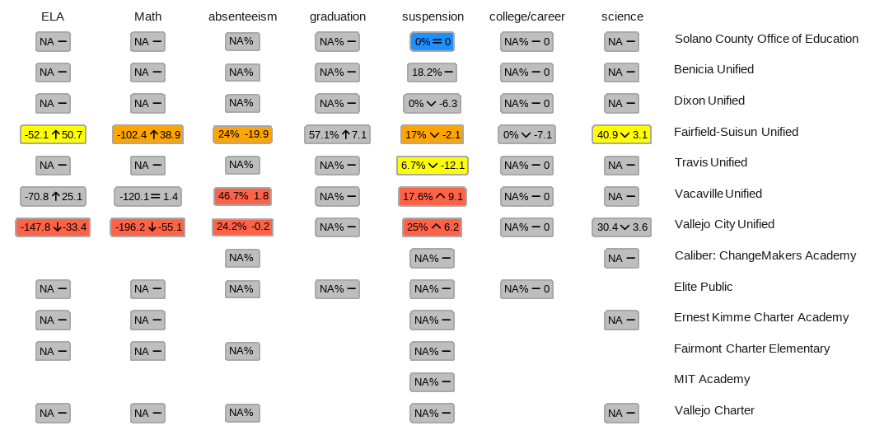
2025 Foster

Slide 21
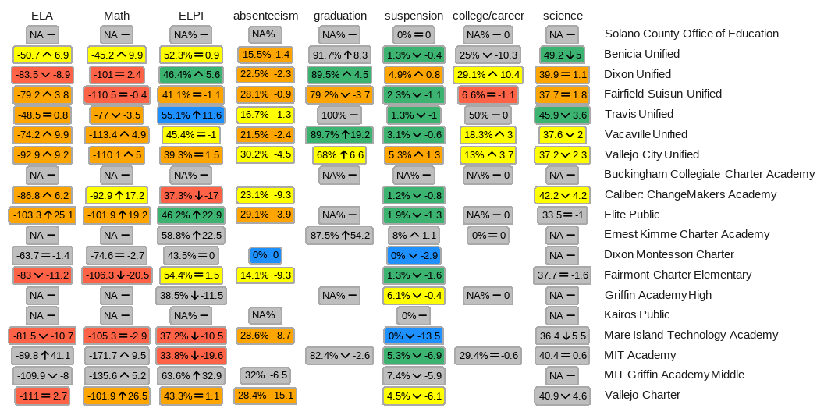
2025 English Learners

Slide 22
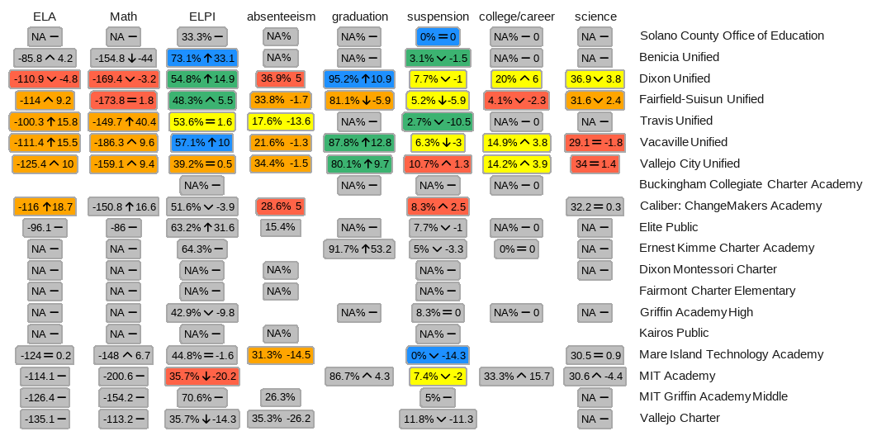
2025 Long-Term English Learners

Slide 23
2025 Black/African American
2025 Black/African American (Anonymized)

Slide 24
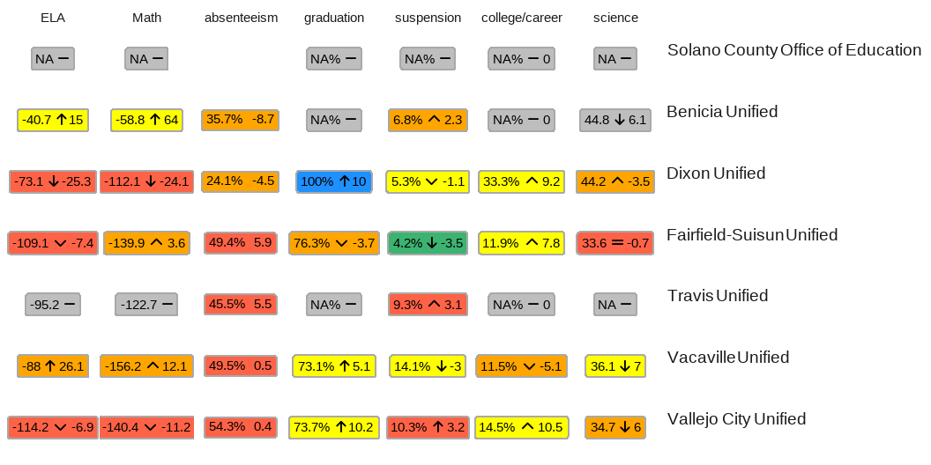
2025 Homeless Youth

