Slide 1
Solano County Dashboard Summary
2023 SCOE Assessment Research and Evaluation

Slide 2
Solano County Districts
 | Performance Colors | Performance Colors | Performance Colors | Performance Colors | Performance Colors
District | Red (lowest performance) | Orange | Yellow | Green | Blue (highest performance)
Benicia Unified | 8 | 19 | 10 | 9 | 3
Dixon Unified | 6 | 11 | 24 | 4 | 0
Fairfield-Suisun Unified | 14 | 29 | 14 | 8 | 1
Solano County Office of Education | 2 | 0 | 0 | 0 | 6
Travis Unified | 4 | 16 | 18 | 5 | 8
Vacaville Unified | 10 | 27 | 18 | 5 | 2
Vallejo City Unified | 10 | 23 | 27 | 2 | 0
This table shows the number of student groups in each district assigned each dashboard performance color for all indicators except College/Career. College/Career did not get a color for the 2023 dashboard so performance on that indicator is not included in this table. Student groups with too few students to be assigned a color are also not included in this table

Slide 3
Solano County Charter Schools
This table mirrors the district table, but for charter schools. College/career is excluded as are student groups at schools with too few students to be given a color.
 | Performance Colors | Performance Colors | Performance Colors | Performance Colors | Performance Colors
Charter School | Red (lowest performance) | Orange | Yellow | Green | Blue (highest performance)
Buckingham Collegiate Charter Academy | 1 | 6 | 2 | 2 | 4
Caliber: ChangeMakers Academy | 5 | 16 | 5 | 2 | 3
Dixon Montessori Charter | 0 | 1 | 7 | 12 | 2
Elite Public | 11 | 12 | 2 | 0 | 0
Ernest Kimme Charter Academy | 5 | 12 | 0 | 3 | 0
Fairmont Charter Elementary | 8 | 14 | 7 | 0 | 0
Griffin Academy High | 3 | 1 | 0 | 0 | 0
Kairos Public | 1 | 5 | 6 | 9 | 3
MIT Academy | 6 | 8 | 2 | 1 | 0
MIT Griffin Academy Middle | 9 | 3 | 0 | 0 | 0
Mare Island Technology Academy | 19 | 3 | 1 | 0 | 0
Vallejo Charter | 12 | 12 | 2 | 1 | 0

Slide 4
Solano County Student Groups
 | Performance Colors | Performance Colors | Performance Colors | Performance Colors | Performance Colors
Student Group | Red (lowest performance) | Orange | Yellow | Green | Blue (highest performance)
All students | 15 | 32 | 18 | 8 | 5
American Indian or Alaska Native | 1 | 2 | 0 | 0 | 0
Asian | 1 | 3 | 7 | 10 | 0
Black/African American | 17 | 22 | 7 | 1 | 2
English Learner | 24 | 15 | 15 | 6 | 1
Filipino | 0 | 9 | 14 | 9 | 5
Foster Youth | 7 | 4 | 0 | 0 | 1
Hispanic | 13 | 35 | 15 | 7 | 3
Homeless Youth | 7 | 9 | 5 | 1 | 0
Multiple Races/Two or more | 3 | 14 | 12 | 5 | 6
Pacific Islander | 1 | 8 | 4 | 0 | 0
Socioeconomically Disadvantaged | 19 | 31 | 19 | 3 | 3
Students with Disabilities | 21 | 18 | 12 | 1 | 2
White | 5 | 16 | 17 | 12 | 4
This table shows the number of indicators assigned each performance level color by student groups in LEAs across the county. Student groups in LEAs too small to be assigned a color were excluded as was the college/career indicator.

Slide 5
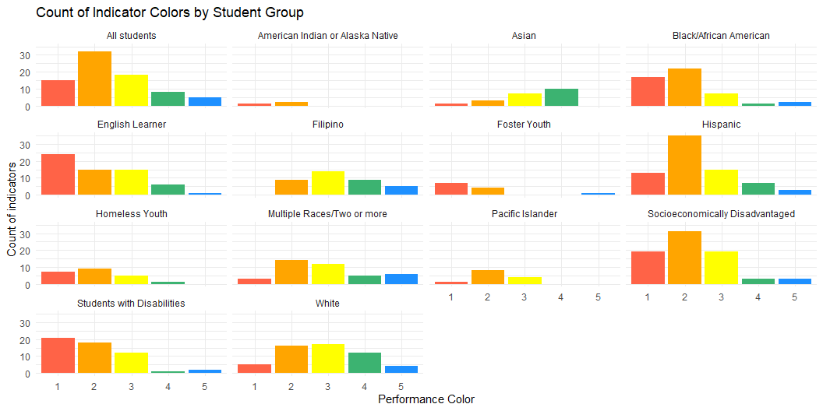
Solano County Student Groups

Slide 6
Academic Performance by District
This table shows the number of each performance color assigned to student groups for the three academic indicators: ELA, Math, and ELPI (English Learners only).
 | Performance Colors | Performance Colors | Performance Colors | Performance Colors | Performance Colors
District | Red (lowest performance) | Orange | Yellow | Green | Blue (highest performance)
Benicia Unified | 0 | 9 | 7 | 5 | 0
Dixon Unified | 4 | 5 | 10 | 0 | 0
Fairfield-Suisun Unified | 7 | 13 | 1 | 6 | 0
Travis Unified | 2 | 10 | 4 | 5 | 0
Vacaville Unified | 5 | 12 | 5 | 3 | 0
Vallejo City Unified | 2 | 14 | 10 | 1 | 0

Slide 7
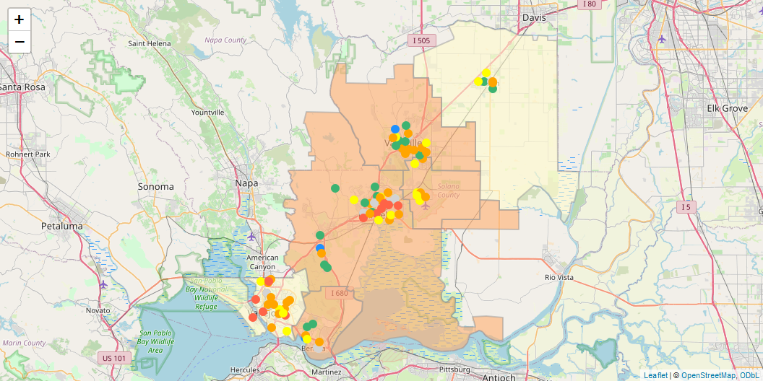
County Wide ELA Performance (All students)

Slide 8
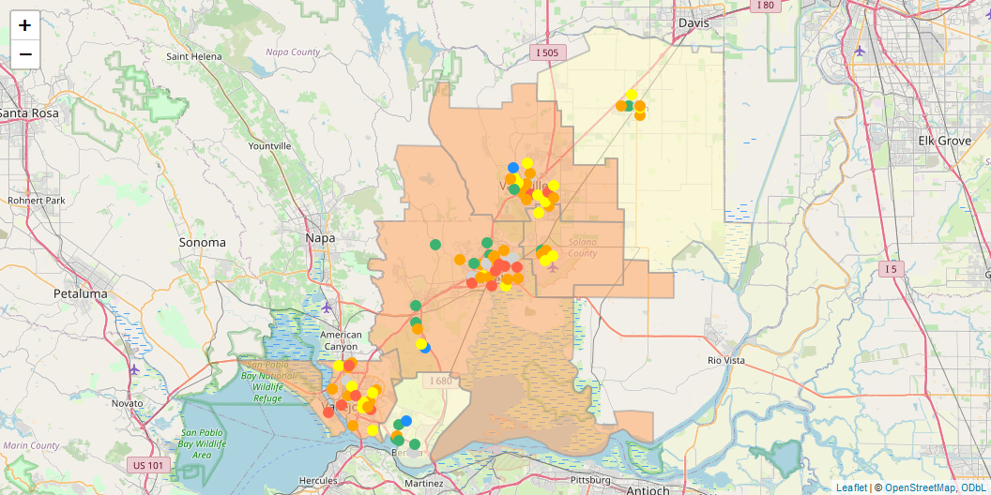
County Wide Math Performance (All students)

Slide 9
Academic Performance by Student Group
This table shows the number of each performance color assigned to student groups for the three academic indicators: ELA, Math, and ELPI (English Learners only).
 | Performance Colors | Performance Colors | Performance Colors | Performance Colors | Performance Colors
Student Group | Red (lowest performance) | Orange | Yellow | Green | Blue (highest performance)
All students | 2 | 22 | 6 | 4 | 0
Asian | 0 | 0 | 3 | 7 | 0
Black/African American | 5 | 13 | 0 | 0 | 0
English Learner | 17 | 7 | 6 | 4 | 0
Filipino | 0 | 2 | 5 | 7 | 0
Foster Youth | 2 | 2 | 0 | 0 | 0
Hispanic | 5 | 20 | 6 | 1 | 0
Homeless Youth | 2 | 5 | 1 | 0 | 0
Multiple Races/Two or more | 0 | 5 | 6 | 3 | 0
Pacific Islander | 0 | 4 | 2 | 0 | 0
Socioeconomically Disadvantaged | 5 | 20 | 7 | 0 | 0
Students with Disabilities | 10 | 7 | 3 | 0 | 0
White | 0 | 5 | 10 | 6 | 1

Slide 10
Dashboard Performance for Students Experiencing Homelessness
This table shows the number of each performance color assigned to youth experiencing homelessness in Solano County districts.
 | Performance Colors | Performance Colors | Performance Colors | Performance Colors | Performance Colors
District | Red (lowest performance) | Orange | Yellow | Green | Blue (highest performance)
Benicia Unified | 1 | 0 | 0 | 0 | 0
Dixon Unified | 2 | 1 | 1 | 1 | 0
Fairfield-Suisun Unified | 1 | 3 | 1 | 0 | 0
Travis Unified | 1 | 0 | 0 | 0 | 0
Vacaville Unified | 1 | 3 | 1 | 0 | 0
Vallejo City Unified | 1 | 2 | 2 | 0 | 0

Slide 11
Dashboard Performance for Students Experiencing Homelessness
This table shows the number of each performance color assigned to youth experiencing homelessness for each indicator.
 | Performance Colors | Performance Colors | Performance Colors | Performance Colors | Performance Colors
Indicator | Red (lowest performance) | Orange | Yellow | Green | Blue (highest performance)
ELA | 0 | 3 | 1 | 0 | 0
Math | 2 | 2 | 0 | 0 | 0
absenteeism | 0 | 3 | 1 | 0 | 0
graduation | 1 | 1 | 1 | 1 | 0
suspension | 4 | 0 | 2 | 0 | 0

Slide 12
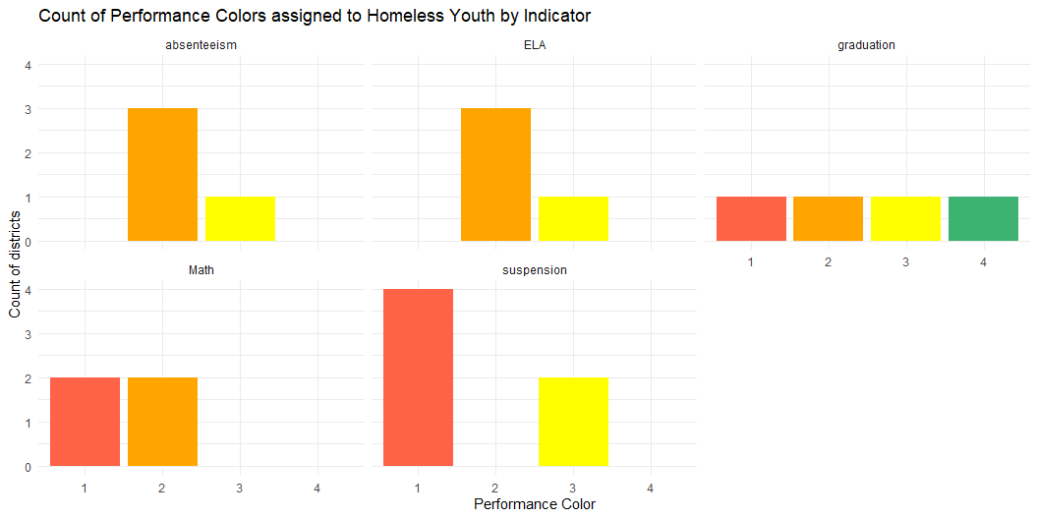
Dashboard Performance for Students Experiencing Homelessness

