Slide 1
Dashboard Trends for Vacaville Unified
SCOE Assessment Research and Evaluation Team

Slide 2
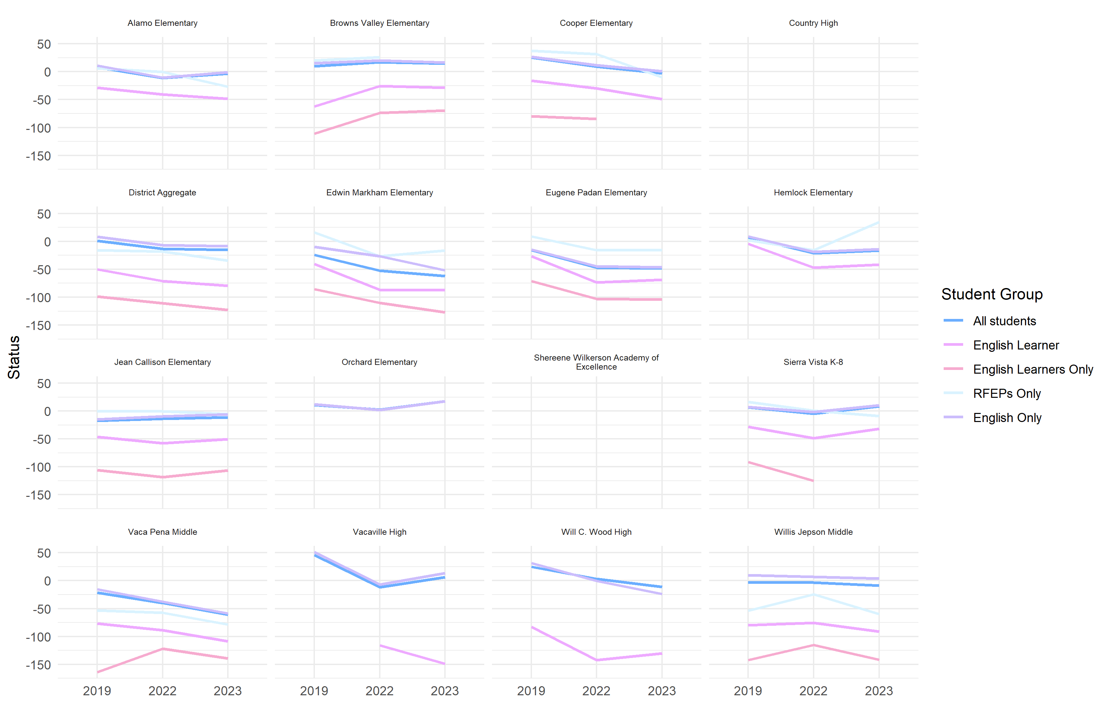
ELA (DFS) status in Vacaville Unified over time

Slide 3
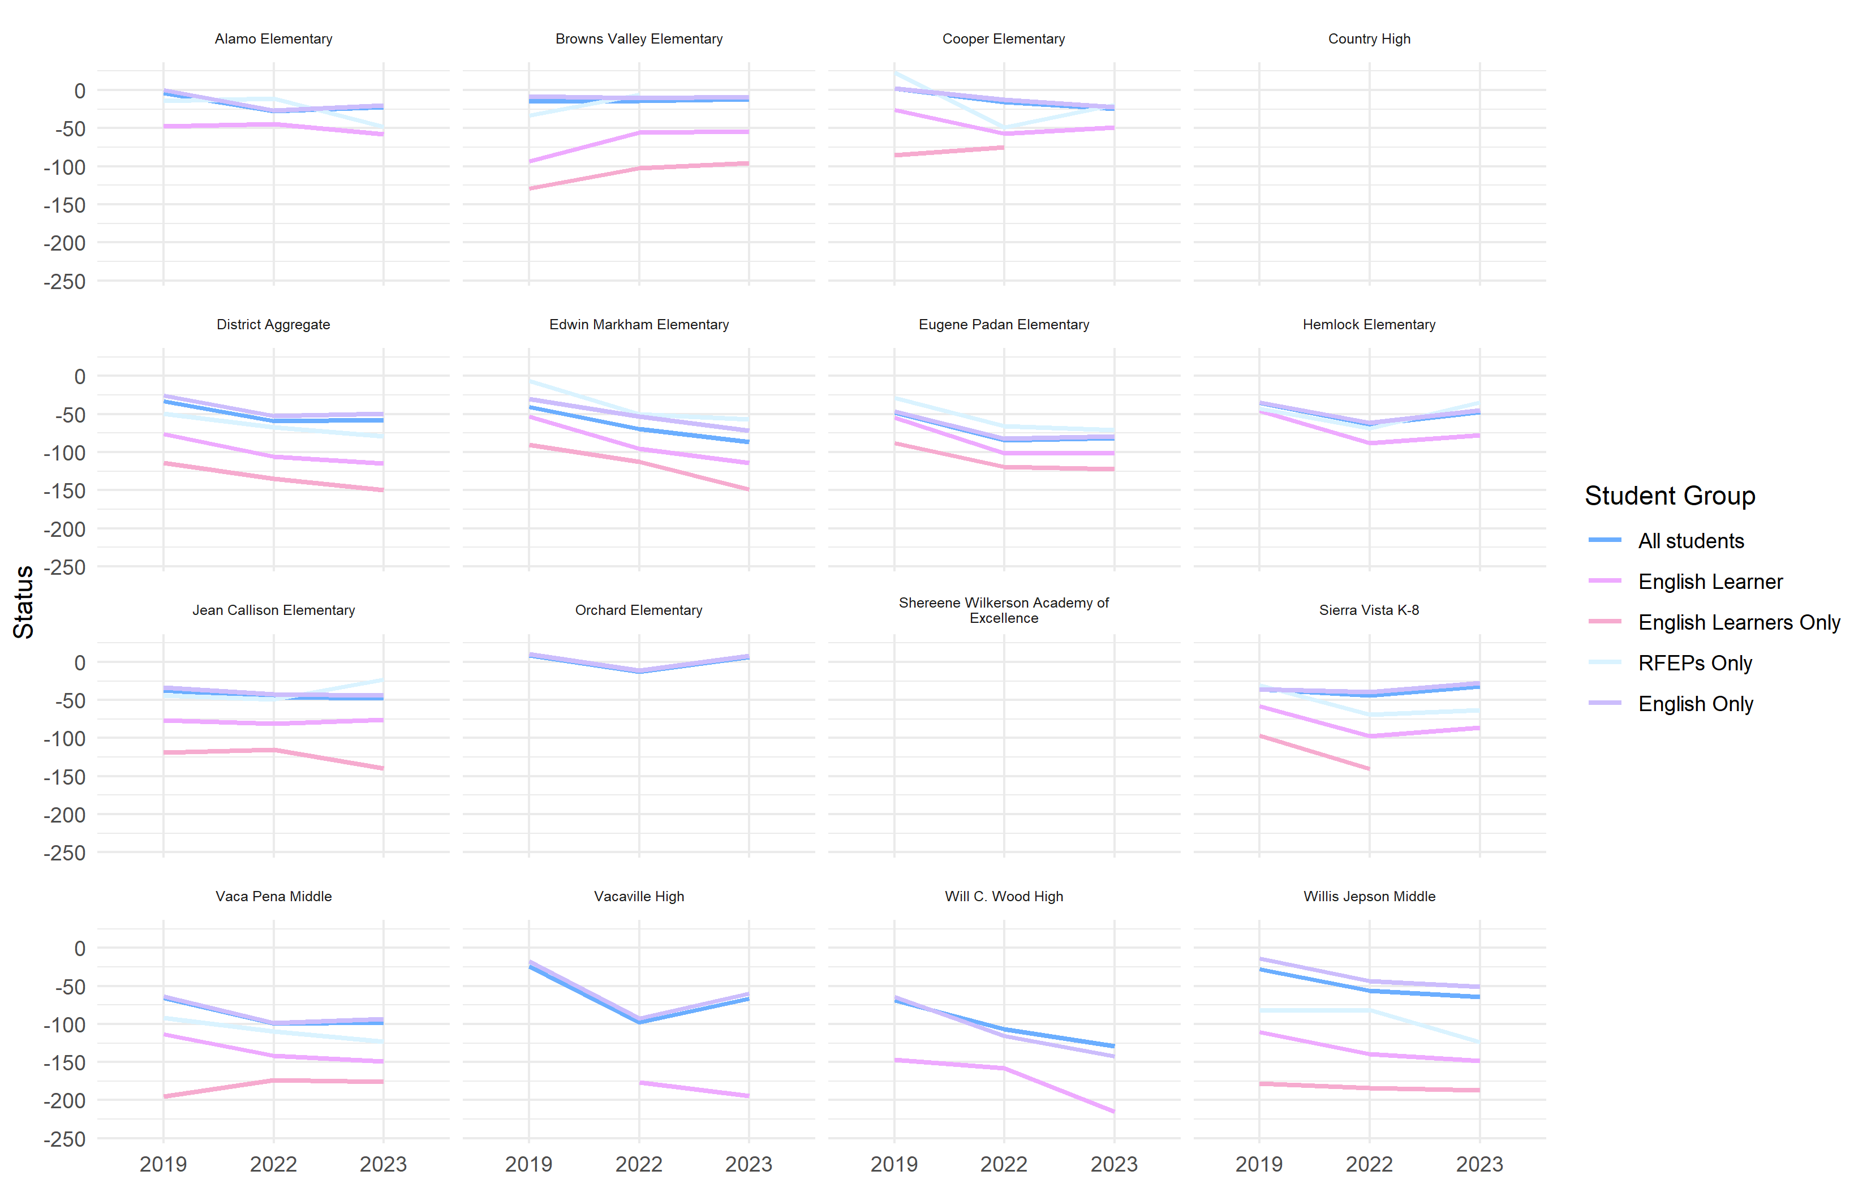
Math (DFS) status in Vacaville Unified over time

Slide 4
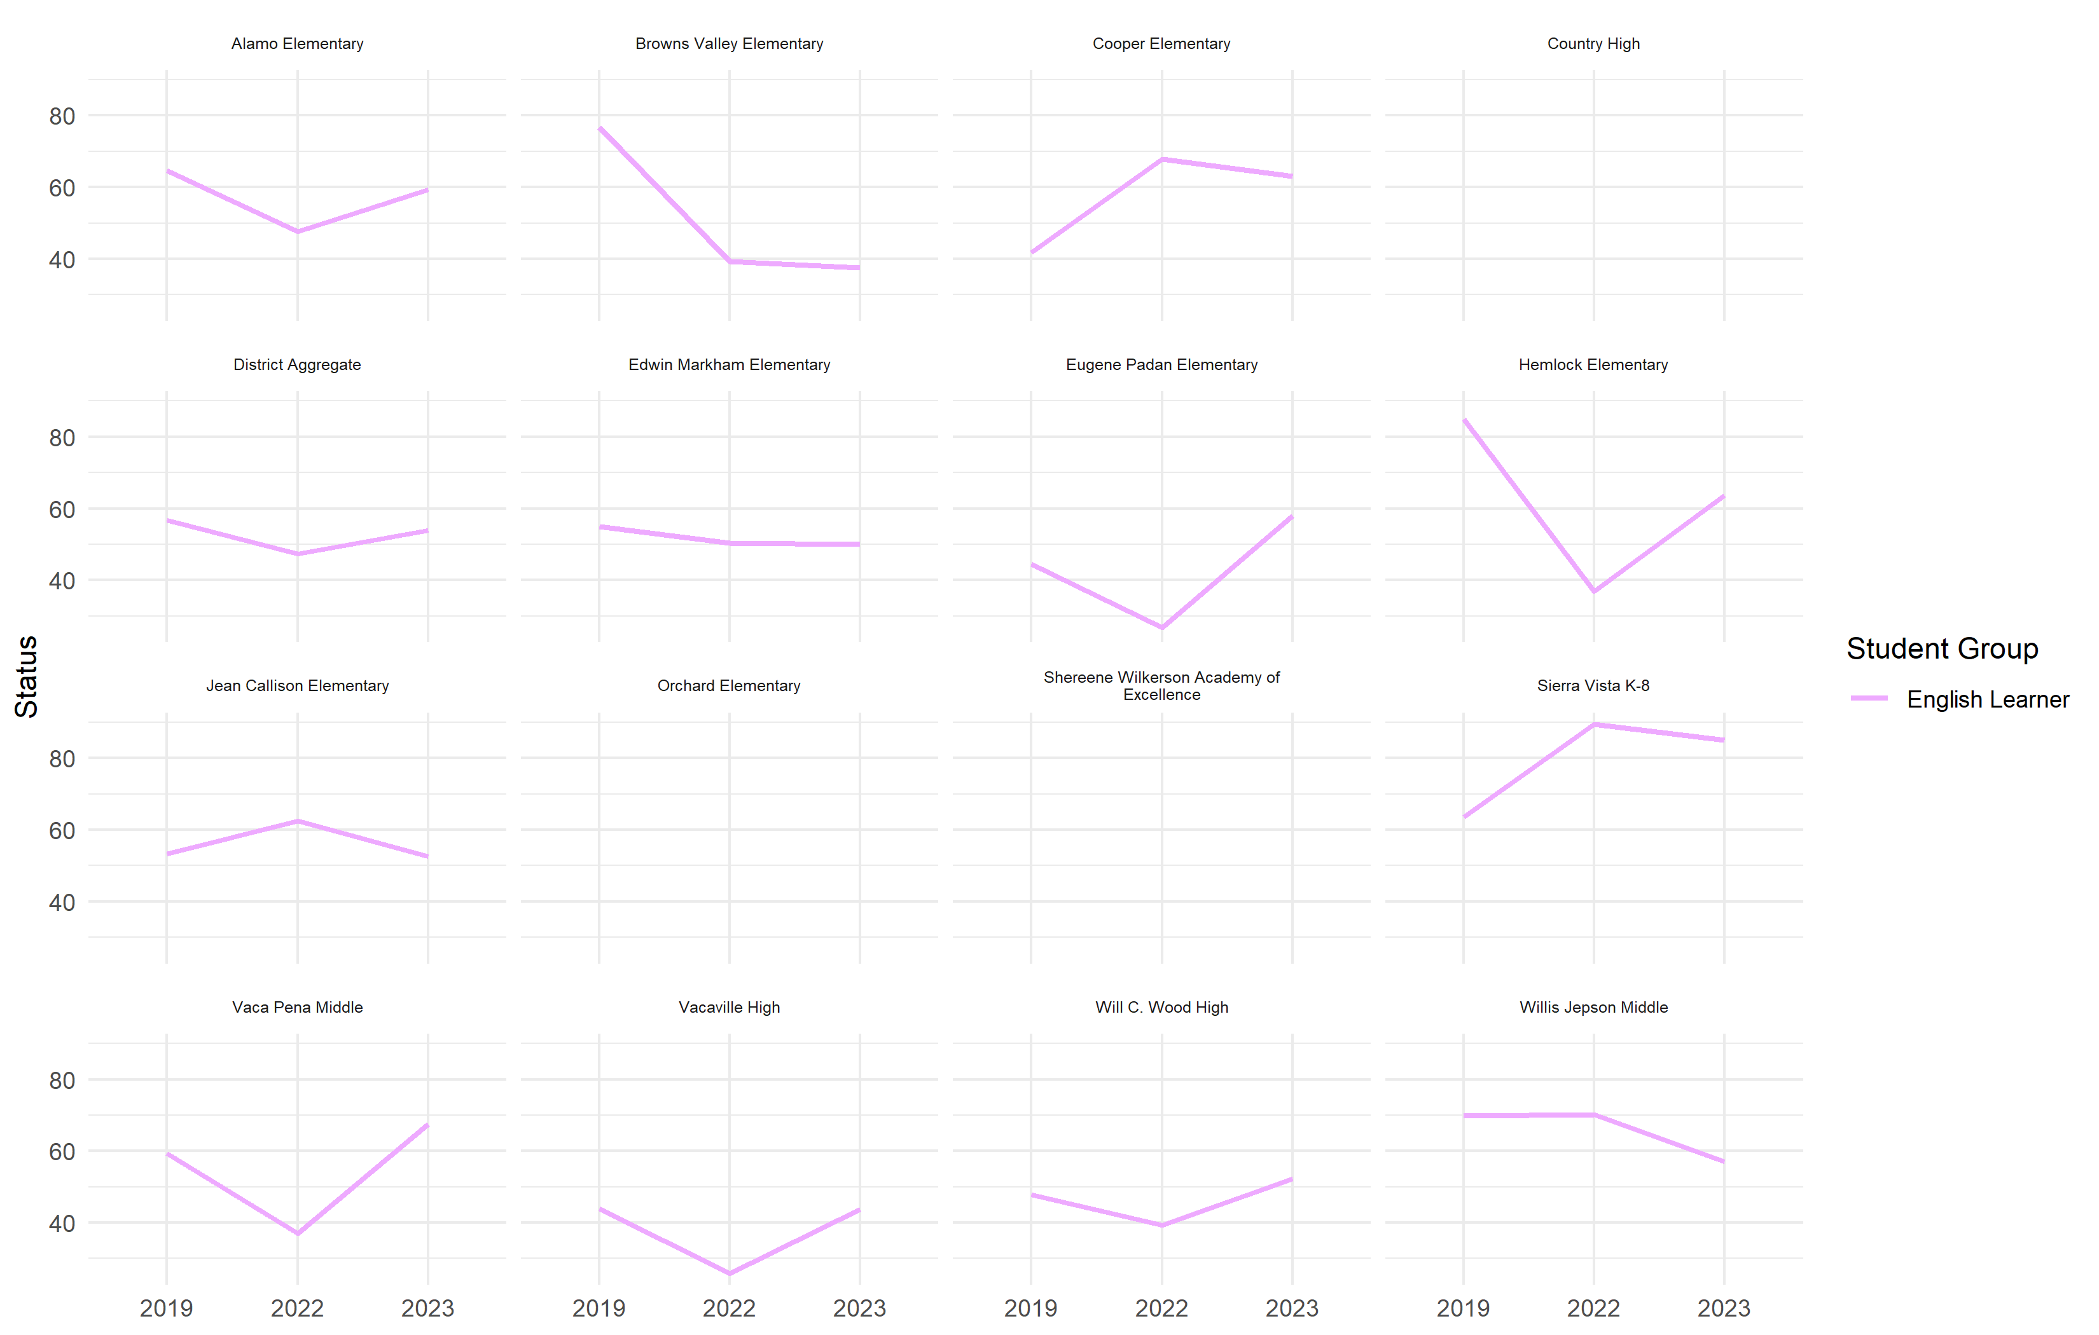
ELPI status in Vacaville Unified over time

Slide 5
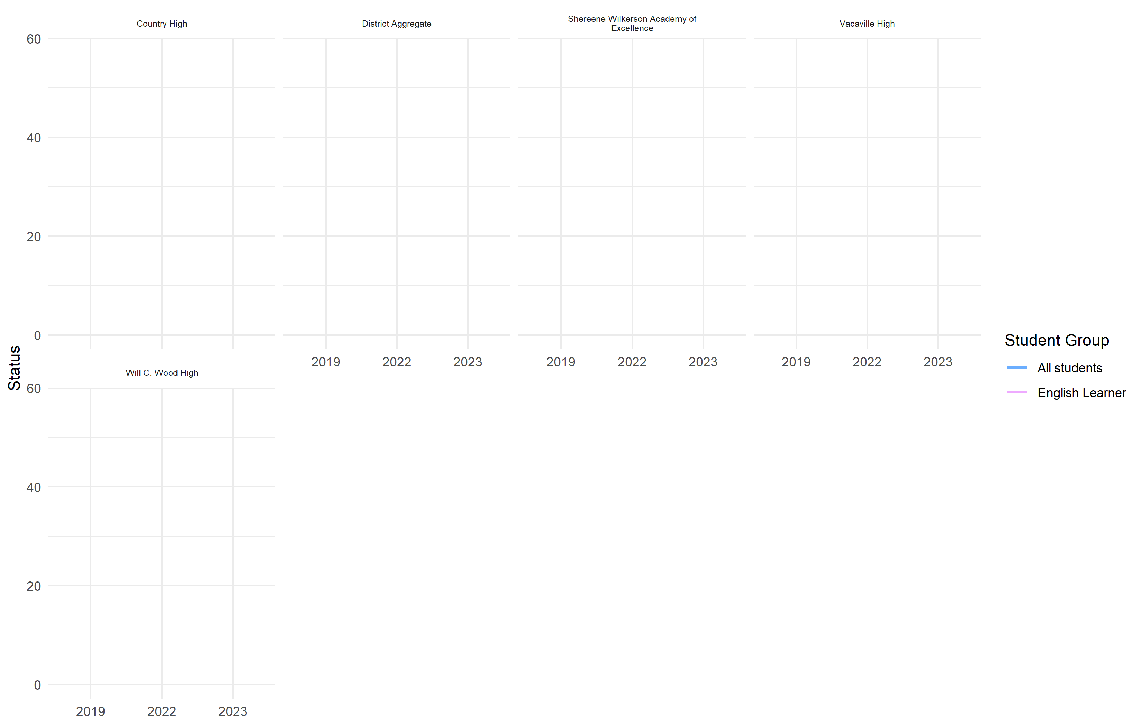
College/Career status in Vacaville Unified over time

Slide 6
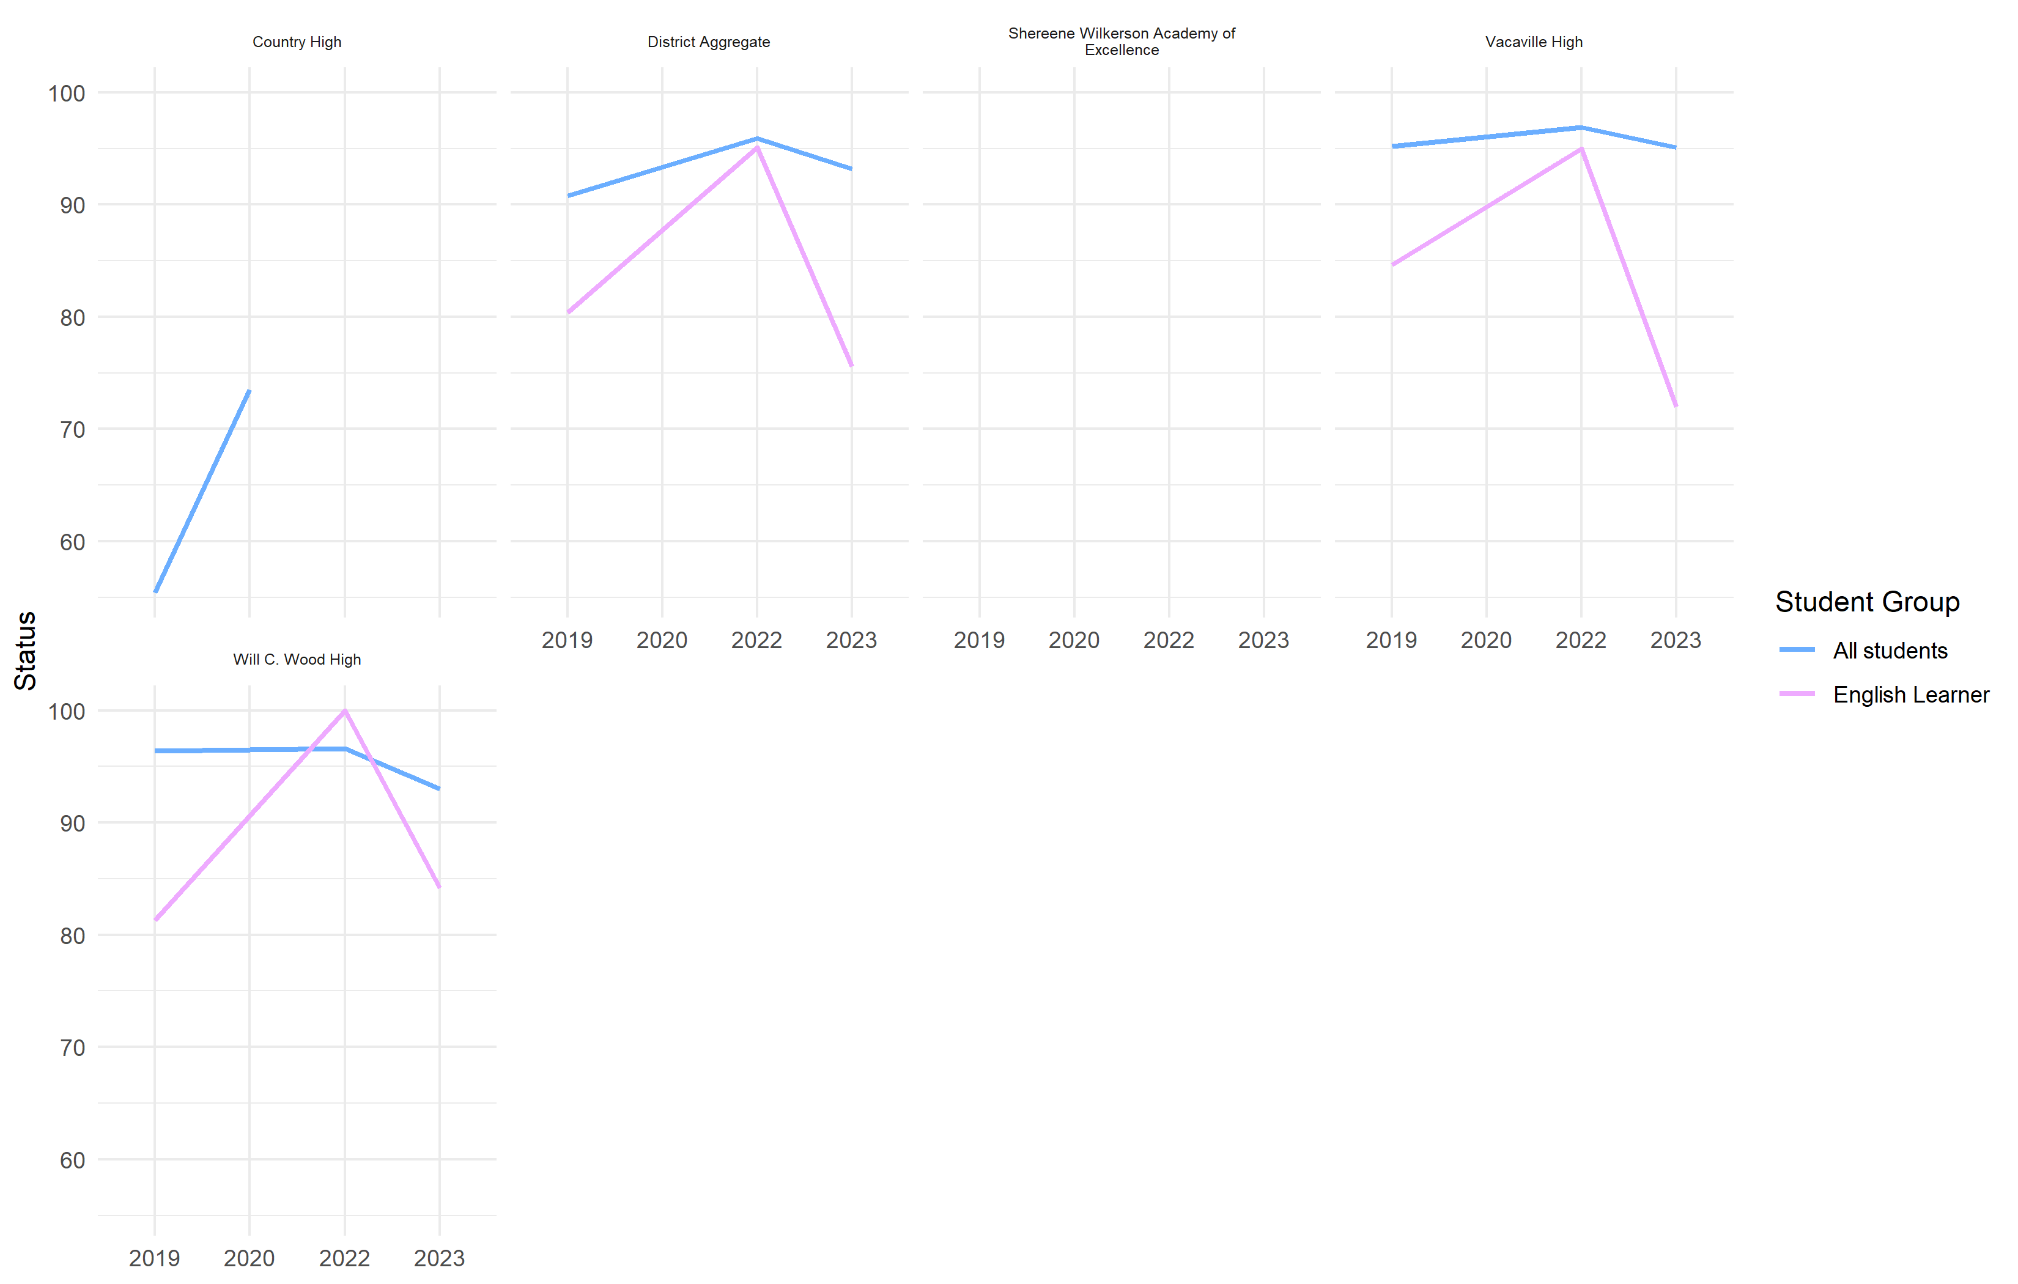
Graduation status in Vacaville Unified over time

Slide 7
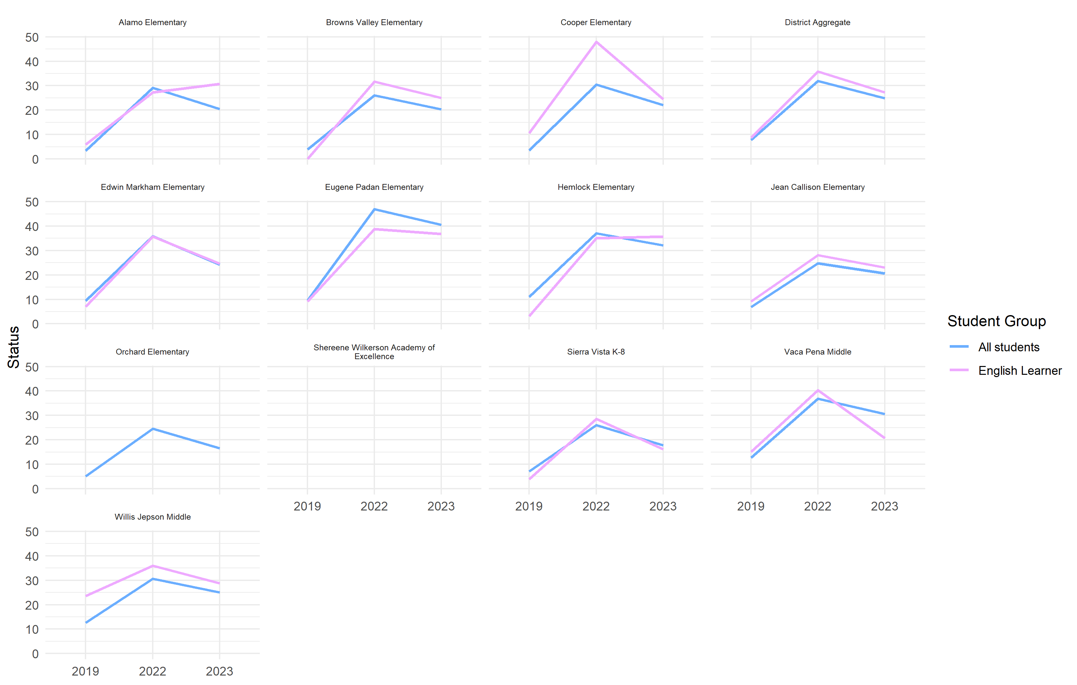
Absenteeism status in Vacaville Unified over time

Slide 8
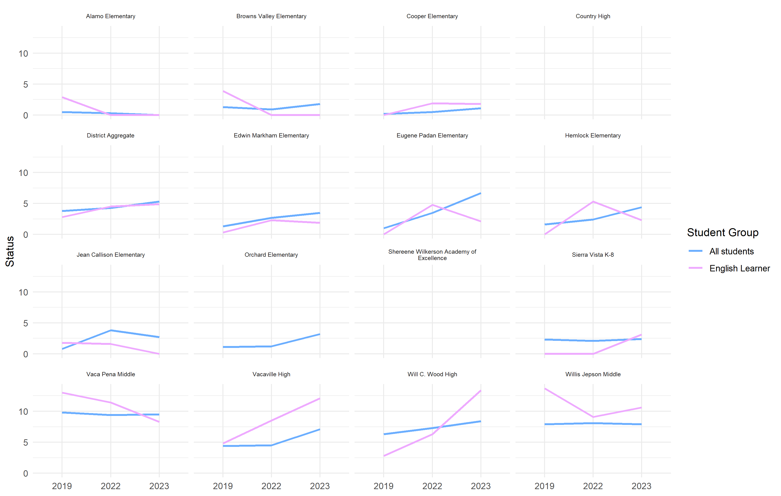
Suspension status in Vacaville Unified over time

Slide 9
## Suspension status in Vacaville Unified over time
## Suspension status in Vacaville Unified over time
## Suspension status in Vacaville Unified over time
## Suspension status in Vacaville Unified over time
## Suspension status in Vacaville Unified over time
## Suspension status in Vacaville Unified over time
## Suspension status in Vacaville Unified over time
Year | School | Student Group | Indicator | Status | Color
2023 | District Aggregate | All students | suspension | 5.3 | 2
2023 | District Aggregate | English Learner | suspension | 4.9 | 2
2023 | Sierra Vista K-8 | All students | suspension | 2.4 | 2
2023 | Sierra Vista K-8 | English Learner | suspension | 3.1 | 0
2023 | Shereene Wilkerson Academy of Excellence | All students | suspension | 13.6 | 0
2023 | Shereene Wilkerson Academy of Excellence | English Learner | suspension |  | 0
2023 | Will C. Wood High | All students | suspension | 8.4 | 2
2023 | Will C. Wood High | English Learner | suspension | 13.4 | 1
2023 | Vacaville High | All students | suspension | 7.1 | 2
2023 | Vacaville High | English Learner | suspension | 12.1 | 1
2023 | Alamo Elementary | All students | suspension | 0.0 | 5
2023 | Alamo Elementary | English Learner | suspension | 0.0 | 5
2023 | Edwin Markham Elementary | All students | suspension | 3.5 | 2
2023 | Edwin Markham Elementary | English Learner | suspension | 1.9 | 4
2023 | Eugene Padan Elementary | All students | suspension | 6.7 | 1
2023 | Eugene Padan Elementary | English Learner | suspension | 2.1 | 4
2023 | Hemlock Elementary | All students | suspension | 4.4 | 2
2023 | Hemlock Elementary | English Learner | suspension | 2.3 | 4
2023 | Willis Jepson Middle | All students | suspension | 7.9 | 3
2023 | Willis Jepson Middle | English Learner | suspension | 10.6 | 2
2023 | Orchard Elementary | All students | suspension | 3.2 | 2
2023 | Orchard Elementary | English Learner | suspension | 6.7 | 0
2023 | Vaca Pena Middle | All students | suspension | 9.5 | 2
2023 | Vaca Pena Middle | English Learner | suspension | 8.3 | 3
2023 | Jean Callison Elementary | All students | suspension | 2.7 | 4
2023 | Jean Callison Elementary | English Learner | suspension | 0.0 | 5
2023 | Browns Valley Elementary | All students | suspension | 1.8 | 2
2023 | Browns Valley Elementary | English Learner | suspension | 0.0 | 5
2023 | Cooper Elementary | All students | suspension | 1.1 | 2
2023 | Cooper Elementary | English Learner | suspension | 1.8 | 3
2022 | District Aggregate | All students | suspension | 4.3
2022 | District Aggregate | English Learner | suspension | 4.5
2022 | Sierra Vista K-8 | All students | suspension | 2.1
2022 | Sierra Vista K-8 | English Learner | suspension | 0.0
2022 | Will C. Wood High | All students | suspension | 7.3
2022 | Will C. Wood High | English Learner | suspension | 6.3
2022 | Vacaville High | All students | suspension | 4.5
2022 | Vacaville High | English Learner | suspension | 8.5
2022 | Alamo Elementary | All students | suspension | 0.3
2022 | Alamo Elementary | English Learner | suspension | 0.0
2022 | Edwin Markham Elementary | All students | suspension | 2.7
2022 | Edwin Markham Elementary | English Learner | suspension | 2.3
2022 | Eugene Padan Elementary | All students | suspension | 3.5
2022 | Eugene Padan Elementary | English Learner | suspension | 4.8
2022 | Hemlock Elementary | All students | suspension | 2.4
2022 | Hemlock Elementary | English Learner | suspension | 5.3
2022 | Willis Jepson Middle | All students | suspension | 8.1
2022 | Willis Jepson Middle | English Learner | suspension | 9.1
2022 | Orchard Elementary | All students | suspension | 1.2
2022 | Orchard Elementary | English Learner | suspension
2022 | Vaca Pena Middle | All students | suspension | 9.4
2022 | Vaca Pena Middle | English Learner | suspension | 11.4
2022 | Jean Callison Elementary | All students | suspension | 3.8
2022 | Jean Callison Elementary | English Learner | suspension | 1.6
2022 | Browns Valley Elementary | All students | suspension | 0.9
2022 | Browns Valley Elementary | English Learner | suspension | 0.0
2022 | Cooper Elementary | All students | suspension | 0.5
2022 | Cooper Elementary | English Learner | suspension | 1.9
2019 | Sierra Vista K-8 | All students | suspension | 2.3 | 4
2019 | Sierra Vista K-8 | English Learner | suspension | 0.0 | 0
2019 | Will C. Wood High | All students | suspension | 6.3 | 3
2019 | Will C. Wood High | English Learner | suspension | 2.8 | 4
2019 | Country High | All students | suspension | 12.8 | 3
2019 | Country High | English Learner | suspension | 5.9 | 0
2019 | Vacaville High | All students | suspension | 4.4 | 4
2019 | Vacaville High | English Learner | suspension | 4.8 | 4
2019 | Alamo Elementary | All students | suspension | 0.5 | 5
2019 | Alamo Elementary | English Learner | suspension | 2.9 | 2
2019 | Edwin Markham Elementary | All students | suspension | 1.3 | 2
2019 | Edwin Markham Elementary | English Learner | suspension | 0.3 | 4
2019 | Eugene Padan Elementary | All students | suspension | 1.0 | 5
2019 | Eugene Padan Elementary | English Learner | suspension | 0.0 | 5
2019 | Hemlock Elementary | All students | suspension | 1.6 | 4
2019 | Hemlock Elementary | English Learner | suspension | 0.0 | 5
2019 | Willis Jepson Middle | All students | suspension | 7.9 | 2
2019 | Willis Jepson Middle | English Learner | suspension | 13.7 | 1
2019 | Orchard Elementary | All students | suspension | 1.1 | 2
2019 | Orchard Elementary | English Learner | suspension |  | 0
2019 | Vaca Pena Middle | All students | suspension | 9.8 | 2
2019 | Vaca Pena Middle | English Learner | suspension | 13.0 | 1
2019 | Jean Callison Elementary | All students | suspension | 0.8 | 5
2019 | Jean Callison Elementary | English Learner | suspension | 1.8 | 2
2019 | Browns Valley Elementary | All students | suspension | 1.3 | 2
2019 | Browns Valley Elementary | English Learner | suspension | 3.9 | 2
2019 | Cooper Elementary | All students | suspension | 0.2 | 5
2019 | Cooper Elementary | English Learner | suspension | 0.0 | 5
2019 | District Aggregate | All students | suspension | 3.8 | 3
2019 | District Aggregate | English Learner | suspension | 2.8 | 2
Year | School | Student Group | Indicator | Status | Color
2023 | District Aggregate | All students | suspension | 5.3 | 2
2023 | District Aggregate | English Learner | suspension | 4.9 | 2
2023 | Sierra Vista K-8 | All students | suspension | 2.4 | 2
2023 | Sierra Vista K-8 | English Learner | suspension | 3.1 | 0
2023 | Shereene Wilkerson Academy of Excellence | All students | suspension | 13.6 | 0
2023 | Shereene Wilkerson Academy of Excellence | English Learner | suspension |  | 0
2023 | Will C. Wood High | All students | suspension | 8.4 | 2
2023 | Will C. Wood High | English Learner | suspension | 13.4 | 1
2023 | Vacaville High | All students | suspension | 7.1 | 2
2023 | Vacaville High | English Learner | suspension | 12.1 | 1
2023 | Alamo Elementary | All students | suspension | 0.0 | 5
2023 | Alamo Elementary | English Learner | suspension | 0.0 | 5
2023 | Edwin Markham Elementary | All students | suspension | 3.5 | 2
2023 | Edwin Markham Elementary | English Learner | suspension | 1.9 | 4
2023 | Eugene Padan Elementary | All students | suspension | 6.7 | 1
2023 | Eugene Padan Elementary | English Learner | suspension | 2.1 | 4
2023 | Hemlock Elementary | All students | suspension | 4.4 | 2
2023 | Hemlock Elementary | English Learner | suspension | 2.3 | 4
2023 | Willis Jepson Middle | All students | suspension | 7.9 | 3
2023 | Willis Jepson Middle | English Learner | suspension | 10.6 | 2
2023 | Orchard Elementary | All students | suspension | 3.2 | 2
2023 | Orchard Elementary | English Learner | suspension | 6.7 | 0
2023 | Vaca Pena Middle | All students | suspension | 9.5 | 2
2023 | Vaca Pena Middle | English Learner | suspension | 8.3 | 3
2023 | Jean Callison Elementary | All students | suspension | 2.7 | 4
2023 | Jean Callison Elementary | English Learner | suspension | 0.0 | 5
2023 | Browns Valley Elementary | All students | suspension | 1.8 | 2
2023 | Browns Valley Elementary | English Learner | suspension | 0.0 | 5
2023 | Cooper Elementary | All students | suspension | 1.1 | 2
2023 | Cooper Elementary | English Learner | suspension | 1.8 | 3
2022 | District Aggregate | All students | suspension | 4.3
2022 | District Aggregate | English Learner | suspension | 4.5
2022 | Sierra Vista K-8 | All students | suspension | 2.1
2022 | Sierra Vista K-8 | English Learner | suspension | 0.0
2022 | Will C. Wood High | All students | suspension | 7.3
2022 | Will C. Wood High | English Learner | suspension | 6.3
2022 | Vacaville High | All students | suspension | 4.5
2022 | Vacaville High | English Learner | suspension | 8.5
2022 | Alamo Elementary | All students | suspension | 0.3
2022 | Alamo Elementary | English Learner | suspension | 0.0
2022 | Edwin Markham Elementary | All students | suspension | 2.7
2022 | Edwin Markham Elementary | English Learner | suspension | 2.3
2022 | Eugene Padan Elementary | All students | suspension | 3.5
2022 | Eugene Padan Elementary | English Learner | suspension | 4.8
2022 | Hemlock Elementary | All students | suspension | 2.4
2022 | Hemlock Elementary | English Learner | suspension | 5.3
2022 | Willis Jepson Middle | All students | suspension | 8.1
2022 | Willis Jepson Middle | English Learner | suspension | 9.1
2022 | Orchard Elementary | All students | suspension | 1.2
2022 | Orchard Elementary | English Learner | suspension
2022 | Vaca Pena Middle | All students | suspension | 9.4
2022 | Vaca Pena Middle | English Learner | suspension | 11.4
2022 | Jean Callison Elementary | All students | suspension | 3.8
2022 | Jean Callison Elementary | English Learner | suspension | 1.6
2022 | Browns Valley Elementary | All students | suspension | 0.9
2022 | Browns Valley Elementary | English Learner | suspension | 0.0
2022 | Cooper Elementary | All students | suspension | 0.5
2022 | Cooper Elementary | English Learner | suspension | 1.9
2019 | Sierra Vista K-8 | All students | suspension | 2.3 | 4
2019 | Sierra Vista K-8 | English Learner | suspension | 0.0 | 0
2019 | Will C. Wood High | All students | suspension | 6.3 | 3
2019 | Will C. Wood High | English Learner | suspension | 2.8 | 4
2019 | Country High | All students | suspension | 12.8 | 3
2019 | Country High | English Learner | suspension | 5.9 | 0
2019 | Vacaville High | All students | suspension | 4.4 | 4
2019 | Vacaville High | English Learner | suspension | 4.8 | 4
2019 | Alamo Elementary | All students | suspension | 0.5 | 5
2019 | Alamo Elementary | English Learner | suspension | 2.9 | 2
2019 | Edwin Markham Elementary | All students | suspension | 1.3 | 2
2019 | Edwin Markham Elementary | English Learner | suspension | 0.3 | 4
2019 | Eugene Padan Elementary | All students | suspension | 1.0 | 5
2019 | Eugene Padan Elementary | English Learner | suspension | 0.0 | 5
2019 | Hemlock Elementary | All students | suspension | 1.6 | 4
2019 | Hemlock Elementary | English Learner | suspension | 0.0 | 5
2019 | Willis Jepson Middle | All students | suspension | 7.9 | 2
2019 | Willis Jepson Middle | English Learner | suspension | 13.7 | 1
2019 | Orchard Elementary | All students | suspension | 1.1 | 2
2019 | Orchard Elementary | English Learner | suspension |  | 0
2019 | Vaca Pena Middle | All students | suspension | 9.8 | 2
2019 | Vaca Pena Middle | English Learner | suspension | 13.0 | 1
2019 | Jean Callison Elementary | All students | suspension | 0.8 | 5
2019 | Jean Callison Elementary | English Learner | suspension | 1.8 | 2
2019 | Browns Valley Elementary | All students | suspension | 1.3 | 2
2019 | Browns Valley Elementary | English Learner | suspension | 3.9 | 2
2019 | Cooper Elementary | All students | suspension | 0.2 | 5
2019 | Cooper Elementary | English Learner | suspension | 0.0 | 5
2019 | District Aggregate | All students | suspension | 3.8 | 3
2019 | District Aggregate | English Learner | suspension | 2.8 | 2
Year | School | Student Group | Indicator | Status | Color
2023 | District Aggregate | All students | suspension | 5.3 | 2
2023 | District Aggregate | English Learner | suspension | 4.9 | 2
2023 | Sierra Vista K-8 | All students | suspension | 2.4 | 2
2023 | Sierra Vista K-8 | English Learner | suspension | 3.1 | 0
2023 | Shereene Wilkerson Academy of Excellence | All students | suspension | 13.6 | 0
2023 | Shereene Wilkerson Academy of Excellence | English Learner | suspension |  | 0
2023 | Will C. Wood High | All students | suspension | 8.4 | 2
2023 | Will C. Wood High | English Learner | suspension | 13.4 | 1
2023 | Vacaville High | All students | suspension | 7.1 | 2
2023 | Vacaville High | English Learner | suspension | 12.1 | 1
2023 | Alamo Elementary | All students | suspension | 0.0 | 5
2023 | Alamo Elementary | English Learner | suspension | 0.0 | 5
2023 | Edwin Markham Elementary | All students | suspension | 3.5 | 2
2023 | Edwin Markham Elementary | English Learner | suspension | 1.9 | 4
2023 | Eugene Padan Elementary | All students | suspension | 6.7 | 1
2023 | Eugene Padan Elementary | English Learner | suspension | 2.1 | 4
2023 | Hemlock Elementary | All students | suspension | 4.4 | 2
2023 | Hemlock Elementary | English Learner | suspension | 2.3 | 4
2023 | Willis Jepson Middle | All students | suspension | 7.9 | 3
2023 | Willis Jepson Middle | English Learner | suspension | 10.6 | 2
2023 | Orchard Elementary | All students | suspension | 3.2 | 2
2023 | Orchard Elementary | English Learner | suspension | 6.7 | 0
2023 | Vaca Pena Middle | All students | suspension | 9.5 | 2
2023 | Vaca Pena Middle | English Learner | suspension | 8.3 | 3
2023 | Jean Callison Elementary | All students | suspension | 2.7 | 4
2023 | Jean Callison Elementary | English Learner | suspension | 0.0 | 5
2023 | Browns Valley Elementary | All students | suspension | 1.8 | 2
2023 | Browns Valley Elementary | English Learner | suspension | 0.0 | 5
2023 | Cooper Elementary | All students | suspension | 1.1 | 2
2023 | Cooper Elementary | English Learner | suspension | 1.8 | 3
2022 | District Aggregate | All students | suspension | 4.3
2022 | District Aggregate | English Learner | suspension | 4.5
2022 | Sierra Vista K-8 | All students | suspension | 2.1
2022 | Sierra Vista K-8 | English Learner | suspension | 0.0
2022 | Will C. Wood High | All students | suspension | 7.3
2022 | Will C. Wood High | English Learner | suspension | 6.3
2022 | Vacaville High | All students | suspension | 4.5
2022 | Vacaville High | English Learner | suspension | 8.5
2022 | Alamo Elementary | All students | suspension | 0.3
2022 | Alamo Elementary | English Learner | suspension | 0.0
2022 | Edwin Markham Elementary | All students | suspension | 2.7
2022 | Edwin Markham Elementary | English Learner | suspension | 2.3
2022 | Eugene Padan Elementary | All students | suspension | 3.5
2022 | Eugene Padan Elementary | English Learner | suspension | 4.8
2022 | Hemlock Elementary | All students | suspension | 2.4
2022 | Hemlock Elementary | English Learner | suspension | 5.3
2022 | Willis Jepson Middle | All students | suspension | 8.1
2022 | Willis Jepson Middle | English Learner | suspension | 9.1
2022 | Orchard Elementary | All students | suspension | 1.2
2022 | Orchard Elementary | English Learner | suspension
2022 | Vaca Pena Middle | All students | suspension | 9.4
2022 | Vaca Pena Middle | English Learner | suspension | 11.4
2022 | Jean Callison Elementary | All students | suspension | 3.8
2022 | Jean Callison Elementary | English Learner | suspension | 1.6
2022 | Browns Valley Elementary | All students | suspension | 0.9
2022 | Browns Valley Elementary | English Learner | suspension | 0.0
2022 | Cooper Elementary | All students | suspension | 0.5
2022 | Cooper Elementary | English Learner | suspension | 1.9
2019 | Sierra Vista K-8 | All students | suspension | 2.3 | 4
2019 | Sierra Vista K-8 | English Learner | suspension | 0.0 | 0
2019 | Will C. Wood High | All students | suspension | 6.3 | 3
2019 | Will C. Wood High | English Learner | suspension | 2.8 | 4
2019 | Country High | All students | suspension | 12.8 | 3
2019 | Country High | English Learner | suspension | 5.9 | 0
2019 | Vacaville High | All students | suspension | 4.4 | 4
2019 | Vacaville High | English Learner | suspension | 4.8 | 4
2019 | Alamo Elementary | All students | suspension | 0.5 | 5
2019 | Alamo Elementary | English Learner | suspension | 2.9 | 2
2019 | Edwin Markham Elementary | All students | suspension | 1.3 | 2
2019 | Edwin Markham Elementary | English Learner | suspension | 0.3 | 4
2019 | Eugene Padan Elementary | All students | suspension | 1.0 | 5
2019 | Eugene Padan Elementary | English Learner | suspension | 0.0 | 5
2019 | Hemlock Elementary | All students | suspension | 1.6 | 4
2019 | Hemlock Elementary | English Learner | suspension | 0.0 | 5
2019 | Willis Jepson Middle | All students | suspension | 7.9 | 2
2019 | Willis Jepson Middle | English Learner | suspension | 13.7 | 1
2019 | Orchard Elementary | All students | suspension | 1.1 | 2
2019 | Orchard Elementary | English Learner | suspension |  | 0
2019 | Vaca Pena Middle | All students | suspension | 9.8 | 2
2019 | Vaca Pena Middle | English Learner | suspension | 13.0 | 1
2019 | Jean Callison Elementary | All students | suspension | 0.8 | 5
2019 | Jean Callison Elementary | English Learner | suspension | 1.8 | 2
2019 | Browns Valley Elementary | All students | suspension | 1.3 | 2
2019 | Browns Valley Elementary | English Learner | suspension | 3.9 | 2
2019 | Cooper Elementary | All students | suspension | 0.2 | 5
2019 | Cooper Elementary | English Learner | suspension | 0.0 | 5
2019 | District Aggregate | All students | suspension | 3.8 | 3
2019 | District Aggregate | English Learner | suspension | 2.8 | 2
Year | School | Student Group | Indicator | Status | Color
2023 | District Aggregate | All students | suspension | 5.3 | 2
2023 | District Aggregate | English Learner | suspension | 4.9 | 2
2023 | Sierra Vista K-8 | All students | suspension | 2.4 | 2
2023 | Sierra Vista K-8 | English Learner | suspension | 3.1 | 0
2023 | Shereene Wilkerson Academy of Excellence | All students | suspension | 13.6 | 0
2023 | Shereene Wilkerson Academy of Excellence | English Learner | suspension |  | 0
2023 | Will C. Wood High | All students | suspension | 8.4 | 2
2023 | Will C. Wood High | English Learner | suspension | 13.4 | 1
2023 | Vacaville High | All students | suspension | 7.1 | 2
2023 | Vacaville High | English Learner | suspension | 12.1 | 1
2023 | Alamo Elementary | All students | suspension | 0.0 | 5
2023 | Alamo Elementary | English Learner | suspension | 0.0 | 5
2023 | Edwin Markham Elementary | All students | suspension | 3.5 | 2
2023 | Edwin Markham Elementary | English Learner | suspension | 1.9 | 4
2023 | Eugene Padan Elementary | All students | suspension | 6.7 | 1
2023 | Eugene Padan Elementary | English Learner | suspension | 2.1 | 4
2023 | Hemlock Elementary | All students | suspension | 4.4 | 2
2023 | Hemlock Elementary | English Learner | suspension | 2.3 | 4
2023 | Willis Jepson Middle | All students | suspension | 7.9 | 3
2023 | Willis Jepson Middle | English Learner | suspension | 10.6 | 2
2023 | Orchard Elementary | All students | suspension | 3.2 | 2
2023 | Orchard Elementary | English Learner | suspension | 6.7 | 0
2023 | Vaca Pena Middle | All students | suspension | 9.5 | 2
2023 | Vaca Pena Middle | English Learner | suspension | 8.3 | 3
2023 | Jean Callison Elementary | All students | suspension | 2.7 | 4
2023 | Jean Callison Elementary | English Learner | suspension | 0.0 | 5
2023 | Browns Valley Elementary | All students | suspension | 1.8 | 2
2023 | Browns Valley Elementary | English Learner | suspension | 0.0 | 5
2023 | Cooper Elementary | All students | suspension | 1.1 | 2
2023 | Cooper Elementary | English Learner | suspension | 1.8 | 3
2022 | District Aggregate | All students | suspension | 4.3
2022 | District Aggregate | English Learner | suspension | 4.5
2022 | Sierra Vista K-8 | All students | suspension | 2.1
2022 | Sierra Vista K-8 | English Learner | suspension | 0.0
2022 | Will C. Wood High | All students | suspension | 7.3
2022 | Will C. Wood High | English Learner | suspension | 6.3
2022 | Vacaville High | All students | suspension | 4.5
2022 | Vacaville High | English Learner | suspension | 8.5
2022 | Alamo Elementary | All students | suspension | 0.3
2022 | Alamo Elementary | English Learner | suspension | 0.0
2022 | Edwin Markham Elementary | All students | suspension | 2.7
2022 | Edwin Markham Elementary | English Learner | suspension | 2.3
2022 | Eugene Padan Elementary | All students | suspension | 3.5
2022 | Eugene Padan Elementary | English Learner | suspension | 4.8
2022 | Hemlock Elementary | All students | suspension | 2.4
2022 | Hemlock Elementary | English Learner | suspension | 5.3
2022 | Willis Jepson Middle | All students | suspension | 8.1
2022 | Willis Jepson Middle | English Learner | suspension | 9.1
2022 | Orchard Elementary | All students | suspension | 1.2
2022 | Orchard Elementary | English Learner | suspension
2022 | Vaca Pena Middle | All students | suspension | 9.4
2022 | Vaca Pena Middle | English Learner | suspension | 11.4
2022 | Jean Callison Elementary | All students | suspension | 3.8
2022 | Jean Callison Elementary | English Learner | suspension | 1.6
2022 | Browns Valley Elementary | All students | suspension | 0.9
2022 | Browns Valley Elementary | English Learner | suspension | 0.0
2022 | Cooper Elementary | All students | suspension | 0.5
2022 | Cooper Elementary | English Learner | suspension | 1.9
2019 | Sierra Vista K-8 | All students | suspension | 2.3 | 4
2019 | Sierra Vista K-8 | English Learner | suspension | 0.0 | 0
2019 | Will C. Wood High | All students | suspension | 6.3 | 3
2019 | Will C. Wood High | English Learner | suspension | 2.8 | 4
2019 | Country High | All students | suspension | 12.8 | 3
2019 | Country High | English Learner | suspension | 5.9 | 0
2019 | Vacaville High | All students | suspension | 4.4 | 4
2019 | Vacaville High | English Learner | suspension | 4.8 | 4
2019 | Alamo Elementary | All students | suspension | 0.5 | 5
2019 | Alamo Elementary | English Learner | suspension | 2.9 | 2
2019 | Edwin Markham Elementary | All students | suspension | 1.3 | 2
2019 | Edwin Markham Elementary | English Learner | suspension | 0.3 | 4
2019 | Eugene Padan Elementary | All students | suspension | 1.0 | 5
2019 | Eugene Padan Elementary | English Learner | suspension | 0.0 | 5
2019 | Hemlock Elementary | All students | suspension | 1.6 | 4
2019 | Hemlock Elementary | English Learner | suspension | 0.0 | 5
2019 | Willis Jepson Middle | All students | suspension | 7.9 | 2
2019 | Willis Jepson Middle | English Learner | suspension | 13.7 | 1
2019 | Orchard Elementary | All students | suspension | 1.1 | 2
2019 | Orchard Elementary | English Learner | suspension |  | 0
2019 | Vaca Pena Middle | All students | suspension | 9.8 | 2
2019 | Vaca Pena Middle | English Learner | suspension | 13.0 | 1
2019 | Jean Callison Elementary | All students | suspension | 0.8 | 5
2019 | Jean Callison Elementary | English Learner | suspension | 1.8 | 2
2019 | Browns Valley Elementary | All students | suspension | 1.3 | 2
2019 | Browns Valley Elementary | English Learner | suspension | 3.9 | 2
2019 | Cooper Elementary | All students | suspension | 0.2 | 5
2019 | Cooper Elementary | English Learner | suspension | 0.0 | 5
2019 | District Aggregate | All students | suspension | 3.8 | 3
2019 | District Aggregate | English Learner | suspension | 2.8 | 2
Year | School | Student Group | Indicator | Status | Color
2023 | District Aggregate | All students | suspension | 5.3 | 2
2023 | District Aggregate | English Learner | suspension | 4.9 | 2
2023 | Sierra Vista K-8 | All students | suspension | 2.4 | 2
2023 | Sierra Vista K-8 | English Learner | suspension | 3.1 | 0
2023 | Shereene Wilkerson Academy of Excellence | All students | suspension | 13.6 | 0
2023 | Shereene Wilkerson Academy of Excellence | English Learner | suspension |  | 0
2023 | Will C. Wood High | All students | suspension | 8.4 | 2
2023 | Will C. Wood High | English Learner | suspension | 13.4 | 1
2023 | Vacaville High | All students | suspension | 7.1 | 2
2023 | Vacaville High | English Learner | suspension | 12.1 | 1
2023 | Alamo Elementary | All students | suspension | 0.0 | 5
2023 | Alamo Elementary | English Learner | suspension | 0.0 | 5
2023 | Edwin Markham Elementary | All students | suspension | 3.5 | 2
2023 | Edwin Markham Elementary | English Learner | suspension | 1.9 | 4
2023 | Eugene Padan Elementary | All students | suspension | 6.7 | 1
2023 | Eugene Padan Elementary | English Learner | suspension | 2.1 | 4
2023 | Hemlock Elementary | All students | suspension | 4.4 | 2
2023 | Hemlock Elementary | English Learner | suspension | 2.3 | 4
2023 | Willis Jepson Middle | All students | suspension | 7.9 | 3
2023 | Willis Jepson Middle | English Learner | suspension | 10.6 | 2
2023 | Orchard Elementary | All students | suspension | 3.2 | 2
2023 | Orchard Elementary | English Learner | suspension | 6.7 | 0
2023 | Vaca Pena Middle | All students | suspension | 9.5 | 2
2023 | Vaca Pena Middle | English Learner | suspension | 8.3 | 3
2023 | Jean Callison Elementary | All students | suspension | 2.7 | 4
2023 | Jean Callison Elementary | English Learner | suspension | 0.0 | 5
2023 | Browns Valley Elementary | All students | suspension | 1.8 | 2
2023 | Browns Valley Elementary | English Learner | suspension | 0.0 | 5
2023 | Cooper Elementary | All students | suspension | 1.1 | 2
2023 | Cooper Elementary | English Learner | suspension | 1.8 | 3
2022 | District Aggregate | All students | suspension | 4.3
2022 | District Aggregate | English Learner | suspension | 4.5
2022 | Sierra Vista K-8 | All students | suspension | 2.1
2022 | Sierra Vista K-8 | English Learner | suspension | 0.0
2022 | Will C. Wood High | All students | suspension | 7.3
2022 | Will C. Wood High | English Learner | suspension | 6.3
2022 | Vacaville High | All students | suspension | 4.5
2022 | Vacaville High | English Learner | suspension | 8.5
2022 | Alamo Elementary | All students | suspension | 0.3
2022 | Alamo Elementary | English Learner | suspension | 0.0
2022 | Edwin Markham Elementary | All students | suspension | 2.7
2022 | Edwin Markham Elementary | English Learner | suspension | 2.3
2022 | Eugene Padan Elementary | All students | suspension | 3.5
2022 | Eugene Padan Elementary | English Learner | suspension | 4.8
2022 | Hemlock Elementary | All students | suspension | 2.4
2022 | Hemlock Elementary | English Learner | suspension | 5.3
2022 | Willis Jepson Middle | All students | suspension | 8.1
2022 | Willis Jepson Middle | English Learner | suspension | 9.1
2022 | Orchard Elementary | All students | suspension | 1.2
2022 | Orchard Elementary | English Learner | suspension
2022 | Vaca Pena Middle | All students | suspension | 9.4
2022 | Vaca Pena Middle | English Learner | suspension | 11.4
2022 | Jean Callison Elementary | All students | suspension | 3.8
2022 | Jean Callison Elementary | English Learner | suspension | 1.6
2022 | Browns Valley Elementary | All students | suspension | 0.9
2022 | Browns Valley Elementary | English Learner | suspension | 0.0
2022 | Cooper Elementary | All students | suspension | 0.5
2022 | Cooper Elementary | English Learner | suspension | 1.9
2019 | Sierra Vista K-8 | All students | suspension | 2.3 | 4
2019 | Sierra Vista K-8 | English Learner | suspension | 0.0 | 0
2019 | Will C. Wood High | All students | suspension | 6.3 | 3
2019 | Will C. Wood High | English Learner | suspension | 2.8 | 4
2019 | Country High | All students | suspension | 12.8 | 3
2019 | Country High | English Learner | suspension | 5.9 | 0
2019 | Vacaville High | All students | suspension | 4.4 | 4
2019 | Vacaville High | English Learner | suspension | 4.8 | 4
2019 | Alamo Elementary | All students | suspension | 0.5 | 5
2019 | Alamo Elementary | English Learner | suspension | 2.9 | 2
2019 | Edwin Markham Elementary | All students | suspension | 1.3 | 2
2019 | Edwin Markham Elementary | English Learner | suspension | 0.3 | 4
2019 | Eugene Padan Elementary | All students | suspension | 1.0 | 5
2019 | Eugene Padan Elementary | English Learner | suspension | 0.0 | 5
2019 | Hemlock Elementary | All students | suspension | 1.6 | 4
2019 | Hemlock Elementary | English Learner | suspension | 0.0 | 5
2019 | Willis Jepson Middle | All students | suspension | 7.9 | 2
2019 | Willis Jepson Middle | English Learner | suspension | 13.7 | 1
2019 | Orchard Elementary | All students | suspension | 1.1 | 2
2019 | Orchard Elementary | English Learner | suspension |  | 0
2019 | Vaca Pena Middle | All students | suspension | 9.8 | 2
2019 | Vaca Pena Middle | English Learner | suspension | 13.0 | 1
2019 | Jean Callison Elementary | All students | suspension | 0.8 | 5
2019 | Jean Callison Elementary | English Learner | suspension | 1.8 | 2
2019 | Browns Valley Elementary | All students | suspension | 1.3 | 2
2019 | Browns Valley Elementary | English Learner | suspension | 3.9 | 2
2019 | Cooper Elementary | All students | suspension | 0.2 | 5
2019 | Cooper Elementary | English Learner | suspension | 0.0 | 5
2019 | District Aggregate | All students | suspension | 3.8 | 3
2019 | District Aggregate | English Learner | suspension | 2.8 | 2
Year | School | Student Group | Indicator | Status | Color
2023 | District Aggregate | All students | suspension | 5.3 | 2
2023 | District Aggregate | English Learner | suspension | 4.9 | 2
2023 | Sierra Vista K-8 | All students | suspension | 2.4 | 2
2023 | Sierra Vista K-8 | English Learner | suspension | 3.1 | 0
2023 | Shereene Wilkerson Academy of Excellence | All students | suspension | 13.6 | 0
2023 | Shereene Wilkerson Academy of Excellence | English Learner | suspension |  | 0
2023 | Will C. Wood High | All students | suspension | 8.4 | 2
2023 | Will C. Wood High | English Learner | suspension | 13.4 | 1
2023 | Vacaville High | All students | suspension | 7.1 | 2
2023 | Vacaville High | English Learner | suspension | 12.1 | 1
2023 | Alamo Elementary | All students | suspension | 0.0 | 5
2023 | Alamo Elementary | English Learner | suspension | 0.0 | 5
2023 | Edwin Markham Elementary | All students | suspension | 3.5 | 2
2023 | Edwin Markham Elementary | English Learner | suspension | 1.9 | 4
2023 | Eugene Padan Elementary | All students | suspension | 6.7 | 1
2023 | Eugene Padan Elementary | English Learner | suspension | 2.1 | 4
2023 | Hemlock Elementary | All students | suspension | 4.4 | 2
2023 | Hemlock Elementary | English Learner | suspension | 2.3 | 4
2023 | Willis Jepson Middle | All students | suspension | 7.9 | 3
2023 | Willis Jepson Middle | English Learner | suspension | 10.6 | 2
2023 | Orchard Elementary | All students | suspension | 3.2 | 2
2023 | Orchard Elementary | English Learner | suspension | 6.7 | 0
2023 | Vaca Pena Middle | All students | suspension | 9.5 | 2
2023 | Vaca Pena Middle | English Learner | suspension | 8.3 | 3
2023 | Jean Callison Elementary | All students | suspension | 2.7 | 4
2023 | Jean Callison Elementary | English Learner | suspension | 0.0 | 5
2023 | Browns Valley Elementary | All students | suspension | 1.8 | 2
2023 | Browns Valley Elementary | English Learner | suspension | 0.0 | 5
2023 | Cooper Elementary | All students | suspension | 1.1 | 2
2023 | Cooper Elementary | English Learner | suspension | 1.8 | 3
2022 | District Aggregate | All students | suspension | 4.3
2022 | District Aggregate | English Learner | suspension | 4.5
2022 | Sierra Vista K-8 | All students | suspension | 2.1
2022 | Sierra Vista K-8 | English Learner | suspension | 0.0
2022 | Will C. Wood High | All students | suspension | 7.3
2022 | Will C. Wood High | English Learner | suspension | 6.3
2022 | Vacaville High | All students | suspension | 4.5
2022 | Vacaville High | English Learner | suspension | 8.5
2022 | Alamo Elementary | All students | suspension | 0.3
2022 | Alamo Elementary | English Learner | suspension | 0.0
2022 | Edwin Markham Elementary | All students | suspension | 2.7
2022 | Edwin Markham Elementary | English Learner | suspension | 2.3
2022 | Eugene Padan Elementary | All students | suspension | 3.5
2022 | Eugene Padan Elementary | English Learner | suspension | 4.8
2022 | Hemlock Elementary | All students | suspension | 2.4
2022 | Hemlock Elementary | English Learner | suspension | 5.3
2022 | Willis Jepson Middle | All students | suspension | 8.1
2022 | Willis Jepson Middle | English Learner | suspension | 9.1
2022 | Orchard Elementary | All students | suspension | 1.2
2022 | Orchard Elementary | English Learner | suspension
2022 | Vaca Pena Middle | All students | suspension | 9.4
2022 | Vaca Pena Middle | English Learner | suspension | 11.4
2022 | Jean Callison Elementary | All students | suspension | 3.8
2022 | Jean Callison Elementary | English Learner | suspension | 1.6
2022 | Browns Valley Elementary | All students | suspension | 0.9
2022 | Browns Valley Elementary | English Learner | suspension | 0.0
2022 | Cooper Elementary | All students | suspension | 0.5
2022 | Cooper Elementary | English Learner | suspension | 1.9
2019 | Sierra Vista K-8 | All students | suspension | 2.3 | 4
2019 | Sierra Vista K-8 | English Learner | suspension | 0.0 | 0
2019 | Will C. Wood High | All students | suspension | 6.3 | 3
2019 | Will C. Wood High | English Learner | suspension | 2.8 | 4
2019 | Country High | All students | suspension | 12.8 | 3
2019 | Country High | English Learner | suspension | 5.9 | 0
2019 | Vacaville High | All students | suspension | 4.4 | 4
2019 | Vacaville High | English Learner | suspension | 4.8 | 4
2019 | Alamo Elementary | All students | suspension | 0.5 | 5
2019 | Alamo Elementary | English Learner | suspension | 2.9 | 2
2019 | Edwin Markham Elementary | All students | suspension | 1.3 | 2
2019 | Edwin Markham Elementary | English Learner | suspension | 0.3 | 4
2019 | Eugene Padan Elementary | All students | suspension | 1.0 | 5
2019 | Eugene Padan Elementary | English Learner | suspension | 0.0 | 5
2019 | Hemlock Elementary | All students | suspension | 1.6 | 4
2019 | Hemlock Elementary | English Learner | suspension | 0.0 | 5
2019 | Willis Jepson Middle | All students | suspension | 7.9 | 2
2019 | Willis Jepson Middle | English Learner | suspension | 13.7 | 1
2019 | Orchard Elementary | All students | suspension | 1.1 | 2
2019 | Orchard Elementary | English Learner | suspension |  | 0
2019 | Vaca Pena Middle | All students | suspension | 9.8 | 2
2019 | Vaca Pena Middle | English Learner | suspension | 13.0 | 1
2019 | Jean Callison Elementary | All students | suspension | 0.8 | 5
2019 | Jean Callison Elementary | English Learner | suspension | 1.8 | 2
2019 | Browns Valley Elementary | All students | suspension | 1.3 | 2
2019 | Browns Valley Elementary | English Learner | suspension | 3.9 | 2
2019 | Cooper Elementary | All students | suspension | 0.2 | 5
2019 | Cooper Elementary | English Learner | suspension | 0.0 | 5
2019 | District Aggregate | All students | suspension | 3.8 | 3
2019 | District Aggregate | English Learner | suspension | 2.8 | 2
Year | School | Student Group | Indicator | Status | Color
2023 | District Aggregate | All students | suspension | 5.3 | 2
2023 | District Aggregate | English Learner | suspension | 4.9 | 2
2023 | Sierra Vista K-8 | All students | suspension | 2.4 | 2
2023 | Sierra Vista K-8 | English Learner | suspension | 3.1 | 0
2023 | Shereene Wilkerson Academy of Excellence | All students | suspension | 13.6 | 0
2023 | Shereene Wilkerson Academy of Excellence | English Learner | suspension |  | 0
2023 | Will C. Wood High | All students | suspension | 8.4 | 2
2023 | Will C. Wood High | English Learner | suspension | 13.4 | 1
2023 | Vacaville High | All students | suspension | 7.1 | 2
2023 | Vacaville High | English Learner | suspension | 12.1 | 1
2023 | Alamo Elementary | All students | suspension | 0.0 | 5
2023 | Alamo Elementary | English Learner | suspension | 0.0 | 5
2023 | Edwin Markham Elementary | All students | suspension | 3.5 | 2
2023 | Edwin Markham Elementary | English Learner | suspension | 1.9 | 4
2023 | Eugene Padan Elementary | All students | suspension | 6.7 | 1
2023 | Eugene Padan Elementary | English Learner | suspension | 2.1 | 4
2023 | Hemlock Elementary | All students | suspension | 4.4 | 2
2023 | Hemlock Elementary | English Learner | suspension | 2.3 | 4
2023 | Willis Jepson Middle | All students | suspension | 7.9 | 3
2023 | Willis Jepson Middle | English Learner | suspension | 10.6 | 2
2023 | Orchard Elementary | All students | suspension | 3.2 | 2
2023 | Orchard Elementary | English Learner | suspension | 6.7 | 0
2023 | Vaca Pena Middle | All students | suspension | 9.5 | 2
2023 | Vaca Pena Middle | English Learner | suspension | 8.3 | 3
2023 | Jean Callison Elementary | All students | suspension | 2.7 | 4
2023 | Jean Callison Elementary | English Learner | suspension | 0.0 | 5
2023 | Browns Valley Elementary | All students | suspension | 1.8 | 2
2023 | Browns Valley Elementary | English Learner | suspension | 0.0 | 5
2023 | Cooper Elementary | All students | suspension | 1.1 | 2
2023 | Cooper Elementary | English Learner | suspension | 1.8 | 3
2022 | District Aggregate | All students | suspension | 4.3
2022 | District Aggregate | English Learner | suspension | 4.5
2022 | Sierra Vista K-8 | All students | suspension | 2.1
2022 | Sierra Vista K-8 | English Learner | suspension | 0.0
2022 | Will C. Wood High | All students | suspension | 7.3
2022 | Will C. Wood High | English Learner | suspension | 6.3
2022 | Vacaville High | All students | suspension | 4.5
2022 | Vacaville High | English Learner | suspension | 8.5
2022 | Alamo Elementary | All students | suspension | 0.3
2022 | Alamo Elementary | English Learner | suspension | 0.0
2022 | Edwin Markham Elementary | All students | suspension | 2.7
2022 | Edwin Markham Elementary | English Learner | suspension | 2.3
2022 | Eugene Padan Elementary | All students | suspension | 3.5
2022 | Eugene Padan Elementary | English Learner | suspension | 4.8
2022 | Hemlock Elementary | All students | suspension | 2.4
2022 | Hemlock Elementary | English Learner | suspension | 5.3
2022 | Willis Jepson Middle | All students | suspension | 8.1
2022 | Willis Jepson Middle | English Learner | suspension | 9.1
2022 | Orchard Elementary | All students | suspension | 1.2
2022 | Orchard Elementary | English Learner | suspension
2022 | Vaca Pena Middle | All students | suspension | 9.4
2022 | Vaca Pena Middle | English Learner | suspension | 11.4
2022 | Jean Callison Elementary | All students | suspension | 3.8
2022 | Jean Callison Elementary | English Learner | suspension | 1.6
2022 | Browns Valley Elementary | All students | suspension | 0.9
2022 | Browns Valley Elementary | English Learner | suspension | 0.0
2022 | Cooper Elementary | All students | suspension | 0.5
2022 | Cooper Elementary | English Learner | suspension | 1.9
2019 | Sierra Vista K-8 | All students | suspension | 2.3 | 4
2019 | Sierra Vista K-8 | English Learner | suspension | 0.0 | 0
2019 | Will C. Wood High | All students | suspension | 6.3 | 3
2019 | Will C. Wood High | English Learner | suspension | 2.8 | 4
2019 | Country High | All students | suspension | 12.8 | 3
2019 | Country High | English Learner | suspension | 5.9 | 0
2019 | Vacaville High | All students | suspension | 4.4 | 4
2019 | Vacaville High | English Learner | suspension | 4.8 | 4
2019 | Alamo Elementary | All students | suspension | 0.5 | 5
2019 | Alamo Elementary | English Learner | suspension | 2.9 | 2
2019 | Edwin Markham Elementary | All students | suspension | 1.3 | 2
2019 | Edwin Markham Elementary | English Learner | suspension | 0.3 | 4
2019 | Eugene Padan Elementary | All students | suspension | 1.0 | 5
2019 | Eugene Padan Elementary | English Learner | suspension | 0.0 | 5
2019 | Hemlock Elementary | All students | suspension | 1.6 | 4
2019 | Hemlock Elementary | English Learner | suspension | 0.0 | 5
2019 | Willis Jepson Middle | All students | suspension | 7.9 | 2
2019 | Willis Jepson Middle | English Learner | suspension | 13.7 | 1
2019 | Orchard Elementary | All students | suspension | 1.1 | 2
2019 | Orchard Elementary | English Learner | suspension |  | 0
2019 | Vaca Pena Middle | All students | suspension | 9.8 | 2
2019 | Vaca Pena Middle | English Learner | suspension | 13.0 | 1
2019 | Jean Callison Elementary | All students | suspension | 0.8 | 5
2019 | Jean Callison Elementary | English Learner | suspension | 1.8 | 2
2019 | Browns Valley Elementary | All students | suspension | 1.3 | 2
2019 | Browns Valley Elementary | English Learner | suspension | 3.9 | 2
2019 | Cooper Elementary | All students | suspension | 0.2 | 5
2019 | Cooper Elementary | English Learner | suspension | 0.0 | 5
2019 | District Aggregate | All students | suspension | 3.8 | 3
2019 | District Aggregate | English Learner | suspension | 2.8 | 2

