Slide 1
Science Colors

Slide 2
Notes
The following graphics are using status levels and color calculated by Solano County Office of Education based on guidance from CDE to assist LEAs in understanding possible updates related to the science indicator on the CA Dashboard.
All calculations such as science points, status level, change level, and color were not provided by CDE and should be treated as hypothetical.

Slide 3
Sources
Data is from the CDE CA Dashboard.
Downloadable data files
Calculations are based on information in the following presentations:
CDE: Updates to Accountability System March 5, 2025
Region 4 Assessment Network: March 27, 2025

Slide 4
Science Status Cut Scores
Status Level | Status Cut Scores
Very Low | 34.9 Science Points of Fewer
Low | 35.0 to 44.9 Science Points
Medium | 45.0 to 54.9 Science Points
High | 55.0 to 64.9 Science Points
Very High | 65.0 Science Points or More

Slide 5
Science Change Cut Scores
Change Level | Change Cut Score
Declined Significantly | Declined by 5.1 points or more
Declined | Declined by 2.0 to 5.0 points
Maintained | Declined or increased by 1.9 points or fewer
Increased | Increased by 2.0 to 4.9 points
Increased Significantly | Increased by 5.0 points or more

Slide 6
Scale Score Ranges for CAST
Grade | Level 1 | Level 2 | Level 3 | Level 4
Grade 5 | 0-28 | 29-63 | 64-80 | 81-100
Grade 8 | 0-27 | 28-64 | 65-82 | 83-100
Grades 10-12 | 0-25 | 26-64 | 65-85 | 86-100
Science Points are calculated from lowest point value of level 1 which sets the lowest score to 0 for each grade.

Slide 7
Science Point Equivalents for CAA
Grade | Level 1 Science Point Equivalent | Level 2 Science Point Equivalent | Level 3 Science Point Equivalent
Grade 5 | 28 | 63 | 80
Grade 8 | 27 | 64 | 82
Grades 10-12 | 25 | 64 | 85

Slide 8
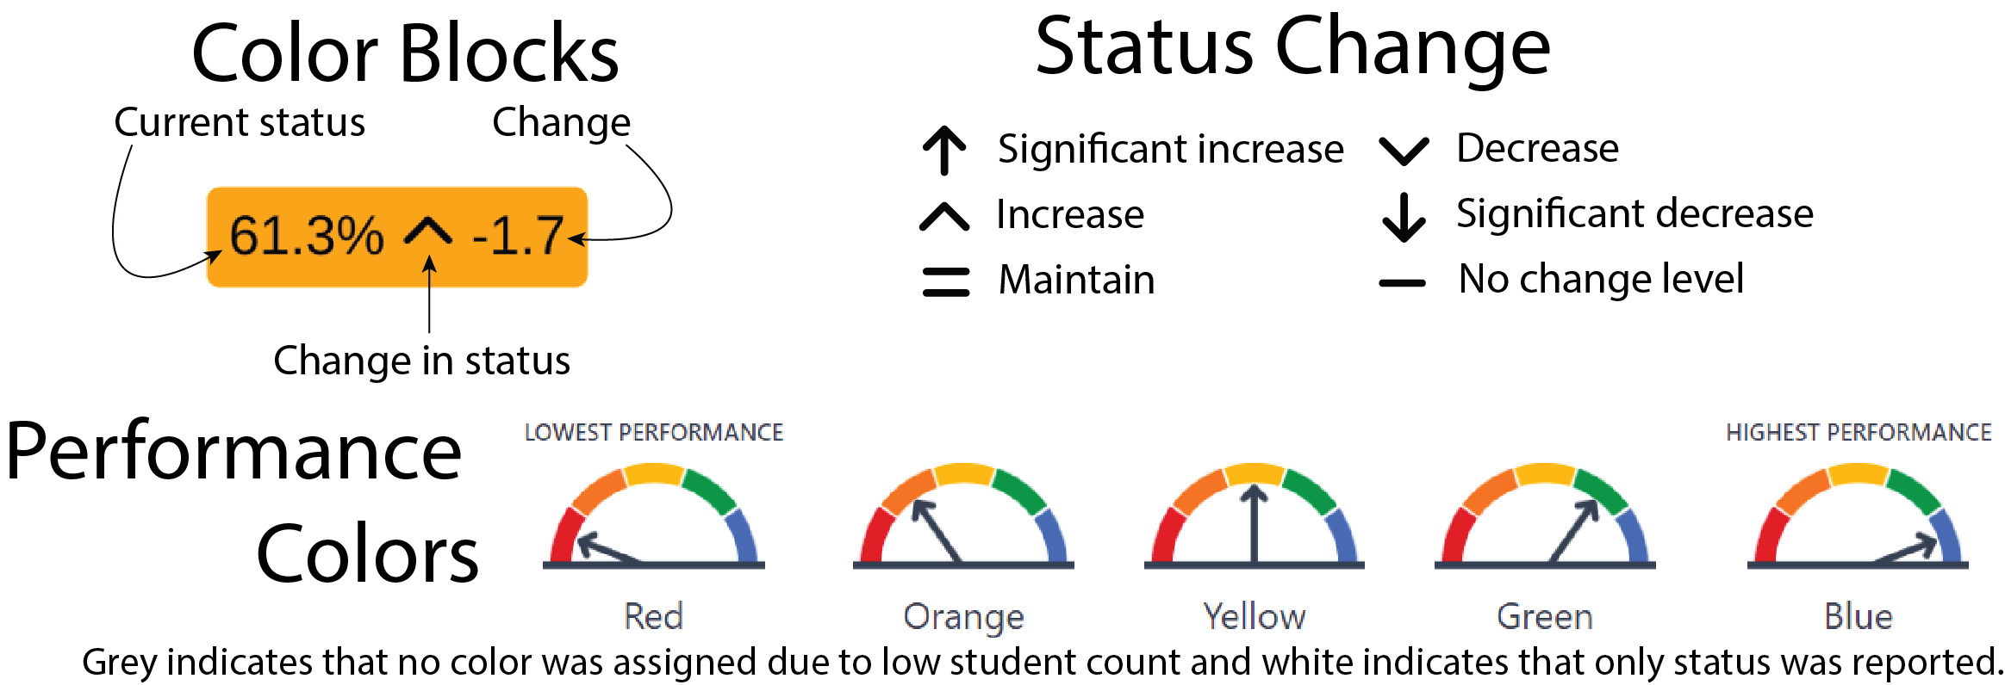
Reading the Graphics

Slide 9
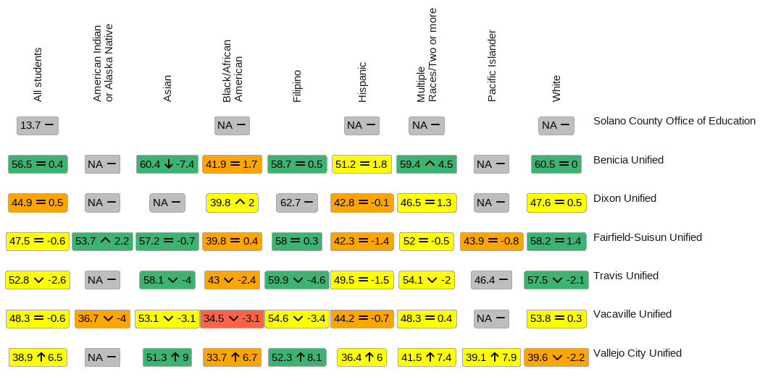
2024 District Science Simulation by Race/Ethnicity

Slide 10
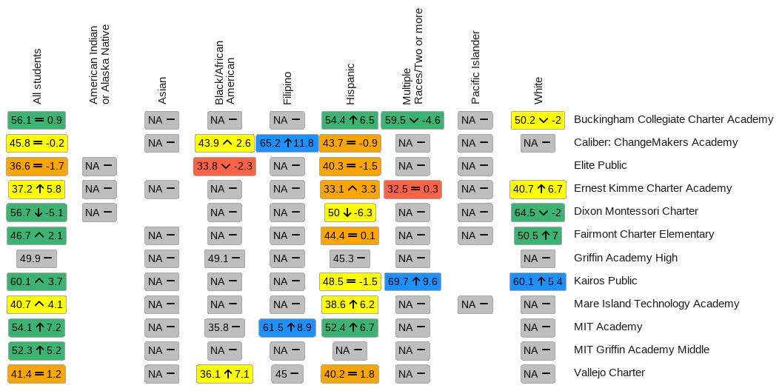
2024 Charter Science Simulation by Race/Ethnicity

Slide 11
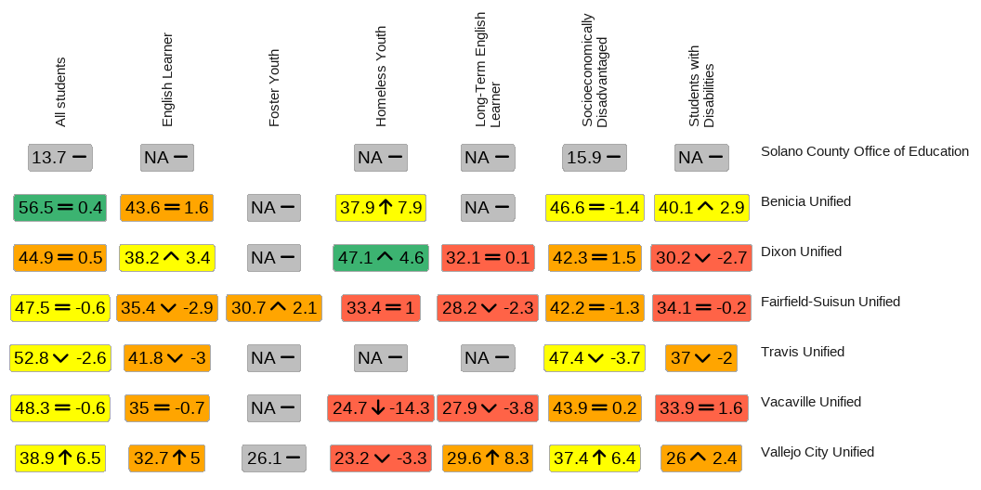
2024 District Science Simulation by Program

Slide 12
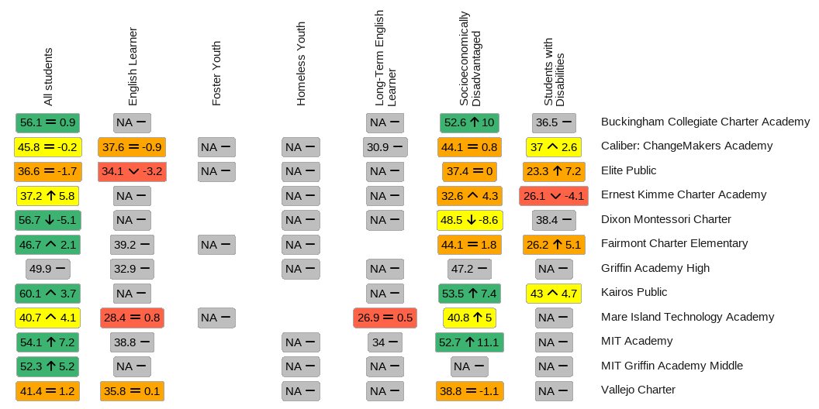
2024 Charter Science Simulation by Program

Slide 13
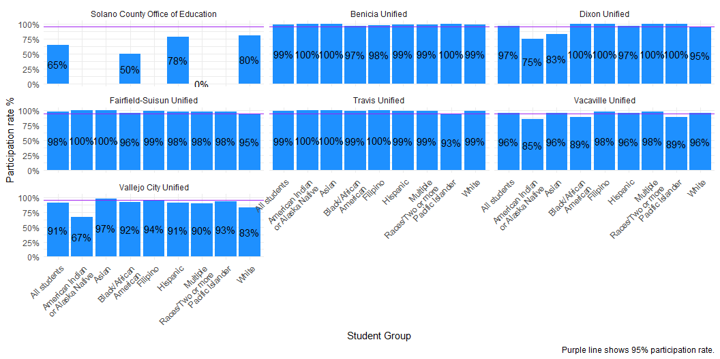
2024 District Science Participation Rates by Race/Ethnicity

Slide 14
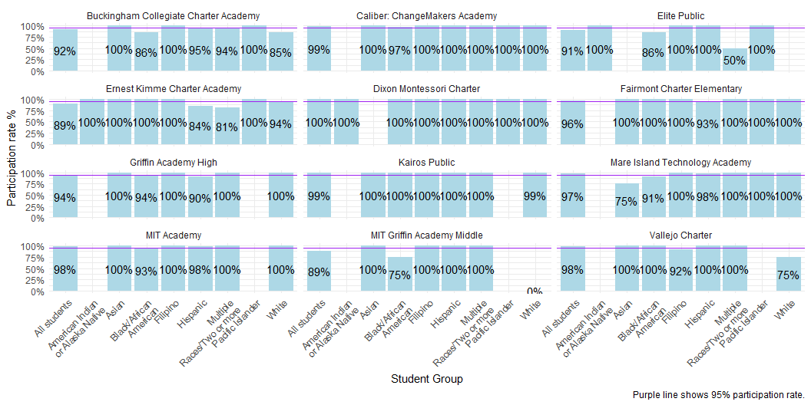
2024 Charter Participation Rates by Race/Ethnicity

Slide 15
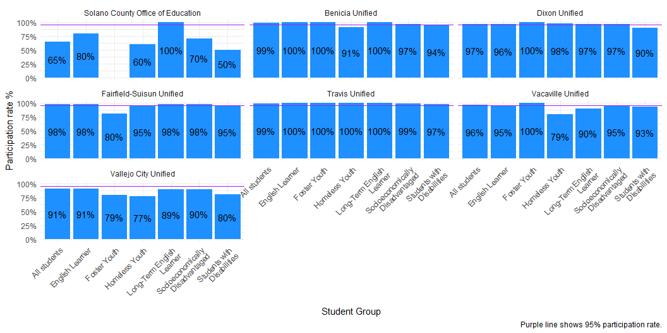
2024 District Science Participation Rates by Program

Slide 16
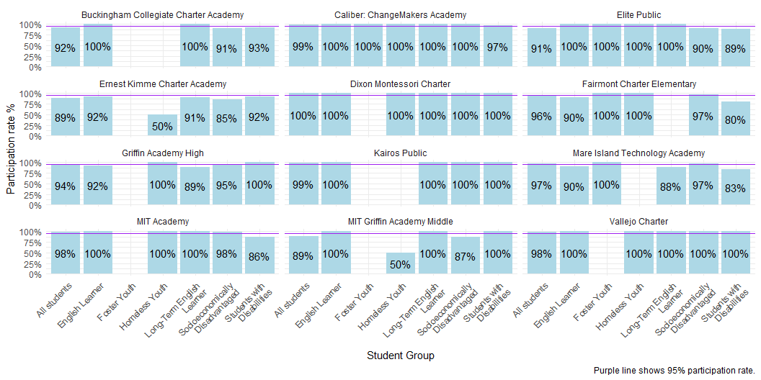
2024 Charter Participation Rates by Program

Slide 17
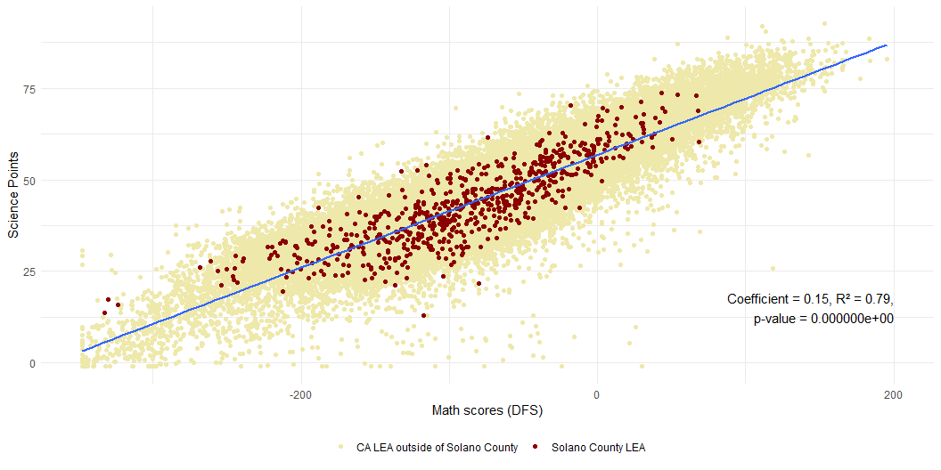
Math and Science Scores (by school and district)

Slide 18
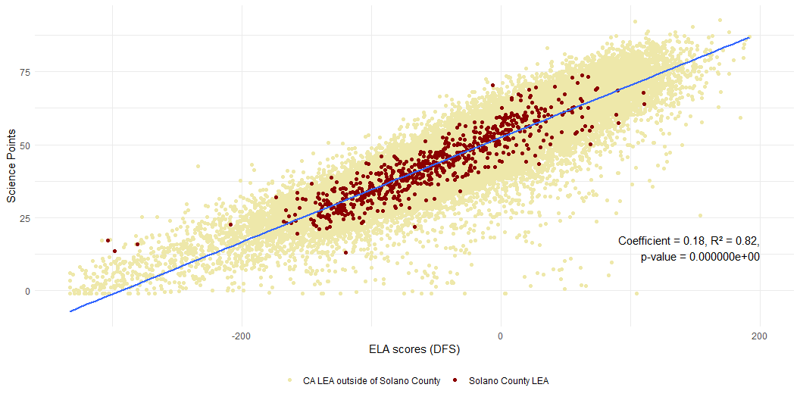
ELA and Science Scores

Slide 19
Summary of linear regressions
Both Math and ELA CAASPP scores are positively associated with science scores. The slightly higher coefficient for ELA scores suggests a stronger effect size, while the higher R² for the ELA model indicates that ELA scores have a slightly greater predictive power at the LEA level. These findings underscore the importance of literacy skills on the CAST exam.

Slide 20
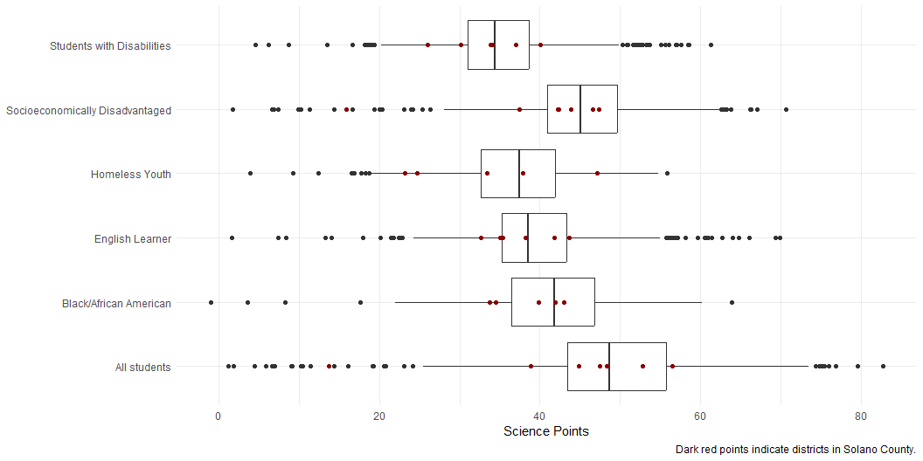
Distribution of Science Scores in CA districts for Select Student Groups

