Slide 1
FIGURES

Slide 2




Figure 1. A. A schematic overview of the workflow used to generate ATAC-Seq libraries for sequencing.
The step marked as “QC” contains standard procedures of PCR amplyfication and bead purification, as well
as the analysis of tapestation profiles used as main quality check point for the ATAC libraries.
Fresh (F)
Cryopreserved (C)
Fixed for 1 day (FX1)
Fixed for 3 days (FX3)
Fixed for 7 days (FX7)
sorting
freezing
inactivated
only, FX1a
inactivated and de-
cross linked, FX1
sorting,
counting
sorting,
counting
sorting,
counting
sorting,
counting
55,000
alive
cells
10 mln
cells
55,000
alive
cells
55,000
alive
cells
recovering,
sorting
55,000
alive
cells
55,000
alive
cells
- ATAC
- fixation for 72 hours
- fixation for 168 hours
- fixation for 24 hours
- 2 PBS washes
- 2 PBS washes
55,000
cells
- fixation for 24 hours
- 2 PBS washes
- ATAC
- ATAC
- 2 PBS washes
- ATAC
- Tn5 inactivation with
EDTA
- Tn5 inactivation with
EDTA
- ATAC
- Tn5 inactivation with
EDTA
- ATAC
- Tn5 inactivation with
EDTA
- de-cross linking with
DTT; QC
- de-cross linking with
DTT
- de-cross linking with
DTT
- QC
- QC
- QC
- QC
- QC

Slide 3
Figure 1. B. A schematic overview of the workflow used to generate ATAC-Seq libraries for sequencing.
The step marked as “QC” contains standard procedures of PCR amplyfication and bead purification, as well
as the analysis of tapestation profiles used as main quality check point for the ATAC libraries.
raw
fastq
adapter
trimming
QC on alignment, removing:
- duplicates;
- not properly paired;
- mapped to mitochondrial
DNA;
- low mapping quality (< 30);
- not uniquely mapped.
quality control
on fragments
alignment
Quality assessment,
calculating:
- number of mapped reads;
- average fragment size;
- normalized number of peaks;
- average peak width;
- average peak intensity;
- signal-to-noise ratio.
raw
alignment
quality control
on alignments
filtered
alignment
peak calling
Quality assessment, plotting:
- fragment size distribution;
- peak width distribution;
- norm. number of peaks per
chr.;
- norm. peak intensity per chr.;
- coverage around TSS.
generating
coverage track
quality assessment
(tables and plots)

Slide 4
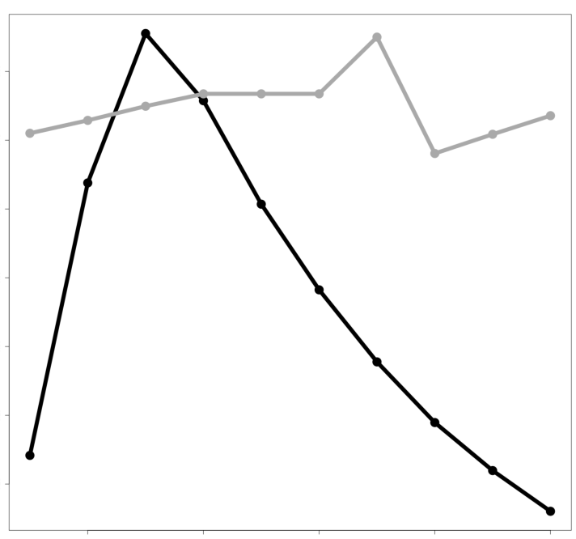
Figure 2. A. F-Score calculated for the peaks called with various values of parameters. The upper panel
represents F-Score values for FSeq. Ten adjacent bars are the F-Score values calculated for the combination
of a particular length labelled value and a set of threshold values (Supplementary table 1). The lower panel
represents F-Score values calculated for Macs2.
B. Threshold (for FSeq) and q-value (for Macs2) for a selected length/extension value (800 for FSeq and 600
for Macs2).
q-value, Macs2
FSeq
0.001
0.01
0.03
0.07
0.1
0.5
F-Score
0.5
100
200
400
600
800
1000
2000
0.4
length value
F-Score
Macs2
0.3
F-Score
FSeq
0.2
0.2
Macs2
100
200
400
600
800
1000
2000
0.01
1
2
4
6
8
10
12
14
16
extension size
threshold value, FSeq
Figure 2, a.
Figure 2, b.

Slide 5
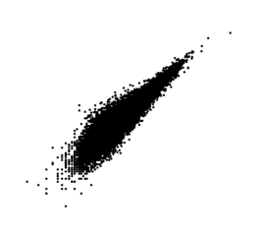





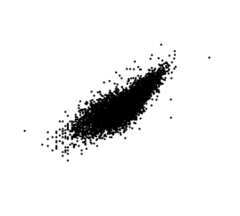
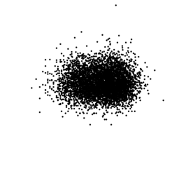
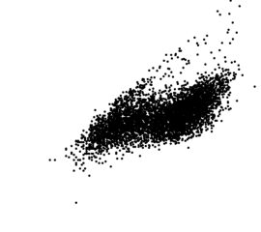
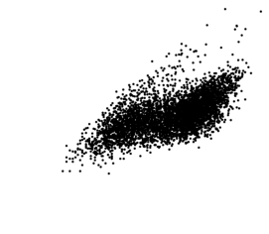
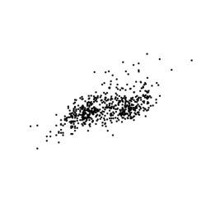
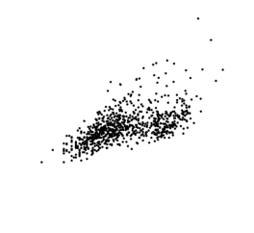
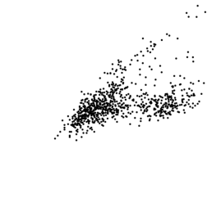
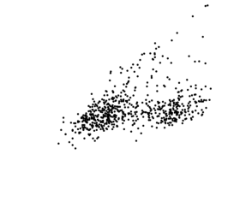
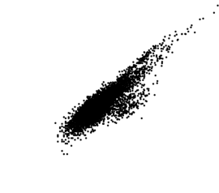
Figure 3. A. Correlation between different types of material. Peaks present in all
three replicates per material type were compared to each other. The top right half
of the table contains the percent of peaks present in each two conditions. The
bottom left half of the table shows the correlation of the normalized coverage of
the peaks common for each pair of material types.
Percent of
overlapping peaks
F
74%
61.9%
65.5%
24.9%
2.9%
C
64.6%
67.1%
23.1%
3.3%
FX1a
78.7%
21.7%
3.5%
FX1
21%
2.8%
FX3
23.1%
FX7
Correlation between
shared peaks

Slide 6
Figure 3. B. Overlap between the called peaks and the annotation. Top left and right panels represent the number and percent of bases in peaks overlapping
with the categories of the ENCODE segmentation track for K562. Bottom left and right panels contain the same information, however, here regions
annotated as TSS, enhancers, weak enhancers and CTCF were merged into the “on target” track and the rest of the annotation (transcribed, repressed
and promoter flanking regions) were merged into the “off target” track.
FX7
annotation categories:
Transcribed
FX3
Repressed
FX1
Promoter Flanks
Weak enhancer
FX1a
CTCF
C
Enhancer
F
TSS
FX7
FX3
major annotation
classes:
FX1
Off target
FX1a
On target
C
F
6
12
18
24
mln
bases
number of bases of all called bases
% bases of all called bases

Slide 7
Figure 3. C. Distribution of peaks common in F, C, FX1a and FX1 across different annotation categories.
294
593
annotation categories:
Transcribed
2,901
Repressed
Promoter Flanks
Weak enhancer
CTCF
10,302
Enhancer
TSS

Slide 8
Figure 3. D. For each material type, the distribution of bases in the called peaks
across different annotation categories. The number above each bar represents the
number of unique peaks for each type of material.
455
4,443
3,094
2,271
9,309
16,016
annotation categories:
Transcribed
Repressed
Promoter Flanks
Weak enhancer
CTCF
Enhancer
TSS
F
C
FX1a
FX1
FX3
FX7

Slide 9
Figure 4, a. Overlap between the called peaks and the annotation. The stacked bar plot represents the number of bases in peaks overlapping
with the categories of the ENCODE segmentation track for K562.
FA.d
annotation categories:
Transcribed
FA
Repressed
D.d
Promoter Flanks
D
Weak enhancer
C.d
CTCF
C
Enhancer
TSS
F
mln
bases

Slide 10
Figure 4, b. Distribution of peaks common in F, C.d and D.d across different annotation categories.
150
401
annotation categories:
Transcribed
2,658
Repressed
Promoter Flanks
Weak enhancer
CTCF
10,287
Enhancer
TSS

Slide 11
Figure 4, c. The distribution of bases in the called peaks
across different annotation categories for peaks unique in F, C.d or D.d.
The number above each bar represents the
number of unique peaks for each type of material.
1,055
2.848
17,007
annotation categories:
Transcribed
Repressed
Promoter Flanks
Weak enhancer
CTCF
Enhancer
TSS
F
C.d
D.d

Slide 12
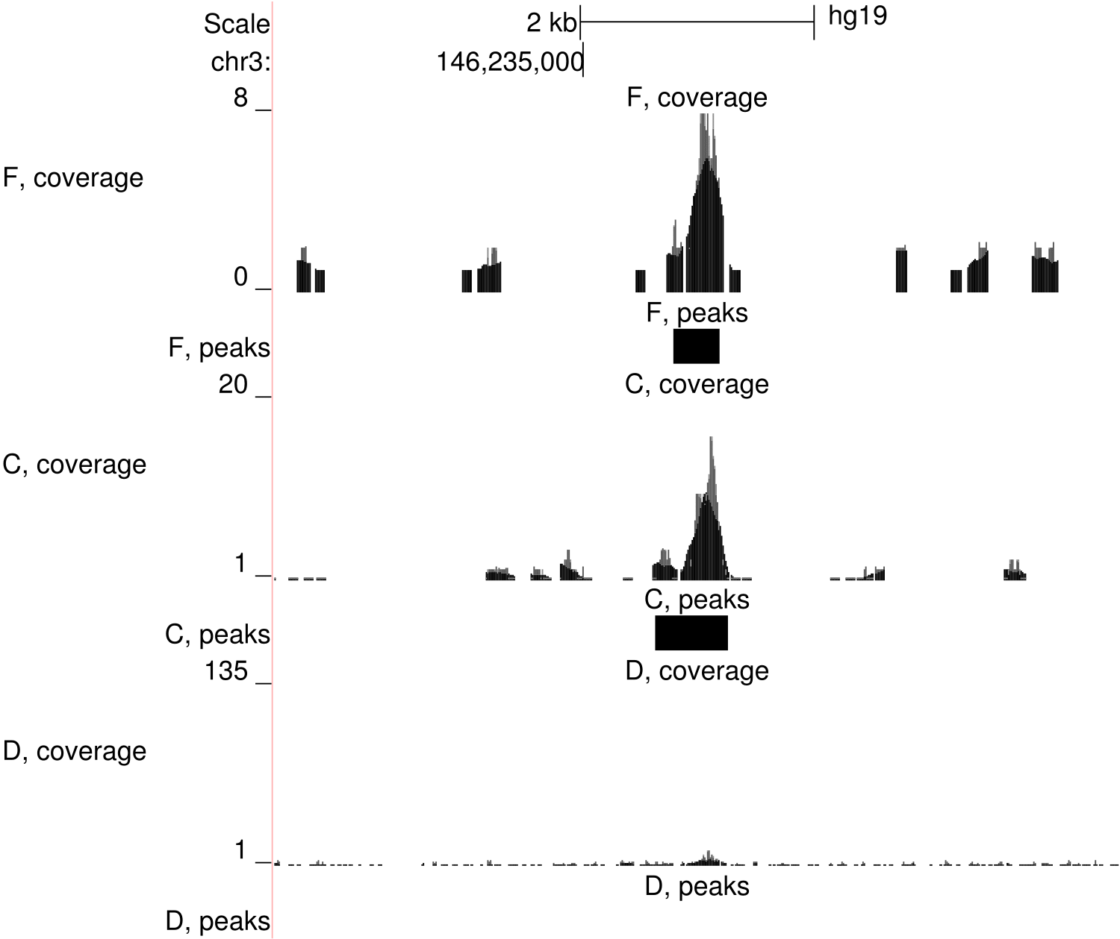
Figure 4, d. An example of a peak located on chr3 specific for ATAC data. First, third and fifth panels
show the coverage profile of samples F.1, C.1 and D.1, respectively. The coverage has been scaled
to the number of mapped reads. Second, fourth and sixth panels show the areas which were called as
peaks (present in F and C and absent in D).

Slide 13
Supplementary figure 1. Tapestation profiles.

Slide 14
Supplementary figure S2. The workflow of calculating signal-to-noise ratio.
grey line represents the reference genome, short black lines represent mapped
reads. R_{p} is calculated as the number of reads mapped to the areas called as
peaks. R_{o} is calculated as the number of reads mapped outside peaks to the
regions as wide as peaks. R_{tot} is the total number of reads.
Signal-to-noise ratio
R
p
140 nt
200 nt
R
o
200 nt
140 nt
R
p
8+4
S-to-N = = = 0.4
R
15
R
tot
1+1
o

Slide 15
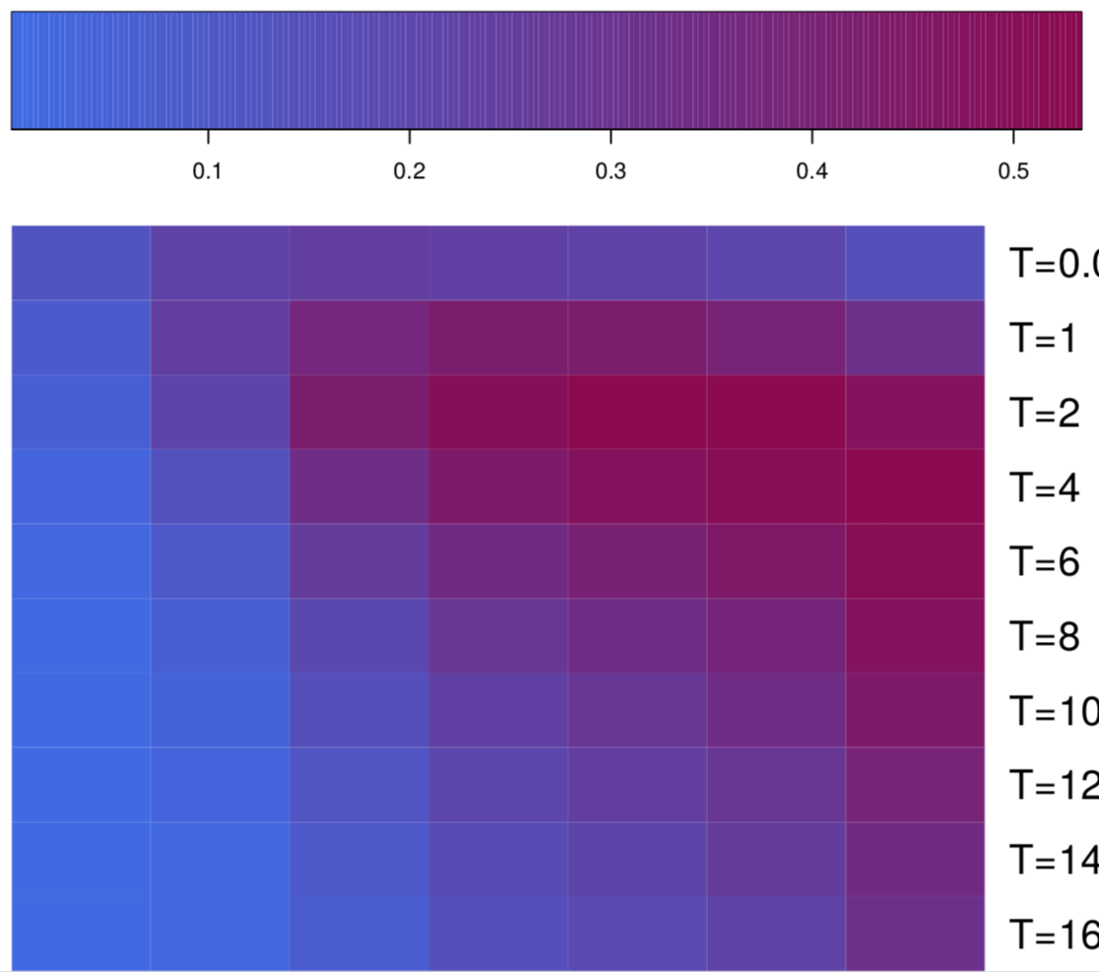
Supplementary figure S3. F-Score values for all the combinations of
Parameters generated for FSeq. The bottom panel represents the colour key
of the heatmap, ranging from light blue (lower values) to dark purple (high
values). Two squares, blue and brown, highlight the F-Score for the default
and the chosen parameter sets, respectively.
F-Score
0.1
0.2
0.3
0.4
0.5
0.01
1
0.53
2
0.43
4
Threshold value
6
8
10
12
14
16
100
200
400
600
800
1000
2000
Length value

Slide 16


Supplementary figure S4. A. The figure demonstrates how the reciprocal
overlap between the peaks from different samples is defined. Only when
at lest 20% of the width of each peak lays within the intersection (left
panel), the intersection is reported as a peak common for two samples.
Supplementary figure S4. B. Difference between the number of peaks considered
as common (Y axis) in all three samples at each minimum required overlap (X
axis).
20%
15%
Difference between the number of
peaks reported as overlapping, %
30%
35%
1
10
20
20
30
40
50
60
70
80
90
100%
Required overlap, % peak length

Slide 17
Supplementary figure S5. F-Score calculated for the peaks called in cryopreserved ATAC samples with various values of parameters. The upper panel
represents F-Score values for FSeq. Ten adjacent bars are the F-Score values calculated for the combination
of a particular length labelled value and a set of threshold values (Supplementary table 1). The lower panel
represents F-Score values calculated for Macs2.
FSeq
F-Score
100
200
400
600
800
1000
2000
length value
Macs2
F-Score
100
200
400
600
800
1000
2000
extension size
Figure 2, a.

Slide 18
Supplementary figure S6. Overlap between the peaks called with different peak callers and the annotation. Four horizontal bars on each plot represent the
distribution of peaks called by Macs2 with the chosen parameter set (e=600, q=0.07); by Macs2 with the default parameter set (e=200, q=0.05); by Fseq
with the chosen parameter set (l=800, t=2); by FSeq with the default parameter set (l=600, t=4). Top left and right panels represent the number and
percent of bases in peaks overlapping with the categories of the ENCODE segmentation track for K562. Bottom left and right panels contain the same
information, however, here regions annotated as TSS, enhancers, weak enhancers and CTCF were merged into the “on target” track and the rest of the
annotation (transcribed, repressed and promoter flanking regions) were merged into the “off target” track.
Macs2
chosen
annotation categories:
Transcribed
Macs2
default
Repressed
Promoter Flanks
Weak enhancer
FSeq
chosen
CTCF
Enhancer
FSeq
default
TSS
Macs2
chosen
Macs2
default
major annotation
classes:
Off target
On target
FSeq
chosen
FSeq
default
5
10
15
20
mln
bases

Slide 19
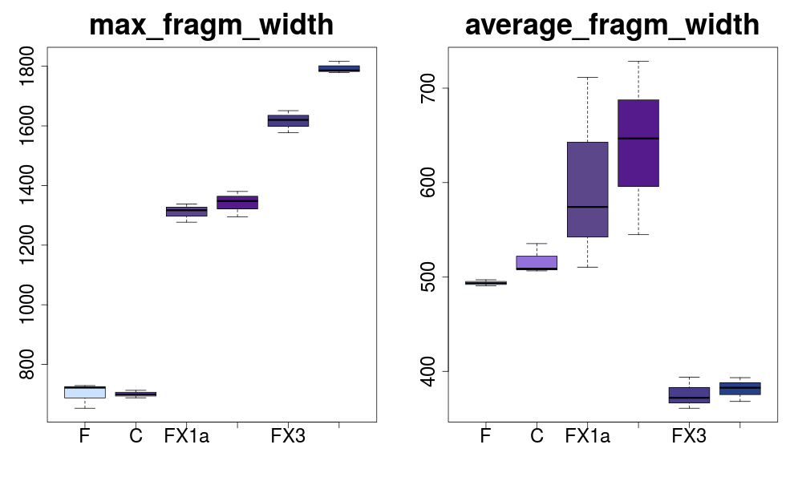
Supplementary figure S7. Maximum and average width of paired-end fragments
In each type of material. Each box contains three values, one from each replicate.
Maximum fragment width
Average fragment width
bp
bp
700
1600
600
1200
500
800
400
F
C
FX1a
FX1
FX3
FX7
F
C
FX1a
FX1
FX3
FX7

Slide 20
BACK-UP FIGURES

Slide 21
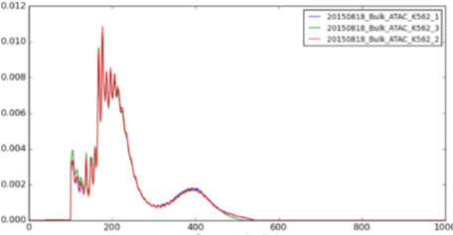
Fresh material
sorting,
counting
PCR
on 10uL
bead
purification
tapestation
QC
ATAC
...
...
55,000 cells
Cryopreservation
sorting,
counting
PCR
on 10uL
bead
purification
tapestation
QC
freezing
recovering
ATAC
...
...
40-50 mln cells
Fixation with inactivation only
sorting,
counting
fixation for
24 hours
2 PBS
washes
ATAC
inactivation
with EDTA
PCR
on 10uL
bead
purification
tapestation
QC
...
fresh
cultured K562
...
55,000 cells
Fixation with inactivation and de-cross linking
de-cross
linking
with DTT
sorting,
counting
fixation for
24 hours
2 PBS
washes
ATAC
inactivation
with EDTA
PCR
on 10uL
bead
purification
tapestation
QC
...
fresh
cultured K562
...
55,000 cells
Figure 1, a.

Slide 22

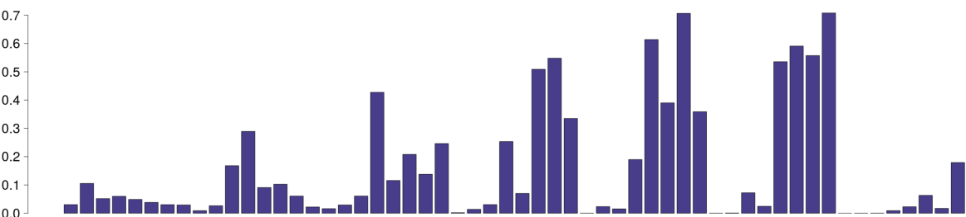
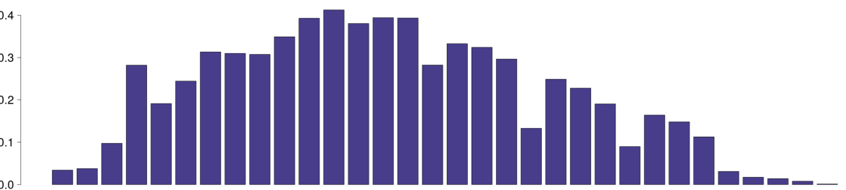
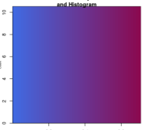
F-score for different parameter values of FSeq
Choosing the highest F-score for FSeq and Macs2
threshold 2
0.7
FSeq
threshold 4
threshold 6
threshold 8
0
threshold 10
length 100
threshold 2
threshold 4
threshold 12
Macs2
threshold 14
0.4
threshold 16
length 100
length 600
Color key
length 200
length 800
length 400
length 2000
0
length 1000
extention 100
q-value 0.01
0
0.7
q-value 0.1
Figure 2, a.
Figure 2, b.

Slide 23
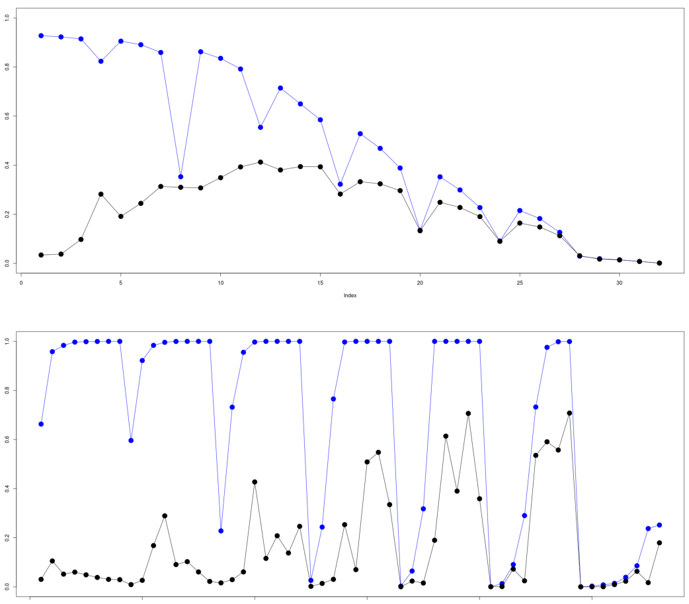

F-score for different parameter values of FSeq
Choosing the highest F-score for FSeq and Macs2
1
Macs2
threshold 2
0.8
threshold 4
0.6
Fraction on target
F-Score
threshold 6
0.4
threshold 8
0.2
threshold 10
0
threshold 12
extention 100
q-value 0.01
q-value 0.1
1
FSeq
threshold 14
0.8
threshold 16
0.6
Color key
0.4
length 100
length 600
length 200
length 800
length 400
length 2000
length 1000
0.2
0
0.7
0
length 100
threshold 2
threshold 4
Figure 2, a.
Figure 2, b.

Slide 24
Figure 3, a.
Percent of
overlapping peaks
F
74%
61.9%
65.5%
24.9%
2.9%
Fr
64.6%
67.1%
23.1%
3.3%
Fxa1
78.7%
21.7%
3.5%
Fx1
21%
2.8%
Fx3
23.1%
Fx7
Correlation between
shared peaks

Slide 25
F
73.95%
61.85%
65.46%
24.93%
2.93%
Fr
64.61%
67.1%
23.09%
3.28%
Fxa1
78.74%
21.67%
3.48%
Fx1
21.03%
2.83%
Fx3
23.1%
Fx7

Slide 26
Overlap with different annotation categories
Fi7
Transcribed
Fi3
Promoter Flanks
Repressed
Fi1
CTCF
Fii1
Weak enhancer
Fr
Enhancer
TSS
F
Amount of peaks mapped on/off target
Fi7
Fi3
Fi1
Off target
Fii1
On target
Fr
F
% peaks of all called peaks
% bases of all called bases
Figure 3, a.

Slide 27
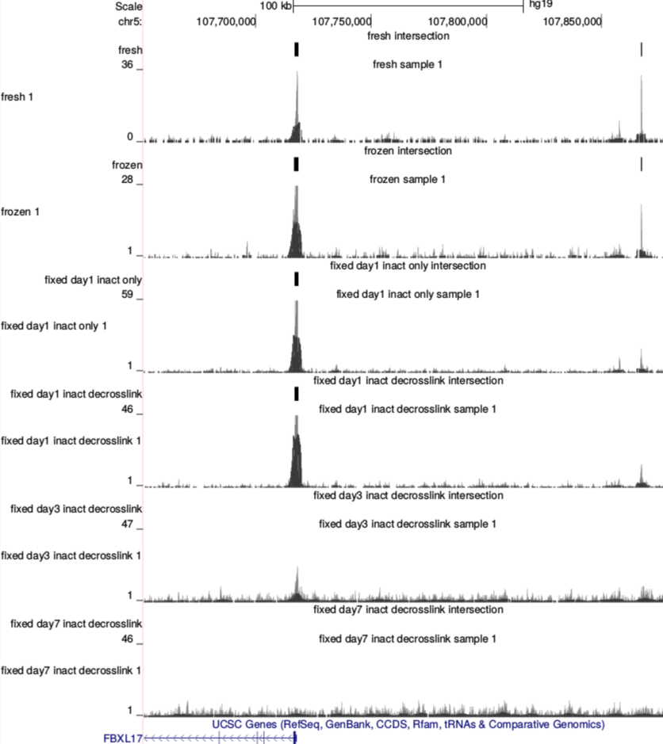
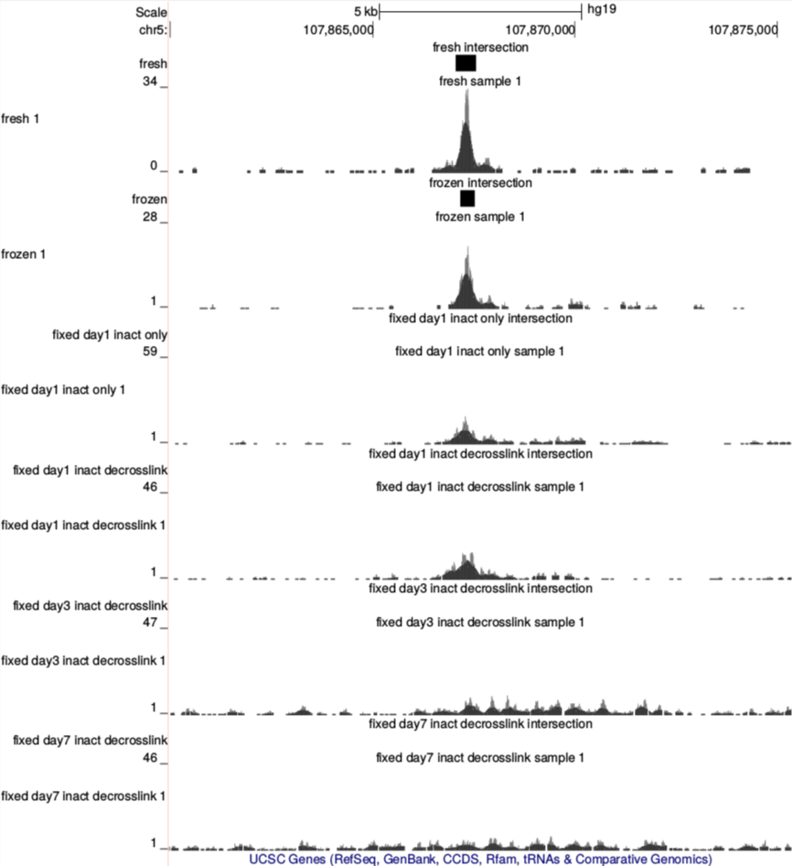
Figure 3, b.

Slide 28
Distribution of peaks across different types of annotated regulatory elements
Macs2
chosen
Transcribed
Macs2
default
Promoter Flanks
Repressed
CTCF
FSeq
chosen
Weak enhancer
Enhancer
FSeq
default
TSS
Macs2
chosen
Macs2
default
Off target
On target
FSeq
chosen
FSeq
default
0
25000
0
100%
Supplementary figure 2.

Slide 29
Figure 3, b.

Slide 30
Annotation of peaks unique for every material type
CTCF
Weak enhancer
Enhancer
TSS
F
Fr
Fii1
Fi1
Fi3
Fi7
F
Fr
Fii1
Fi1
Fi3
Fi7
Figure 3, c.

Slide 31
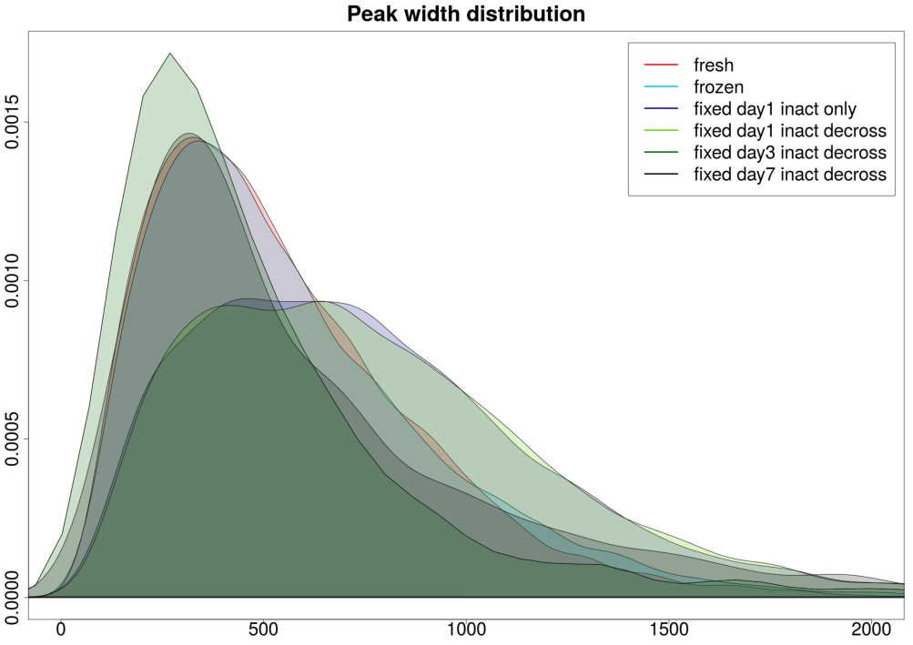
Supplementary figure 3.

Slide 32
 | Fixed day7 inact decross | Fixed day3 inact decross | Fixed day1 inact decross | Fixed day1 inact only | Frozen
Fresh | 2.6% | 25.4% | 60.7% | 54.6% | 72.1%
Frozen | 3.2% | 22.6% | 64% | 59.7%
Fixed day1 Inact only | 7% | 22.7% | 78.7%
Fixed day1 Inact decross | 5.8% | 22.1%
Fixed day3 inact decross | 25.9%
 | Fixed day1 Inact decross | Fixed day1 Inact only | Fixed day3 Inact decross | Fixed day7 Inact Decross | fresh | frozen
Fixed day1 Inact decross | X | 78.7% | 22.1% | 5.8% | 60.7% | 64%
Fixed day1 Inact only |  | X | 22.7% | 7% | 54.6% | 59.7%
Fixed day3 inact decross |  |  | X | 25.9% | 25.4% | 22.6%
Fixed day7 inact decross |  |  |  | X | 2.6% | 3.2%
fresh |  |  |  |  | X | 72.1%
Frozen |  |  |  |  |  | X
1. Within a group, overlap between each two replicates is > 20%.
2. This generates a consensus peak file.
3. Between the two consensus peak files, overlap is > 20%.

Slide 33
Average peak width
across different annotation categories
CTCF
Enhancers
TSS
Weak
enhancers
Promoter
flanks
Repressed
Transcribed

Slide 34
Overlap with
fresh
Overlap with
fixed d1 inact only
Frozen
Fixed
Day 1
Inact
decross
Fixed
Day 1
Inact
only
Fixed
Day 3
Fixed
Day 7
Fresh
Frozen
Fixed
Day 1
Inact
decross
Fixed
Day 3
Fixed
Day 7
Overlap with
frozen
Overlap with
fixed d3
Fresh
Fixed
Day 1
Inact
decross
Fixed
Day 1
Inact
only
Fixed
Day 3
Fixed
Day 7
Fresh
Frozen
Fixed
Day 1
Inact
decross
Fixed
Day 1
Inact
only
Fixed
Day 7
Overlap with
fixed d1 inact decros
Overlap with
fixed d7
Fresh
Frozen
Fixed
Day 1
Inact
only
Fixed
Day 3
Fixed
Day 7
Fresh
Frozen
Fixed
Day 1
Inact
decross
Fixed
Day 1
Inact
only
Fixed
Day 3

Slide 35
Peaks remaining in fresh samples
after removing overlap with frozen, fixed, etc
– Frozen
– Fixed
Day 1
Inact
only
– Fixed
Day 1
Inact
decross
– Fixed
day3
– Fixed
day7

Slide 36
Annotation of peaks unique for every material type
Fresh
Frozen
Fixed
Day 1
Inact
only
Fixed
Day 1
Inact
decross
Fixed
Day 3
Fixed
Day 7
Fresh
Frozen
Fixed
Day 1
Inact
only
Fixed
Day 1
Inact
decross
Fixed
Day 3
Fixed
Day 7

Slide 37
Distribution of peaks across different types of annotated regulatory elements
Macs2
chosen
T
Macs2
default
PF
R
CTCF
FSeq
chosen
WE
E
FSeq
default
TSS
Macs2
chosen
Macs2
default
Off target
On target
FSeq
chosen
FSeq
default

Slide 38
Pairwise unique peaks for each type of material
Fixed day3 inact decross
Fixed day7 inact decross
Fixed day1 inact decross
Fixed day1 inact only
Frozen
Fresh
Fixed day7 inact decross
Fixed day3 inact decross
Fixed day1 inact decross
Fixed day1 inact only
Frozen
Fresh
Fixed day7 inact decross
Fixed day3 inact decross
Fixed day1 inact only
Fixed day1 inact decross
Frozen
Fresh
Fixed day7 inact decross
Fixed day3 inact decross
Fixed day1 inact decross
Fixed day1 inact only
Frozen
Fresh
Fixed day7 inact decross
Fixed day3 inact decross
Fixed day1 inact decross
Frozen
Fixed day1 inact only
Fresh
Fixed day7 inact decross
Fixed day3 inact decross
Fixed day1 inact decross
Fresh
Fixed day1 inact only
Frozen

Slide 40
Unique peaks overlap with the annotation (peaks)

