Slide 1
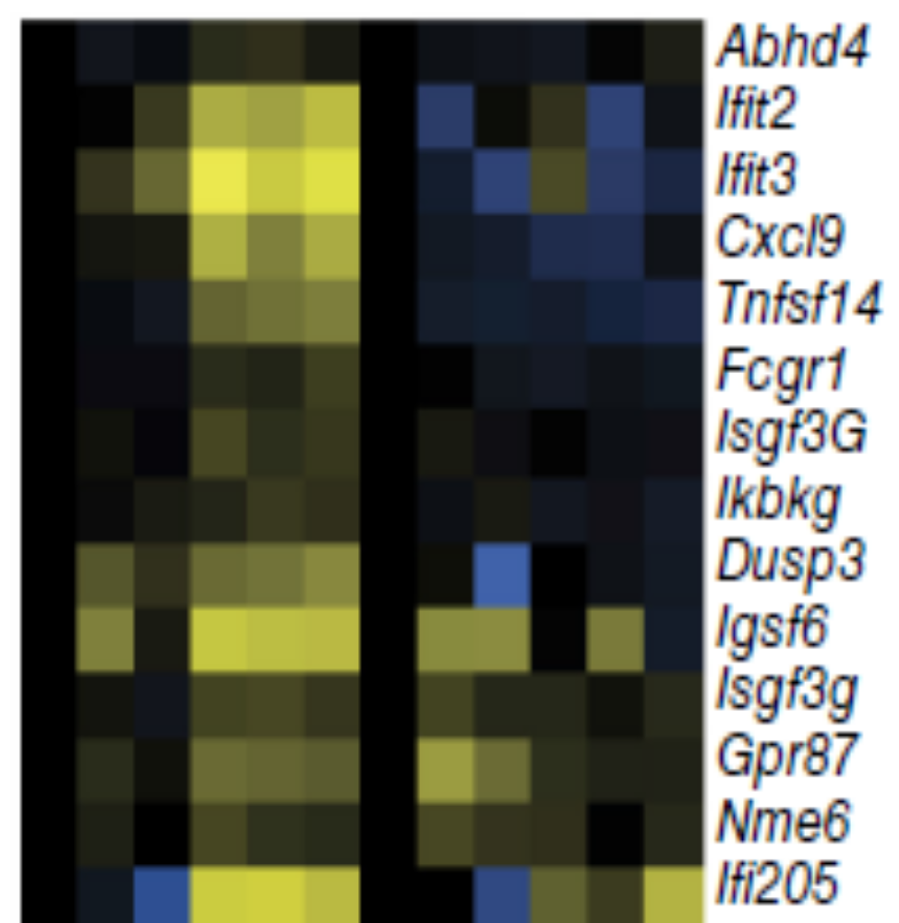
miR-control
miR-10b
Gene name
P2RX5
VEGFA
ZNF410
MAP2K2
NEK7
KCTD18
ZNF385A
CMPK1
E2F7
ZNF747
METTL23
INPP5J
TMPRSS6
LRRC66
HIATL2
IGLV2-14
IGHV3-15
RPS12P26
ETF1P3
RP11-227D13.4 MAP3K7

Slide 2
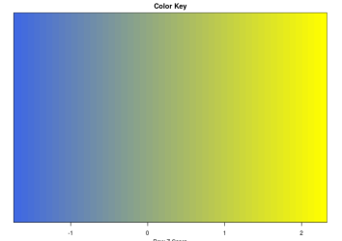
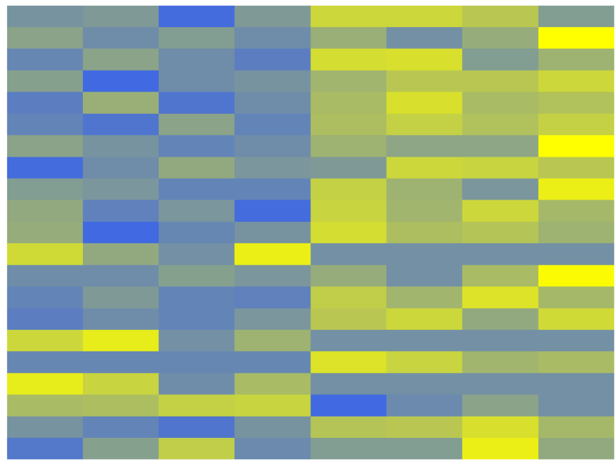
Color Key
-1
0
1
2
P2RX5
VEGFA
ZNF410
MAP2K2
NEK7
KCTD18
ZNF385A
CMPK1
E2F7
ZNF747
METTL23
INPP5J
TMPRSS6
LRRC66
HIATL2
IGLV2-14
IGHV3-15
RPS12P26
ETF1P3
RP11-227D13.4
MAP3K7
miR-control
miR-10b

