Slide 1
C0D3R: A Programmer’s Dating App
Josh Brown
Lisa Dean
Joshua Owens
July 3, 2018

Slide 2

What’s it for?
C0D3R is a web application that facilitates genuine and meaningful interactions between programmers in search of a like-minded partner.

Slide 3
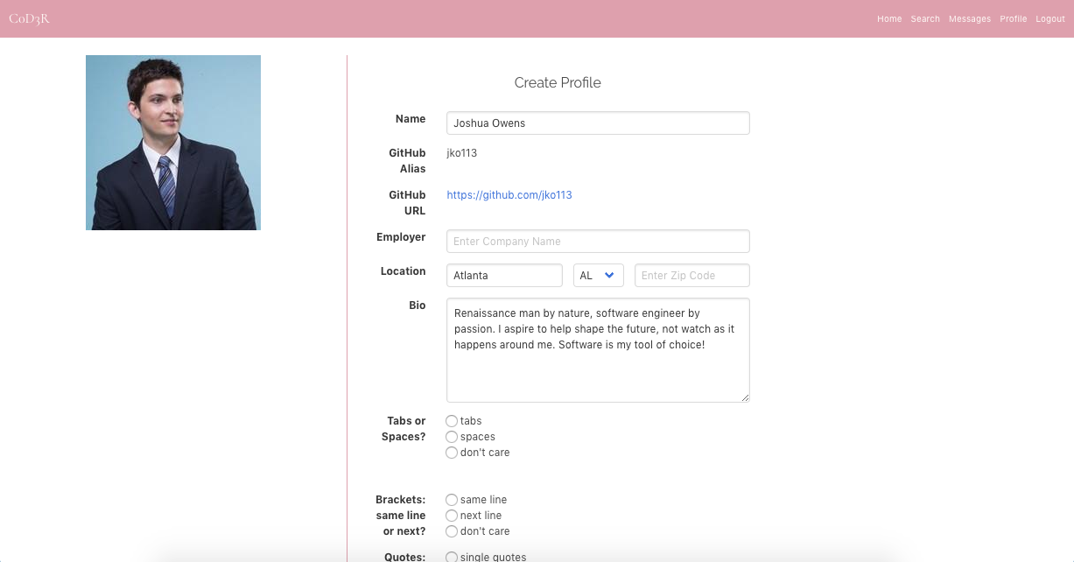
What’s it do?
After entering C0D3R via GitHub authentication, users create a C0D3R profile (mostly pre-populated with GitHub data) to access the full range of app features: home, messages, profile, and search.

Slide 4
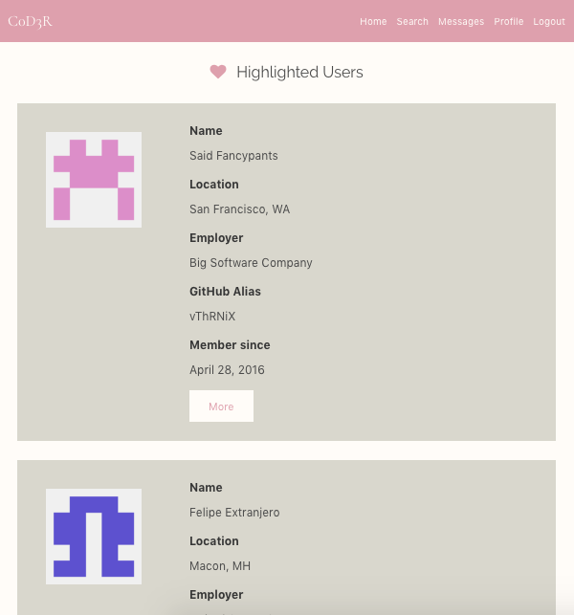
Home
Home displays 5 random users’ profile snippets. Individuals’ full profiles may be accessed from the profile snippet. Additional users can be displayed on demand by clicking the refresh button at the bottom of the list.

Slide 5
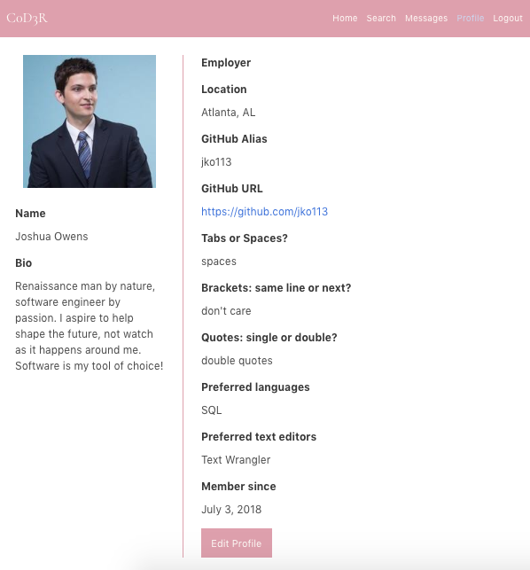
Profile
The full profile page lists the searchable data fields for a given user. The “edit profile” option appears only on the user’s own profile. Not all fields are editable. When in edit mode, changes can be either saved or discarded.

Slide 6
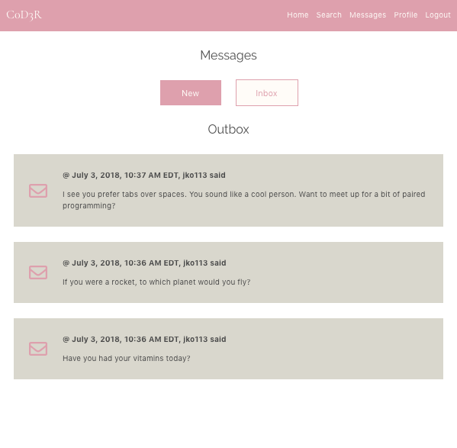
Messages
Messages may be selectively displayed as inbox and outbox. They are ordered chronologically descending. Messages are timestamped and include author’s GitHub alias. The ‘New Message’ form is readily accessible.

Slide 7
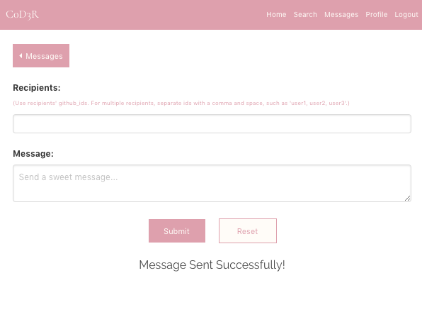
New Message
New messages may be sent to valid users via their registered GitHub alias, separated by ‘, ‘ or space only. After sending successfully, the user is notified accordingly. There is a back button to quickly return to Messages.

Slide 8
Demo!

Slide 9
Improvements for the future
Send message directly from profile [snippet]
Would need to auto-populate recipients field
Streamline/strengthen/secure search feature
Simplify layout, or perhaps reduce available fields
Make clear how it’s searching, not just what
Ensure SQL injection is fully prevented
Introduce message threading
An alternative would be a chat box that instantly displays new messages
Can also specify message recipients
Introduce horizontal profile swiping for mobile

Slide 10
Things we’re proud of
SQL generation for AND/OR searches and dummy data
Search implemented by passing in a JSON object from the search form which triggers dynamic SQL generation based on a dictionary of possible statement permutations.
Dummy data insert statement generated via JS program that randomly generates most fields in the users table, including date-time values
Get random users feature
Ensures the current user is not included in the result set
Draws from the JS Math library’s random() function
Keeps track of users being displayed to prevent duplicates

Slide 11
SQL Generator
let chunks = {
editors: 'JOIN user_editors ue ON ue.user_id = users.user_id JOIN editors ON editors.editor_id = ue.editor_id ',
tabs_preference: 'JOIN tabs_preferences tp ON tp.preference_id = users.tabs_preference ',
editorsWhere: 'editors.editor_id IN ',
tabs_preferenceWhere: 'tp.preference_id IN ',
employerWhere: 'users.employer ILIKE'
}

Slide 12
SQL Generator
let result = ’’; let select = 'SELECT DISTINCT users.* FROM users ‘; let where = ' WHERE ';
Object.keys(searchObject).forEach((key, outerIndex) => {
objString = ’’;
if (typeof searchObject[key] === 'object' && searchObject[key]) {
searchObject[key].forEach( (datum, innerIndex) => {
if (innerIndex === searchObject[key].length - 1) {
objString += datum;
} else {
objString += datum + ', ‘
}
});
if (chunks[key]) {
select += (chunks[key]);
}
if (outerIndex === Object.keys(searchObject).length - 1) {
where += chunks[key + 'Where'] + '(' + objString + ') ‘;
} else {
where += chunks[key + 'Where'] + '(' + objString + ') AND ‘;
}
result = select + where + ';';
return db.any(result);

Slide 13
Get Random Users
function getRandomUsers(current_user_id, num_users) { return getAllUserIds()
.then((arrayOfAllUserIds) => { if (num_users > arrayOfAllUserIds.length) {
throw new Error('number of users specified must be <= the dataset’);
} let randomIds = [];
for (let i = 0; i < num_users; i++) {
let randomIndex = Math.floor(Math.random() * intIds.length);
let randomValue = intIds[randomIndex];
randomIds.push(randomValue);
intIds.splice(randomIndex, 1);
}
let initial = 'SELECT * FROM users WHERE user_id != $1 AND user_id IN (‘; let userIds = ’’; let final = ');’;
randomIds.forEach((item, index) => {
index === randomIds.length - 1 ? userIds += item: userIds += item + ', ‘;
});
results = initial + userIds + final;
return db.any(results, [current_user_id]);
})

Slide 14
Q&A
Thanks for your attention and suggestions!

