Slide 1
Quantum Computing, Rieffel & Polak Chapters 1 and 2
Drs. Charles Tappert and Ron Frank
The information presented here, although greatly condensed, comes almost entirely from the textbook

Slide 2
Chapter 1 – Introduction
Quantum computing is a beautiful combination of quantum physics, CS, and information theory
Includes quantum computing, quantum cryptography, quantum communications, and quantum games
Uses quantum mechanics rather than classical mechanics to model information and its processing
The book consists of three parts
Part I Quantum Building Blocks
Part II Quantum Algorithms
Part III Entanglement and Robust Quantum Computation

Slide 3
Chap 2 Single-Qubit Quantum Systems
Quantum bits are the fundamental units of information in quantum computing, just as bits are fundamental units in classical computing
There are many ways to realize classical bits
Similarly, there are many ways to realize qubits
We begin by examining the behavior of polarized photons, a possible realization of quantum bits

Slide 4
Chap 2 Single-Qubit Quantum Systems Quantum mechanics of photon polarization
A simple experiment illustrates some of the non-intuitive behavior of quantum systems
Minimal equipment required
Laser pointer and three polarized lenses (polaroids) available from any camera supply store
3D movies project the same scene into both eyes, but from slightly different perspectives
The viewer wears low-cost eyeglasses which contain a pair of different polarizing filters

Slide 5
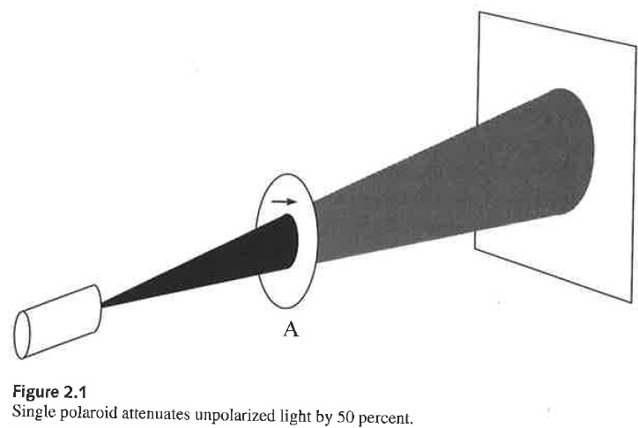
Chap 2 Single-Qubit Quantum Systems Quantum mechanics of photon polarization
Shine a beam of light on a projection screen
Insert polaroid A between light source and screen

Slide 6
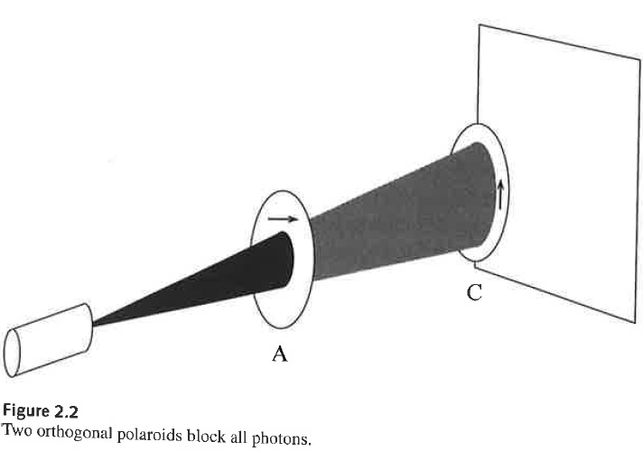
Chap 2 Single-Qubit Quantum Systems Quantum mechanics of photon polarization
Insert polaroid C between A and screen and rotate it

Slide 7
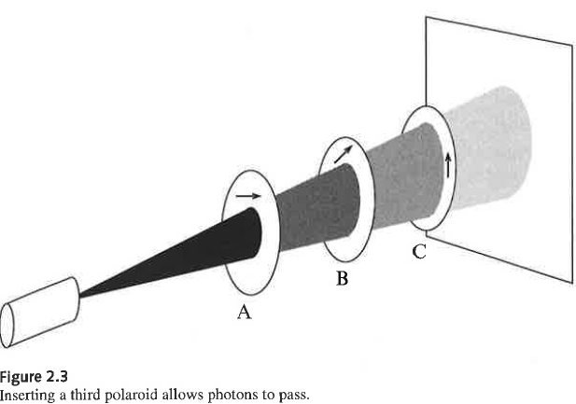
Chap 2 Single-Qubit Quantum Systems Quantum mechanics of photon polarization
Finally, insert polaroid B between A and C

Slide 8
Chap 2 Single-Qubit Quantum Systems Quantum mechanics of photon polarization
Turns out that the results of this experiment can be explained classically in terms of waves
The same experiment can be performed with more sophisticated equipment using a single-photon emitter to yield the same results
Results explained only with quantum mechanics
The explanation consists of two parts
Model of photon’s polarization state
Model of interaction between photon and polaroid

Slide 9
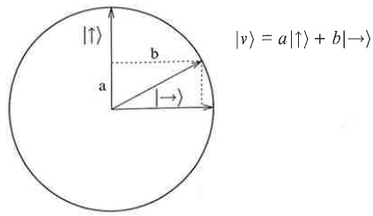
Chap 2 Single-Qubit Quantum Systems Quantum mechanics of photon polarization
A photon’s polarization state can be represented by a superposition of base vectors
Now, when photon with polarization meets polaroid , the photon gets thru with prob a²
The probability is the square of the coefficient

Slide 10


Chap 2 Single-Qubit Quantum Systems Quantum mechanics of photon polarization
What happens when polaroid B with preferred axis is inserted?
We note that
Therefore, ½ of the photons get thru B
In summary, 1/8 of the photons get thru ABC
1/2 get thru A, 1/2 get thru B, 1/2 get thru C

Slide 11
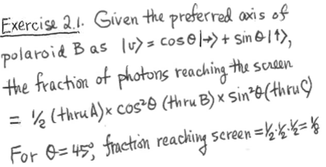
Chap 2 Single-Qubit Quantum Systems Quantum mechanics of photon polarization

Slide 12
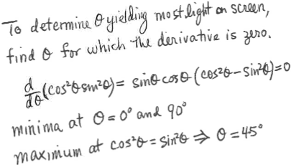
Chap 2 Single-Qubit Quantum Systems Quantum mechanics of photon polarization

Slide 13





Chap 2 Single-Qubit Quantum Systems Single quantum bits
The set of the infinite number of possible states of a physical quantum system is called the state space
States of a two-state system can be represented in terms of two orthonormal basis states
The basis states can also be written as
Arbitrary state can be written as
This is a complex vector space with
Inner product satisfying (bra = , ket = )

Slide 14
Chap 2 Single-Qubit Quantum Systems Single-qubit measurement
Quantum theory postulates that any device that measures a two-state quantum system must have two preferred states whose representative vectors form an orthonormal basis for the associated vector space
And measurement of a state transforms the state into one of the measuring device’s associated basis vectors
And the probability the state is measured as is the square of the amplitude of that basis vector
For example, the state is measured as with probability a²

Slide 15
Chap 2 Single-Qubit Quantum Systems Quantum key distribution protocol
Now we can describe the first application
Relies on quantum effects for security
Quantum key distribution protocol establishes a symmetric key between 2 parties, Alice & Bob
Alice & Bob connected by two public channels
Bidirectional classical channel
Unidirectional quantum channel for sending qubits
Channels observed by eavesdropper Eve

Slide 16
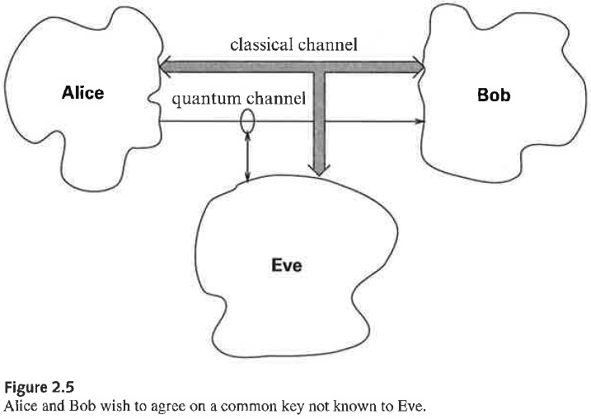
Chap 2 Single-Qubit Quantum Systems Quantum key distribution protocol

Slide 17
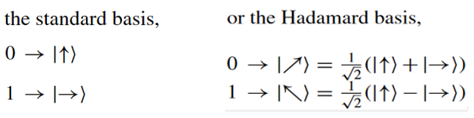
Chap 2 Single-Qubit Quantum Systems Quantum key distribution protocol
Alice generates a random sequence of bits
Random subset of sequence will be the private key
Alice randomly encodes each bit of the sequence in the polarization state of a photon
Randomly choosing for each bit one of the bases

Slide 18
Chap 2 Single-Qubit Quantum Systems Quantum key distribution protocol
Alice sends the sequence of photons to Bob
Bob measures the state of each photon he receives by randomly picking either basis
Over the classical channel, Alice and Bob tell each other the bases they used for each bit
When choice of bases agree, Bob’s measured bit values agree with bit values Alice sent
Without revealing bit values, they discard all bits on which their bases differed (about 50%)

Slide 19
Chap 2 Single-Qubit Quantum Systems Quantum key distribution protocol
About 50% of bits transmitted remain
Then Alice and Bob compare a certain number of bit values to check if eavesdropping occurred
The checked bits are also discarded
The remaining bits will now be used as the private key

Slide 20

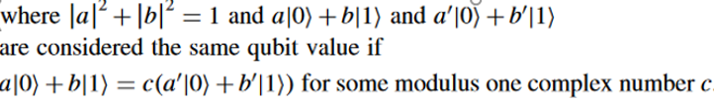
Chap 2 Single-Qubit Quantum Systems State space of single-qubit system
The state space of a quantum system is the set of all possible states of the system
The state space for a single qubit system, no matter how realized, is the set of qubit values

Slide 21
Chap 2 Single-Qubit Quantum Systems State space of single-qubit system
Relative phases versus global phases
Global phase is
The multiple by which two vectors representing the same quantum state differ
It has no physical meaning
This is a common source of confusion for newcomers to the field

Slide 22

Chap 2 Single-Qubit Quantum Systems State space of single-qubit system
The relative phase of superposition
Is a measure of the angle in the complex plane between the two complex numbers a and b
Specifically, it is the modulus one complex number
Two superpositions whose amplitudes have the same magnitudes but differ in relative phase represent different states
The physically meaningful relative phase and the physically meaningless global phase should not be confused

Slide 23
Chap 2 Single-Qubit Quantum Systems State space of single-qubit system
Geometric views of single qubit state space
Two ways of looking at complex projective space
1. Extended complex plane
Complex plane C with additional point labeled
2. Bloch sphere

Slide 24
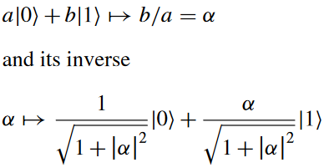
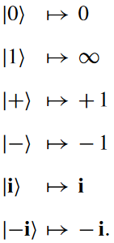
Chap 2 Single-Qubit Quantum Systems State space of single-qubit system
Extended complex plane (with added )
Correspondence between the set of all complex numbers and single-qubit states

Slide 25

Chap 2 Single-Qubit Quantum Systems State space of single-qubit system
Bloch sphere
Starting with the previous representation, map each state represented by the complex number onto the unit sphere in 3D
The points via the standard stereographic projection map

Slide 26
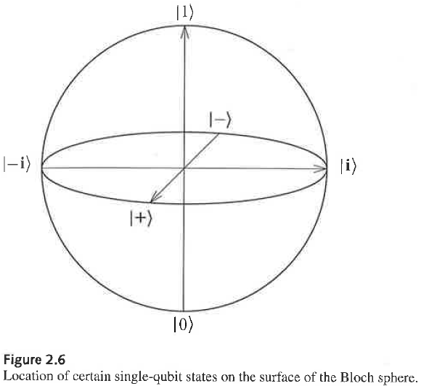
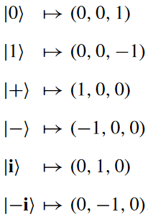
Chap 2 Single-Qubit Quantum Systems State space of single-qubit system

Slide 27

Chap 2 Single-Qubit Quantum Systems State space of single-qubit system
3 representations of single-qubit state space
1. Vectors in ket notation with complex coeficients subject to
Where are unique up to a unit complex factor
Representation not one-to-one
2. Extended complex plane
One-to-one representation
3. Bloch sphere
One-to-one representation

