Slide 1
Problems & Solutions, Steeb & Hardy Chapter 1
Drs. Charles Tappert and Ron Frank
The information presented here, although greatly condensed, comes almost entirely from the textbook

Slide 2
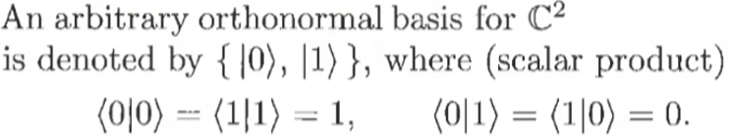
Chapter 1 – Qubits

Slide 3
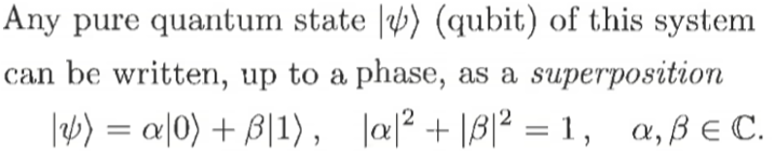

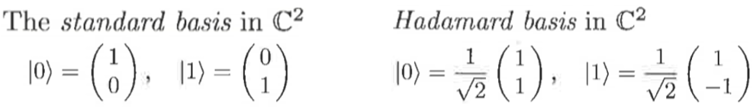
Chapter 1 – Qubits

Slide 4
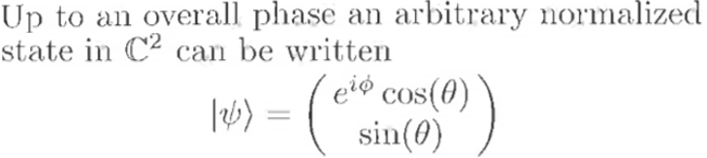
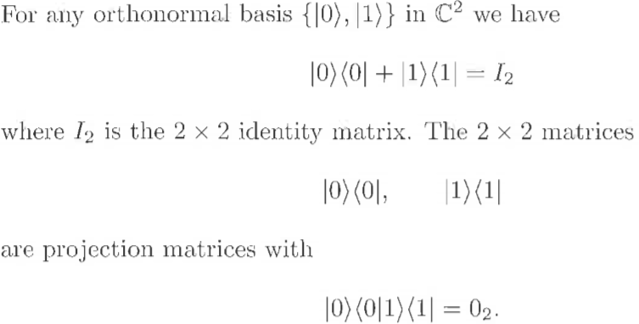
Chapter 1 – Qubits

Slide 5
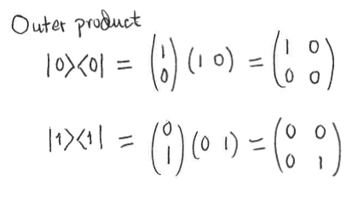
Chapter 1 – Qubits

