Slide 1
Quantum Computation and Information
Chap 1 Intro and Overview: p 1-28
Dr. Charles Tappert
The information presented here, although greatly condensed, comes almost entirely from the course textbook: Quantum Computation and Quantum Information by Nielsen & Chuang

Slide 2
1.1 Global Perspectives
This chapter develops in broad brushstrokes a picture of the field of quantum computation and quantum information
  Detail comes in later chapters
Quantum computation and quantum information is the study of the information processing tasks that can be accomplished using quantum mechanical systems

Slide 3
1.1.1 History
Early 1920s – creation of the modern theory of quantum mechanics
  Quantum mechanics is the math framework or set of rules for the construction of physical theories
  The rules are simple but can be counterintuitive
Early 1980s – idea of signaling faster than light hinged on cloning an unknown quantum state
  No-cloning theorem showed this not possible

Slide 4
1.1.1 History (cont)
1970s – interest started in obtaining complete control over single quantum systems
  Modest success to date
  Small quantum computers capable of doing dozens of operations on a few quantum bits (or qubits)
  Experimental prototypes were demonstrated for doing quantum cryptography, secret communication over long distances

Slide 5
1.1.1 History (cont)
Modern incarnation of computer science
  1936 – Alan Turing’s paper on an abstract idea of a programmable computer, Universal Turing Machine
  Church-Turing thesis – any algorithmic process can be simulated using a Turing machine
  Electronic component von Neumann machines
  1947 – transistor invention increased development
    Vacuum tubes, transistors, integrated circuits
  1960s – Moore’s law: computing power doubles every two years

Slide 6
1.1.1 History (cont)
Modern incarnation of computer science
  Efficient (polynomial time) versus inefficient (super-polynomial, usually exponential) algorithm
  Strong Church-Turing thesis: any algorithmic process can be simulated efficiently using a Turing machine
  Mid 1970s – the Solovay-Strassen randomized algorithm for testing whether an integer is prime
  Stronger Church-Turing thesis: any algorithmic process can be simulated efficiently using a probabilistic Turing machine

Slide 7
1.1.1 History (cont)
In 1985, trying to further extend the Church-Turing thesis, David Deutsch tried to define a computational device capable of simulating efficiently an arbitrary physical system
  Because the laws of physics are ultimately quantum mechanical he thought of quantum devices
  At this time, it is not clear whether Deutsch’s notion of a Universal Quantum Computer is correct
  He did show that quantum computers might have computing powers greater than classical computers

Slide 8
1.1.1 History (cont)
In 1994, Peter Shor showed that two important problems could be solved efficiently on a quantum computer
  Finding prime factors and the ‘discrete logarithm’
  Giving further indication that quantum computers are more powerful than classical computers
In 1995, Lov Grover found another problem that could be sped up on a quantum computer
  Search through some unstructured search space

Slide 9
1.1.1 History (cont)
At this time, mid 1990s, many came to believe Richard Feynman’s 1982 idea that computers could be based on quantum mechanics
But designing good quantum algorithms is hard
  Human intuition is rooted in the classical world
  To be interesting, the algorithm must be better than any existing classical algorithm

Slide 10
1.1.1 History (cont)
Switching topics, in 1948 Claude Shannon created modern information theory
Quantum information theory followed
  In 1995, Ben Schumacher provided an analog to Shannon’s noiseless coding theorem
  Although no analog exists to Shannon’s noisy channel coding theorem, we do have a class of quantum error-correcting codes (CSS codes, after the 1996 inventors Calderbank, Shor, and Steane)

Slide 11
1.1.1 History (cont)
Transmitting classical information using a quantum channel
  In 1992 Charles Bennett and Stephen Wiesner explained how to transmit two bits with one qubit
    Called superdense coding (more in chapter 2)
Networked information theory is a rich subject
  But networked quantum information theory is in its infancy

Slide 12
1.1.1 History (cont)
Networked quantum information theory
  Sending quantum information from Alice to Bob through a noisy quantum channel with zero capacity for quantum information is impossible
  However, with two copies of the channel and reversing the direction of one of the channels, non-zero transmission capacity is possible (Fig. 1.1)

Slide 13
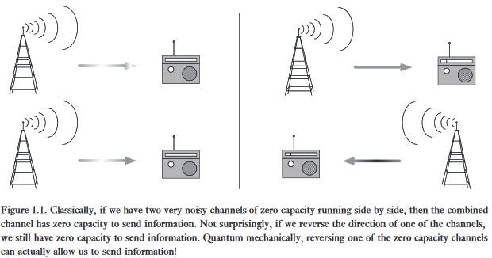
1.1.1 History (cont)

Slide 14
1.1.1 History (cont)
Switching topics again, now to cryptography
  We have public and private key cryptosystems
  A fundamental problem with private key cryptosystems is distributing the key
    Quantum key distribution solves this problem (1984)
      Now used in limited-scale real-world applications
  The problem with public key systems, like RSA, is that they depend on the difficulty of certain math problems like the factoring of large integers
    But quantum computing may soon speed up factoring

Slide 15
1.1.1 History (cont)
We have looked at the historical antecedents for quantum computation and information
But, as the field has grown, it has sprouted its own subfields of research in the quantum arena
  Perhaps the most striking is quantum entanglement
  Many researchers believe that further study of quantum entanglement will lead to new applications

Slide 16
1.1.2 Future Directions
Notions we learned may yield future results
  Think physically about computation
  Any physical theory, not just quantum mechanics, could be the basis for information processing and communication
  Also, we should think computationally about physics

Slide 17

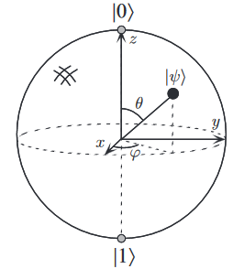
1.2 Quantum Bits or Qubits
Qubit = basic concept of quantum computing
  Qubits are abstract mathematical objects
  A qubit has two possible states, |0> and |1>
  And superpositions
    where α and β are complex numbers, and α²+ β² = 1
  Also
Bloch sphere representation of a qubit as a point on a sphere

Slide 18
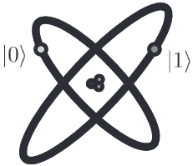

1.2 Quantum Bits or Qubits
Many physical systems realize qubits, and their existence and behavior validated by experiment
  Two different polarizations of a photon
  Nuclear spin alignment in a uniform magnetic field
  Two states of an electron orbiting an atom
ground state and excited state and a 50%-50% state denoted
that is

Slide 19
1.2.1 Multiple Qubits
A two qubit system has four computational basis states denoted
A pair of qubits can exist in superpositions of these four states with complex coefficients called amplitudes
And the possible measurement results occur with probabilities

Slide 20

1.2.1 Multiple Qubits
An important two qubit state is the Bell state or EPR pair (for Einstein, Podolsky, and Rosen)
Measured results are unexpectedly correlated
  Measuring the 2nd qubit gives the same result as 1st
These strange measurement correlations are stronger than could exist in classical systems

Slide 21
1.2.1 Multiple Qubits
Consider a system of n qubits
  The computational basis states are
  And a quantum state is specified by 2^{n} amplitudes
  So, for n=500, this number of amplitudes is larger than the number of atoms in the universe
  This enormous potential computing power is something we would like to exploit

Slide 22
1.3 Quantum Computation
Classical computer built from electrical circuit
  Containing wires and logic gates
Quantum computer built from quantum circuit
  Wires and quantum gates to carry around and manipulate the quantum information

Slide 23
1.3.1 Single Qubit Gates
Classical computers have only one non-trivial single bit gate
  The NOT gate
Quantum computers can have infinitely many single qubit gates
  Each described by a unitary two-by-two matrix U
    Unitary means obtained by transposing and then complex conjugating U

Slide 24

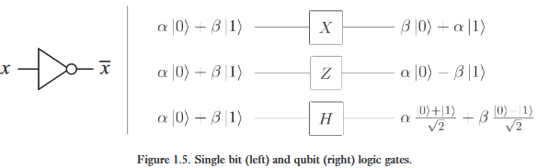
1.3.1 Important Single Qubit Gates

Slide 25
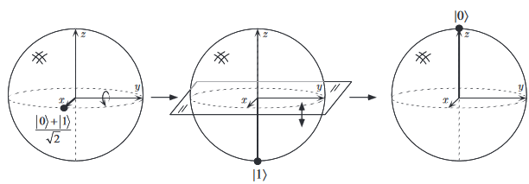
1.3.1 Hadamard (H) Single Qubit Gate
Hadamard operation = rotation about y axis by 90⁰, followed by rotation about x axis by 180⁰

Slide 26
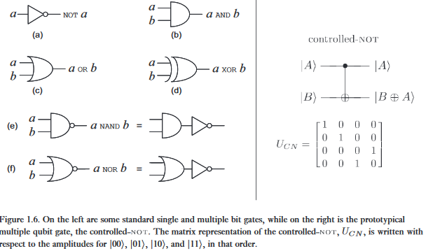
1.3.2 Multiple Qubit Gates
Classical (left), Quantum (right)

Slide 27
1.3.2 Multiple Qubit Gates
Prototypical quantum controlled–NOT gate
  Two input qubits: control qubit and target qubit
    If the control qubit is set to 0, target qubit is left alone
    If the control qubit is set to 1, target qubit is flipped

Slide 28
1.3.2 Multiple Qubit Gates
Classical NAND gate is universal – any function on bits can be computed from only NAND gates
A similar quantum universality result – any multiple qubit logic gate can be composed from controlled-NOT and single qubit gates

Slide 29
1.3.2 Multiple Qubit Gates
Classical versus quantum gates
  All quantum gates are reversible because the inverse of a unitary matrix is also unitary
  However, many classical gates, like NAND and XOR, are irreversible or non-invertible because it is not possible to determine what the inputs were
    Thus, an irretrievable loss of information occurs
  Understanding how to do classical logic in this reversible way will be crucial in understanding how to harness the power of quantum computing

Slide 30
1.3.3 Measurements in Bases Other Than the Computational Basis
So far, a qubit in a state has been described using the basis states
Other bases can be used, and its importance is to describe experimental results (section 2.2.3)

Slide 31
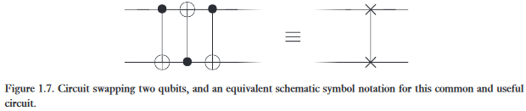

1.3.4 Quantum Circuits
additions are modulo 2

Slide 32
1.3.4 Quantum Circuits
Classical circuits not present in quantum circuits
  Loops – therefore, quantum circuits are acyclic
  Fan-in – wires joined together
  Fan-out – produces copies of a bit

Slide 33
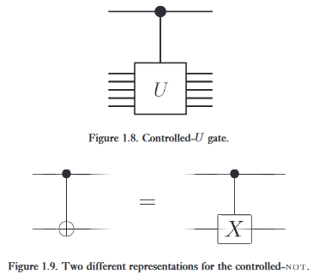
1.3.4 Quantum Circuits
Top line is control qubit
U = any unitary matrix
Matrix X = quantum not gate

Slide 34

1.3.4 Quantum Circuits
Quantum measurement circuit
  Converts qubit state into a bit M
    Result = 0 with probability α², 1 with probability β²

Slide 35
1.3.5 Qubit Copying Circuit?
This section shows that qubits can’t be copied
This is known as the no-cloning theorem
This is a key difference between quantum and classical information

Slide 36
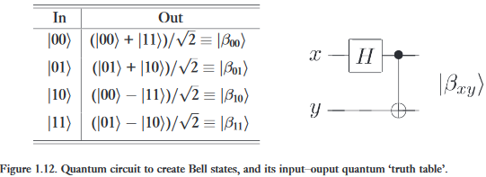
1.3.6 Example: Bell States

Slide 37
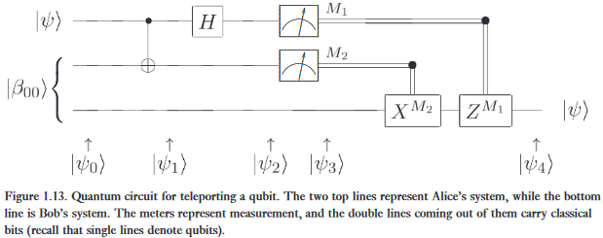
1.3.7 Example:
Quantum Teleportation
Quantum teleportation is a technique for moving quantum states around

Slide 38
1.3.7 Example:
Quantum Teleportation
Quantum teleportation has interesting features
  It emphasizes the different quantum resources
    In particular, chap 10 explains how it is used to build quantum gates resistant to noise, and chap 12 explains how it is connected with properties of quantum error-correcting codes
  However, it does not
    Enable faster-than-light communication
    And does not violate the no-cloning theorem

