Slide 1
Quantum Computation and Information
Chap 1 Intro and Overview: p 28-58
Dr. Charles Tappert
The information presented here, although greatly condensed, comes almost entirely from the course textbook: Quantum Computation and Quantum Information by Nielsen & Chuang

Slide 2
1.4 Quantum Algorithms
What class of computations can be performed using quantum circuits?
  Can quantum circuits do everything that classical circuits can do?
    Yes, quantum mechanics can explain everything
Are there tasks that can be performed better on a quantum computer?

Slide 3
1.4.2 Classical Computations on a Quantum Computer
We can simulate a classical logic circuit with a quantum circuit? Yes! Toffoli gate does this.
  A classical circuit can be replaced by an equivalent circuit containing only reversible elements by using Toffoli gates that can simulate NAND gates
  The Toffoli gate can be implemented as either a classical gate or a quantum gate

Slide 4
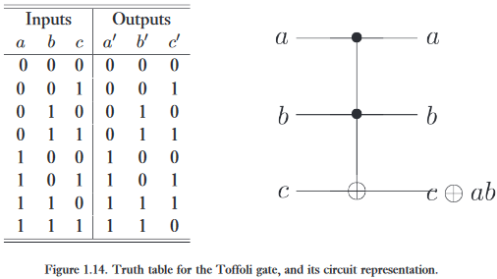
1.4.1 Classical Computations on a Quantum Computer

Slide 5
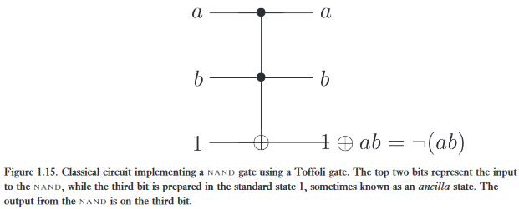
1.4.1 Classical Computations on a Quantum Computer
Therefore, a quantum computer can perform any computation possible on a classical computer

Slide 6
1.4.2 Quantum Parallelism
Quantum Parallelism is a fundamental feature of many quantum algorithms
  Can evaluate (one-bit domain and range) for different x values simultaneously
  To compute on a quantum computer, let a two qubit computer start in state and transform this state into
  Let be defined by the map
  If y=0, then the final state of the 2nd qubit is f(x)

Slide 7
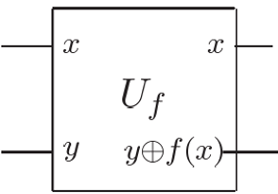
1.4.2 Quantum Parallelism
performs the mapping

Slide 8


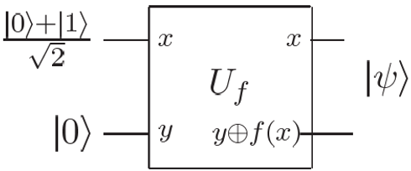
1.4.2 Quantum Parallelism
Now, recall Hadamard
  turns
  and
Now we use the output of as input to

Slide 9
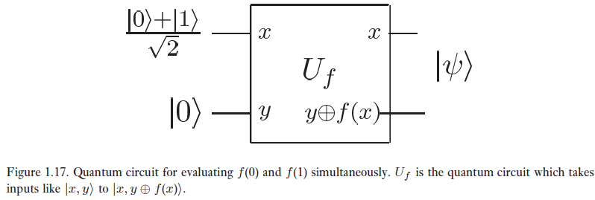
1.4.2 Quantum Parallelism
If y=0, then the final state of the 2nd qubit is f(x)

Slide 10

1.4.2 Quantum Parallelism
The resulting state is
This result is remarkable because it evaluates f(0) and f(1) simultaneously

Slide 11
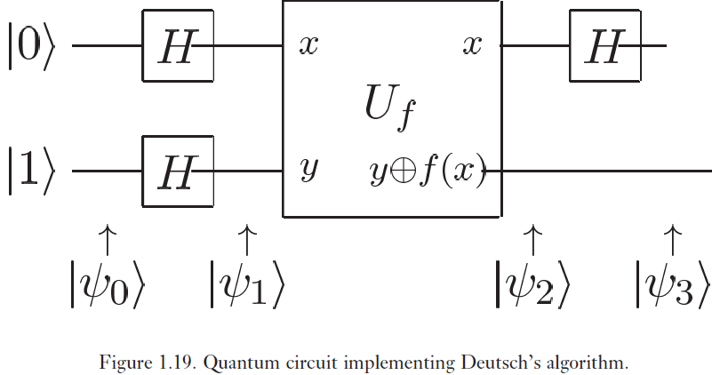
1.4.3 Deutsch’s Algorithm
Deutsch’s algorithm comes from a simple modification to the previous circuit

Slide 12


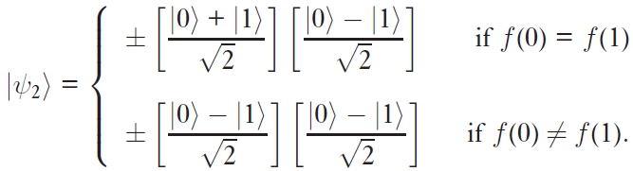
1.4.3 Deutsch’s Algorithm
is sent through two Hadamard gates to give
which then yields

Slide 13
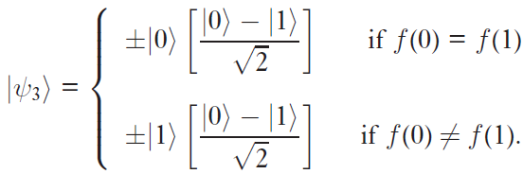

1.4.3 Deutsch’s Algorithm
The final Hadamard gate on the 1st qubit gives
Since rewrite this as
This quantum circuit computes a global property of f(x) with only one evaluation of f(x) which is faster than possible on a classical machine

Slide 14
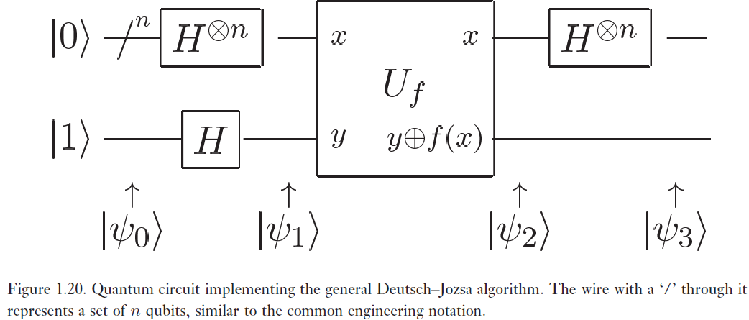
1.4.4 Deutsch-Jozsa Algorithm

Slide 15
1.4.5 Quantum Algorithms Summarized
Deutsch’s and Deutsch-Jozsa algorithms suggest that quantum computers can solve some problems more efficiently than classical computers but the problems they solved are of little interest
Are there more interesting problems solved more efficiently on quantum computers?
  Yes, three classes of algorithms: those based on quantum Fourier transform, quantum search, and quantum simulation

Slide 16

1.4.5 Quantum Algorithms Summarized
Quantum Fourier Transform Algorithms
Usual discrete Fourier transform
A generalized theory of the Fourier transform has been developed using finite groups
  Not described here
  Hadamard transform in Deutsch-Jozsa does this
  Most important quantum Fourier algorithms
    Shor’s fast algorithms for factoring and discrete logarithm

Slide 17
1.4.5 Quantum Algorithms Summarized
Quantum Fourier Transform Algorithms
How fast is the quantum Fourier transform?
  Classical
  Quantum
Not so easily done
  The information is hidden in the amplitudes of the quantum states
  Cleverness is required to obtain the result
More in chapter 5

Slide 18
1.4.5 Quantum Algorithms Summarized
Quantum Search Algorithms
Problem: given a search space of size N, find an element satisfying a known property
Classical versus quantum
  Classical – N operations
  Quantum – sqrt(N)
  While only a quadratic speedup, search covers a wider range of applications
More in chapter 6

Slide 19
1.4.5 Quantum Algorithms Summarized
Quantum Simulation
Simulating naturally occurring quantum mechanical systems
  Difficult on classical computers
    Storing quantum state size of n takes c^{n} bits of memory
      c is a constant that depends on the system simulated
  Quantum computers do better
    Use kn qubits
      k is a constant that depends on the system simulated

Slide 20
1.4.5 Quantum Algorithms Summarized
Power of Quantum Computation
Two important complexity classes: P and NP
  P = class of problems that can be solved quickly
  NP = class of problems whose solutions can be quickly checked
    Example: finding prime factors of an integer
  We don’t know whether P = NP or not
PSPACE = small computer space but long computation time problems
  Believed to be strictly larger than P and NP
Now we define BQP as the class of problems solved efficiently on a quantum computer

Slide 21
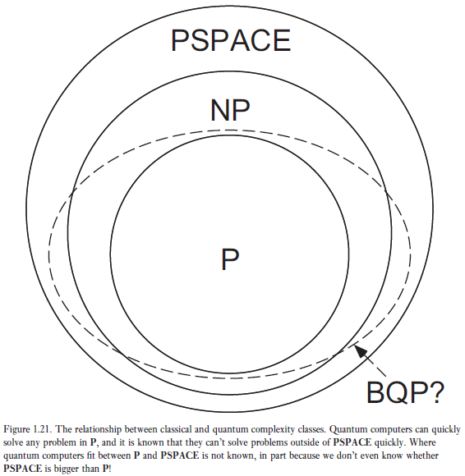
1.4.5 Quantum Algorithms Summarized
Power of Quantum Computation

Slide 22
1.5 Experimental Quantum Information Processing
  Skip for now

