Slide 1
Chap 2.2 Postulates of Quantum Mechanics: p 80-97
Dr. Charles Tappert
The information presented here, although greatly condensed, comes almost entirely from the course textbook: Quantum Computation and Quantum Information by Nielsen & Chuang

Slide 2
2.2 Postulates of Quantum Mechanics
Quantum mechanics is the math framework for the development of physical theories
The basic postulates below were derived after a long process of trial and (mostly) error
The motivation for the postulates is not always clear and appear surprising even to experts

Slide 3
2.2.1 Postulate 1: State Space
Associated to any isolated physical system is a Hilbert space (complex vector space with inner product) known as the system state space
The system is completely described by its state vector, a unit vector in the system state space

Slide 4


2.2.1 Postulate 1: State Space
The simplest quantum mechanical system, our fundamental system, is the qubit
  2D state space with orthonormal basis
  With arbitrary state vector as the superposition of the basis states
  For example, the state
  is a superposition of the states

Slide 5
2.2.2 Postulate 2: Evolution
The evolution of a closed quantum system is described by a unitary transformation U
  Operator U changes the state from t₁ to t₂
For single qubits, any unitary operator can be realized in realistic systems

Slide 6

2.2.2 Postulate 2: Evolution
Examples: Pauli unitary matrices X, Y, Z
Hadamard gate H matrix representation

Slide 7
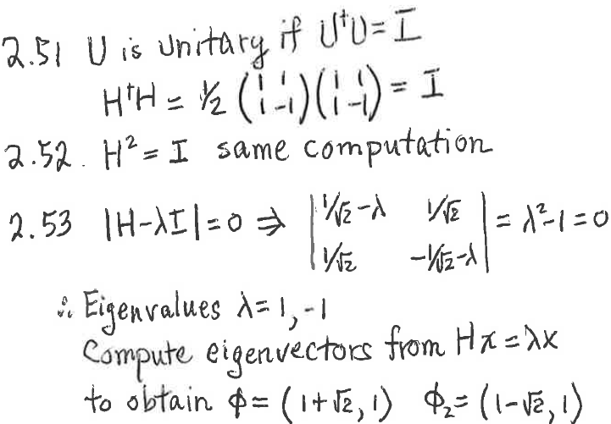
2.2.2 Postulate 2: Evolution
Homework exercises 2.51-2.53, page 82

Slide 8

2.2.2 Postulate 2’:
Continuous Evolution
Schrödinger’s equation describes the time evolution of a closed quantum system state
  h bar is Plank’s constant, often absorbed into H
  is the wave function of the quantum system
  H is the Hamiltonian (Hermitian) operator which characterizes the total energy of the system (note: H is also used for the Hadamard operator)

Slide 9

2.2.2 Postulate 2’:
Continuous Evolution
H is a Hermitian operator with decomposition
  eigenvalues E, eigenvectors (energy eigenstates)
  E is the energy of the state
  The lowest energy is known as ground state energy and the corresponding eigenstate as ground state
  In time they acquire a numerical factor

Slide 10
2.2.2 Postulate 2’:
Continuous Evolution
Example: suppose (Pauli’s operator X)
  where ω is an experimentally determined parameter
  eigenstates of this Hamiltonian are those of X

Slide 11
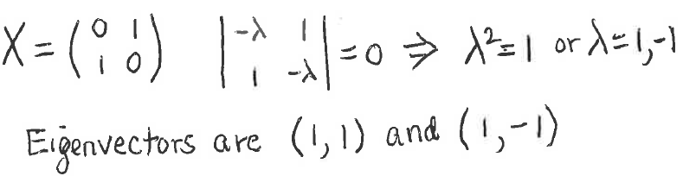


2.2.2 Postulate 2’:
Continuous Evolution
Example: suppose (Pauli’s operator X)
  Eigen computation
  Thus, energies (eigenvalues) are
  & states (eigenvectors)

Slide 12


2.2.2 Postulate 2’:
Continuous Evolution
Connection between postulates 2’ and 2
  Solution to Schrödinger’s equation is
  where we define
  Exercises show U unitary and realized
  Thus, one-to-one correspondence between the discrete-time and continuous-time descriptions
  This book primarily uses the unitary formulation

Slide 13



2.2.3 Postulate 3:
Quantum Measurement
Quantum measurements are described by a set of measurement operators on state space
  Index m refers to measurement outcomes
  If is state before measurement, then probability that result m occurs is and the state after the measurement is
  Operators satisfy completeness equation
    probabilities sum to one

Slide 14

2.2.3 Postulate 3:
Quantum Measurement
Important example: measurement of a qubit
  Two measurement operators
  Operators Hermitian, so
  Completeness obeyed
  If state measured is
    probability outcome 0 is
  State after measurement is
    Multipliers like
    can be ignored

Slide 15
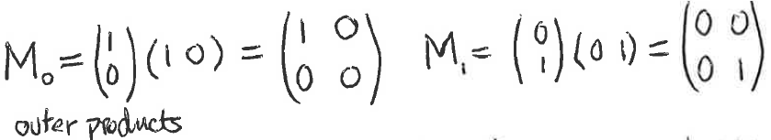

2.2.3 Postulate 3:
Quantum Measurement
Measurement of a qubit – computations
  Thus and
  For
  Computing

Slide 16
2.2.4 Distinguishing Quantum States
(application of postulate 3)
In classical physics, states of an object are distinguishable
  Like whether a coin has landed heads or tails
In quantum mechanics, it is more complex
In a quantum system, given the states
  If states are orthonormal, they are distinguishable, meaning measurable
  Otherwise, they are not distinguishable
We omit the proof

Slide 17


2.2.5 Projective Measurements
(special case of postulate 3)
A projective measurement is described by an observable Hermitian operator M on the system state space being observed
  Observable M has a spectral decomposition
  P_{m} = projector onto the eigenspace of M with eigenvalue m
  Outcomes correspond to eigenvalues m of M
  On measuring state , prob of getting m is
  And the state after measurement is

Slide 18


2.2.6 POVM Measurements
POVM = Positive Operator-Valued Measure
POVM is an elegant and widely used math tool for determining outcome probabilities
Suppose comes from quantum state
  Then outcome probability
  Suppose we define
  Then is a positive operator such that
  And operators determine outcome probabilities
  The complete set is known as a POVM

Slide 19

2.2.7 Phase
Meaning of ‘phase’ depends on the context
  Consider the state where is a state vector and θ a real number
    Then
    And measurement of the two states are identical
  Relative phase has a different meaning
    Consider the states
    In 1st state amplitude of = and in 2nd =
    These amplitudes, a and b, differ only in phase if for some θ,

Slide 20

2.2.8 Postulate 4:
Composite Systems
The state space of a composite physical system is the tensor product of the state spaces of the component physical systems
  Joint state of total system =

Slide 21

2.2.8 Postulate 4:
Composite Systems
We now define entanglement, one of the most interesting and puzzling quantum phenomena
Consider the composite two qubit state
  Remarkable property: there exist no single qubit states such that
  A state of a composite system with this property is called an entangled state

Slide 22
2.2.9 Quantum Mechanics:
A Global View
Most of the rest of the book derives consequences from the postulates
Postulate overview
  Specifies how a quantum system state is described
  Schrödinger equation describes quantum system dynamics
  Extracting quantum system information by measurement
  Describes how to combine state spaces of different quantum systems into a composite system

