Slide 1
Quantum Computation and Information
Preface and Nomenclature
Dr. Charles Tappert
The information presented here, although greatly condensed, comes almost entirely from the course textbook: Quantum Computation and Quantum Information by Nielsen & Chuang

Slide 2
Purpose of the Book
Introduce the background material in computer science, mathematics, and physics necessary to understand quantum computation and quantum information
Develop the central results of quantum computation and quantum information

Slide 3
Structure of the Book
Part I provides main ideas & results of the field
  With background in quantum mechanics and CS
Part II describes quantum computation in detail
  Two fundamental quantum computing algorithms
    Quantum Fourier transform and quantum search
Part III concerns quantum information
  What it is, how it is represented and communicated using quantum states, and how to deal with the corruption of quantum and classical information

Slide 4
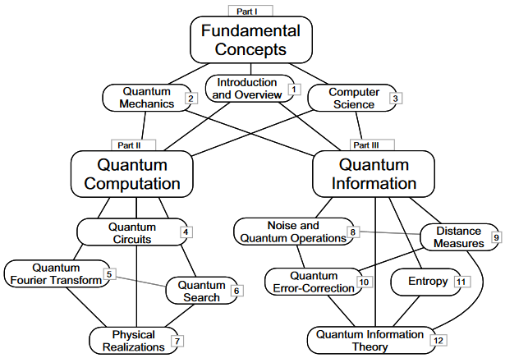
Structure of the Book

Slide 5
Exercises and Problems
Exercises appear in the text of each chapter and are intended to solidify understanding
  Should be easily solved with a few minutes work
Problems appear at the end of each chapter and are intended to introduce new material

Slide 6
How to Use This Book
Can be the basis for a variety of courses
  One-semester course on quantum computation
    Chapters 1-3 (selected material), chap 4-6, chap 7 (selected material), chap 8-10 with focus on 10
    We will also include a chap 12 section on cryptography
      Quantum key distribution – well-understood by Dr. Frank
  One-semester course on quantum information
  Full year course could cover all the material
Can be used for self study or as a reference

Slide 7
Further Reading and Errors
Each chapter has ‘History and further reading’
Errata
  Book’s errata - link not working
  Original errata

Slide 8
Nomenclature: Linear algebra and quantum mechanics
Positive operator A:
Positive definite operator A:
Operator support is vector space orthog. to its kernel
  For the Hermitian operator, the vector space spanned by the operator’s eigenvectors having non-zero eigenvalues
U denotes a unitary operator
H denotes the Hadamard quantum logic gate
  And sometimes the Hamiltonian

Slide 9
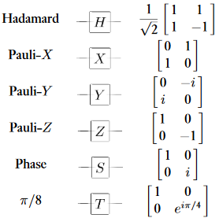
Nomenclature: Common Quantum Gates and Circuits
(not)

Slide 10
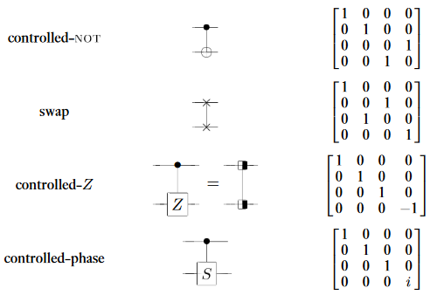
Nomenclature: Common Quantum Gates and Circuits
(controlled Pauli X)

Slide 11
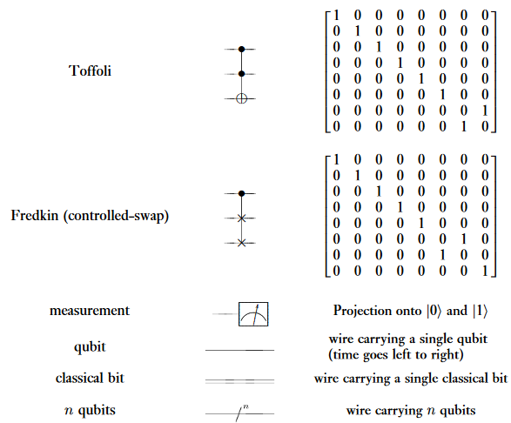
Nomenclature: Common Quantum Gates and Circuits
Toffoli gates can simulate classical NAND gates
(multi-controlled not)

