Slide 1
Quantum Computing, Rieffel & Polak Chapter 3
Drs. Charles Tappert and Ron Frank
The information presented here, although greatly condensed, comes almost entirely from the textbook

Slide 2
Chapter 3 – Multiple-Qubit Systems
The state space of a quantum system grows exponentially with the number of qubits
Large state spaces speed computation – main focus of book
Entangled states are a critical ingredient of quantum computation
Most states in a multiple-qubit system are entangled
Difference between the way classical and quantum states combine
Classical uses direct sum of two or more vector spaces
Quantum uses the tensor product of a set of vector spaces

Slide 3
Chapter 3 – Multiple-Qubit Systems 3.1 Quantum State Spaces
In classical physics, the possible states of n objects can be described by vectors in a vector space of 2n dimensions
In quantum physics, the state space of n quantum systems, each state modeled by a 2D vector, combined through the tensor product is 2^{n} dimensions

Slide 4
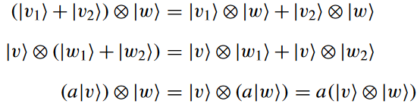
Chapter 3 – Multiple-Qubit Systems 3.1 Quantum State Spaces

Slide 5
Chapter 3 – Multiple-Qubit Systems 3.1 Quantum State Spaces

Slide 6

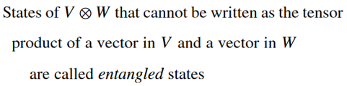
Chapter 3 – Multiple-Qubit Systems 3.1 Quantum State Spaces

Slide 7
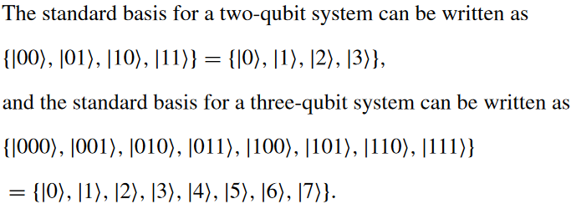
Chapter 3 – Multiple-Qubit Systems 3.1 Quantum State Spaces

Slide 8
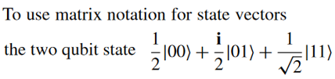
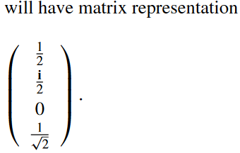
Chapter 3 – Multiple-Qubit Systems 3.1 Quantum State Spaces

Slide 9
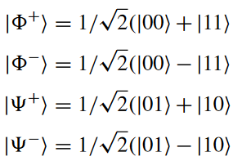
Chapter 3 – Multiple-Qubit Systems 3.1 Quantum State Spaces

Slide 10
Chapter 3 – Multiple-Qubit Systems 3.2 Entangled States
States that cannot be written as the tensor product of n single-qubit states are called entangled states
The vast majority of quantum states are entangled
The definition of entanglement has no reference to a basis
Most n-qubit states are superpositions
Nontrivial linear combinations of basis vectors
Helpful to think of superpositions as being in multiple states at once

Slide 11
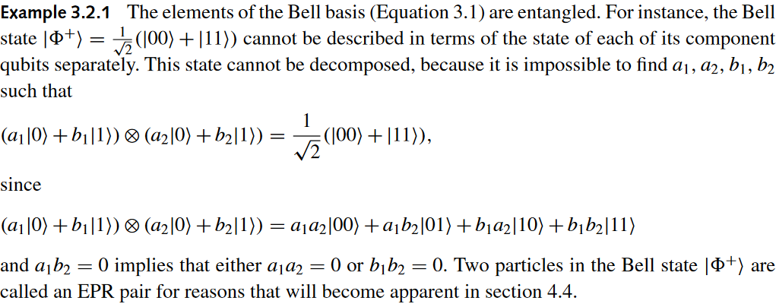
Chapter 3 – Multiple-Qubit Systems 3.2 Entangled States

Slide 12
Chapter 3 – Multiple-Qubit Systems 3.3 Basics of Multi-Qubit Measurement
Measurements of multi-qubit systems is similar to that of single qubit systems, except that the set of possible measurements and outcomes is significantly richer
Let V be the N=2^{n} dim vector space of n-qubit system

Slide 13
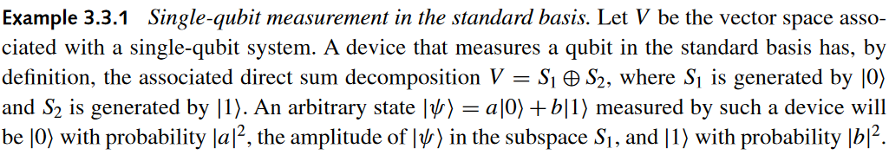
Chapter 3 – Multiple-Qubit Systems 3.3 Basics of Multi-Qubit Measurement

Slide 14
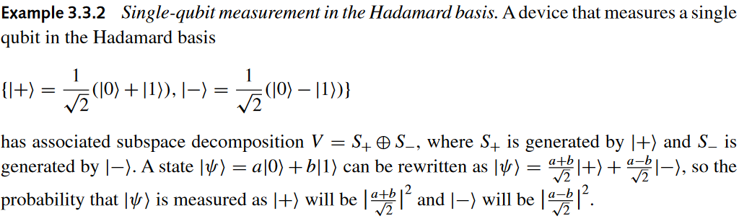
Chapter 3 – Multiple-Qubit Systems 3.3 Basics of Multi-Qubit Measurement

Slide 15

Chapter 3 – Multiple-Qubit Systems 3.4 Quantum Key Distribution with Entangled States
It is easy to prove the security of protocols based on quantum entangled states
The BB84 protocol described earlier begins with the creation of a sequence of pairs of qubits all in the entangled state

