Slide 1
Magenta Transformers

Slide 2
Task 1 - Classification
Problem: predict which team should receive new tickets
Solution:
using TF-IDF vectorized and simplification of categories
CatBoost
20% least frequent teams => “Other”
Result = 65%

Slide 3
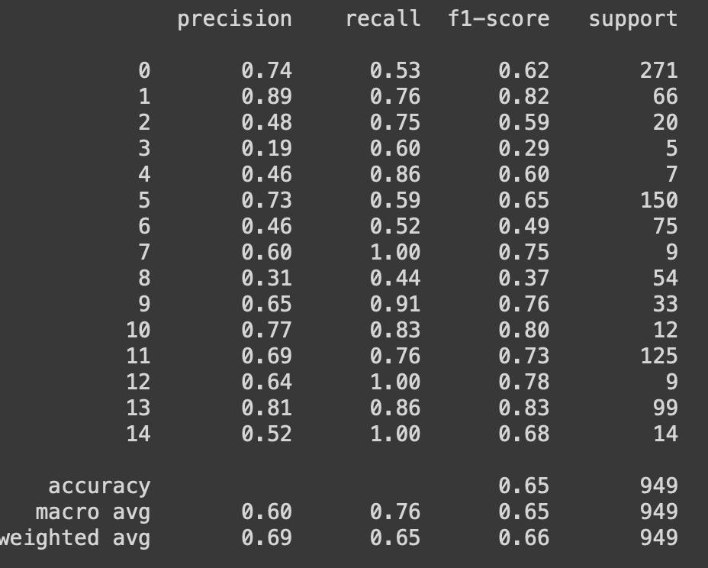
Accuracy on
categories

Slide 4
Task 2 - Regression
Problem: estimate solution time of new tickets
Solution:
Solution time calculated as difference between Opened date & Closed date
Solving time related features
CatBoost
Residuals = 0.83
Median = 113 h
Average = 834 h

Slide 5
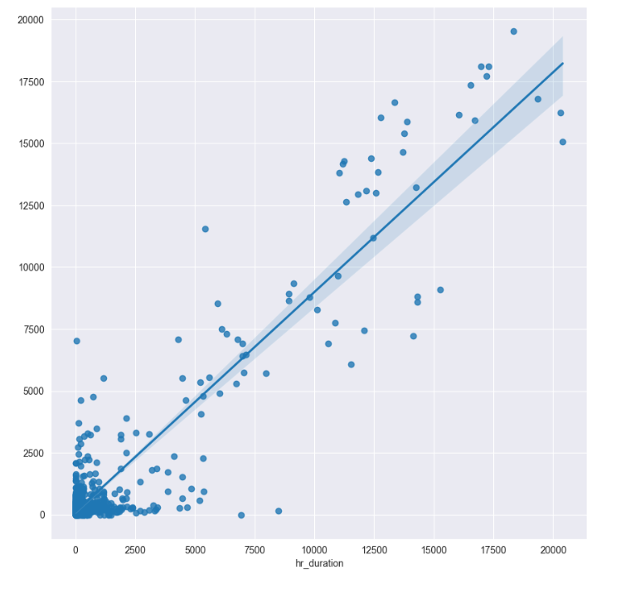

Slide 6
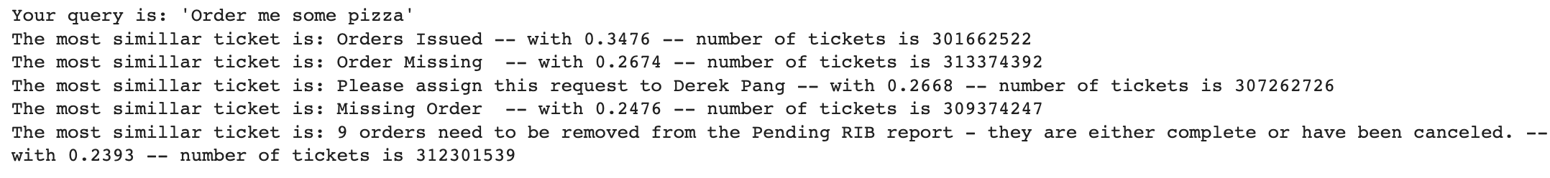
Task 3 – Semantic similarity
Problem: link incoming tickets with existing ones based on semantics
Solution:
Pretrained model (state of the art, transformer arch.)
All-mpnet-base-v2
Cosine similarity on 768 dim. vectors

Slide 7
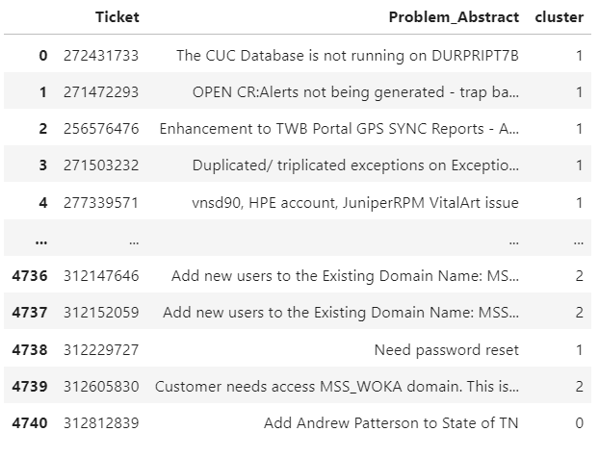
Task 4 – Semantic clustering
Problem: cluster tickets based on semantics
Solution:
K-means & PCA
Data cleaning
and word removal
3 Clusters

Slide 8
