Slide 1
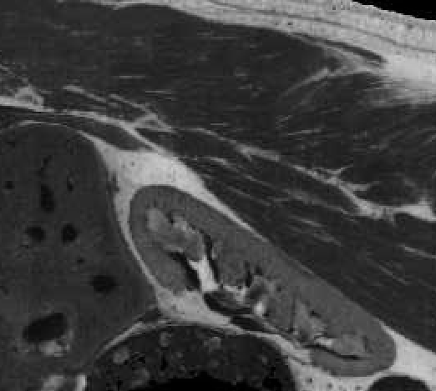
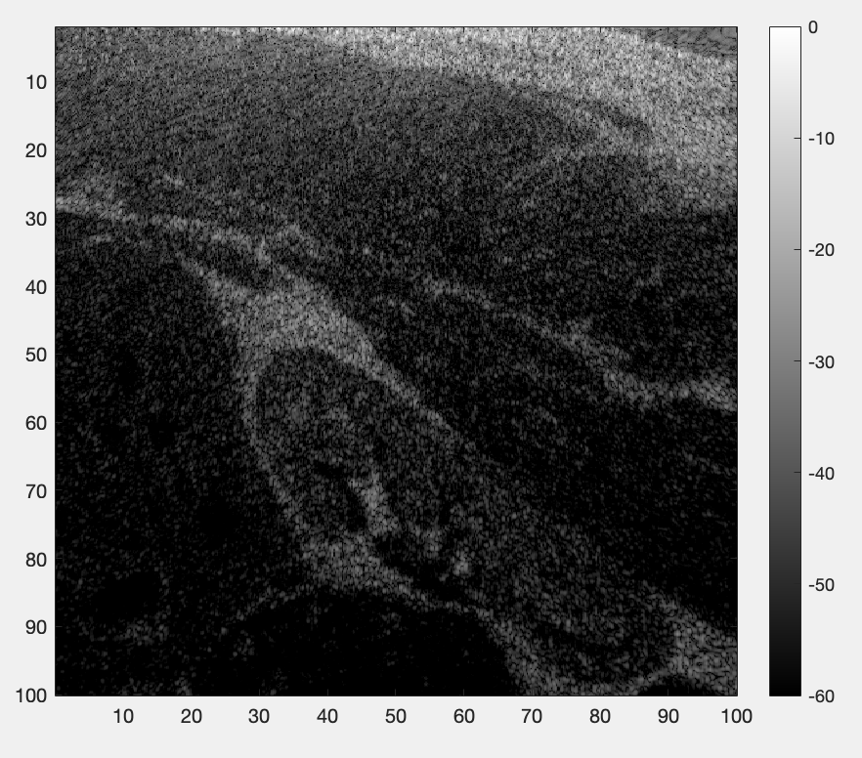
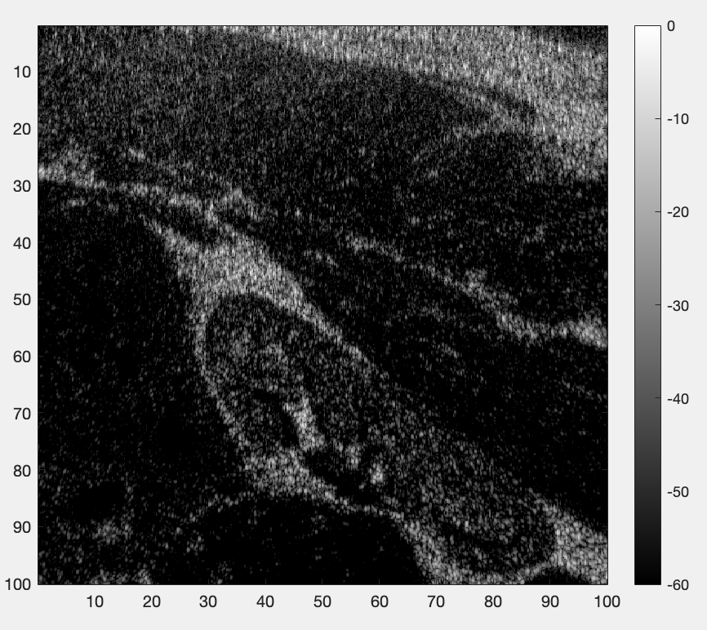
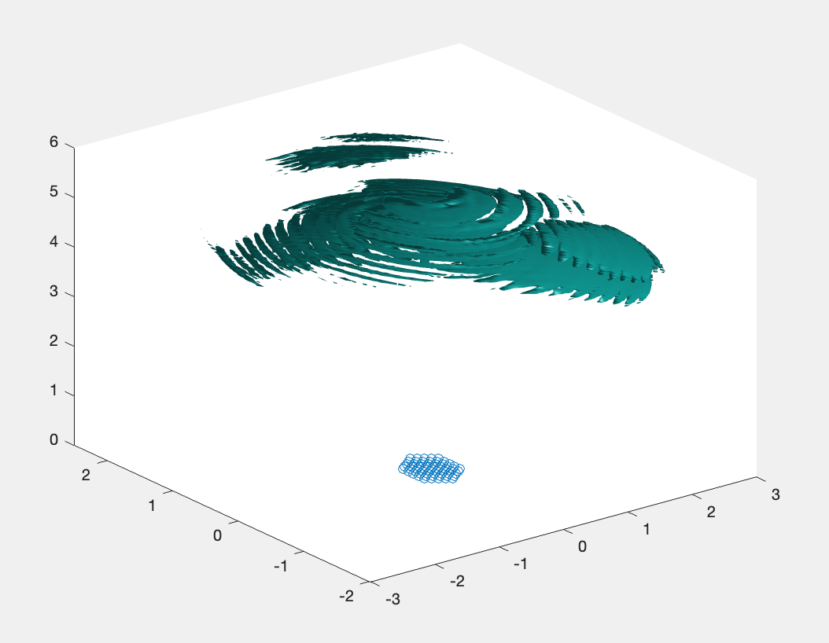
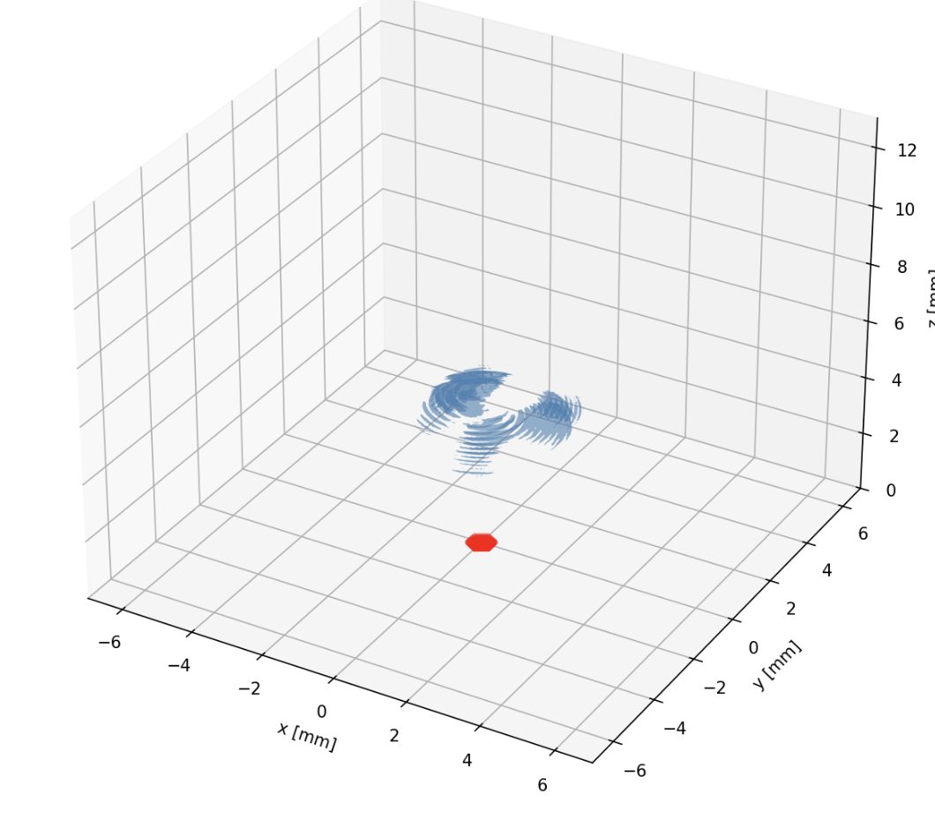
Goal: Improve resolution via beamforming
Algorithm Development in MATLAB
DAS (Delay and Sum), DMAS (Delay Multiply and Sum), Time Reversal (using MATLAB parfor / parallel computing toolbox)
Migration to Python
Performance Optimization
Benchmarking Python against MATLAB
Exploring GPU acceleration
Recreated algorithms in Python (using joblib for parallelism)
DAS
DMAS
Time Reversal
MATLAB
Python

