Slide 1
k_estimator.mlapp

Slide 2
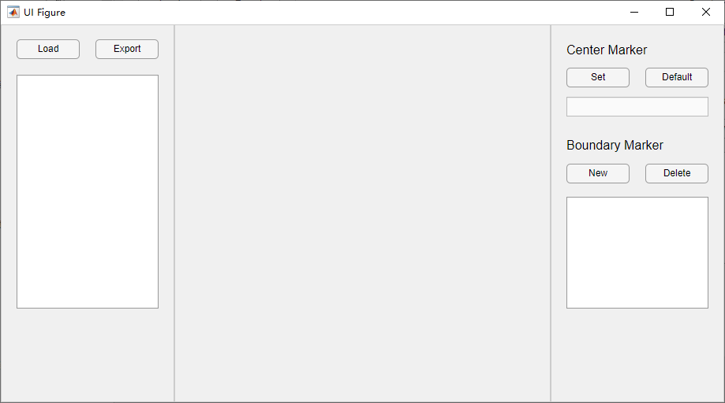
Step 1: Load a table that contains following fields:
1) Id: Image names of flat mount RPE images
2) Av: Average diameters of eyeballs
3) um_per_pixel
4) FilePath: paths to images

Slide 3
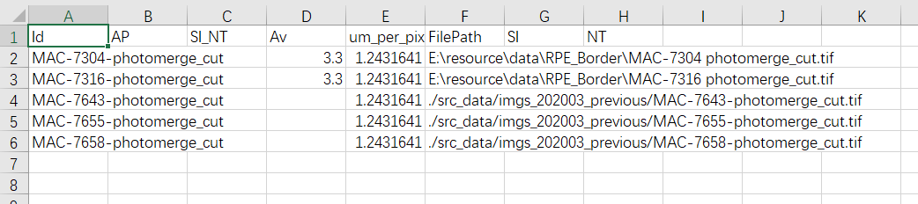
Input example

Slide 4
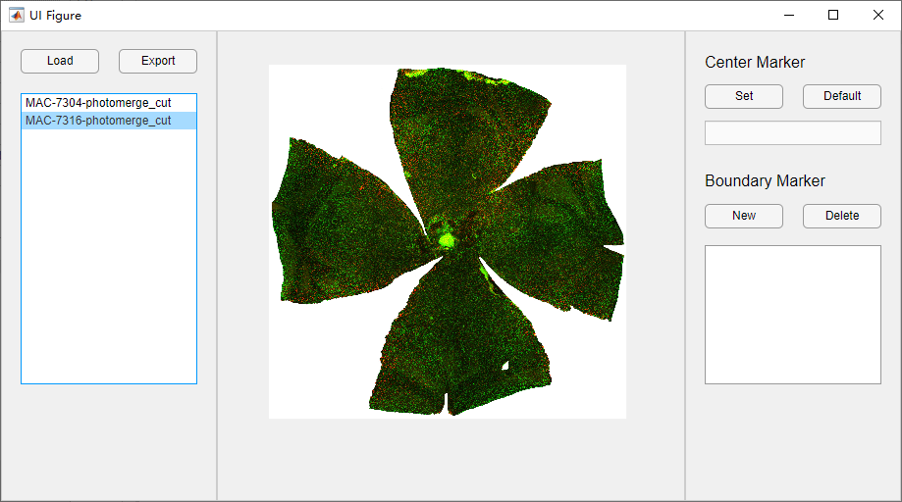
Step 2: Select an item in the list box
The selected image will be shown in the middle

Slide 5
Step 3: Mark the position of optic disc

Slide 6
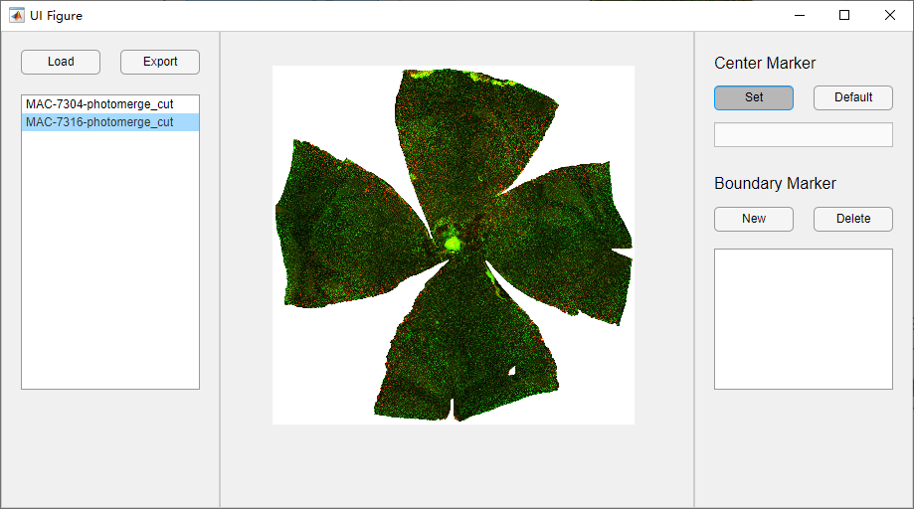
When the ‘Set’ button is pushed, user can click on the plot to set the position

Slide 7
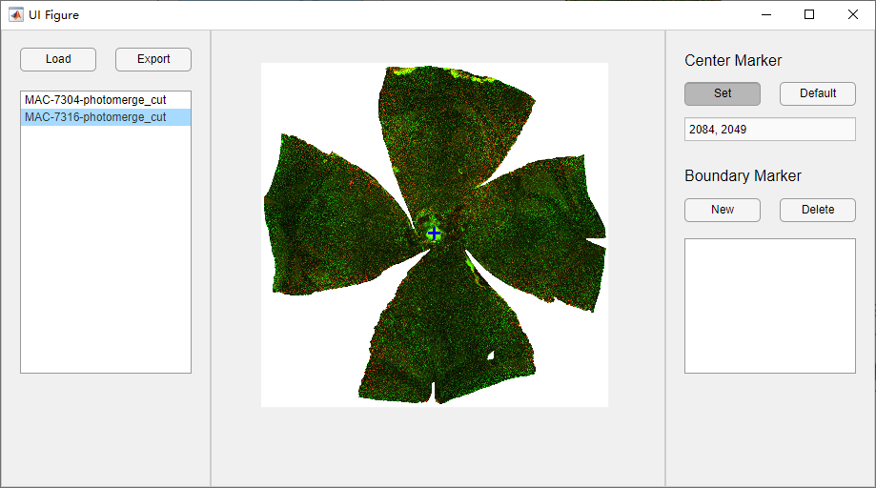
Click ‘Default’ button can set the position of the optic dis to the image center
Center marker

Slide 8
Step 4: Add a boundary marker

Slide 9
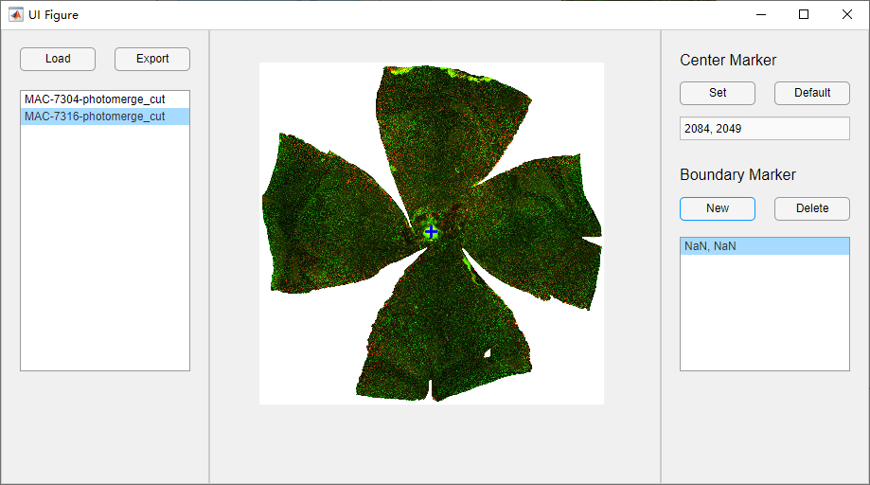
A new created marker does not have a position

Slide 10

The position of the currently selected marker can be changed by clicking mouse.

Slide 11
Clicking ‘Delete’ button can remove currently selected marker

Slide 12
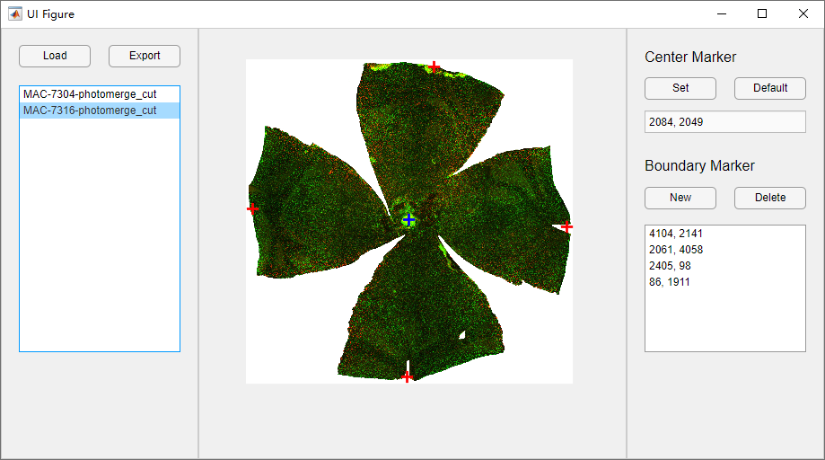
Step 5: After all images are marked, user can export a table that contains estimated coefficient k.
For each image, k_all is estimated with all data and k_mid is estimated with data in the middle (not include the regions near the optic disc and outer boundary).

Slide 13
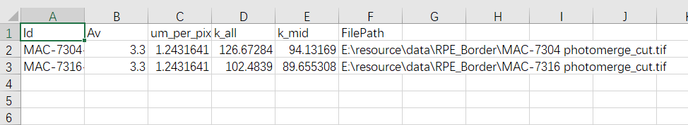
Output example

Slide 14
r_estimator.mlapp

Slide 15
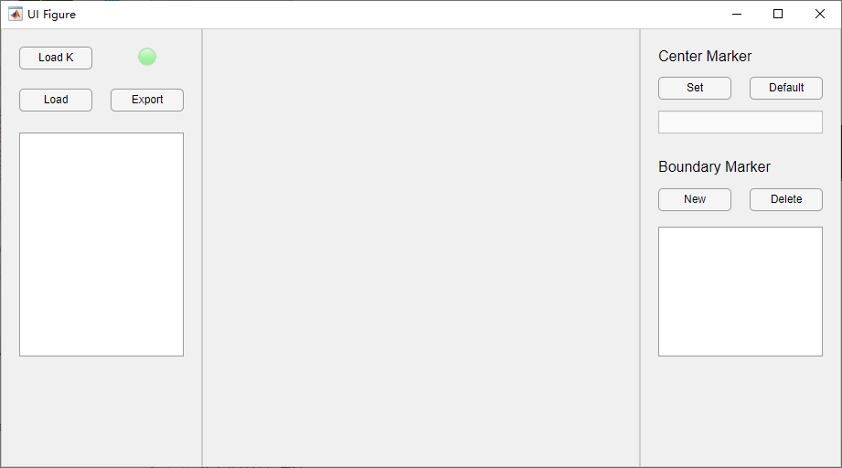
The usage of this app is quite similar to k_estimator.mlapp

Slide 16
Step 1: Load the table generated by k_estimator.mlapp

Slide 17
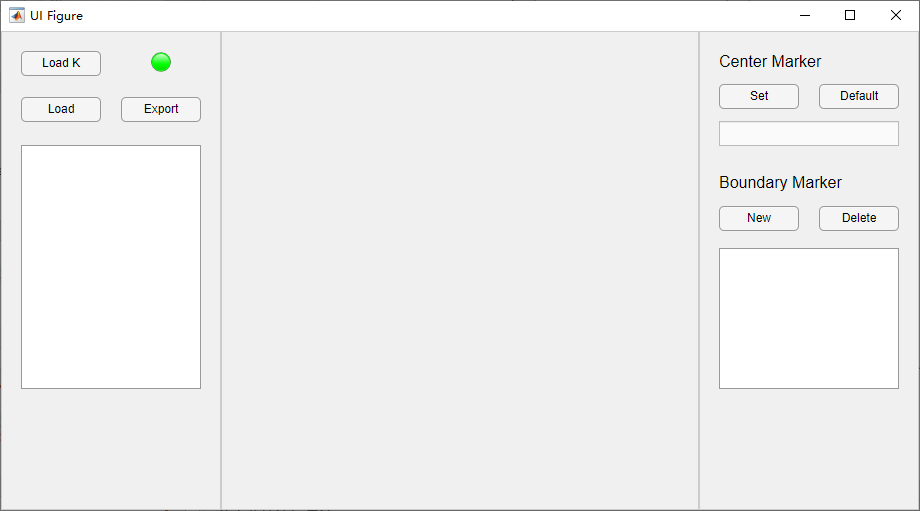
When coefficient k is loaded, the lamp will turn on.

Slide 18
Step 2: Load a table that contains following fields:
1) Id: Image names of flat mount RPE images
2) um_per_pixel
3) FilePath: paths to images

Slide 19
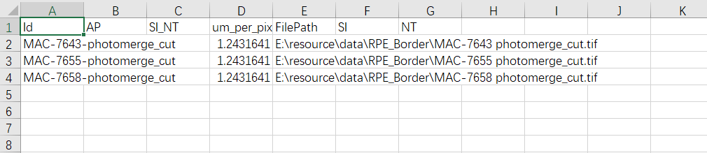
Input example

Slide 20
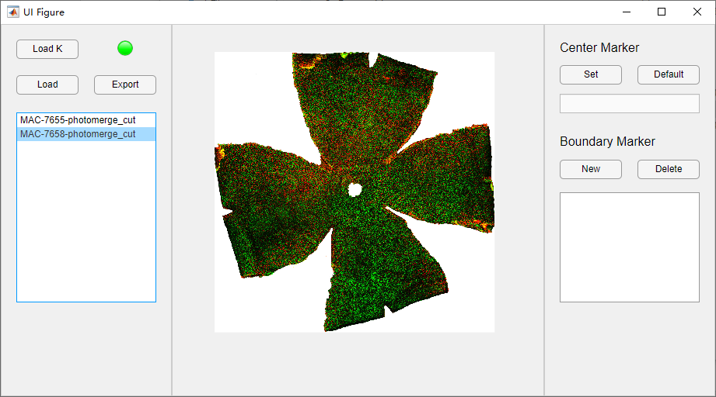
Step 3: Set markers (the same way as k_estimator.mlapp)

Slide 21
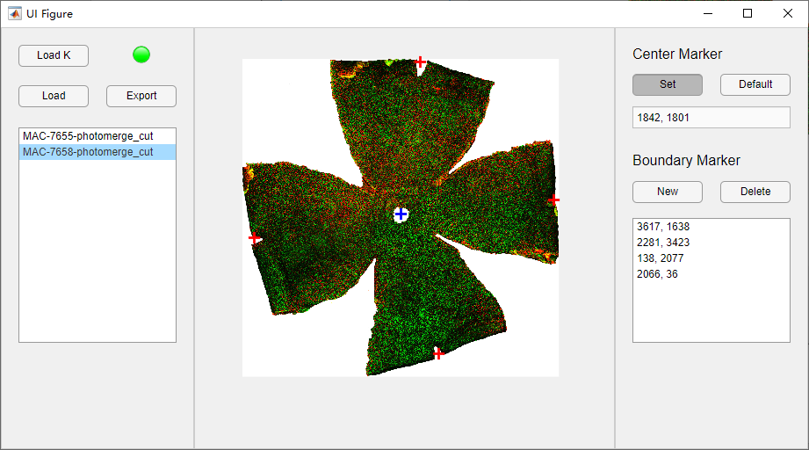
Step 4: After all images are marked, user can export a table that contains estimated diameters and angles.
Similarly, results are estimated with both all data and data in the middle.

Slide 22
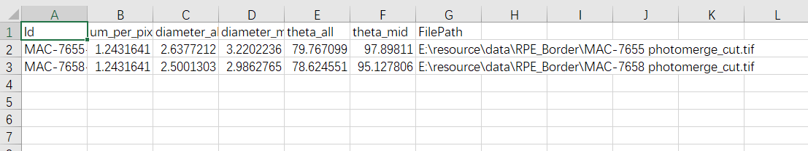
Output example

