Slide 1
Reverse Engineering
IAP 2018
James Koppel
MIT CSAIL
jkoppel@mit.edu
Mike Specter
MIT CSAIL
specter@mit.edu
Joe Leong
joeleong@mit.edu

Slide 2
Plan
Background and motivation
Assembly crash course
Walk-through in IDA
Fun with crackme

Slide 3
What is reverse engineering?
Forward Engineering
Design
Code
Binary
ReverseEngineering

Slide 4
Applications
Exploitation
Binary modification
Espionage
Compatibility

Slide 5
Exploitation example: Obamify/Romnify Your Hotspot

Slide 6
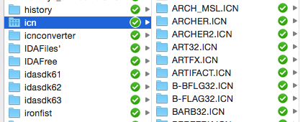
Modification example 1: Dropbox

Slide 7

