Slide 1
Reproducible Data Analysis and Paper Writing in R
Jessica E. Kosie & Sara Weston

Slide 2
Learning Goals:
By the end of this workshop, you will know:
Basic R usage (using R as a calculator, creating variables, indexing vectors)
How to read in and examine data
What a pipe is, how to use pipes to chain together tidyverse verbs, and how to create useful summaries of your data using tidyverse
How to start creating plots in ggplot2
Basics of writing in RMarkdown

Slide 3
We will pause frequently for exercises. Please use your stickies to let us know how you’re doing!
If you are DONE, use the GREEN sticky!
If you need some help, use the PINK sticky!

Slide 4
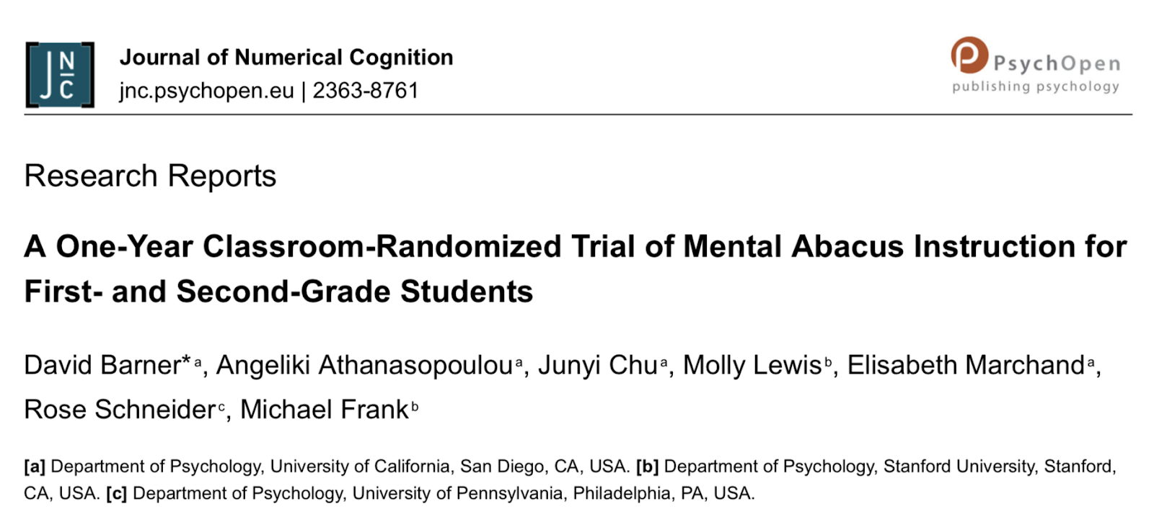
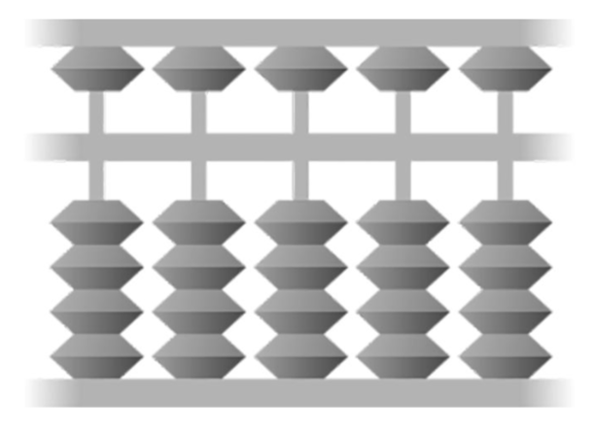
The Dataset:
Notes:
These are data from Barner et al. (2017), JNC, a classroom-randomized controlled trial of an elementary math intervention. The design was a simple pre-post assessment at the beginning and end of the school year. The primary question was whether assignment to group (control vs. mental abacus) produced differences in any of the outcomes (ravens:woodcockTotal). A secondary question was about the role of grade level and baseline math knowledge in the success of the intervention.
Mental abacus – visualizing an abacus while they’re trying to do math problems.

