Slide 1
Εισαγωγή στη Java
© Γιάννης Κωστάρας

Slide 2
Objectives
To be able to:
Understand the intent of the Singleton Pattern
Recognize Singleton
Singleton pattern in:
  Java
  C#
  C++
  Visual Basic
  Ruby

Slide 3
Intent
Ensure that a class has only one instance and provide a global point of access to it.
One value accessible globally in an application

Slide 4
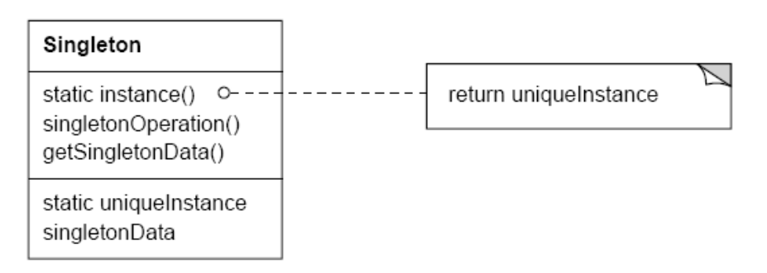
Singleton pattern
Scope: object Purpose: creational
Intent
  ensure a class has only one instance, and provide a global point of access to it.
Applicability
  when there must be exactly one instance of a class, and it must be accessible from a well-known point of access
  when the sole instance should be extensible by subclassing, and clients should be able to use an extended instance without modifying their code
Structure

Slide 5
Singleton pattern (cont’d)
Consequences
  reduces namespace pollution
  makes it easy to change your mind and allow more than one instance
  allow extension by subclassing
  same drawbacks of a global if misused
  implementation may be less efficient than a global
  concurrency pitfalls
Implementation
  static instance operation
  registering the singleton instance
Known Uses
  Unidraw's Unidraw object
  Smalltalk-80 ChangeSet, the set of changes to code
  InterViews Session object

Slide 6
Singleton - more than one instances
[Singleton] permits a variable number of instances. The pattern makes it easy to change your mind and allow more than one instance of the Singleton class. Moreover, you can use the same approach to control the number of instances that the application uses. Only the [Instance] operation that grants access to the Singleton instance needs to change.

Slide 7
Implementation
public static final User logIn (String loginName,
String password) {
if (password incorrect for loginName) {
return null;
}
if (a User instance exists for loginName) {
return it;
} else {
return new User instance for loginName;
}
}

Slide 8
Differences between a static class and a Singleton
static class is one of the approaches that makes a class “Singleton”
One could also create a class as “final” by declaring all its methods as “static”. But is this a good approach?

Slide 9
Related patterns
Abstract factory, which is often used to return unique objects.
Builder, which is used to construct a complex object, whereas a singleton is used to create a globally accessible object.
Prototype, which is used to copy an object, or create an object from its prototype, whereas a singleton is used to ensure that only one prototype is guaranteed.

Slide 10
Object Pool pattern

Slide 11
Intent
Ensure that a class has only a predefined number of instances (more than one) and provide a global point of access to them.
If there is a need of sharing objects in the pool, you can create a solution involving a check-out and check-in of the shared objects.
Application: database connection pools

Slide 12
Singleton in Java

Slide 13
Singleton in Java
final class Singleton {
public static final Singleton instance = new Singleton();
// private empty constructor
private Singleton() {
throw new AssertionError();
}
}
Since this isn't inherited from a Cloneable base class and cloneability isn't added, making it final prevents cloneability from being added through inheritance
To avoid invoking the private constructor reflectively with the aid of AccessibleObject.setAccessible method
Notes:
Make all constructors private, and create at least one constructor to prevent the compiler from synthesizing a default constructor for you (which it will create using package access). This implementation is also thread safe.
A privileged client can invoke the private constructor reflectively with the aid of the AccessibleObject.setAccessible method.
Modify the constructor to make it throw an exception if it’s asked to create a second instance.

Slide 14
Singleton in Java using a factory method
final class Singleton {
private static final Singleton instance = new Singleton();
// private empty constructor
private Singleton() {
throw new AssertionError();
}
public static Singleton getInstance() {
return instance;
}
}
Notes:
Make all constructors private, and create at least one constructor to prevent the compiler from synthesizing a default constructor for you (which it will create using package access). This implementation is also thread safe.

Slide 15
Singleton in Java – lazy initialisation
final class Singleton {
private static Singleton singleton = null;
// private constructor
private Singleton() {
throw new AssertionError();
}
public static Singleton getInstance() {
if (singleton == null)
singleton = new Singleton();
return singleton;
}
}
Notes:
Since Singleton is inherited directly from Object, the clone( ) method remains protected so it cannot be used (doing so produces a compile-time error). However, if you’re inheriting from a class hierarchy that has already overridden clone( ) as public and implemented Cloneable, the way to prevent cloning is to override clone( ) and throw a CloneNotSupportedException.

Slide 16
Serializable Singleton in Java
final class Singleton implements Serializable {
public static final Singleton instance = new Singleton();
// private empty constructor
private Singleton() {
throw new AssertionError();
}
// readResolve method to preserve singleton property
private Object readResolve() {
// Return the instance and let the garbage collector
// take care of the rest.
return instance;
}
}
Notes:
If you don’t add readResolve, then on the other side, a new Singleton object will be created.

Slide 17
Singleton in Java – multi-threaded version
final class Singleton {
private volatile static Singleton singleton = null;
private static final Object classLock = Singleton.class;
// private constructor
private Singleton() {
throw new AssertionError();
}
public static Singleton getInstance() {
synchronized (classLock) {
if (singleton == null)
singleton = new Singleton();
return singleton;
}
}
}
Notes:
Double check locking doesn’t work in JVM 1.4 or earlier.
When you are using a "synchronized" marker, you have two choices on its granularity: "method locks" or "block locks". If you put the "synchronized" on a method, you are locking on "this" object implicitly.

Slide 18
Singleton in Java 5.0
public enum Singleton {
INSTANCE;
}

Slide 19
Object Pool in Java

Slide 20
Object Pool in Java - Implementation
public class PoolManager {
private static class PoolItem {
boolean inUse = false;
Object item;
PoolItem(Object item) {
this.item = item; }
}
private ArrayList items = new ArrayList();
public void add(Object item) {
items.add(new PoolItem(item));
}
public Object get() throws EmptyPoolException {
for(int i = 0; i < items.size(); i++) {
PoolItem pitem = (PoolItem)items.get(i);
if(pitem.inUse == false) {
pitem.inUse = true;
return pitem.item;
}
}
// Fail early:
throw new EmptyPoolException();
// return null; // Delayed failure
}
public void release(Object item) {
for(int i = 0; i < items.size(); i++) {
PoolItem pitem = (PoolItem)items.get(i);
if(item == pitem.item) {
pitem.inUse = false;
return;
}
}
throw new RuntimeException(item + " not found");
}
}
static class EmptyPoolException extends Exception {}

Slide 21
Singleton in C#

Slide 22

Singleton in C#
defines an Instance operation that lets clients access its unique instance. Instance is a class operation.
responsible for creating and maintaining its own unique instance

Slide 23
Singleton in C# - Implementation
// Singleton pattern -- Structural example
using System;
// "Singleton"
class Singleton
{
// Fields
private static Singleton instance;
// Constructor
protected Singleton() {}
// Methods
public static Singleton Instance()
{
// Uses "Lazy initialization"
if ( instance == null )
instance = new Singleton();
return instance;
}
}
/// <summary>
/// Client test
/// </summary>
public class Client
{
public static void Main()
{
// Constructor is protected -- cannot use new
Singleton s1 = Singleton.Instance();
Singleton s2 = Singleton.Instance();
if( s1 == s2 )
Console.WriteLine( "The same instance" );
}
}
Notes:
Output
The same instance

Slide 24
Singleton in C# - Multi-threaded Implementation
// Singleton pattern – Multi-threaded Structural example
using System;
// "Singleton"
class Singleton
{
// Fields
private static Singleton instance;
// Lock synchronization object
private static object syncLock = new object();
// Constructor
protected Singleton() {}
// Methods
public static Singleton Instance()
{
// Support multithreaded applications through
// "Double checked locking" pattern which (once
// the instance exists) avoids
// locking every time the method is invoked
if ( instance == null ) lock (syncLock) // Uses "Lazy initialization"
if ( instance == null )
instance = new Singleton();
return instance;
}
}
Notes:
Output
The same instance

Slide 25
Singleton in C++

Slide 26
Singleton in Ruby

Slide 27
Singleton class
The Singleton module implements the Singleton pattern.
Usage:
class Klass
include Singleton
# ...
end
this ensures that only one instance of Klass can be created.
a,b = Klass.instance, Klass.instance a == b # => true a.new # NoMethodError - new is private ...
“The instance'' is created at instantiation time, in other words the first call of Klass.instance().

Slide 28
Singleton implementation in Ruby
class Singleton_
@@instance = Singleton_.new;
# private constructor
private_class_method :new
def self.instance
return @@instance;
end
end
irb(main):031:0> one = Singleton_.instance
=> #<Singleton_:0xd930adc>
irb(main):032:0> two = Singleton_.instance
=> #<Singleton_:0xd930adc>

Slide 29
Singleton in Visual Basic

Slide 30

Singleton in Visual Basic – Roles & Relations
The roles and functions of the Singleton design pattern are as follows:
  TargetFactory Defines a CreateInstance method to create a single unique instance of a Target object.
  Target Defines the object expected by the client.
A TargetFactory object creates a single instance of the Target class and retains a reference to that instance. The TargetFactory object then returns the reference to that Target object to the client. All subsequent CreateInstance requests will result in the TargetFactory object returning a reference to the same Target object that the TargetFactory object is referencing.

Slide 31
Singleton in Visual Basic
You can extend the Singleton design pattern to support multiple instances of the target class when this solution is warranted.
The only requirement is that you must modify the implementation of the CreateInstance method of the TargetFactory class.
If you have scenarios that each require different behavior, you can design TargetFactory as an interface that concrete TargetFactory classes can implement, thus providing the benefit of polymorphism.

Slide 32
Singleton in Visual Basic - Implementation
' Globals module
Public g_Target As Target
' Possible implementation of the CreateInstance
' method in the TargetFactory class
Public Function CreateInstance() As Target
If g_Target Is Nothing Then
Set g_Target = New Target
End If
Set CreateInstance = g_Target
End Function

Slide 33
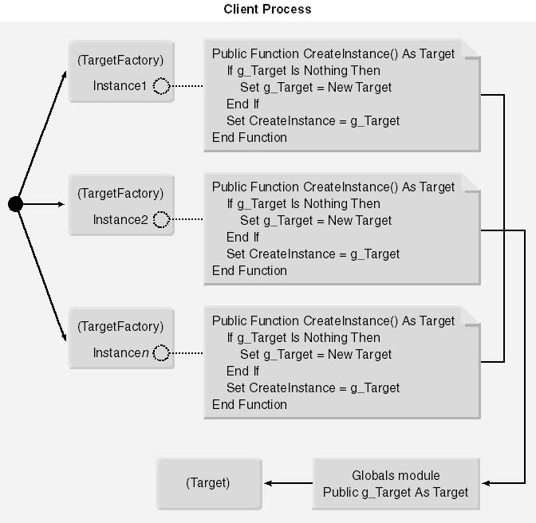
Singleton in Visual Basic - Implementation
A client process with multiple TargetFactory class instances that share the same global object reference variable to a single Target class instance.

Slide 34
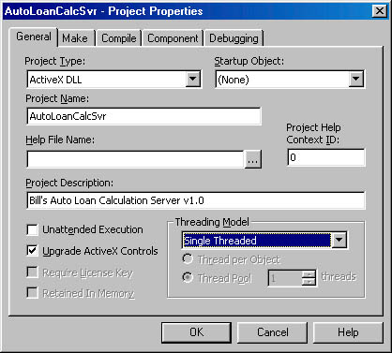
Singleton in Visual Basic - Implementation
Notes:
The Singleton design pattern will always work between Visual Basic clients and servers. However, it has the potential to fail miserably when used with non-Visual Basic clients. COM threading apartment models are to blame for this failure. In short, publicly defined variables in Visual Basic modules are globally accessible to all instances of classes declared within the same project. Therefore, the Singleton is enforceable, or so it seems. It's more accurate to say that publicly defined variables in Visual Basic modules are globally accessible to all instances of classes declared within the same project that reside in the same COM apartment. It is therefore possible for two instances of CalcFactory to exist in different COM apartments, which results in unique instances of the Calculator class existing in each apartment.
To guarantee compliance of the Singleton implementation in a Visual Basic-generated ActiveX DLL, set the Threading Model option of the DLL to Single Threaded on the General tab of the Project Properties dialog box. (See Figure 10-3.) This forces all instances of classes defined in this DLL to exist in the same COM apartment. However, if the client is multithreaded, all requests to the Calculator object will be marshaled across thread boundaries via a proxy. The price you pay in this scenario is performance, and the price can be huge. If performance becomes an issue, avoid the Singleton implementation.

Slide 35
Singleton in Ruby

Slide 36
Singleton in Ruby
require ‘singleton’

Slide 37
References
Bloch J. (2008), Effective Java, 2nd Edition, Addison-Wesley.
Geary, D. (2003), Simply Singleton, JavaWorld.com, http://www.javaworld.com/javaworld/jw-04-2003/jw-0425-designpatterns.html?page=1
Eckel, B. (2003), Thinking in Patterns with Java, MindView, http://mindview.net/Books/TIPatterns/.
Freeman, E. & Freeman, E. (2004), Head First Design Patterns, O’ Reilly.
GoF (1995), Design Patterns – Elements of reusable components, Addison-Wesley.
JavaCamp, http://javacamp.org/designPattern/index.html, Singleton
Kabutz, H. (2002), Double-checked locking, The Java Specialists' Newsletter, Issue 061, http://www.javaspecialists.co.za/archive/newsletter.do?issue=061
Kabutz, H. (2002), J2EE Singleton, The Java Specialists' Newsletter, Issue 052, http://www.javaspecialists.co.za/archive/newsletter.do?issue=052&locale=en_US
Metsker, S. J. (2002), Design Patterns Java Workbook, Addison-Wesley.
Stamatakis W. (2000), MS Visual Basic Design Patterns, MS Press.
Design Patterns in Ruby, http://designpatternsinruby.com/.

Slide 38
End of section
Back to contents

